Slide 1
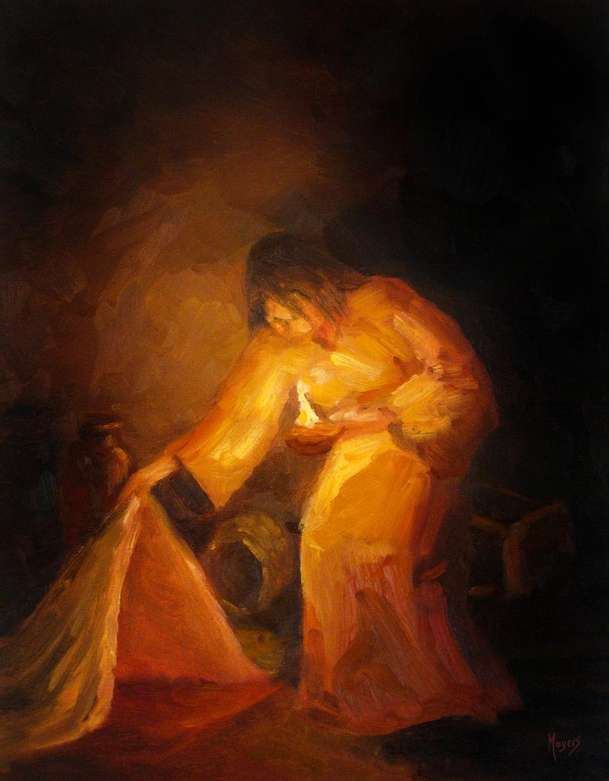
Today’s story can be found in Matthew 13:33
Stories as treasure to be found
‘The seeker’ by Mike Moyers, from the Vanderbilt University Library, Art in the Christian Tradition
Notes:
‘Stories as treasure to be found’ – Summer term 2026 These resources are ©The Diocese of Guildford
The Gospels are full of the parables of Jesus, which he used to communicate ideas about the Kingdom of God to his listeners, often challenging their thinking, and quite often in answer to a question he had been posed. For Christians – as for Jesus’ original audiences – the parables don’t just illustrate a truth, they contain a truth that the listeners are supposed to search for for themselves, appealing to the intellect through the imagination. These collective worship materials don’t need to be used in any particular order, but loosely follow the parables of Jesus from Matthew 13. Although these parables were told to a specific audience, with a specific set of cultural expectations, Christians believe that Jesus’ parables can speak just as truthfully to a modern audience: like a well-cut gemstone, the light will shine through the different facets and show different colours at different times.
Notes for the teacher: This resource is to be used for collective worship during tutor times or in other groupings that work for your setting. There may be enough material here to resource more than one tutor time.
Each resource contains some images and words to support the spiritual development of students, with a script for the leader written under the slides.
Any bold text indicates when a click will animate either text or an image for students to ponder, and italic text contains pointers for the leader.
Especially important is the slide denoted as ‘Going deeper: responding and words for worship’, which ensures that the resource meets the requirement for daily collective worship in your Church school. The words are invitational, and prayer is optional.
At the end of each set of slides, there is an image from across times and cultures illustrating the story from a different perspective. You might want to include a question on this slide that will challenge students’ thinking as they leave, or at another time, picking up on what has been talked about during the gathering.
Today’s parable, the Parable of the Yeast, can be found in Matthew 13:33. In it, Jesus invites his listeners to reflect on how the daily action of making bread might help them to understand the Kingdom of Heaven. This parable and the parable of the mustard seed are thought to be a pair that Jesus told together. We use two versions of the parable of the yeast to help students to draw their own conclusions about its meaning….the first is based on the Bible verse, the second on the idea of the growth of God’s Kingdom, which scholars think is the likely interpretation. We use the parable to help students to reflect on small things having a big impact…..

Slide 2
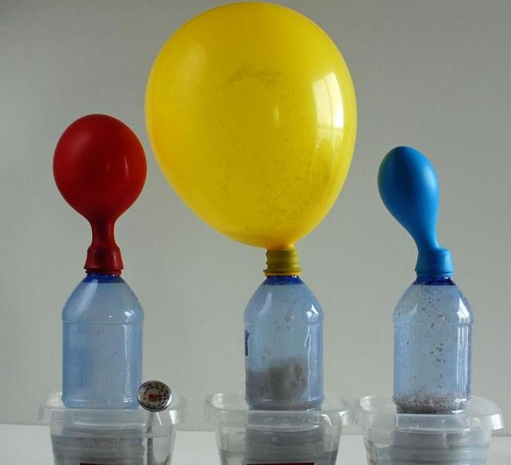
What’s happening here?
These bottles contain yeast, sugar and water.
Notes:
Gathering: What’s going on here?!
Invite students to discuss with each other what they think is happening. You can watch a 1min20sec video of a similar experiment here: https://www.youtube.com/watch?v=_1DV0q1_9ac
This is an experiment with yeast to show the production of carbon dioxide during the process of fermentation. There are different amounts of sugar in each bottle – sugar is the ‘food’ that helps the process of fermentation to happen. The nature of yeast is to grow and to change whatever it contacts.

Slide 3
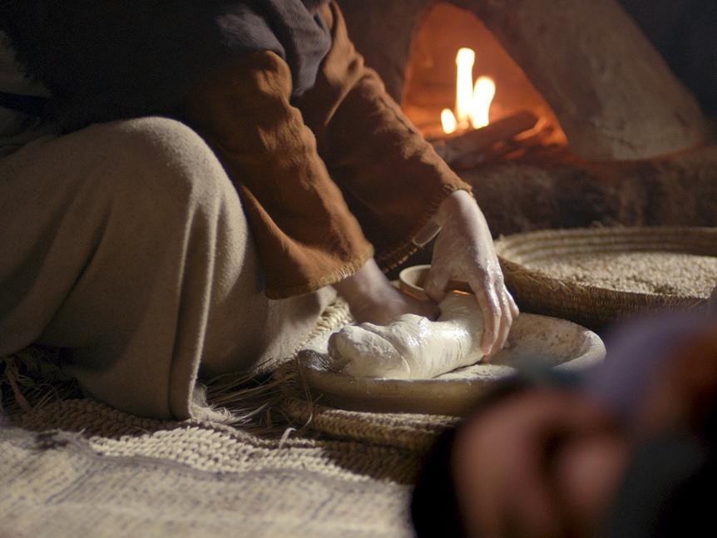

An agent of change
Notes:
Engaging: the Parable of the Yeast
Our parable today is even shorter than the mustard seed – just one verse! Here’s a slightly expanded version of the story to help us to think…
Jesus said that the Kingdom of Heaven is like this….
One day, a woman went into her kitchen to make some bread. Out of her cupboard she took flour, sugar, and a tiny piece of yeast.
‘Soon’, she thought, ‘my kitchen will be filled with the smell of my delicious bread!’
Into her bowl, she put the flour and mixed the other ingredients with some warm water to put the yeast to work. And then her work began.
She began to knead to help the yeast to reach every part of the dough. She kneaded until her arms ached and the dough was smooth.
Her work was done. In a warm patch of sunshine, she left the dough to rest – and the yeast to do its job.
Some time later, when the dough was ready for baking, the woman shaped the loaf and put it in the oven. Before too long, the kitchen was filled with the smell of freshly-baked bread, and her longed-for loaf was perfectly risen and deliciously browned: the yeast had done its job!
Invite students to share thoughts on what they think Jesus was meaning. A possible example follows on the next slide – you might choose to omit this, or use it on a different occasion.

Slide 4
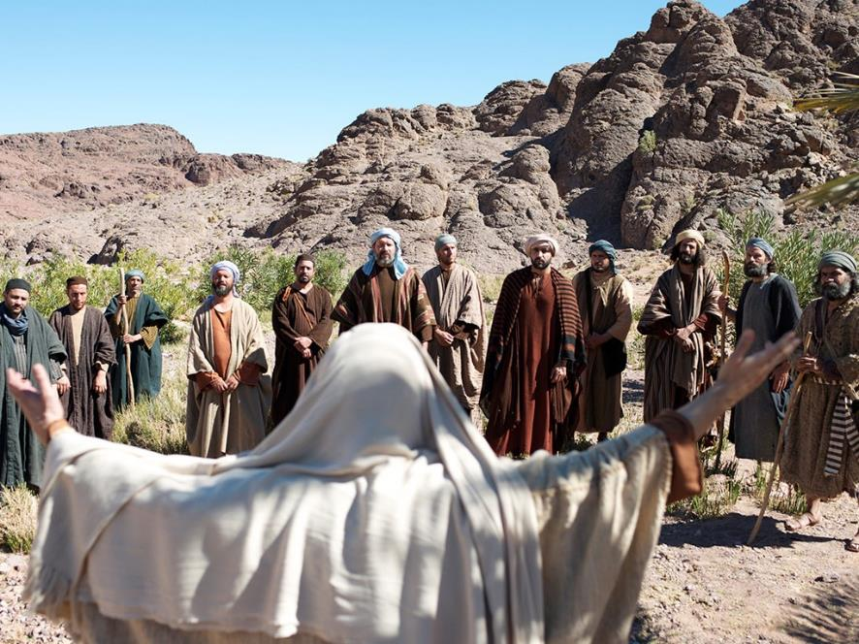
Notes:
Engaging: the Parable of the Yeast
This is another story, a story of twelve men* who were followers of Jesus, bringing God’s message of love and light to a lost world. They were small in number, but God used them in mighty ways to change the world. The kingdom of God has grown to over 2.3 billion Christians across the world.…and the kingdom of God is still growing….
I wonder how this story might help us to understand Jesus’ parable?
[*Judas was replaced after Pentecost, by a follower named Matthias]

Slide 5
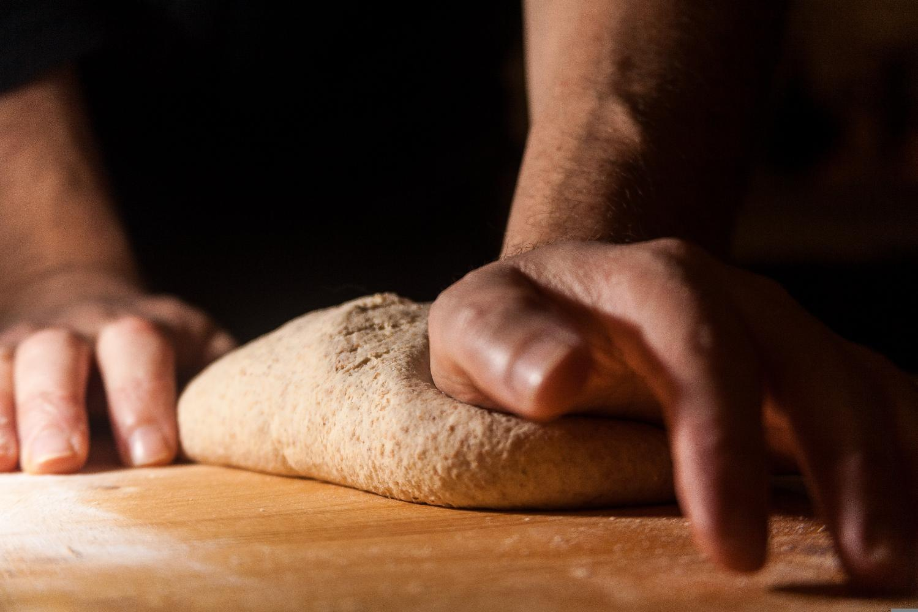
….I wonder which actions, even very small ones, might make a whole lot of difference to someone today?....
“Do small things with great love.”
All images copyright-free from pixabay, unless otherwise identified
Notes:
Going deeper: responding and words for worship
I wonder what Jesus’ illustration about the Kingdom of Heaven being like yeast might mean for us? We heard earlier that the nature of yeast is to grow and to change whatever it contacts. You only need a small bit of yeast to make a very big difference….
Sometimes, we might feel that our actions in the world or even our very selves, are too small to make any difference at all, but this parable encourages us to think differently…..
….I wonder which actions, even very small ones, might make a whole lot of difference to someone today?....
Mother Teresa once said that we should ‘do small things with great love’…
…I wonder what this might look like for us?...
…these small things, done out of a heart of love, can change the world and maybe show others what God’s kingdom is like….
As you look at these words on the screen, you might want to use them to pray if this is something that you are comfortable with.
Sending: you might wish to leave students with a final challenge based on this slide, then blow out the candle as a sign that the collective worship is finished.

Slide 6
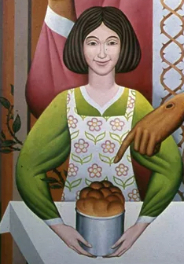
Notes:
Parable of the Yeast, detail from a larger image
By British Catholic artist Peter Koenig, 1975
You can view the entire painting on the artist’s website here: https://www.pwkoenig.co.uk/Portfolio/parable-of-the-yeast
This image source: https://diglib.library.vanderbilt.edu/act-imagelink.pl?RC=58557

