Slide 1
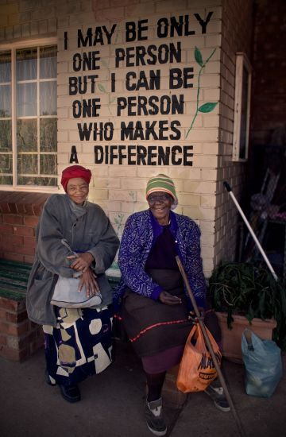
How can we be a person who makes a difference?
God loves us and we can love others in all sorts of ways that make a difference.

Slide 2
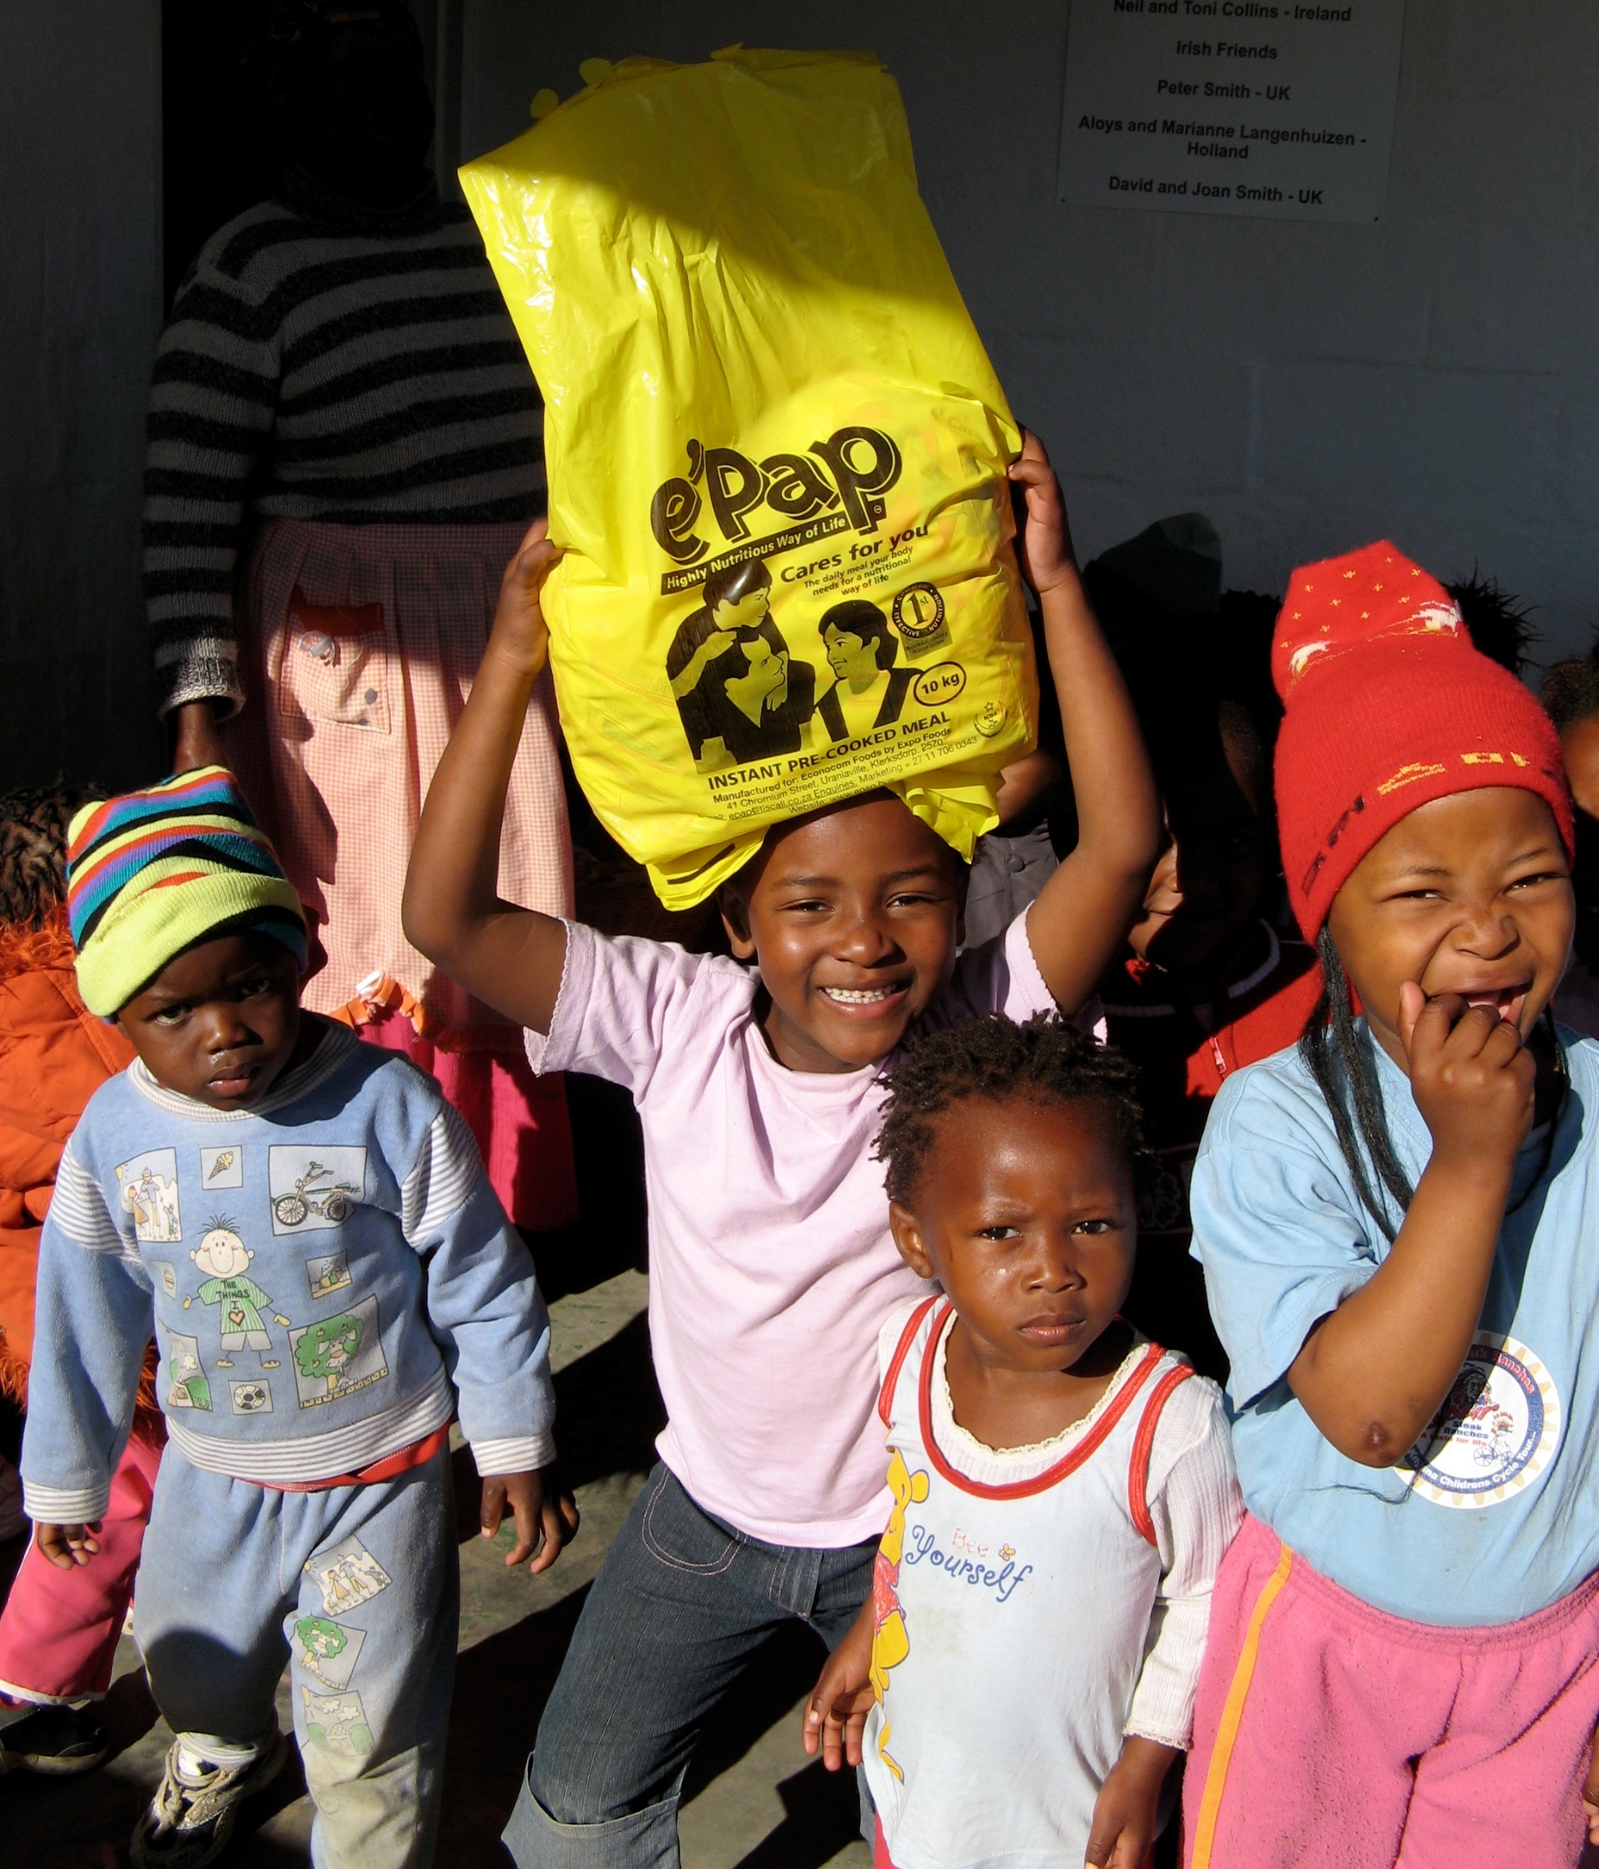
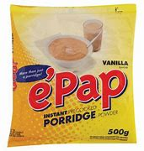
This is the story of how a bowl of e’Pap from a mixed from a little yellow packet came to make a huge difference……
At the GRCT we raise money to fund e’Pap for breakfasts for over 8000 children at schools in South Africa.

Slide 3
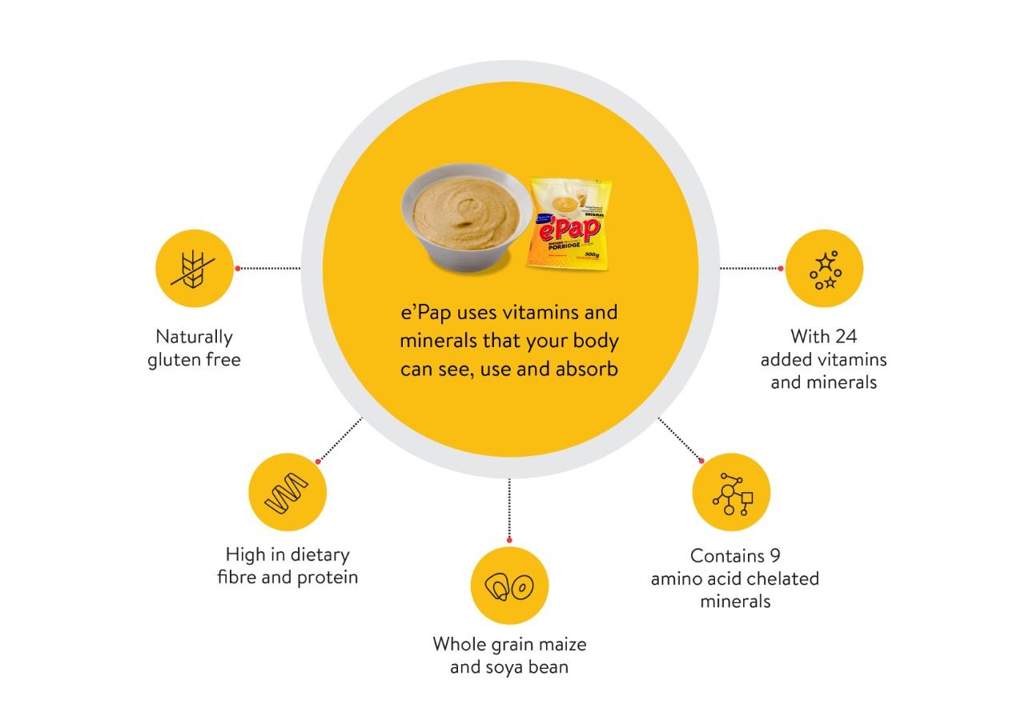
ePap’s remarkable journey began amidst circumstances that touched the lives of many. It was a time when compassion and dedication converged to address a pressing need. Rose, a dedicated volunteer distributing parcels, discovered that conventional food packs lacked essential nutrients. This realisation led to a transformative collaboration that would shape e’Pap’s mission.
In 1999, a dietician returned from Paris with insights that would set the stage for change. Conversations between Rose, a business consultant, and Basil, a surface particle chemist, sparked the idea of creating a solution to this nutritional gap – even before the age of widespread supplementation. Basil embarked on an exploration that spanned the globe, connecting with a maize expert to find a solution tailored to Africa’s needs.
However, the journey was far from over. The truth surfaced about the nutritional void caused by the refinement of maize – a staple in South African diets. Empty calories offered little sustenance, leaving many malnourished and micronutrient deficient. The vision of providing wholesome nutrition led to stories woven around maize, sorghum, and soya – gathering knowledge from worldwide programs.

Slide 4
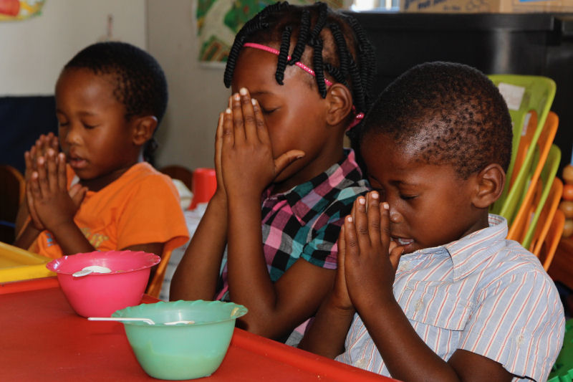
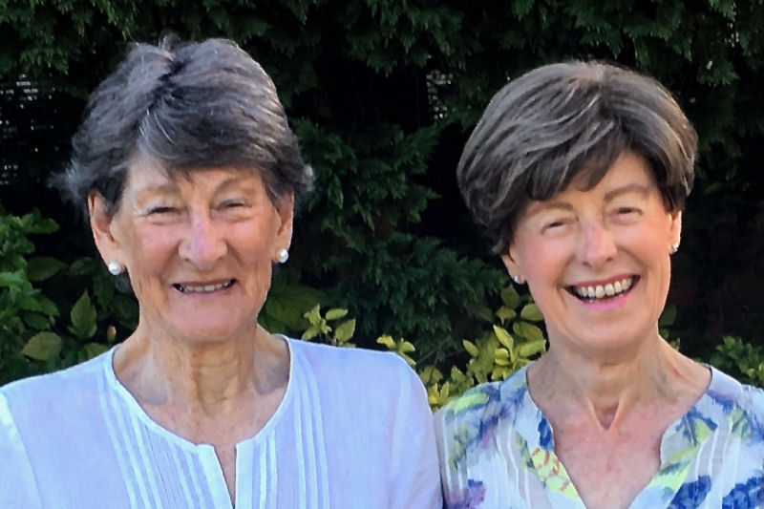
In 2000, e’Pap was born to respond to the developing HIV pandemic. The solution focused on nourishing mothers and bolstering immune systems. The realisation that various micronutrients were essential marked the birth of e’Pap’s unique formula. This nutrient-rich blend became the backbone of e’Pap’s pursuit to address malnutrition at its core.
Two new people enter the story of how the little yellow packet has a huge impact……
Shelley Godsell and Lally Viljoen first started working together in 1997 facilitating a training course for about 30 pre-school teachers in Knysna. It was a five-year course. During the fifth and last year, Shelley’s husband Peter and Cathy Bath, who were both working at a Hospice, became aware of a highly nutritious food called e’Pap. We thought that if it could feed HIV+ patients it could be a good thing for many of our undernourished children.
Two pre-schools, one in Concordia (a big township) and one in Rheenendal (a rural village outside of Knysna) were chosen for a six-month pilot study. Joan Huskisson, a retired head of Dietetics from UCT, and Beth Wilkinson, a local dietician, provided guidance on monitoring height and weigh. The results were encouraging.
This was at the end of 2002. Traditionally the Christmas collection at Methodist churches is given to a children’s charity, so we approached the leaders of the Knysna Methodist Church who readily agreed to support our Feeding Project in the year ahead. The journey had started.

Slide 5
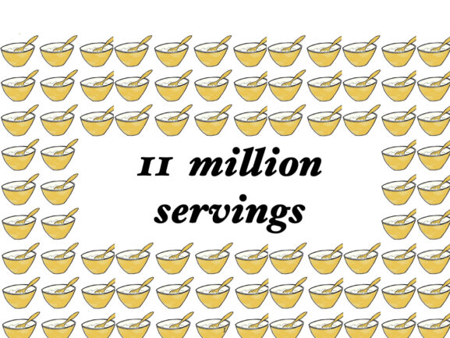
Today, just over 20 years on, Shelley leads a team of people who deliver e’Pap to pre-schools stretching from George in the West to Plettenberg Bay in the East.
Together this team of volunteers, school staff and donors have, to date, provided over 11 million meals to the children of the Garden Route.
Our founder, Penny Fleming, was born and grew up in South Africa. Following her move to the UK, she continued to be concerned for those in South Africa who have so little. Penny was a close friend of Shelley’s and when she started working with informal schools in the townships surrounding Knysna, Penny saw a way to help her friend by raising a little money in the UK, and that’s how the GRCT was born.

Slide 6
We are all what we eat – but why does an e’Pap breakfast make children stronger after just two weeks?
Contains 22 added vitamins, minerals and sorghum
Naturally gluten free
Contains 8 amino acid chelates, tailored for absorption
High in dietary fibre and protein
Partly it is Basil’s clever recipe but also children in South Africa do not have school lunches provided. They might leave home having eaten nothing – or they have something to eat at home but it might just be rice which does not provide a healthy balance of nutrients. It’s important the we all eat a mixed, nutritious diet – especially when we are growing and trying to concentrate in school.

Slide 7
Basil, Rose, Shelley, Lally and Penny all started out by taking one step to use their God given skills to make a little bit of a positive difference to the situation they could see around them.
You can do that too.

Slide 8
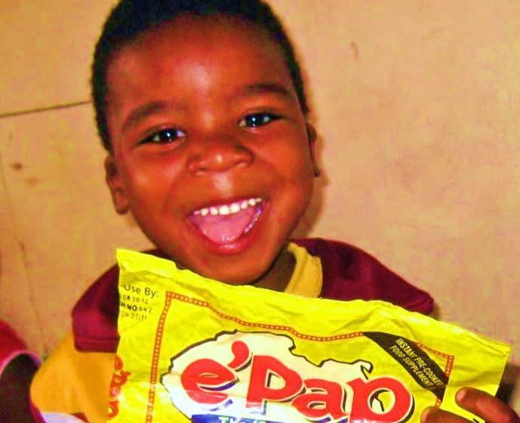
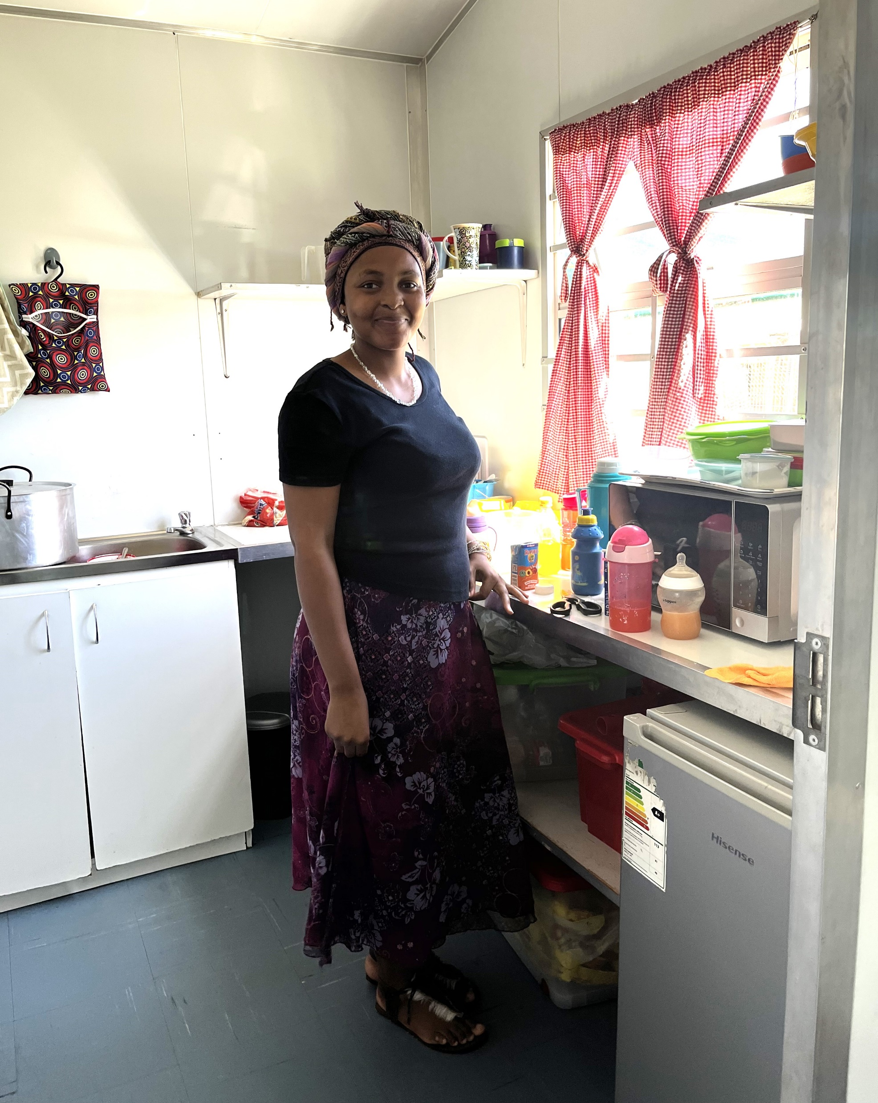
This is Nora. She works in a creche in Addo in South Africa.
If you look closely you can see the box of little yellow packets of e’Pap at her feet.
Each packet costs about £1.50 and has about 20 servings depending on the age of the child.
That means that even if you can only give us 10p you can help us buy a child a nutritious breakfast which will help them concentrate and about £20 will buy a child breakfast every single school morning for a whole year.

Slide 9
One idea which is fun fundraising is
And we’d be happy to help.
If you would like more information go to
www.grct.org.uk
or email b4b@grct.org.uk
We value your prayers for our work as much as fundraising.

Slide 10
With these ideas you can be a person who makes a difference.
Notes:
There is an evaluation question at the end of Rosslyn’s section to help you to talk together.

