Slide 1
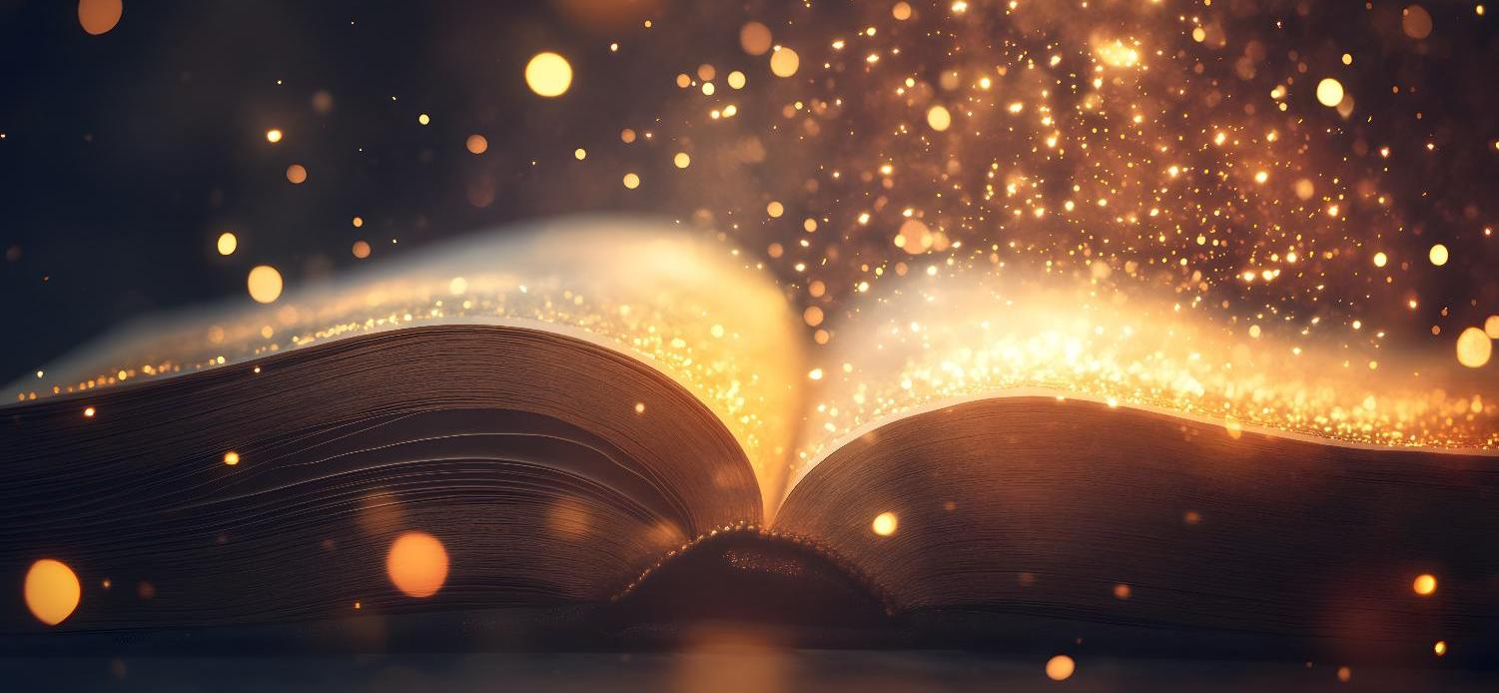
Today’s words can be found in Psalm 8:3-4
Words to make you wonder…
Image from pixabay
Notes:
‘Words to make you wonder’ – Summer term 2026 These resources are ©The Diocese of Guildford
This is a companion resource to ‘Stories as treasure to be found’, collective worship resources created to support Secondary schools in the Diocese of Guildford. ‘Words to make you wonder’ are taken from different parts of the Bible and used in response to world events or big questions in life. Our materials today explore the impact of our words on others, and on ourselves, referencing an image used in the book written by one of Jesus’ brothers, James. This is called a ‘Letter’ but is actually more like the wisdom writings of Proverbs or Ecclesiastes in the Old Testament.
Notes for the teacher: This resource is to be used for collective worship during tutor times or in other groupings that work for your setting. There may be enough material here to resource more than one tutor time.
Each resource contains some images and words to support the spiritual development of students, with a script for the leader written under the slides.
Any bold text indicates when a click will animate either text or an image for students to ponder, and italic text contains pointers for the leader.
Especially important is the slide denoted as ‘Going deeper: responding and words for worship’, which ensures that the resource meets the requirement for daily collective worship in your Church school. The words are invitational, and prayer is optional.
Today’s words come from James 3:5. This verse makes use of a really stark image of a forest fire out of control to help these early Christian believers, (who were scattered all over the Roman world), to reflect on the power of ill-spoken words. In our materials, we use a less uncomfortable, but no less powerful, image of a party popper to help get the conversation started!

Slide 2

Careless words stab like a sword.
But wise words bring healing.
[Proverbs 12:18]
Image from pixabay
Notes:
Gathering: You might want to light a candle to signal the start of collective worship. Invite students to be quiet and still and look at the image.
As we begin, listen to these words, from a book of ancient wisdom contained within the Bible, many of them written by King David’s son, Solomon, who was renowned in the ancient world for his wisdom.
‘Careless words stab like a sword. But wise words bring healing.’ [Proverbs 12:18]
Consider these questions with a talking partner, or reflect individually:
Do you think these words are true?
I wonder if you have ever experienced words like this?
Or if you might have spoken words like this?

Slide 3
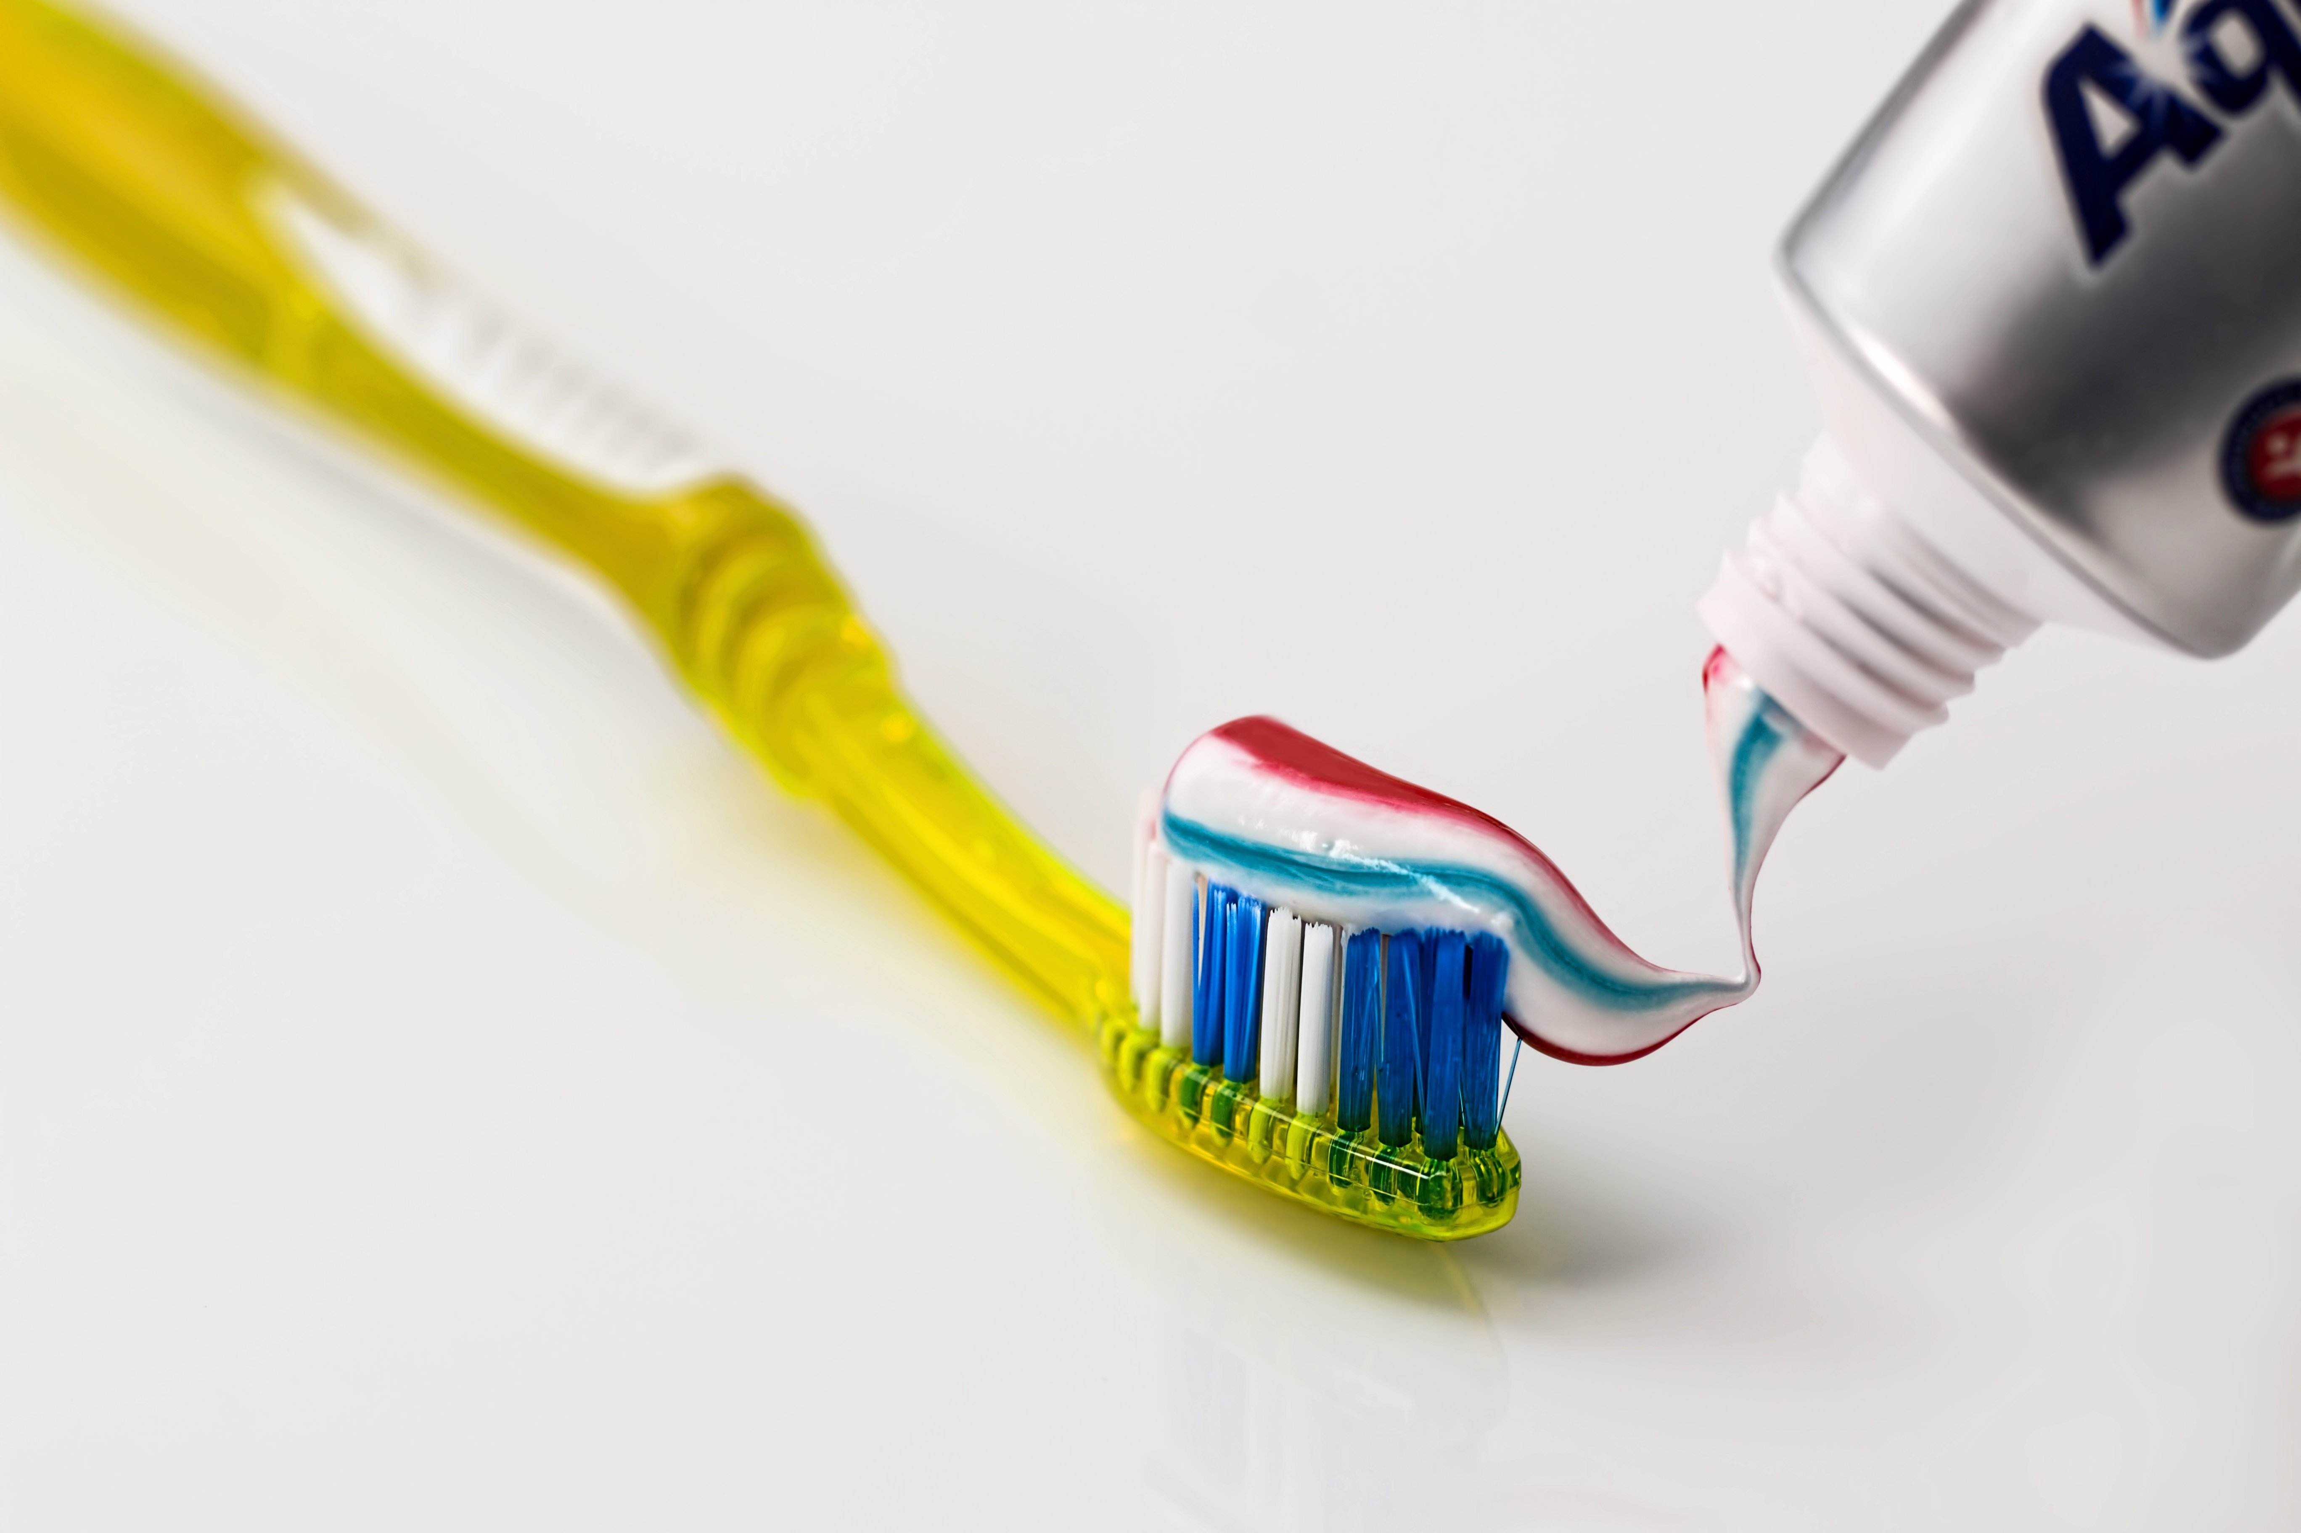

Notes:
Engaging: The toothpaste challenge
Imagine that you have squeezed too much toothpaste out of the tube – can you put it back in again?
Well, maybe yes, but not very easily….or very successfully.
The same is true, as you well know, of the words that we speak.
Once we have unleashed them, we cannot take them back…..

Slide 4
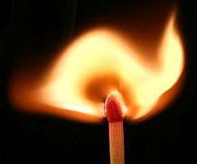
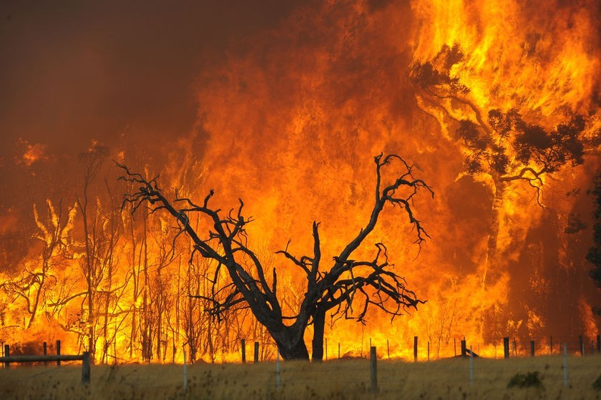
It is the same with the tongue. It is a small part of the body, but it brags about doing great things. A big forest fire can be started with only a little flame!
(James 3:5)
Notes:
Engaging: The power of our words
The writer of this New Testament letter, written by James the brother of Jesus, said it like this:
It is the same with the tongue. It is a small part of the body, but it brags about doing great things. A big forest fire can be started with only a little flame! (James 3:5)
Talk together:
What might have happened that James felt he needed to write these strong words?
Are these words that are only relevant for people who read the Bible?
What examples from our own life experiences can we think of where this has happened?

Slide 5
A big forest fire can be started with only a little flame!
(James 3:5)
…I wonder what impact these words might have on our words today?...
Notes:
Going deeper: responding and words for worship
We’ve just heard a very stark picture about the power of words – spreading and causing damage like a forest fire. We can all think of times when this has happened for us. If our words have this enormous power….
…I wonder what impact these words might have on our words today?...
….on our school community…..our friendships….our families…..our world….?

Slide 6


May the words of our mouths,
And the thoughts and attitudes in our hearts
Be pleasing to you, O God.
May the words of our mouths [touch lips]
The thoughts of our hearts [touch heart]
May the words of our mouths
Notes:
Going deeper: responding and words for worship
For many people, talking to God in prayer helps them to take more care of their words, as they ask for God’s help, so I’m going to pray now, using some words written by King Solomon’s father, David…. [Psalm 19:14, with a small adaptation for this context]
May the words of our mouths,
And the thoughts and attitudes in our hearts
Be pleasing to you, O God.
Sending: you might wish to leave students with a final challenge based on this slide, then blow out the candle as a sign that the collective worship is finished.

