Slide 1


Today’s words can be found in Psalm 56:8 & Romans 5:12
Words to make you wonder…
Image from pixabay
Notes:
‘Words to make you wonder’ – Summer term 2026 These resources are ©The Diocese of Guildford
This is a companion resource to ‘Stories as treasure to be found’, collective worship resources created to support Secondary schools in the Diocese of Guildford. ‘Words to make you wonder’ are taken from different parts of the Bible and used in response to world events or big questions in life.
Following on from the recent images of the Moon released by NASA as part of the Artemis II expedition, in this session, we reflect back to a time before science explained how things are, to when people used stories….and a traditional tale from Algeria, to help us think about the importance of compassion.
Notes for the teacher: This resource is to be used for collective worship during tutor times or in other groupings that work for your setting. There may be enough material here to resource more than one tutor time.
Each resource contains some images and words to support the spiritual development of students, with a script for the leader written under the slides.
Any bold text indicates when a click will animate either text or an image for students to ponder, and italic text contains pointers for the leader.
Especially important is the slide denoted as ‘Going deeper: responding and words for worship’, which ensures that the resource meets the requirement for daily collective worship in your Church school. The words are invitational, and prayer is optional.
Today’s words come from Psalm 56:8 & Romans 12:15 and speak of ways to understand sadness, using hard times to grow compassion.

Slide 2
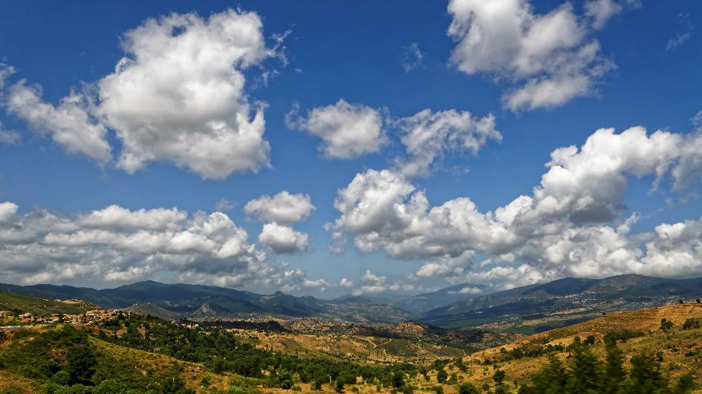

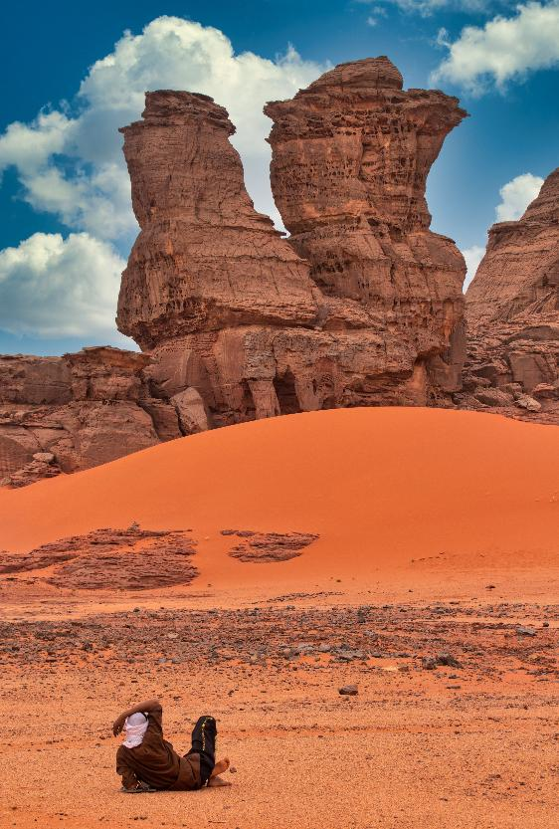
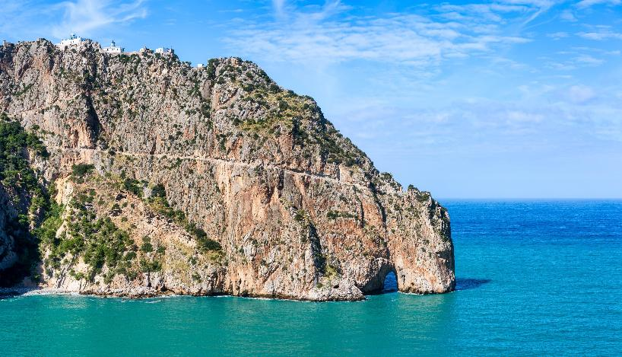
Notes:
Engaging: Where in the world….?
All these photos are from one country – but where?
[Clockwise from top L: Kabylie, northern Algeria; Tassili n’Ajjer in SE Algeria; Plage Les Aiguades, in Bejaia on the north coast]
These photos were all taken in Algeria, North Africa which we will briefly visit in our time today. As you can see it’s a country with some really contrasting landscapes!

Slide 3
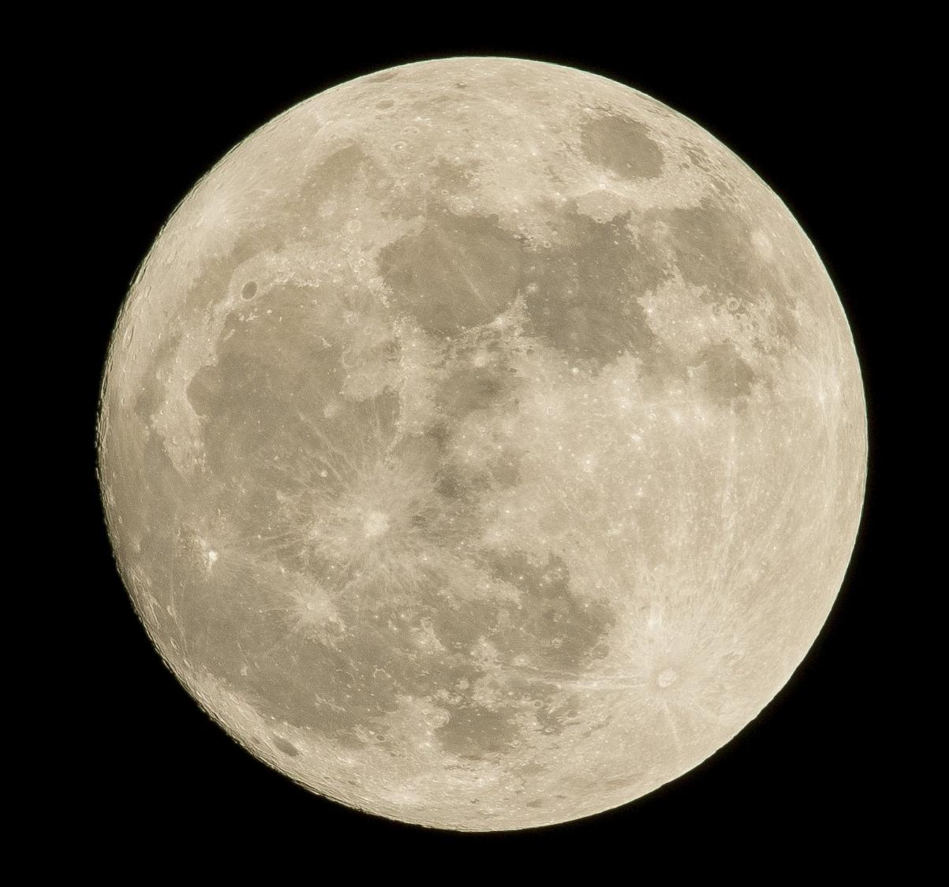
Notes:
Engaging: Why the moon is sad
Last week, we saw scientific evidence of the moon craters from the Artemis II expedition – but before there was science to explain the world, people often used to tell stories.
You might imagine ancient peoples looking at the Moon and wondering how to explain the dark patches that they could see on the Moon’s surface….
A traditional story from Algeria gives us one idea.
The story tells of an orphan child who has no-one to look after them. As night fell, and the moon rose in the sky, the moon saw the child and felt great compassion.
The moon decided that the child could be alone no longer and so it came down from the night sky to sit beside the lonely child, and spoke these words:
"Weep, sad child! Let your tears fall onto me. I will then carry them all back with me up into the sky."
When the child could weep no more, the moon returned to the heavens…..
And now, every time you look at the moon's face, you will be able to see the stains left by the tears of the orphan child.
Talk together:
I wonder what you think about this story?
Does it matter whether it’s true or not?
Are there things that we can learn from it?
When has someone sat with you like the Moon sat with the orphan child?
What does ‘compassion’ mean for you?
How does compassion help us to build strong relationships with each other?

Slide 4
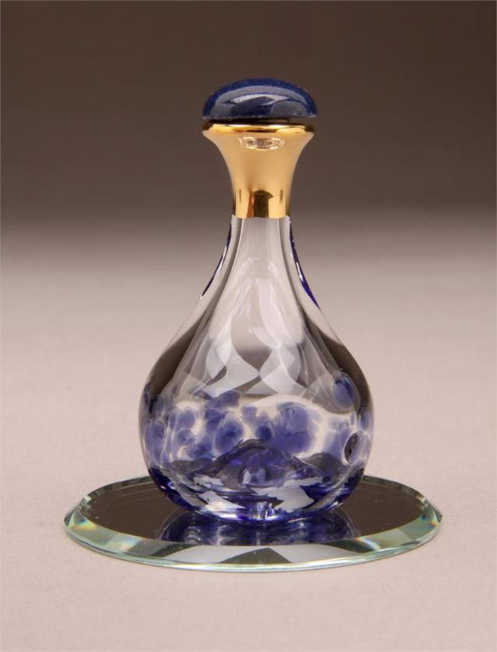
‘You have counted each of my tears and stored them in a bottle.’
Notes:
Going deeper and words for worship: ‘You have counted my tears and stored them in a bottle’ (Psalm 56:8)
The Psalms are full of words like this from David, expressing his deepest and most painful emotions before God.
They also often contain truths that David believed about God’s character and nature. David experienced his fair share of pain and grief in his life, but was never afraid to complain to God, to be honest before God or, clearly, to sit and cry before God.
Reflect together:
I wonder what you think about these words?
Why might David’s – or anyone else’s – tears matter to God?
I wonder if you think it helped David to think about God’s compassion in this way?
I wonder how easy you find it to express your emotions – to yourself, or to others?
I wonder if these words might help you to think about your own sadnesses differently?
Spend a few moments in quiet thinking about your own personal response to what you’ve heard today.

Slide 5
‘When others are happy, be happy with them, and when they are sad, be sad with them.’
(Romans 12:15)
Notes:
Sending: Romans 12:15
You might want to read these words out loud to one another to encourage one another as you go from this time – and to inspire compassion in each other:
‘When others are happy, be happy with them, and when they are sad, be sad with them.’ (Romans 12:15)
You might also wish to leave students with a final challenge based on this slide, then blow out the candle as a sign that the collective worship is finished.

