Slide 1
‘Passion for Spiritual Administration’
Volunteer Management
and Support

Slide 2
Volunteer Management and Support
Volunteering is at the
heart of Christian service and discipleship
Stewardship of Time and Talents
Definitions of ‘Volunteer’
A person who freely offers to take part in an enterprise or undertake a task.
A person who works for an organization without being paid
Volunteering is generally considered an altruistic activity where an individual or group provides services for no financial gain. Volunteering is also renowned for skill development, and is often intended to promote goodness or to improve human quality of life. Volunteering may have positive benefits for the volunteer as well as for the person or community served

Slide 3
Volunteer Management and Support
Benefits of Volunteering
People volunteer for a variety of reasons
Benefits for the volunteer:
practise existing skills
develop new skills or interests
making a contribution to church or community – active citizenship
stimulation & improve well being
be part of a team
gain confidence
gain experience & training
improve employment prospects
fulfilment

Slide 4
Volunteer Management and Support
Benefits for your church
churches would not be able to function without volunteers!
able to reduce operating costs by using volunteers.
volunteers contribute time, energies, expertise, skills and talents to help fulfil the church's mission.
they extend and augment the work of clergy & staff
volunteers generate enthusiasm and interest
they can focus on individuals or subject areas thus bringing new insights, energy & time to their role
volunteers can also increase the quality and number of services/facilities which a church can offer e.g. running a parent and toddler group or a café
Annual Review of how church members donate their time and talents

Slide 5
Volunteer Management and Support
Good Practice in Managing and Supporting Volunteers
Volunteer ‘role’ not a ‘job’
Role Description - needs to include:
i. The responsibilities and duties of the volunteer
ii. The purpose of the role – set it in context
iii. Support and supervision structures
iv. Information about hours, frequency and location of duties
v. Anticipated length of the role
vi. Training provided and needed
vii. Allowable expenses
2. Volunteer Agreement
3. Selection process
4. Offer travel expenses
5. Manager
6. Regular Communication
7. Reviews and feedback
8. Resourcing
9. Encouragement and Recognition - National Volunteer Week 1st -12th June
10 Training
11. Prayer

Slide 6
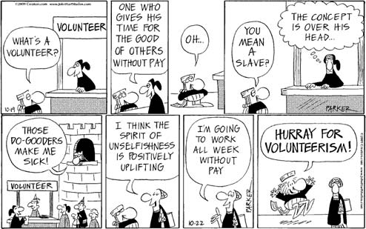
Volunteer Management and Support
Office Volunteers
How many of you have office volunteers to assist you??
Consider arranging a volunteer or two to provide invaluable assistance with weekly tasks e.g. answering telephone, updating the publicity board, weekly notice sheet.
OR discrete one off or regular tasks which a volunteer could do occasionally e.g. database management

Slide 7
Volunteer Management and Support
Resources for managing volunteers
‘Working Well With Volunteers’ is an excellent new online resource produced by Church Urban Fund and the Church of England Lay Training Adviser about managing volunteers in churches. It offers 7 themed guidance sheets about working with volunteers and templates that parishes can adapt:
http://www.cuf.org.uk/Pages/FAQs/Category/working-with-volunteers
Another good resource called ‘Faithfully Volunteering’ has been produced with support from Church Urban Fund (CUF) by Church and Society in the Diocese of Liverpool.
http://www.parishresources.org.uk/people/working-with-volunteers/
The NCVO (The National Council for Voluntary Organisations) website is another valuable resource including a section on How to set up a volunteering programme
https://knowhownonprofit.org/how-to/how-to-set-up-a-volunteering-programme
and also on Managing and retaining volunteers
https://knowhownonprofit.org/people/volunteers/keeping/
UCAN: http://www.church-administrator.net/Resources/Training-Notes/Affirming-volunteers

