Slide 1
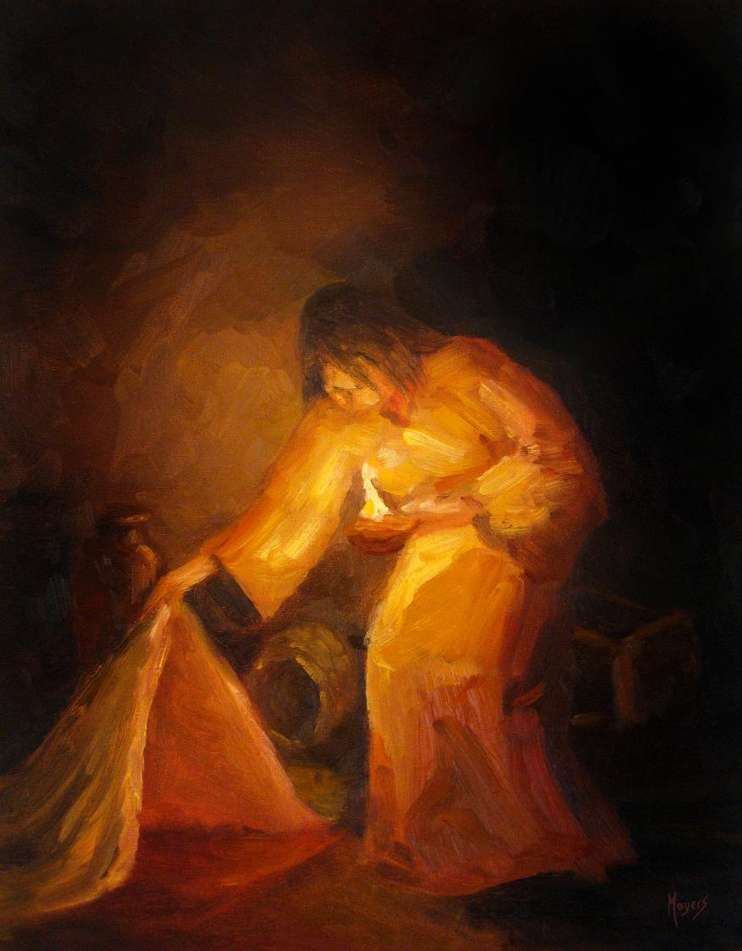
Today’s story can be found in Matthew 13:52
Stories as treasure to be found
‘The seeker’ by Mike Moyers, from the Vanderbilt University Library, Art in the Christian Tradition
Notes:
‘Stories as treasure to be found’ – Summer term 2026 These resources are ©The Diocese of Guildford
The Gospels are full of the parables of Jesus, which he used to communicate ideas about the Kingdom of God to his listeners, often challenging their thinking, and quite often in answer to a question he had been posed. For Christians – as for Jesus’ original audiences – the parables don’t just illustrate a truth, they contain a truth that the listeners are supposed to search for for themselves, appealing to the intellect through the imagination. These collective worship materials don’t need to be used in any particular order, but loosely follow the parables of Jesus from Matthew 13. Although these parables were told to a specific audience, with a specific set of cultural expectations, Christians believe that Jesus’ parables can speak just as truthfully to a modern audience: like a well-cut gemstone, the light will shine through the different facets and show different colours at different times.
Notes for the teacher: This resource is to be used for collective worship during tutor times or in other groupings that work for your setting. There may be enough material here to resource more than one tutor time.
Each resource contains some images and words to support the spiritual development of students, with a script for the leader written under the slides.
Any bold text indicates when a click will animate either text or an image for students to ponder, and italic text contains pointers for the leader.
Especially important is the slide denoted as ‘Going deeper: responding and words for worship’, which ensures that the resource meets the requirement for daily collective worship in your Church school. The words are invitational, and prayer is optional.
At the end of each set of slides, there is an image from across times and cultures illustrating the story from a different perspective. You might want to include a question on this slide that will challenge students’ thinking as they leave, or at another time, picking up on what has been talked about during the gathering.
Today’s parable is about treasure and can be found in Matthew 13:52 – a very short, pithy parable for Jesus’ audience showing that wisdom comes from having an open mind to accept new teaching and hold it alongside old teaching.

Slide 2
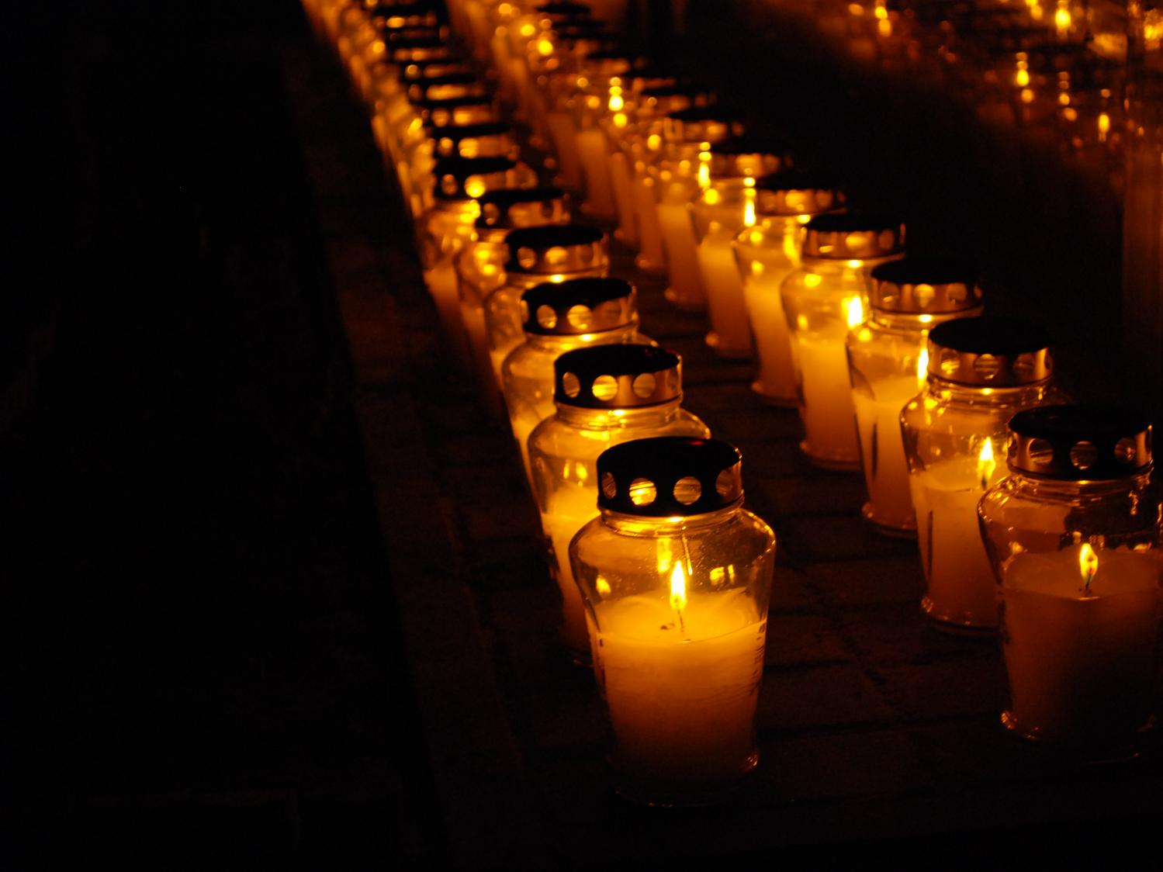
Gathering:
Father of all,
We gather here together as seekers after truth.
We give thanks for all that we treasure in our hearts….for our community, loved ones and the world in which we live.
Be present among us today.
Amen.
All images copyright-free from pixabay, unless otherwise identified
Notes:
Gathering
You might want to light a candle to signal the start of collective worship. Invite students to be quiet and still and to use the words of the prayer if it helps them…..
Father of all
We gather here together as seekers after truth.
We give thanks for all that we treasure in our hearts….for our community, loved ones and the world in which we live.
Be present among us today.
Amen

Slide 3

He said to them, ‘….every teacher of the law who has become a disciple in the kingdom of heaven is like the owner of a house who brings out of his storeroom new treasures as well as old.’
What do we mean by ‘treasure’?
Notes:
Engaging: What do we mean by ‘treasure’?
This word can be used as a noun or as a verb.
Use think-pair-share to gather some responses, pushing thinking beyond the monetary value of something to the emotional value.
Do people always treasure the same thing? Respectfully probe what might influence someone’s view of ‘treasure’.
We read in Matthew 13 verse 35 some words that Christians believe were written about Jesus: ‘“I will use stories to speak my message and to explain things hidden since the origins of the world.” Parables are stories that contain hidden meanings, like treasure to be found. They were designed to engage Jesus’ listeners, provoke conversation and challenge their thinking. Jesus often used parables to communicate the deep truths about God’s Kingdom to his listeners and often told them in response to a question. We’re going to use a very short parable from the very end of that same chapter, Matthew 13 (verse 52), about treasure…. [you might want to read it more than once]
He said to them, ‘….every teacher of the law who has become a disciple in the kingdom of heaven is like the owner of a house who brings out of his storeroom new treasures as well as old.’

Slide 4

…I wonder what the treasure might represent in this parable?...
…Do you think the new treasure is better than the old? Or do both have value here?...
He said to them, ‘….every teacher of the law who has become a disciple in the kingdom of heaven is like the owner of a house who brings out of his storeroom new treasures as well as old.’
Notes:
Engaging: What might this parable mean?
Let’s wonder about this parable together…..
You might like to create discussion opportunities here….questions in bold are the most significant and will animate on the screen
I wonder who was listening to this parable?
I wonder what the difference between a teacher of the law and a disciple of heaven might be?
Or whether you can be both at the same time?
I wonder what the treasure might represent in this parable?
[Try replacing the word ‘treasure’ with the word ‘idea’ or ‘wisdom’….]
I wonder where the storeroom really is?
Do you think the new treasure is better than the old? Or do both have value here?...

Slide 5

…I wonder what you think about Jesus’ ideas?...or how these words might help us or others to understand more about God’s Kingdom?...
…I wonder which things might be like ‘old treasure’ and ‘new treasure’ for us?...
…I wonder what new thinking we might need to embrace in order to become wise?...
…I wonder how this parable might speak to us as we go into the rest of this day?...
Notes:
Going deeper: responding and words for worship
Let’s think about what this parable might mean for us today…..
…I wonder what you think about Jesus’ ideas?...or how these words might help us or others to understand more about God’s Kingdom?...
…I wonder which things might be like ‘old treasure’ and ‘new treasure’ for us?...
…I wonder what new thinking we might need to embrace in order to become wise?...
…I wonder how this parable might speak to us as we go into the rest of this day?...
I’m going to use some words in prayer now: if this is something that you are comfortable with, then find a way to make the prayer your own….you will hear some repeated words that might help you.
Creator God, who is the great shaper of stories,
Thank you for the power of stories in our lives. In them….. may we find treasure, old and new.
As we encounter wisdom from different times and different places…. may we find treasure, old and new.
In the people we meet, and the diverse community we share….. may we find treasure, old and new.
Be our source of wisdom, old and new, we pray.
Amen
Sending: you might wish to leave students with a final challenge based on this slide, then blow out the candle as a sign that the collective worship is finished.

Slide 6
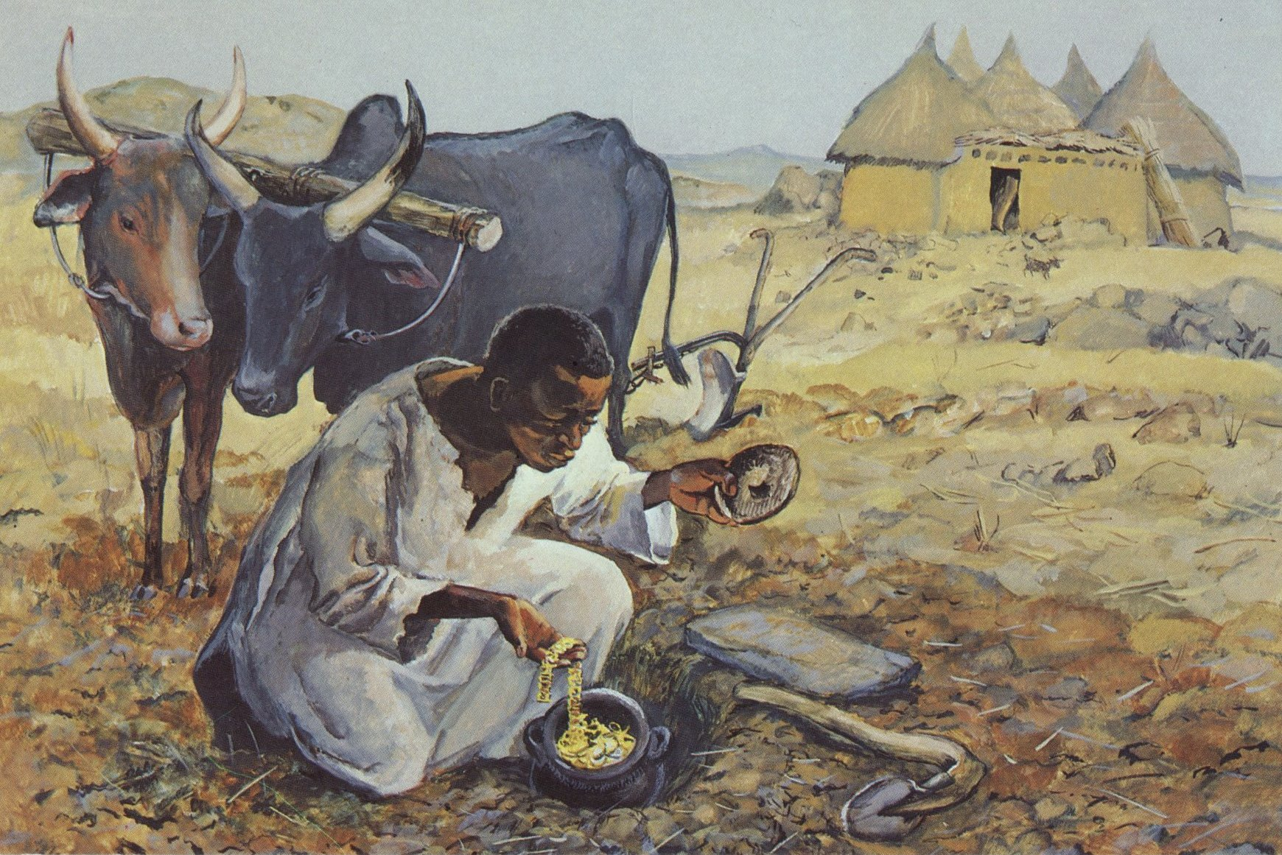
Notes:
Finding the treasure – Jesus MAFA project, Cameroon
Although this is an image that specifically relates to the parable of the treasure in the field, as we are not using this parable in this series, we are borrowing the image to illustrate finding new treasure…..
‘The Life of Jesus Mafa’ is a set of 63 pictures from the life and teaching of Jesus, viewed by the artist as if the events had taken place in a village in Cameroon.
Original source: https://diglib.library.vanderbilt.edu/act-imagelink.pl?RC=48286

