Slide 1
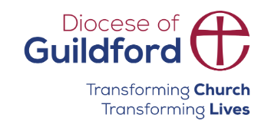
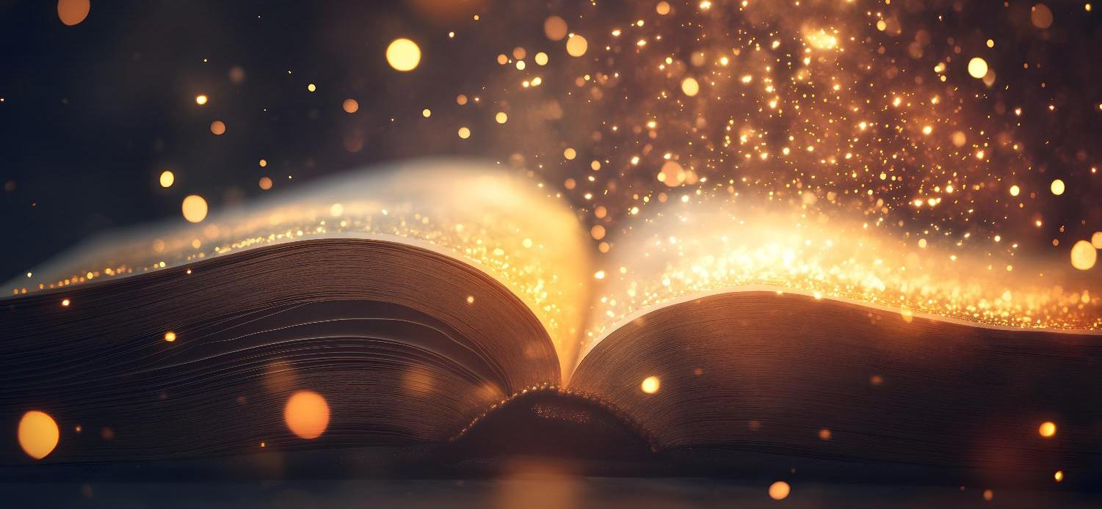
Today’s words can be found in Psalm 24:1-2
Words to make you wonder…
Image from pixabay
Notes:
‘Words to make you wonder’ – Summer term 2026 These resources are ©The Diocese of Guildford
This is a companion resource to ‘Stories as treasure to be found’, collective worship resources created to support Secondary schools in the Diocese of Guildford. ‘Words to make you wonder’ are taken from different parts of the Bible and used in response to world events or big questions in life. Our materials today reference the recent 100th birthday of Sir David Attenborough.
Notes for the teacher: This resource is to be used for collective worship during tutor times or in other groupings that work for your setting. There may be enough material here to resource more than one tutor time.
Each resource contains some images and words to support the spiritual development of students, with a script for the leader written under the slides.
Any bold text indicates when a click will animate either text or an image for students to ponder, and italic text contains pointers for the leader.
Especially important is the slide denoted as ‘Going deeper: responding and words for worship’, which ensures that the resource meets the requirement for daily collective worship in your Church school. The words are invitational, and prayer is optional.
Today’s words come from Psalm 24:1-2 written by David, the Psalm-writer, placing ownership of our world very firmly into God’s hands. We consider these alongside some words from Sir David Attenborough about our responsibilities towards our planet.

Slide 2
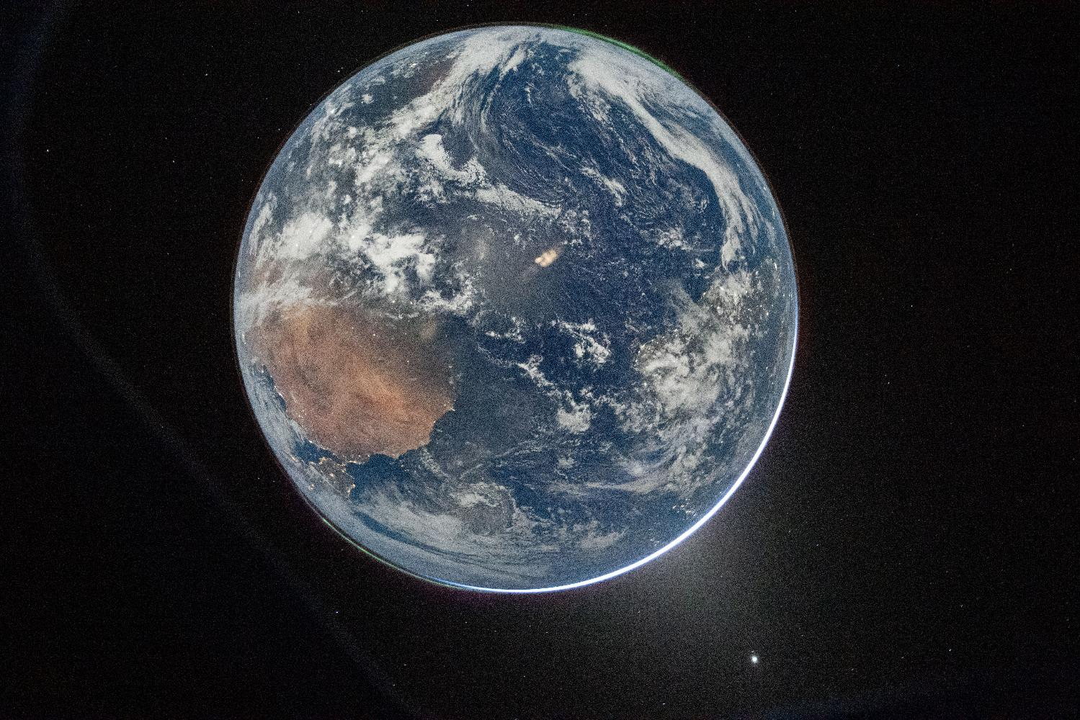
‘Every breath of air we take, every mouthful of food that we take, comes from the natural world. And if we damage the natural world, we damage ourselves.’
Image ©NASA
Notes:
Gathering: image of the Earth from Artemis II Mission, April 7th 2026
You might want to light a candle to signal the start of collective worship. Invite students to be quiet and still and look at the image.
As we begin, listen to these words, spoken by one of the most universally loved men of our time….
‘Every breath of air we take, every mouthful of food that we take, comes from the natural world. And if we damage the natural world, we damage ourselves.’
Discuss together, maybe using the following questions….
I wonder what you think about these words? Do you agree with them?
I wonder if you can guess who spoke them?
I wonder what key messages you might want to share with others about environmental issues?

Slide 3
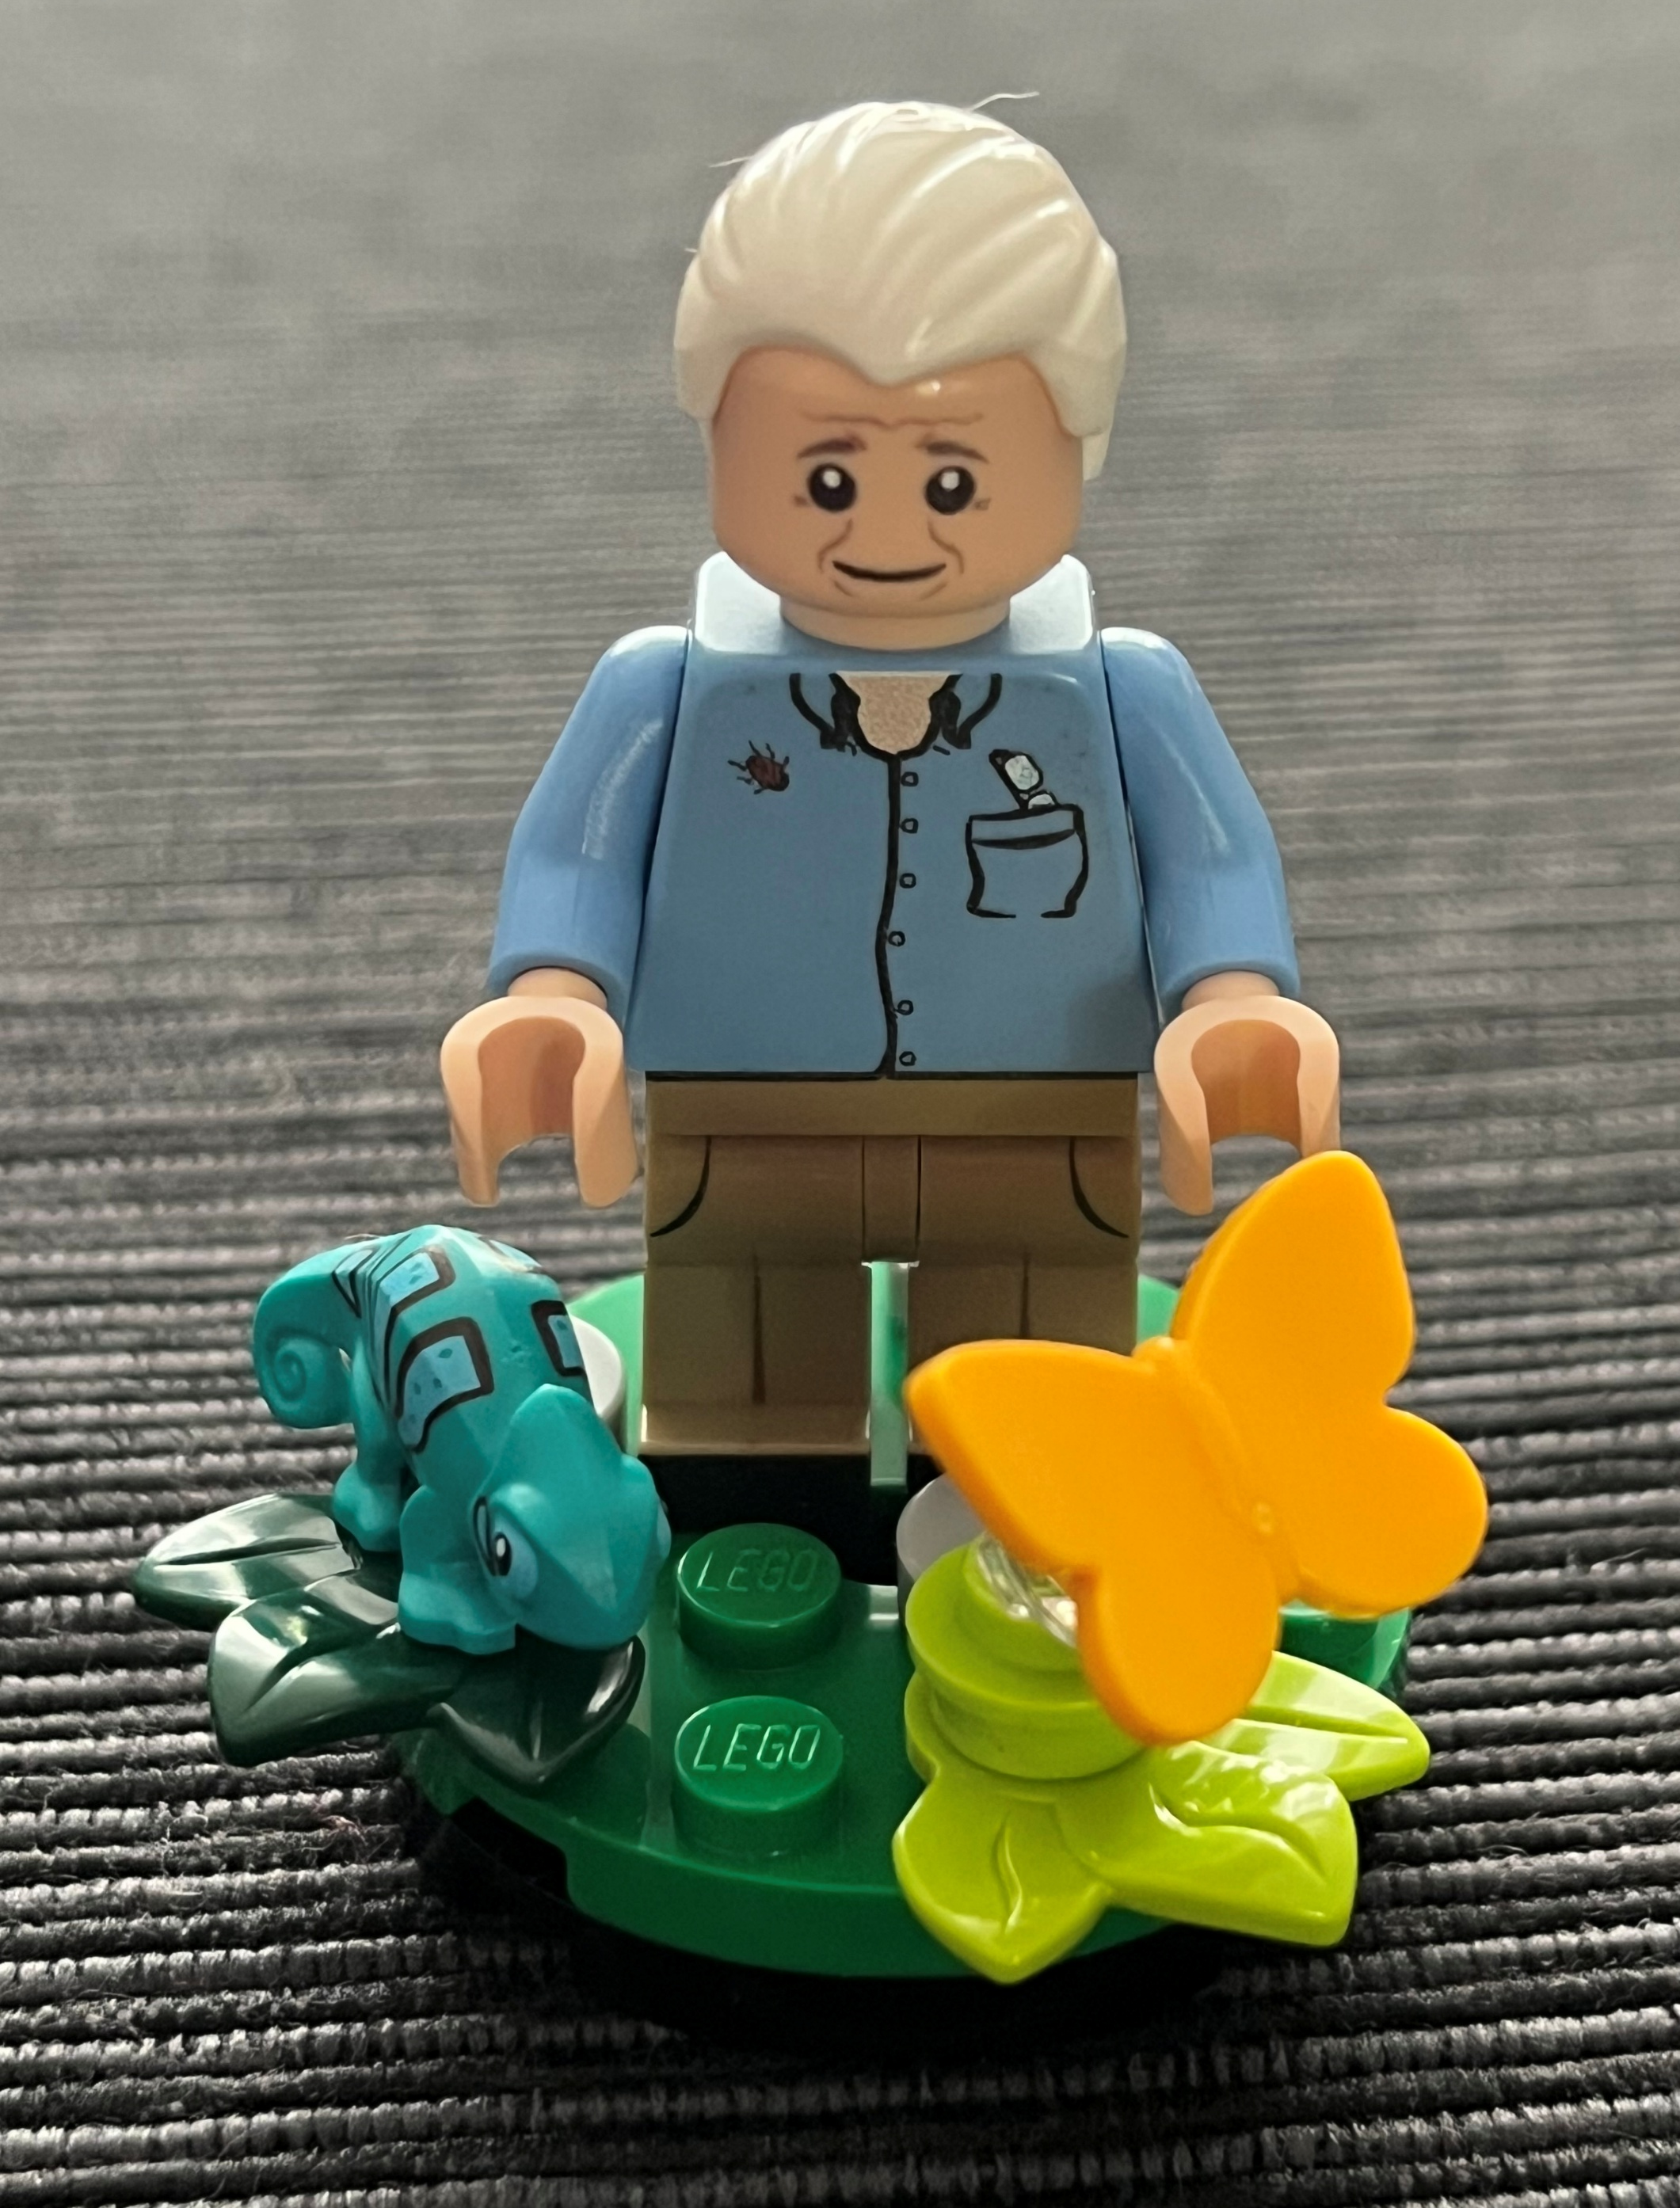
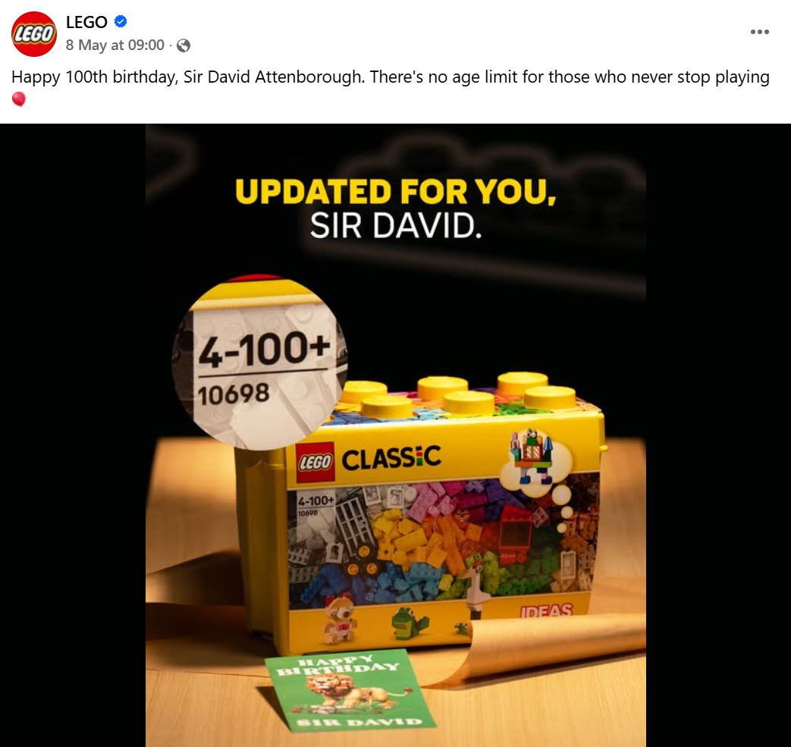
Notes:
Engaging: Sir David Attenborough turns 100
The man who spoke those words is none other than Sir David Attenborough, who recently celebrated his 100th birthday – and, as you can see here, has been immortalised in LEGO® who also humorously posted this birthday greeting to mark the occasion….
I wonder why you think so many people have chosen to commemorate this particular human being’s birthday?
Do you think turning 100 has made him view the world any differently?

Slide 4

In our hands now lies not only our own future, but that of all other living creatures with whom we share the earth.
(Sir David Attenborough)
The earth is the Lord’s, and everything in it, the world, and all who live in it; for he founded it on the seas and established it on the waters. (Psalm 24:1-2)
…Who does the world belong to?...
…Does how we answer this question make any difference to how we care for our world?...
Notes:
Going deeper: responding and words for worship
Here are some more words for us to think about – some from the Bible, and others spoken by Sir David Attenborough. (you might like to ask students to read the words out loud.
Talk together about the words:
Are these words contradictory or complementary?
Which viewpoint do you most align with?
…Who does the world belong to?...
…Does how we answer this question make any difference to how we care for our world?...
Does it matter? Is the outcome – environmental action – the same?

Slide 5
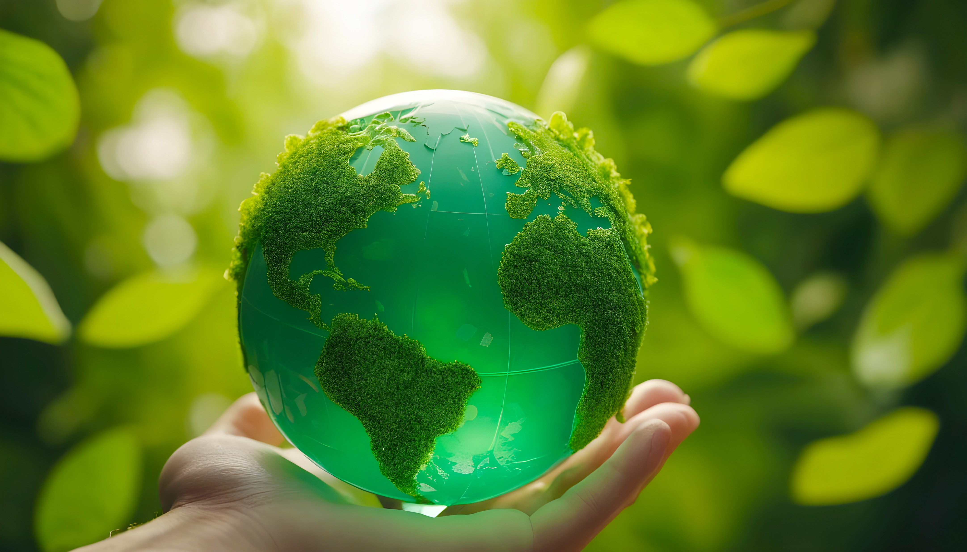
Notes:
Going deeper: responding and words for worship
Whatever our views about the origins of our world, or whose world it is, we can probably agree that it is a fragile gift that needs us to pay attention to its care.
If earth was this small, do you think we might have cared for it differently?
At the end of this time, you might like to hold out your hands as if you are cradling the earth in them….
If the future of the world does lie in our hands, what should our response be?
If the earth is God’s, does this make a difference to how we act?
As you imagine the world in your hands, you might like to take the opportunity to pray, or to make promises about future action…..
Sending: you might wish to leave students with a final challenge based on this slide, then blow out the candle as a sign that the collective worship is finished.

