Slide 1
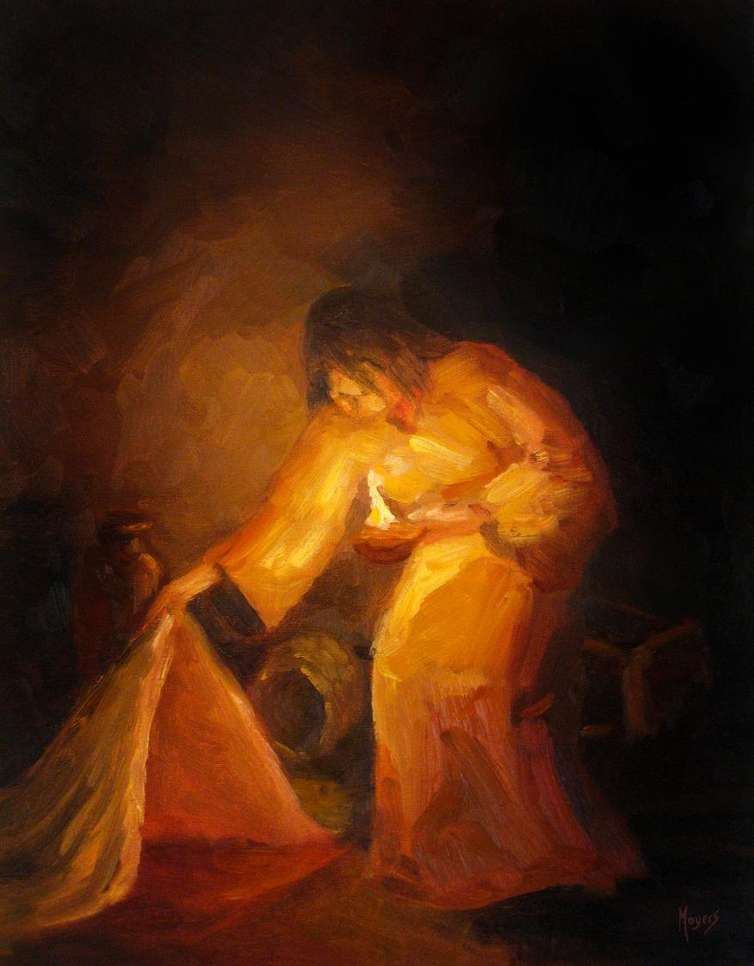

Today’s words can be found in Matthew 23:11-12 & John 13;15
Stories as treasure to be found
‘The seeker’ by Mike Moyers, from the Vanderbilt University Library, Art in the Christian Tradition
Notes:
‘Stories as treasure to be found’ – Summer term 2026 These resources are ©The Diocese of Guildford
Today’s ‘parable’ is one that Jesus himself acted out for his disciples in the upper room before they celebrated the Passover together on the night that Jesus was betrayed. The servant whose job it was to wash the feet of the family and their guests held one of the lowest positions in the household. Jesus was deliberately using this knowledge to make a point about how those who follow him should treat others.
Notes for the teacher: This resource is to be used for collective worship during tutor times or in other groupings that work for your setting. There may be enough material here to resource more than one tutor time.
Each resource contains some images and words to support the spiritual development of students, with a script for the leader written under the slides.
Any bold text indicates when a click will animate either text or an image for students to ponder, and italic text contains pointers for the leader.
Especially important is the slide denoted as ‘Going deeper: responding and words for worship’, which ensures that the resource meets the requirement for daily collective worship in your Church school. The words are invitational, and prayer is optional.
At the end of each set of slides, there is an image from across times and cultures illustrating the story from a different perspective. You might want to include a question on this slide that will challenge students’ thinking as they leave, or at another time, picking up on what has been talked about during the gathering.
Today’s words come from Matthew 23:11-12 and John 13:15 both describing what is, for Christians, one of the most poignant moments in history – the Maker of the Universe kneeling to wash the feet of his disciples. Also included in this resource is reference to another story of service, which parallels this one beautifully and originates as a traditional Māori tale about the Kiwi.

Slide 2
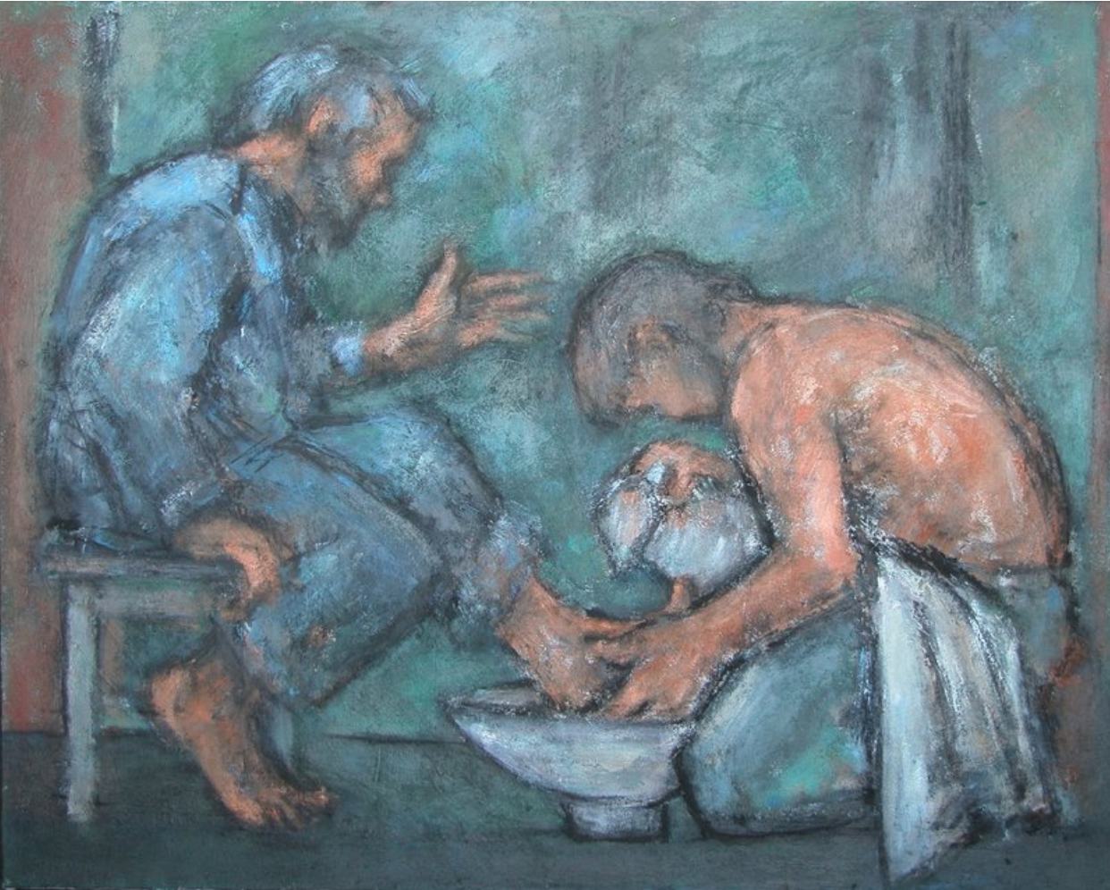
‘The Washing of the Feet’ by Ghislaine Howard from The Methodist Modern Art Collection, ©TMCP, used with permission
‘He who serves you as a servant is the greatest among you…..Whoever makes himself humble (like a servant) will be made great.’…. ‘You should do as I have done.’
[Matthew 23:11-12 & John 13:15]
Notes:
Gathering: Matthew 23:11-12 & John 13:15
You might want to light a candle to signal the start of collective worship. Invite students to be quiet and still and look at the image and the words.
The image that you can see is one of Jesus washing the disciples’ feet, which is part of the Easter narrative. In doing this, Jesus wanted to show his disciples what he meant by serving others. Here are some words that Jesus spoke, ‘He who serves you as a servant is the greatest among you…..Whoever makes himself humble (like a servant) will be made great.’….. ‘You should do as I have done.’
Allow some time for discussion here, including some of the points / questions below:
What do you think about Jesus’ words?
How does this view of ‘being great’ sit with you?
What might make us ‘great’ in the world’s eyes?
How do we understand ‘greatness’ in our school community?
Is it possible to conduct a truly self-less act? [Think Phoebe’s philosophical dilemma in ‘Friends’ Series 5 Episode 4 The one where Phoebe hates PBS]
How do you think followers of Jesus might ‘act out’ Jesus’ actions in their own lives?

Slide 3
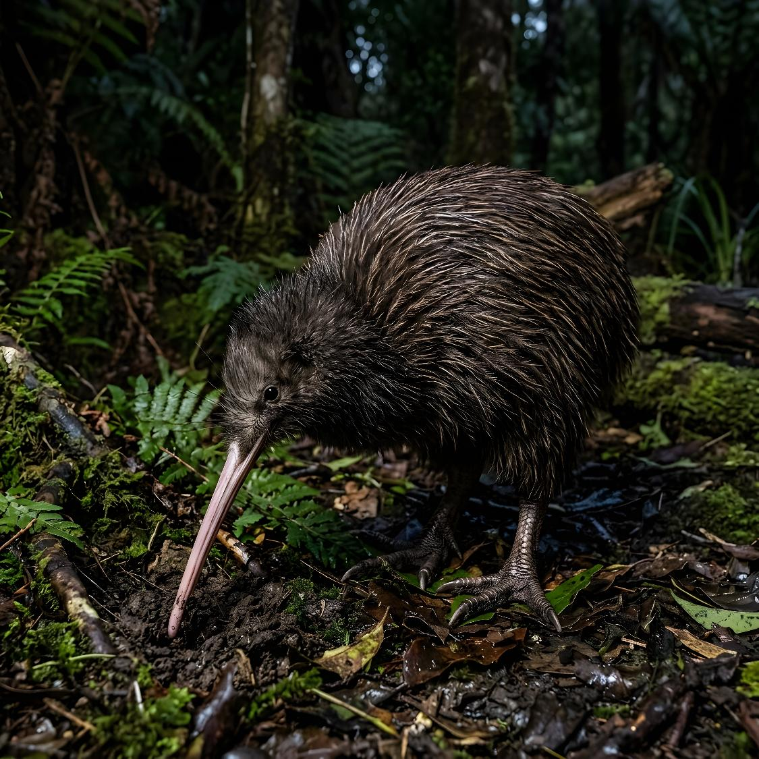
The Self-less Kiwi
Notes:
Engaging: The Self-less Kiwi (or how the Kiwi became flightless)
Many cultures have ancient tales of how certain things came about, attempting to explain such extraordinary creatures such as this bird, the Kiwi, New Zealand’s national bird.
This Māori story tells of how the King of the Forest, Tane Mahuta [Tarn-ay Ma-hoot-a], notices that his children, the trees, are very sick, and asks his brother, Tane Hokahoka [Tarn-ay Hock-a Hock-a], to appeal to his children, the birds, to help to eat the bugs on the forest floor. One by one all the birds refuse, not wanting to leave their home in the skies to live on the ground.
All except for Kiwi, that is, who realises that everyone’s future depends on the health of the trees, and agrees to commit to a future on the dark forest floor, searching for bugs, losing his colourful feathers and ability to fly. In return, Tane Hokahoka promises that this little bird will become the most famous and most beloved of all the birds – and over time, has also given the people of New Zealand their nickname, ‘Kiwis’!
Lead a short discussion about some of the themes from these stories:
What might you have done if you were one of Tane Hokahoka’s children, the birds?
Should Kiwi have made this sacrifice?
What connections might there be between these two stories?...
Why do you think that Jesus chose to ‘act out’ this ‘parable’? i.e. How did Jesus’ actions foreshadow his death on the cross?
Have you ever had to sacrifice something for the sake of someone else?
If you’re interested, here are some fascinating facts about the Kiwi:
It’s a flightless bird, and mostly nocturnal
It’s about the size of a chicken. Male and female kiwis pair for life.
Female kiwis lay eggs that are about one-fifth of their body weight – in human terms, that’s equivalent to a 28lb (13kg) baby!
Their nostrils are at the very end of their beak so that they can sniff out insects in the undergrowth. At night, they can be heard snorting to get the dust out of their nostrils!

Slide 4


…I wonder how our school community might make this a priority?...
…I wonder what you think about the idea of putting others first?...
…or how you might put this idea into action?...
Notes:
Going deeper: responding and words for worship
As you look at these two images, reflect on some of the ideas that the stories raise for you….
…I wonder what you think about the idea of putting others first?...
…or how you might put this idea into action?...
…I wonder how our school community might make this a priority?...

Slide 5
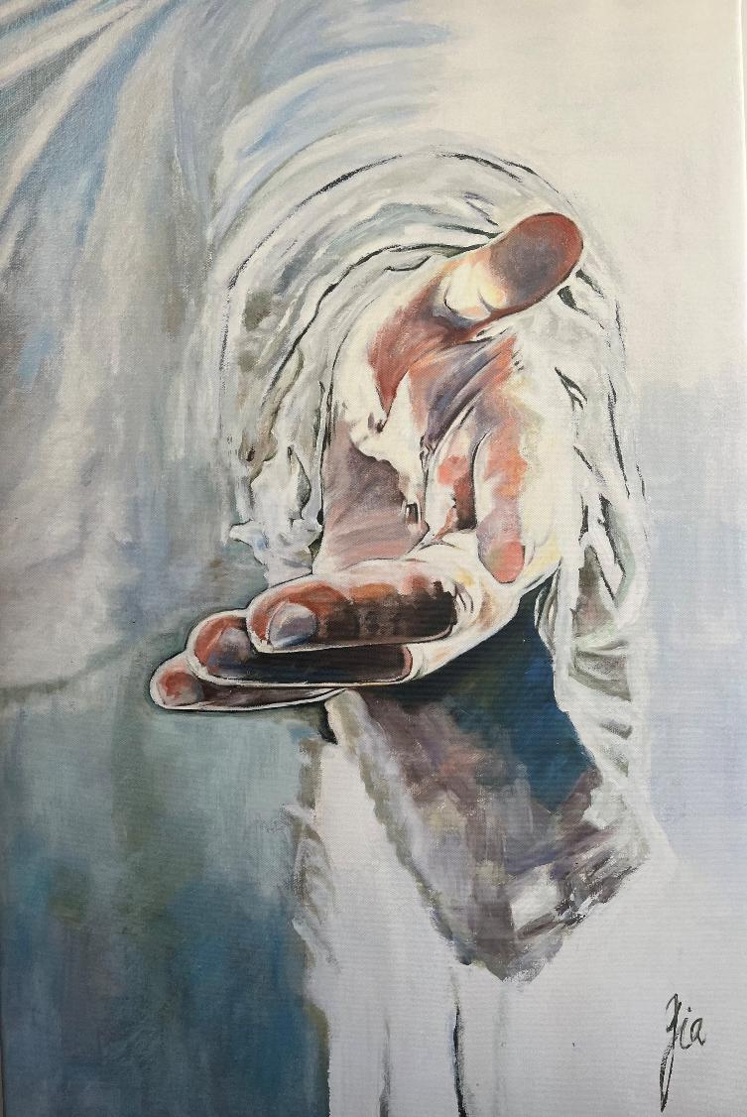
‘So, let us learn how to serve, and in our lives enthrone him.
Each other’s needs to prefer, for it is Christ we’re serving.’
Notes:
Sending & Blessing: This is an image by Chinese artist Cathy Henfrey, who painted it during the pandemic after becoming a Christian. She said she it felt to her that God was reaching out to her, inviting her in. We are grateful to her for allowing us to use this original work.
The words on the screen may be already familiar to you, as part of a song, ‘The Servant King’, written by Graham Kendrick. You might want to turn them into your own personal prayer:
‘So, let us learn how to serve, and in our lives enthrone him.
Each other’s needs to prefer, for it is Christ we’re serving.’
Sending: you might wish to leave students with a final challenge based on this slide, then blow out the candle as a sign that the collective worship is finished.
If you want to, use this lyric video version of Graham Kendrick’s song, Servant King: https://www.youtube.com/watch?v=C4FtZ9XzZag

Slide 6
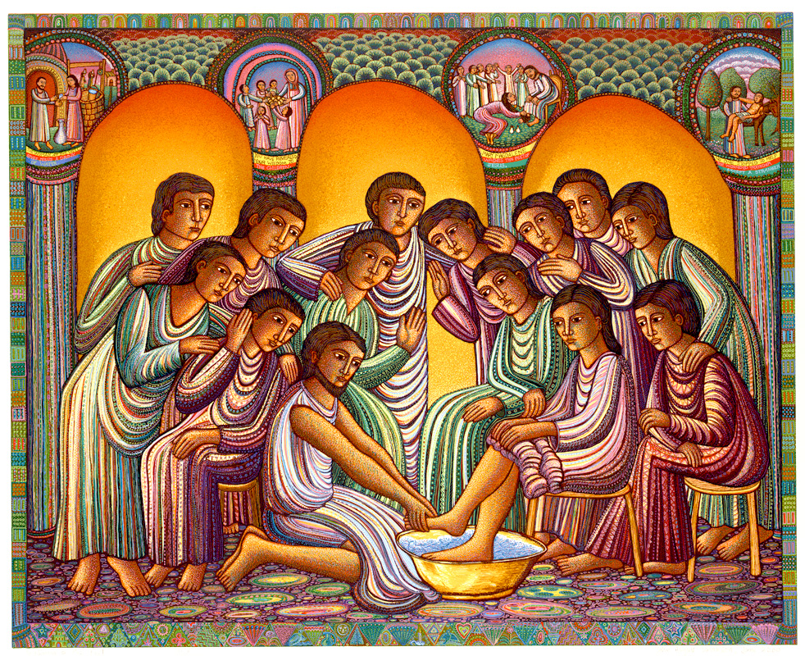
Notes:
The washing of the feet by John August Swanson
This artist’s unique style is influenced by the imagery of Islamic and medieval miniatures, Russian iconography, the colour of Latin American folk art, and the tradition of Mexican muralists.
Image from: https://diglib.library.vanderbilt.edu/act-imagelink.pl?RC=58579

