Slide 1


Today’s words can be found in Matthew 5:9
Count your blessings
Images from pixabay, unless otherwise identified
Notes:
‘Count Your Blessings’ – Autumn term 2026 These resources are ©The Diocese of Guildford
These form part of the collective worship resources created to support Secondary schools in the Diocese of Guildford. Research reveals the importance of gratitude even in the midst of adversity: that being aware of each day’s ‘blessings’ can counteract anxiety, and so this term, we want to encourage schools to highlight this especially in their collective worship. As always, each week’s materials link with Biblical content, whilst also ensuring that they are inclusive for pupils and adults of all faiths, or none. Over this short series ‘Count your blessings’, we will highlight things that we might consider to be ‘blessings’ and will refer to this in the ‘Going deeper: responding and words for worship’ section each week.
The materials in this PPT have been created for Remembrance. There is opportunity within the resource to pause to mark the two minutes’ silence if you are doing this on Armistice Day. We use the words that Jesus spoke about being a peacemaker to reflect on the challenges that one young soldier faced in committing to a life of peace in the middle of war time. Huge thanks go to A-level student Ben Musters for his help with this resource, as part of his Y12 work experience.
Notes for the teacher: This resource is to be used for collective worship during tutor times or in other groupings that work for your setting. There may be enough material here to resource more than one tutor time.
Each resource contains some images and words to support the spiritual development of students, with a script for the leader written under the slides.
Any bold text indicates when a click will animate either text or an image for students to ponder, and italic text contains pointers for the leader.
Especially important is the slide denoted as ‘Going deeper: responding and words for worship’, which ensures that the resource meets the requirement for daily collective worship in your Church school. The words are invitational, and prayer is optional.
You may wish to light a candle at the beginning as a sign that you are entering this different space in the school day.
Today’s words come from Matthew 5:9 and are some of Jesus’ most famous words as part of the Sermon on the Mount, where Jesus laid before his listeners some of the topsy-turvy principles of living in God’s Kingdom.

Slide 2
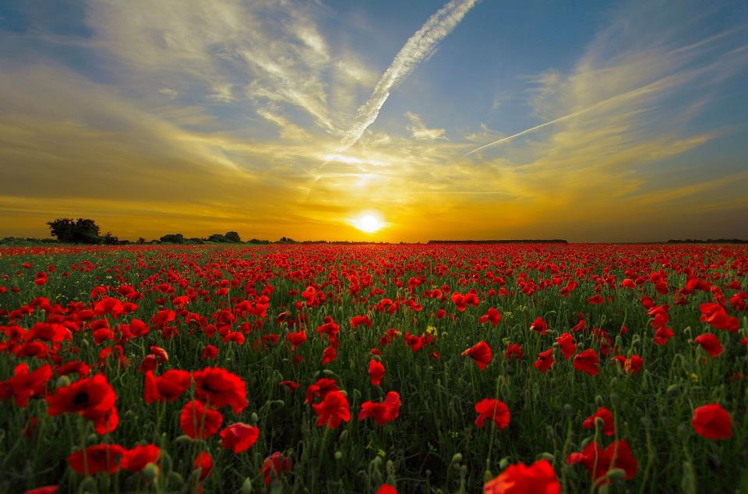
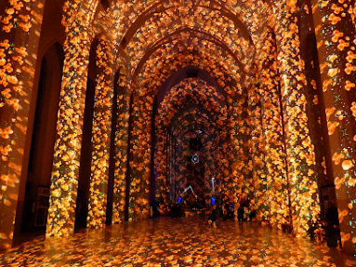
Should we always remember like this?
Poppy Fields Guildford Cathedral, Oct 2018
Notes:
Engaging: Armistice Day
I wonder what you think of when you see this? For most of us, it will be ‘Poppy Day’ or more correctly, Remembrance or Armistice Day – when across the world, the nations remember the many acts of courage, selflessness and service of those who fought in past wars, and those who are still doing so.
I wonder…..Should we always remember like this?
Lead a short discussion to help students to think about the different attitudes that might exist towards Remembrance, or war and peace.
To help us to think and remember today, we are going to hear the story of one young soldier who, like so many, went to war in 1914…..

Slide 3
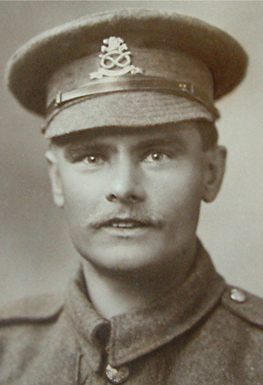
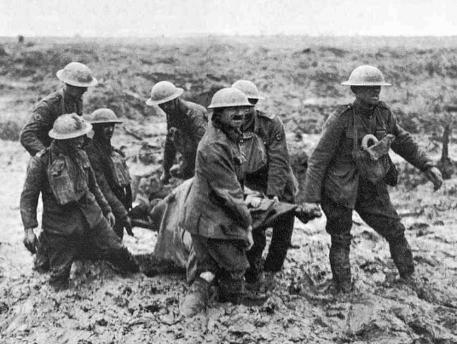
‘This very gallant NCO tended the wounded unceasingly for 48 hours….He won many other medals too, yet never fired a single bullet.’
Lance Corporal William Coltman
(1891-1974)
Notes:
Engaging: William Coltman’s story
William Coltman joined the army in 1915 but chose not to fight, becoming a stretcher‑bearer because of his Christian commitment to saving lives and being a ‘peace-maker’. Despite his small stature, he repeatedly braved No‑Man’s Land under enemy fire to rescue wounded soldiers, often carrying them on his back. For three years he ventured out nightly to ensure no one was left behind, risking his life amongst the barbed wire and mud. His extraordinary courage earned him the Victoria Cross for actions in October 1918. His official letter states that: ‘This very gallant NCO tended the wounded unceasingly for 48 hours….He won many other medals too, yet never fired a single bullet.’ William Coltman was one of the few who survived WWI.
Talk together:
I wonder what challenges you think Walter Coltman might have faced, living as a ‘peacemaker’ in the midst of war?
Does hearing about the life of an individual change how we think about the act of Remembrance?
Do you think that being a peacemaker can sometimes be more courageous than being a fighter?

Slide 4
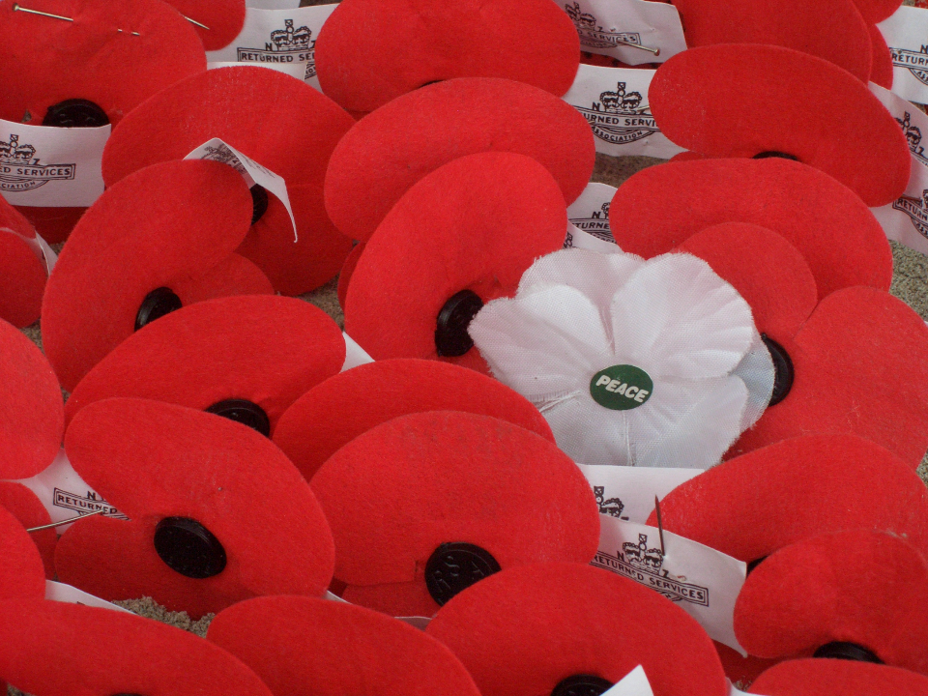
‘At the going down of the sun, and in the morning, we will remember them…’
Notes:
Engaging: Remembrance
Our peace was won at a very great cost, which is why on Remembrance Day each year, we hear the words ‘At the going down of the sun, and in the morning, we will remember them’, as we think of those who gave so much so that we might live at peace….

Slide 5
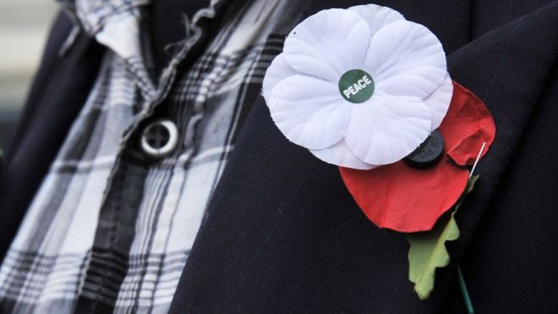
...Blessed are the peacemakers…
Notes:
Going deeper: responding and words for worship - you might also wish to hold your own period of silence at this point.
William Coltman chose to be a peace-maker, even in the midst of war. I wonder what you think about his example?
He took the instructions of Jesus to ‘be a peacemaker’ very seriously, believing that God blesses those who live in this way.
Talk together, selecting from the following questions to suit your context:
I wonder if being a peacemaker is only for those who follow Jesus?
I wonder what blessings a peacemaker might receive?
I wonder whether we need peace more, or less, in our world today?
I wonder how our actions might make for peace in our community this week?

Slide 6
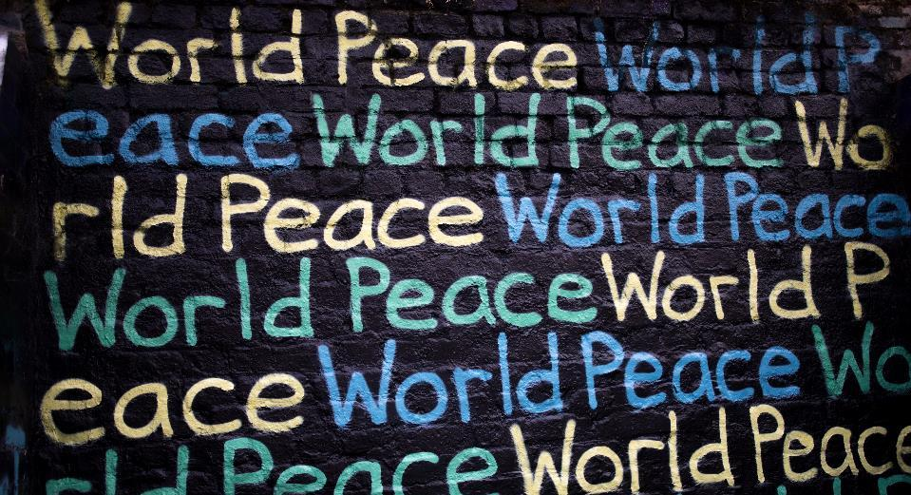
Photo by Humphrey Muleba on Unsplash
For peacemakers and peacekeepers, who seek to keep our world secure and free; may God give peace.
God give peace.
Amen
Notes:
Prayer: for peacemakers
You might want to use this prayer and say the words in bold to make the prayer your own, or think about the blessing that living at peace is, for ourselves, and those whom we love.
For peacemakers and peacekeepers, who seek to keep our world secure and free; may God give peace.
God give peace.
Amen
Sending: In Christian communities across the world, people often share ‘the peace’ as part of their worship – using the words ‘Peace be with you.’ You might want to bless each other in this way before you leave the room. Then blow out the candle as a sign that the collective worship is finished.

