Slide 1


Today’s words can be found in Joshua 4:6-7
Count your blessings
Images from pixabay, unless otherwise identified
Notes:
‘Count Your Blessings’ – Autumn term 2026 These resources are ©The Diocese of Guildford
These form part of the collective worship resources created to support Secondary schools in the Diocese of Guildford. Research reveals the importance of gratitude even in the midst of adversity: that being aware of each day’s ‘blessings’ can counteract anxiety, and so this term, we want to encourage schools to highlight this especially in their collective worship. As always, each week’s materials link with Biblical content, whilst also ensuring that they are inclusive for pupils and adults of all faiths, or none. Over this short series ‘Count your blessings’, we will highlight things that we might consider to be ‘blessings’ and will refer to this in the ‘Going deeper: responding and words for worship’ section each week.
The materials in this PPT pick up on some ideas about gratitude and remembrance, focusing on a command from God to the people of Israel at the end of their 40-year long desert journey to ‘Remember that….’ This is a common thread in Judaism today, where many of the calendar events are centred around re-enacting past events to inspire both gratitude and compassion. Within this resource, there is an option to build a classroom ‘cairn’ with pebbles (see slide 5).
Notes for the teacher: This resource is to be used for collective worship during tutor times or in other groupings that work for your setting. There may be enough material here to resource more than one tutor time.
Each resource contains some images and words to support the spiritual development of students, with a script for the leader written under the slides.
Any bold text indicates when a click will animate either text or an image for students to ponder, and italic text contains pointers for the leader.
Especially important is the slide denoted as ‘Going deeper: responding and words for worship’, which ensures that the resource meets the requirement for daily collective worship in your Church school. The words are invitational, and prayer is optional.
You may wish to light a candle at the beginning as a sign that you are entering this different space in the school day.
Today’s words come from Joshua 4:6-7 and describe a very special ‘cairn’ that God commanded Joshua to build as a way to remember. You might like to do this for yourselves, using pebbles that can be bought very cheaply from garden centres.

Slide 2

How does remembering help us to be grateful?
Remember that….
Notes:
Engaging: How does remembering help us to be grateful?
Lead a short discussion to begin this time.
What sorts of things should we remember – and be grateful for?
Use the sentence starter…… Remember that…..

Slide 3
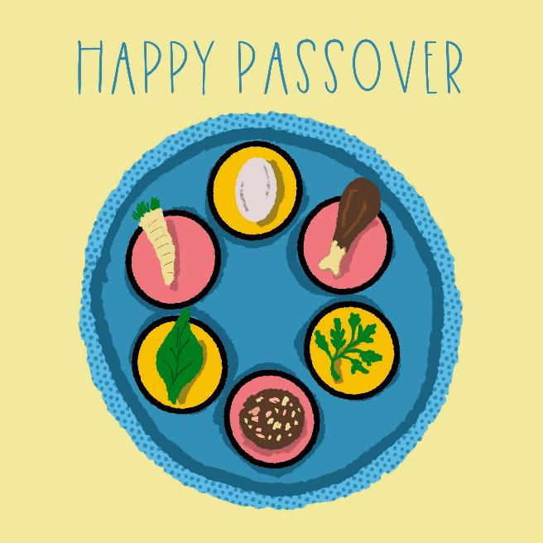
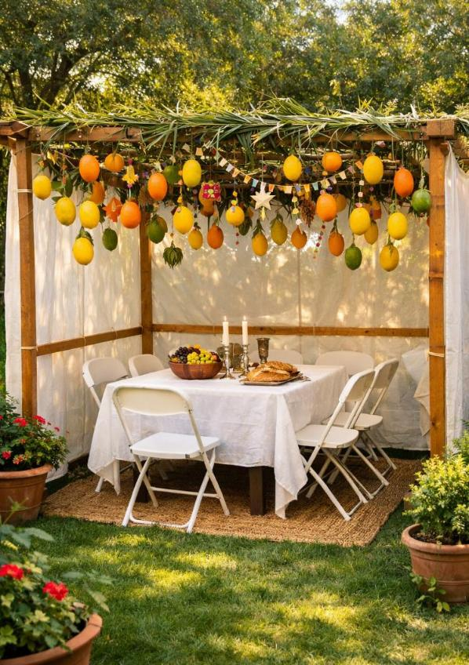
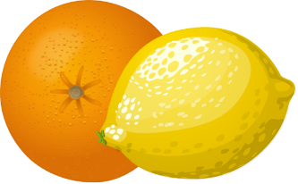
Remember that…
….God brought you out of Egypt…
….all Israel lived in sukkahs….
Notes:
Engaging: Remembering in Judaism
In the history of the Jewish people, God repeatedly reminded them to ‘Remember that….’ so that events like the Exodus and God’s provision for them on the 40-year-long desert journey would not be forgotten.
Within the celebration of Passover, and the seder meal, there are commands to remember that ‘God brought you out of Egypt’, and in building shelters for the Autumn festival of Sukkot, Jewish people today still remember that ‘all Israel lived in sukkahs’ as they travelled through the desert.
Talk together using some of these questions:
Why do you think God wanted the Jewish people to ‘remember’?
How might remembering help Jewish people today feel connected with their ancestors?
Are there events in your own life that you might want to remember in this way?
What might you use to help you to ‘remember that….’?
God also asked the people to ‘remember that’ they were slaves in Egypt. Why do you think he did this?
Can remembering even a painful event be helpful?

Slide 4
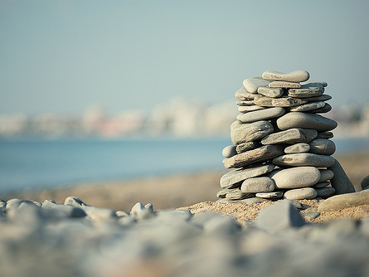
‘These rocks will always remind our people of what happened here today.’
Notes:
Going deeper and words for worship: Joshua 4:6-7
At the very end of the journey to freedom and a new home, God gave a further command to the people as they crossed the River Jordan. As he had parted the Red Sea in Egypt, he also parted the Jordan to allow the people to cross on dry land. Each leader of the 12 tribes of Israel was instructed to pick up a large stone from the river-bed and create a monument on the bank where they had stepped into this new part of their story.
God told them: ‘Someday your children will ask, “Why are these rocks here?” Then you can tell them how the water stopped flowing when the chest* was being carried across the river. These rocks will always remind our people of what happened here today.’ [CEV Bible translation]
As you look at the pile of stones, think about what they might have represented for God’s people…..
….I wonder why God chose stones to represent this event in the history of his people?....and why in this place?....
.…I wonder what events might have happened in your life that you might want to remember in this way?....
….What – or who – might the stone represent for you?....
….If God has been a part of your journey, do you have experiences like the people did that you might want to remember?....
*This is the Ark of the Covenant, the symbol of God’s presence with his people. It had been carried with the people throughout their journey – and is still symbolically represented within synagogues as the Ark – the cupboard where the Torah resides.

Slide 5
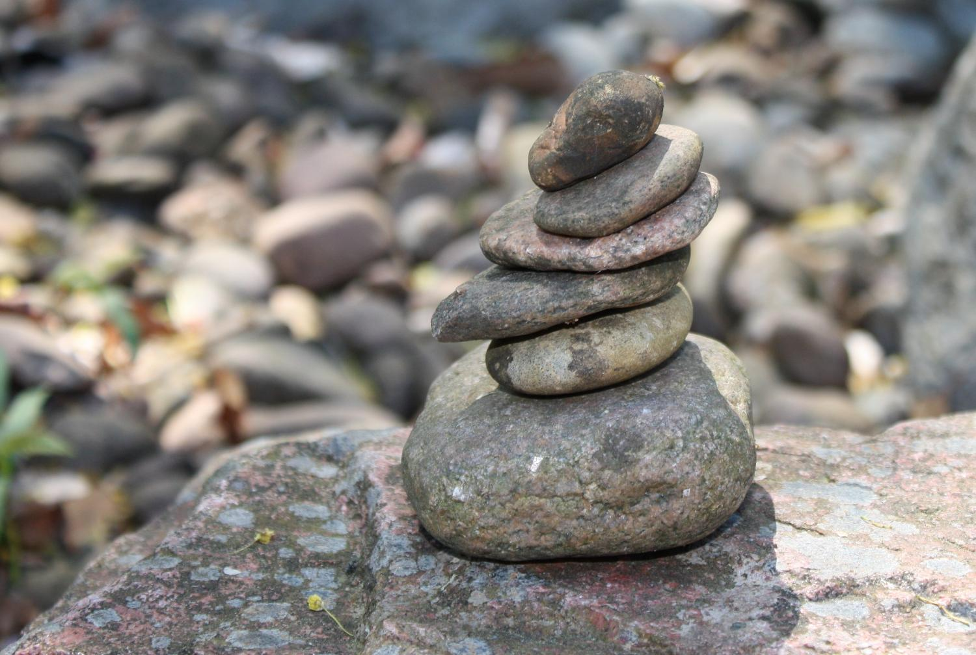
Notes:
Prayer and Sending: If you have provided pebbles, students could build a classroom ‘cairn’ as a way of marking a special memory for them.
Invite them to hold the stone in their hand and reflect or pray quietly about what it represents.
Ask them to place their stone on the ‘cairn’ as they leave the room, as a way of ending the worship today.
If you’re not using real stones, then turn this into a metaphorical cairn as you end this time of worship.

