Slide 1


Today’s words can be found in Romans 12:18 & Matthew 5:9
Count your blessings
Images from pixabay, unless otherwise identified
Notes:
‘Count Your Blessings’ – Autumn term 2026 These resources are ©The Diocese of Guildford
These form part of the collective worship resources created to support Secondary schools in the Diocese of Guildford. Research reveals the importance of gratitude even in the midst of adversity: that being aware of each day’s ‘blessings’ can counteract anxiety, and so this term, we want to encourage schools to highlight this especially in their collective worship. As always, each week’s materials link with Biblical content, whilst also ensuring that they are inclusive for pupils and adults of all faiths, or none. Over this short series ‘Count your blessings’, we will highlight things that we might consider to be ‘blessings’ and will refer to this in the ‘Going deeper: responding and words for worship’ section each week.
The materials in this PPT have been created especially to reflect on the blessing of ‘peace’; we recommend that you coincide using them with the International Day of Peace on September 21st 2026.
You can find out more about International Day of Peace here: https://internationaldayofpeace.org/ and the United Nations link here: https://www.un.org/en/observances/international-day-peace There are some good short videos on this webpage.
Notes for the teacher: This resource is to be used for collective worship during tutor times or in other groupings that work for your setting. There may be enough material here to resource more than one tutor time.
Each resource contains some images and words to support the spiritual development of students, with a script for the leader written under the slides.
Any bold text indicates when a click will animate either text or an image for students to ponder, and italic text contains pointers for the leader.
Especially important is the slide denoted as ‘Going deeper: responding and words for worship’, which ensures that the resource meets the requirement for daily collective worship in your Church school. The words are invitational, and prayer is optional.
You may wish to light a candle at the beginning as a sign that you are entering this different space in the school day.
Today’s words come from Romans 12:18 and Matthew 5:9 and relate to the importance of living at peace with others – and actively being involved in peace-building.

Slide 2
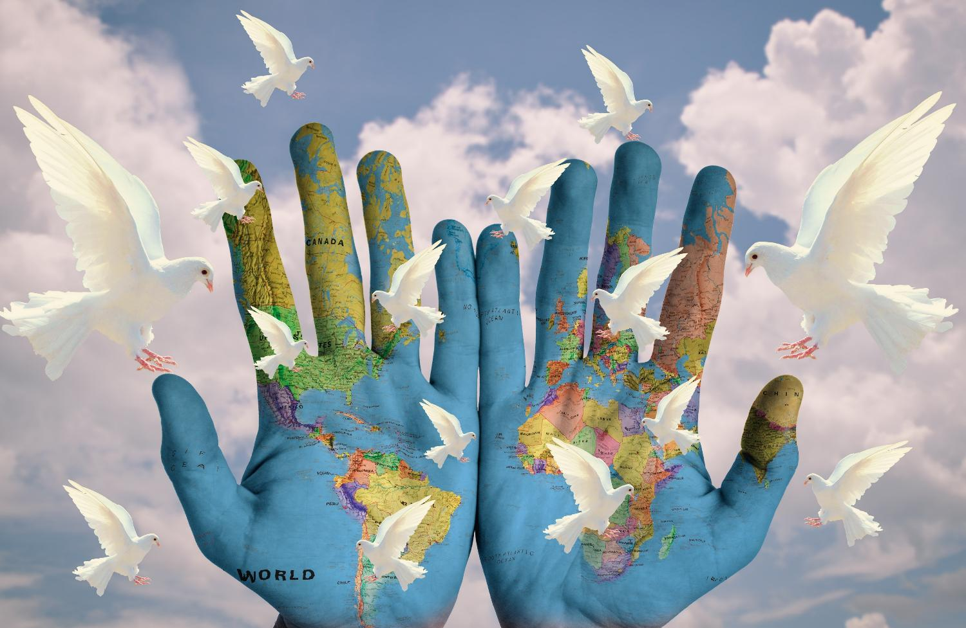
Notes:
Gathering / Engaging: What’s the message of this image?
You might want to light a candle to signal the start of collective worship. Invite students to be quiet and still and think about the message of this image.
Use think-pair-share to gather some ideas about the messages of this image. Hopefully the word ‘peace’ will be mentioned!

Slide 3

Peace is not just made at conference tables, but in classrooms, neighbourhoods, and everywhere people meet with open minds and open hearts. Together, day by day, we can build a more just world, with compassion, equality and dignity for all.
International Day of Peace
Notes:
Engaging: International Day of Peace
Today [or September 21st] is a special day across the world, as people think about the blessing of Peace – and how to make more of it! Many thousands of people across the world are focused on how to do this in our troubled world through the work of the United Nations – and International Peace Day is a way of helping us all to play our part.
This year’s theme is ‘Invest in Peace – for everyone, everywhere, every day’ – and so today, we will be thinking and talking about peace.
The Secretary-General of the United Nations, António Guterres, says this: ‘Peace is not just made at conference tables, but in classrooms, neighbourhoods, and everywhere people meet with open minds and open hearts. Together, day by day, we can build a more just world, with compassion, equality and dignity for all.’
As you look at these words, talk together:
Whose responsibility is it, to invest in peace?
Why is it important that it’s ‘for everyone, everywhere, every day’?
Which words especially stand out for you?
Are these qualities evident in our own school community? How? Where?

Slide 4

MUSLIM
As-Salamu-Alaikum
Peace be upon you!
ISLAM
SALAAM
Notes:
Engaging: Peace in Islam
Peace is an important idea in different religions as well. For people who are Muslims, the very name that they give to their religion – Islam – comes from the Arabic word for peace Salaam, and is also one of God – Allah’s – beautiful names: As-Salam, bringer of peace.
You’ll also hear it when Muslims greet one another with this peaceful greeting – As-Salamu-Alaikum, Peace be upon you!, which in Arabic* looks like this…. [it’s read from R-L] It’s as common a greeting across the Middle East as saying ‘Hello’ is for us!
[*Arabic Calligraphy By Hadysylmy - This file was derived from: Assalamu-aleykum.svg, CC BY-SA 4.0, https://commons.wikimedia.org/w/index.php?curid=161196036]

Slide 5
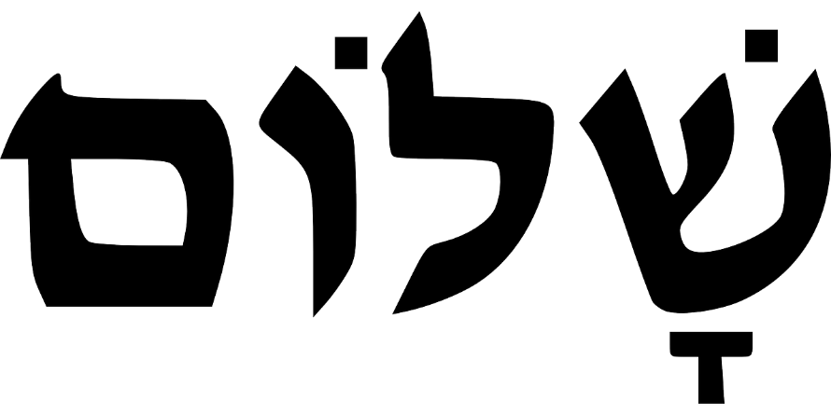
‘Do your best to live at peace with everyone.’
‘Shalom’
Notes:
Engaging: Peace in Judaism and Christianity
This is the Hebrew word for peace – ‘Shalom’ (it also reads from right to left) It’s one of the most beautiful words in the Bible and refers to a sense of wholeness – a completeness – of wellbeing. It’s not just the absence of conflict, but the presence of something better – this sense of complete wellbeing. It is this kind of peace that many people throughout history have worked hard to bring, a peace that has often been hard to find.
‘Shalom’ is also the peace that Christians believe Jesus brings, making right all wrongs, putting all things right.
Jesus talked about people who followed him needing to be ‘peace-makers’ and it’s an idea that the very first Christians took very seriously – to act peacefully wherever and whenever they could.
St Paul, who wrote a lot of letters in the New Testament part of the Bible, wrote these words to encourage the Early Church, who were living in challenging times: ‘Do your best to live at peace with everyone.’*
Question: What do you think this meant – for then? What might this mean for us – now?
*These words are from the CEV (Contemporary English Version) Bible, but there are other translations which express this same idea slightly differently:
Do your best to live in peace with everyone. (ICB)
If you’ve got it in you, get along with everybody. (The Message)
If it is possible, as far as it depends on you, live at peace with everyone. (NIV)

Slide 6
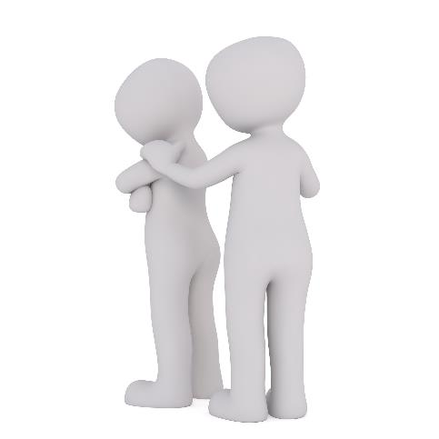
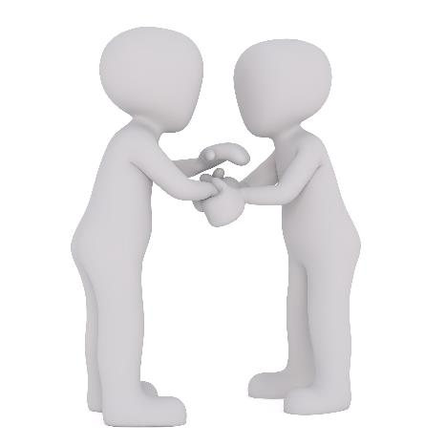
‘Blessed are the peacemakers’
Notes:
Engaging: Peace-making is an active word, a doing word. Jesus wanted his followers to be peacemakers, to copy him, working for peace, putting things right, bringing wholeness, ‘shalom’ wherever they went. This sounds like an enormous job, and although it’s often hard work, it’s not as difficult as it might seem, because all we need to do is to translate it into our own, everyday context. Peace starts in the small things that we do for others…..
Some questions to think/talk about together:
How / where have you been able to be a peacemaker?
What situations might we face today where we might need peacemakers?
When might it be more challenging to be a peacemaker?
Are there any times when it would be wrong to be a peacemaker?

Slide 7
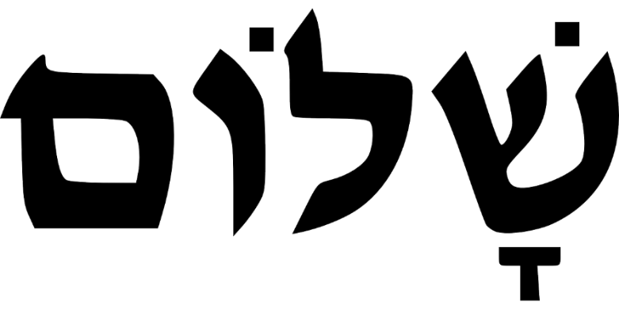
‘Do your best to live at peace with everyone.’
Notes:
Going deeper: responding and words for worship
Let’s be still and quiet together now….
…We’ve been thinking today about the blessing of peace – whatever that word means for each of us….
….and on this day especially, on the importance of each one of us trying to make peace wherever we go….
….As you look at these words, you might want to make some decisions for yourself about how you might make this happen….
….You might also want to turn your thoughts into a personal prayer…..
[Arabic Calligraphy By Hadysylmy - This file was derived from: Assalamu-aleykum.svg, CC BY-SA 4.0, https://commons.wikimedia.org/w/index.php?curid=161196036]

Slide 8
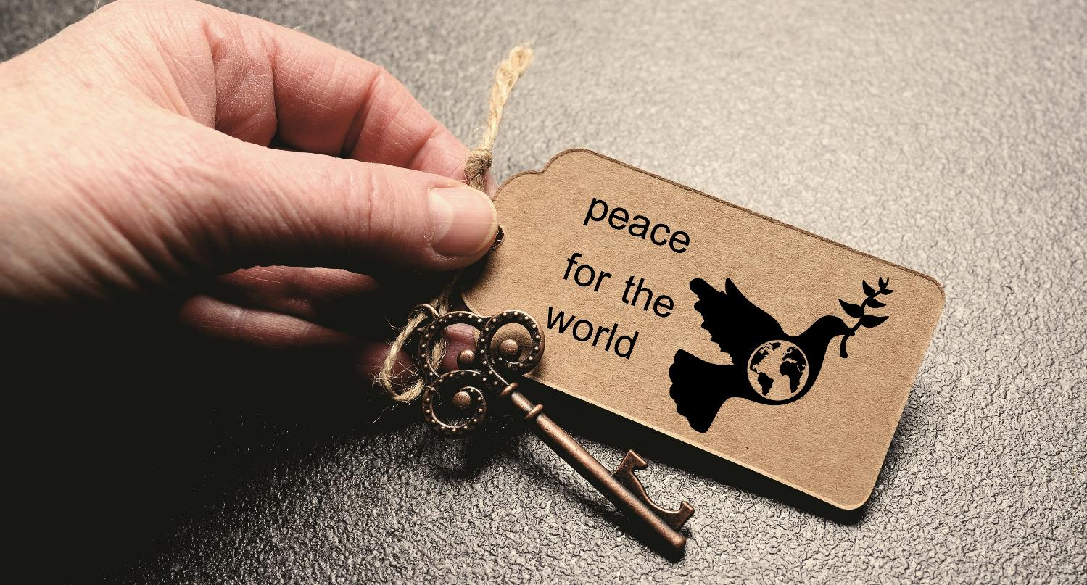
God, who is peace,
As we go about our day, may we bring your peace to other people.
Where people have given up, may we bring hope.
Where peoples’ lives feel dark, may we bring light.
And where there's sadness, may we bring joy.
Amen.
Notes:
Sending: a blessing based on the Prayer of St Francis
You might like to invite students to read the words at the end of each line, in italics.
God, who is peace,
As we go about our day, may we bring your peace to other people.
Where people have given up, may we bring hope.
Where peoples’ lives feel dark, may we bring light.
And where there's sadness, may we bring joy.
Amen (based on St. Francis’ Prayer, ‘Make me a channel of your peace’)
Sending: you might wish to leave students with a final peace-making challenge, then blow out the candle as a sign that the collective worship is finished.

