Slide 1
Guildford Administrators
11th November 2017
Pastoral Contact & Care
The Revd Sarah Swift
The Christian Healing Mission

Slide 2
1 Who are you?!
Individual In Role
Entrustments
What energises you?
What depletes you?
Notes:
Not as stupid as it sounds!

Slide 3
Pastoral Contact
What is it?
Where does it happen in your life?
Individual In Role
Base lines / juggling
Base lines will be different for us all & will vary through time

Slide 4
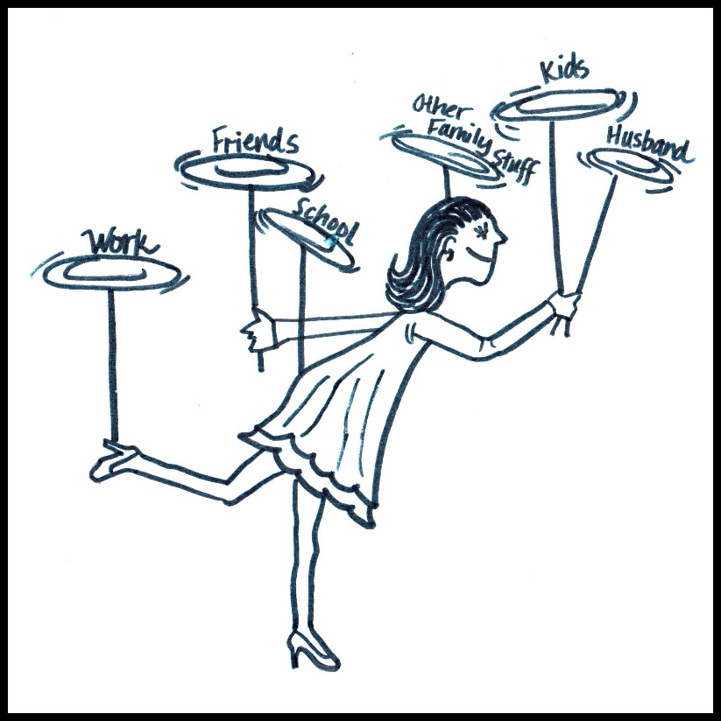
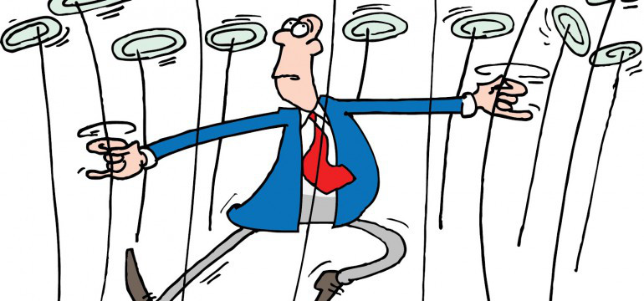
The art of plate spinning?!

Slide 5
What about Jesus? – WWJD?
Jesus & pastoral care
Did he do everything?
Disciples were sent out 2x2
He dismissed crowds & withdrew (Mt 14, Mk 6)
Process for some (x2 blind men)
Not every interruption is a ‘God’ interruption (Acts 16 - fortune telling girl)
Not everything needs to be done immediately
The subversive extra mile …? (Mt 5:41)
Notes:
WWJD – not always everything.
Called to follow & serve
Js did & we want to do same – how do we w’out getting burn out / overdone etc
Did Jesus respond to all?

Slide 6
Administration is Kingdom Work!
Clear job description?
Expectations – yours & others
Notes:
‘I am sending you out like sheep among wolves. Therefore be as shrewd as snakes and as innocent as doves. Matt 10:16
Job …
(Scarves/hats)
We make job our own –
Who are you following?
What do others anticipate you’ll do?
Job description
who owns/decides your time?
who knows what you do?
PCC/vicar etc
do pple know?
Easier for pple to support you if they know what your role is
& for you if you know who or where can also help

Slide 7
Administration is Kingdom Work!
Who is on the wider team?
Signposting
Gatekeepers not
necessarily final port
Notes:
who else is on your pastoral team?
what are their roles?
Signposting

Slide 8
Handling Interruptions – are they all God’s?
Probably handle them all time
Expectations – yours & others
Expectations of ‘the church’
Expectations of ‘God’
What do they actually want?
Asking the right questions
Notes:
What are God’s interruptions?
Not all of them!
instant vs booked in
crisis vs ongoing
what else is around?
knowing the area
you are not an expert
manipulation
What are some of questions you might ask?
What can you offer?
I have 5 mins now – what can I do to help in that time?
I can’t do … but I can …

Slide 9
Questions … responses …
What is the problem?
What would you like the church to do?
How do you think we/the church can help?
We can’t do x but can do y
Or ‘…’ can do x
I’m sorry you’ve found that,
how can we help now?
Notes:
What are some of questions you might ask?
What can you offer?
I have 5 mins now – what can I do to help in that time?
I can’t do … but I can …

Slide 10
Questions … responses …
Know your policies
Know where to refer – or find out
Refer to clergy/line manager!
Watch for manipulation
Know your limits

Slide 11
Enjoy your coffee!

Slide 12
Difficult People – who are yours?

Slide 16
Difficult People – who are yours?
Recognise them
What buttons do they push?
Importance of knowing yourself
For you & for them
Not ungodly to say ‘No’ or ‘Not now’
Practical & Godly wisdom & insight
What are your warning flags?
Notes:
‘Fear, frustration, anxiety, panic, exasperation, …?

Slide 17
Difficult People –
those with mental health issues
You are not an expert
Many different issues …
Are they seeing a GP?
Are they taking their medication?
Have they eaten?
Everything is not demonic …

Slide 18
Difficult People
God’s love –
appropriate acceptance
appropriate boundaries
What can you offer?
Do you know where else they can go?
Recognise EGNs!
Pray

Slide 19
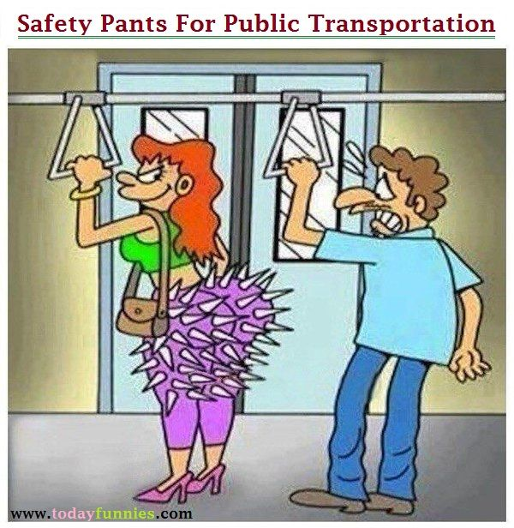
Personal Safety
What are your church policies?
Easy to follow?
Whose responsibility to maintain them?
Practical safety issues
Office/church layout, sight lines
Body language
Other?
Notes:
safety
what are your policies? – Lone worker etc, PCC take care?
how easy do you find to kp to?
no money ...
wisdom
practical safety issues
camera?
lone worker policy
does your PCC recognise policy issues?
are they aware of implications?
Distance, body language, access to doors etc, office layout
Sight lines

Slide 20
Pastoral Care – think about …
What does your church/community need?
What do you need?
Unloading with others
Unloading with God
Which plates are you being asked to tend & which ones is God watching?
Ps 46:10, Matt 11:28

Slide 21
Valuing Yourself to Value Others
Entrustments
Pitfalls with difficult people
Dependency
Longer time
Lack of safety
Who is affected?
Boundaries
Having them
Permeable not unbreakable
Respecting yourself & others
Notes:
boundaries
whose work takes precedence?
what do you want?
job vs ministry vs mixture & other entrustments
which boundaries get pushed if you say 'yes' here?
Finite time & life
where things go wrong
dependency
longer time
unsafe
what are the implications?
what are your gifts?
administration
pastoral care
who is affected?
congregn
you
your family
others
what do pple expect if you do sthg?
how does it impact others?

Slide 22
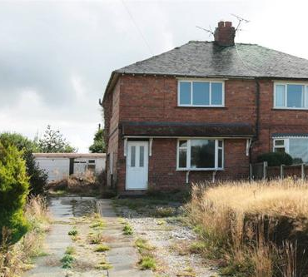
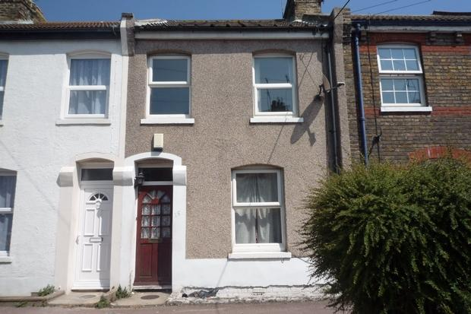
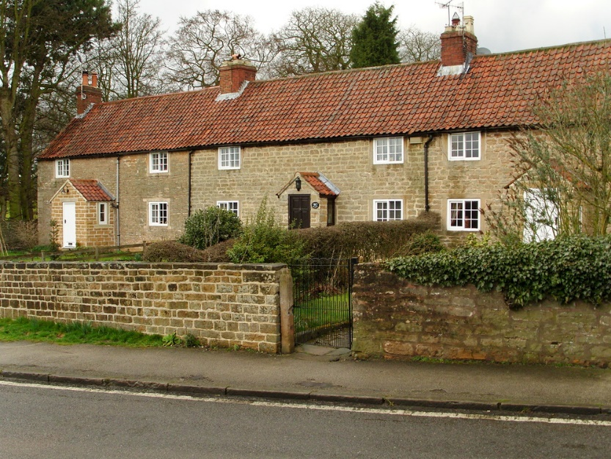
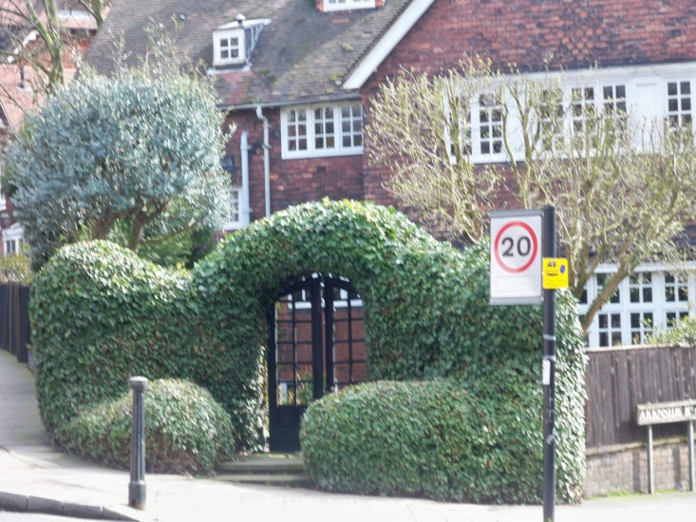
Boundaries …
Notes:
PRAYER - ENCOUNTER

