Slide 1
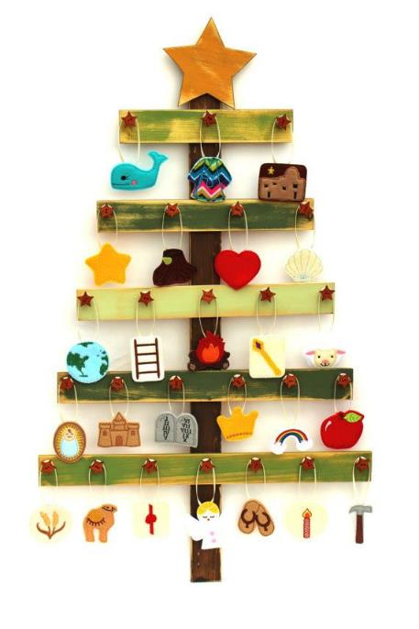
The Jesse Tree for Advent
This is the family history of Jesus Christ. He came from the family of David. David came from the family of Abraham.
Reading Matthew 1:1-14

Slide 2

Stump and Shoot
A branch will grow
from a stump of a tree that was cut down.
So a new king will come
from the family of Jesse.
Reading Isaiah 11 :1&2

Slide 3

Earth
Then God said, “Let the earth be filled with animals. And let each produce more of its own kind. Let there be tame animals and small crawling animals and wild animals. And let each produce more of its kind.” And it happened.
Reading Genesis 1:24-31

Slide 4

Apple and Snake
The woman answered the snake, “We may eat fruit from the trees in the garden. But God told us, ‘You must not eat fruit from the tree that is in the middle of the garden. You must not even touch it, or you will die.’
Reading Genesis 3: 1-21

Slide 5
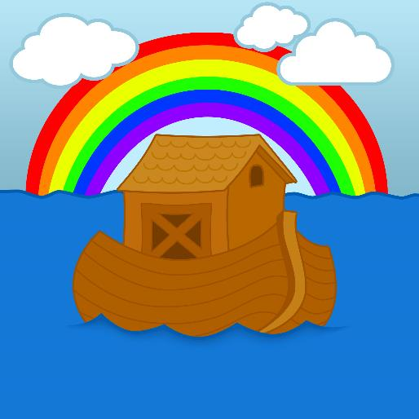
Noah’s Ark
But Noah pleased the Lord.
Reading Genesis 6:5-8

Slide 6
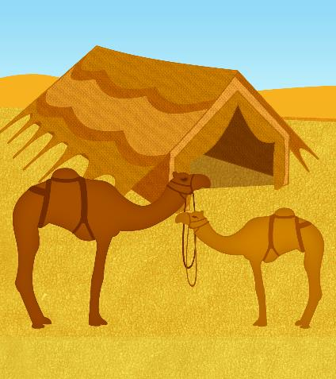
Camels and tent – God’s promise to Abram
Then the Lord said to Abram, “Leave your country, your relatives and your father’s family. Go to the land I will show you. I will make you a great nation, and I will bless you.
I will make you famous. And you will be a blessing to others
Reading Genesis 12: 1-7

Slide 7
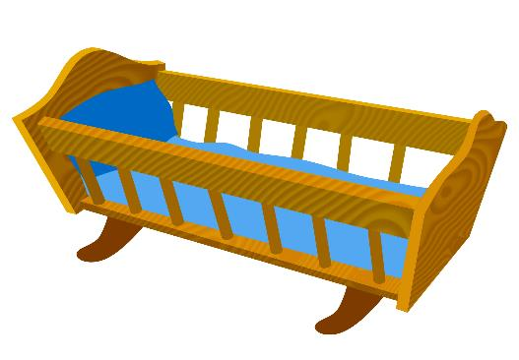
Cradle – Isaac is born
Everything happened at the time God had said it would. Abraham named his son Isaac.
Reading Genesis 21: 1-7

Slide 8
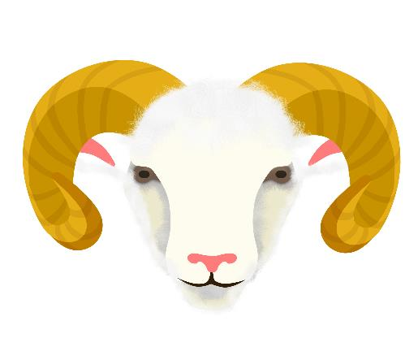
Ram – Abraham obeys God
The angel said, “Don’t kill your son or hurt him in any way. Now I can see that you respect God. I see that you have not kept your son, your only son, from me.”
Reading Genesis 22: 1-14

Slide 9

Jacob’s Ladder
Jacob dreamed that there was a ladder resting on the earth and reaching up into heaven. And he saw angels of God going up and coming down the ladder.
Reading Genesis 28: 10-22

Slide 10
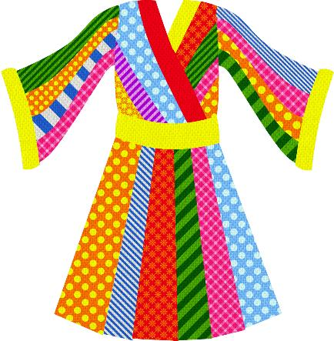
Coat of Many Colours - Joseph
Then Joseph said to them, “Don’t be afraid. Can I do what only God can do? ²⁰ You meant to hurt me. But God turned your evil into good. It was to save the lives of many people. And it is being done.
Reading Genesis 37: 31-33& 50:15-20

Slide 11
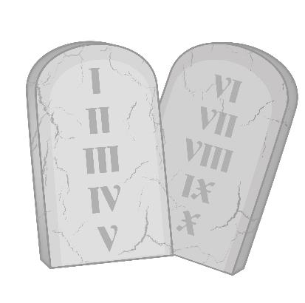
Ten Commandments
Moses called all the people of Israel together and said: Listen, Israel, to the commands and laws I give you today. Learn them and obey them carefully.
Reading Deuteronomy: 5 1-22

Slide 12

Wheat – Ruth
But Ruth said, “Don’t ask me to leave you! Don’t beg me not to follow you! Every place you go, I will go. Every place you live, I will live. Your people will be my people. Your God will be my God.
Reading Ruth 1-2:3 & Matthew 1:5&16

Slide 13

Rope – Rahab helps the spies
You are using a red rope to help us escape. When we return to this land, you must tie it in the window through which you let us down. Bring your father, mother, brothers and all your family into your house.
Reading Joshua 2:1-21

Slide 14

Horn of Oil – David is chosen as king
So Samuel took the container of olive oil. Then he poured oil on Jesse’s youngest son to appoint him in front of his brothers. From that day on, the Lord’s Spirit entered David with power.
Reading 1 Samuel 16:1-13

Slide 15

Crown – David is crowned king
So Samuel took the container of olive oil. Then he poured oil on Jesse’s youngest son to appoint him in front of his brothers. From that day on, the Lord’s Spirit entered David with power.
Reading 2 Samuel 5:1-5

Slide 16

Sun/Light – A prophecy about the light
Now those people live in darkness. But they will see a great light.
They live in a place that is very dark. But a light will shine on them.
Reading Isaiah 9:2,6-7

Slide 17
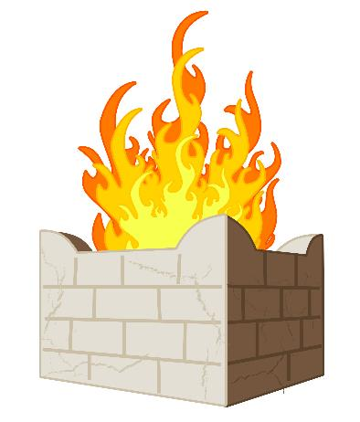
Altar – Elijah and the prophets of Baal
Then fire from the Lord came down. It burned the sacrifice, the wood, the stones and the ground around the altar. It also dried up the water in the ditch. When all the people saw this, they fell down to the ground. They cried, “The Lord is God! The Lord is God!
Reading 1 Kings 18:17-39

Slide 18
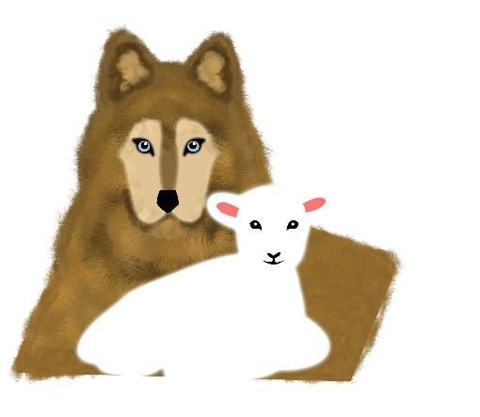
Wolf and Lamb – A prophecy about peace
When wolves will live in peace with lambs.
And leopards will lie down to rest with goats.
Calves, lions and young bulls will eat together.
And a little child will lead them.
Reading Isaiah 11:1-9

Slide 19

Whale - Jonah
The people of Nineveh believed in God. They announced they would stop eating for a while. They put on rough cloth to show how sad they were. All the people in the city wore the cloth.
Reading Jonah 1-4

Slide 20
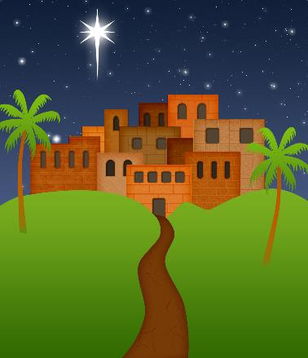
Bethlehem – A prophecy about Bethlem
But you, Bethlehem Ephrathah,
are one of the smallest towns in Judah.
But from you will come one who will rule Israel for me.
Reading Micah 5:2-5

Slide 21

Scepter – Queen Esther
No man or woman may go to the king in the inner courtyard without being called. There is only one law about this. Anyone who enters must be put to death. But if the king holds out his gold scepter, that person may live.
Reading Esther 4:10-17

Slide 22
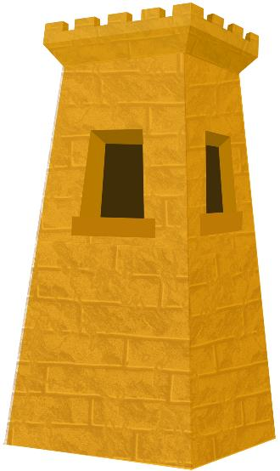
Tower – a message from God
I will stand like a guard to watch.
I will stand on the tower.
I will wait to see what the Lord will say to me.
I will wait to learn how to answer his complaint.
Reading Habakkuk 2:1 & 3:16-19

Slide 23
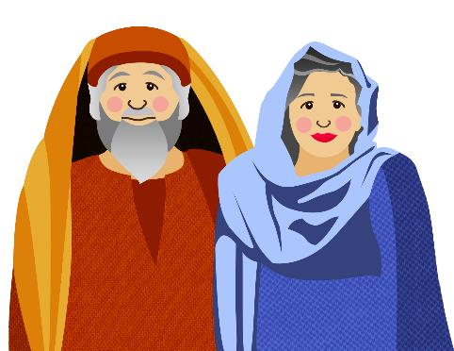
Zechariah and Elizabeth
But the angel said to him, “Zechariah, don’t be afraid. Your prayer has been heard by God. Your wife, Elizabeth, will give birth to a son. You will name him John. You will be very happy. Many people will be happy because of his birth.
Reading Luke 1:5-25

Slide 24

Clam and Water - John The Baptist
About that time John the Baptist came and began preaching in the desert area of Judea. John said, “Change your hearts and lives because the kingdom of heaven is coming soon.”
Reading Matthew 3:1-6

Slide 25

Heart - Mary
The angel said to her, “Don’t be afraid, Mary, because God is pleased with you. Listen! You will become pregnant. You will give birth to a son, and you will name him Jesus..
Reading Luke 1:26-38

Slide 26
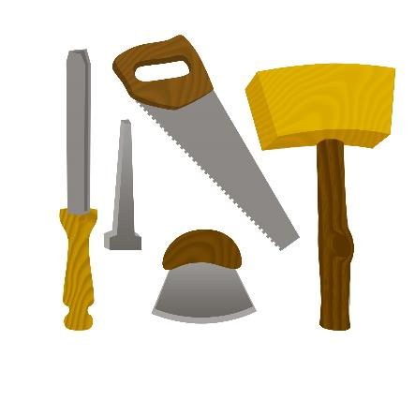
Carpentry Tools - Joseph
When Joseph woke up, he did what the Lord’s angel had told him to do. Joseph married Mary. Joseph named the son Jesus.
Reading Matthew 1:18-25

Slide 27
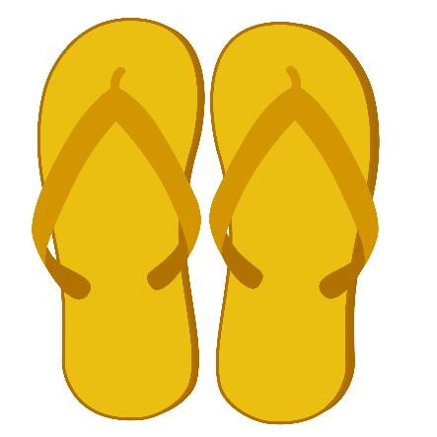
Sandals – the journey to Bethlehem
While Joseph and Mary were in Bethlehem, the time came for her to have the baby.
Reading Luke 2: 1-5

Slide 28

Star of Bethlehem
The wise men heard the king and then left. They saw the same star they had seen in the east. It went before them until it stopped above the place where the child was.
Reading Matthew 2: 1-12

