Slide 1

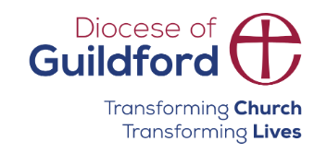
Today’s words can be found in Acts 2:44 and I Timothy 6:18
Count your blessings
Images from pixabay, unless otherwise identified
Notes:
‘Count Your Blessings’ – Autumn term 2026 These resources are ©The Diocese of Guildford
These form part of the collective worship resources created to support Secondary schools in the Diocese of Guildford. Research reveals the importance of gratitude even in the midst of adversity: that being aware of each day’s ‘blessings’ can counteract anxiety, and so this term, we want to encourage schools to highlight this especially in their collective worship. As always, each week’s materials link with Biblical content, whilst also ensuring that they are inclusive for pupils and adults of all faiths, or none. Over this short series ‘Count your blessings’, we will highlight things that we might consider to be ‘blessings’ and will refer to this in the ‘Going deeper: responding and words for worship’ section each week.
The materials in this PPT have been created for Harvest time – which we recognise may not be celebrated in Secondary settings with the same regularity as in the Primary phase. However, research has again suggested that being a part of a community that gives to others is good for everyone’s mental health, and so we choose to pause and reflect on the practice of marking this seasonal moment in the calendar. There are two alternatives for a ‘blessing’ to end your time.
Notes for the teacher: This resource is to be used for collective worship during tutor times or in other groupings that work for your setting. There may be enough material here to resource more than one tutor time.
Each resource contains some images and words to support the spiritual development of students, with a script for the leader written under the slides.
Any bold text indicates when a click will animate either text or an image for students to ponder, and italic text contains pointers for the leader.
Especially important is the slide denoted as ‘Going deeper: responding and words for worship’, which ensures that the resource meets the requirement for daily collective worship in your Church school. The words are invitational, and prayer is optional.
You may wish to light a candle at the beginning as a sign that you are entering this different space in the school day.
Today’s words come from Acts 2:44 and I Timothy 6:18 and relate to the importance of sharing as a way of blessing others, as reflected in the practices of the Early Church.

Slide 2
H A R V E S T
Notes:
Engaging: H A R V E S T……how many words can you make that are linked with the practice of celebrating Harvest?
Timed activity, 1 minute; timer bar will start counting down when you click.
Here are some suggestions: students must explain any random words!
HARVEST
EARTH
EAT
TEA
‘TA!’ (short for ‘thankyou’!!)
HAVE
STARVE
SHARE – if this word has not been suggested by students, make sure you do!

Slide 3
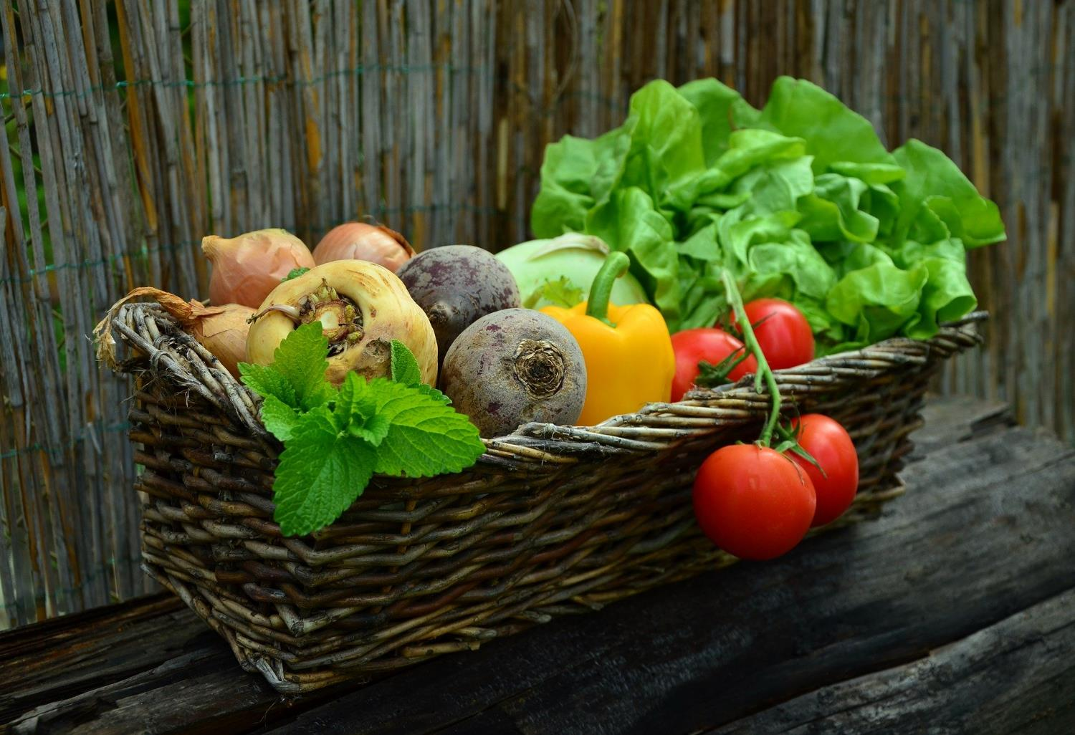
Do we still need ‘Harvest’?
Notes:
Engaging: Do we still need ‘Harvest’?
Talk together:
Why/why not? Might it be needed more than ever?
How does being thankful for the harvest help us to maintain connections with the natural world?
Can Harvest help us to be better stewards of the earth?
Is giving to others [at Harvest time] a spiritual or material blessing?
Who benefits more – those we share with or those who give?
Sharing is important across all communities and cultures, religious and non-religious. I wonder why this is?

Slide 4
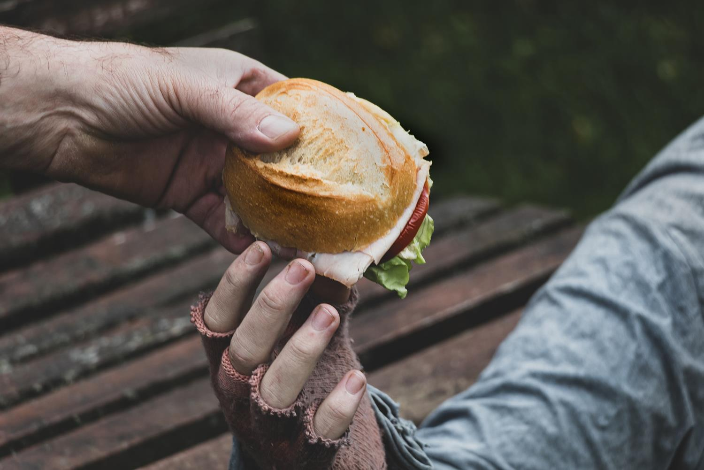
‘They shared everything.’
(Acts 2:44)
share
‘Be generous and willing to share.’
(1 Timothy 6:18)
Notes:
Going deeper: responding and words for worship
Of all the words we created at the start, I wonder which word might be most important?.....or which word made you think the hardest?..…
At the end of this time together today, we’re going to focus on just one….. share… and think about how this principle impacted the first Christian communities. Luke writes in the Book of Acts….‘They shared everything.’
Those who had more gave to those who were in need, so that there were no needy people among them. This made them very distinctive as a community across the ancient world, giving because God had given first to them in the person of Jesus.
St. Paul, writing to encourage Christians in Ephesus, told them to: ‘Be generous and willing to share.’
.…I wonder why these first Christians considered giving to be so important to their way of life?....or how the Church does this now?....
….I wonder what these words might mean, for us, in our school community, today?....
.…How might we be characterised by the same generosity as the Early Church?....
Highlight ways in which your school community is distinctive….or the projects/initiatives you are aware of locally that your school supports e.g. food banks

Slide 5
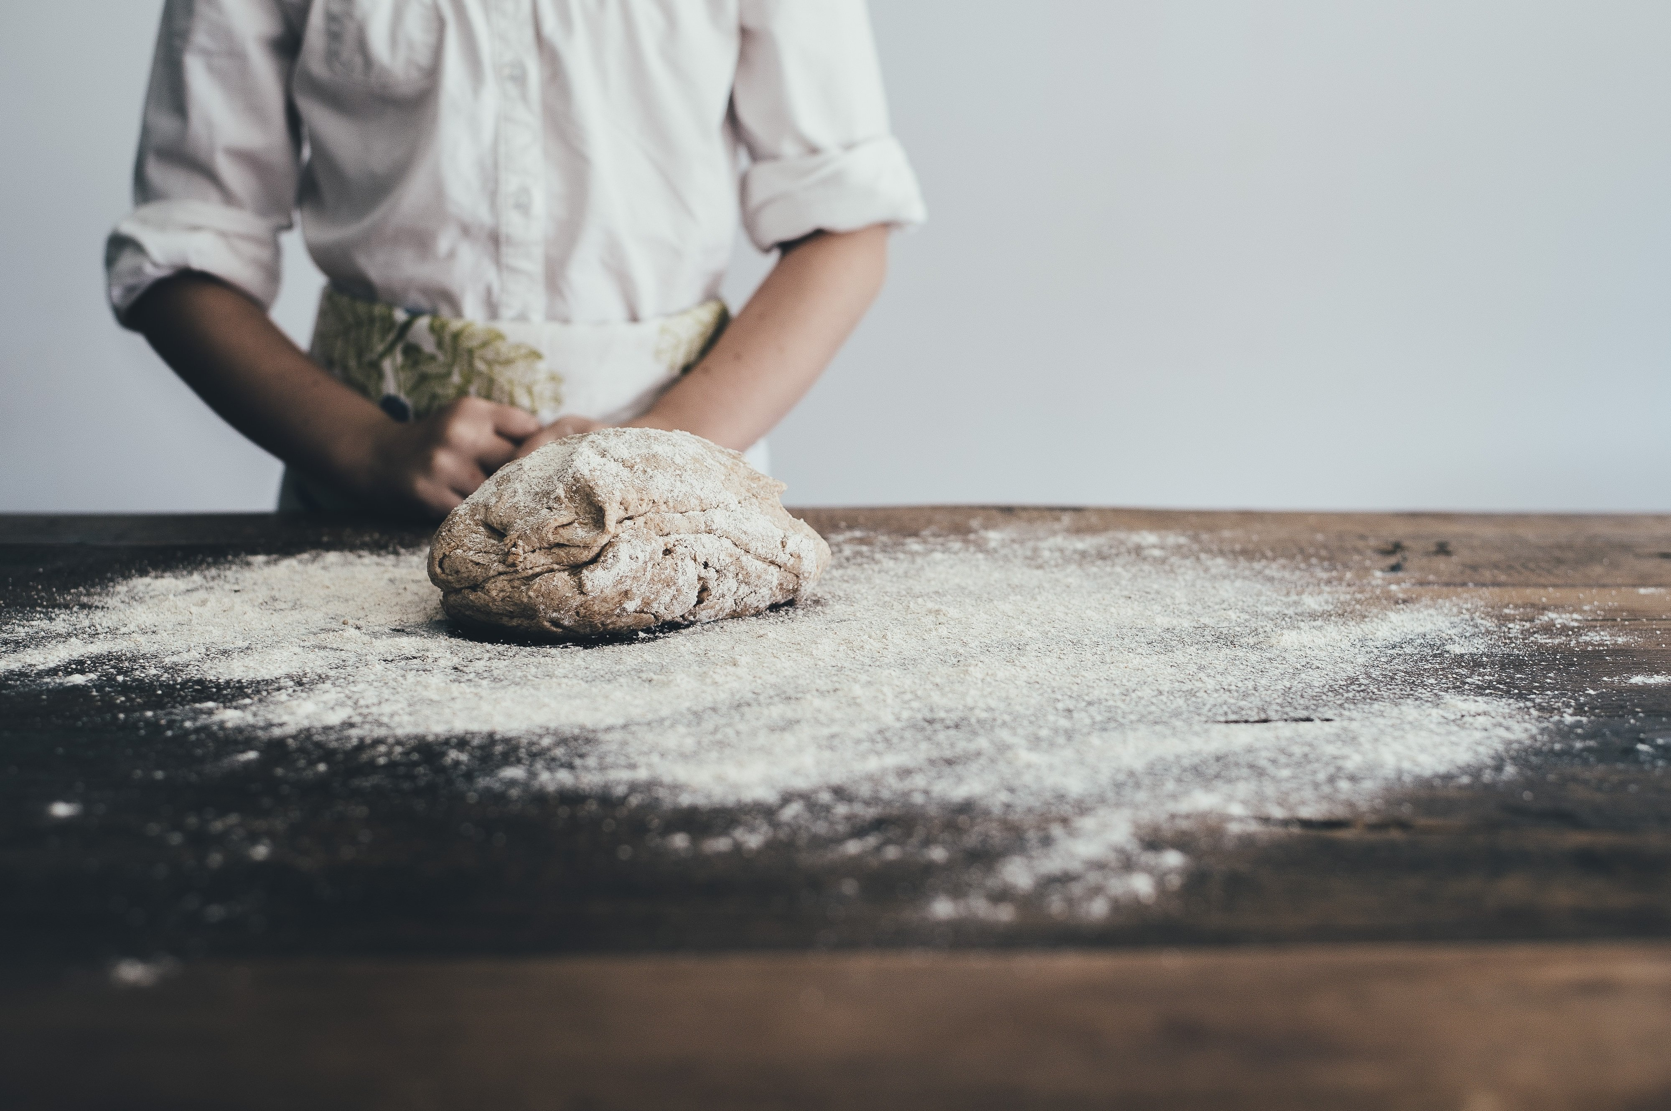
May the blessing of the God who cycles the seasons and swells the grain go with us.
May the blessing of the Son who breaks the bread go with us.
May the blessing of the Spirit who challenges us to a just sharing of earth’s harvest go with us.
Now and into the week ahead. Amen.
Notes:
Sending: a blessing, ©Clare McBeath and Tim Presswood, 2009 (Baptist Union of Great Britain), slightly adapted
May the blessing of the God who cycles the seasons and swells the grain go with us.
May the blessing of the Son who breaks the bread go with us.
May the blessing of the Spirit who challenges us to a just sharing of earth’s harvest go with us.
Now and into the week ahead.
Sending: blow out the candle as a sign that the collective worship is finished.

Slide 6

The earth is fruitful; may we be generous.
The earth is fragile; may we be gentle.
The earth is fractured; may we be just.
Notes:
Sending: a blessing, ©Christian Aid, 2024
The earth is fruitful; may we be generous.
The earth is fragile; may we be gentle.
The earth is fractured; may we be just.
Sending: blow out the candle as a sign that the collective worship is finished.

