Slide 1
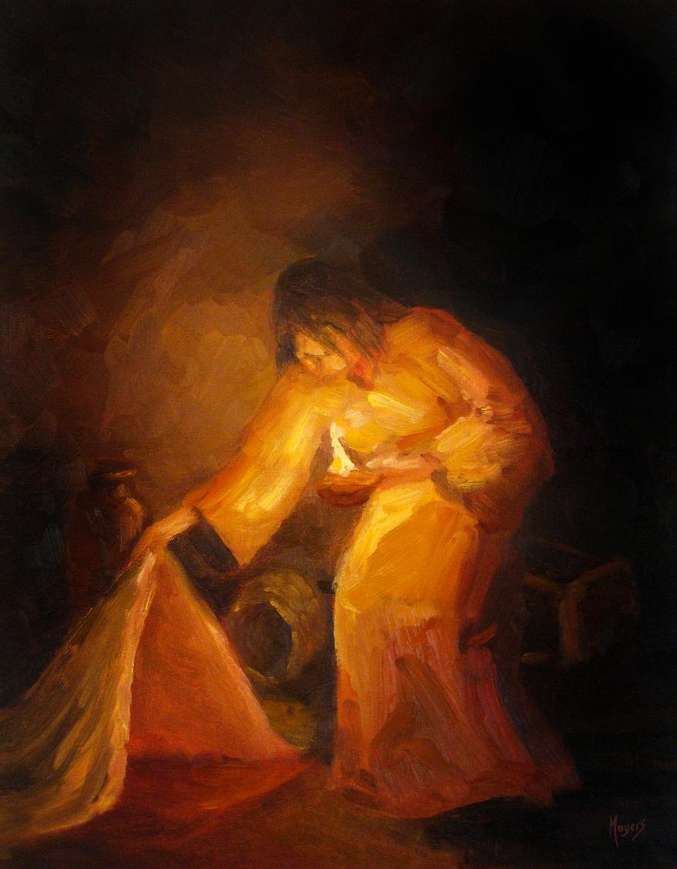
Today’s story can be found in Matthew 13:1-9 & 18-23
Stories as treasure to be found
‘The seeker’ by Mike Moyers, from the Vanderbilt University Library, Art in the Christian Tradition
Notes:
‘Stories as treasure to be found’ – Summer term 2026 These resources are ©The Diocese of Guildford
The Gospels are full of the parables of Jesus, which he used to communicate ideas about the Kingdom of God to his listeners, often challenging their thinking, and quite often in answer to a question he had been posed. For Christians – as for Jesus’ original audiences – the parables don’t just illustrate a truth, they contain a truth that the listeners are supposed to search for for themselves, appealing to the intellect through the imagination. These collective worship materials don’t need to be used in any particular order, but loosely follow the parables of Jesus from Matthew 13. Although these parables were told to a specific audience, with a specific set of cultural expectations, Christians believe that Jesus’ parables can speak just as truthfully to a modern audience: like a well-cut gemstone, the light will shine through the different facets and show different colours at different times.
Notes for the teacher: This resource is to be used for collective worship during tutor times or in other groupings that work for your setting. There may be enough material here to resource more than one tutor time.
Each resource contains some images and words to support the spiritual development of students, with a script for the leader written under the slides.
Any bold text indicates when a click will animate either text or an image for students to ponder, and italic text contains pointers for the leader.
Especially important is the slide denoted as ‘Going deeper: responding and words for worship’, which ensures that the resource meets the requirement for daily collective worship in your Church school. The words are invitational, and prayer is optional.
At the end of each set of slides, there is an image from across times and cultures illustrating the story from a different perspective. You might want to include a question on this slide that will challenge students’ thinking as they leave, or at another time, picking up on what has been talked about during the gathering.
Today’s parable, the Parable of the Sower, is the only parable that Jesus gave meanings for himself – about the importance of allowing the good things of God’s Kingdom to grow in the lives of those who listened. It can be found in Matthew 13:1-9 & 18-23. Today, we use it to think about the things that we might consider we are growing – either personally, or in your school community.

Slide 2
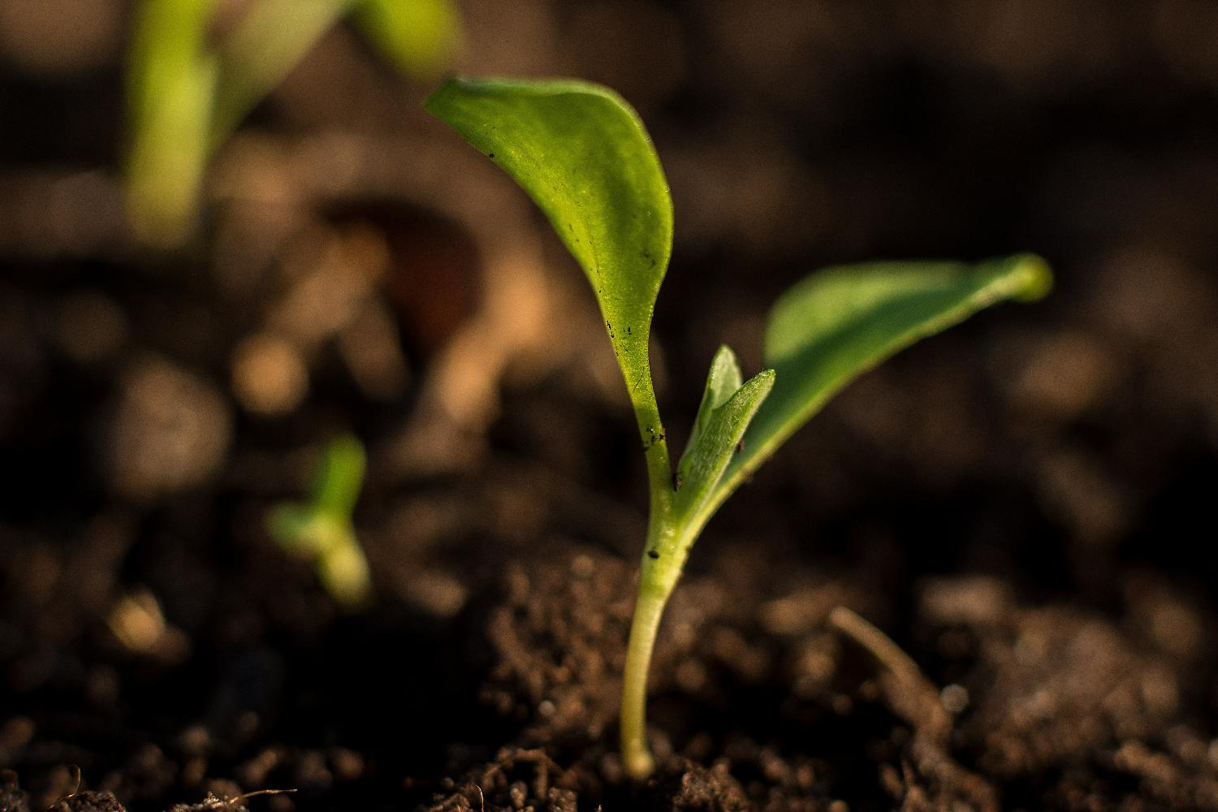
Gathering:
Creator God
As we gather today, we are grateful for the signs of life all around us.
Please help us to grow well as part of this community.
Be present in our thoughts and hearts today.
Amen.
All images copyright-free from pixabay, unless otherwise identified
Notes:
Gathering
You might want to light a candle to signal the start of collective worship. Invite students to be quiet and still and to use the words of the prayer if it helps them…..
Creator God
As we gather today, we are grateful for the signs of life all around us.
Please help us to grow well as part of this community.
Be present in our thoughts and hearts today.
Amen.

Slide 3
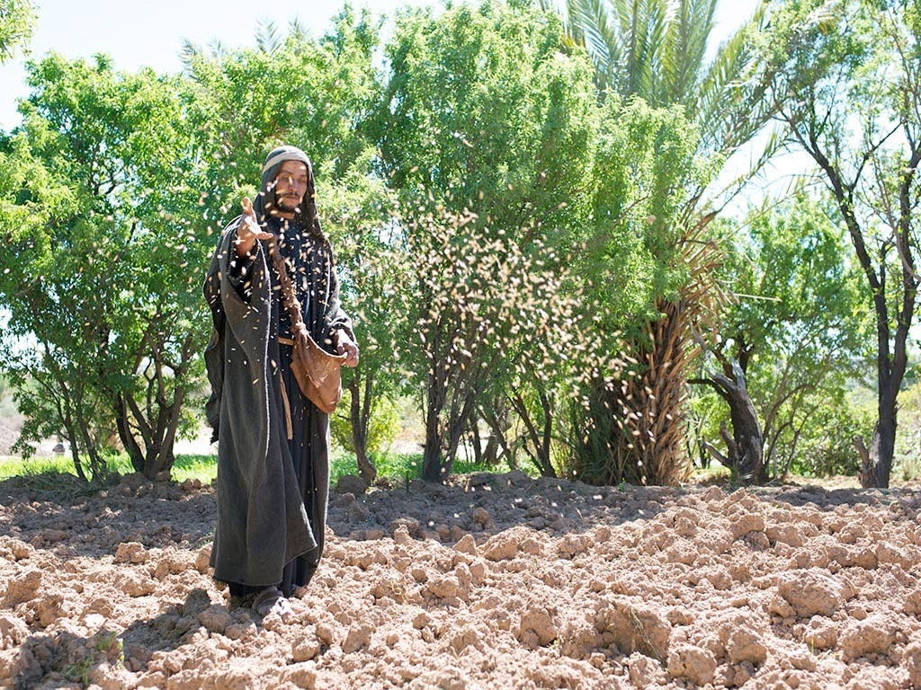
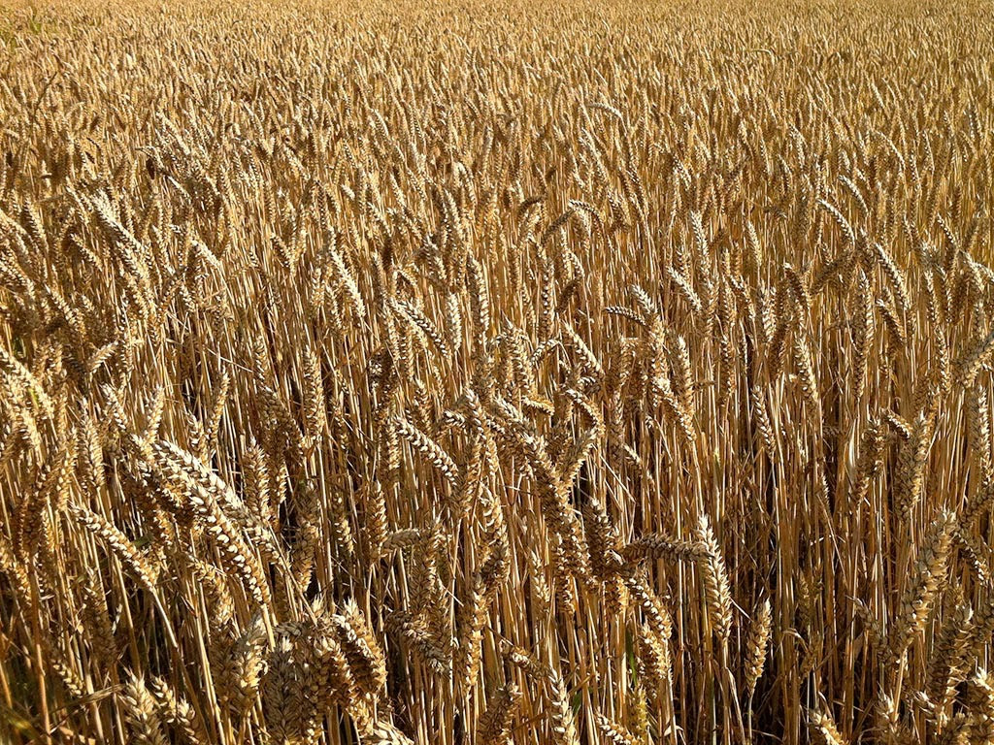
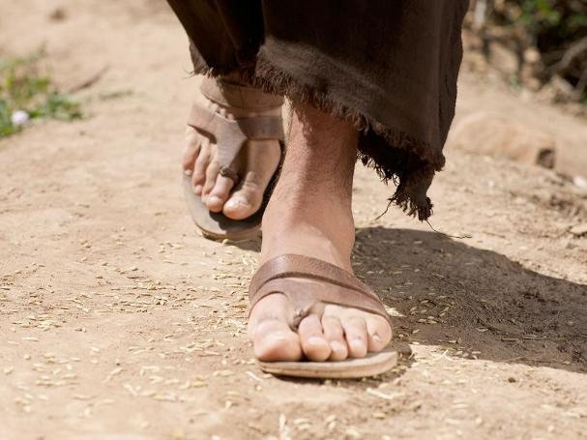
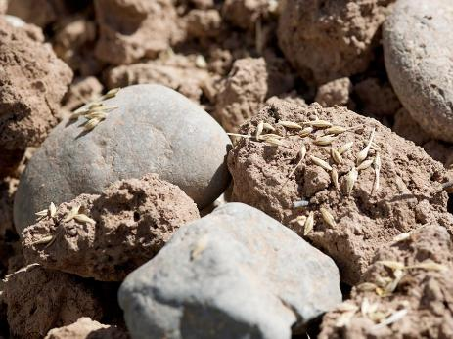
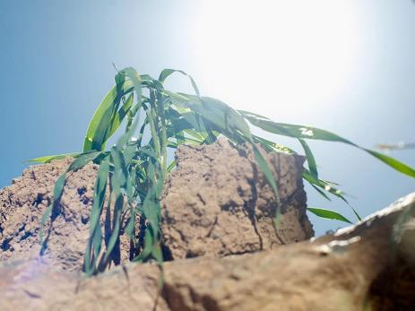
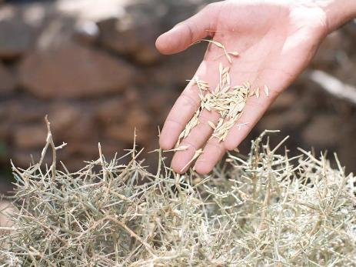

Notes:
Engaging: The Parable of the Sower (Matthew 13:1-9)
We begin today with another of Jesus’ parables – and the only one that he explained to his listeners. Here’s how it goes: [you could ask 4 students to read the words, a line at a time. Bold text brings up an image on the screen.]
Reader 1: Jesus said: “A farmer went out to plant his seed. While he was planting, some seed fell by the road. The birds came and ate all that seed.
Reader 2: Some seed fell on rocky ground, where there wasn’t enough dirt. That seed grew very fast, because the ground was not deep. But when the sun rose, the plants dried up because they did not have deep roots.
Reader 3: Some other seed fell among thorny weeds. The weeds grew and choked the good plants.
Reader 4: Some other seed fell on good ground where it grew and became grain, many hundreds of times what was sown.
Spend a few moments talking together about what students remember / think the meaning of this parable is…..

Slide 4
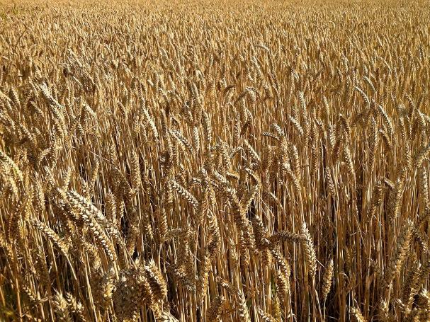
Does this parable have meaning for anyone, or only for Christians?
Notes:
Engaging: the meaning of the parable (Matthew 13: 18-23) [Students can again be readers, with the teacher reading the words in bold]
So, now let’s listen to the meaning of that story about the farmer.
What is the seed that fell by the road?
Reader 1: That seed is like the person who hears the teaching about the kingdom but does not understand it. The Evil One comes and takes away the things that were planted in that person’s heart.
And what is the seed that fell on rocky ground?
Reader 2: That seed is like the person who hears the teaching and quickly accepts it with joy. But they does not let the teaching go deep into their life and it stays only a short time. When trouble or challenges come, then they quickly give up.
And what is the seed that fell among the thorny weeds?
Reader 3: That seed is like the person who hears the teaching but lets worries about this life and love of money stop that teaching from growing. So the teaching does not produce fruit in that person’s life.
But what is the seed that fell on the good ground?
Reader 4: That seed is like the person who hears the teaching and understands it. That person grows and produces fruit, many hundreds of time that which was sown.
Talk together: Does this parable have meaning for anyone, or only for Christians?

Slide 5
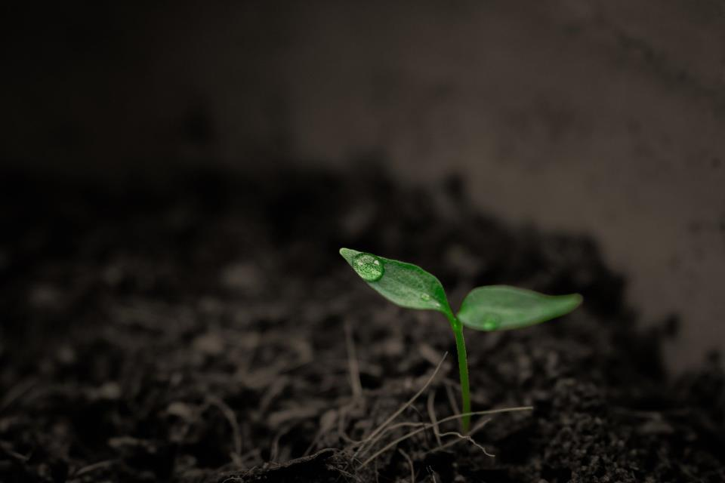
What are we growing in life?
…I wonder what might challenge our own personal growth or the growth of things that are important in our school community?...
…I wonder how we might encourage these ‘seeds’ to grow well?...
Notes:
Going deeper: responding and words for worship
What are we growing in life?
I wonder how you might answer this question? [Students could write a personal/private response to this question]
Whether or not Jesus’ parable has meaning for you or not, we also need to care for the ‘seeds’ that grow in our lives, in our hearts and in our community.
NB Reference your school’s vision and values here
…I wonder what might challenge our own personal growth or the growth of things that are important in our school community?...
…I wonder how we might encourage these ‘seeds’ to grow well?...
I’m going to leave some space for you to reflect in the quietness of your own hearts….
Now I’ll use some words in prayer: if this is something that you are comfortable with, then find a way to make the prayer your own….
Creator God, who sees all growing things,
Thank you for the seeds that we carry deep in our hearts….values that are important to us…..our priorities in life…..our character….our inner self….
These are all seeds that are known to you.
Please help us to give attention to them and help them to grow well.
Amen
Sending: you might wish to leave students with a final challenge based on this slide, then blow out the candle as a sign that the collective worship is finished.

Slide 6
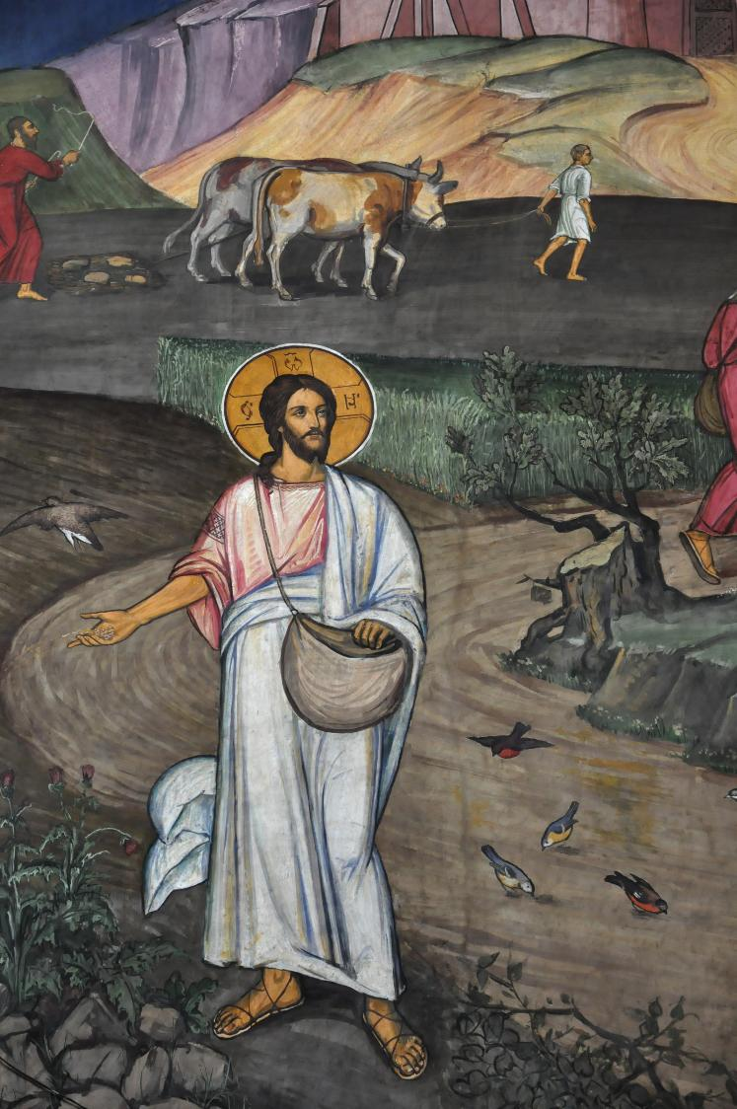
Notes:
Parable of the sower
From Brasow, Romania
Original source: https://diglib.library.vanderbilt.edu/act-imagelink.pl?RC=55021

