Slide 1
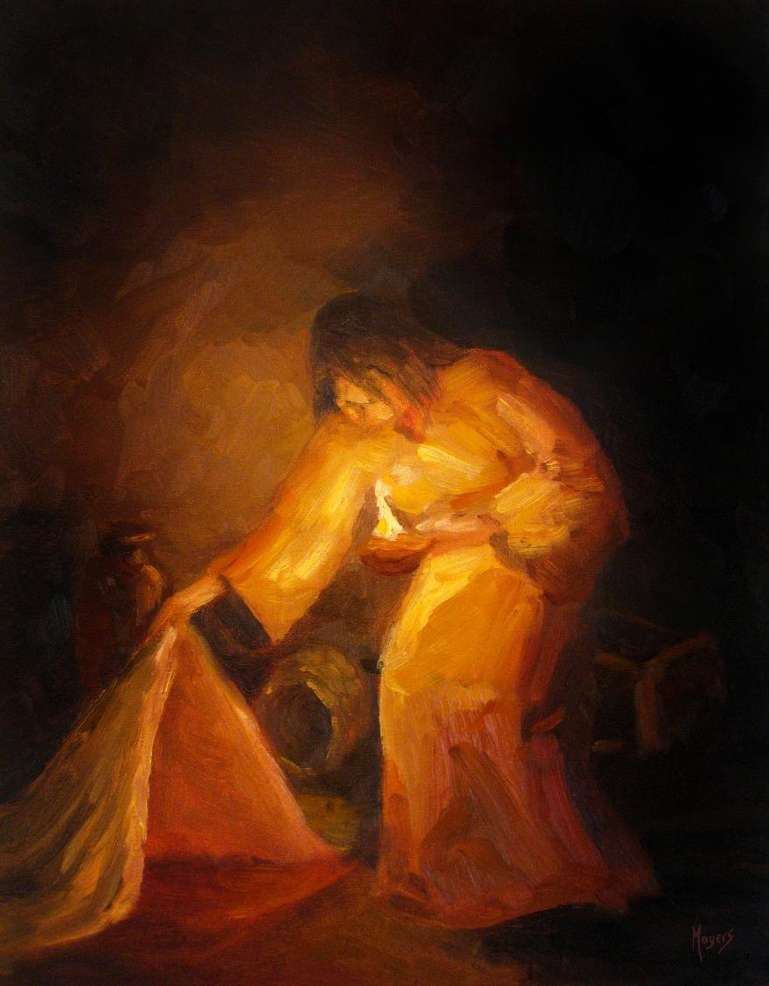
Today’s words can be found in Matthew 7:16 & Galatians 5:22-23
Stories as treasure to be found
‘The seeker’ by Mike Moyers, from the Vanderbilt University Library, Art in the Christian Tradition
Notes:
‘Stories as treasure to be found’ – Summer term 2026 These resources are ©The Diocese of Guildford
The Gospels are full of the parables of Jesus, which he used to communicate ideas about the Kingdom of God to his listeners, often challenging their thinking, and quite often in answer to a question he had been posed. For Christians – as for Jesus’ original audiences – the parables don’t just illustrate a truth, they contain a truth that the listeners are supposed to search for for themselves, appealing to the intellect through the imagination. These collective worship materials don’t need to be used in any particular order, but loosely follow the parables of Jesus from Matthew 13. Although these parables were told to a specific audience, with a specific set of cultural expectations, Christians believe that Jesus’ parables can speak just as truthfully to a modern audience: like a well-cut gemstone, the light will shine through the different facets and show different colours at different times.
Notes for the teacher: This resource is to be used for collective worship during tutor times or in other groupings that work for your setting. There may be enough material here to resource more than one tutor time.
Each resource contains some images and words to support the spiritual development of students, with a script for the leader written under the slides.
Any bold text indicates when a click will animate either text or an image for students to ponder, and italic text contains pointers for the leader.
Especially important is the slide denoted as ‘Going deeper: responding and words for worship’, which ensures that the resource meets the requirement for daily collective worship in your Church school. The words are invitational, and prayer is optional.
At the end of each set of slides, there is an image from across times and cultures illustrating the story from a different perspective. You might want to include a question on this slide that will challenge students’ thinking as they leave, or at another time, picking up on what has been talked about during the gathering.
Today’s words come from Galatians 5:22-23, building on the Parable of the Sower and the idea of seeds producing fruit. These words from Galatians are some of the most famous in the Bible and were written by the Apostle Paul to encourage the Early Church in Galatia, which he visited on all 3 of his missionary journeys. They are very accessible words and, in all likelihood, align with several of your school’s values!

Slide 2
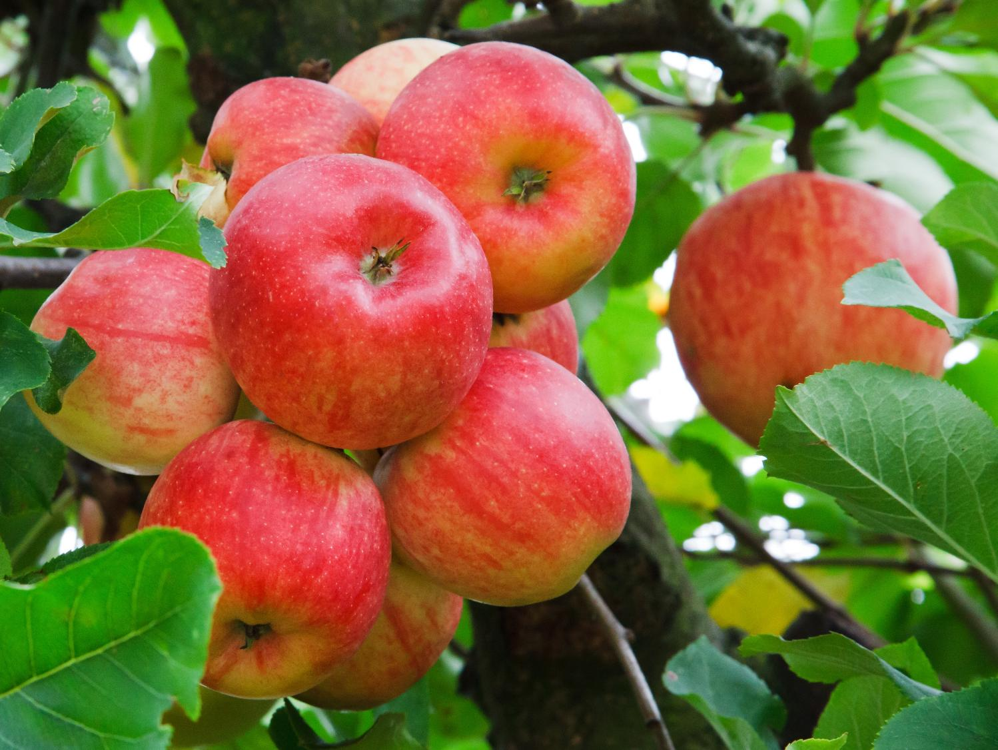
Gathering:
Listen to these words:
Jesus said, ’You will recognise them by their fruits.’
…I wonder who Jesus is talking about – and what he means by fruits?...
All images copyright-free from pixabay, unless otherwise identified
Notes:
Gather
You might want to light a candle to signal the start of collective worship. Invite students to be quiet and still and to use the words of the prayer if it helps them…..
As we settle into our time of collective worship today, listen to these words….I’m going to read them six times, and emphasise a different word each time. [read the words from Matthew 7:16 slowly, with the emphasis on the underlined word each time, leaving a pause between each.]
Jesus said, ’You will recognise them by their fruits.’
Jesus said, ’You will recognise them by their fruits.’
Jesus said, ’You will recognise them by their fruits.’
Jesus said, ’You will recognise them by their fruits.’
Jesus said, ’You will recognise them by their fruits.’
Jesus said, ’You will recognise them by their fruits.’
I wonder who Jesus is talking about – and what he means by fruits?
Talk together about your thoughts…..

Slide 3
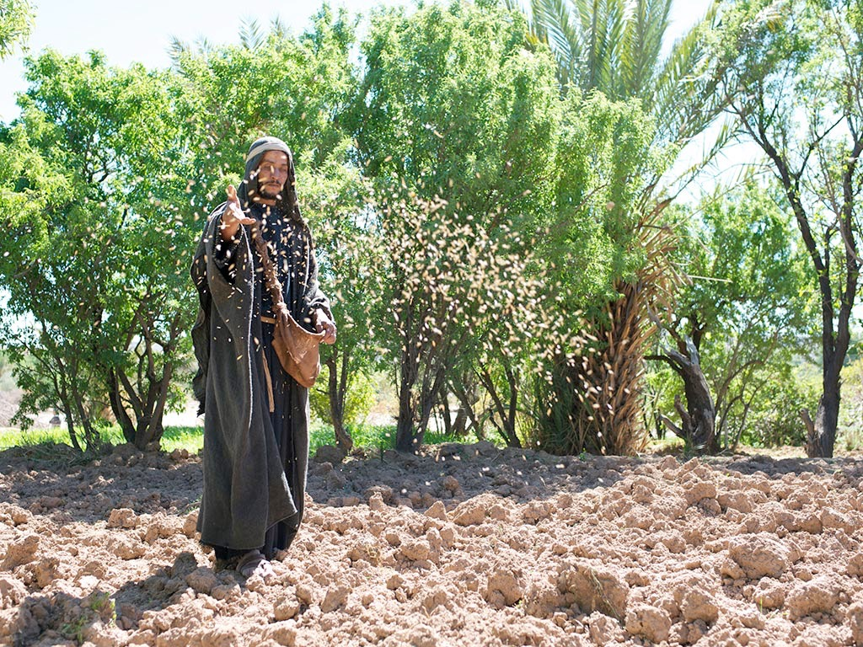
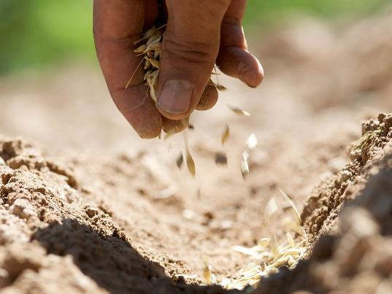
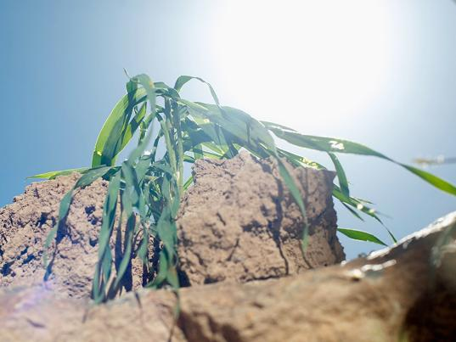
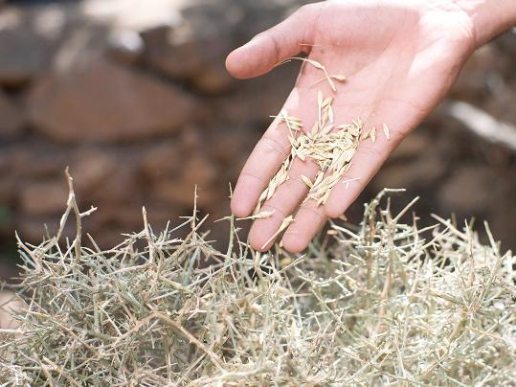
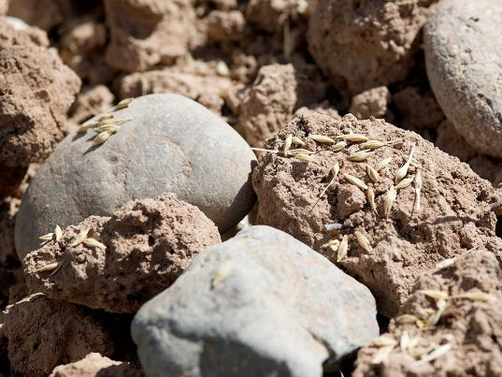

…I wonder what ‘fruit’ this is?...
What are we growing in life?
Notes:
Engaging: revisiting the Parable of the Sower
You may recall Jesus’ parable about good seed and good soil….and some of the challenges that came along to stop the seed from growing.
Take your mind back to some of the things that we talked about together, about this parable – and what we thought we might be growing in our lives….
I wonder how you feel your ‘growing’ is going?!
Leave a pause, or time for discussion
At the end of Jesus’ explanation of this parable, you might remember that he said that the good soil grew a harvest of seeds many hundreds of time what was sown; that the seed that fell on the good ground is like the person who hears the teaching and understands it, who grows and produces fruit.
…I wonder what ‘fruit’ this is?...
Allow time for discussion

Slide 4

peace
love
joy
patience
kindness
goodness
self-control
faithfulness
gentleness
‘fruit of the Spirit’
Notes:
Engaging: the Parable of the Sower and the Fruit of the Spirit
The Apostle Paul, one of the very first converts to Christianity, wrote some very famous words about what he called the ’fruit of the Spirit’ – the things that are supposed to grow in the lives of those who choose to follow Jesus. Listen to his words from Galatians chapter 5:
But the fruit of the Spirit is love, joy, peace, patience, kindness, goodness, faithfulness, gentleness and self-control.
Discussion ideas:
I wonder if this helps to answer our question?
Are these words just for Christians, do you think, or can anyone ‘grow’ them?
Are there any words missing, do you think?

Slide 5
…I wonder how we might grow these good things in our lives?...
…I wonder which ‘fruits’ are hardest to grow?....and what might stop them from growing at all?...
…I wonder which words we might take from this time into the rest of the day?...
‘I wonder….?’
Notes:
Going deeper: responding and words for worship
I wonder what these words might mean for us.…here….today?....
…I wonder how we might grow these good things in our lives?...
…I wonder which ‘fruits’ are hardest to grow?....and what might stop them from growing at all?...
…I wonder which words we might take from this time into the rest of the day?...
I’m going to leave some space for you to reflect in the quietness of your own hearts….

Slide 6
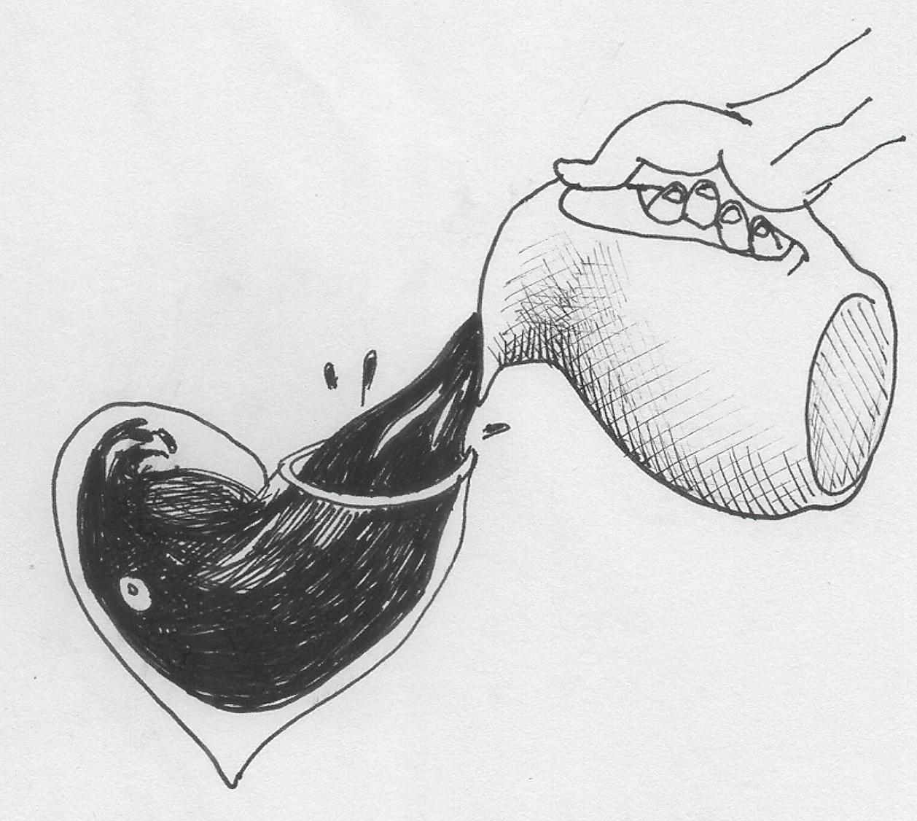
…turn my heart to You…
…help me to be your compassionate hands and feet…
…protect me…
…may my life exhale the aroma of Jesus…
‘Fill me’ by Liz Valente
Notes:
Sending: This is an image by Brazilian artist Liz Valente.
This prayer was written to accompany this image: you may want to make some of the challenging words your own…. [a selection of words will animate on the screen]
Lord, turn my heart to You to receive once more Your love and mercy poured out on me each morning.
May every breath of this day be to celebrate and remember your glorious presence that sustains and guides me.
Fill me with the power of Your Holy Spirit [and help me] to be your compassionate hands and feet redeeming a sick world.
Protect me from what in myself wants to keep me away from You.
May my life exhale the aroma of Jesus.
Amen.
Sending: you might wish to leave students with a final challenge based on this slide, then blow out the candle as a sign that the collective worship is finished.
Image source: https://diglib.library.vanderbilt.edu/act-imagelink.pl?RC=59323

