Slide 1
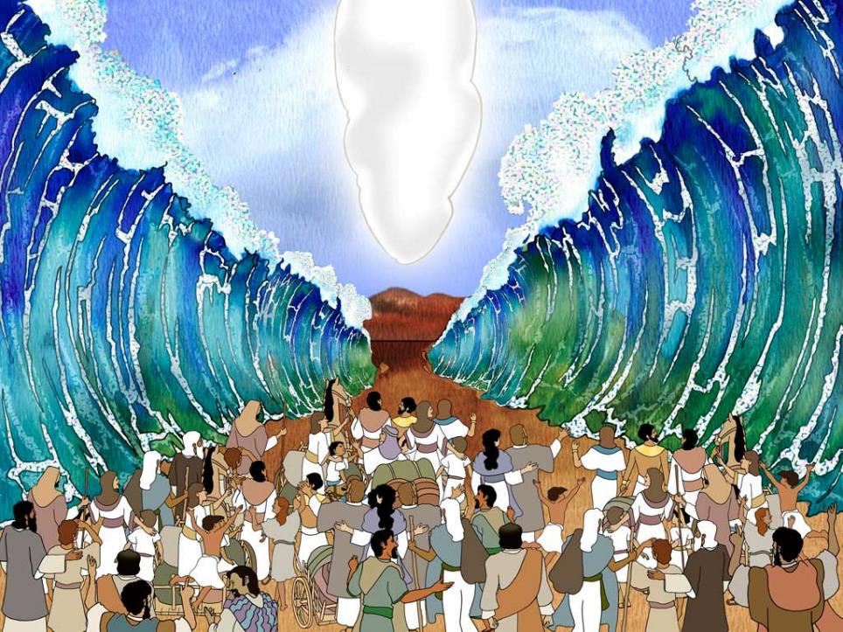
Moses: Are we nearly there yet?!
Autumn 2023
Notes:
Slide 1: As you know, this term, we are travelling with Moses and God’s people to the land that God had promised them long ago. [Add where you’ve got to in the story….]

Slide 2
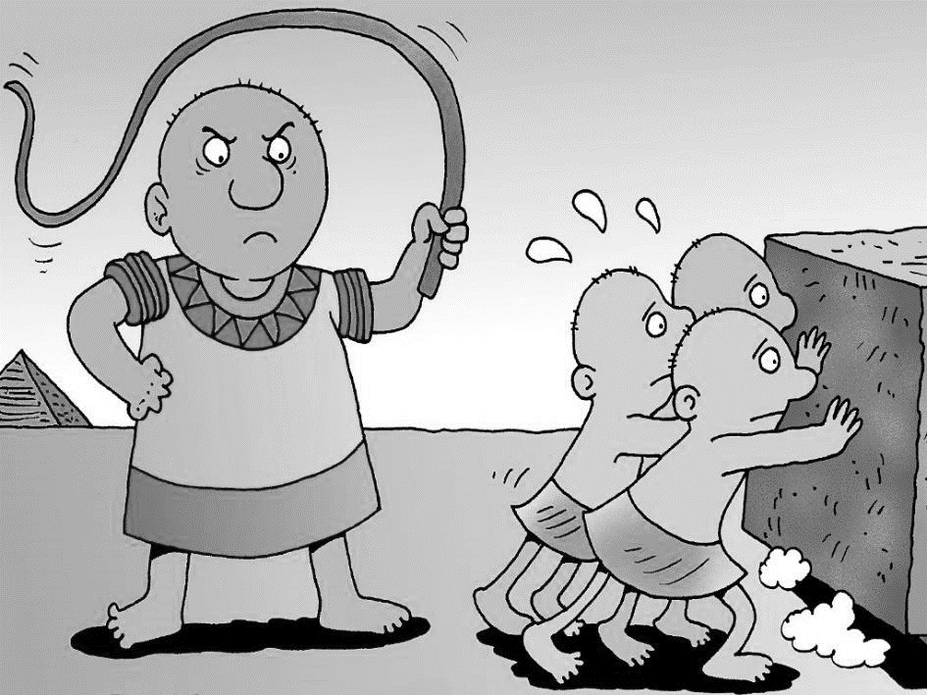
Notes:
Slide 2: We know from the stories we have shared that God’s people have faced many hardships….but we also heard that God saw it all….

Slide 3
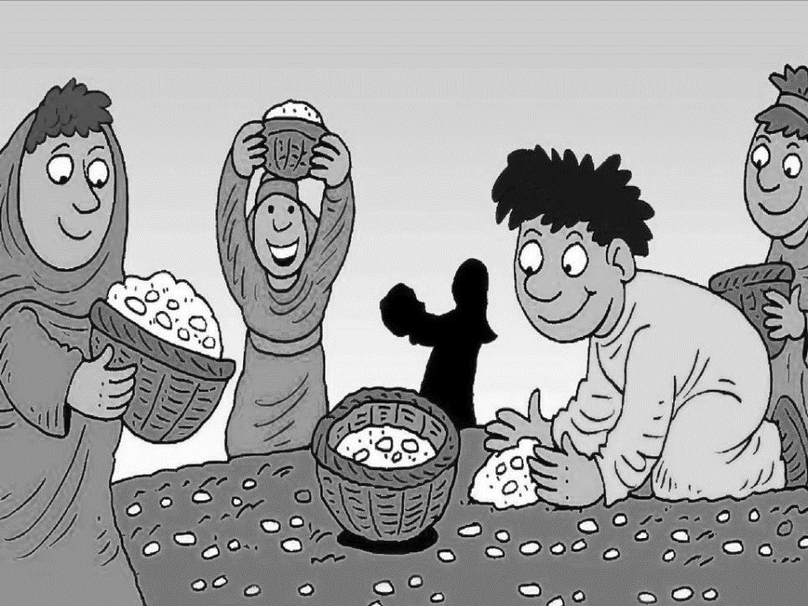
Notes:
Slide 3: ….and that God provided for his people in many ways.
So, it’s hard for us to see what’s going on in our world and not have questions….

Slide 4
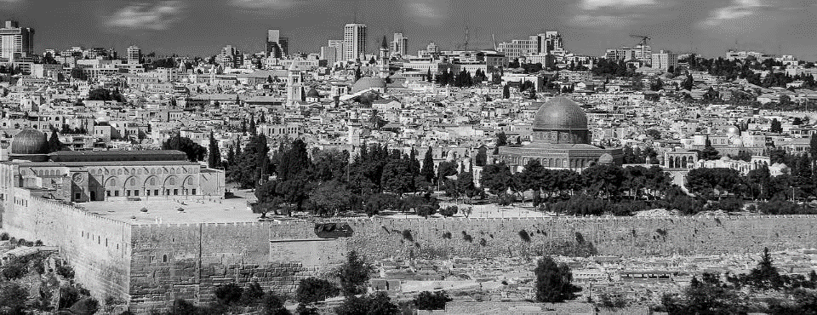
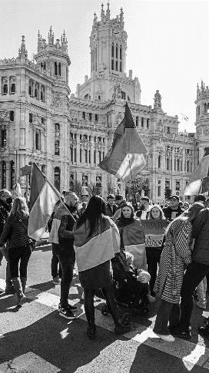
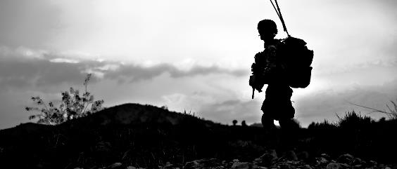
Notes:
Slide 4: This is Jerusalem, the capital city of the place that God’s people called the Promised Land, where they will eventually end up in our story, as we’ll hear towards the end of term. It’s the homeland of God’s people.
But it’s also a place where there are sad events happening at the moment, as you may have seen on the news.
Here, and across the border in Gaza, as well as in many other parts of our world, people are fighting…

Slide 5
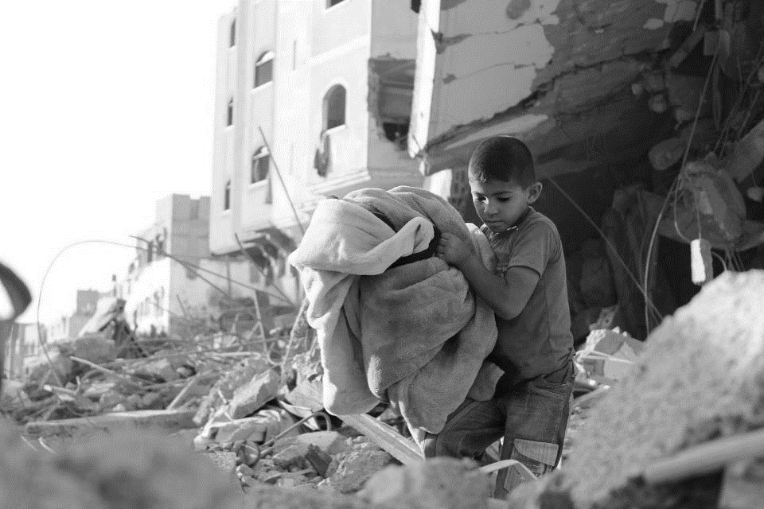
Notes:
Slide 5: ….and people are hurting….

Slide 6
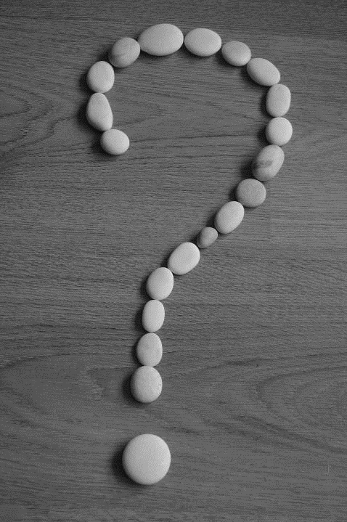
How long must I worry? How long must I feel sad in my heart?
Psalm 13:1-2
Why are you far away, Lord? Do something, Lord God, and use your powerful arm to help those in need… …You listen to the longings of those who suffer.
You offer them hope, and you pay attention to their cries for help.
Psalm 10
Notes:
Slide 6: David the Psalmist wrote many songs of praise to God, but he also wrote many about hard times. Let me read you some of his words: How long must I worry? How long must I feel sad in my heart?....Why are you far away, Lord? Do something, Lord God, and use your powerful arm to help those in need… …You listen to the longings of those who suffer. You offer them hope, and you pay attention to their cries for help.
However we are feeling, it’s good to know that it’s OK to share our feelings, our worries and our concerns. If David could do it, then so can we!
I wonder what questions feel ‘sad in your heart’ at the moment?
[If you have them, you could use pipe cleaners to make a question mark to go with this reflection]

Slide 7
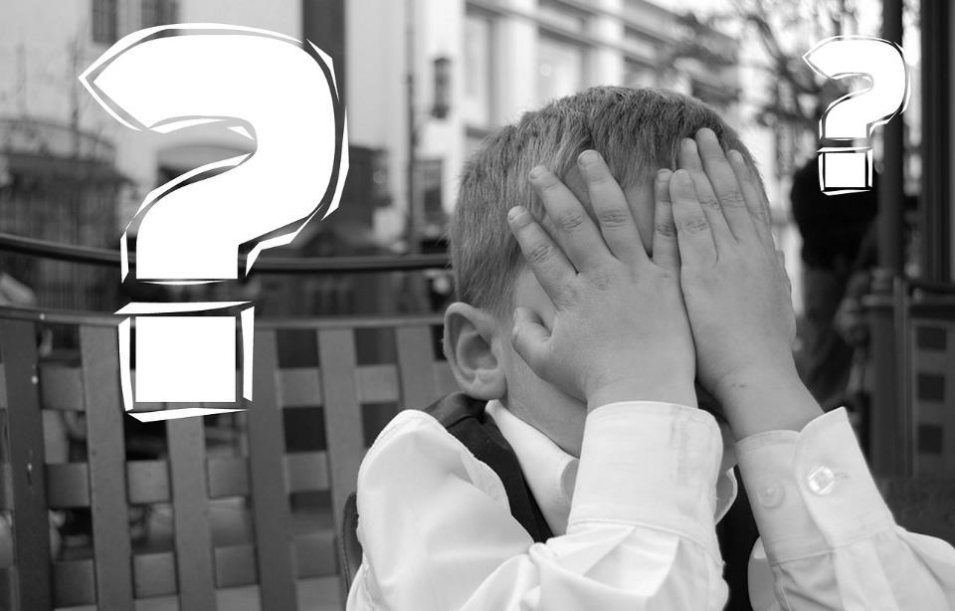
Notes:
Slide 7:
Today, we simply want to pause….. and be together with our questions, our worries and our feelings….
[you might want to use this time to play some quiet music, or to talk together, before continuing with the final 2 slides]

Slide 8
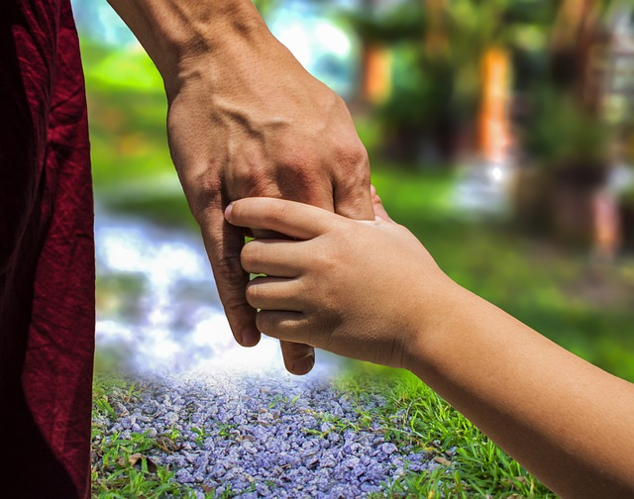
Jesus said to his disciples,
‘Don't be worried! Have faith in God and have faith in me.’
John 14: 1
Notes:
Slide 8:
Many years after Moses’ long journey with God’s people, and many years after David wrote his Psalms, Jesus and his disciples also lived in this part of the world. They also faced uncertain times. But Jesus said to them: ‘Don't be worried! Have faith in God and have faith in me.’
Turn your pipecleaner into a heart shape, to represent God’s love

Slide 9
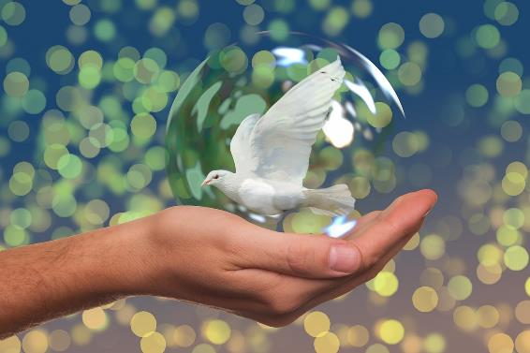
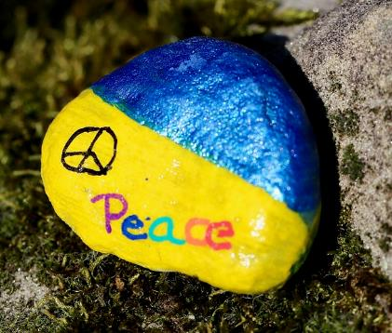
‘Blessed are the peacemakers; God will call them his children.’ Matthew 5:9
Notes:
Slide 9:
….and however we are feeling, it’s never wrong to hope and pray for peace, and to do whatever we can, wherever we are, to act as peacemakers in our world.
Jesus said ‘Blessed are the peacemakers; God will call them his children’ Matthew 5:9
Turn your pipecleaner into a dove (bird) shape, to represent hope for peace
You might want to pray together before you finish, or display the doves in your reflective areas to remind you to pray for peace – and to be peacemakers.

