Slide 1

Pictures copyright-free from pixabay
Leader: We are a creative community. As we gather together today…
ALL: May our thinking, talking and wondering help us to grow.
Notes:
Slide 1: Gathering
Use the new greeting, with BSL actions if desired.
Leader: We are a creative community. As we gather together today….
ALL: May our thinking, talking and wondering help us to grow.
Here are BSL actions for some of the words:
Leader’s words:
Creative: https://www.signdictionary.co.uk/view/creative?q=creative#title
Community: (we use the word ‘gathering’ as it’s a simpler sign!) https://www.signbsl.com/sign/gathering
Gather together: https://www.signbsl.com/sign/gather (1st video)
Pupils’ response:
Think: https://www.brightbsl.co.uk/signs/think
Talk: https://www.signbsl.com/sign/talk (1st video)
Wonder: https://www.signbsl.com/sign/wonder (1st video)
Grow: https://www.signbsl.com/sign/grow (2nd video)

Slide 2
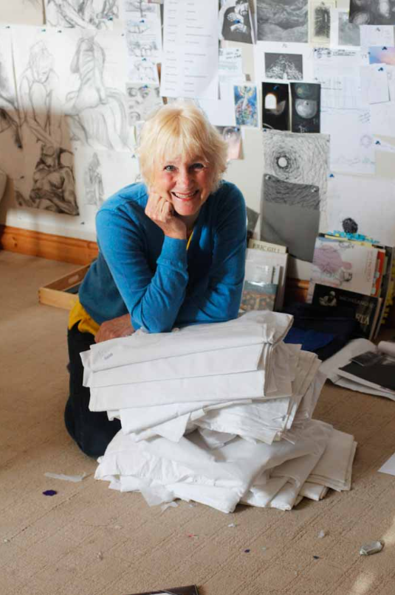
Threads Through the Cross
Notes:
Slide 2: Threads Through the Cross
This is an extra presentation featuring the birds that are included with each of Jacqui’s panels. You might like to use these in conjunction with each week’s resources, as an additional reflective activity or maybe as a stimulus for class collective worship alongside the reflection cards. We back-date these to include the birds in weeks 4&5.
The full panel slide is included before the bird image(s) for each week if it helps.

Slide 3
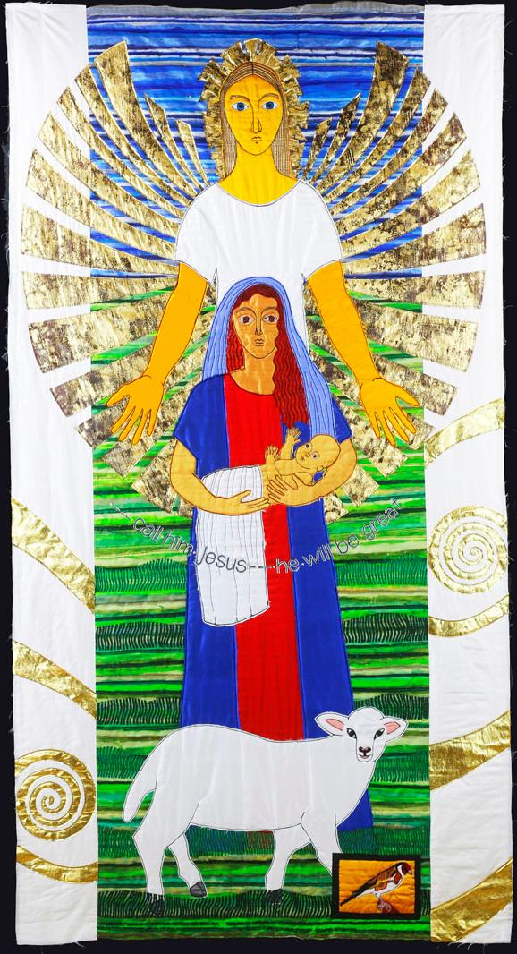
‘call him Jesus – he will be great’
Notes:
Week 4: Chosen

Slide 4
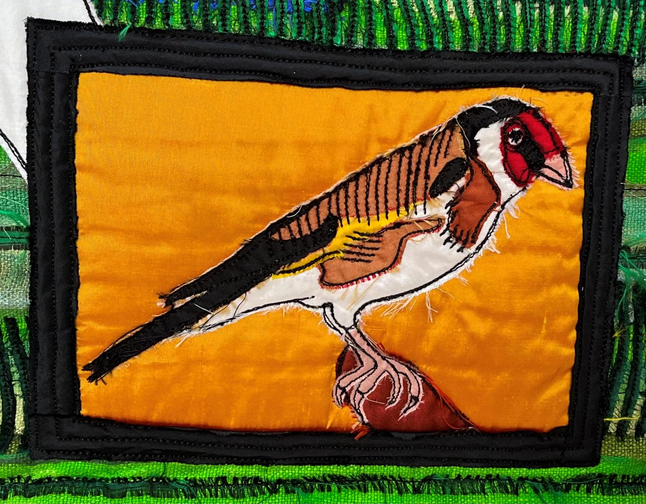
Notes:
Week 4: Chosen
This is a goldfinch, which Jacqui chose as the colours of its plumage traditionally symbolise Jesus’ humanity (the red stripe on its head) and Jesus’ divinity (the gold stripe on its wing). Christians believe that Jesus is God’s Son, who is both human, like us, and holy, like God. Christians call this the Incarnation and it’s a deep mystery, because it’s quite hard to understand. For Christians, Jesus is 100% human and yet 100% God, so it’s mysterious maths as well!!
Here are some questions to ponder….
….I wonder what you think about this Christian idea about Jesus being God and human?....
….I wonder what symbol you might choose to represent this idea?....
….I wonder if you know any stories about Jesus that link with this idea?....
….I wonder what Mary might have thought about being chosen to be the mother of God?....
….I wonder how this story might help us if we’re chosen for a special role or to do a special job?....

Slide 5
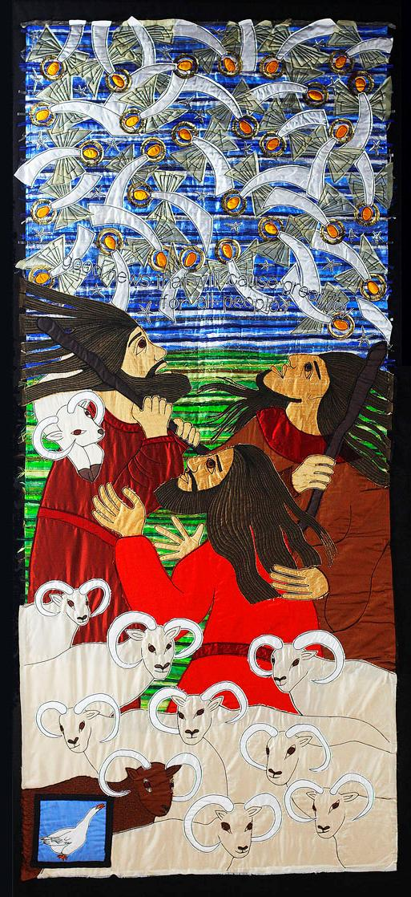
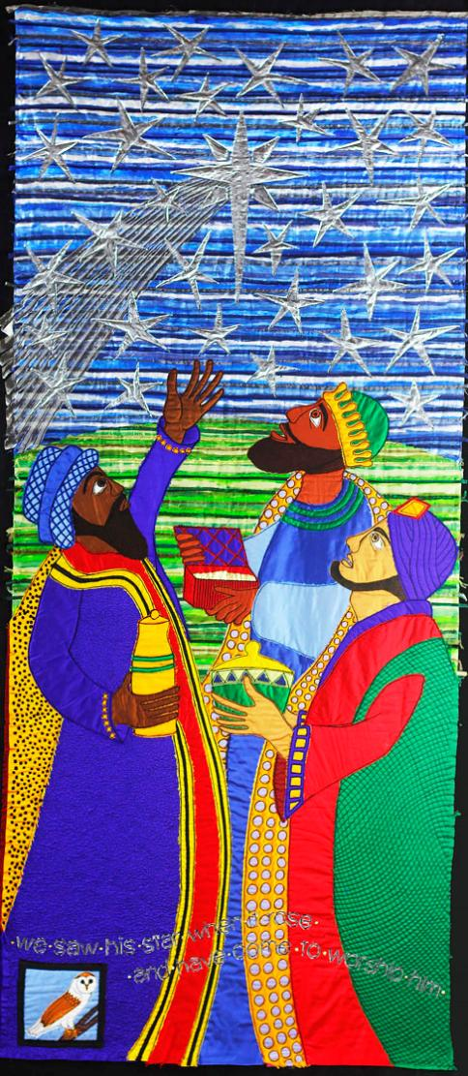
Do not be afraid!
Follow the star
Notes:
Week 5: Gospel (Good news!)

Slide 6
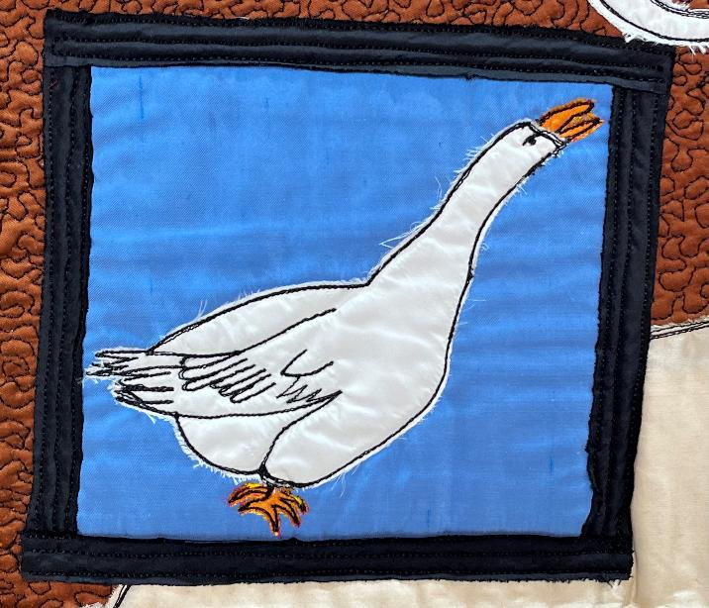
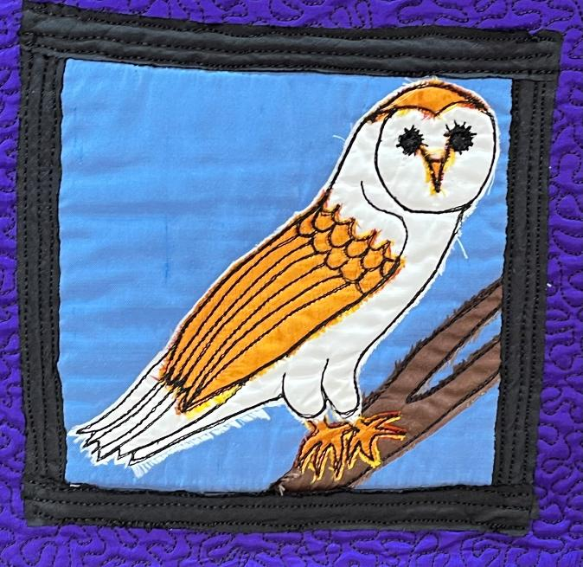
Notes:
Week 5: Gospel (Good news!)
On the panels with the shepherds and wise men, there are two birds: a white goose, and an owl.
Here are some questions to ponder….
….I wonder what similarities there are between a flock of geese and the angels in the panel?*....
.…I wonder why you think Jacqui chose the owl to be on the panel with the wise men?!....
….I wonder how the shepherds and the wise men felt to be included in this story of good news?....
….I wonder what you feel about this story of good news?....
* NB Jacqui wrote that the white goose represents light – and there’s a lot of that in the sky over the fields in Bethlehem!

Slide 7
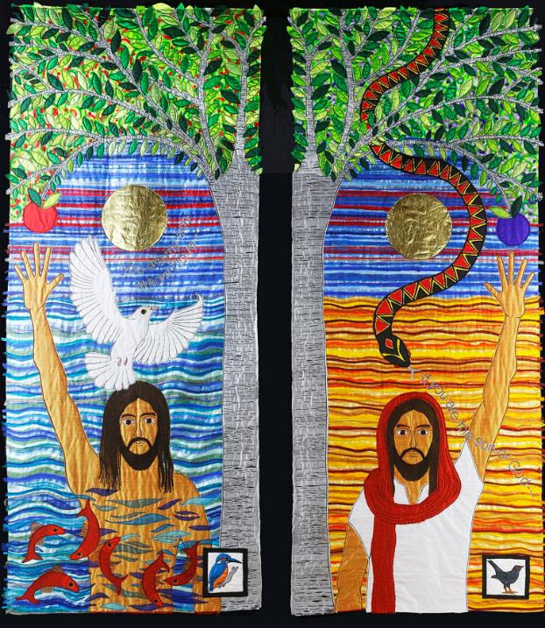
You are my Son, whom I love.
If you are the Son of God….
Notes:
Week 6: Choices

Slide 8
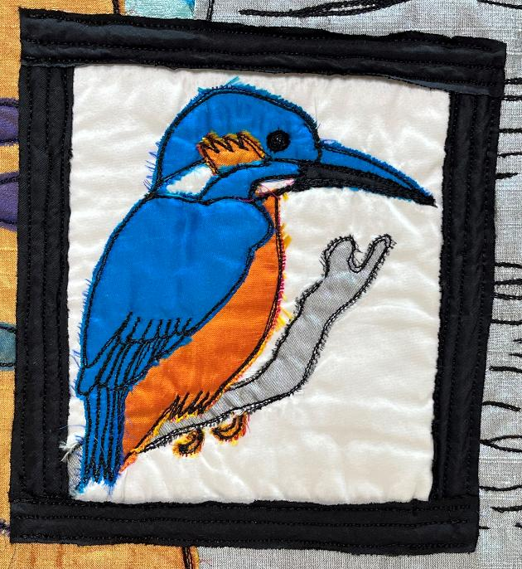
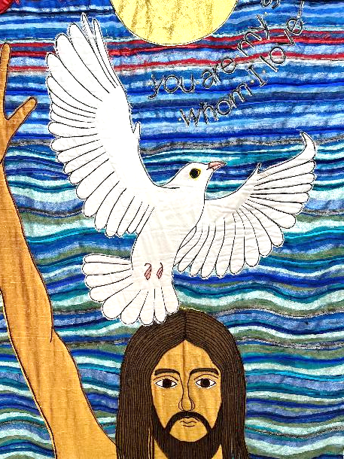
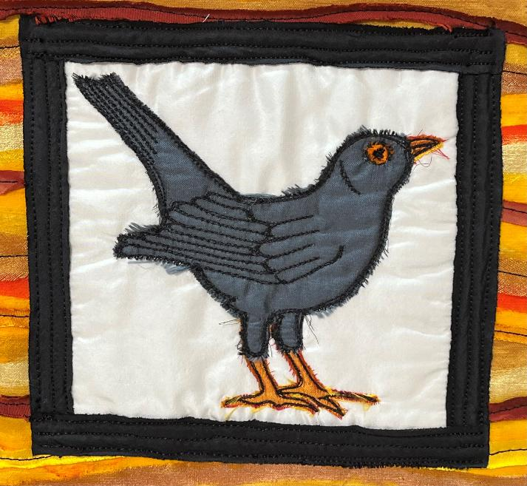
Notes:
Week 6: Choices
You may never have seen this little kingfisher in real life before – it’s a rare sight in the wild, and lives near water as it is an expert fisher! So maybe we can understand why Jacqueline chose it to be on the panel of Jesus being baptised. For some people, it’s a symbol of new beginnings. But did you also notice the 2nd bird on this panel? A white dove, the symbol of the Holy Spirit which descends on Jesus as he is baptised…..keep your eyes open in future weeks as we will see this bird again!
On the second panel is a bird that you will probably have seen before, many times, as it’s a regular visitor to gardens throughout the year. This bird is quite simply called a blackbird – because that’s what it is, a bird that is black! In the past, blackbirds were often associated with temptation, so is very appropriate as a symbol in the story of Jesus in the desert, where the snake tempts Jesus to try to trick him, and cause him to act in a way that was wrong and would go against God’s plan.
Here are some questions to ponder….
….I wonder how Jesus’ baptism was like a new beginning?….
….or why temptation came so soon afterwards?…..
….I wonder what new things we might be facing, or where we might face temptation to act differently than what we know is right?….
….I wonder what might help us when faced with temptation?….

Slide 9
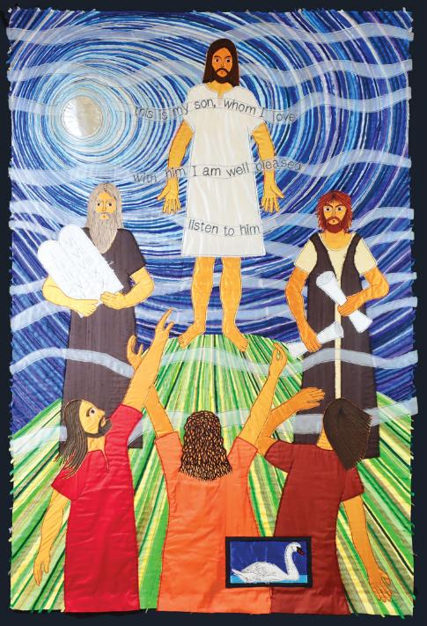
This is my Son, whom I love. With him I am well pleased. Listen to him.
Notes:
Week 7: Meeting

Slide 10
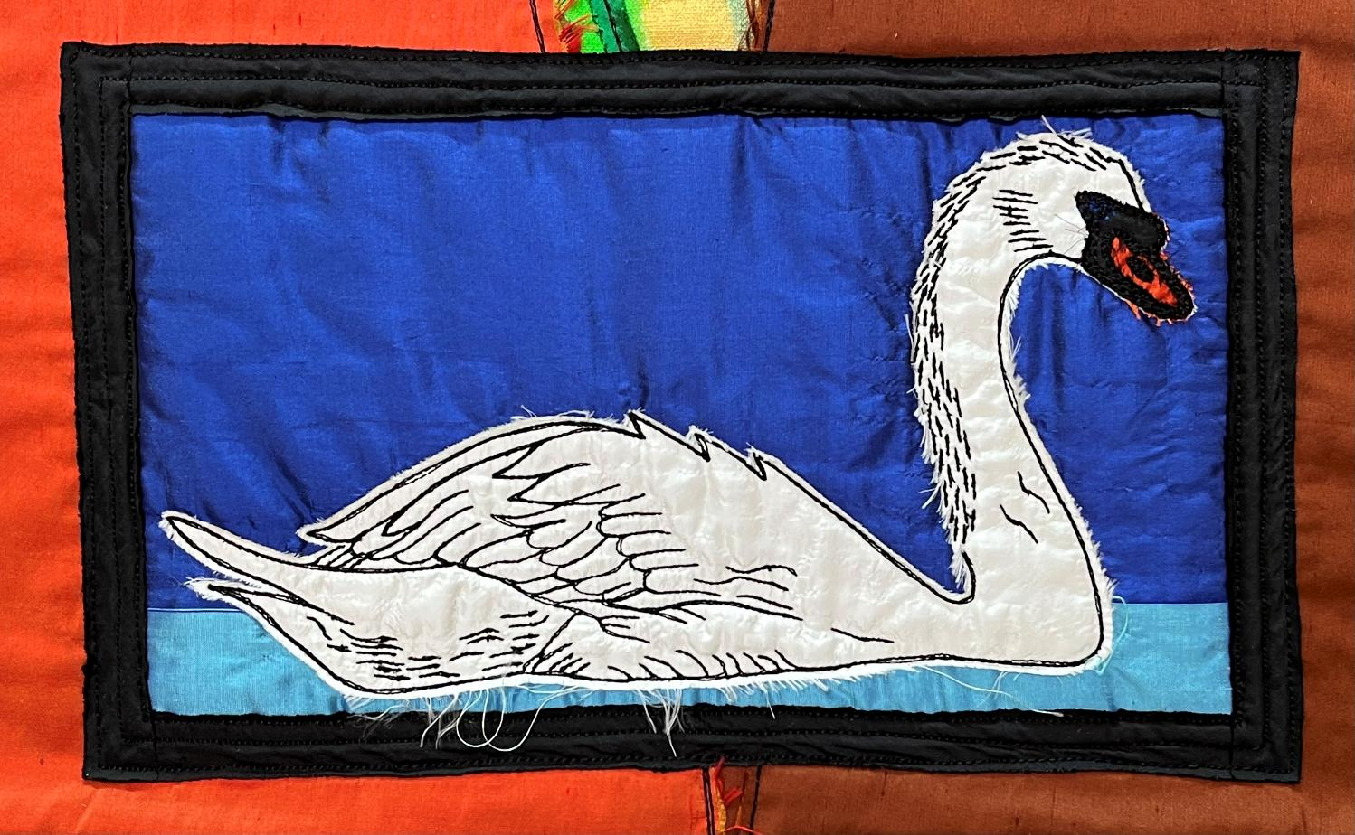
Notes:
Week 7: Meeting
On this panel, Jacqui shows the disciples seeing Jesus differently and getting a glimpse of who he really is; he was transfigured, or transformed – changed – in front of their eyes. Jacqui chose a swan to represent this part of the story because it too is transfigured as it grows from being a cygnet (the baby), with dull, grey feathers and stubby little wings, to the adult, with its pristine, white plumage and graceful neck. There’s a very famous children’s story, ‘The Ugly Duckling’ about this transformation, which you can look up later! [Clip of Danny Kaye in the film version of Hans Christian Andersen’s story: https://www.youtube.com/watch?v=DHHa9T73fMU]
Here are some questions to ponder…
….as you look at the swan, think of the story of how Jesus’ friends saw him differently as they looked at him standing next to Moses and Elijah….
….I wonder how they felt, seeing their friend Jesus like this?....
….I wonder if it changed their understanding of the things that had happened or the things that would happen?.....
…I wonder if there are people in our lives that we might need to ‘see’ differently?.....
….or situations that we might need to view differently?....

Slide 11
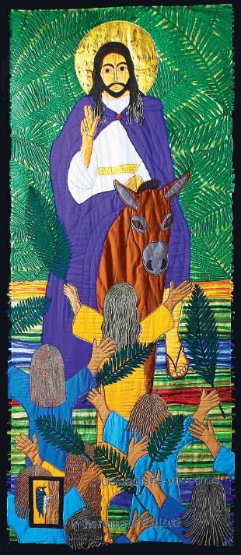
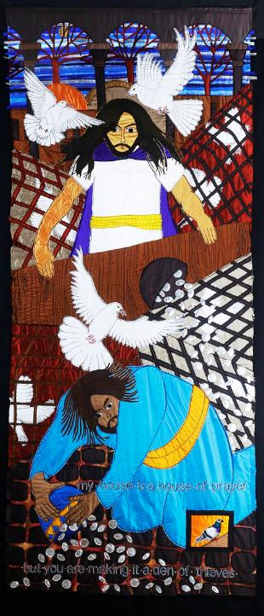
Hosanna! Jesus is Lord
My house is a house of prayer
Notes:
Week 8: Weeping

Slide 12
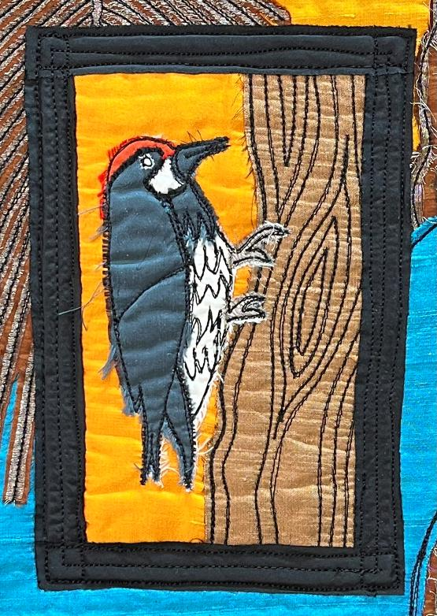
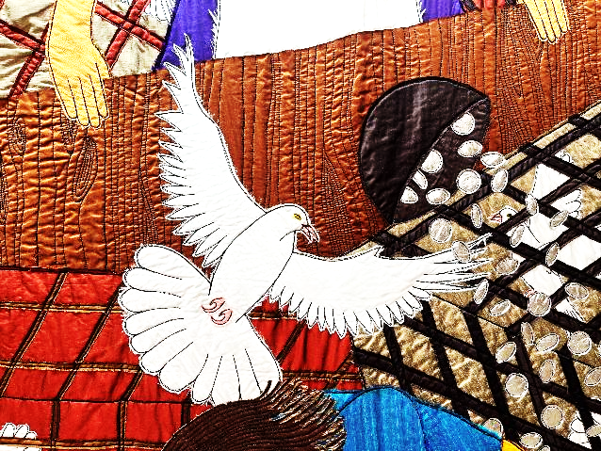
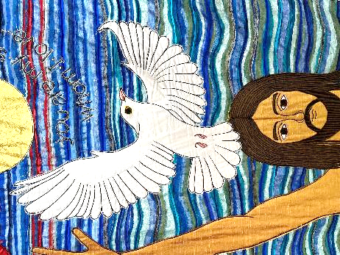
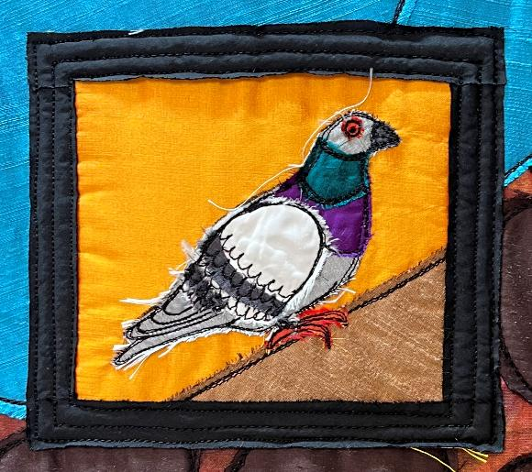
Notes:
Week 8: Weeping
These two birds are part of more panels depicting events which happen on the same day, the day that is known as Palm Sunday, when Jesus rode into Jerusalem as King on a young donkey.
Jacqui says that she chose a woodpecker for the panel with Jesus on the donkey, as it drums out its rhythm on a tree and can be heard for long distances, just like the praises of the people as Jesus rode by.
The pigeon that Jacqui stitched onto the second panel is a reminder of all the pigeons and doves that were set free by Jesus that day as he turned over the tables in the Temple. And did you notice another very special bird that appears on this panel and mirrors one that we’ve seen before? Remember the dove, the symbol of God’s Holy Spirit which we saw on the panel of Jesus’ baptism?
As the birds fly free in the Temple, Jacqui said the dove is a reminder that one day, the Holy Spirit would be set free to be at home in the lives of people who follow Jesus.
Some questions to ponder…..
….there are some big emotions in this part of the story! I wonder what this shows Christians about Jesus?….
….Jesus stood up for ordinary people who were being wrongly treated in the Temple….I wonder if you’ve ever felt angry about something like this, as Jesus did?…..
….I wonder what you did about it?....
……..I wonder which of the birds you think are the best reminder of this part of the story?….

Slide 13
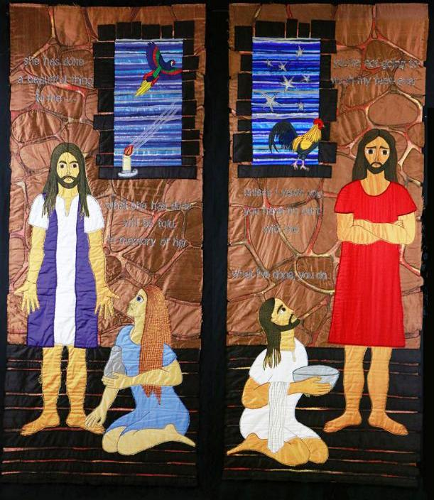
You will be remembered
Do as I have done
Notes:
Week 9: Humility

Slide 14
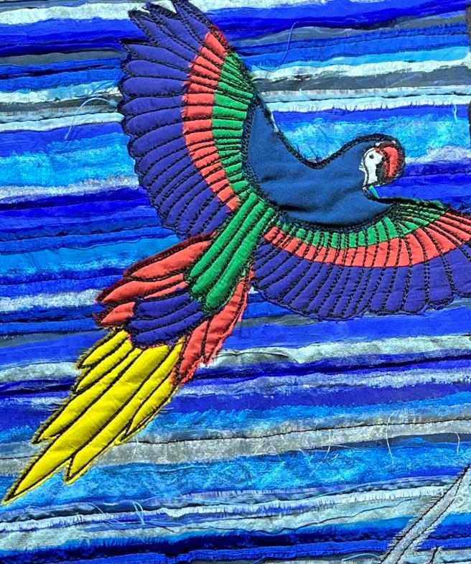
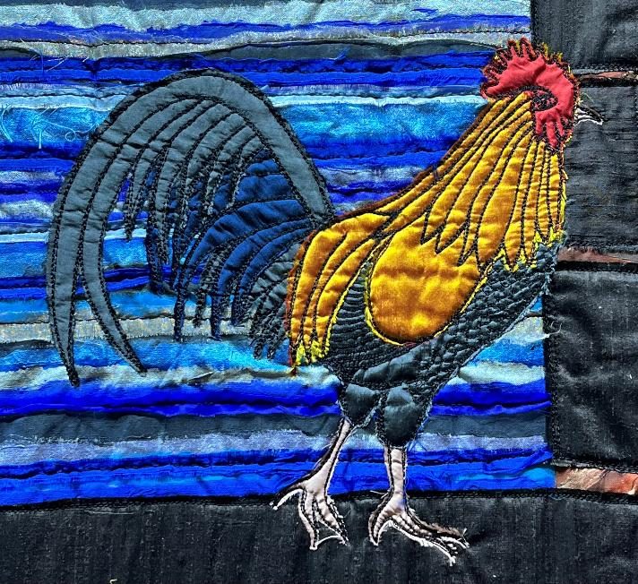
Notes:
Week 9: Humility
You can see these birds in the windows of the rooms where Jesus is.
Jacqui said that the beautiful macaw, with the extravagantly coloured feathers, symbolises the wonderful act of generous kindness that the woman showed to Jesus when she washed and anointed his feet. In the other half of the panel, the cockerel is a sign of Peter’s betrayal of Jesus, which will happen later that night, when he will say that he doesn’t know Jesus at all.
Some questions to ponder…..
….Jesus said that people the woman would be remembered for her kind act….
…..I wonder what this shows us about being a true friend to others?….or how Peter’s actions remind us that everyone makes mistakes?….
…..I wonder how other people view our actions towards our friends?….

Slide 15
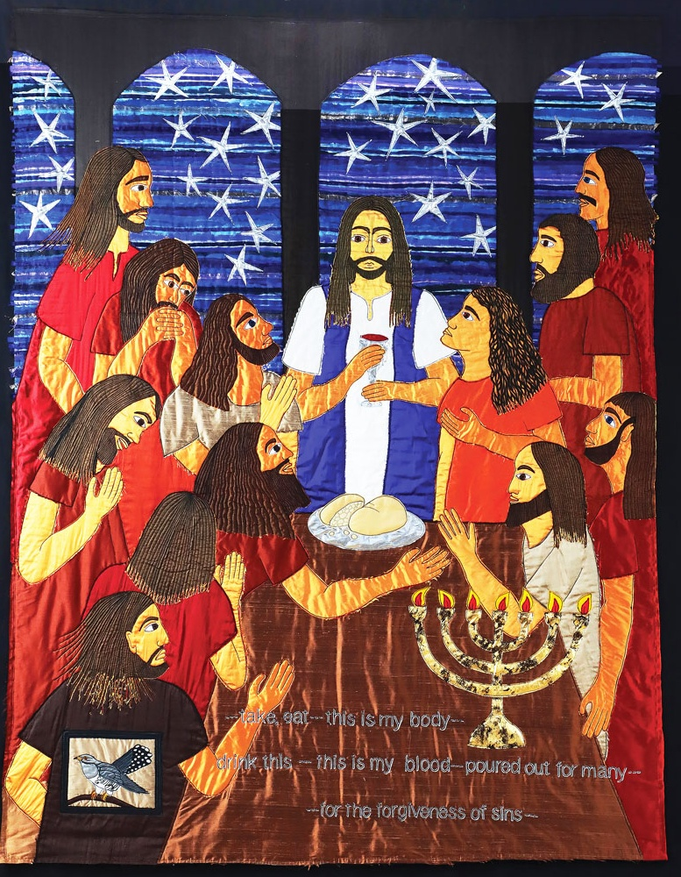
Remember me
Notes:
Week 10: Remember

Slide 16
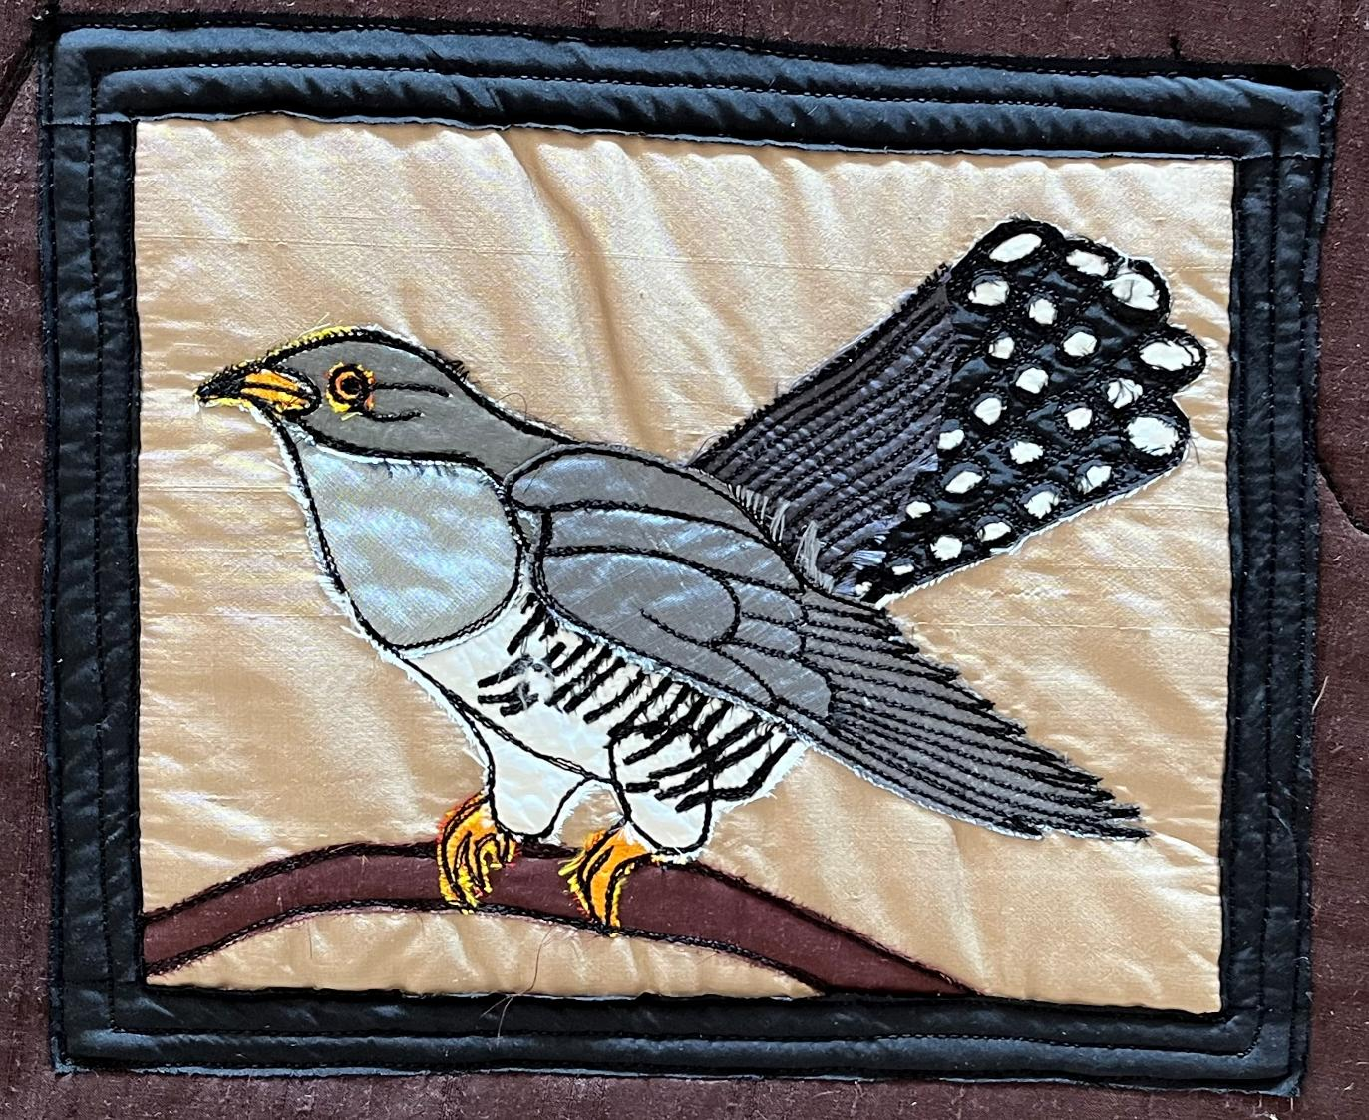
Notes:
Week 10: Remember
This is a cuckoo….it’s a sneaky little bird who places its own eggs into other birds’ nests. When the cuckoo hatchlings emerge, they are much stronger than the others and often push the other babies out of the nest. I wonder how this is like the actions that Judas took to betray Jesus? He sat at the same table as all the other disciples, sharing the same meal and yet he was already planning to give Jesus up to the Romans.....
Some questions to ponder…..
…..as they shared their meal together, Jesus asked the disciples to ‘remember’…..
….I wonder what Judas thought about?.... or how he was feeling?....
….I wonder whether Judas regretted his actions afterwards?.....

Slide 17
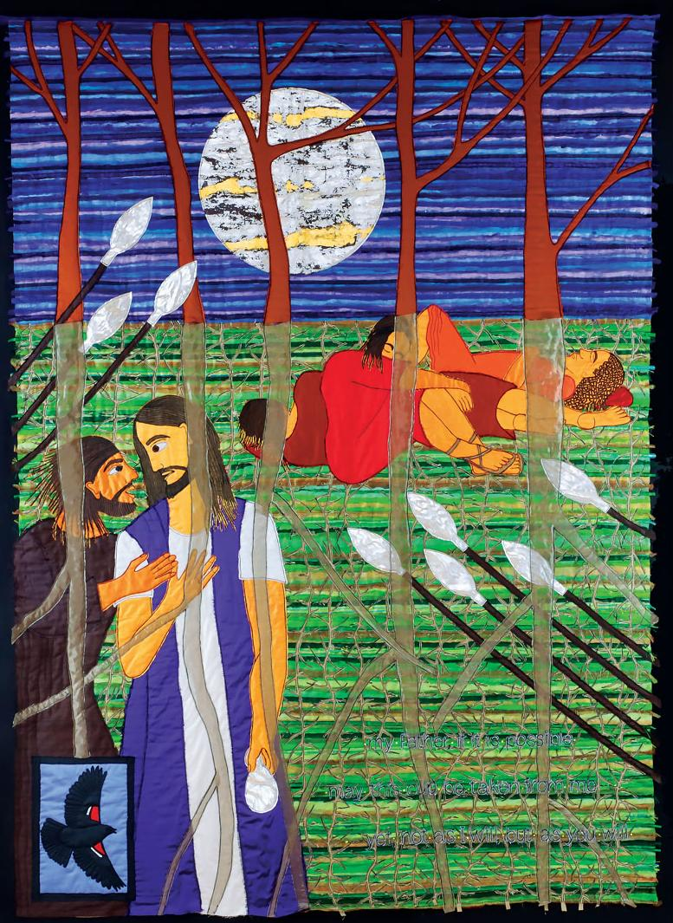
Your will be done
My Father, if it is possible, may this cup be taken from me; yet not as I will, but as you will.
Notes:
Week 11: Surrender

Slide 18
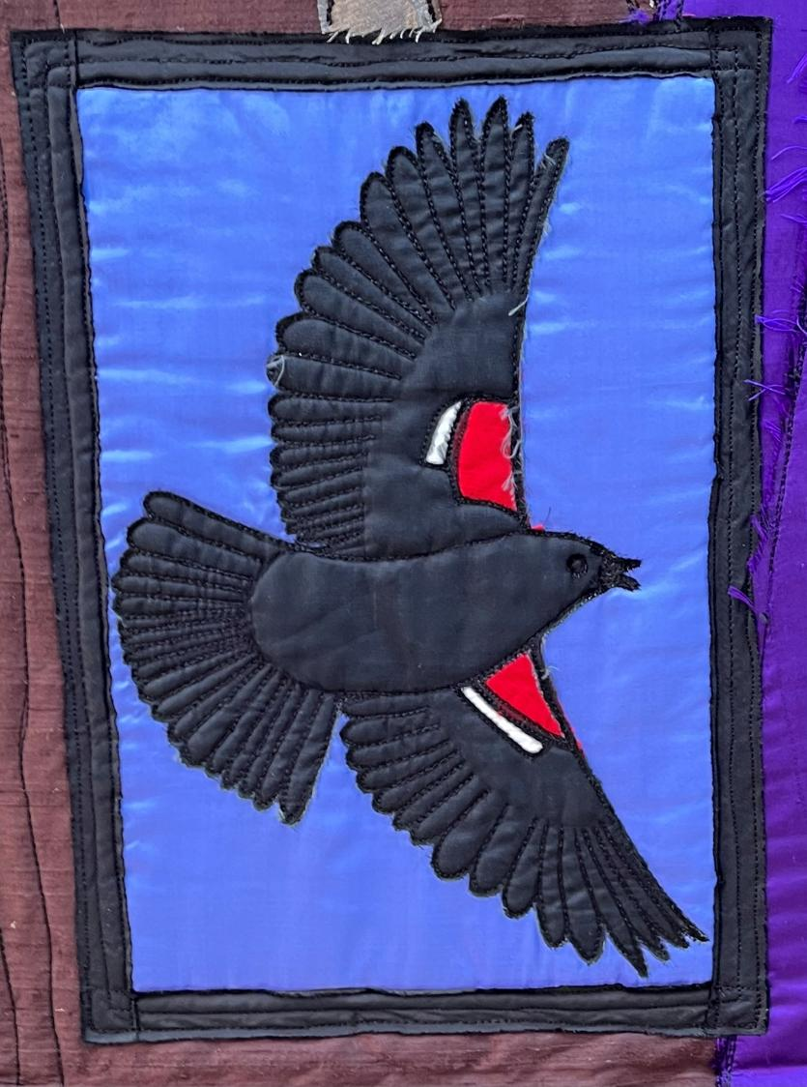
Notes:
Week 11: Surrender
This is a North American Blackbird, the red flash on its wings signalling danger. Despite the fact that Jesus knew what would be coming his way, Christians believe that he still chose to go into the garden where Judas brought the soldiers to take him away. Although Judas had betrayed him, and the soldiers would lead him away to die on the cross, Jesus chose not to fight or run away. He knew that this dangerous path to the cross was the salvation plan that God had made to save the world…..forever. Christians believe that Jesus gave himself up willingly, as an act of love for those he would save.
Some questions to ponder…..
…..I wonder how Jesus felt as he saw the soldiers come?....
….I wonder how Judas felt as he watched this too?.....
….I wonder if the flash of red might also be a reminder of Jesus’ death, of the blood that he said would be spilled to save humankind?.....
….I wonder if you’ve ever done a brave deed out of great love for someone else?....

Slide 19
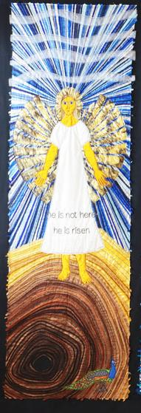
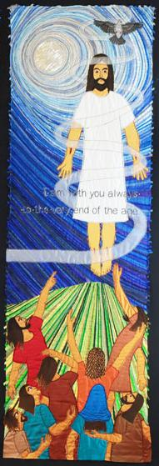
Empty tomb
Ascension
Notes:
Week 12: Risen

Slide 20
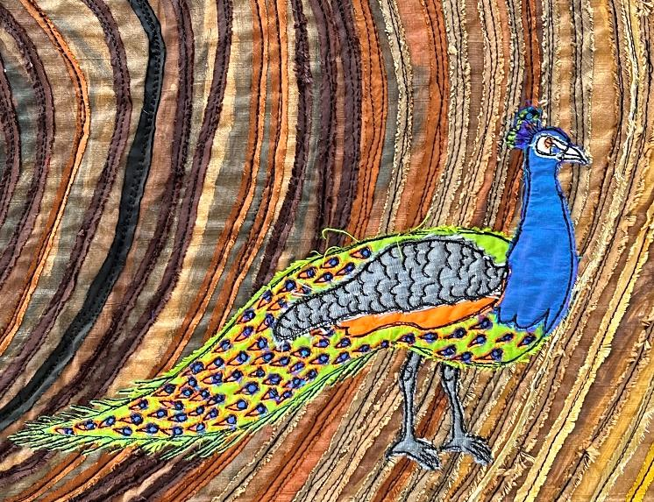
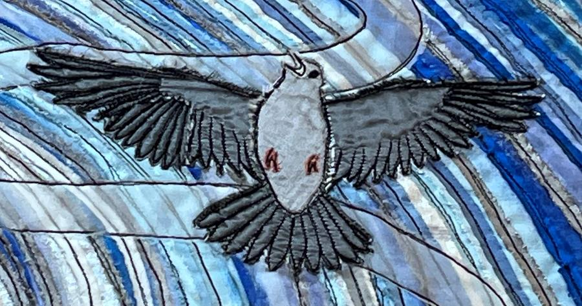
Notes:
Week 12: Risen
You might recognise this beautiful bird as a peacock, with its fantastic tail feathers. Every year, it sheds all its tail feathers and grows a brand-new set: the old set goes and the new one comes! Early Christians adopted the peacock as a symbol for Jesus’ resurrection because of these tail feathers, which is why Jacqui chose this bird for her panel. By contrast, the bird in the Ascension picture, as Jesus returns to heaven, is a lark. You might not have spotted it straight away! This little bird soars high in the clouds: although you often can’t see it, you are more likely to be able to hear it because it has a distinctive clear tune as it soars, higher and higher. [Listen here: https://www.british-birdsongs.uk/sky-lark/]
Some questions to ponder…..
…..I wonder how well you think these birds symbolise the very special endings to this story of Jesus, in his resurrection and ascension?....
….I wonder if you might have had different ideas than Jacqui?.....
…..As we come to the end of this series, I wonder which of the panels you might remember most?.....
....I wonder how Jacqui’s birds might have helped you to think deeply?.....

