Slide 1


Explo RE Easter: Journeys
UKS2: Passion Play ‘Sculptures’

Slide 2
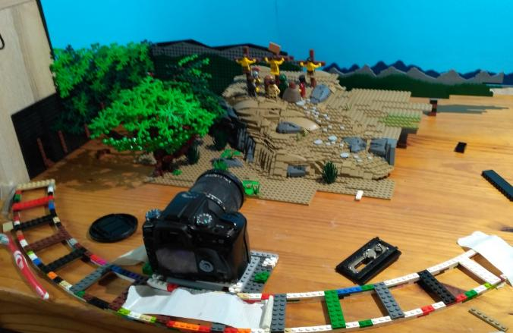
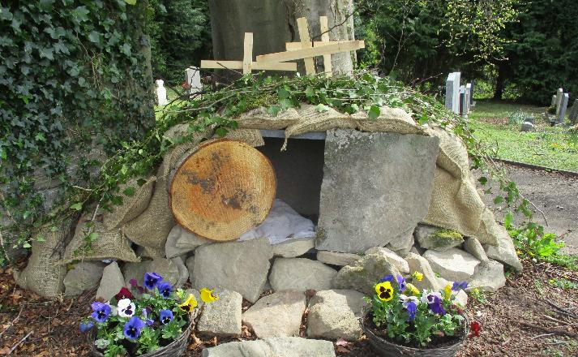
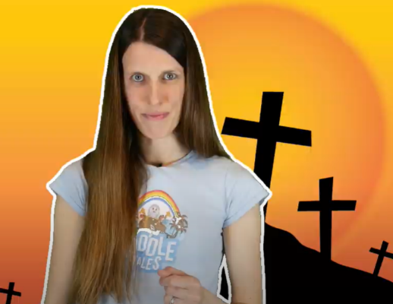
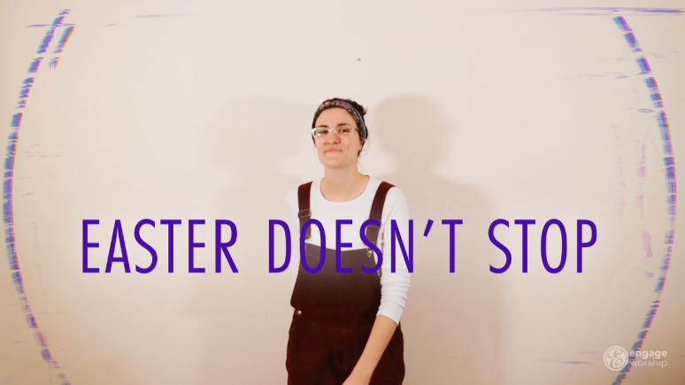
Telling the Easter story
Notes:
Telling the Easter story in different ways – you might remember some of these from the Y5 Salvation unit!
Joshua Whitehouse’s LEGO stop-motion movies, used by GO Chatter
Easter Gardens – thanks to Anne Hayward for the use of her photo https://pilgrimstreet.uk/being-a-church-visitor/easter-gardens/
Lauren’s Toddle Tales – using puppets
Timo and Gemma’s song ‘Easter Doesn’t Stop’

Slide 3
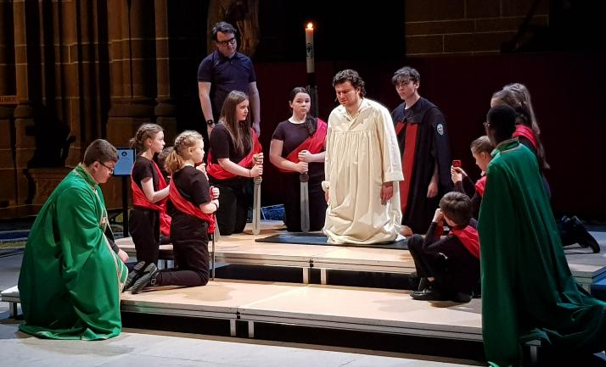
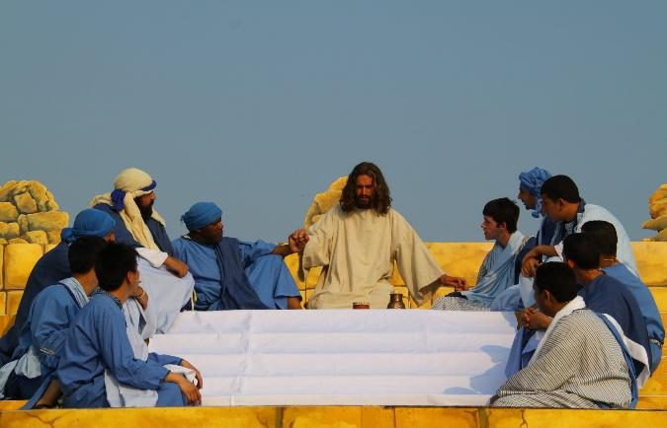
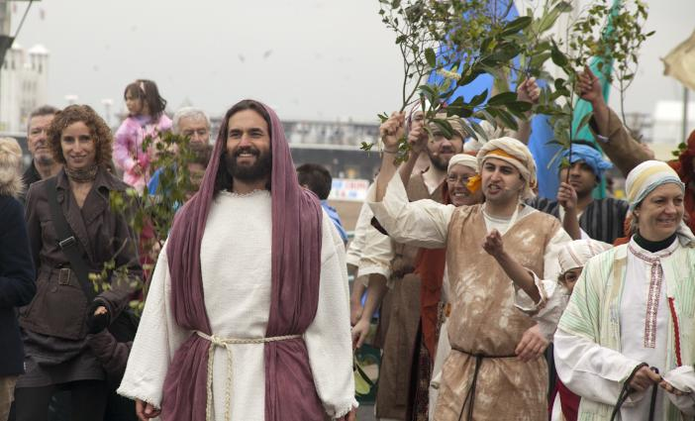
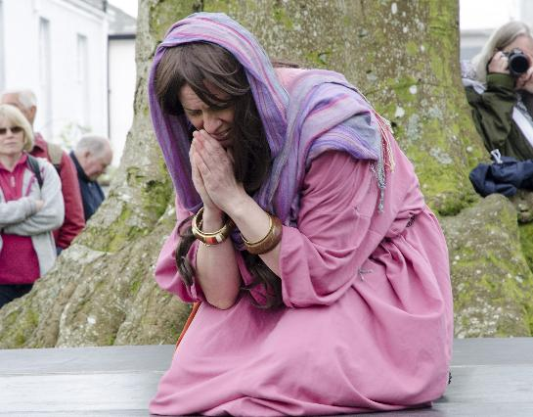
© Liverpool Cathedral/Passion Play 2022
© Lee Redman/Brighton Passion Play 2011
Passion Plays
© Lee Redman/Brighton Passion Play 2011
© Tavistock Passion Play 2017
Notes:
These photos are a selection from the Passion Plays website linked from the planning for UKS2. Our thanks go to the Passion Trust for allowing us to use them. Please do visit the website to find more! www.passiontrust.org

Slide 4
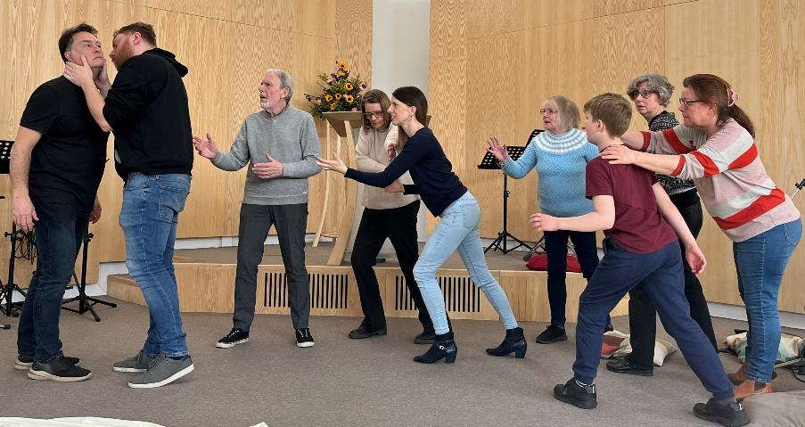
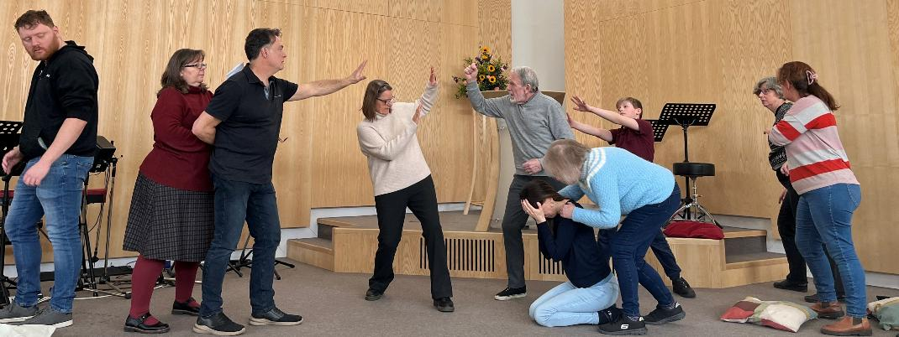

‘Living’ sculptures
Notes:
These images show how a live sculpture can powerfully communicate without words, and were created for an all-age event for Easter, 2025, depicting events in the Garden of Gethsemane. Can you tell which one is Judas? And which is Jesus?
Our thanks go to members of Keeper’s Theatre Group for their permission to use them.
Betrayed by a kiss
Peter defends Jesus

Slide 5
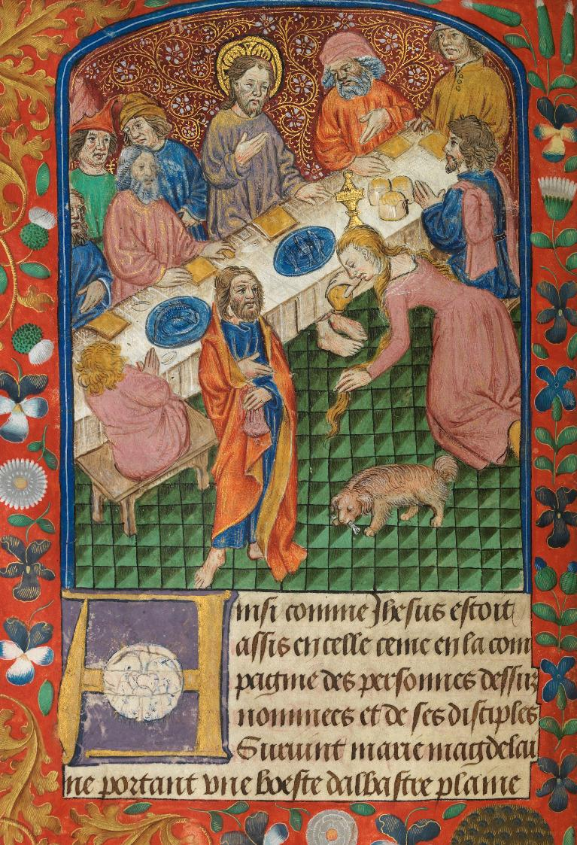
Manuscript, National Library of Wales c. 1503CE © Art in the Christian Tradition

Slide 6
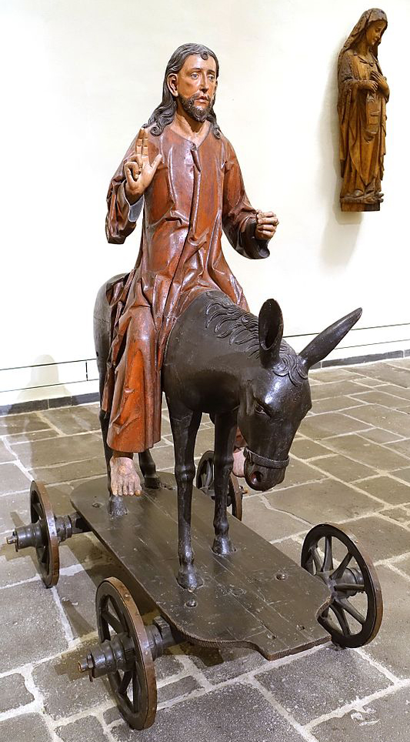
Palm Sunday sculpted figure, Cologne Wales c. 1520CE © Art in the Christian Tradition

Slide 7
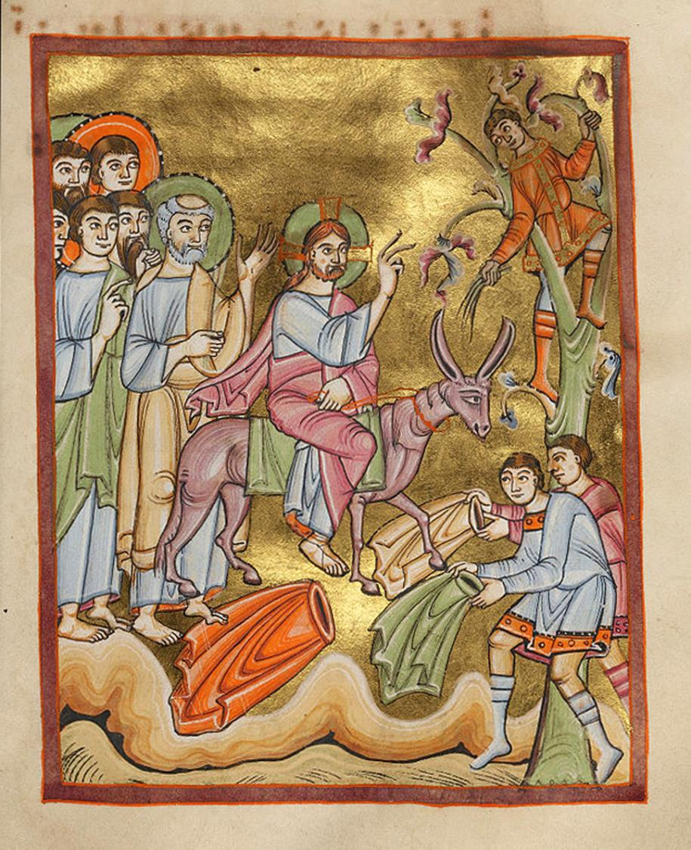
Entry into Jerusalem © Art in the Christian tradition, 11th C CE
Notes:
Palm Sunday

Slide 8
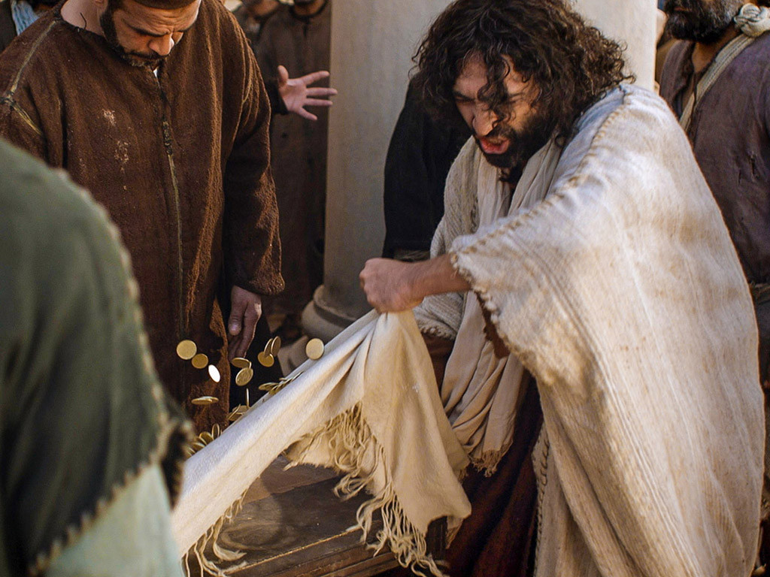

Notes:
Turning over the tables – cleansing the Temple

Slide 9
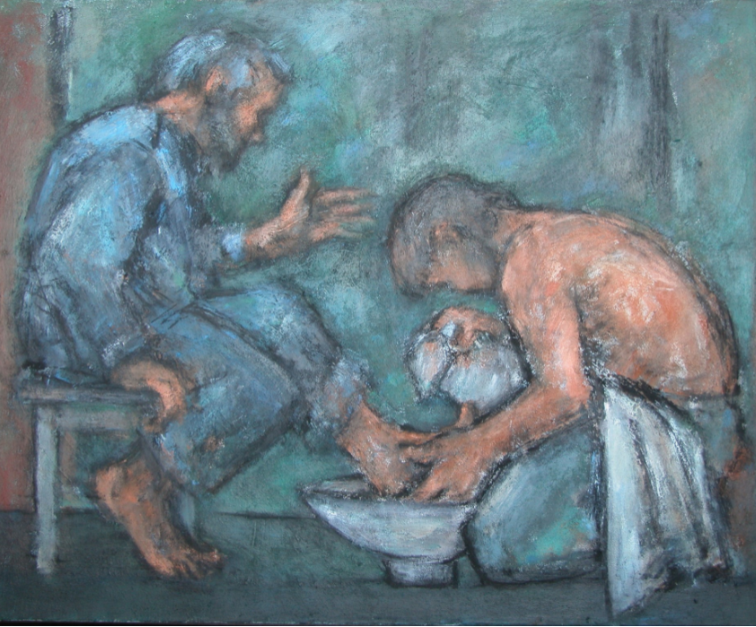
Ghislaine Howard © Methodist Modern Art Collection
Notes:
Foot-washing

Slide 10
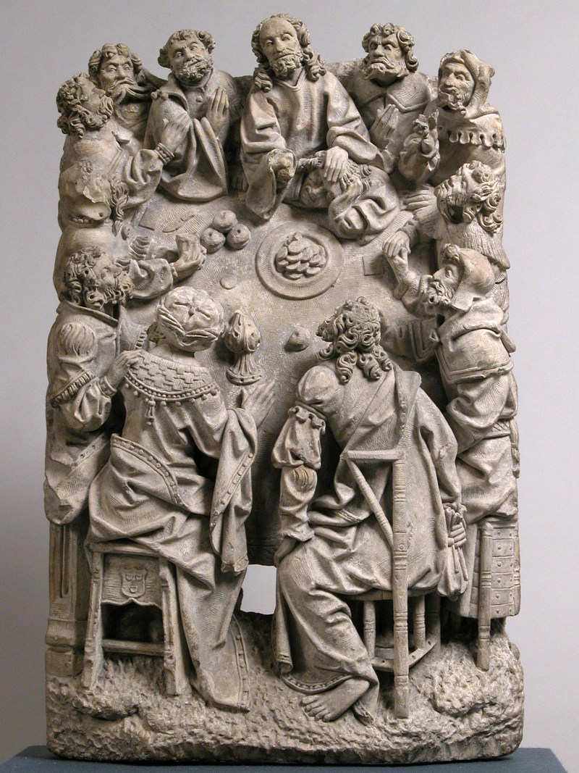
Sculpture in Metropolitan Museum of Art c. 1500CE © Art in the Christian Tradition
Notes:
Last Supper (Passover)

Slide 11
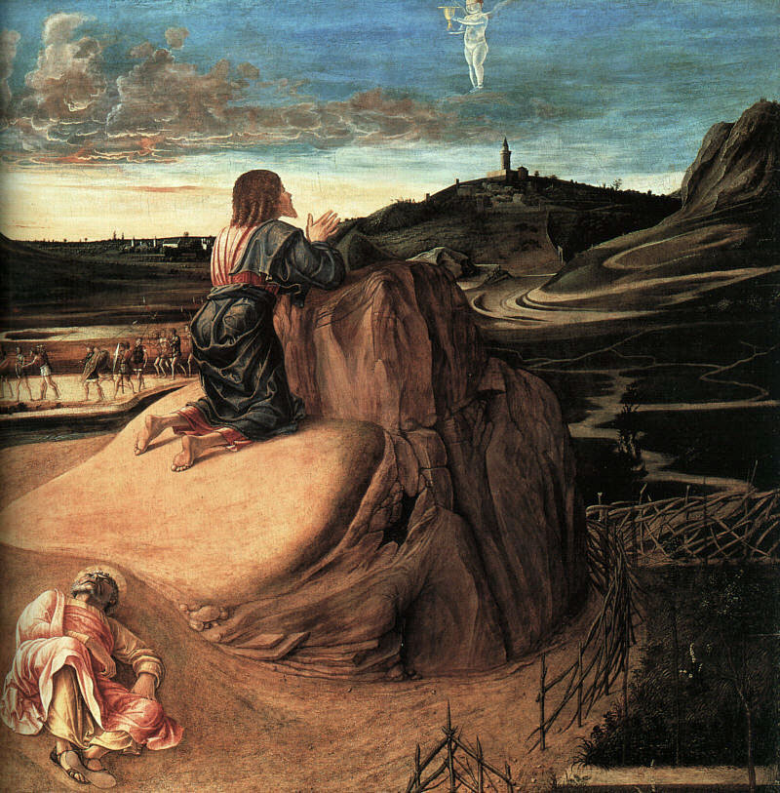
Agony in the Garden, Giovanni Bellini, c. 1565 © National Gallery
Notes:
Garden of Gethsemane

Slide 12
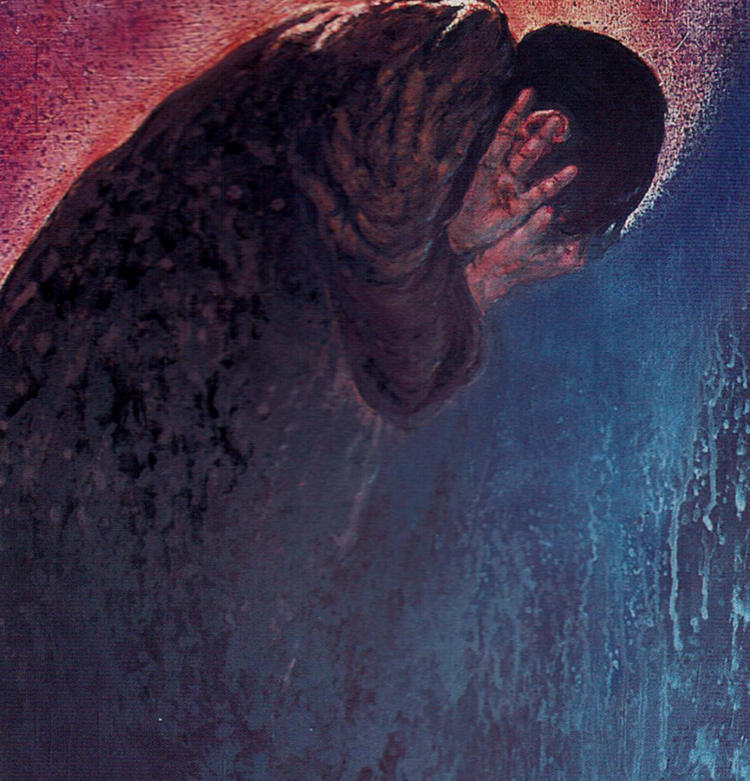
© Frank Wesley, Methodist Modern Art Collection
Notes:
Peter’s Denial

Slide 13
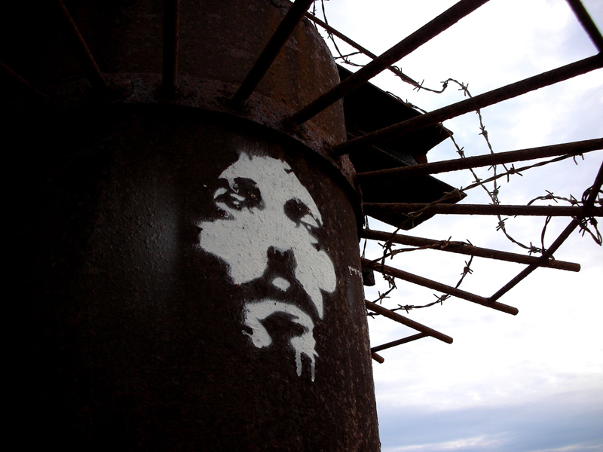
Crown of thorns, West Pier Brighton, 2007 © Art in the Christian Tradition
Notes:
The trial before Pilate

Slide 14
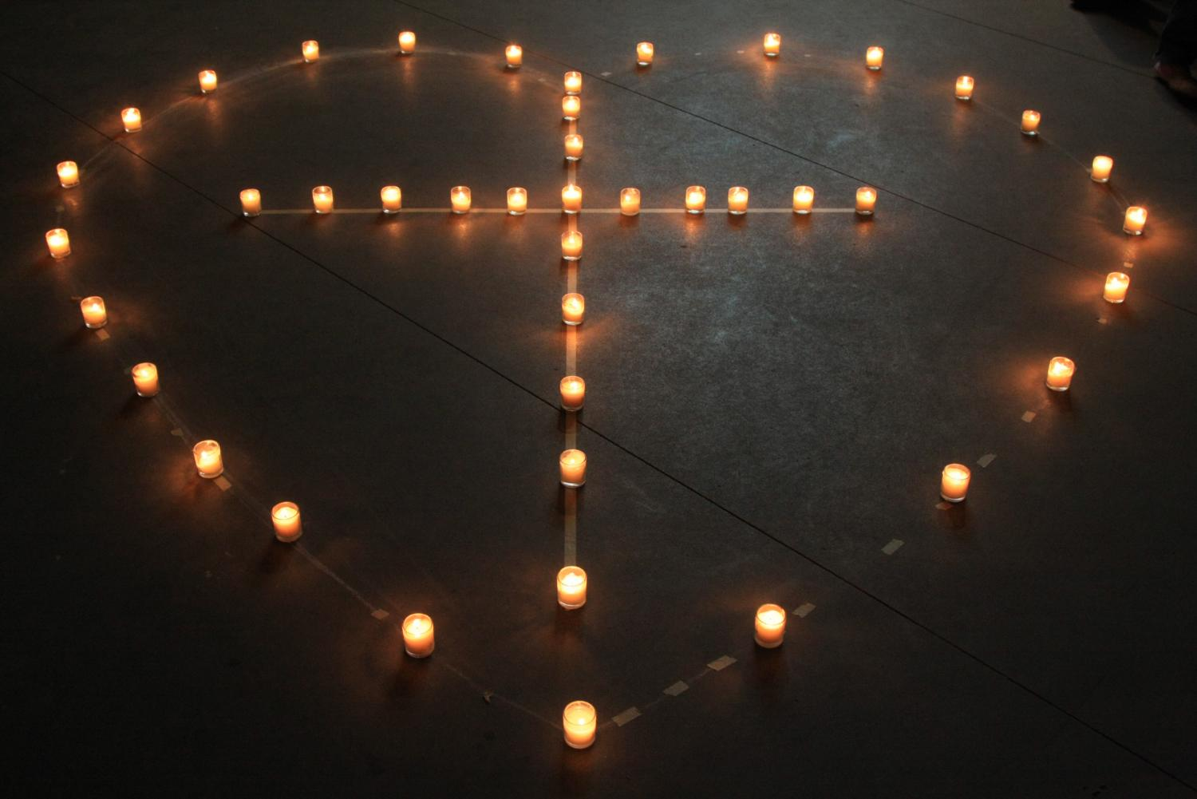
God is love © Art in the Christian Tradition
Notes:
At the cross

Slide 15
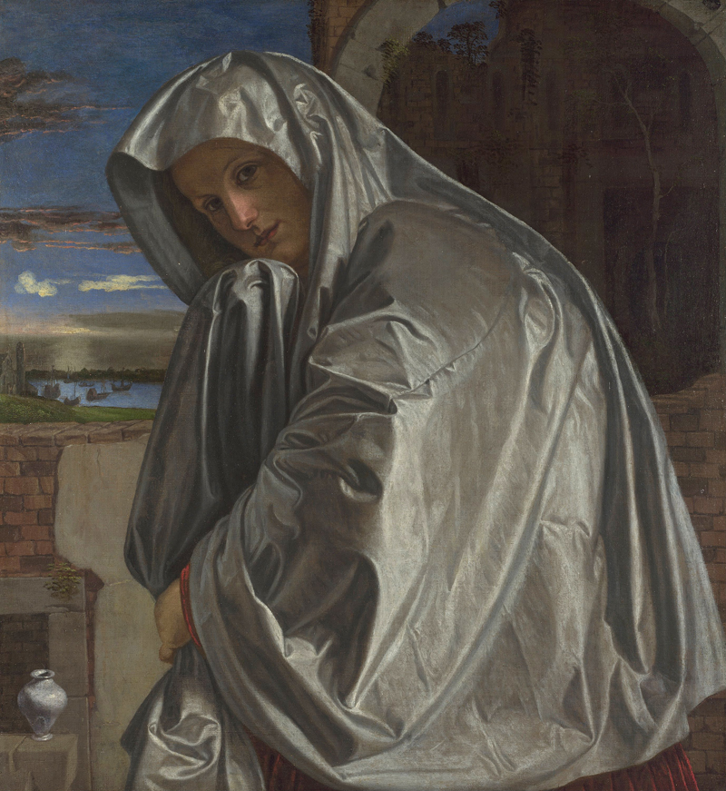
Mary Magdalene, National Gallery © Art in the Christian Tradition
Notes:
Silent Saturday

Slide 16
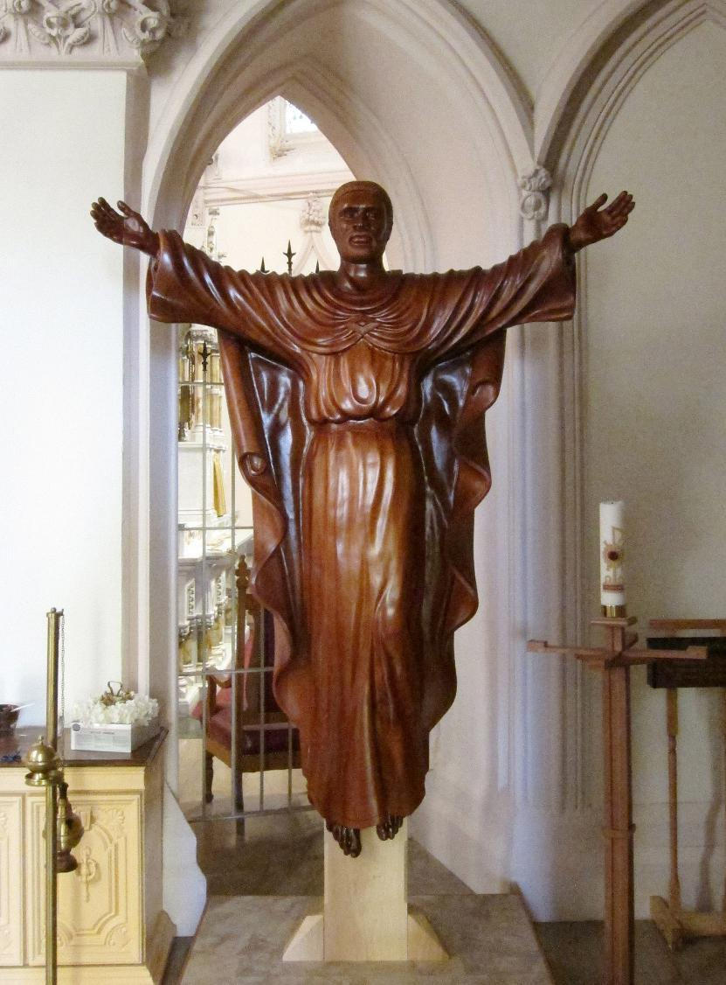
Ugandan Risen Jesus © Art in the Christian Tradition
Notes:
Resurrection Day (Easter Day)

Slide 17
Evaluating our ‘living sculptures’
Notes:
How have our ‘sculptures’ helped us to understand the deeper meaning of the Easter story?
Has being able to focus on one element of the story in such detail helped to understand that event in a new way?
Deeper evaluation questions: choose from these, depending on the age/stage/ability of your pupils
Which of your ‘sculptures’ were the hardest to create – and why?
Is this answer the same for all groups? Why? Did you all choose the same locations? Why might there be differences?
Some Passion Plays end with the crucifixion, especially if they are performed around Good Friday, to help audiences engage with these events. Does it matter that audiences don’t get the whole story?
Has retelling this story reduced its impact for us after all?

