Slide 1


Explo RE Easter: Journeys
LKS2: Easter Landscapes

Slide 2
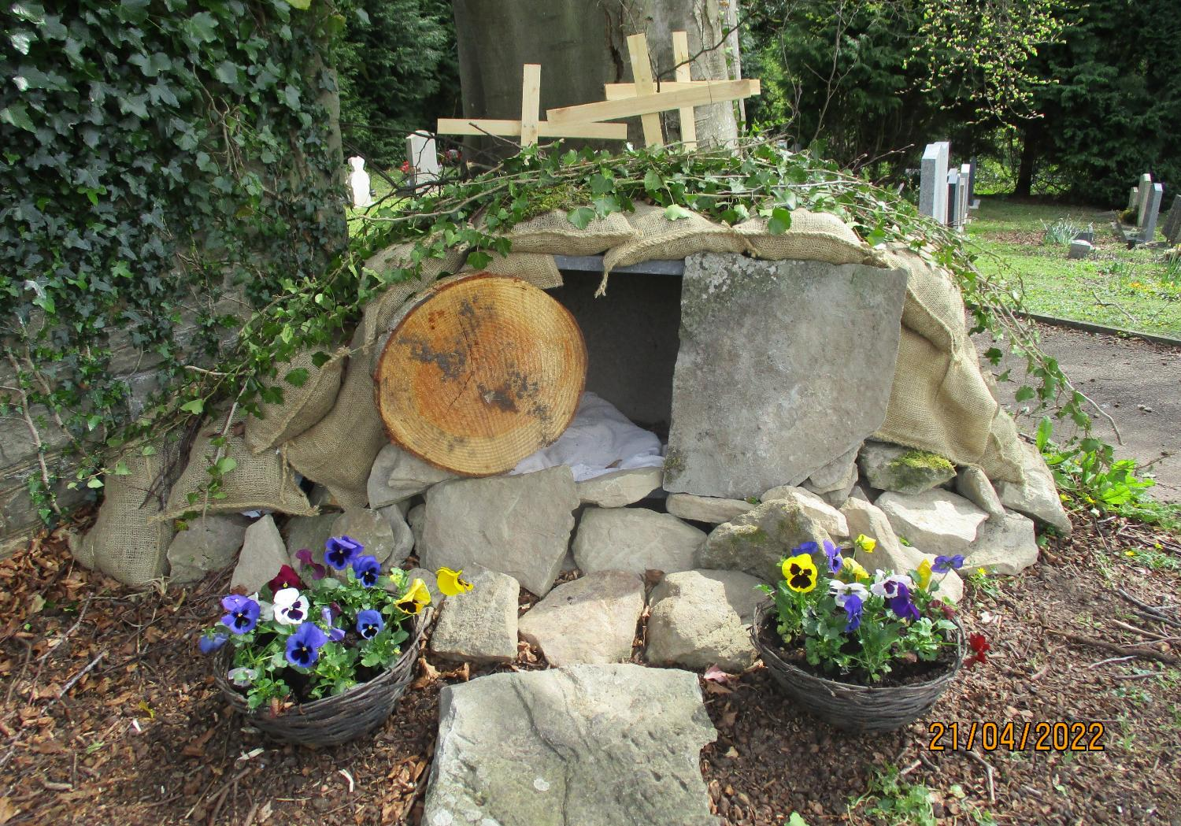
With grateful thanks to Anne Hayward for sharing these photos with us https://pilgrimstreet.uk/being-a-church-visitor/easter-gardens/
Notes:
Easter Gardens
We have included more than you need – because they were all so lovely! There are some very inspired ideas for taking advantage of different nooks and crannies in church buildings, which might inspire your children…..

Slide 3
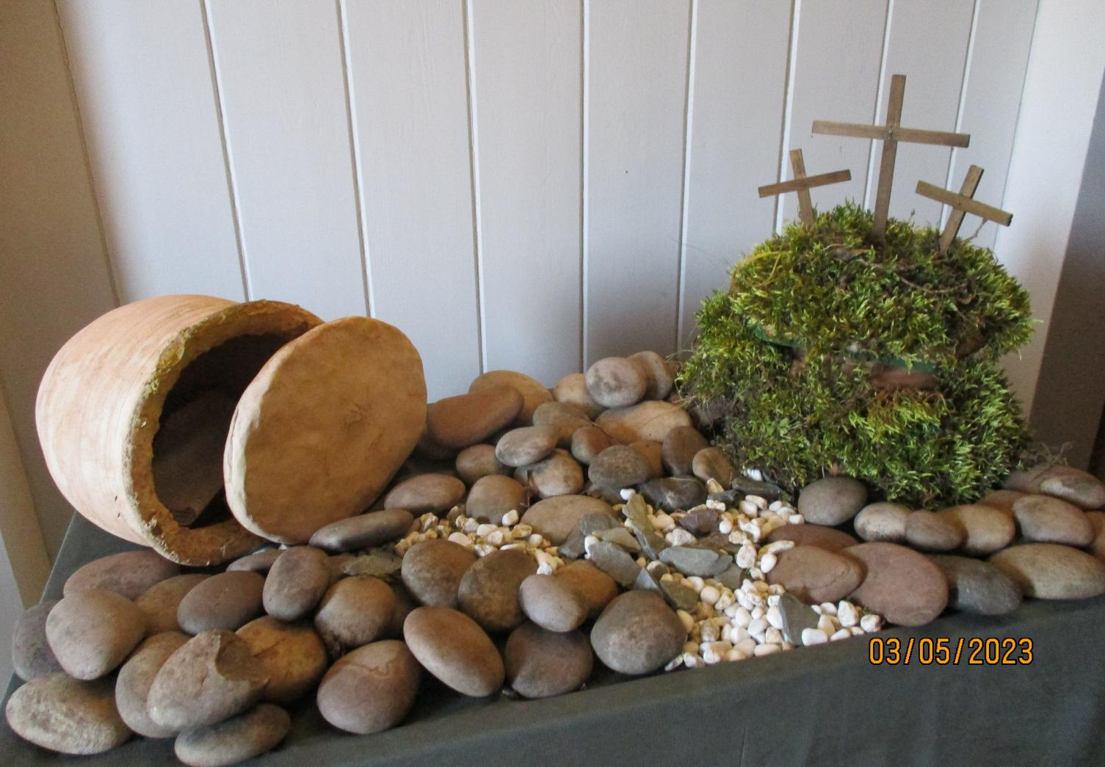
With grateful thanks to Anne Hayward for sharing these photos with us https://pilgrimstreet.uk/being-a-church-visitor/easter-gardens/
Notes:
Easter Gardens
We have included more than you need – because they were all so lovely! There are some very inspired ideas for taking advantage of different nooks and crannies in church buildings, which might inspire your children…..

Slide 4
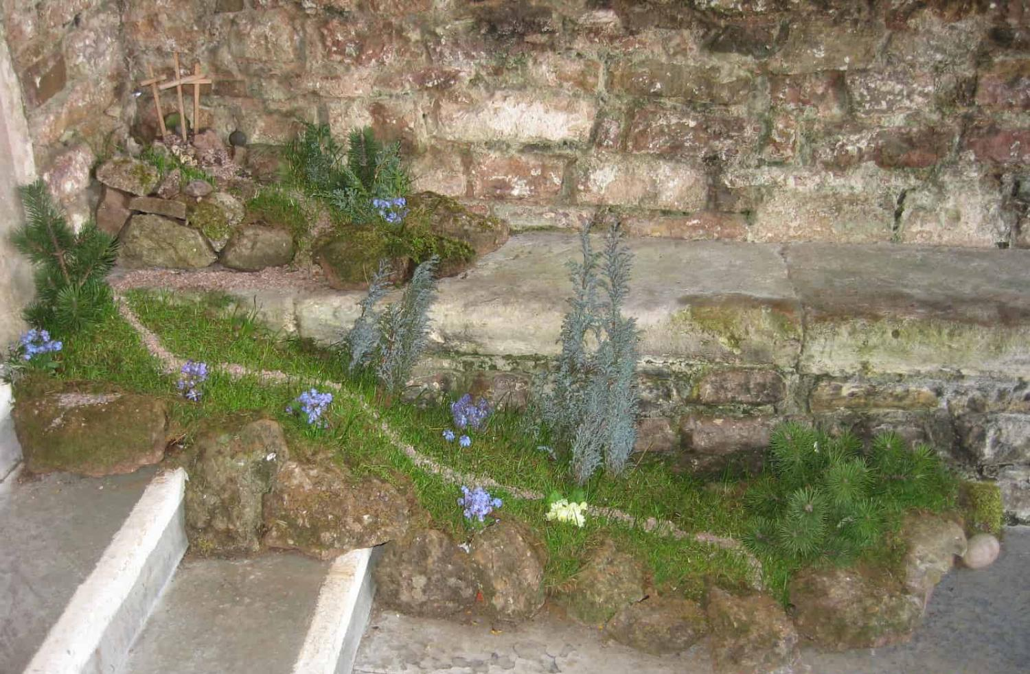
With grateful thanks to Anne Hayward for sharing these photos with us https://pilgrimstreet.uk/being-a-church-visitor/easter-gardens/
Notes:
Easter Gardens
We have included more than you need – because they were all so lovely! There are some very inspired ideas for taking advantage of different nooks and crannies in church buildings, which might inspire your children…..

Slide 5
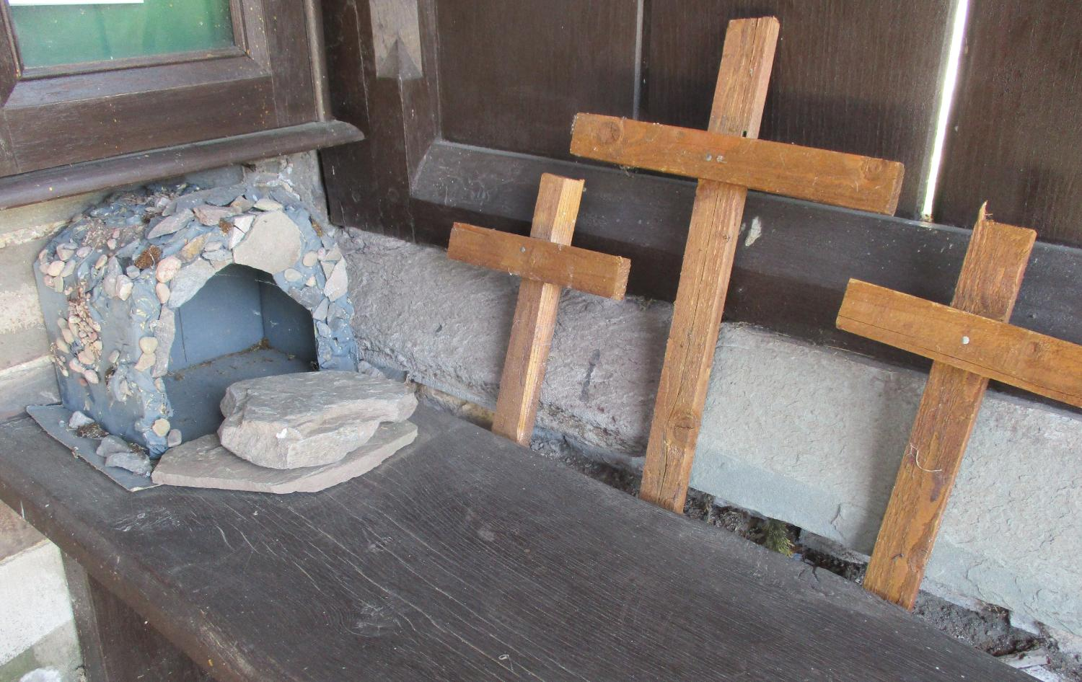
With grateful thanks to Anne Hayward for sharing these photos with us https://pilgrimstreet.uk/being-a-church-visitor/easter-gardens/

Slide 6
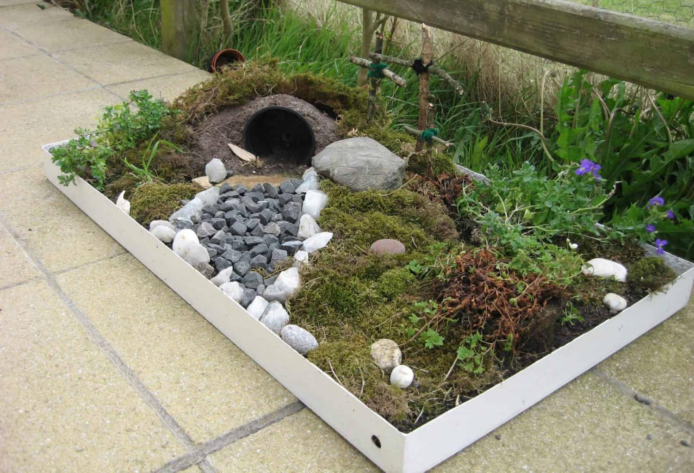
With grateful thanks to Anne Hayward for sharing these photos with us https://pilgrimstreet.uk/being-a-church-visitor/easter-gardens/
Notes:
Easter Gardens
We have included more than you need – because they were all so lovely! There are some very inspired ideas for taking advantage of different nooks and crannies in church buildings, which might inspire your children…..

Slide 7
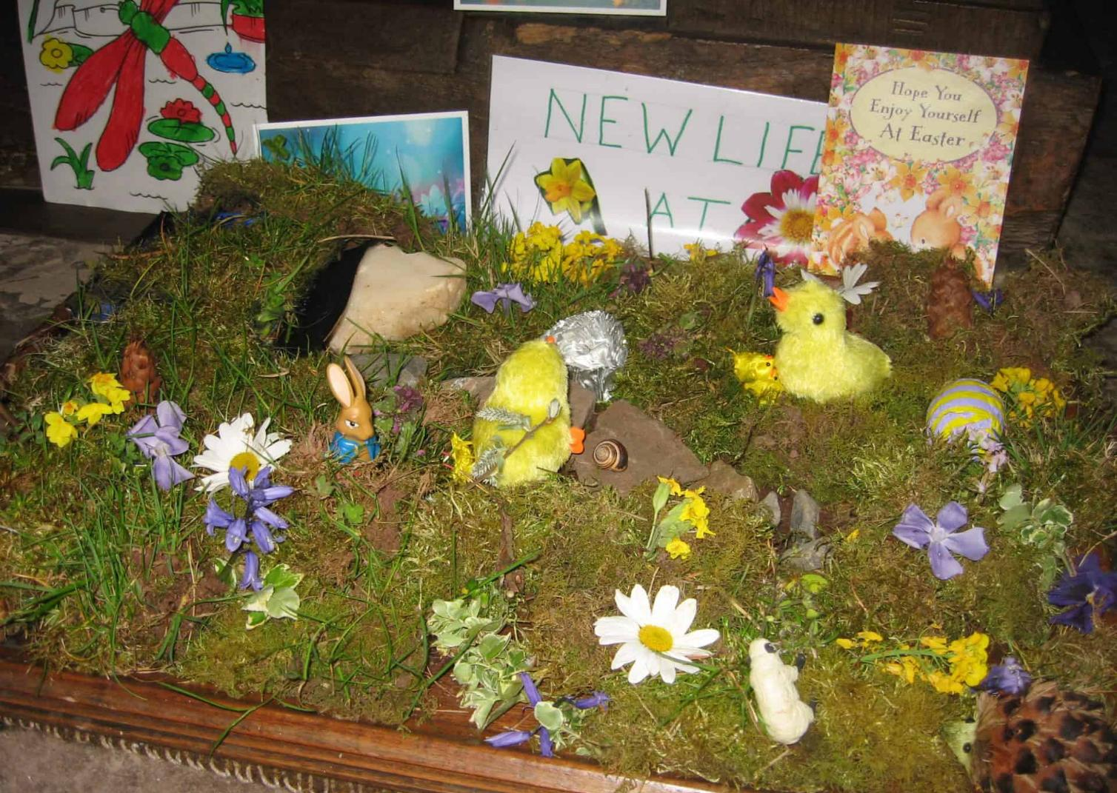
With grateful thanks to Anne Hayward for sharing these photos with us https://pilgrimstreet.uk/being-a-church-visitor/easter-gardens/
Notes:
Easter Gardens
We have included more than you need – because they were all so lovely! There are some very inspired ideas for taking advantage of different nooks and crannies in church buildings, which might inspire your children…..

Slide 8
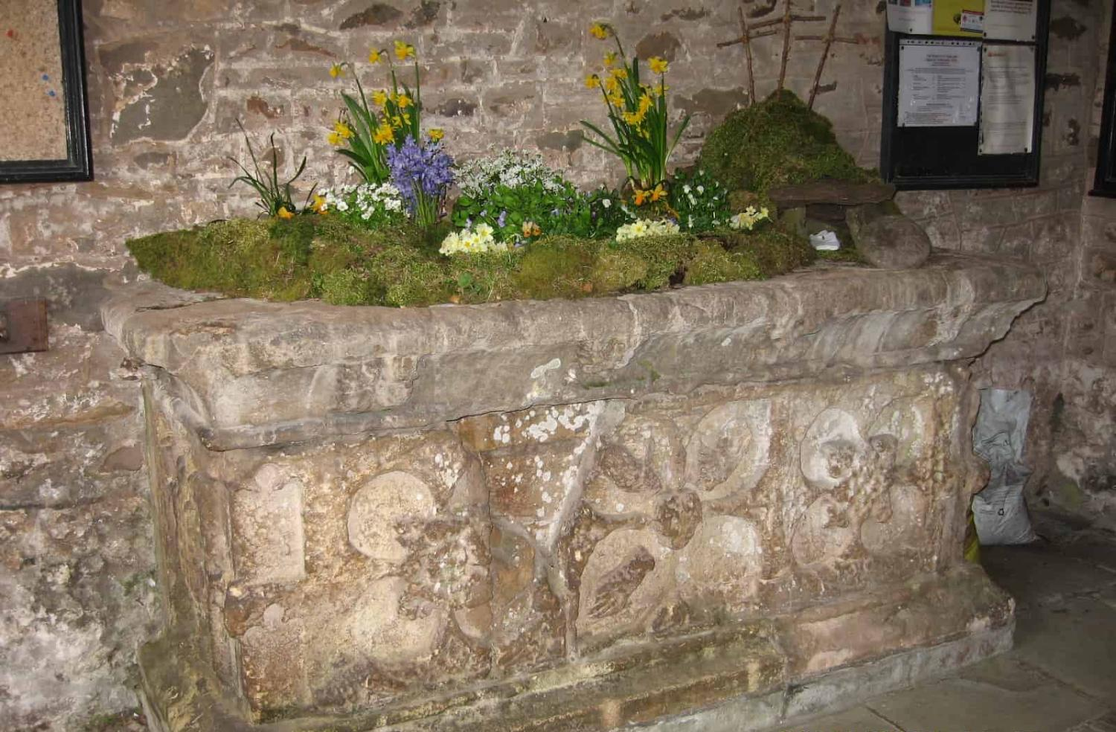
With grateful thanks to Anne Hayward for sharing these photos with us https://pilgrimstreet.uk/being-a-church-visitor/easter-gardens/
Notes:
Easter Gardens
We have included more than you need – because they were all so lovely! There are some very inspired ideas for taking advantage of different nooks and crannies in church buildings, which might inspire your children…..

Slide 9
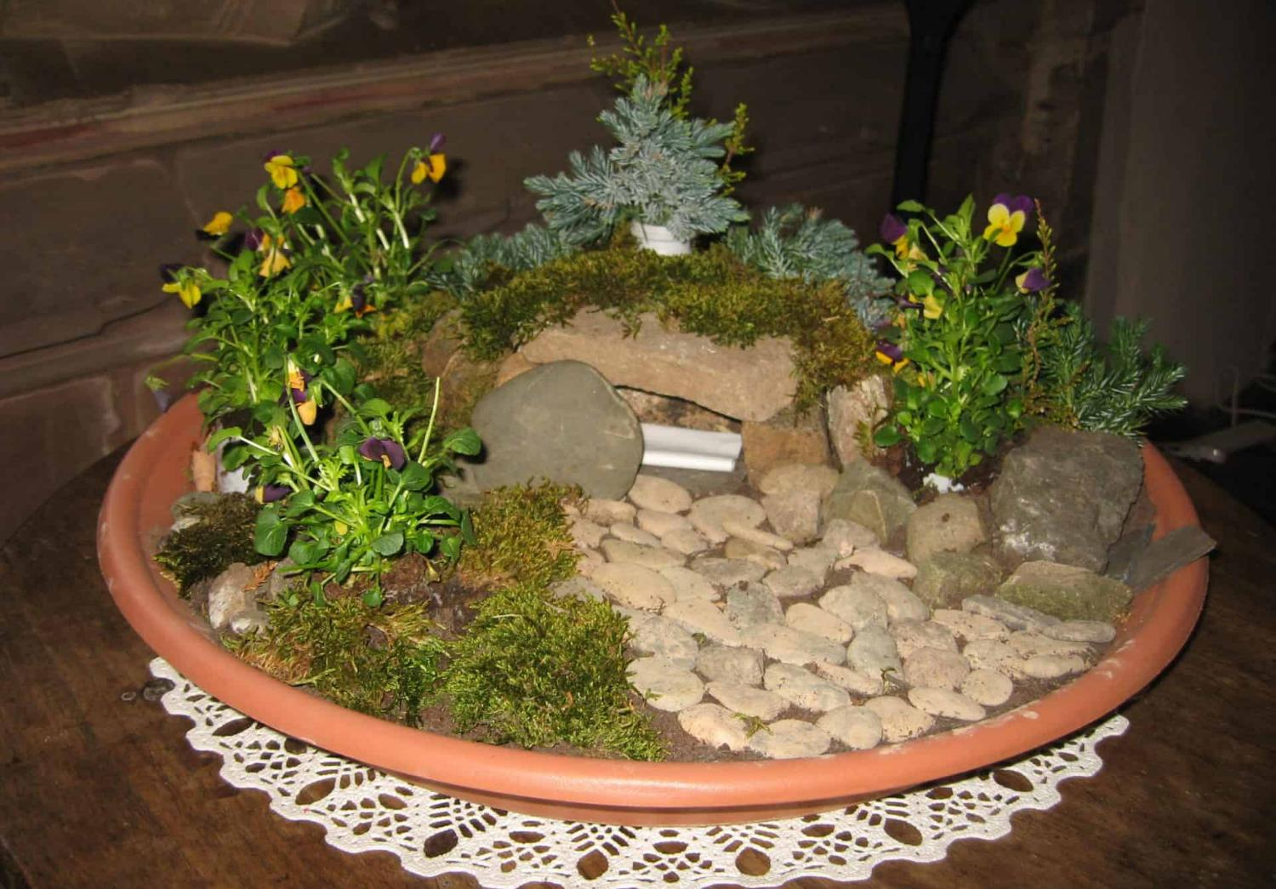
With grateful thanks to Anne Hayward for sharing these photos with us https://pilgrimstreet.uk/being-a-church-visitor/easter-gardens/
Notes:
Easter Gardens
We have included more than you need – because they were all so lovely! There are some very inspired ideas for taking advantage of different nooks and crannies in church buildings, which might inspire your children…..

Slide 10
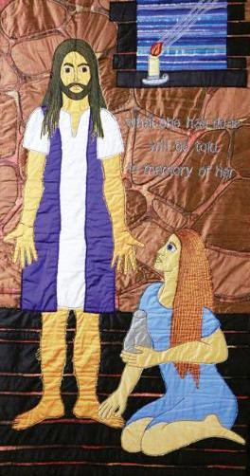
Mary washes Jesus’ feet © Jacqui Parkinson

Slide 11
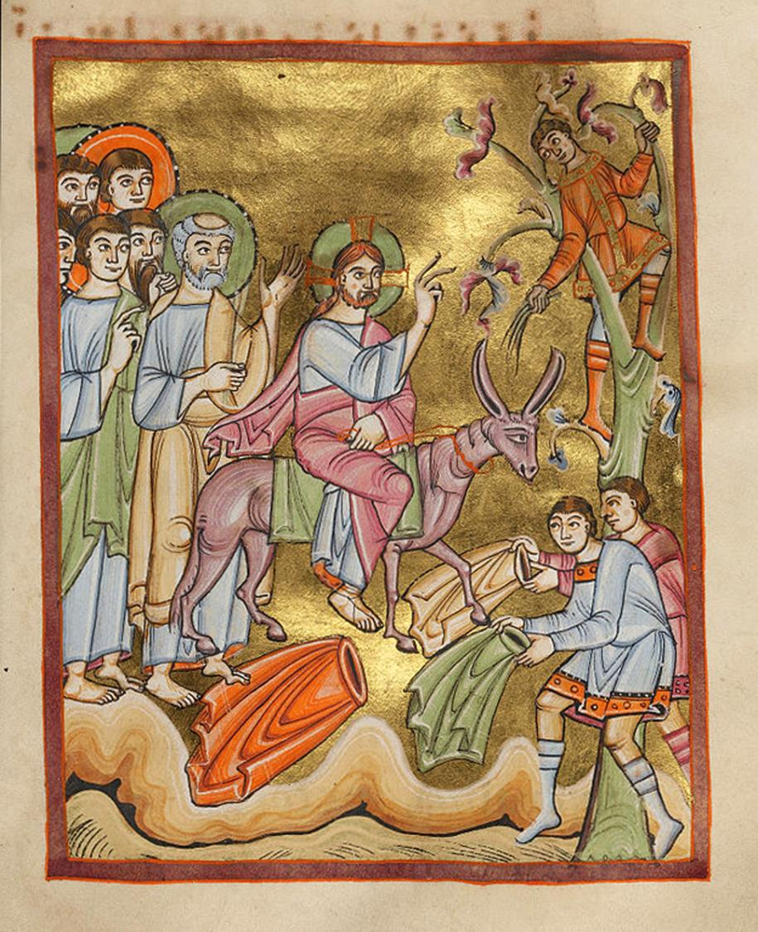
Entry into Jerusalem © Art in the Christian tradition, 11th C CE
Notes:
Palm Sunday

Slide 12
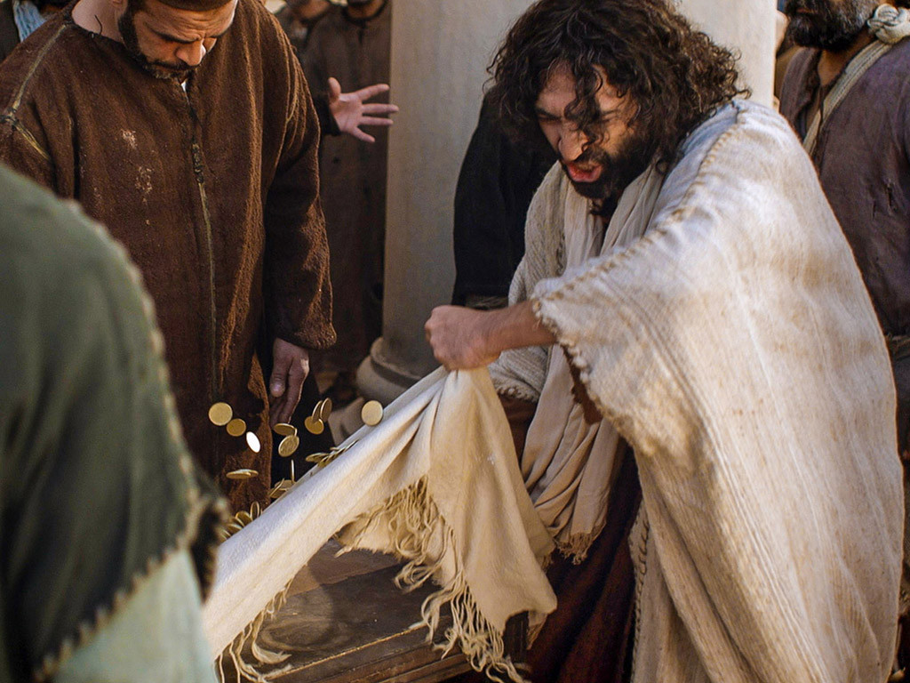

Notes:
Turning over the tables – cleansing the Temple

Slide 13
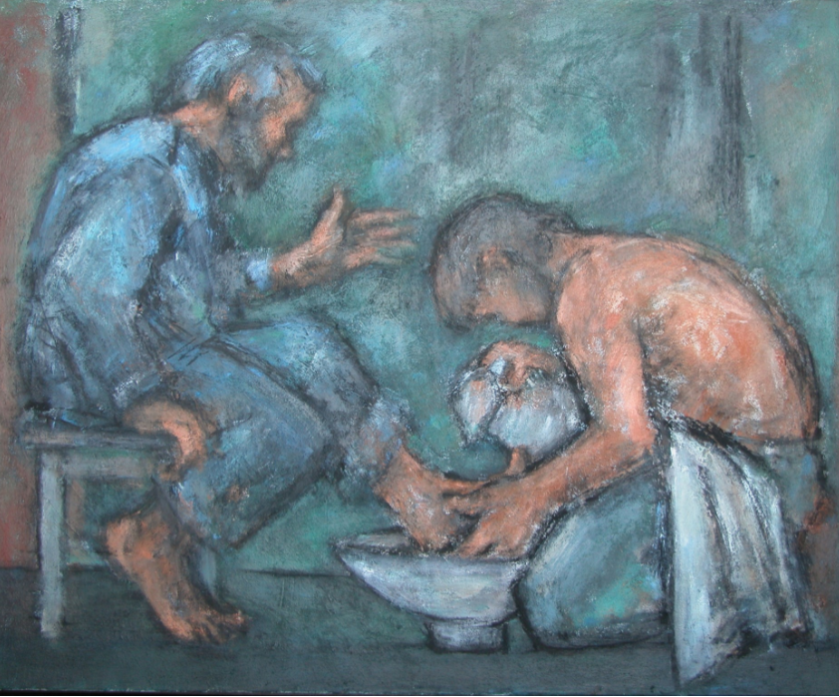
Ghislaine Howard © Methodist Modern Art Collection
Notes:
Foot-washing

Slide 14
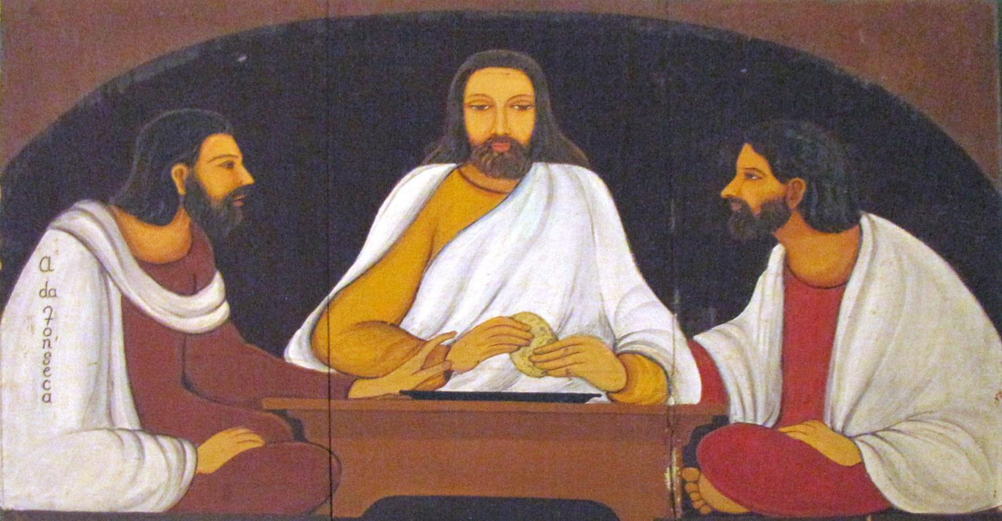
Christa Prema Seva Ashram © Art in the Christian Tradition
Notes:
Last Supper (Passover)

Slide 15
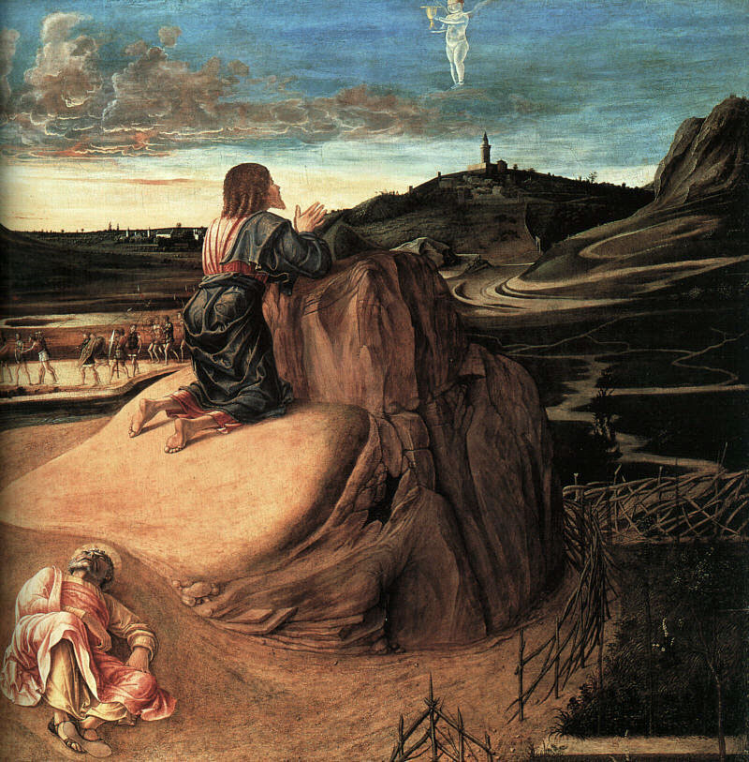
Agony in the Garden, Giovanni Bellini, c. 1565 © National Gallery
Notes:
Garden of Gethsemane

Slide 16
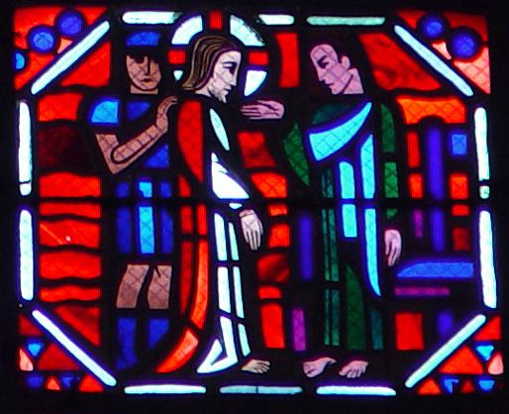
Stained glass, Amiens 1508-19CE © Art in the Christian Tradition
Notes:
The trial before Pilate

Slide 17
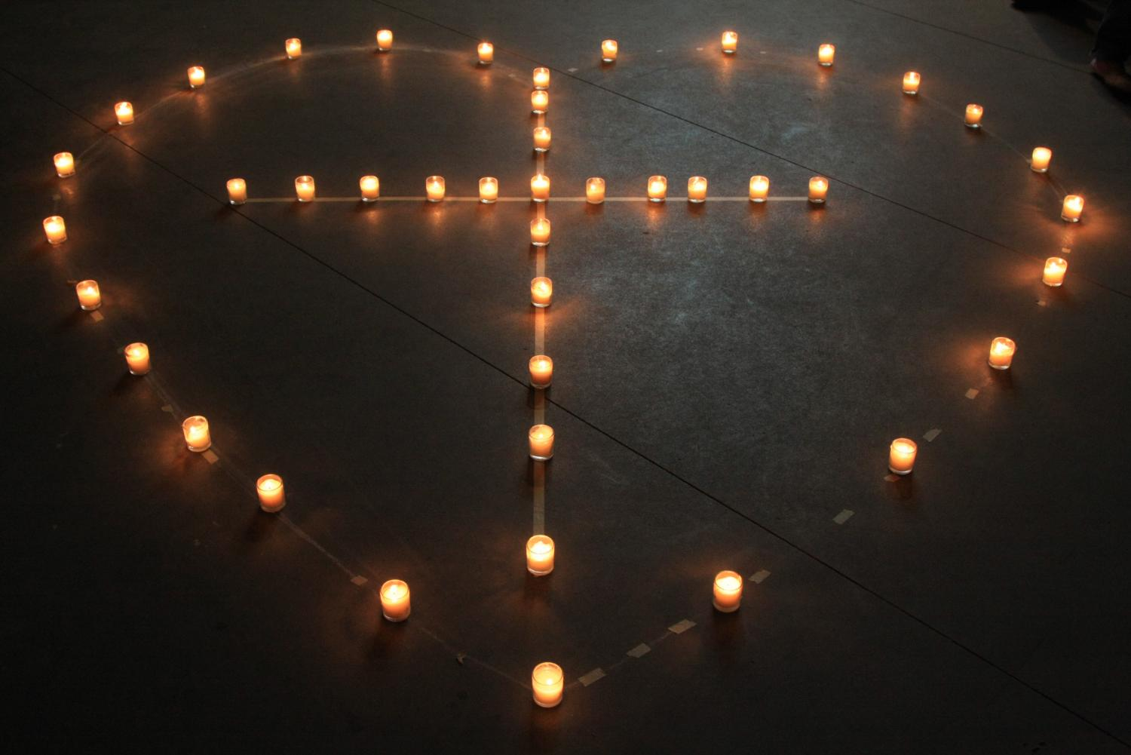
God is love © Art in the Christian Tradition
Notes:
At the cross

Slide 18
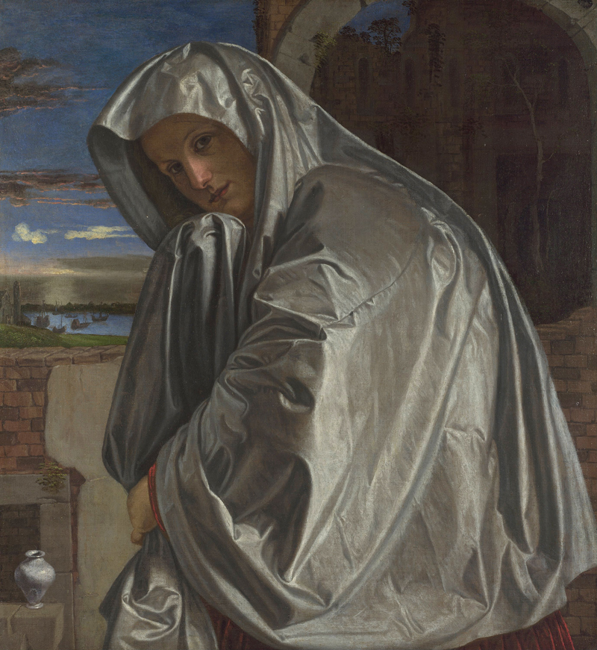
Mary Magdalene, National Gallery © Art in the Christian Tradition
Notes:
Silent Saturday
Although this is a painting of Peter’s denial, the image is very evocative of tears and grief.

Slide 19
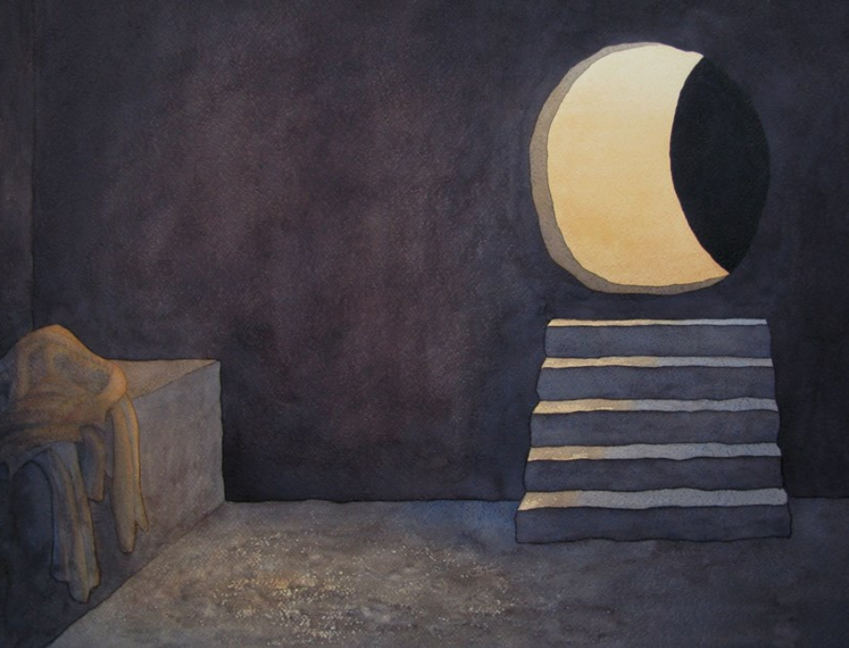
Richard Bavin © Methodist Modern Art Collection
Notes:
Resurrection Day (Easter Day)

Slide 20
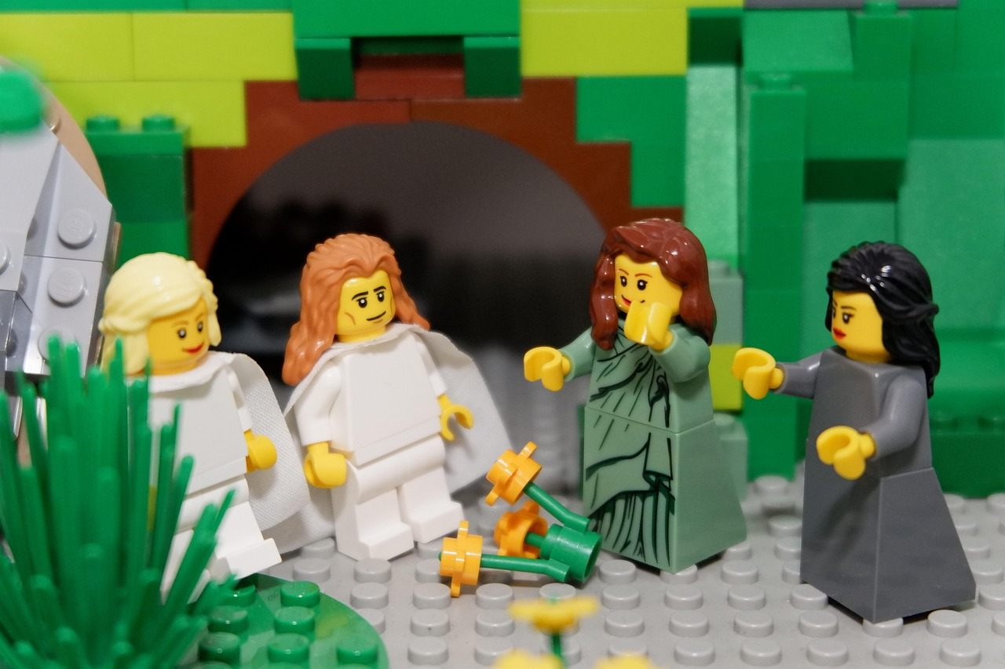
Telling the story together
Notes:
Telling the story together

Slide 21
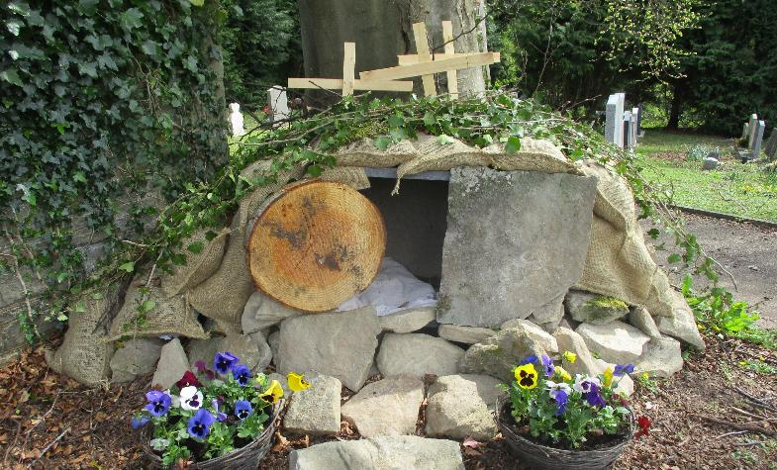
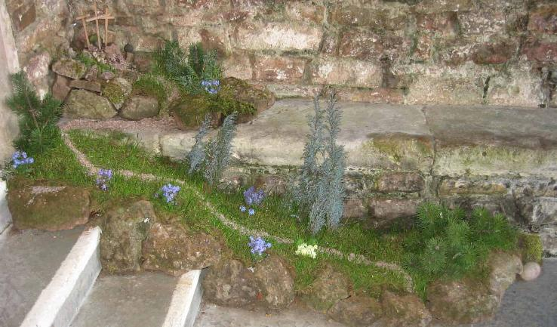
Evaluating our ‘Easter Landscapes’
Notes:
How has building our Easter Landscape helped us develop a deeper understanding of the Easter story?
Has focusing on the events in this new way helped us to understand the story in a new way?
If on location, asked after Easter: What has been the impact for our local church community?
Evaluation questions: choose from these, depending on the age/stage/ability of your pupils
Is this a more important story than other stories you know? Why (not)?
Could we tell the story if a section was missing?
Which events are absolutely essential to understanding the meaning of the Easter story?
Which part(s) of the story do you think is the most important? Do you think a Christian would answer the same? Why?

