Slide 1



Explo RE Easter: Journeys
KS1: Easter Pilgrims

Slide 2
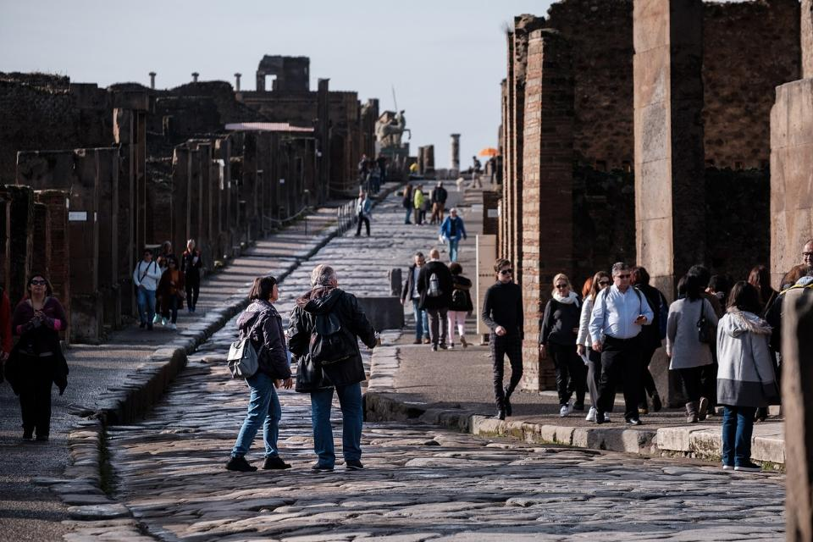
‘pilgrimage’
What journeys have we been on?
Picture copyright-free from pixabay
Notes:
Look at the picture together and talk about what you see.
Where are the people going, do you think?
What might make this place a special place to visit?
What journeys have we been on? In our families? As a class?
Talk to a partner about your ideas.
Are some journeys more ‘special’ than others? e.g. visiting family far away, compared to the journey to school. What makes a journey ‘special’?
Introduce the word ‘pilgrimage’: a special journey to a sacred place, or with special significance.

Slide 3
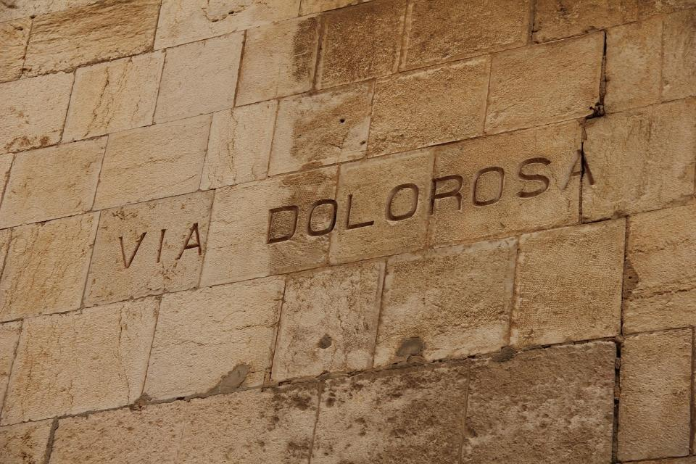
Picture copyright-free from pixabay
Notes:
Pilgrimage – Via Dolorosa
Some Christians might go on a pilgrimage to Jerusalem, especially at Easter time, to walk along the roads that Jesus would’ve walked on and think about the Easter story.
We are going to go on a very special pilgrimage together today (but not to Jerusalem!) – to explore the Easter story, to think about what it means to Christians and to gather some items to go in our ‘pilgrim bags’ – which will help us to tell the story to each other later on.

Slide 4
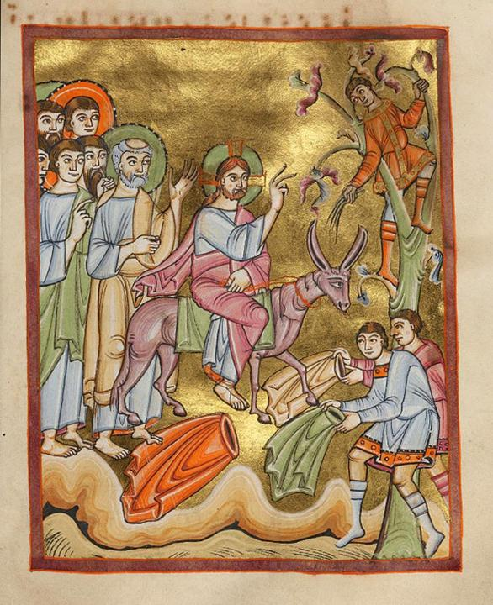
Entry into Jerusalem © Art in the Christian tradition, 11th C CE
Notes:
Palm Sunday

Slide 5
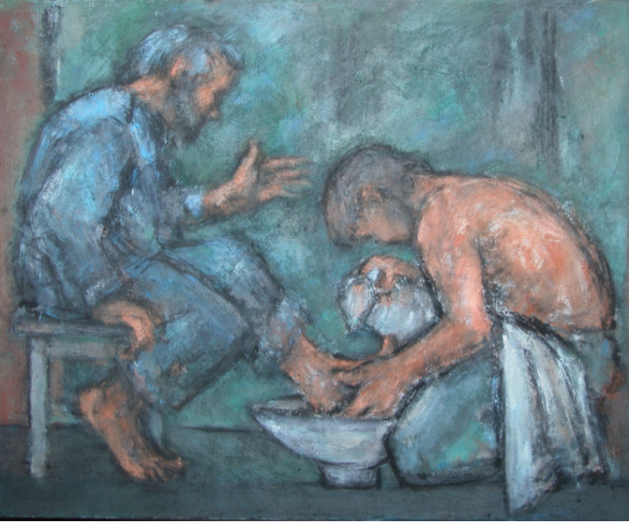
Ghislaine Howard © Methodist Modern Art Collection
Notes:
Foot-washing

Slide 6
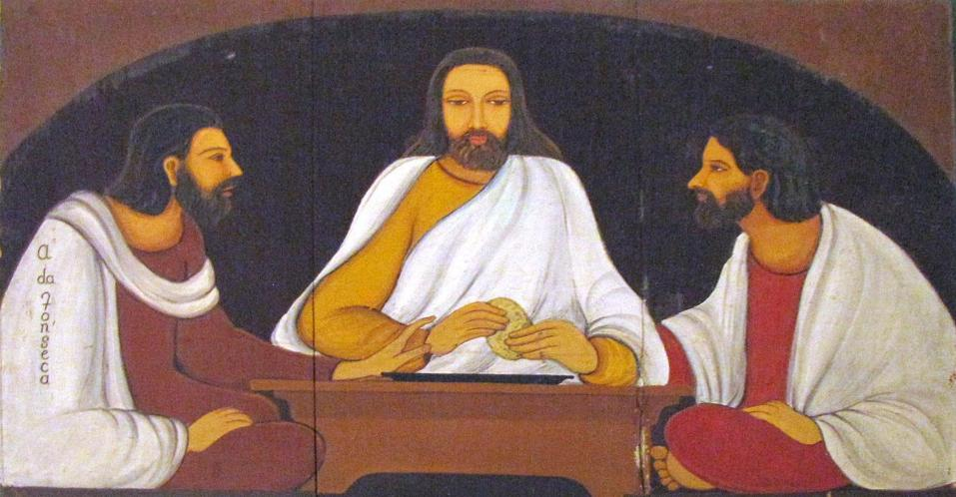
Christa Prema Seva Ashram © Art in the Christian Tradition
Notes:
Last Supper (Passover)

Slide 7
Notes:
Garden of Gethsemane

Slide 8
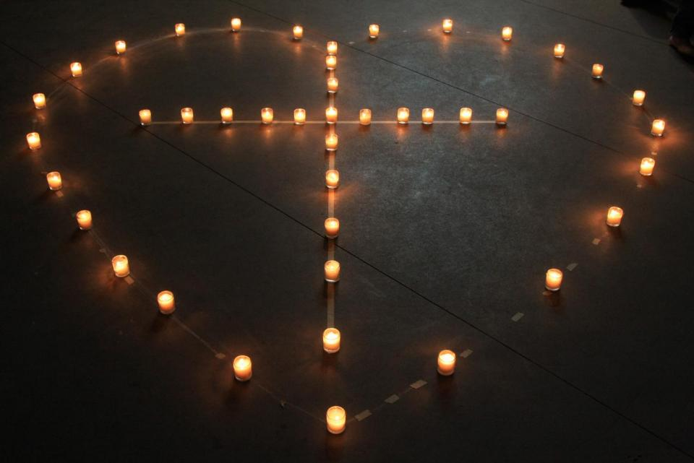
God is love © Art in the Christian Tradition
Notes:
At the cross

Slide 9
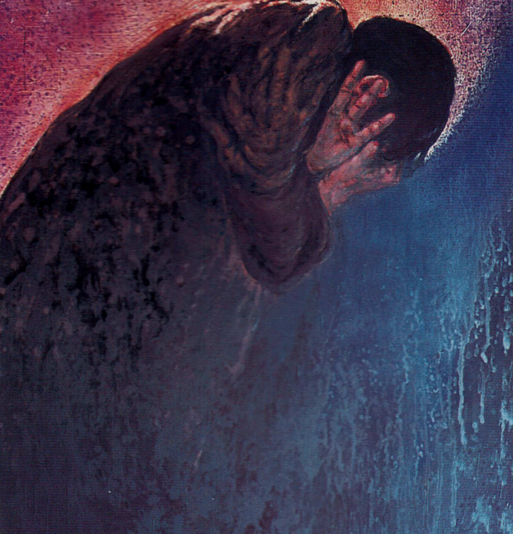
© Frank Wesley, Methodist Modern Art Collection
Notes:
Silent Saturday
Although this is a painting of Peter’s denial, the image is very evocative of tears and grief.

Slide 10
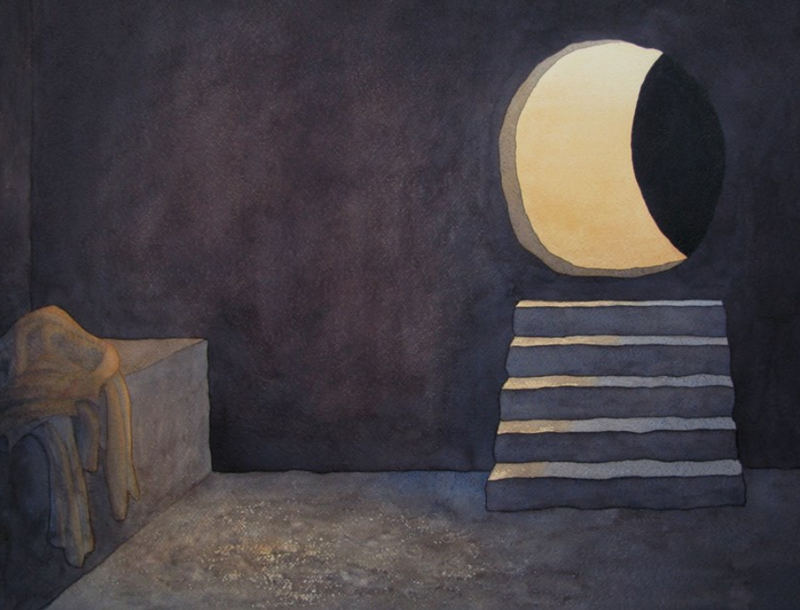
Richard Bavin © Methodist Modern Art Collection
Notes:
Resurrection Day (Easter Day)

Slide 11
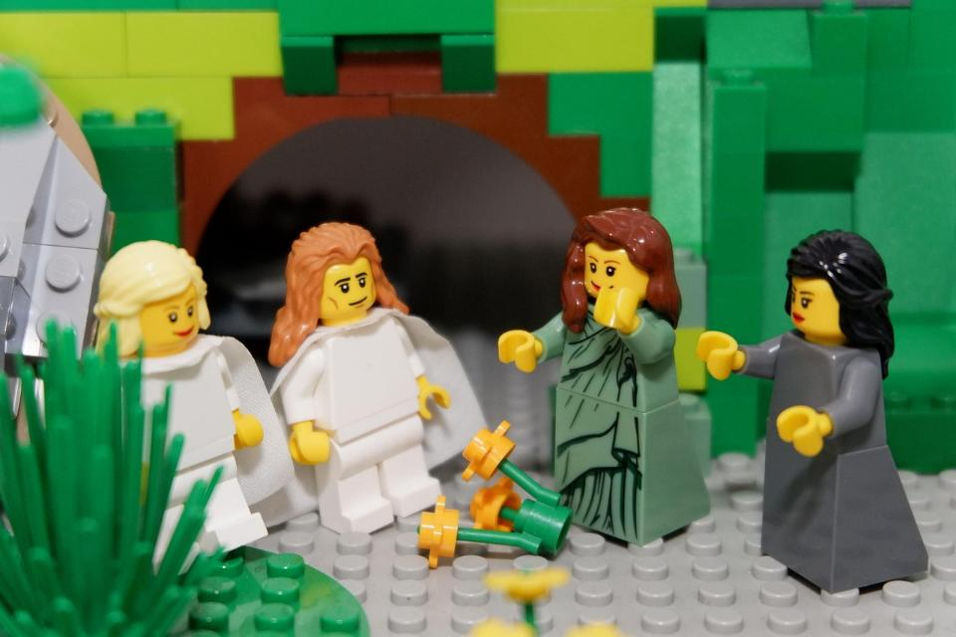
Telling the story together
Image from video © Lightbulb Head
Notes:
Telling the story together

Slide 12
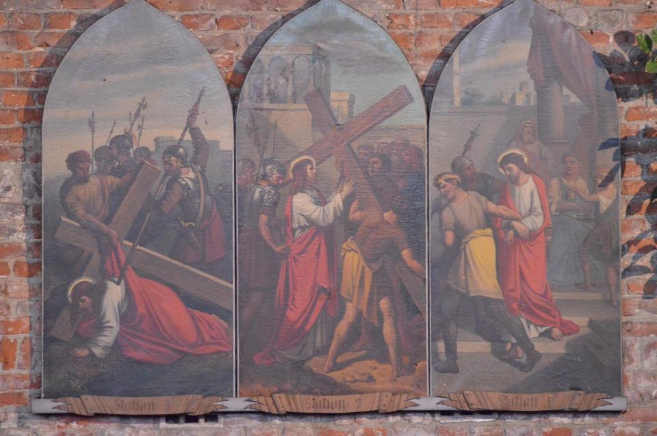
‘triptych’
Picture copyright-free from pixabay
Notes:
Triptych – lit. tri=three; tych=(writing) tablets

