Slide 1


Explo RE Easter: Journeys
EYFS: Easter emotions

Slide 2

How are they feeling?
Picture copyright-free from pixabay
Notes:
Engage: How are we feeling? (Emotion fun and games)
Read one of your favourite EYFS story books exploring emotions, then use the images in the PPT (slides 2-10 – or a selection of your choice) to explore what emotions they think are being shown. Explore different words for that emotion to expand their vocabulary range e.g. instead of happy, how about using the word ‘joyful’, ‘delighted’, ‘thankful’ etc.

Slide 3
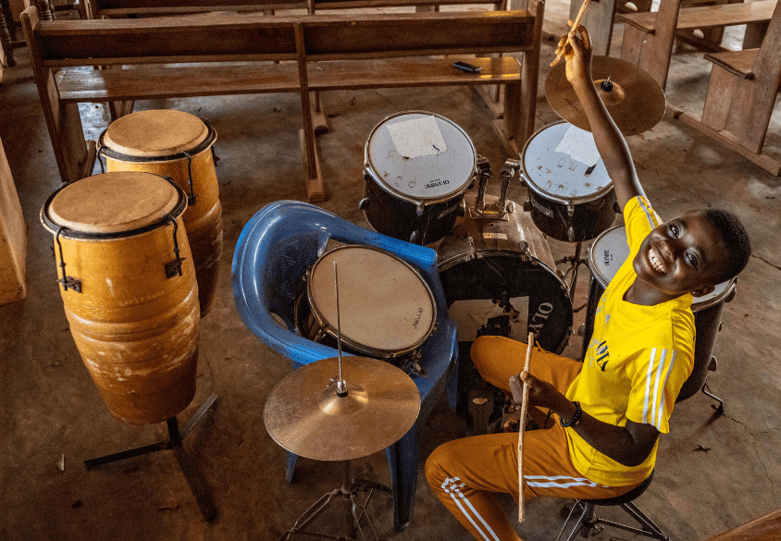
Picture © Compassion UK

Slide 4

Picture copyright-free from pixabay

Slide 5
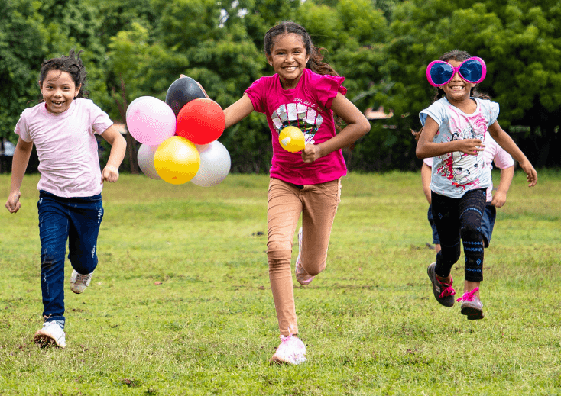
Picture © Compassion UK

Slide 6

Picture copyright-free from pixabay

Slide 7
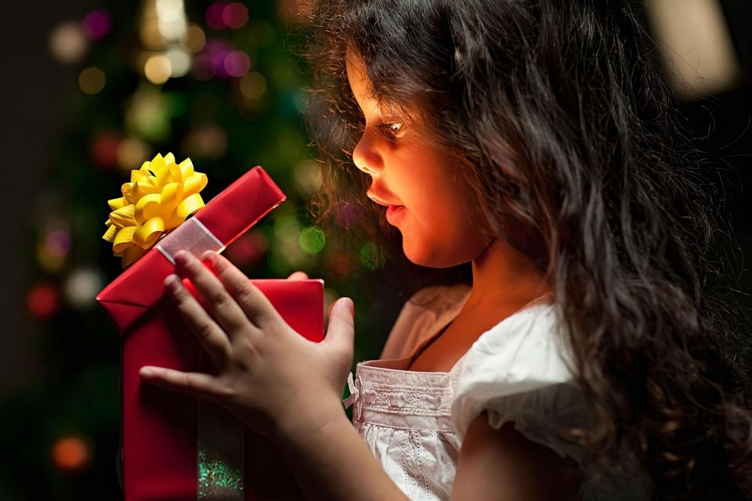
Picture copyright-free from pixabay

Slide 8
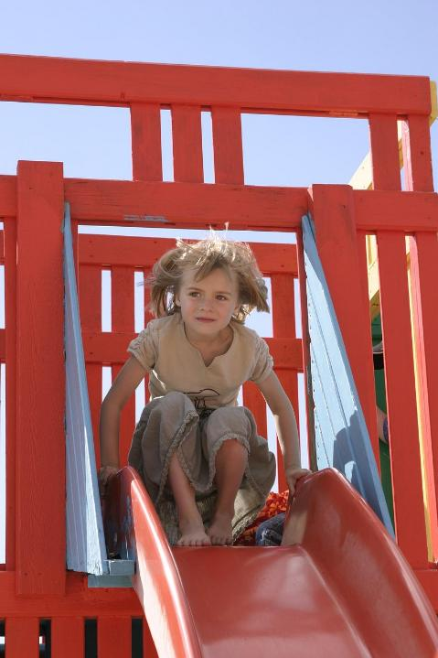
Picture copyright-free from pixabay

Slide 9
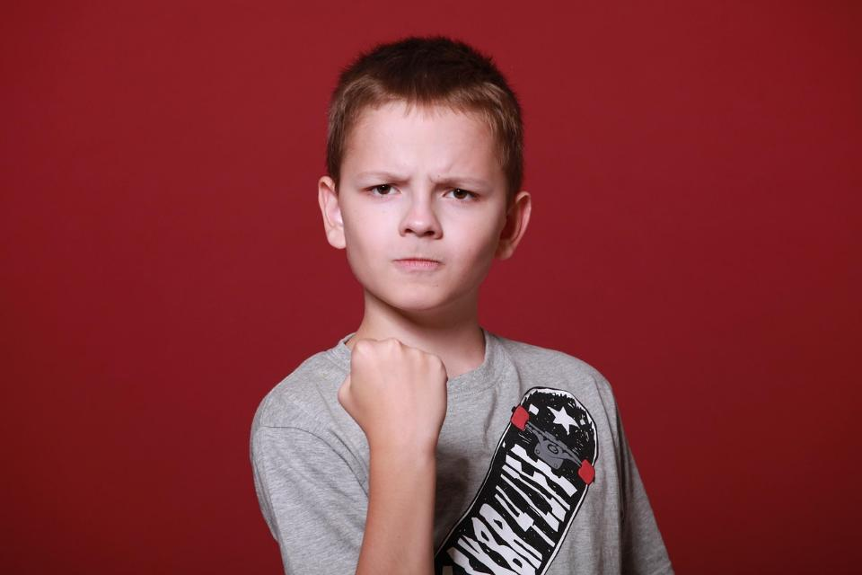
Picture copyright-free from pixabay

Slide 10
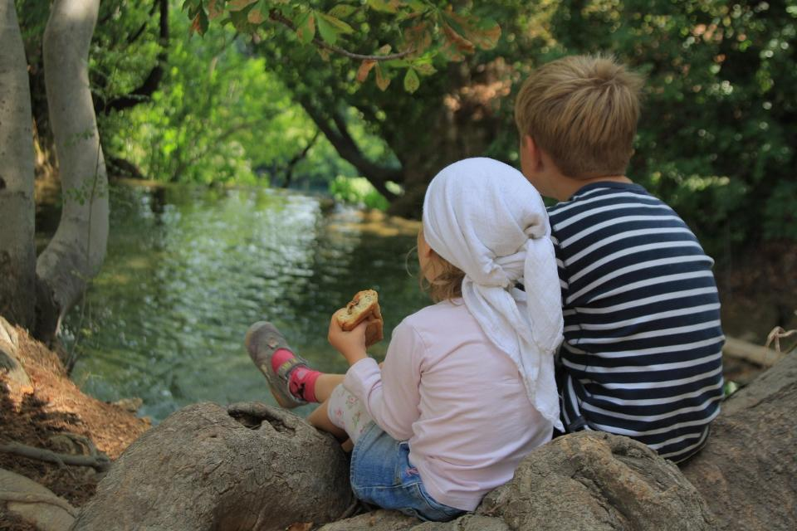
Picture copyright-free from pixabay

Slide 11
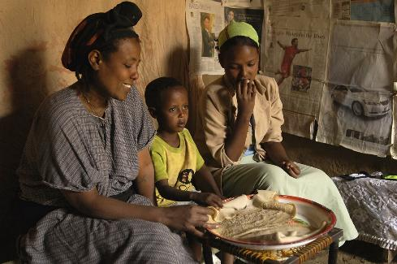
Easter Day: Joyful, happy times
Pictures © Compassion UK
Notes:
Slides 11-12 : Before you leave to go on your egg hunt
The Easter story is very important to Christians all across the world. Slide 11: They celebrate Easter joyfully in lots of different ways….
Joyful times together on Easter Day with food, fun and family (Ethiopia, Togo and Nicaragua)

Slide 12
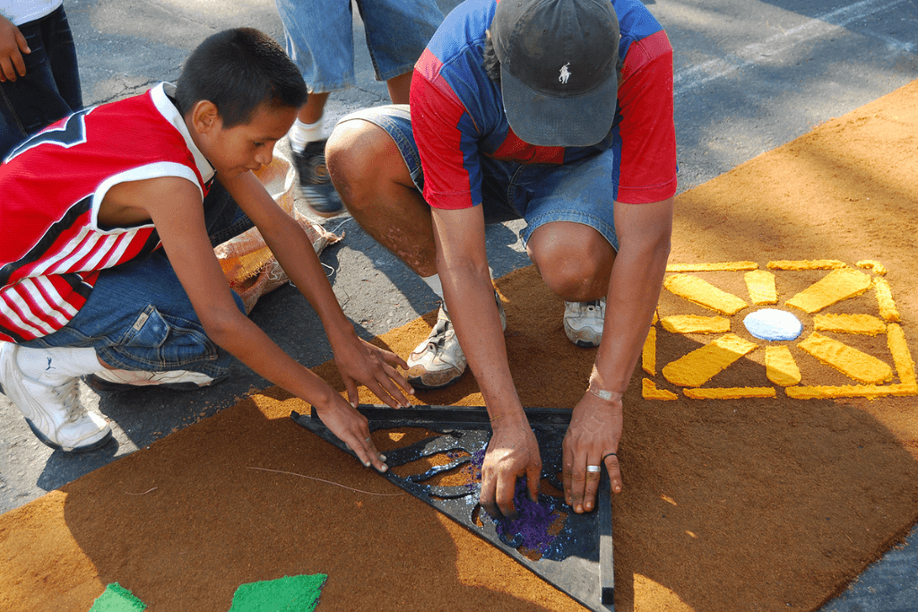
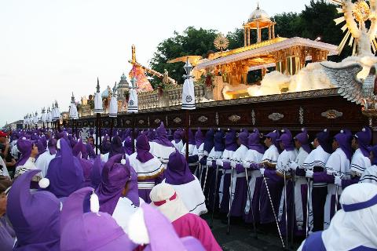
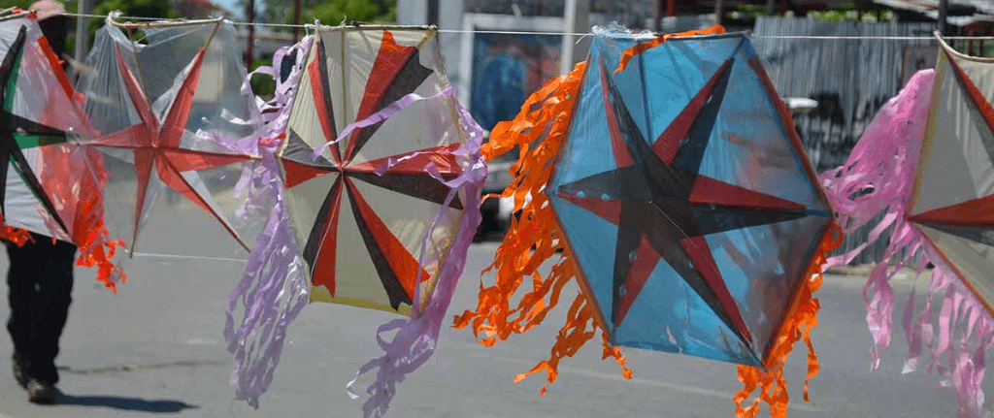
Good Friday: Sad, thoughtful times
Pictures © Compassion UK
Notes:
Slide 12: ….and they find ways to help them think about the sad parts too.
Thoughtful times on Good Friday to reflect on the sadder parts of Easter (El Salvador, Guatemala, Haiti)

Slide 13
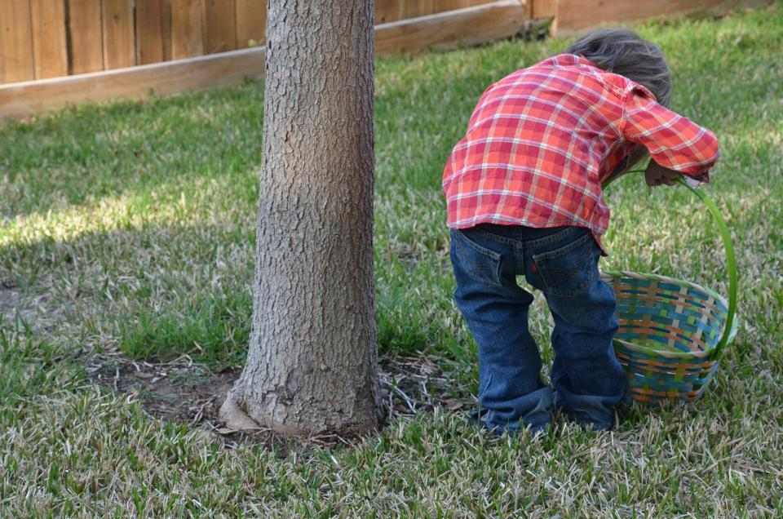
Easter Emotions Egg Hunt
Picture copyright-free from pixabay

Slide 14
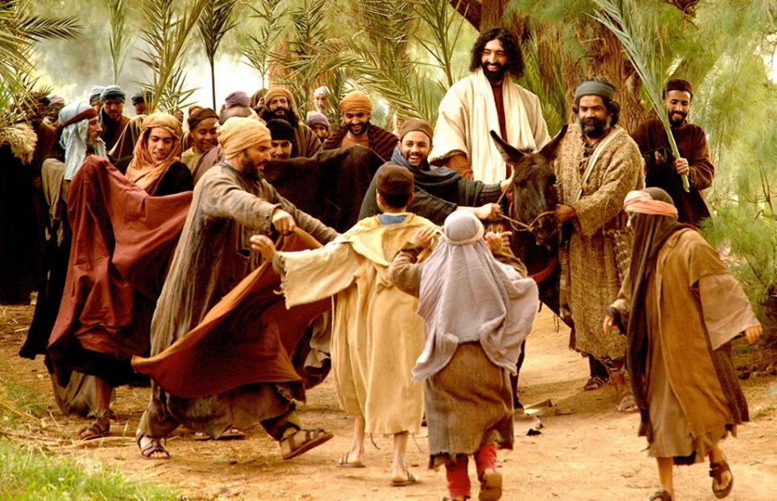
Picture copyright-free from Free Bible Images
Notes:
Palm Sunday

Slide 15
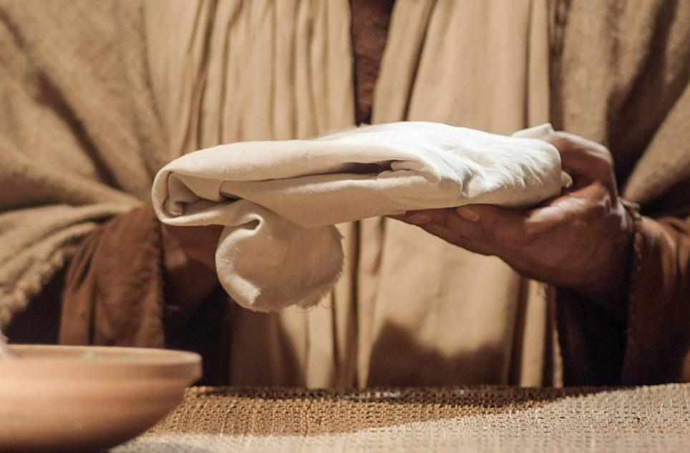
Picture copyright-free from Free Bible Images
Notes:
Jesus shares a meal

Slide 16
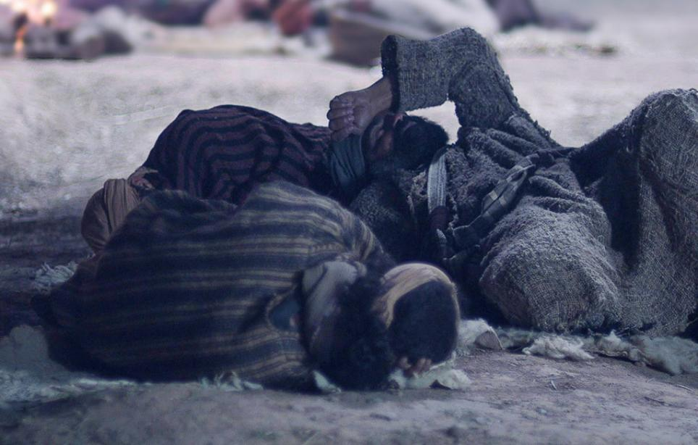
Picture copyright-free from Free Bible Images
Notes:
Jesus in the Garden

Slide 17

Picture copyright-free from pixabay
Notes:
At the cross

Slide 18
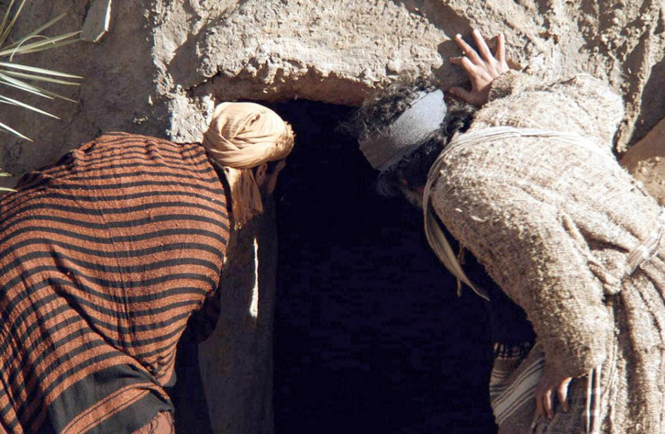
Picture copyright-free from Free Bible Images
Notes:
Empty tomb

Slide 19
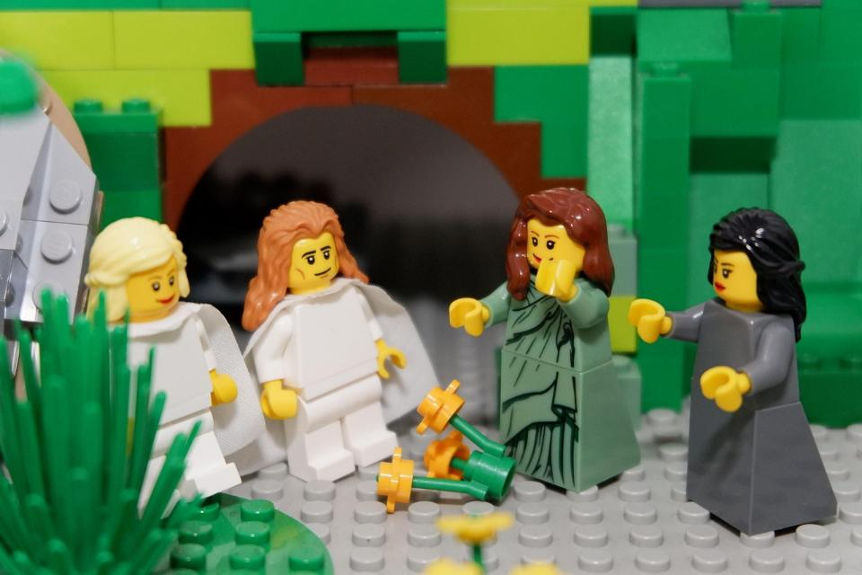
Telling the story together
Image from video © Lightbulb Head
Notes:
Telling the story together

Slide 20
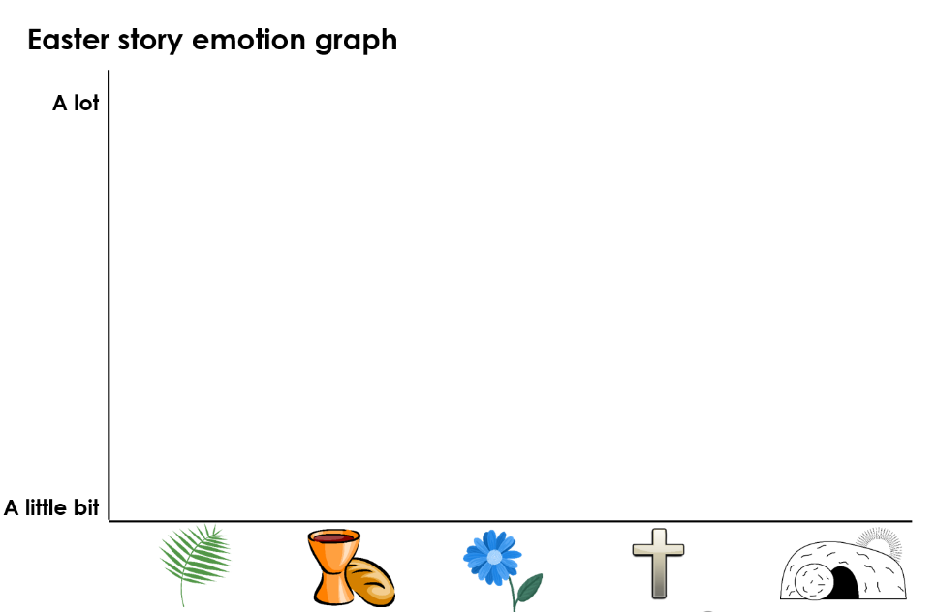

Notes:
Emotion graph example
You may need to model this first. Drawing simple emotion ‘faces’, record your thoughts about the emotions at different parts of the story. Explain that children can decide which emotion should go with which event – and that the graph can also help them show whether it’s a little bit (e.g. happy) or a lot. Can you use your graph to retell the story?

Slide 21
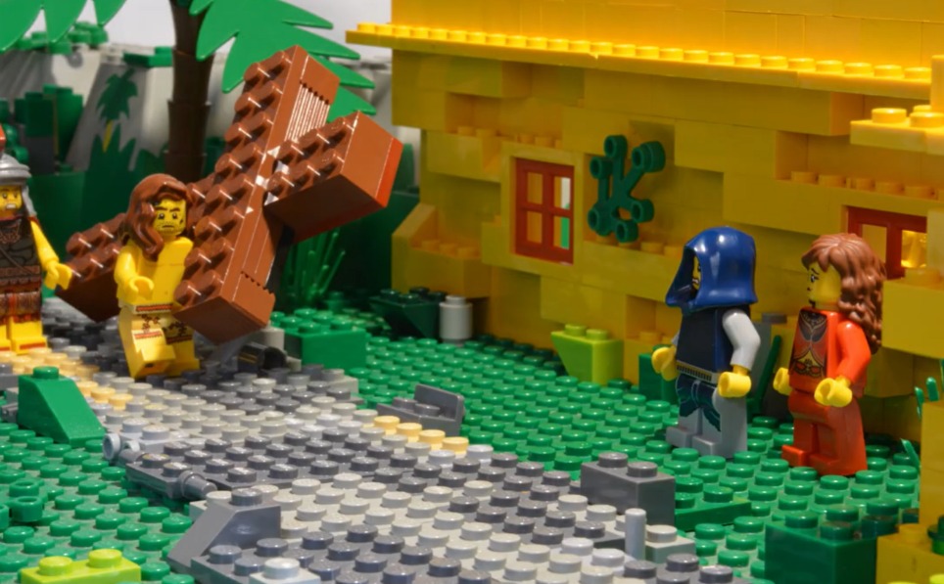
Telling the story together
Image from video © Lightbulb Head
Notes:
Telling the story together

