Slide 1


Today’s words can be found in Numbers 6:24-26 & Psalm 103:2
Count your blessings
Images from pixabay, unless otherwise identified
Notes:
‘Count Your Blessings’ – Autumn term 2026 These resources are ©The Diocese of Guildford
These form part of the collective worship resources created to support Secondary schools in the Diocese of Guildford. Research reveals the importance of gratitude even in the midst of adversity: that being aware of each day’s ‘blessings’ can counteract anxiety, and so this term, we want to encourage schools to highlight this especially in their collective worship. As always, each week’s materials link with Biblical content, whilst also ensuring that they are inclusive for pupils and adults of all faiths, or none. Over this short series ‘Count your blessings’, we will highlight things that we might consider to be ‘blessings’.
The materials in this PPT explore some ancient words from the Bible about blessing – spoken by David in the Psalms and Aaron in the book of Numbers. We also use words from a song that went viral during COVID, simply called ‘The Blessing’ – this is linked from an image on slide 4 – and we strongly encourage you to use the recording as part of this collective worship, even if you only use a small section.
Notes for the teacher: This resource is to be used for collective worship during tutor times or in other groupings that work for your setting. There may be enough material here to resource more than one tutor time.
Each resource contains some images and words to support the spiritual development of students, with a script for the leader written under the slides.
Any bold text indicates when a click will animate either text or an image for students to ponder, and italic text contains pointers for the leader.
Especially important is the slide denoted as ‘Going deeper: responding and words for worship’, which ensures that the resource meets the requirement for daily collective worship in your Church school. The words are invitational, and prayer is optional.
You may wish to light a candle at the beginning as a sign that you are entering this different space in the school day.
Today’s words come from Numbers 6:24-26 and Psalm 103:2 These verses reflect on David’s attitude to blessing and the importance of the Aaronic Blessing as the oldest blessing in the Torah (from c.1300BCE) These words are also found as part of the oldest surviving Biblical inscription, from c.600BCE, but are still used in contemporary worship in churches worldwide today.

Slide 2
What do we mean by ‘blessing’?
Notes:
Gathering: You might want to light a candle to signal the start of collective worship. Invite students to be quiet and still and think about the question.
What do we mean by ‘blessing’?
Use this as a discussion starter. You might want to ask these additional questions:
Is this a noun or a verb? Or both?
Is ‘blessing’ something that is religious? Or not?
Have you ever received a ‘blessing’? Or been a ‘blessing’ to someone?
What might you call your ‘blessings’?

Slide 3
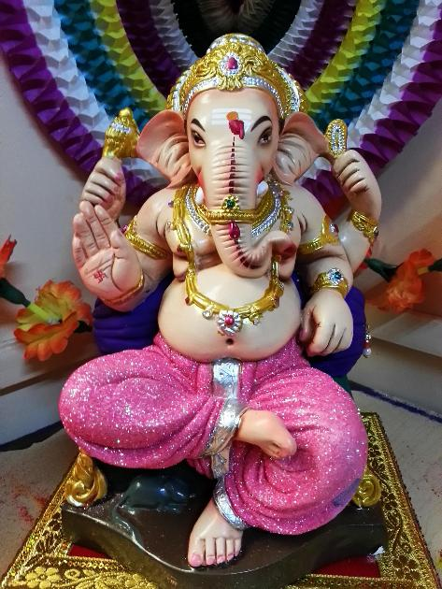
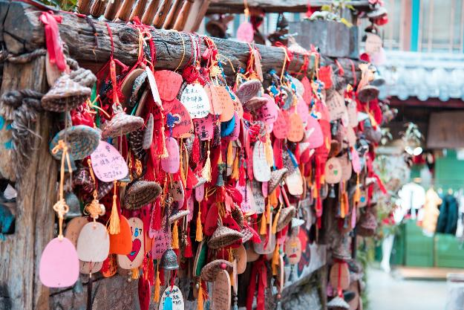
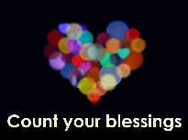
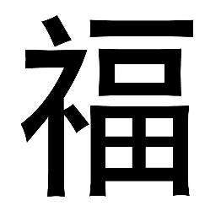
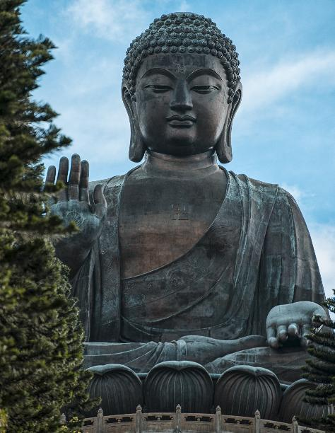
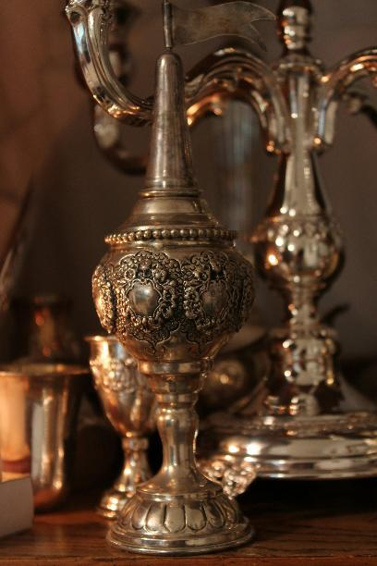
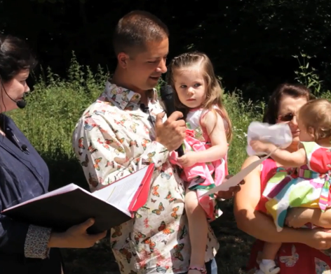
Image from Humanists UK
Notes:
Engaging: Blessing across religions and beliefs
‘Blessing’ is a universal idea that is shared across many different religions and beliefs, as you can see in the images here. [from L-R, top-bottom: Ganesh, giver of blessings (Hindu Dharma); Buddhist blessings; Chinese character for ‘blessing’; Humanist baby naming ceremony; Buddha with Varada (blessing) mudra (hand positions); Spice box blessing as part of Havdalah (Jewish Shabbat ceremony)]
A blessing can be a good thing that we have – or it can also be something that we do or give to others to wish them well. It’s a noun – and a verb!

Slide 4
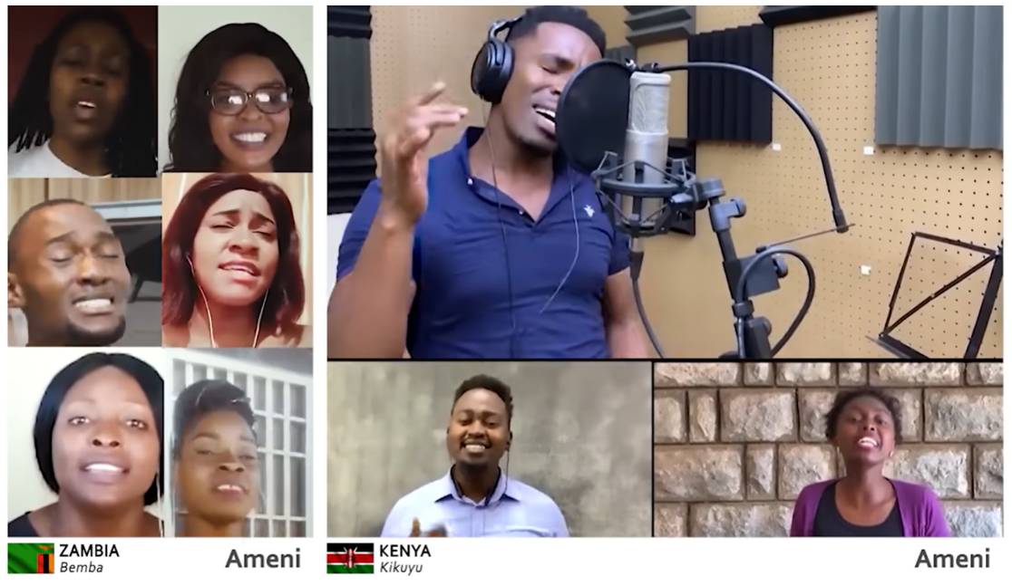
‘May the Lord bless you and
keep you. May the Lord show you
his kindness. May he have mercy on you. May the Lord watch over you
and give you peace.’Numbers 6:24-26
Notes:
Engaging: The Aaronic Blessing
‘May the Lord bless you and keep you. May the Lord show you his kindness. May he have mercy on you. May the Lord watch over you and give you peace.’ (ICB version)
These words are the oldest blessing in the Torah (the Jewish holy book), and the Bible (the holy book for Christians). They were spoken by Aaron the priest (and brother of Moses) over the people of Israel and have been a way for people to declare blessing over one another since ancient times.
These words are still used today – in fact very recently, they became part of a global spreading of blessing across the nations during March 2020, as the world experienced the first lockdown of COVID. Across the world, this song, simply called ‘The Blessing’, was recorded in hundreds of languages, by thousands of people and edited into this version showing some of the people and places that it reached…..
[Click on the image to link to the video & use as long or short an excerpt as you would like. There are also lots of different versions, including one released by 65+ churches in the UK: https://www.youtube.com/watch?v=PUtll3mNj5U, BSL signed https://www.youtube.com/watch?v=g9a8dRACF18 and by children: https://www.youtube.com/watch?v=uiWZXLsdE9w]
Talk together:
Why do you think these words became so important to people at such a time in the history of the world?
Which words really stand out for you?
Why do you think that kindness, mercy and peace might be important – then and now?
What words of ‘blessing’ might you want to speak over the nations at this moment in time?

Slide 5
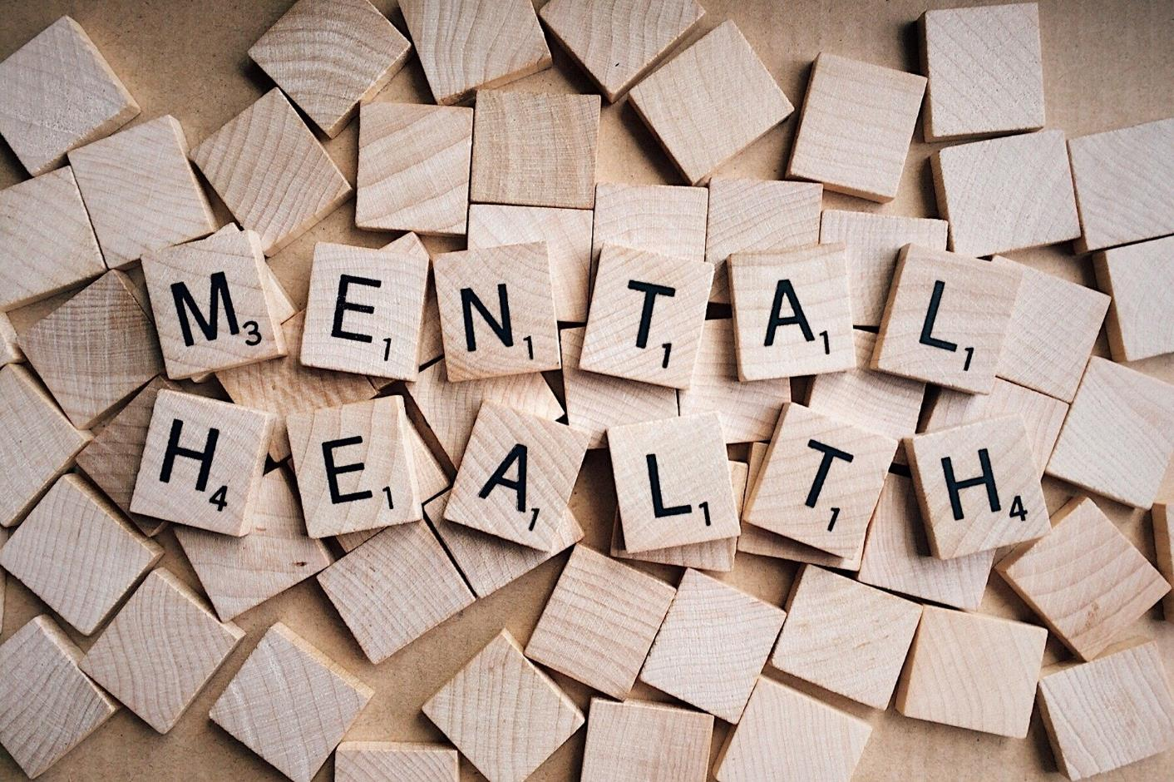
Notes:
Engaging: Gratitude and mental health
Over recent years, many people have found that thinking about the good things in life, their blessings, helps them to cope better with any challenges that might be going on around them. There is now clinical evidence that shows this in the way the brain reacts.* This is perhaps what people mean when they say they are counting their blessings, and maybe this is one of the reasons The Blessing had such popularity during COVID. Counting our blessings is good for our mental health, but it’s not a new idea!
*Psychologist Dr Lisa Miller, in her book ‘The Awakened Brain’ claims that spirituality is not an add‑on to human life — it is a core biological capacity that supports mental health, resilience, and meaning.
Her work reframes spirituality as a scientifically grounded pathway to wellbeing. She discovered, after many years of research as a psychologist treating severely depressed patients, that there were significant links between depression and spirituality. Or rather that being spiritually ‘awakened’ (e.g. through personal faith or a spiritual/reflective practices of some sort, or through deep connections with nature) actually increases the thickness of the cortical layer in the brain, protecting against depression.
She concludes that modern living overuses the achieving part of the brain and neglects the ‘awakened’ brain, and that human beings are wired for spirituality. Activating this capacity strengthens mental health, resilience, and wellbeing.

Slide 6
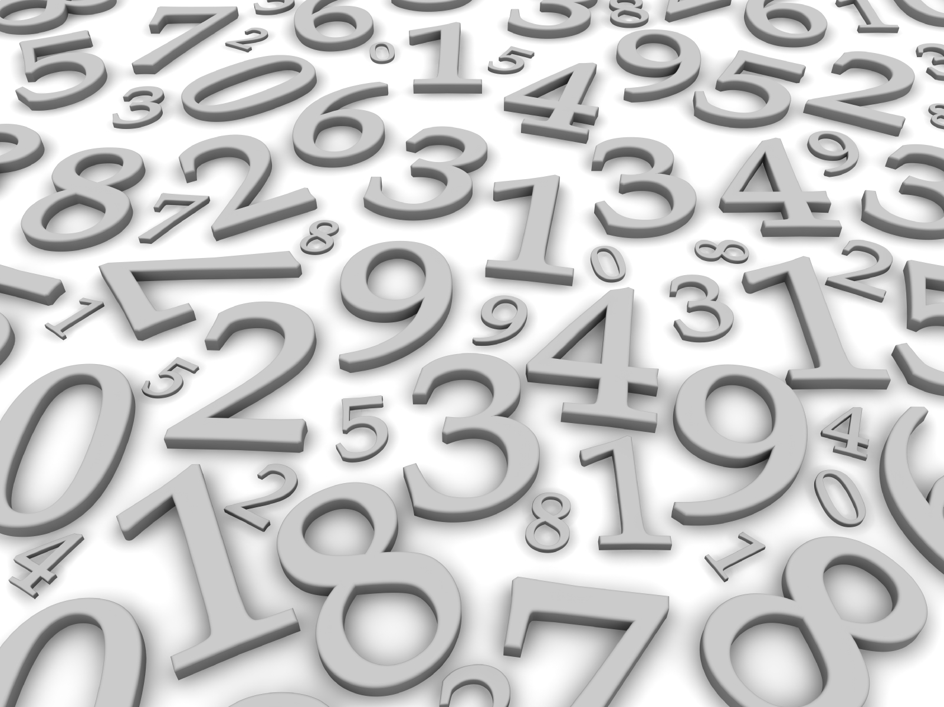
‘O my soul, praise God: don’t forget a single blessing!’
Psalm 103:2
Notes:
Going deeper: responding and words for worship
In these words from Psalm 103, the Shepherd-King, David, talked about how it was good for his soul to remember all that God had done for him, all his blessings. David often did this in his poems – and gave himself a good ‘talking to’. I wonder if you’ve ever had to do this?!
Sometimes, it can be easy to forget all the good things that are part of our lives, but as we’ve heard, ‘counting our blessings’ can help us to get things in balance again, and improve our mental health. As we’ve heard, we became very aware of this during COVID when so much was out of our control.
Just for a few moments now, you might want to close your eyes and think about the good things that are a part of your own life, the things that you might call your ‘blessings’…..
….you might want to take the chance to turn your thoughts into a prayer of gratitude….

Slide 7
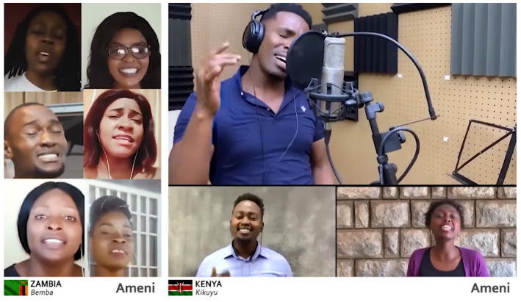
‘May the Lord bless you and keep you. May the Lord show you his kindness. May he have mercy on you. May the Lord watch over you and give you peace.’ Numbers 6:24-26
…I wonder how the words we speak today might bless others – or how we might be a blessing to someone else?....
…I wonder how our school’s vision might help us to do this?....
Notes:
Going deeper: responding and words for worship
We’ve also heard today how some simple and ancient words of blessing transformed communities during COVID, spoken over the nations just as Aaron had spoken them over the Jewish people some 3000 years ago. God told Aaron that this was how he was to bless the people, with the kindness, mercy and peace that comes from God himself.
As you look at these words now, you might want to ‘pronounce’ them over people you know and love, or places in the world that you think need them……
And some final thoughts for us to take away from this time…..
…I wonder how the words we speak today might bless others – or how we might be a blessing to someone else?....
…I wonder how our school’s vision might help us to do this?....
Sending & Blessing: You might want to pray for / bless one another with Aaron’s blessing as you leave, and issue a final challenge based on this slide, then blow out the candle as a sign that the collective worship is finished. If you want to play the song again, it is also linked from the image on this slide.

