Slide 1


Today’s words can be found in Psalm 133:1 & John 17:21
Count your blessings
Images from pixabay, unless otherwise identified
Notes:
‘Count Your Blessings’ – Autumn term 2026 These resources are ©The Diocese of Guildford
These form part of the collective worship resources created to support Secondary schools in the Diocese of Guildford. Research reveals the importance of gratitude even in the midst of adversity: that being aware of each day’s ‘blessings’ can counteract anxiety, and so this term, we want to encourage schools to highlight this especially in their collective worship. As always, each week’s materials link with Biblical content, whilst also ensuring that they are inclusive for pupils and adults of all faiths, or none. Over this short series ‘Count your blessings’, we will highlight things that we might consider to be ‘blessings’.
The materials in this PPT focus on the blessing of ‘community’ and reflect on some words written by Aesop, King David and Jesus, about the importance of unity. Huge thanks go to A-level student Ben Musters for his help with this resource, as part of his Y12 work experience.
Notes for the teacher: This resource is to be used for collective worship during tutor times or in other groupings that work for your setting. There may be enough material here to resource more than one tutor time.
Each resource contains some images and words to support the spiritual development of students, with a script for the leader written under the slides.
Any bold text indicates when a click will animate either text or an image for students to ponder, and italic text contains pointers for the leader.
Especially important is the slide denoted as ‘Going deeper: responding and words for worship’, which ensures that the resource meets the requirement for daily collective worship in your Church school. The words are invitational, and prayer is optional.
You may wish to light a candle at the beginning as a sign that you are entering this different space in the school day.
Today’s words come from Psalm 133:1 and John 17:21 which both speak of the blessing of unity as part of community together. We suggest that you set this within the context of your own school community, reflecting on the challenges that might be obstacles to unity together.

Slide 2
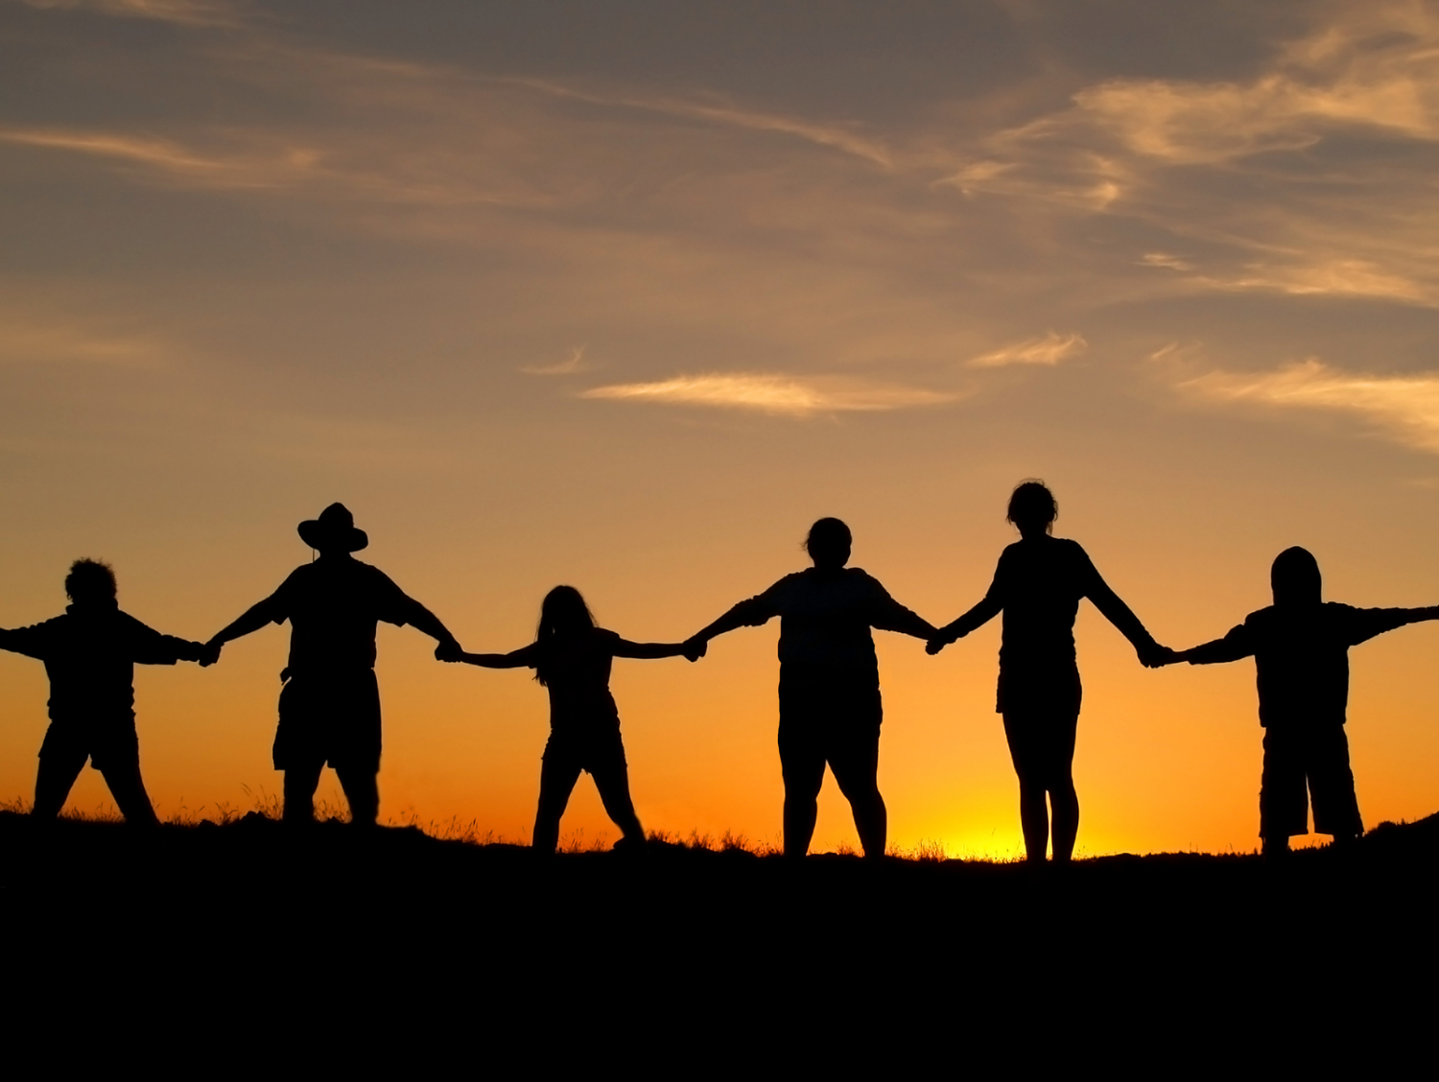
COMMUNITY
COMMUNITY
Notes:
Engaging: A word within a word
I wonder if you can see a word within this word? (It’s Unity) – Can you think of other words that have other words hidden within them?
I wonder if you think the hidden word is important to the idea of Community?
What might Unity have to do with Community?

Slide 3
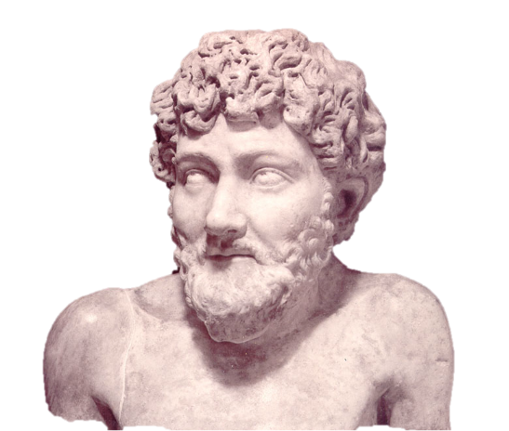
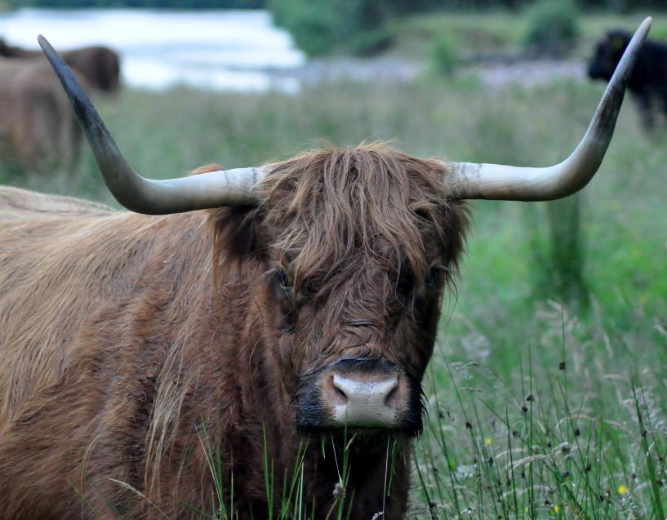
Aesop
620-560 BC
‘United we stand;
divided we fall.’
What’s the moral of this tale?
The Four Oxen
Notes:
Engaging: Aesop’s story of the Four Oxen
Aesop was a fabled storyteller in the Ancient World, whose stories were used in classical Greek and Roman education to train young minds in how to think and use rhetoric.
Aesop once told a story about four oxen who stayed safe from a stalking lion by standing back‑to‑back in perfect unity, with their formidable horns providing protection against the predator. No matter how the lion tried, he couldn’t attack them while they held together. Eventually, quarrels drove the oxen apart, leaving each one isolated. Once divided, they were easily picked off by the hungry lion.
What’s the moral of this tale, do you think? Can you come up with a pithy summary?
Aesop summarised the meaning as ‘United we stand; divided we fall.’
Talk about the fable together: select from…
Do you agree with Aesop’s idea?
I wonder what quarrels might prevent us from being united?
Can you think of a time where quarrels caused your you and your peers to be less united?

Slide 4

‘United we stand; divided we fall’
Aesop (620-560BC)
‘How good and pleasant it is when God’s people live together in unity!’
Psalm 133:1 (c.900BCE)
Notes:
Engaging: Some words about unity
Here are some more words about unity.
Talk together:
I wonder what you think connects these ideas together?
Are these words saying the same thing?
Psalm 133, written by King David, is called a psalm of ascents, sung as pilgrims ‘ascended’ to the Temple in Jerusalem for festivals. Why do you think pilgrims might have wanted to sing about unity?
Which idea do you like the best/agree with the most – Aesop’s or David’s?
Why do you think these people from different time periods might be saying the same thing?
What might we want to say in this age about unity, or community?

Slide 5
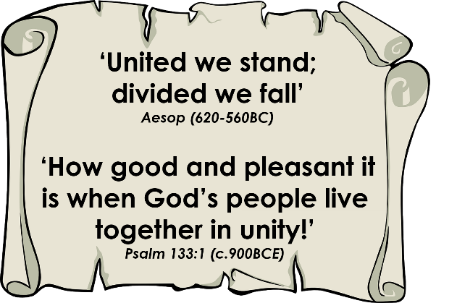
COMMUNITY
COMMUNITY
Notes:
Going deeper: responding and words for worship
The words we have heard today have helped us to think about the importance of unity within a community.
…I wonder if you agree that as part of a school community, we are strongest when we stand together?…..
….I wonder how we might become an even stronger school community today?.....or what obstacles might get in our way?....
….I wonder how our school’s vision and values might help us to be more united?....
….What might happen if we do not stand united together?....

Slide 6

Father, I want all of them to be one with each other, just as I am one with you and you are one with me…..
Notes:
Prayer and sending: Jesus prays for his followers (John 17:21)
Jesus prayed this prayer the night before his crucifixion, about his disciples, and all those who would follow him after.
If unity was this important to Jesus, I wonder if it might be important to us as well?
You might want to turn Jesus’ words into your own prayer for unity as part of our community…..
Sending: you might wish to leave students with a final challenge based on this slide, then blow out the candle as a sign that the collective worship is finished.

