Slide 1
‘Y2: Why is giving important to Christians?’
All the materials in this unit have been created to support the statutory content: you are free to use them or to adapt them to suit the needs, abilities and interests of your pupils. Where needed, there are notes for the teacher under the slides.
Notes:
In this PowerPoint is a presentation about Christian charity The Garden Route Trust, as a response to an additional question for session 4 ‘How does giving by Christians make a difference to others across the world?

Slide 2
Sessions 3&4: What is ‘worship’? How do Christians [the Church] give to God in worship?
How does giving by Christians make a difference across the world?
Incarnation

Slide 3
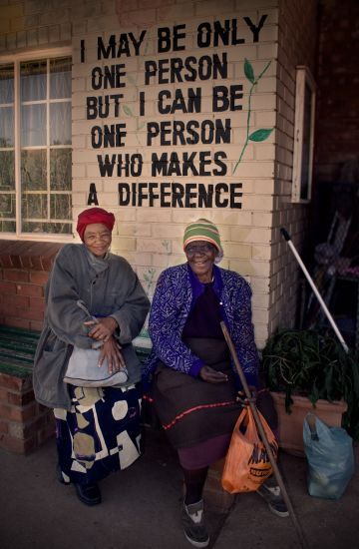
How might we be a person who makes a difference?
Notes:
Talk about the words in the picture. What do you think about them? How might we be a person who makes a difference?

Slide 4
Help with chores
Say a kind word
Listen to others
Support a charity
Share our things
Here is the story of someone making a small difference, which inspired lots of people to make a big difference.
Notes:
I wonder if these were any of the things you talked about?
Here is the story of someone making a small difference, which inspired lots of people to make a big difference.

Slide 5
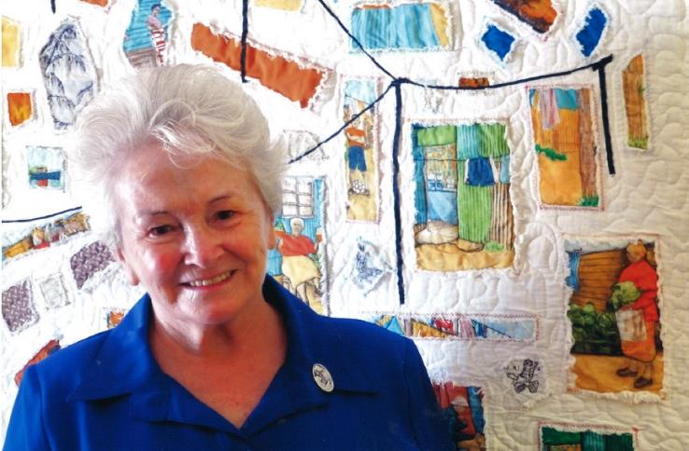
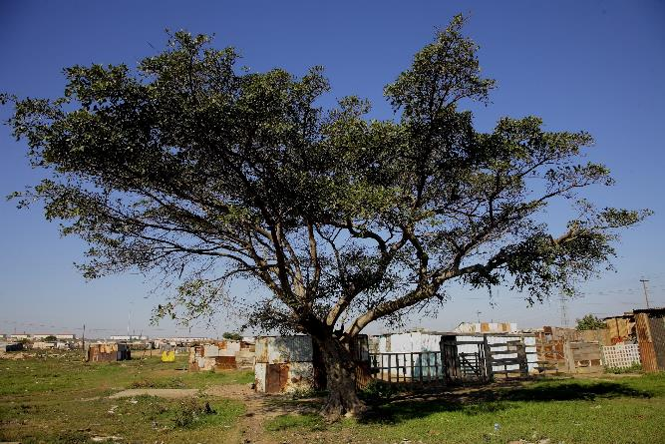
This is Sister Ethel. In 1963 Sister Ethel joined the Little Company of Mary in South Africa.
In 1987, she visited South Africa for a second time.
When she arrived, she had nothing, but a lady called Diane said she could work in the shade of this tree.
Notes:
Explain that ‘Sister’ is the name given to some Christian women who live and work together as part of a Christian community.

Slide 6
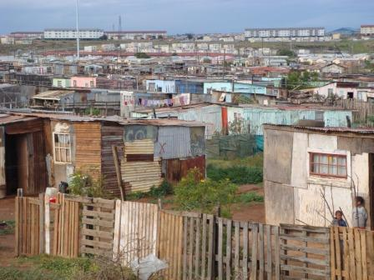
Being a qualified nurse, Sister Ethel began with basic healthcare and soon many people came to her for help underneath that famous tree. She treated everyone with exceptional love and care, something people in Missionvale speak of to this day.
Sister Ethel was surprised by how many children were around in the day and soon started to split her time between healthcare and teaching because she found there was no school the children could go to.

Slide 7
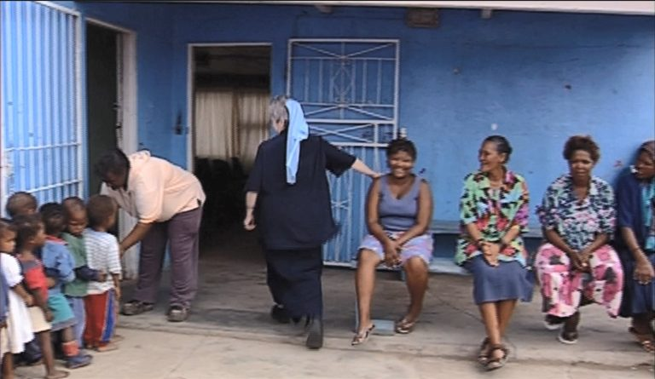
Gradually with more help…..
…Sister Ethel moved her work into a shipping container and then to a small building in 1988….

Slide 8
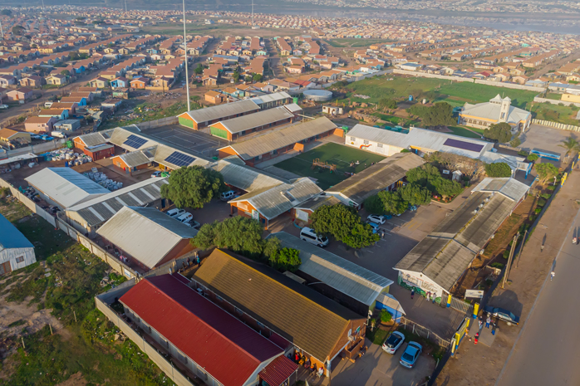
… and today the Missionvale Care Centre looks like this!

Slide 9
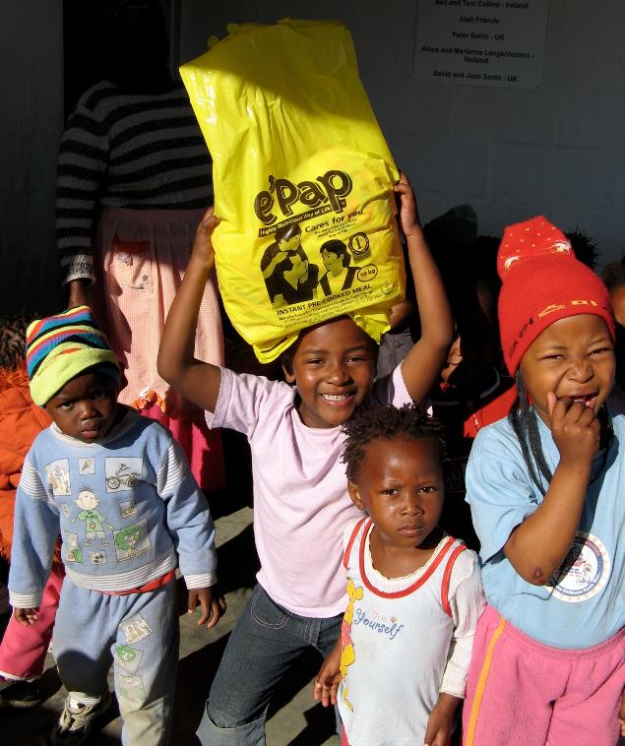
The Garden Route Children’s Trust is a Christian charity which helps to carry on the work that Sister Ethel started.
As Christians, they believe that God loves them and that they can love others in all sorts of ways that make a difference.
Notes:
The Garden Route Children’s Trust is a Christian charity which helps to carry on the work that Sister Ethel started.
As Christians, they believe that God loves them and that they can love others in all sorts of ways that make a difference.

Slide 10
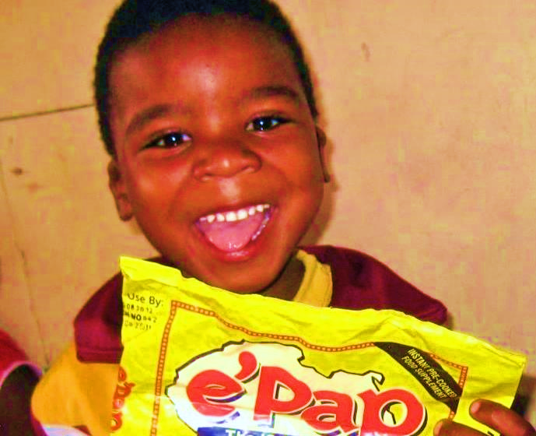
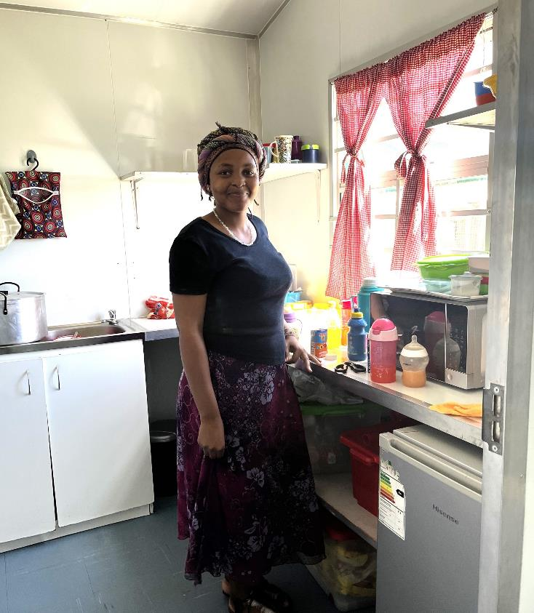
This is Nora. She works in a creche in Addo in South Africa.
If you look closely, you can see the box of packets of e’Pap at her feet.
Each packet costs about £1.50 and has about 20 servings depending on the age of the child.
So, it only costs about 10p for nutritious breakfast which will help children to concentrate in school.
The charity raises money to fund a type of porridge called e’Pap for breakfast at Missionvale School and other schools in South Africa.

Slide 11
How does Sister Ethel’s story and the work of GRCT help us to answer the question ‘How does giving by Christians make a difference across the world?’
Notes:
How does Sister Ethel’s story and the work of GRCT help us to answer the question ‘How does giving by Christians make a difference across the world?’

