Slide 1
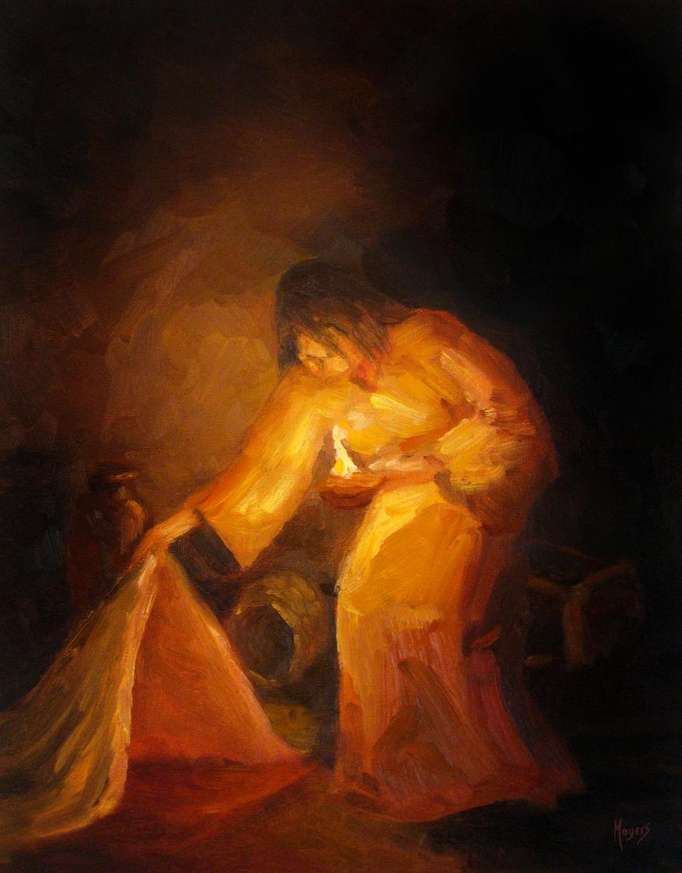

Today’s story can be found in Matthew 13:47-48
Stories as treasure to be found
‘The seeker’ by Mike Moyers, from the Vanderbilt University Library, Art in the Christian Tradition
Notes:
‘Stories as treasure to be found’ – Summer term 2026 These resources are ©The Diocese of Guildford
The Gospels are full of the parables of Jesus, which he used to communicate ideas about the Kingdom of God to his listeners, often challenging their thinking, and quite often in answer to a question he had been posed. For Christians – as for Jesus’ original audiences – the parables don’t just illustrate a truth, they contain a truth that the listeners are supposed to search for for themselves, appealing to the intellect through the imagination. These collective worship materials don’t need to be used in any particular order, but loosely follow the parables of Jesus from Matthew 13. Although these parables were told to a specific audience, with a specific set of cultural expectations, Christians believe that Jesus’ parables can speak just as truthfully to a modern audience: like a well-cut gemstone, the light will shine through the different facets and show different colours at different times.
Notes for the teacher: This resource is to be used for collective worship during tutor times or in other groupings that work for your setting. There may be enough material here to resource more than one tutor time.
Each resource contains some images and words to support the spiritual development of students, with a script for the leader written under the slides.
Any bold text indicates when a click will animate either text or an image for students to ponder, and italic text contains pointers for the leader.
Especially important is the slide denoted as ‘Going deeper: responding and words for worship’, which ensures that the resource meets the requirement for daily collective worship in your Church school. The words are invitational, and prayer is optional.
At the end of each set of slides, there is an image from across times and cultures illustrating the story from a different perspective. You might want to include a question on this slide that will challenge students’ thinking as they leave, or at another time, picking up on what has been talked about during the gathering.
Today’s parable, the Parable of the Net, can be found in Matthew 13:47-48. It is a challenging theme; for Christians, interpreted in the context of God’s Kingdom. We widen the theme here to look at the actions of the fishermen, in choosing between the good and the bad fish – and think about what Jesus might have been saying about the choices that people make as part of God’s Kingdom.

Slide 2

Why is it sometimes hard to make good choices?
Notes:
Engaging: A question to ponder as we begin: why is it sometimes hard to make good choices? [Talk together for a while]

Slide 3
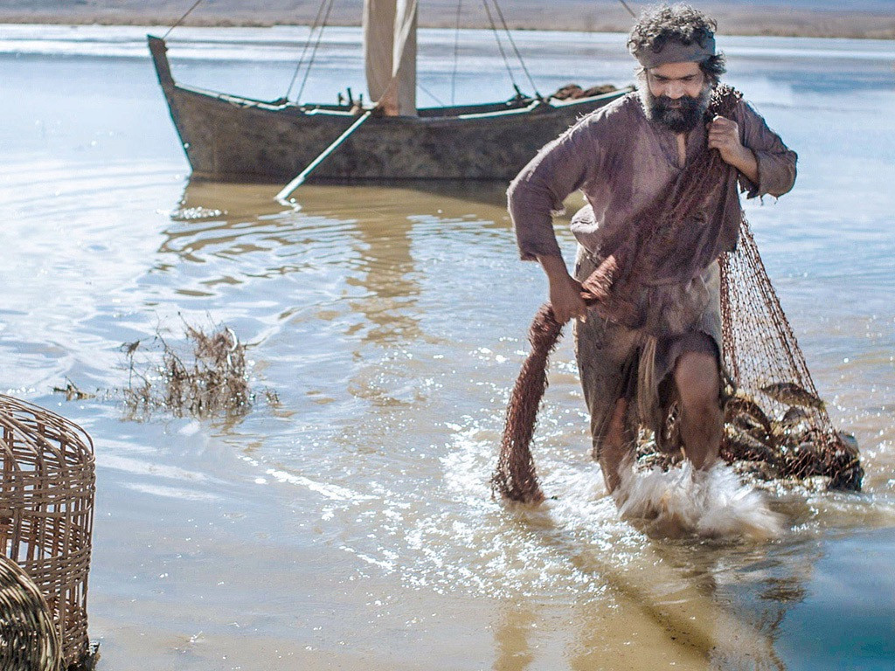
‘The kingdom of heaven is like a net that was put into the lake. The net caught many different kinds of fish. When it was full, the fishermen pulled the net to the shore. They sat down and put all the good fish in baskets. Then they threw away the bad fish….’
[Matthew 13:47-48]
Notes:
Engaging: The parable of the net
Today’s parable is about fishing, which was something that many of his disciples knew a LOT about!!
This is what Jesus said in this parable: ‘The kingdom of heaven is like a net that was put into the lake. The net caught many different kinds of fish. When it was full, the fishermen pulled the net to the shore. They sat down and put all the good fish in baskets. Then they threw away the bad fish….’ [Matthew 13: 47&48]
Hold a short discussion based on the following questions:
I wonder what you think Jesus was meaning in this parable?
I wonder how the fishermen might choose what’s good and what’s bad?
I wonder what you think the fish might represent?
Do you think they should have thrown the bad fish away? Why?
What do you think Jesus’ listeners might have thought of this parable?
Is this a parable that anyone can learn from – or is it just for followers of Jesus?
People often accused Jesus of teaching them hard things: the message in this parable for those who wanted to belong to God’s Kingdom was a hard one, about making Kingdom choices – and about the consequences of making bad choices.

Slide 4

Choices
Notes:
Going deeper and words for worship: Choices
We make choices every day – good choices, and sometimes bad choices.
Our choices impact on us – and they impact on others: there are always consequences to our actions.
Jesus taught his followers that choices also have an impact as part of God’s Kingdom.
I wonder what you think

Slide 5
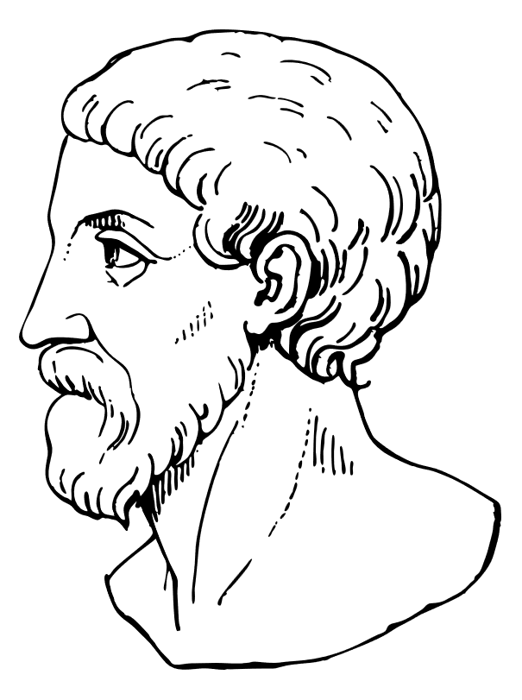
‘Choices are the hinges of destiny.’
Pythagoras
(c.570-495BCE)
Notes:
Sending: A challenge
About 500 years before the birth of Jesus, a mathematician and philosopher called Pythagoras spoke these words.
They also speak to us of the importance of the choices that we make.
Spend a few moments in silence reflecting on what you might be taking away from this time today…..
Sending: you might wish to leave students with a final challenge based on this slide, then blow out the candle as a sign that the collective worship is finished.

Slide 6
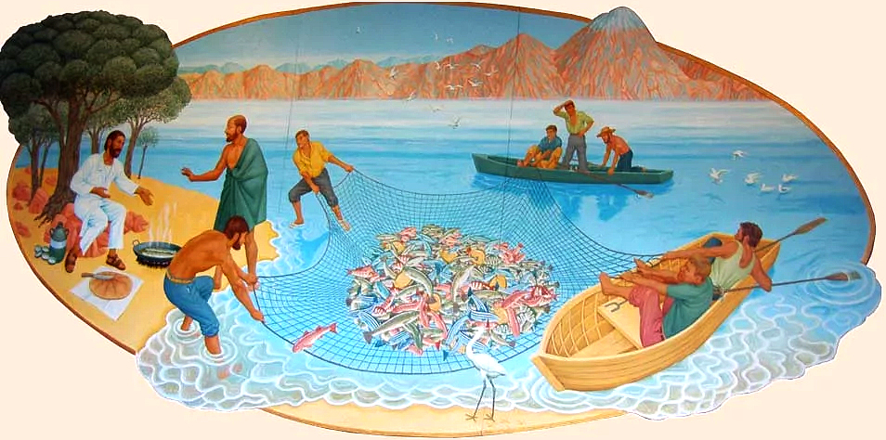
Notes:
Breakfast on the beach
By Peter Koenig, sited in the Church of St Edward, Kettering
This art comes from the story of Breakfast on the beach, but shows fishermen (the disciples) hauling in a net of fish.
Source for this image: https://diglib.library.vanderbilt.edu/act-imagelink.pl?RC=58541

