Slide 1


Today’s words can be found in Hebrews 13:2 & Matthew 25:40
Words to make you wonder…
Image from pixabay
Notes:
‘Words to make you wonder’ – Summer term 2026 These resources are ©The Diocese of Guildford
This is a companion resource to ‘stories as treasure to be found’, collective worship resources created to support Secondary schools in the Diocese of Guildford. ‘Words to make you wonder’ are taken from different parts of the Bible and used in response to world events or big questions in life.
These resources feature a sculpture in a communal garden space near Canterbury Cathedral. It’s called ‘Be Welcoming’ – and so this is the title of this collective worship
Huge thanks go to secondary school student Miriam Audsley for her help with this resource, as part of her Y10 work experience.
Notes for the teacher: This resource is to be used for collective worship during tutor times or in other groupings that work for your setting. There may be enough material here to resource more than one tutor time.
Each resource contains some images and words to support the spiritual development of students, with a script for the leader written under the slides.
Any bold text indicates when a click will animate either text or an image for students to ponder, and italic text contains pointers for the leader.
Especially important is the slide denoted as ‘Going deeper: responding and words for worship’, which ensures that the resource meets the requirement for daily collective worship in your Church school. The words are invitational, and prayer is optional.
Today’s words come from Hebrews 13:2 and Matthew 25:40. Jesus challenges people that when we care for those most overlooked, we care for him. Hebrews echoes this message of showing hospitality to people that are strangers to us, saying that we don’t actually know who they really are and that we may have cared for angels without realising.

Slide 2
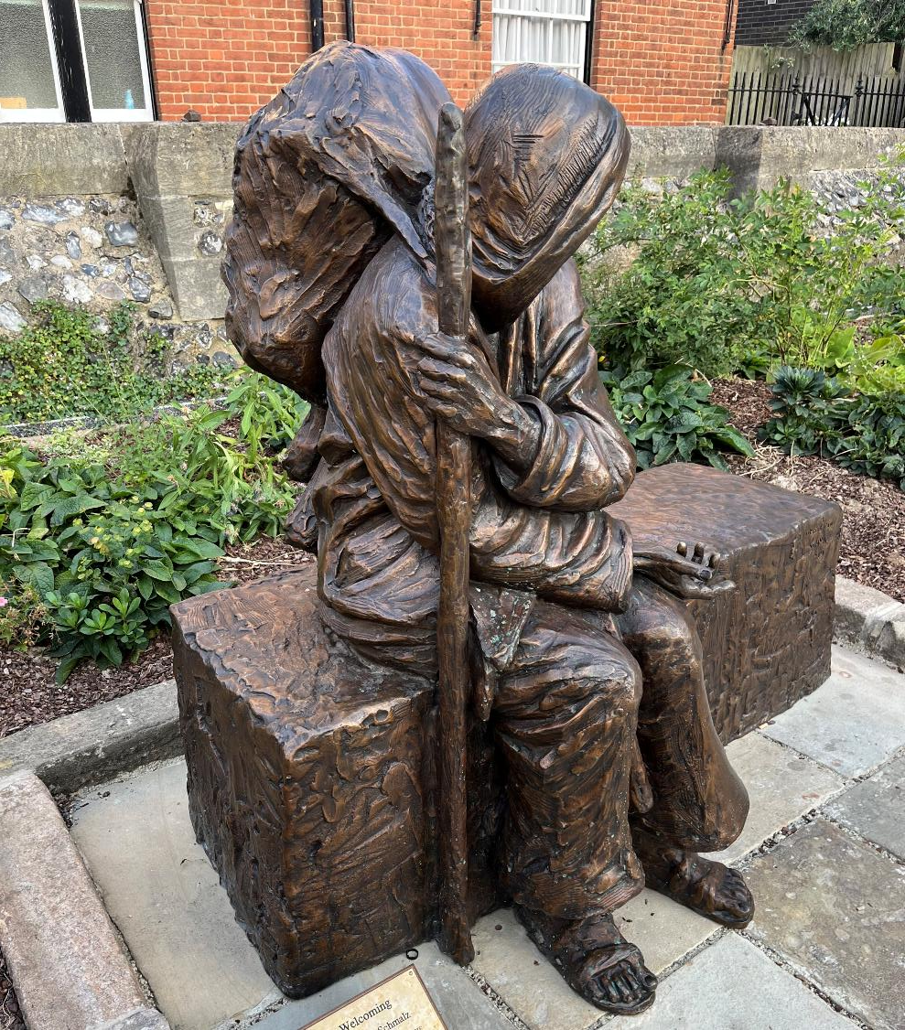
Notes:
Engaging: What can you see?
This is a bronze sculpture, located in popular communal gardens, not far from Canterbury Cathedral.
Talk together – questions to select from:
Which words come to mind when you look at this photo?
Imagine this was a real person and not a sculpture – what would you do if you saw them? Would you notice them in the first place?
What do you think the artist is trying to tell us through this piece? What is their message?
Are there any questions you would ask the artist about their work?
Why do you think the figure is facing away?
What does it make you think about?
The sculpture is called ‘Be Welcoming’: why do you think the artist gave it this title?

Slide 3
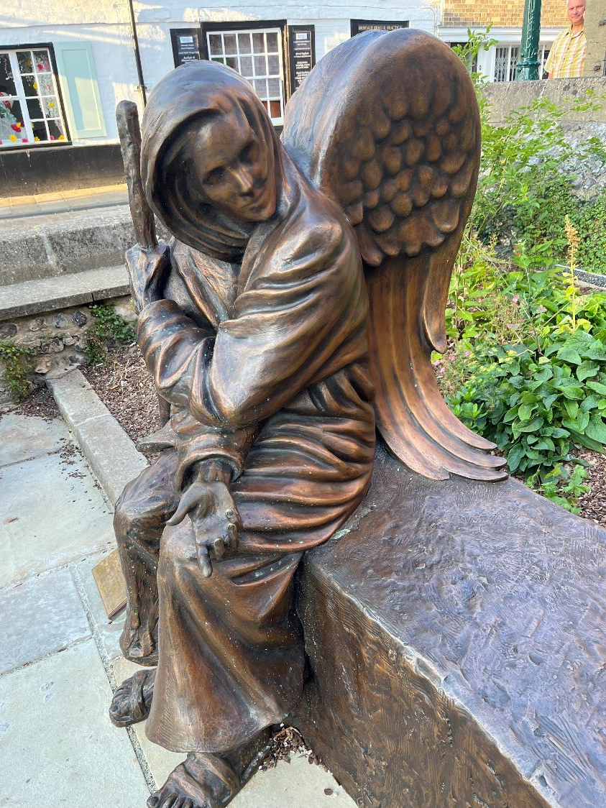
Notes:
Engaging: Be welcoming
When you sit on the bench next to the figure, this is the view you get…..
Talk together – questions to select from:
Does this other side of the sculpture shock you? Why?
What does it make you think of?
How has it changed your perspective of the sculpture?
Do you think the artist’s message is different now that you can see both sides?
If you were simply to walk past the sculpture, you wouldn’t see this side; why do you think that is? What do you think the artist is trying to say through that?
If you had seen this sculpture in real life, would you have just walked past and missed this side, or would you have sat down next to it, revealing the bigger picture?
How does this make you reflect?

Slide 4
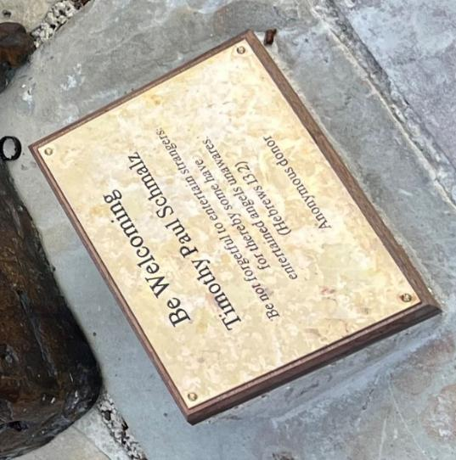
‘Do not forget to show hospitality to strangers, for by so doing some people have shown hospitality to angels without knowing it.’
[Hebrews 13:2]
‘….whatever you did for one of the least of these brothers and sisters of mine, you did for me.’ [Matthew 25:40]
Notes:
Going deeper: responding and words for worship There are opportunities here (in the bulleted questions) to think and/or talk – use appropriately to your context
The text on the plate beside the sculpture is a verse from Hebrews 13: ‘Do not forget to show hospitality to strangers, for by so doing some people have shown hospitality to angels without knowing it.’ [Hebrews 13:2]
How do these words connect with the sculpture?
How do Paul’s words make you think?
What do you think is Paul’s main message in this verse?
Why is it so easy to overlook people that we don’t know?
How might you show hospitality to a stranger or someone outside of your circle today?
How do you think this message is relevant/what does it mean for us today?
Is this a message you have heard before or is it new to you? What do you think of it?
Have you ever experienced a welcome like this?
Jesus also speaks of a similar message in Matthew 25:40 when talking about caring for those overlooked: ‘….whatever you did for one of the least of these brothers and sisters of mine, you did for me.’
How do these words link with Paul’s words?
What does Jesus mean by ‘the least of these’? Who might he be talking about? Who might that be in your own life or our school community?
What do you think Jesus means by saying that ‘you did it to me’?
Do you have any questions about this verse?
What do you think Jesus’s message is?
How does Jesus’s message link to the sculpture?
What does this verse tell us about Jesus’s heart? What does it tell us about who he is and how he cared for people?
Are there any times where you might have overlooked someone when you could have extended care to them?
What might this message mean to us today?

Slide 5
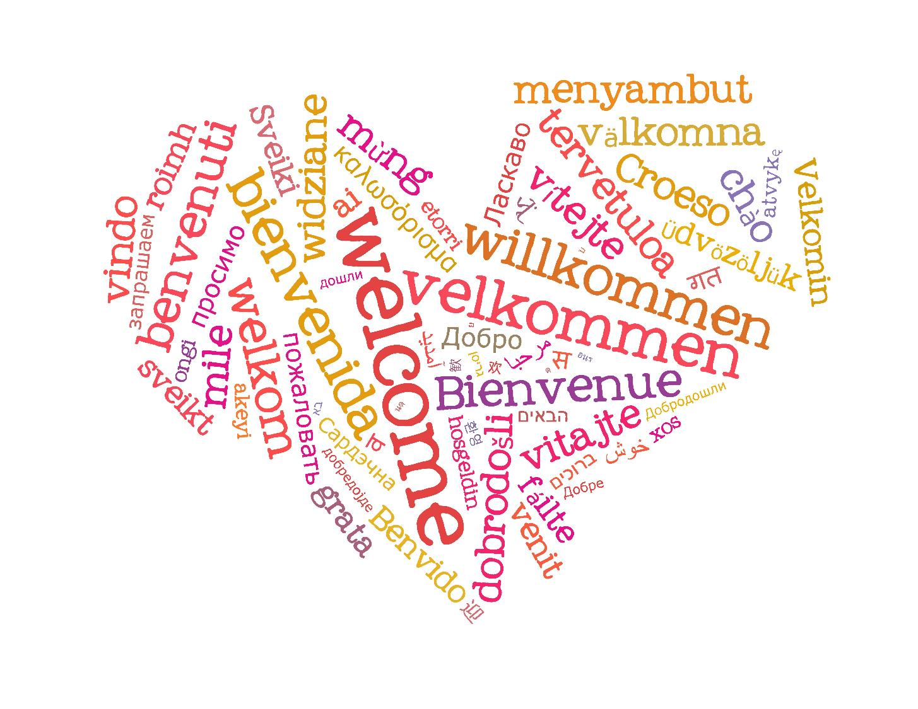
Notes:
Going deeper: responding and words for worship
Now let’s pause for a few moments and think…..
….we have been challenged today to reflect on the welcome that we offer to all….
….Jesus taught that those whom we might overlook are very close to his heart, and that by welcoming them, we are welcoming him…..
You might want to use a few moments of stillness now to reflect…..or bring your thoughts to God in prayer…..

Slide 6
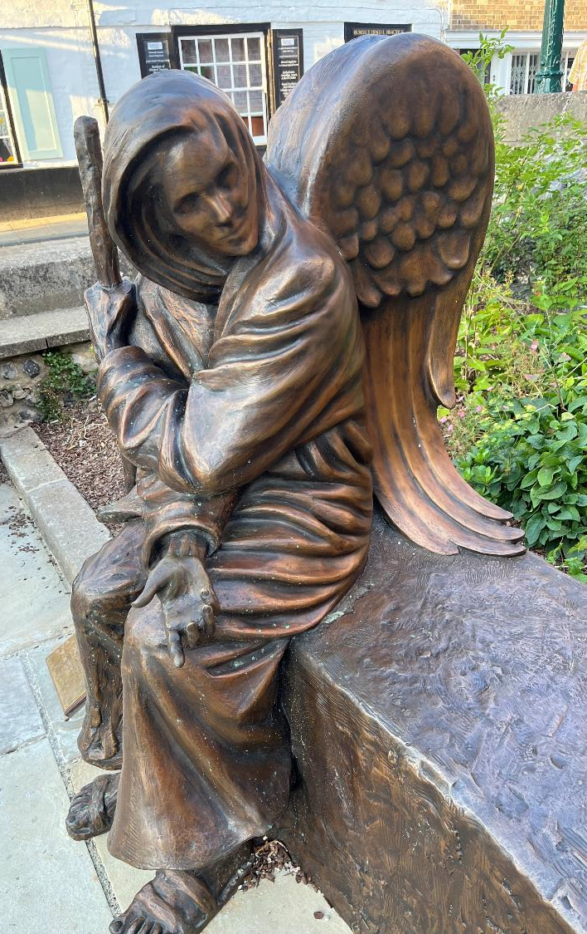
‘Do not forget to show hospitality to strangers, for by so doing some people have shown hospitality to angels without knowing it.’
[Hebrews 13:2]
Notes:
Sending: You might want to say these words together as an encouragement and a challenge.
Then blow out the candle as a sign that the collective worship is finished.

