Slide 1


Today’s words can be found in Matthew 7:3 & Proverbs 16:18
Words to make you wonder…
Image from pixabay
Notes:
‘Words to make you wonder’ – Summer term 2026 These resources are ©The Diocese of Guildford
This is a companion resource to ‘Stories as treasure to be found’, collective worship resources created to support Secondary schools in the Diocese of Guildford. ‘Words to make you wonder’ are taken from different parts of the Bible and used in response to world events or big questions in life.
These resources focus on the Banksy statue that appeared overnight in Central London in April 2026 and consider some of the many questions that this provocative sculpture might raise. It has been called ‘Blind Patriotism’, but for this session, we have not used this title. Banksy is a bit of an enigma, and not much is known about him other than what he shows through his street art, providing lots of opportunity for discussion and debate. There are 2 slides you could use: one exploring the meaning of the statue; a second exploring it in its location, giving plenty of material to choose from!
Huge thanks go to A-level student Ben Musters for his help with this resource, as part of his Y12 work experience.
Notes for the teacher: This resource is to be used for collective worship during tutor times or in other groupings that work for your setting. There may be enough material here to resource more than one tutor time.
Each resource contains some images and words to support the spiritual development of students, with a script for the leader written under the slides.
Any bold text indicates when a click will animate either text or an image for students to ponder, and italic text contains pointers for the leader.
Especially important is the slide denoted as ‘Going deeper: responding and words for worship’, which ensures that the resource meets the requirement for daily collective worship in your Church school. The words are invitational, and prayer is optional.
Today’s words come from Matthew 7:3 & Proverbs 16:18 Jesus uses a very extreme ‘parable’ about specks and planks to address the arrogance and hypocrisy he sees around him, building on wise advice found in the Wisdom book of Proverbs.

Slide 2
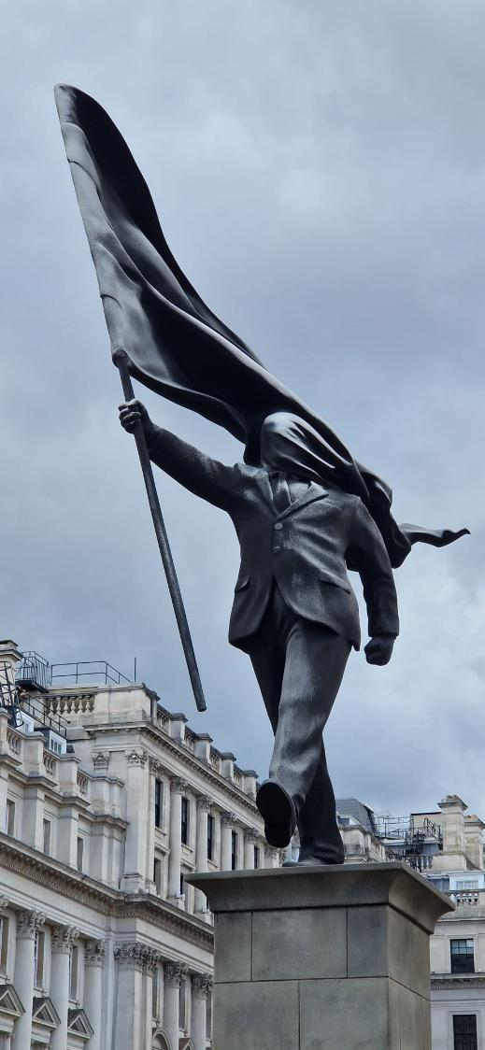
Notes:
Engaging: Banksy’s Statue on Waterloo Place
Some of you may have picked up that another Banksy art installation appeared overnight on 29th April this year, in Waterloo Place, St. James’s (Westminster).
Talk together – questions to select from:
What is Banksy trying to say? If you were to give this piece a title, what would you choose?
Who might this figure represent?
What sometimes makes people ‘blind’ in this sense e.g. influencers, celebrities, nationalism?
What sort of consequences might come from him stepping off the plinth?
What sort of a leader do you think this man is? Can you think of any leaders who might be like this?
What questions would you want to ask Banksy about his work?
What might it make us think about ourselves as human beings?

Slide 3
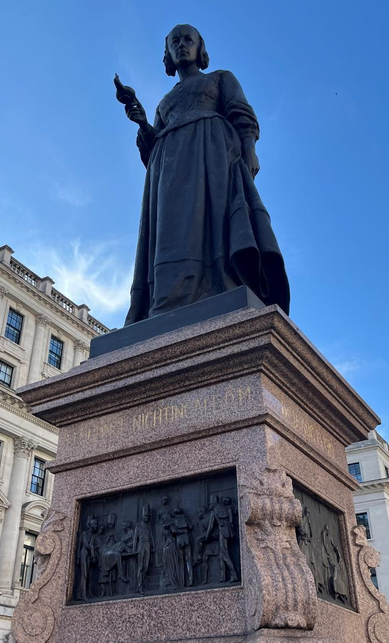
Notes:
Engaging: Banksy’s Statue in the context of Waterloo Place
Banksy’s statue sits alongside some very famous people from history…. near statues of Edward VII, Florence Nightingale and the Crimean War Memorial.
Talk together – questions to select from:
Why do you think Banksy chose this specific location?
Should the statue be allowed to remain in this setting – or do you think the council will remove it?
What do you think we are supposed to learn from this installation?

Slide 4
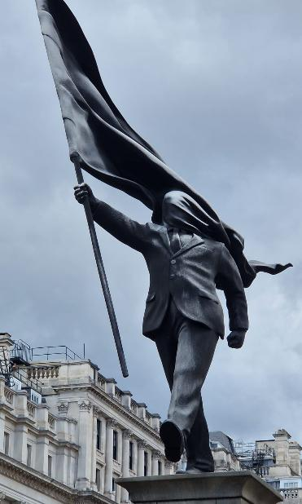
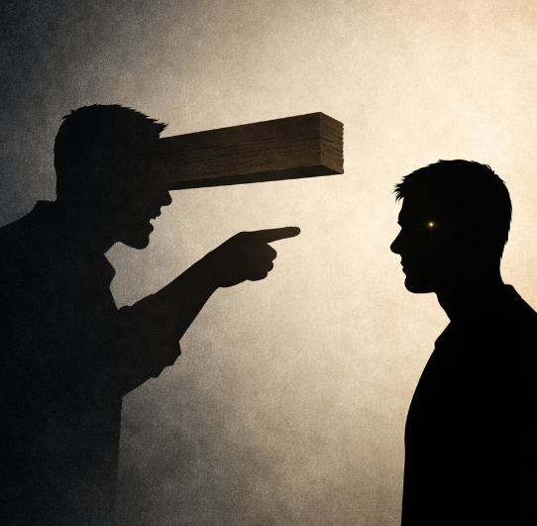
‘Why do you look at the speck of sawdust in your brother’s eye and pay no attention to the plank in your own?’
[Matthew 7:3]
Pride comes before disaster, and arrogance before a fall. [Proverbs 16:18]
AI image generated by MS Co-Pilot
Notes:
Going deeper: responding and words for worship There are opportunities here (in the bulleted questions) to think and/or talk – use appropriately to your context
Banksy is not alone in using stark imagery to challenge people’s thinking: Jesus created this verbal image for his listeners in what is called the Sermon on the Mount: ‘Why do you look at the speck of sawdust in your brother’s eye and pay no attention to the plank in your own?’ - [Matthew 7:3]
What does Jesus mean by ‘the speck’?
What does Jesus mean by ‘the plank’?
What links might you make between Banksy’s work and this verse?
Can you recognise any ‘planks’ you might have in your life?
Why is it sometimes difficult to judge others fairly?
How might Jesus’ teaching help people today?
Which person (the person with the speck or the person with the plank) do you think Banksy’s statue represents?
(Highlight that Jesus is saying that we should first examine ourselves before judging/criticising others.)
You might also have heard these words (Pride comes before disaster, and arrogance before a fall. [Proverbs 16:18]), about pride coming before a fall…..
How might these words connect with Banksy’s statue?
What is this verse saying about the danger of pride and arrogance?
When have you been prideful or arrogant and it led to disaster?
Can pride be helpful? At what point does it become dangerous?
What might you need to change to take the ‘plank’ out of your eye?

Slide 5


…I wonder what impact these images might have had on our attitudes today?...
Notes:
Going deeper: responding and words for worship
Now let’s pause for a few moments and think…..
…I wonder what impact these images might have had on our attitudes today?...
…and what our attitudes might reveal about what’s in our hearts?
….I wonder how our attitudes have an impact on our school community…..our friendships….our families…..our world….?
You might want to use a few moments of stillness now to reflect…..or bring your thoughts to God in prayer…..

Slide 6


May the words of our mouths,
And the thoughts and attitudes in our hearts
Be pleasing to you, O God.
May the words of our mouths [touch lips]
The thoughts of our hearts [touch heart]
May the words of our mouths
Notes:
Going deeper: responding and words for worship
For many people, talking to God in prayer helps them to confess any attitudes that might be wrong, and put things right again. King David, who wrote many of the Psalms in the Bible, often did this – and these words come from one of his prayers…. [Psalm 19:14, with a small adaptation for this context]
Create some stillness for students to think, reflect or pray
May the words of our mouths,
And the thoughts and attitudes in our hearts
Be pleasing to you, O God.
Sending: you might wish to leave students with a final challenge based on this slide, then blow out the candle as a sign that the collective worship is finished.

