Slide 1
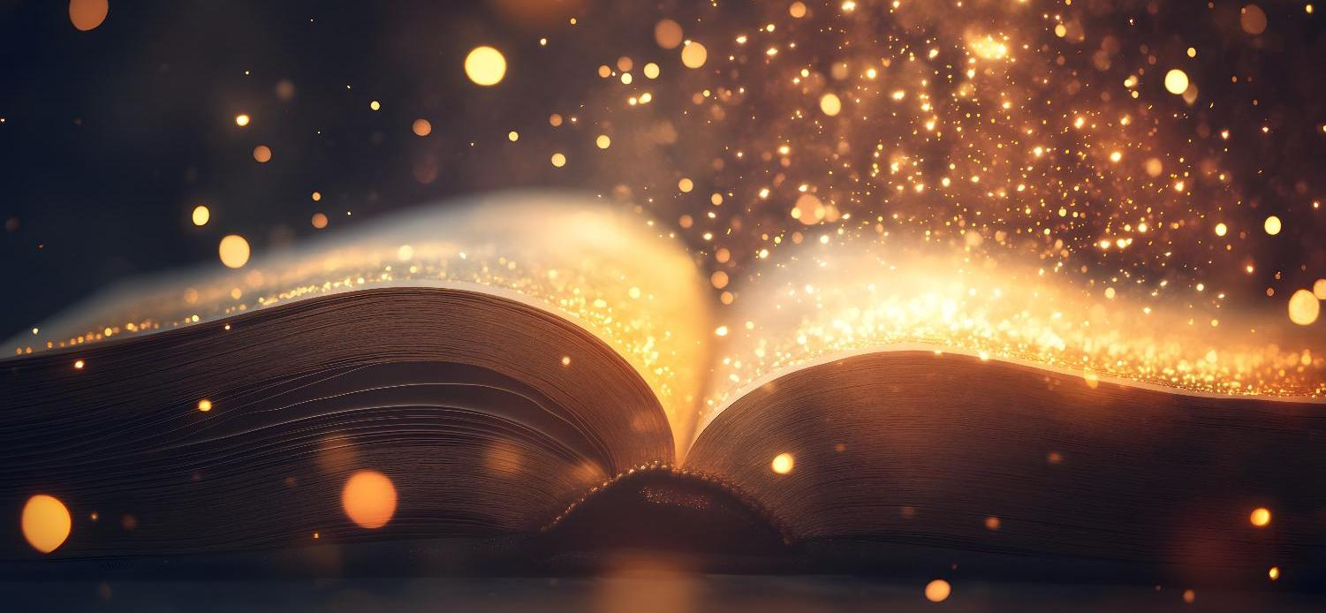
Today’s words can be found in Psalm 8:3-4
Words to make you wonder…
Image from pixabay
Notes:
‘Words to make you wonder’ – Summer term 2026 These resources are ©The Diocese of Guildford
This is a companion resource to ‘Stories as treasure to be found’, collective worship resources created to support Secondary schools in the Diocese of Guildford. ‘Words to make you wonder’ are taken from different parts of the Bible and used in response to world events or big questions in life. Our materials today make unashamed use of the recent images (April 2026) released by NASA as part of the Artemis II expedition.
Notes for the teacher: This resource is to be used for collective worship during tutor times or in other groupings that work for your setting. There may be enough material here to resource more than one tutor time.
Each resource contains some images and words to support the spiritual development of students, with a script for the leader written under the slides.
Any bold text indicates when a click will animate either text or an image for students to ponder, and italic text contains pointers for the leader.
Especially important is the slide denoted as ‘Going deeper: responding and words for worship’, which ensures that the resource meets the requirement for daily collective worship in your Church school. The words are invitational, and prayer is optional.
Today’s words come from Psalm 8:3-4 and speak of David, the Psalm-writer, who has quite clearly experienced something of the power of the natural world to make human beings wonder….We use some photos from the recent Artemis II mission to the Moon, capturing some of the most extraordinary images of Moon and Earth from space. There are maybe some interesting philosophical conversations to be had (at another time!) about the timing of this mission when America is at war with Iran, fuel supplies are compromised and our planet needs more of our care than ever before, but it’s hard not to feel a huge sense of awe looking at the images that have returned from the mission.

Slide 2
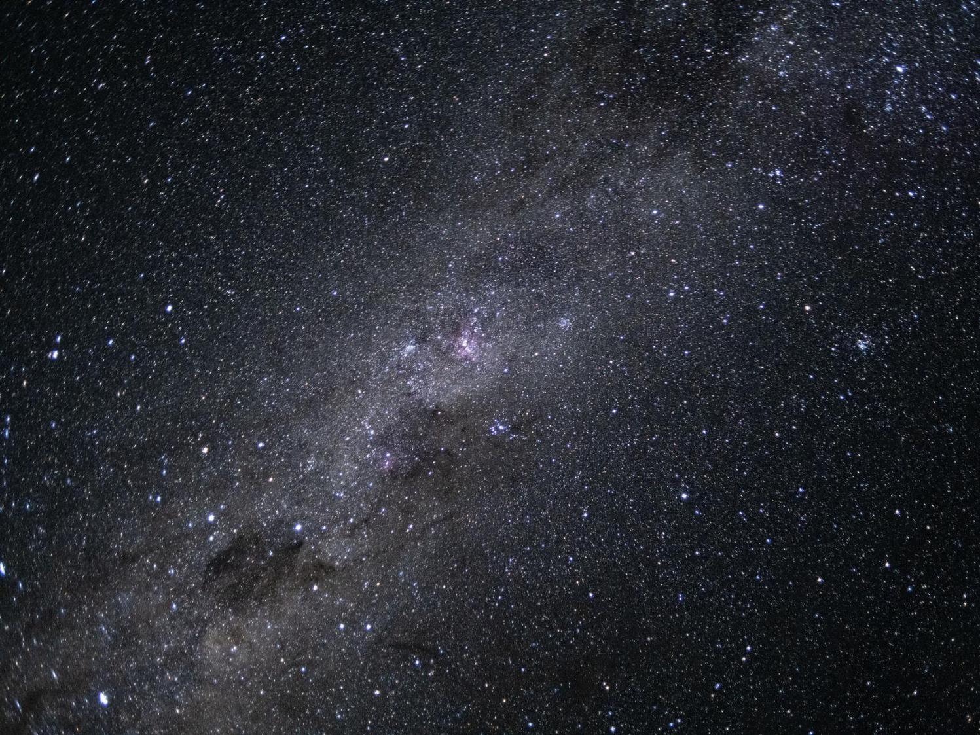
‘When I consider your heavens, the work of your fingers, the moon and the stars, which you have set in place, what is mankind that you are mindful of them, human beings that you care for them?’ [Psalm 8:3-4]
Image ©NASA
Notes:
Gathering: image of the Milky Way from Artemis II Mission, April 7th 2026
You might want to light a candle to signal the start of collective worship. Invite students to be quiet and still and look at the image.
As we begin, listen to these words, written by David the Psalmist around 3000 years ago… You can almost imagine him lying on the hillsides where he would have safely stowed the sheep in a sheepfold for the night, staring up at the night sky.
‘When I consider your heavens, the work of your fingers, the moon and the stars, which you have set in place, what is mankind that you are mindful of them, human beings that you care for them?’ [Psalm 8:3-4]
This image was taken from the small spacecraft, Integrity, as part of the recent NASA mission to conduct a ‘flyby’ of the Moon.
I wonder how it makes you feel as you look at it?.....
I wonder how similar your thoughts were to David’s?....
Maybe you can identify with this experience of feeling overwhelmed by the enormity of the natural world?.....
Or feeling a sense of the spiritual, and asking some big questions about life, the universe and everything? [to quote Douglas Adams, 40 years ago!]

Slide 3
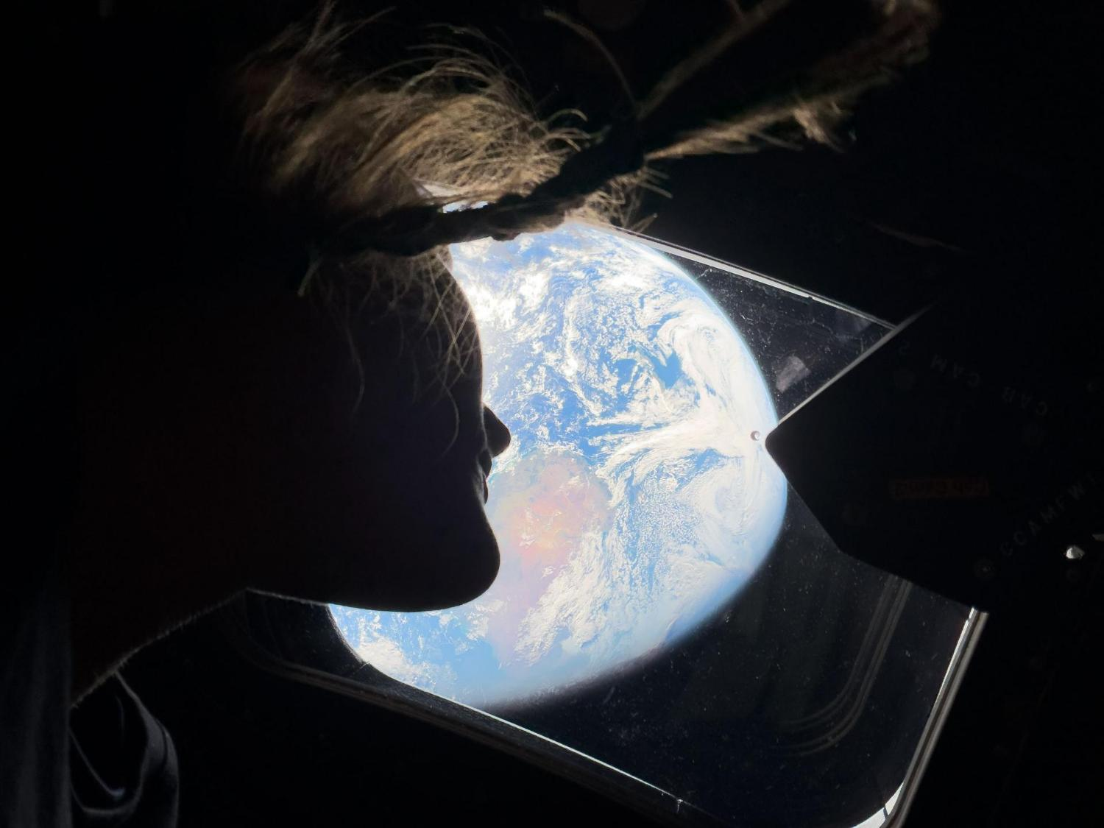
“…small and powerless, yet powerful together.”
Notes:
Engaging: images from Artemis II mission - Astronaut Christina Koch looking out of the window at Earth
I wonder how you think she felt?
Or how you feel, seeing our beautiful shared home from her perspective?
One of the other astronauts said that they all had “….that same feeling: small and powerless, yet powerful together.”

Slide 4
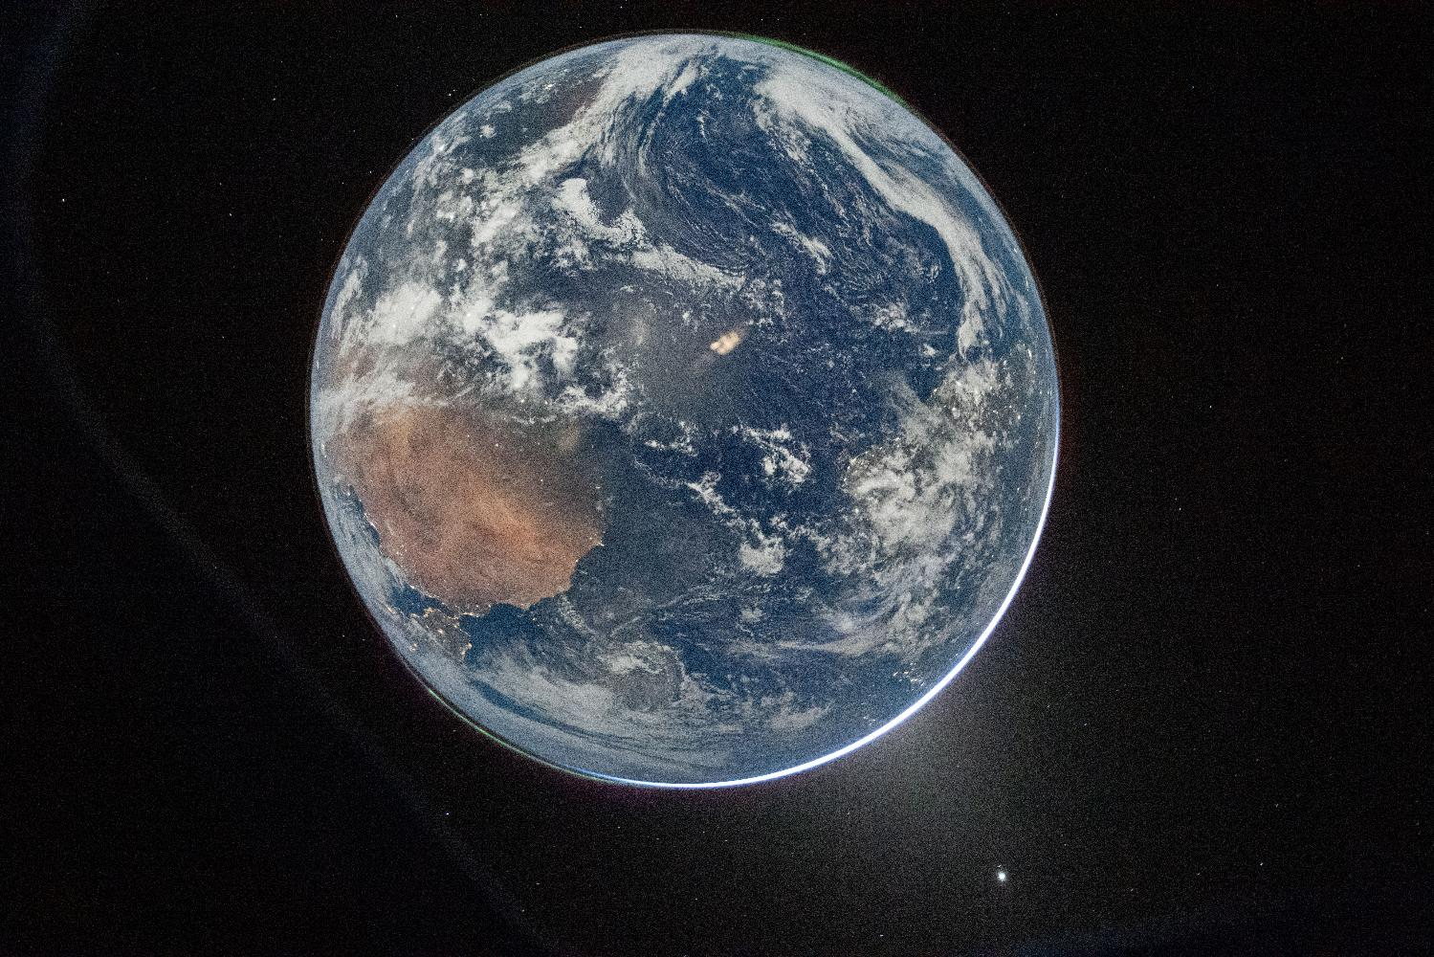
“…how beautiful Earth is.”
“…What I've seen has brought me more joy…more hope for our future."
Notes:
Engaging: images from the Artemis II mission, taken from underneath
The two auroras (top right [Australis, ‘Southern Lights’] and bottom left [Borealis, Northern Lights]) and zodiacal light (bottom right) are visible as the Earth eclipses the Sun.
Astronaut Victor Glover, talking to the base team as they got closer to the Moon, said how they were "looking at you and how beautiful Earth is."
Jeremy Hansen, a Canadian member of the team, found that returning to Earth had deepened his faith in people. "We don't always do great things. We're not always in our integrity, but our default is to be good and to be good to one another," he said. "What I've seen has brought me more joy…more hope for our future."
Lead a short discussion helping students to share their thoughts about the images they have seen, using the following points/questions:
I wonder what you think about their words?
Is Earth really this beautiful?
How might this impact on our need to take climate change seriously? [Maybe students might feel the irony of a space mission at a time when fuel supplies are compromised!...]
Why do they think Hansen felt so optimistic? Is he right to feel this way?
What difference do you think this mission might make to the team’s personal priorities?
What should our response be?

Slide 5
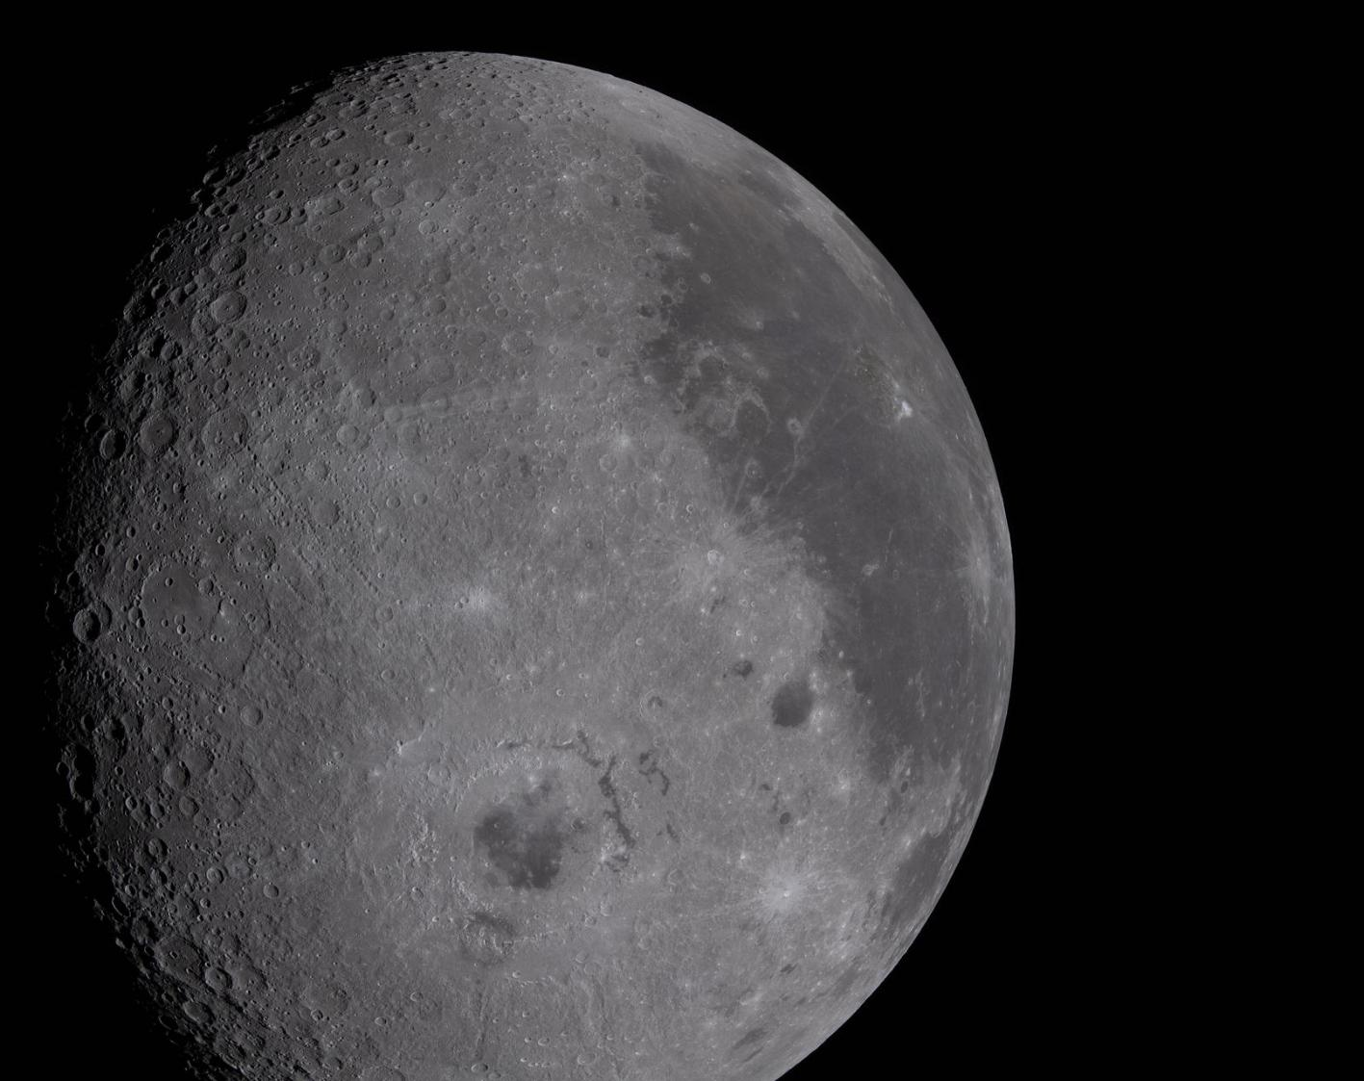
Creator God,
When we look at the heavens and the earth, the ‘work of your fingers’, we are humbled.
We are grateful that even though we are just small human beings, you remember us and care for us.
Amen
‘When I consider your heavens, the work of your fingers, the moon and the stars, which you have set in place, what is mankind that you are mindful of them, human beings that you care for them?’
[Psalm 8:3-4]
Notes:
Going deeper: responding and words for worship
Let’s return to the words we started with from Psalm 8…
‘When I consider your heavens, the work of your fingers, the moon and the stars, which you have set in place, what is mankind that you are mindful of them, human beings that you care for them?’ [Psalm 8:3-4]
I wonder if you noticed David’s final clause: ‘what is mankind that you are mindful of them, human beings that you care for them?’
‘Mindful’ here means that God brings human beings to mind; he remembers them.
For David, it wasn’t so much the smallness that he felt in comparison with the vastness of space, it was the reminder that for him, there was a Creator behind all of this vastness – a Creator who cared for him, a human being.
I wonder what you think about this idea?
I’m going to leave some space for you to reflect in the quietness of your own hearts….then I’m going to turn some of David’s words into a prayer: if this is something that you are comfortable with, then find a way to make the prayer your own….
Creator God,
When we look at the heavens and the earth, the ‘work of your fingers’, we are humbled.
We are grateful that even though we are just small human beings, you remember us and care for us.
Amen
Sending: you might wish to leave students with a final challenge based on this slide, then blow out the candle as a sign that the collective worship is finished.

