Slide 1


Today’s words can be found in Isaiah 9:2&6 and John 1:9
Count your blessings
Images from pixabay, unless otherwise identified
Notes:
‘Count Your Blessings’ – Autumn term 2026 These resources are ©The Diocese of Guildford
These form part of the collective worship resources created to support Secondary schools in the Diocese of Guildford. Research reveals the importance of gratitude even in the midst of adversity: that being aware of each day’s ‘blessings’ can counteract anxiety, and so this term, we want to encourage schools to highlight this especially in their collective worship. As always, each week’s materials link with Biblical content, whilst also ensuring that they are inclusive for pupils and adults of all faiths, or none. Over this short series ‘Count your blessings’, we will highlight things that we might consider to be ‘blessings’.
The materials in this are for the start of Advent, and reflect on some famous words that are often heard in churches at this time of year, from the Prophet Isaiah & the Gospel of John. We include an opening greeting which you might want to use throughout Advent, welcoming the Light of the World into our darkness. There are several slides focusing on each part of the prophecy in Isaiah 9:6, which you could use over several days.
Notes for the teacher: This resource is to be used for collective worship during tutor times or in other groupings that work for your setting. There may be enough material here to resource more than one tutor time.
Each resource contains some images and words to support the spiritual development of students, with a script for the leader written under the slides.
Any bold text indicates when a click will animate either text or an image for students to ponder, and italic text contains pointers for the leader.
Especially important is the slide denoted as ‘Going deeper: responding and words for worship’, which ensures that the resource meets the requirement for daily collective worship in your Church school. The words are invitational, and prayer is optional.
You may wish to light a candle at the beginning as a sign that you are entering this different space in the school day.
Today’s words come from the prophecy in Isaiah (chapter 9 verses 2 & 6) and the opening words of John’s Gospel (v9) which Christians believe speaks of Jesus, light of the world, shining into the darkness. Time will be given today to thinking about the ‘darkness’ that we face, and how these significant words might bring light.

Slide 2
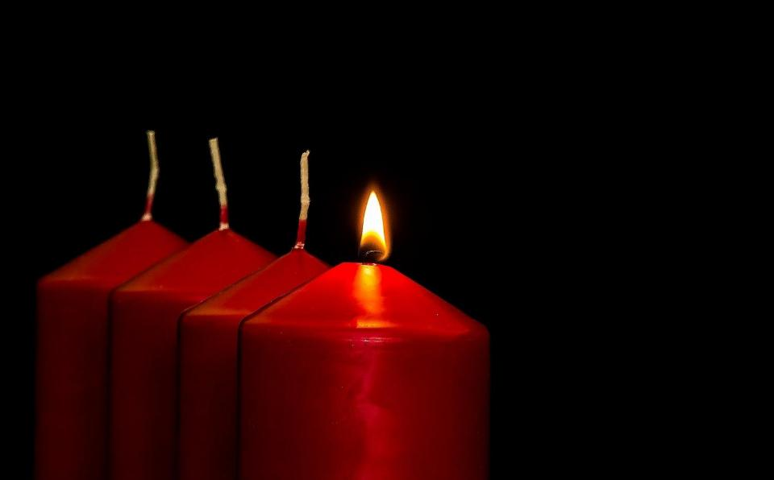


Leader: Jesus, Light of the World….
All: …shine on our darkness today.
Notes:
Gathering: Use this special greeting for the Advent season, as you light your Advent candle.

Slide 3
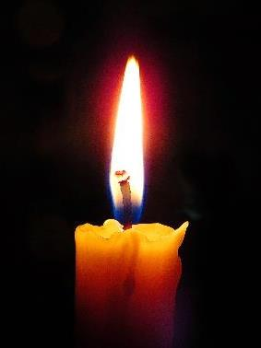
Those who walked in the dark have seen a bright light. And it shines upon everyone who lives in the land of darkest shadows.
Notes:
Engaging: Read these words out loud together
Talk about times when light has been very welcome, shining into a dark situation. This might be literal – a torch on a dark walk – or figurative.
When have you needed a light in the darkness?
Which words stand out for you?
Is there a situation you are facing which feels ‘dark’; or a place that needs ‘light’?
I wonder which words might have been light in the darkness for you in difficult times?
What do you think might make these words significant for Christians?
These words are from the most famous of Isaiah’s prophecies about the Messiah and set the context of the dark times in which Isaiah was writing these words. Isaiah was writing at a time when the people had forgotten God, were being led by corrupt leaders, and an invasion from the Babylonian Empire looked imminent. Dark times indeed!

Slide 4

His name will be Wonderful Counsellor, Mighty God, Everlasting Father, Prince of Peace.
Isaiah 9:6
Notes:
Engaging: Isaiah’s prophecy
Hundreds of years before Jesus was born, prophets brought messages from God about what the Messiah would be like. Christians believe that this is Jesus, which is why Advent is such an important time in the Christian calendar, lighting the way in the darkness and waiting for the celebration of his birth.
I wonder which words strike you most as you read this prophecy?

Slide 5

His name will be….. Wonderful Counsellor
Notes:
Engaging: His name will be…..Wonderful Counsellor.
A counsellor gives advice and helps people to make wise choices.
I wonder what choices you have made in life?
Easy choices….and difficult choices
What we say to people….. If we will help someone….how we will live….
Christians believe that Jesus, the Wonderful Counsellor, will help them to make wise choices.
As you look at this image and these words, be conscious of where your thoughts take you….

Slide 6

His name will be….. Mighty God
Notes:
Engaging: His name will be…..Mighty God,
Christians believe that God is a mighty, powerful God. He can do things that seem impossible to humans. They believe He made the universe, including the stars millions of light years away.
They also believe that Jesus shows God’s power. I wonder which stories you know about Jesus that show this?
What have you seen that might show Christians that God is powerful?
Are there times when you wish God would show his power more in our world?
As you look at this image and these words, be conscious of where your thoughts take you….

Slide 7

His name will be ….. Everlasting Father
Notes:
Engaging: His name will be …..Everlasting Father
NB Be sensitive to the fact that not all children will have a father in their lives, and some may have negative experiences of fathers. Christians’ understanding of God is not modelled on their human experience of fatherhood, but on the perfect example of God within the Trinity.
Christians believe that God is with them for ever; he loves like a good parent loves their child.
This is a mobius strip. If you run your finger round it, it never ends.
(You can make one from a long strip of paper, half twist it and stick the ends together with tape.)
How might it help Christians to know that God is ‘everlasting’?
As you look at this image and these words, be conscious of where your thoughts take you….

Slide 8
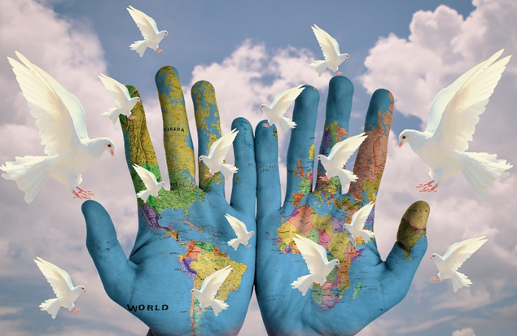
His name will be….. Prince of Peace
Notes:
Engaging: His name will be……Prince of Peace
There is so much war and conflict in our world.
People find it difficult to make and keep peace.
Our own hearts are often not at peace, but anxious and worried.
Christians believe that Jesus brings peace – for them, and for our world.
As you look at this image and these words, be conscious of where your thoughts take you….

Slide 9

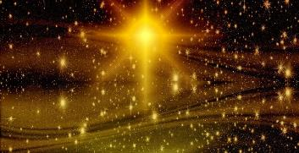


His name will be Wonderful Counsellor, Mighty God, Everlasting Father, Prince of Peace.
Isaiah 9:6
Notes:
Going deeper and words for worship:
…think about the names of Jesus that we have looked at…..
How might they each provide light in dark times?
I wonder which one is the most important to you?
I wonder which one you think is most important for Christians in this season of Advent?
I wonder which one you think our world needs most?
Maybe think or pray about the places in your life – and the world – where light most needs to shine.

Slide 10
The true light that shines on everyone was coming into the world.
Notes:
Sending: Words from John’s Gospel
The disciple John writes in the very first verses of his Gospel book: The true light that shines on everyone was coming into the world.
Jesus came to be a light in the darkness – and His names bring light and hope into a dark world.
But it doesn’t stop there, because followers of Jesus can be a part of God’s Kingdom on earth, and shine God’s light wherever they go.
I wonder what challenges this idea might present us with as we go away from this place and into the rest of the day?
You might also wish to leave students with a final challenge based on this slide, then blow out the candle as a sign that the collective worship is finished.

