Slide 1

Today’s words can be found in Psalm 8:3-4
Words to make you wonder…
Image from pixabay
Notes:
‘Words to make you wonder’ – Summer term 2026 These resources are ©The Diocese of Guildford
This is a companion resource to ‘Stories as treasure to be found’, collective worship resources created to support Secondary schools in the Diocese of Guildford. ‘Words to make you wonder’ are taken from different parts of the Bible and used in response to world events or big questions in life. The words we use in this resource include a section of one of Paul’s letters to the Early Church in Corinth, and have strong resonance with an ancient fable, told by ancient Greek fable-writer Aesop – which in all likelihood, inspired St. Paul to write words containing one of the most famous images in the New Testament, that of a body at war with itself.
Notes for the teacher: This resource is to be used for collective worship during tutor times or in other groupings that work for your setting. There may be enough material here to resource more than one tutor time.
Each resource contains some images and words to support the spiritual development of students, with a script for the leader written under the slides.
Any bold text indicates when a click will animate either text or an image for students to ponder, and italic text contains pointers for the leader.
Especially important is the slide denoted as ‘Going deeper: responding and words for worship’, which ensures that the resource meets the requirement for daily collective worship in your Church school. The words are invitational, and prayer is optional.
At the end of the slides, there is an image from across times and cultures illustrating the story from a different perspective. You might want to include a question on this slide that will challenge students’ thinking as they leave, or at another time, picking up on what has been talked about during the gathering.
Today’s words come from 1 Corinthians 12: 14-21, written by St. Paul to the Church in Corinth at a time when they were experiencing the challenges of growing an increasingly diverse community. Paul was a well-educated Roman citizen, and a fluent Greek speaker and writer, so it is quite likely that Aesop’s stories would have been familiar to him. In the education of ancient Greeks and Romans, fables were known as 'progymnasmata’, translated as ‘fore-exercises’, training students in the ancient skill of rhetoric (persuasive speaking/writing).

Slide 2
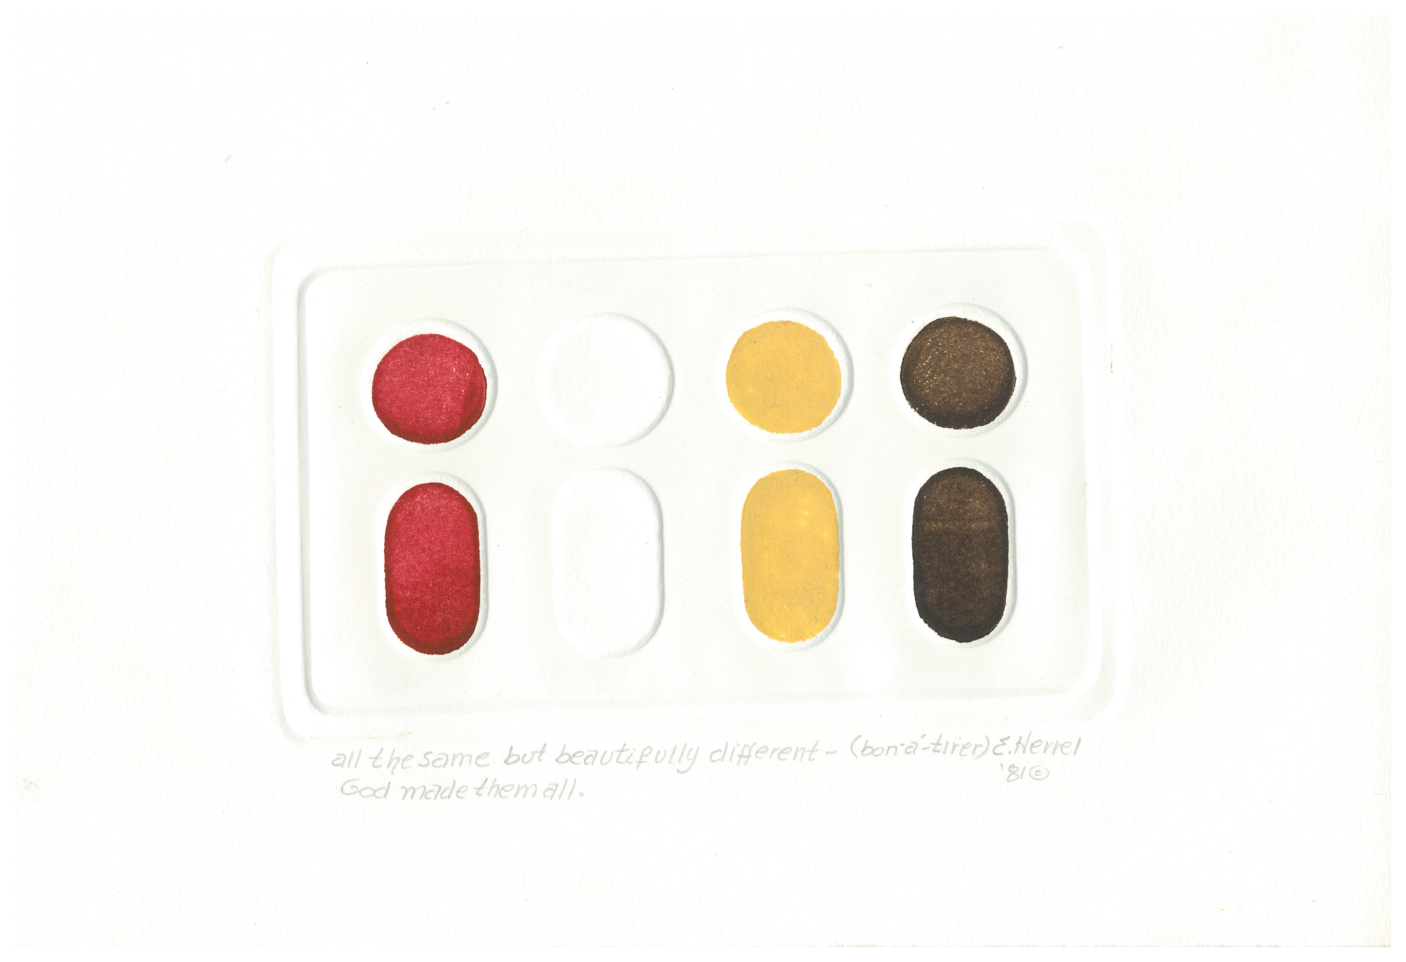
Gathering:
Listen to these words, written by the artist:
‘All the same, but beautifully different – God made them all.’
Print by Edie Mae Herrel from Art in the Christian Tradition
Notes:
Gathering: All the same but beautifully different – by Edie Mae Herrel
You might want to light a candle to signal the start of collective worship. Invite students to be quiet and still and look, then listen to the words.
Talk together about this print by American artist Edie Mae Herrel.
How does it illustrate the words that the artist has written underneath?
Why is it important that communities are not mono-cultural (in its widest sense) and that we value difference? [This may be a challenge to us all!]
(How) is this evident in our school community?
What could be better?
Our theme for today is as relevant for us today as it was for people living in Ancient Greece……when Aesop wrote a story called The Divided Body.

Slide 3
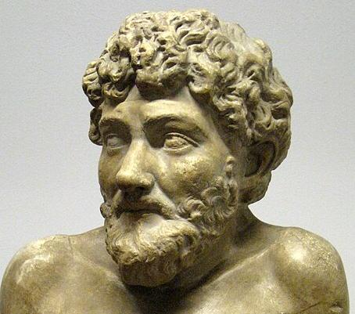
user:shakko, CC BY-SA 3.0 <https://creativecommons.org/licenses/by-sa/3.0>, via Wikimedia Commons
Aesop (c.620-564 BCE)
The Divided Body
Notes:
Engaging: Aesop
The Greek writer Aesop was born in roughly 630BCE and was probably a slave who won his freedom through the telling of the fables for which he is famous, especially those that are about animals. We probably all know the Hare and the Tortoise – or the Boy Who Cried Wolf.
‘The Divided Body’ tells of the day that the body’s arms and legs started arguing with the stomach about the fact that they did all the work gathering food, but the stomach got all the benefit, and then going on strike. You can probably guess the conclusion of this cautionary tale…..the arms and legs got weaker and weaker because the stomach wasn’t getting food – and the whole body stopped working.
I wonder what you think the message of this story is – and why we have told it today?

Slide 4
…a person’s body has more than one part. It has many parts. ¹⁵ The foot might say, “I am not a hand. So, I am not part of the body.” But saying this would not stop the foot from being a part of the body. ¹⁶ The ear might say, “I am not an eye. So, I am not part of the body.” But saying this would not make the ear stop being a part of the body. ¹⁷ If the whole body were an eye, the body would not be able to hear. If the whole body were an ear, the body would not be able to smell anything. ¹⁸⁻¹⁹ If each part of the body were the same part, there would be no body. But truly God put the parts in the body as he wanted them. He made a place for each one of them. ²⁰ And so there are many parts, but only one body.
²¹ The eye cannot say to the hand, “I don’t need you!” And the head cannot say to the foot, “I don’t need you!”
Notes:
Engaging: 1 Corinthians 12: 14-21
These words by St. Paul, written to the Church in Corinth, where some Christians were disagreeing with each other….. Nobody really knows for sure whether Aesop’s story was known to St. Paul, but they have some striking similarities! [You might want to ask a student to read this out loud]
Lead a short discussion based on Paul’s words:
I wonder what had happened in Corinth that meant Paul needed to write these words?
I wonder which of these words you think contain the most important message for us today?
I wonder where in our school community we face the same struggles as the Corinthian Church?
I wonder if you’ve ever felt like this – wishing that you were something that you’re not?
I wonder whether we’ve ever said anything to someone else that has made them feel as if they don’t matter?...or that we are more important than they are?...

Slide 5
….God put the parts in the body as he wanted them. He made a place for each one of them. And so there are many parts, but only one body…..
…If difference is important to God, should it be important to us?...
…I wonder how these words might help us to live better together as a school community?...
Notes:
Going deeper: responding and words for worship
1 Corinthians 12: 19b-20a
If difference is important to God, should it be important to us?
I wonder how these words might help us to live better together as a school community?

Slide 6
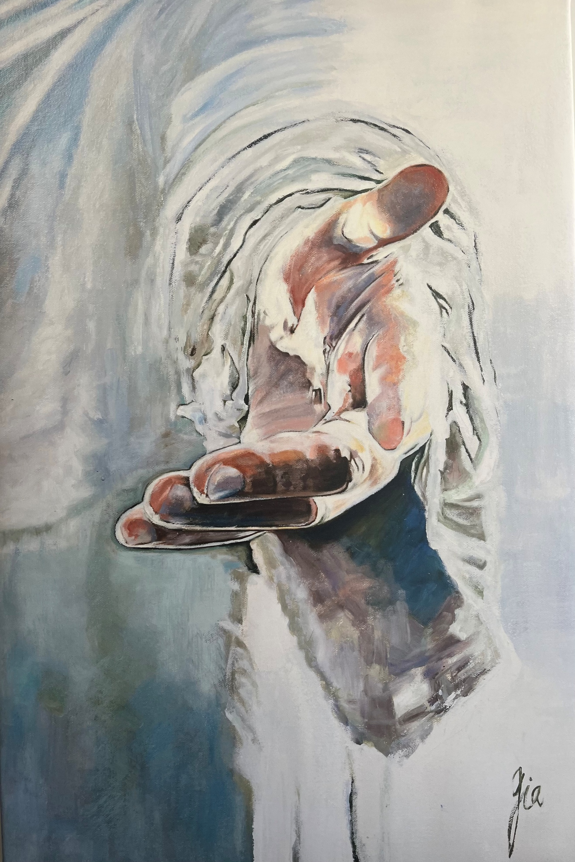
Christ has no body now but yours. No hands, no feet on earth but yours.
Yours are the eyes through which he looks compassion on this world. Yours are the feet with which he walks to do good.
Yours are the hands through which he blesses all the world.
Notes:
Sending & Blessing: This is an image by Chinese artist Cathy Henfrey, who painted it during the pandemic after becoming a Christian. She said she it felt to her that God was reaching out to her, inviting her in. We are grateful to her for allowing us to use this original work.
The words of this blessing were written by 16th Century Spanish mystic and saint, Teresa of Avila. They express a challenge in the difference that each one of us can make….
Christ has no body now but yours. No hands, no feet on earth but yours.
Yours are the eyes through which he looks compassion on this world. Yours are the feet with which he walks to do good.
Yours are the hands through which he blesses all the world.
So, go out into this day to be a blessing….
Sending: you might wish to leave students with a final challenge based on this slide, then blow out the candle as a sign that the collective worship is finished.

Slide 7
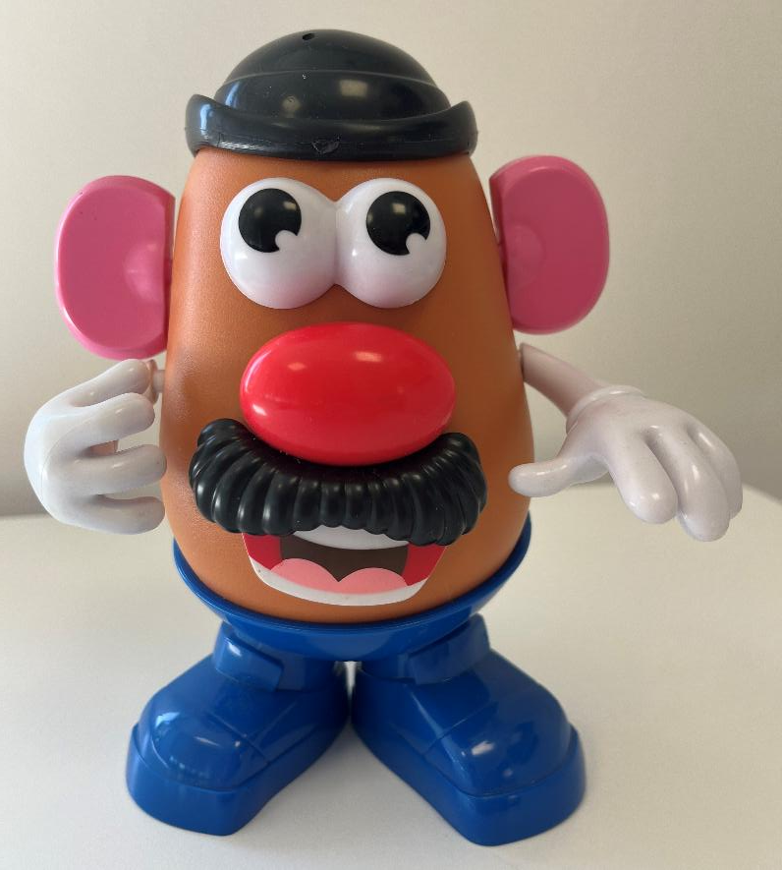
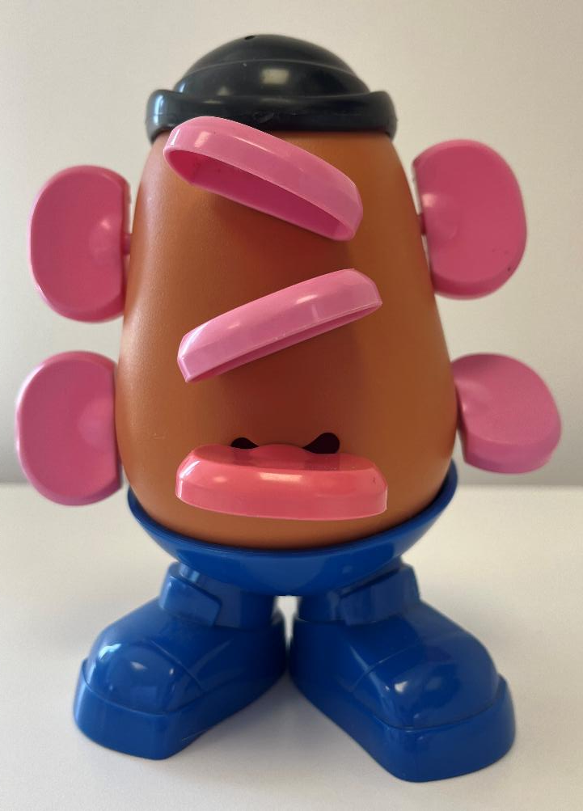
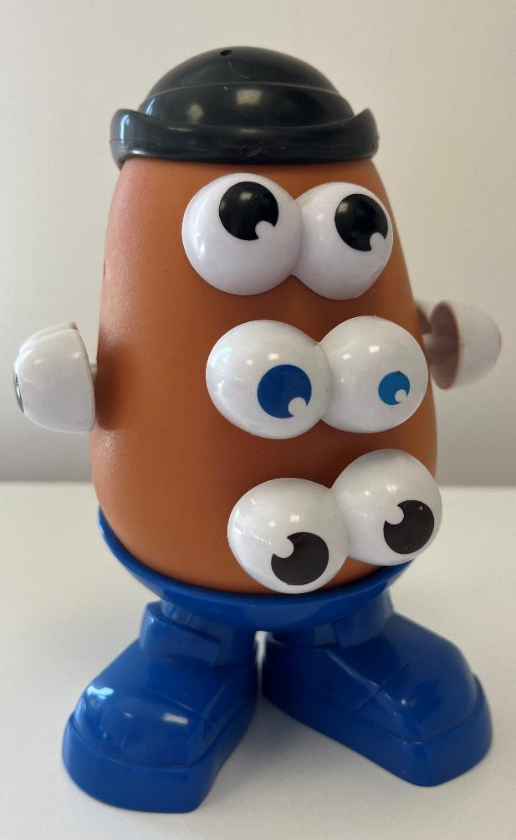
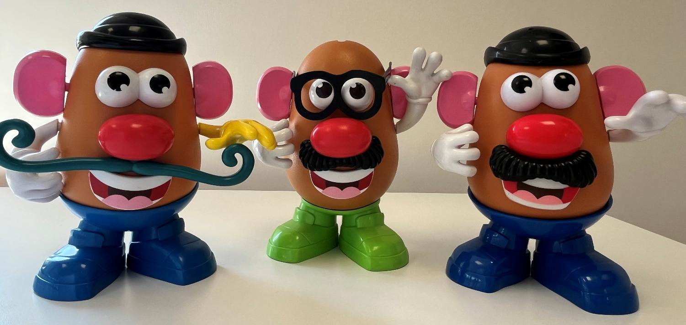
I Corinthians 12:14-21
Notes:
1 Corinthians 12:14-21, adapted with help from Mr. Potato-Head!
This slide contains images that we created using Mr. Potato-Head to illustrate the words written by St. Paul in 1 Corinthians 12.
They may provide a light-hearted version for you to use as a reminder – much as Paul did in (re)creating this rather ridiculous scenario in his words.

