Slide 1
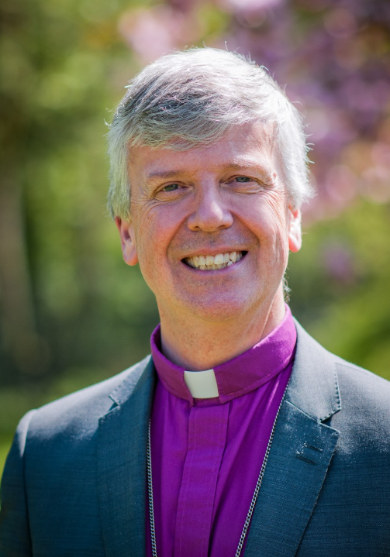

Notes:
For adults using this resource: Text in bold indicates further animations on the slide.
This a resource designed for use with children and young people, as part of the ‘Vacancy in See’ process; there are further resources, including a video from Bishop Paul inviting children to respond and to help you to consider your ideas or gather children’s responses on the Guildford Diocese ‘Vacancy in See’ webpage: https://www.cofeguildford.org.uk/about-us/governance/vacancyinsee-committee-members/vacancyinsee/
As you’ll notice from the photos we have chosen in this resource, there are Anglican Bishops all over the world – and in the UK – from many different backgrounds. Some are former clergy from the Diocese of Guildford, so may be recognised by some.
Slide 1: You might remember Bishop Andrew, who was the last Bishop of Guildford, and who died in March this year.
The people appointing the new Bishop of Guildford would especially like to hear from children and young people in the diocese, so this resource is going to help us to think about this important job – and what sort of person might do it well….

Slide 2
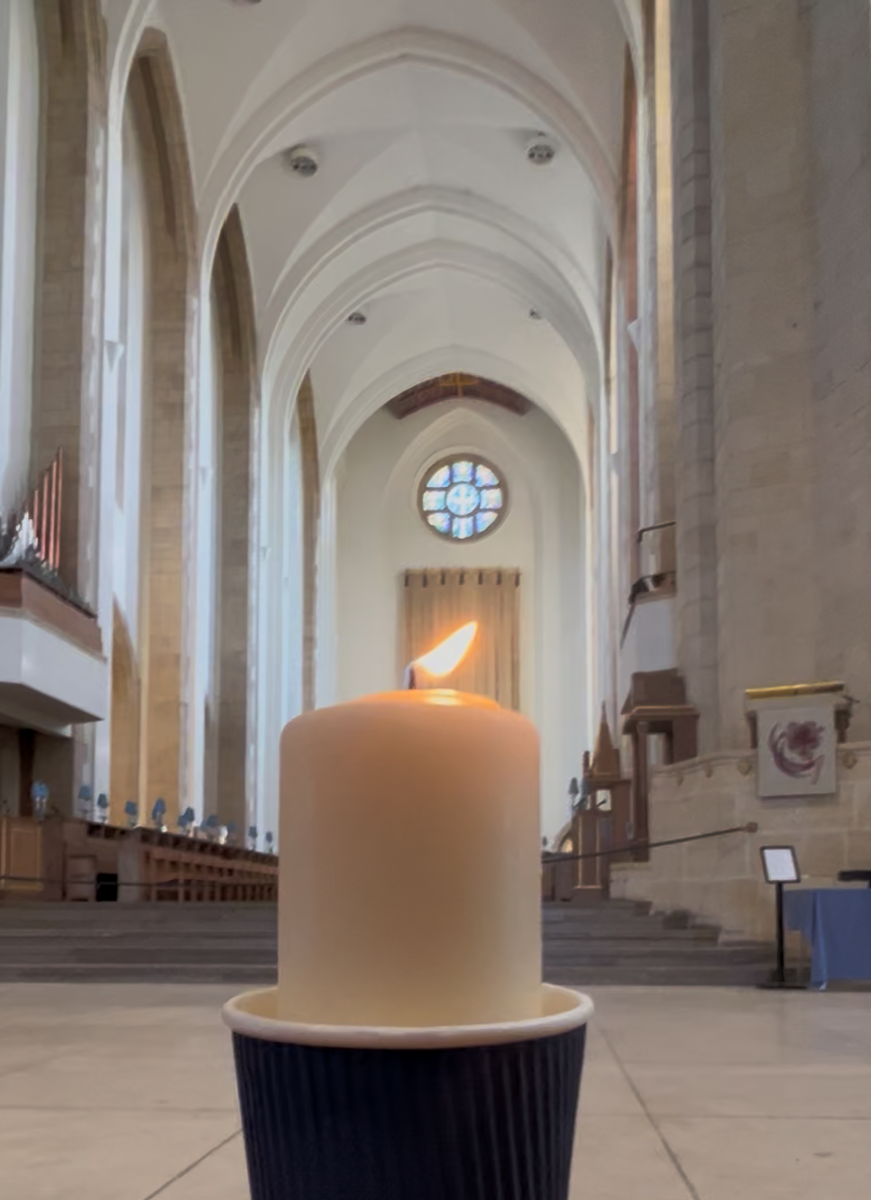
Notes:
Slide 2: Flickering Leavers’ Candle in Guildford Cathedral slide
This video is of one of our special Year 6 Leavers’ candles. It was Bishop Andrew’s idea that these candles should be given out at our Leavers’ Services, to use in collective worship back in school and to remind us to be a light in dark places. So, as you begin, you might want to be still with your own thoughts or prayers for a few moments….

Slide 3
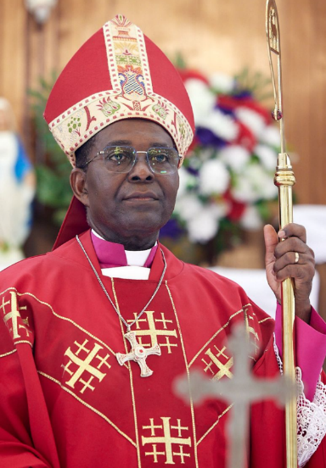
What does a Bishop do?
‘You must be like shepherds to the flock of the church of God’.
Acts 20:28
Who is the ‘flock’?
What should a shepherd do?
Rt Rev’d Dr. George Kotei Neequaye, Bishop of Tema
Notes:
Slide 3: The very first Churches appointed people to lead them, and wrote these words about what leaders should be like: ‘You must be like shepherds to the flock of the church of God’.
Talk together:
Who is the ‘flock’?
What should a shepherd do?

Slide 4
Notes:
Slide 4: Here are a few ideas about what a shepherd does for his flock…..
Helps them to find good food & water
Keeps them safe from danger
Helps when they are injured or ill
Rescues them when they are lost
Protects them from wild animals
On the final slide, there is a link to a reflective story based on Psalm 23, about God the good shepherd. The QR code will take you to the video.

Slide 5
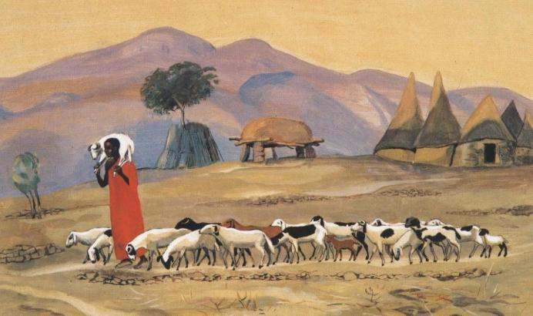
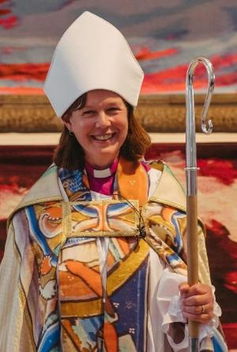
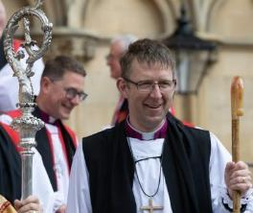
Jesus said, ‘I am the Good Shepherd’.
John 10:11
Rt Revd Robert Saner-Haigh Bishop of Carlisle
Rt Revd Debbie Sellin, Bishop of Peterborough
Notes:
Slide 5: The Good Shepherd
Jesus called himself the ‘Good Shepherd’ who looks after the sheep – so a Bishop is simply following in Jesus’ footsteps and copying what Jesus does, caring for the people in his care as Jesus would.
One of the symbols of office that a Bishop carries is a crook, (its special name is a ‘crozier’!) – a reminder of this important job, caring for and leading the flock. You can see them in the photos.

Slide 6
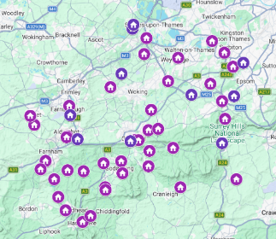
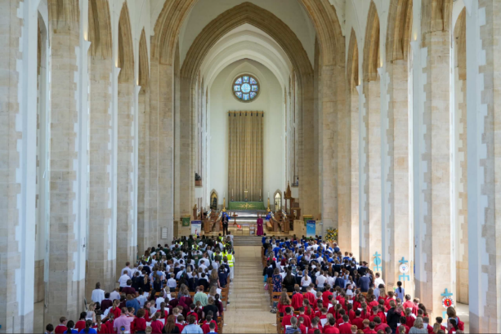
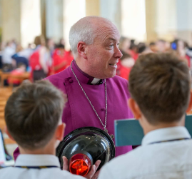
Leading a community
Jesus said, ‘I am the Good Shepherd’.
John 10:11
Rt. Rev’d Paul Davies, Bishop of Dorking
Notes:
Slide 6: The Bishop of Guildford will have an important role in leading and looking after churches and schools across the Diocese – a bit like your headteacher leads your school and looks after all the adults and the children who are a part of your school community.

Slide 7
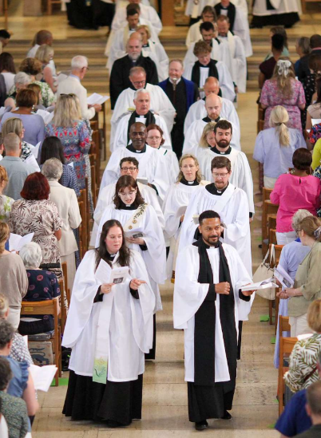
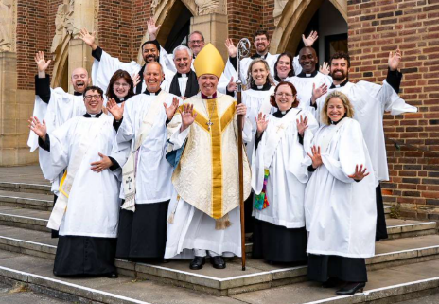
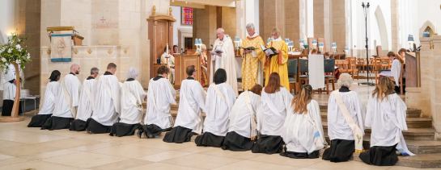
Ordinations
Notes:
Slide 7: Like your headteacher helps to appoint new teachers to your school, the Bishop also helps to choose new vicars and clergy for the churches in the Diocese of Guildford. When people become a vicar, there is a special service at the Cathedral called an ordination when the Bishop presents them with a Bible and prays for them in their new role.
When a new vicar starts in a local church, there is another special service when the Bishop and the local church welcome them to their new parish.

Slide 8
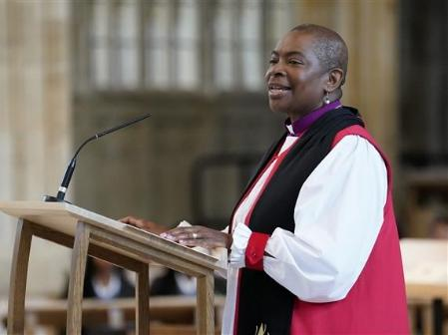
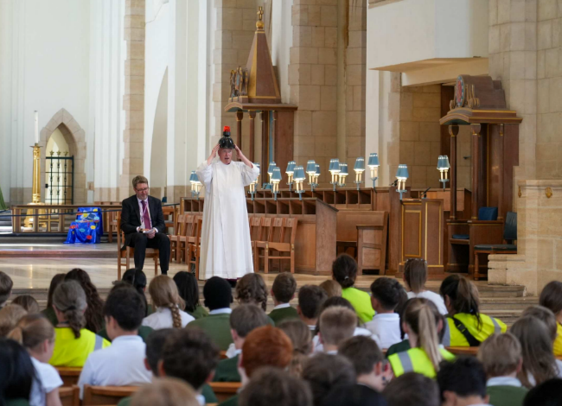
Teaching a community
Rt Rev’d Rose Hudson-Wilkin, Bishop of Dover
Rt Rev’d Paul Davies, Bishop of Dorking
Notes:
Slide 8: A Bishop also has an important role teaching people about Jesus, in the Cathedral, in churches and in schools across the Diocese. Sometimes they might be teaching vicars, and sometimes children, so they have to be good at talking to everyone!

Slide 9
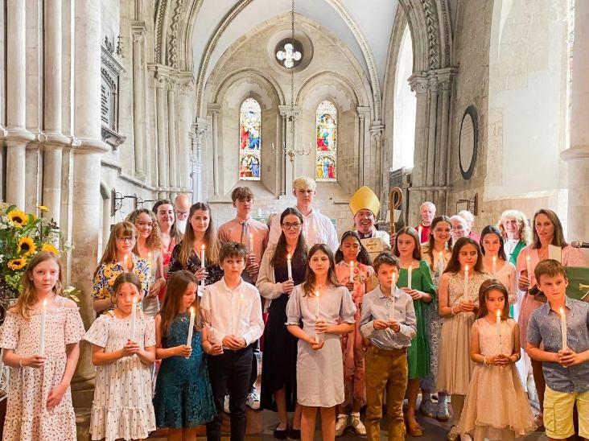
Confirmations
Confirmation candidates at All Saints Church, Crondall
Notes:
Slide 9: People in our Diocese who wish to be confirmed as followers of Jesus will have a special prayer when the Bishop blesses them during the service of confirmation. The Bishop likes to talk to each one of these people about their journey of faith before the service.

Slide 10
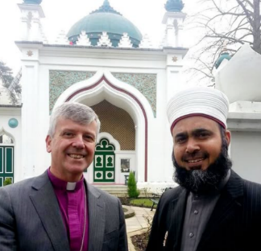
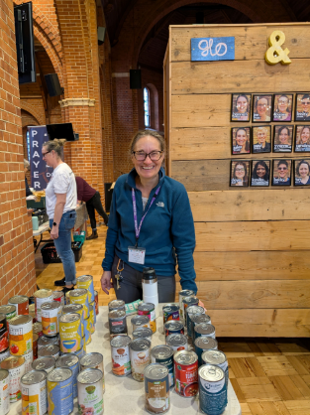

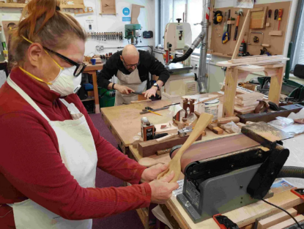

Being part of a community
Notes:
Slide 10: The Bishop also joins in with other local leaders to support the whole community in living well together. This includes supporting charities and community initiatives such as food banks, eco churches and life skills projects to show that looking after everyone is important.

Slide 11
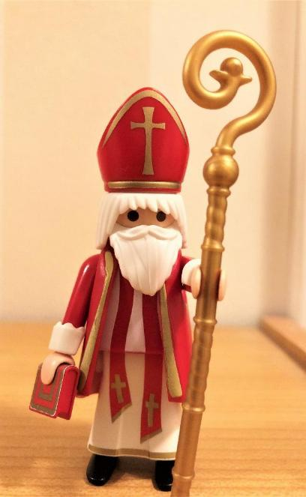
What do you think?
Notes:
NB Adults, there are further resources, including a video from Bishop Paul inviting children to respond and to help you to consider your ideas or gather children’s responses! These are on the Guildford Diocese ‘Vacancy in See’ webpage.
Slide 11: What do you think?
We are asking children and young people for their ideas about what our new Bishop should be like, so here are a few thoughts to reflect on….
What do you think should be in the new Bishop’s heart?
What should they carry in their backpack to help in their work?
What would they pray about?
If the Bishop has visited your school or church, how would you finish the sentence…?
When the Bishop visited, I liked……
If the Bishop hasn’t visited your school or church, how would you finish the sentence…?
I like it in collective worship (or assembly) when we……

Slide 12
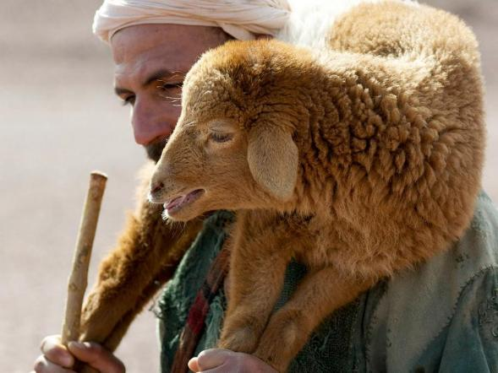
O God, who gives wisdom to all who ask,
We are grateful for all those who lead us…. in our schools….our churches…..our community….and our wider world…..and especially now, as we pray for whoever will be our new Bishop.
Please guide their thoughts and their hearts as they respond to your call to shepherd this flock in the Diocese of Guildford.
Notes:
Slide 12: Prayer
Here is a prayer to use, if you would like to, after you have thought about all these ideas.
O God, who gives wisdom to all who ask,
We are grateful for all those who lead us…. in our schools….our churches…..our community….and our wider world…..and especially now, as we pray for whoever will be our new Bishop.
Please guide their thoughts and their hearts as they respond to your call to shepherd this flock in the Diocese of Guildford.

Slide 13


Slide 14
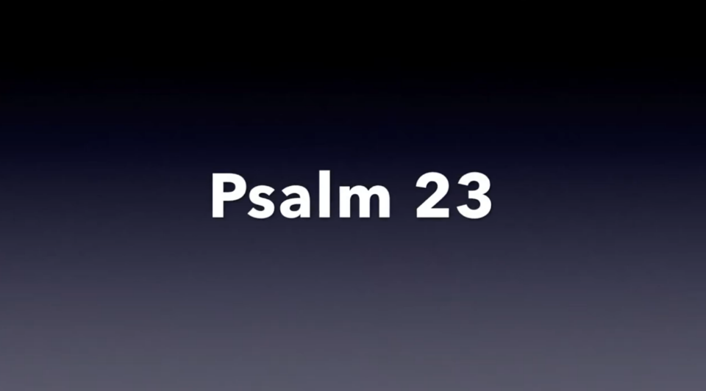
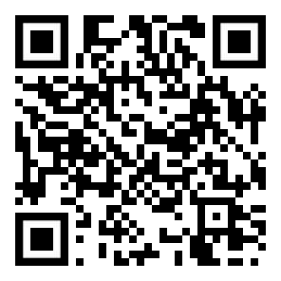
Notes:
Slide 14: Psalm 23 video, a reflective story
This QR code will take you to a reflective story based on Psalm 23, about God, the Good Shepherd.
It might help you as you think about the role of the new Bishop.

