Slide 1

All images copyright-free from pixabay, unless otherwise identified
Notes:
Gathering:
Slide 1: Sparkling gemstones stilling exercise
Use the stilling slide if desired: the suggested words should be spoken slowly, leaving pauses inbetween to create a sense of stillness.
As you sit quietly, look at the gems falling and sparkling…… [PAUSE]
Now practise slower breathing…..in…..and out…..in……and out…..as you watch….[PAUSE]
You maybe notice that you are feeling calmer and more relaxed….[PAUSE]
As you breathe, think about yourself and what you bring into this time today….. [PAUSE]
We come into this special / sacred space and time to be still….to think deeply…..to be together as a school community…..
In our time together today, we will have a team challenge, share a story, and then think together.

Slide 2

Leader: As we gather to share our story today….
All: May we grow in our understanding of ourselves.
Notes:
Slide 2: Use our new gathering words for this term, or your usual greeting if you prefer. These greetings may change slightly each week to reflect the spiritual elements that we will be exploring in each week’s materials.
Leader: As we gather to share our story today….
All: May we grow in our understanding of ourselves.

Slide 3

Stories that help us to grow
Notes:
Slide 3: Over the last few weeks, as part of this term’s series, ‘Stories that help us to grow’, we’ve heard some parables of Jesus, stories that have had hidden meanings for us to find. In a short while, we are going to hear a very different kind of story – a traditional tale – which also may have a meaning for us to search for…..and help us to grow!

Slide 4
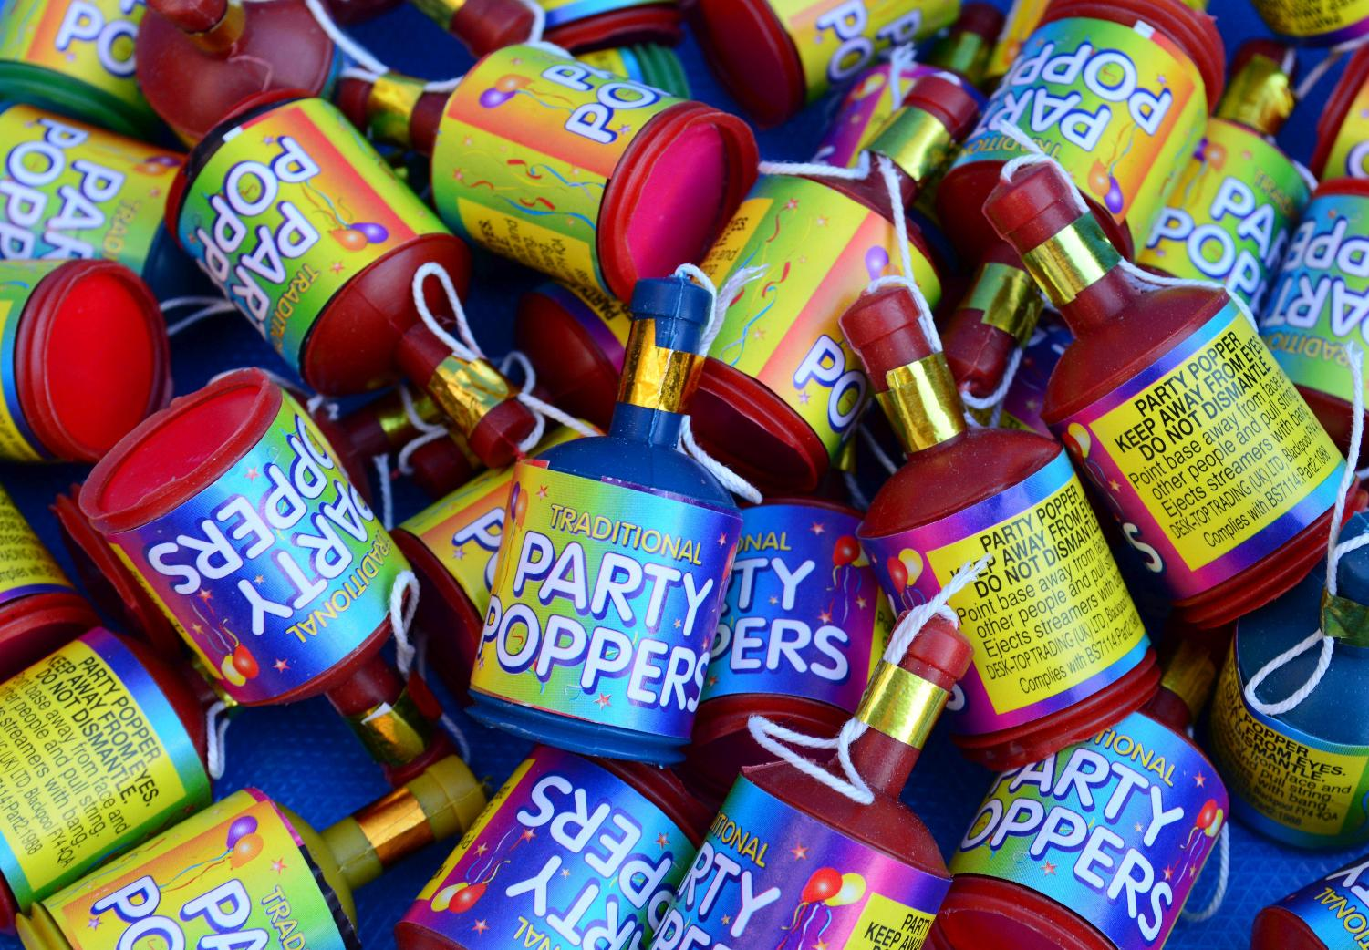

Notes:
Slide 4: The party popper challenge
Before that, and to start our assembly today, I have a team challenge for two teams of players – for a game that has something to do with our story. I need 4 players, 2 on each team. Each team needs a party popper. I’m sure you’ve all seen how these work, so we will need to handle them very carefully to ensure that no one gets hurt. One player / the adult on each team is going to pop their popper when I count down, and the other player on each team have to collect all the bits and put them back in their poppers – you’ll see why later! You’ve got until I say ‘STOP!’ to collect as much of the popper bits as you can – but you’ve got to get them back into the poppers to win! [Conduct the challenge, ensuring afterwards that you reassure all that you set them an impossible/difficult challenge!]
For now, I’m not going to tell you what the point of that game was, although some of you might be able to work it out, once you hear what happens in our story today. It’s a very old traditional story from France about two very different sisters – listen and see if you can work out what the story has to do with our popper game…..[use story on p4-5 and slides 5-11]

Slide 5
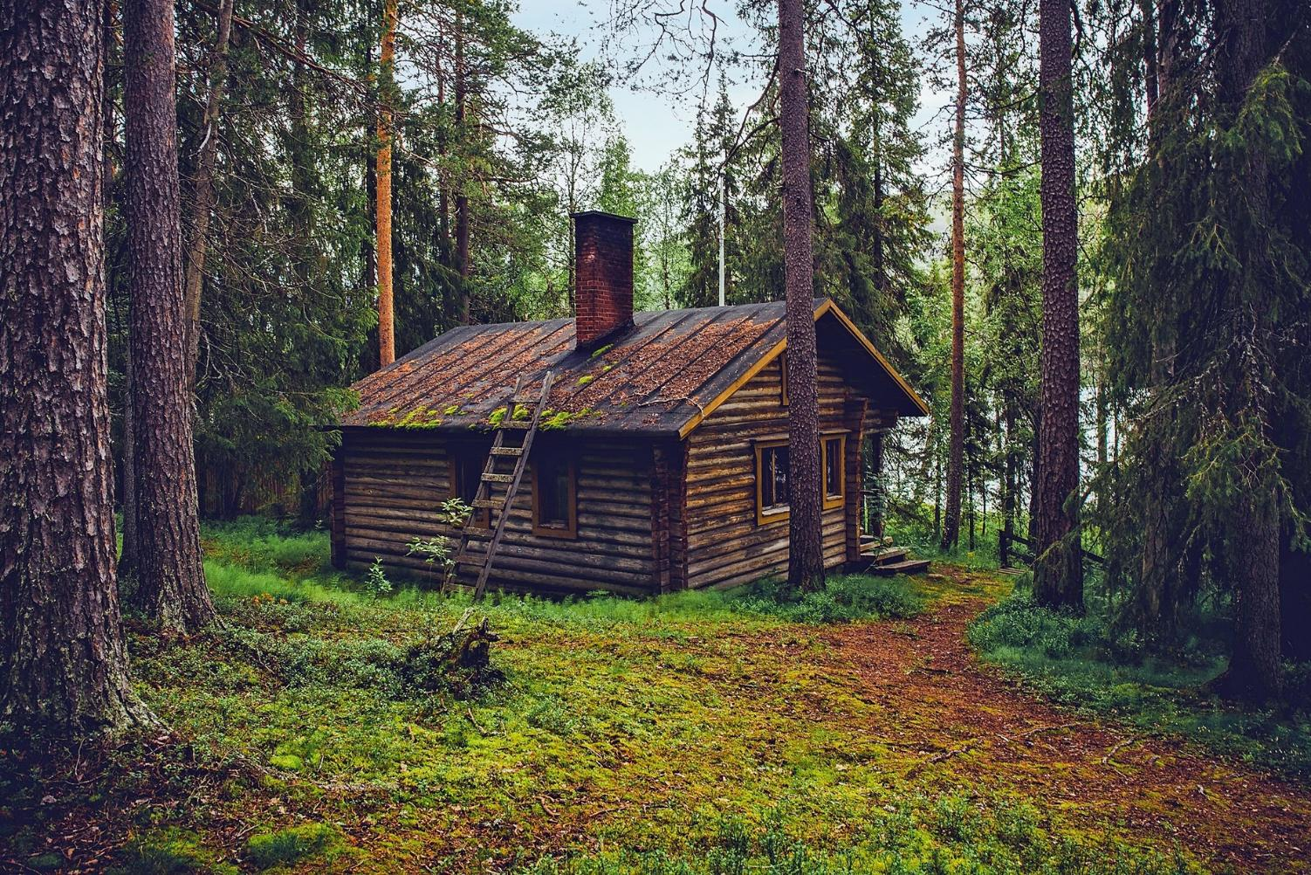
Notes:
Slide 5: Long, long ago, in a village in France, there were two sisters, who lived with their mother in a little cottage near the woods. The older sister, Claudette, was rude and bad tempered, and never had anything nice to say about anything or anyone. Colette, the younger sister, was the exact opposite. She was kind and generous and always had good things to say about other people.

Slide 6
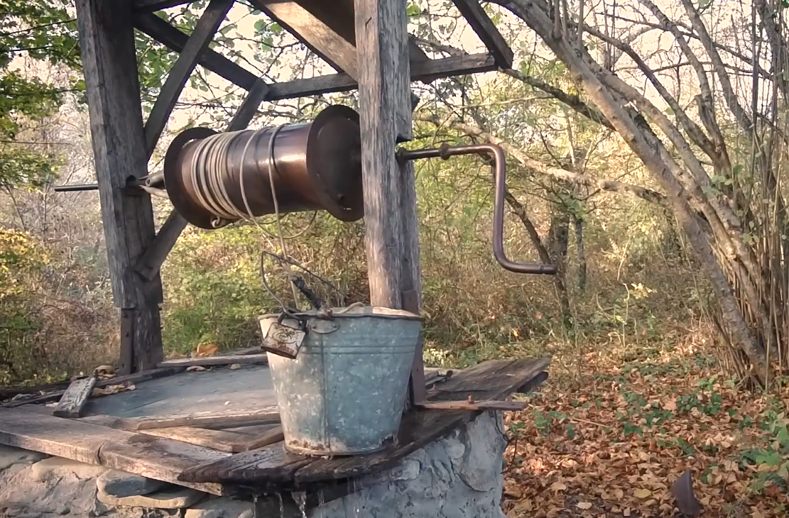
Notes:
Slide 6: One day, Colette was sent to the well at the edge of the woods to get water. [explain how this works if you need to.] It wasn’t far, but the well was deep and the bucket was heavy. On her way back, she met an old woman, resting by a tree. Now, the old woman was really a fairy in disguise.

Slide 7

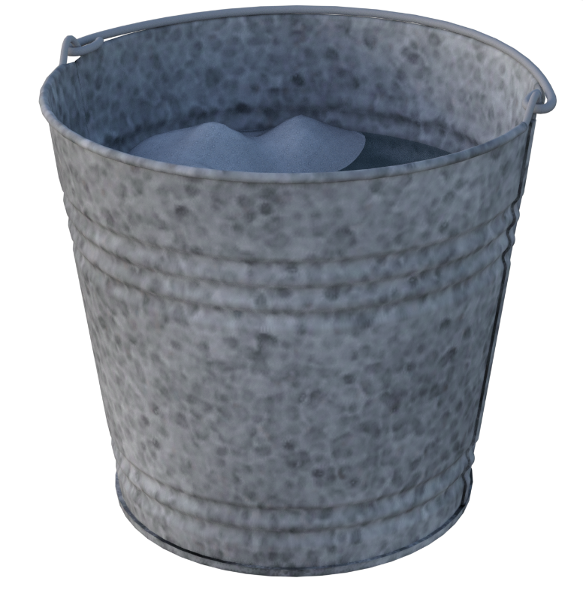

Slide 8
Notes:
Slide 8: Meanwhile, back in the little cottage, Colette’s mother and sister were waiting – VERY impatiently. ‘You stupid girl! Where have you been? We’re desperate for a drink!’ they snapped at Colette as she came through the door. As Colette explained what had happened to her….

Slide 9

Notes:
Slide 9: …precious jewels dropped from her mouth, just as the old woman had said they would. Her mother and sister could hardly believe their luck as they gazed at the glistening piles that of stones at Colette’s feet! ‘We’ll be rich beyond our wildest dreams!’ her mother exclaimed. ‘Claudette! Go into the woods and get more water. When you meet the old woman, be sure to give her a drink. Then we will be twice as rich!!!’

Slide 10
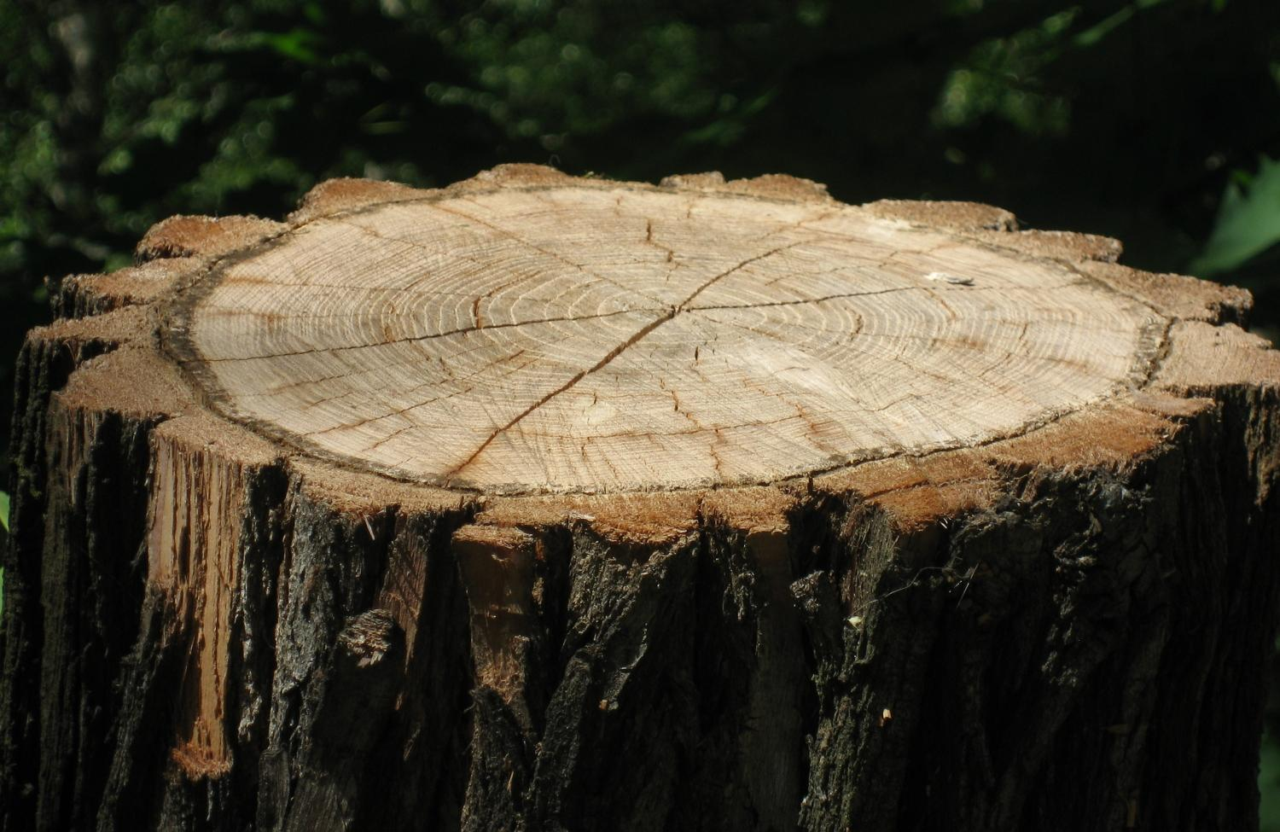
Notes:
Slide 10: So off Claudette went and got more water. On the way back, she looked all around for the old woman, but she was nowhere to be seen. Claudette carried on her way, muttering crossly. Imagine her surprise when a princess called out from her seat on a tree stump, asking for a drink. Claudette replied in her usual manner ‘Who do you think I am – your slave? Get your own water!!!’ How rude!
Now what Claudette didn’t realise was that it was the same fairy, but this time disguised as a princess! The princess stood up, looked at Claudette and said ‘Your words are as ugly as….

Slide 11
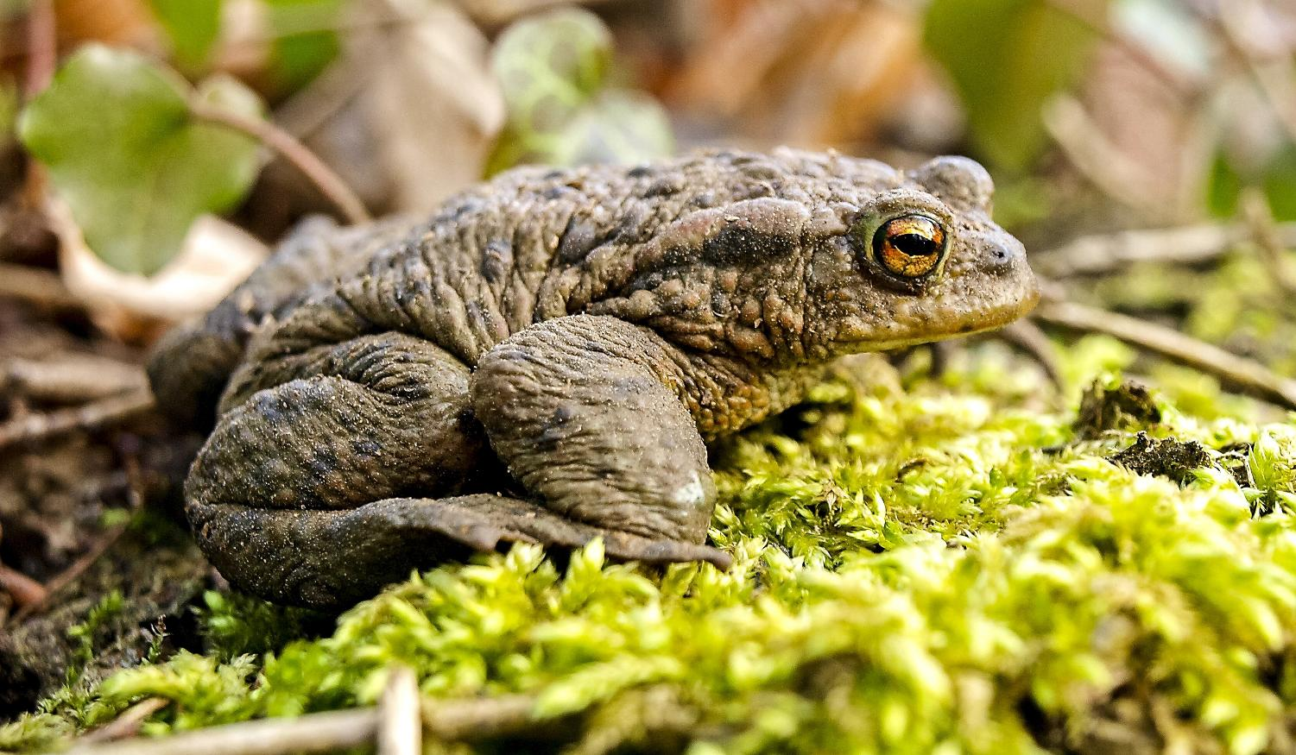
Notes:
Slide 11: ….toads and frogs. So, whenever you speak, that’s exactly what will fall from your mouth. Let that be a lesson to you!!’ And with that….the princess went on her way and was never seen again.

Slide 12

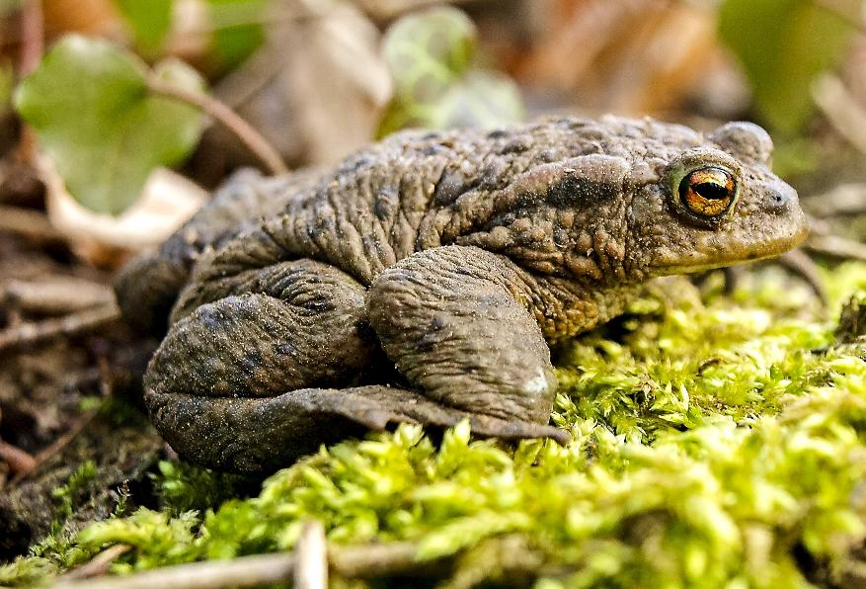
Notes:
Slide 12: I wonder what this story shows us – what meaning we might find in this strange tale? [ask for some ideas, which will hopefully have something to do with kind v. unkind words]
Do you think it’s a true story?!
Our words are just like the bits from the party popper – once they’re out of our mouths, it’s impossible to put them back again. If our words are unkindly spoken like Claudette’s, then they can really hurt other people. Like our out of control party popper bits, our words can sometimes get out of control. Maybe we’re angry or hurt or tired and we say something to someone that we later regret. Listen to these words from the Bible which put it like this….

Slide 13
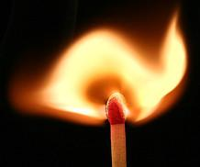
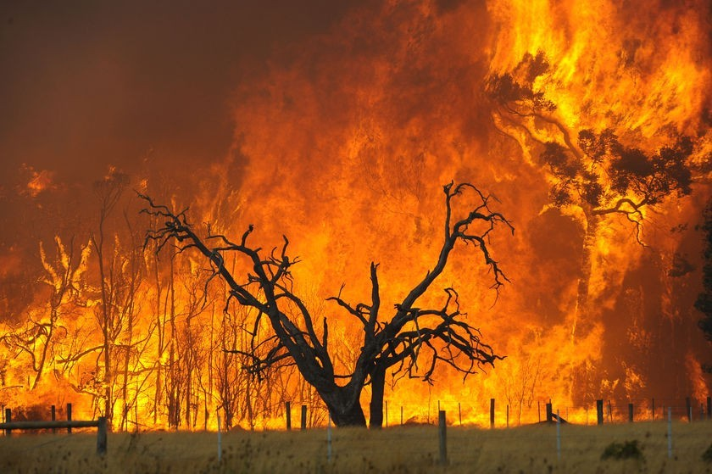
It is the same with the tongue. It is a small part of the body, but it brags about doing great things. A big forest fire can be started with only a little flame!
(James 3:5)
Notes:
Slide 13: It is the same with the tongue. It is a small part of the body, but it brags about doing great things. A big forest fire can be started with only a little flame! (James 3:5)
These words are a little bit like some of Jesus’ parables – they create a picture in words, saying that it only takes a very small flame to set a whole forest on fire. The words we speak are like this – a little word can do a great deal of damage. Our words are our responsibility: we need to choose them carefully and speak them kindly, like Colette. We have the power to control what we say – and even better, to use this power for the good of others; to speak kind, thoughtful and encouraging words.

Slide 14
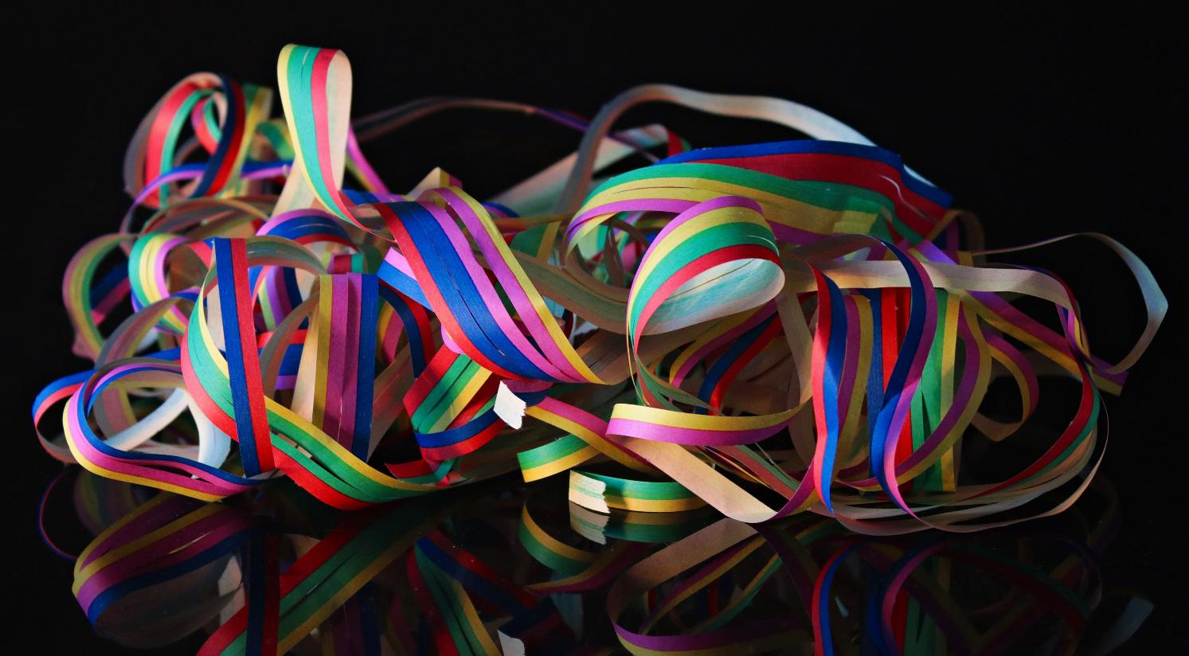
…I wonder what might help us to take care with our words?...
…I wonder which words might encourage others?...
…and how we might use our words to be a blessing?...
Notes:
Slide 14: Responding (and words for worship)
Let’s stop to be quiet and still and wonder together….
….I’m going to place our party popper bits here in front of us as a reminder of the power that our words have….
….we saw this in the story of Claudette and Colette….
The Bible writer James said that ‘a big forest fire can be started with only a little flame’ – our words can easily get out of control….we’ve all seen it happen….
…I wonder what might help us to take care with our words?...
…I wonder which words might encourage others?...
…and how we might use our words to be a blessing?...
For many people, talking to God in prayer helps them to take more care of their words, as they ask for his help, so I’m going to pray now, using some words we used earlier this term – because they are about words! There are some words for you to join in with if you would like to make the prayer your own, and they go like this:

Slide 15
…may the words of our mouths please you, O God.
Notes:
Slide 14: May the words of our mouths [place your hands on your lips] please you, God [both thumbs up]. [words adapted from Psalm 19:14]

Slide 16
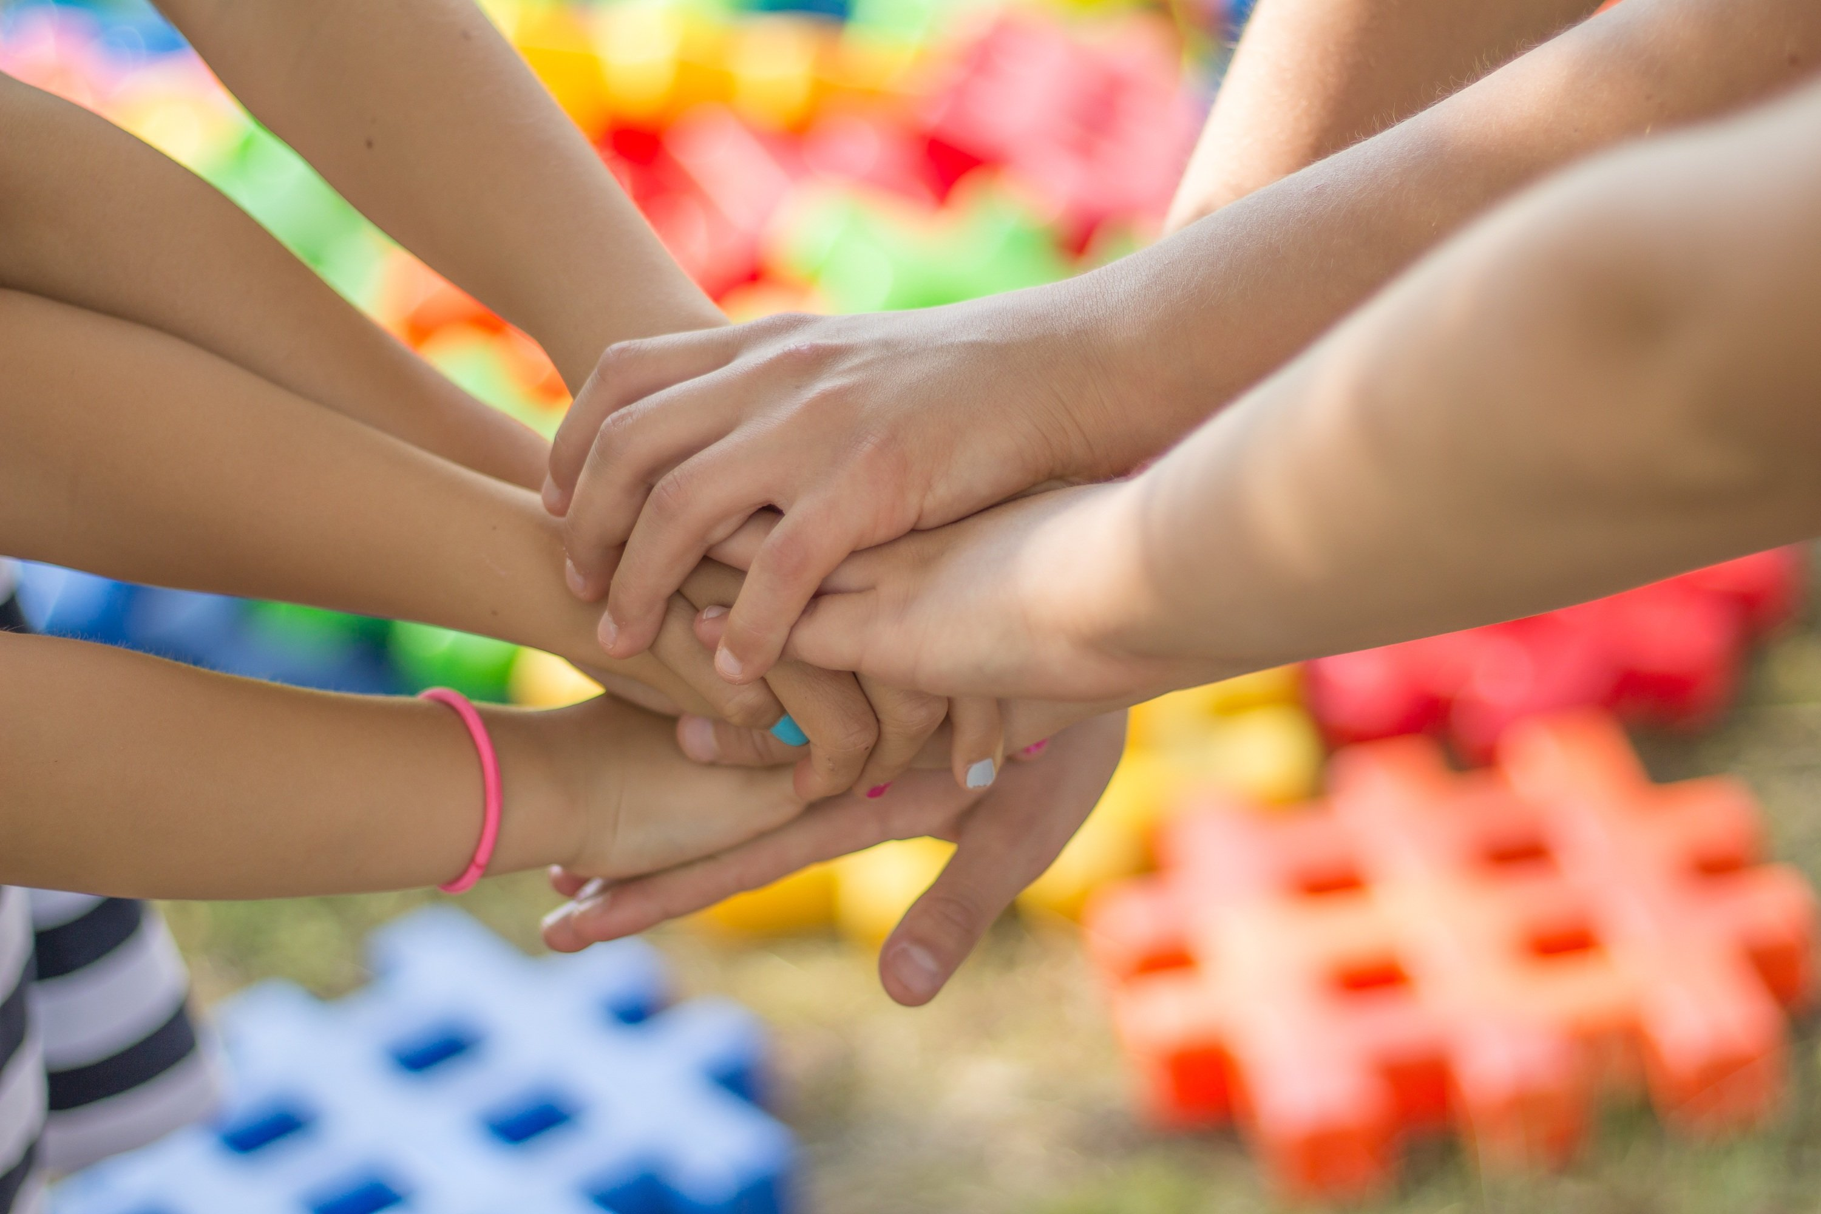
…may the words of our mouths please you, O God.
Notes:
Slide 16: Dear God
In our friendships, may the words of our mouths [place your hands on your lips] please you, God [both thumbs up].

Slide 17
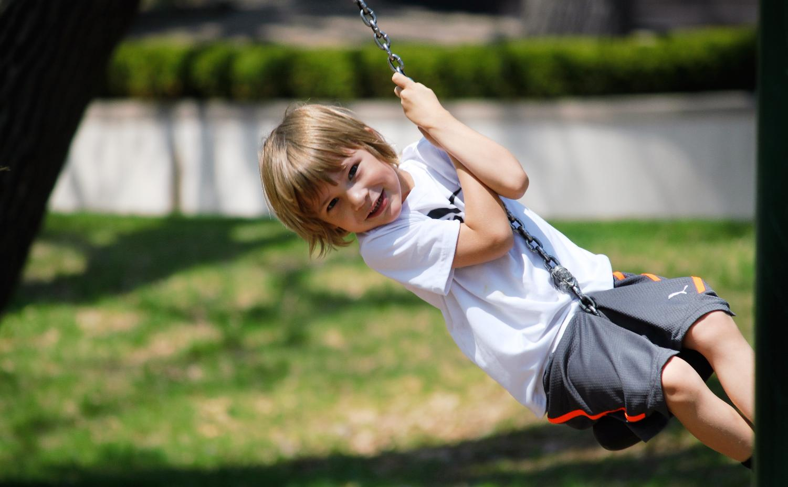
…may the words of our mouths please you, O God.
Notes:
Slide 17: At our playtimes, may the words of our mouths [place your hands on your lips] please you, God [both thumbs up].

Slide 18
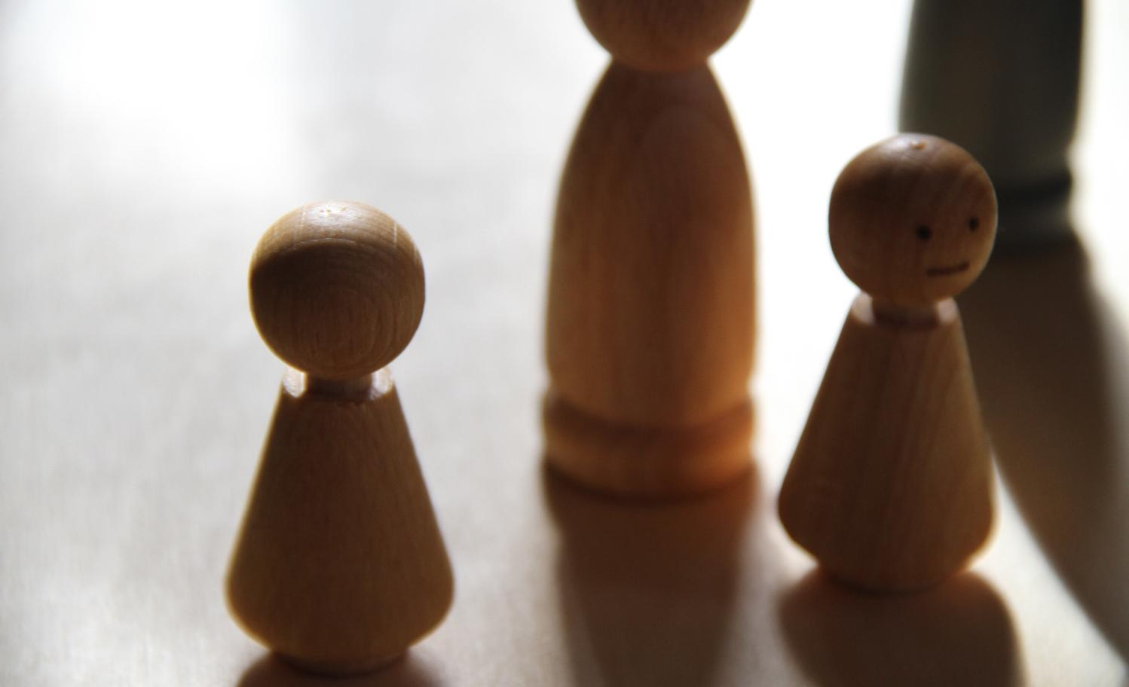
…may the words of our mouths please you, O God.
Notes:
Slide 18: In our families, may the words of our mouths [place your hands on your lips] please you, God [both thumbs up].

Slide 19
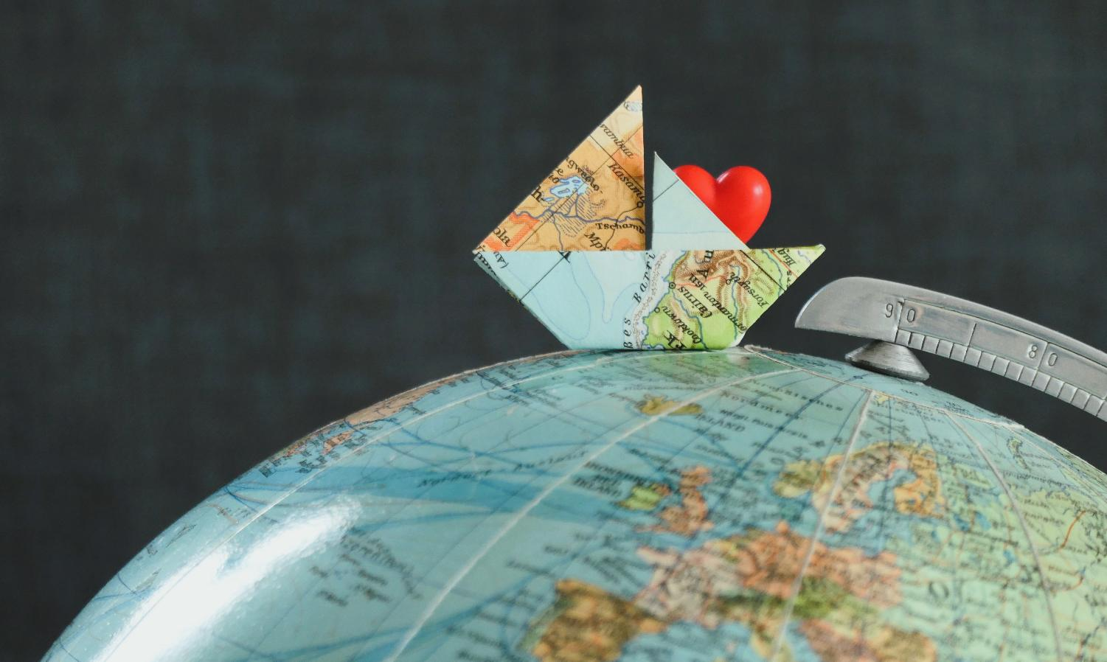
…may the words of our mouths please you, O God.
Notes:
Slide 19: Wherever we go, may the words of our mouths [place your hands on your lips] please you, God [both thumbs up].

Slide 20

Notes:
Slide 20: Amen.

Slide 21


[Slide 4:]
Leader: As we leave this place & time and go into the day ahead…
All: May we take care with the words we speak.
Notes:
Slide 21: Sending
Leader: As we leave this place & time and go into the day ahead…
All: May we take care with the words we speak.

Slide 22
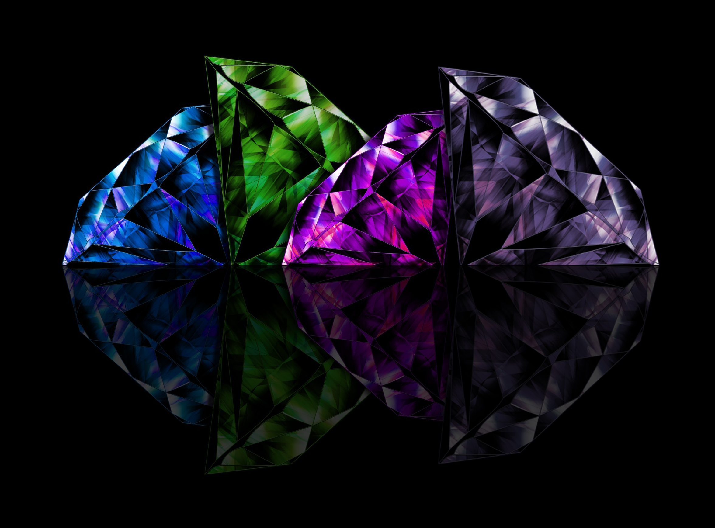
Notes:
Slide 22: Reflection areas
Do: Take a gemstone out of the bowl and hold it in your hand.
Think: Think about words that you might say to help or encourage others.
Talk: Now place the gemstone back in the bowl, and go and speak those words to others!

