Slide 1



Leader: We are here together
Children: With ears ready to hear and hands ready to serve.
ALL: May we be wise in all our actions today.
Notes:
Slide 1: Use our new gathering words. Why not invent your own actions to accompany them?
Leader: We are here together
Children: With ears ready to hear and hands ready to serve.
All: May we be wise in all our actions today.

Slide 2

Notes:
Slide 2: Let’s begin our time with today’s wise words…..

Slide 3



‘Saying the right thing at the right time brings joy.’ (Proverbs 15:23)
Notes:
Slide 3: ‘Saying the right thing at the right time brings joy.’ I wonder what you think this means? [talk together] I’ve got a game to help us to see what this looks like in real life – it’s very simple and is called…..

Slide 4


Say the right thing!
Notes:
Slide 4: Game – ‘Say the right thing!’ [use printed cards from p. 3. There are slides to accompany each scenario, but if you want to play the game without a screen, skip slides 6-11]
As we’ve just discovered, most of the time, we really do know what the ‘right thing’ to say is, but sometimes in real life, it doesn’t seem quite as easy. Sometimes we might think ‘Oh well, someone else will do that or say that’ – and so we don’t. Other times, we might not feel brave enough to say something, even when we know what we should do. During this time, leading up to Easter, we are exploring some stories about Jesus to find out how he lived out our Wise Words and to help us to see what this might mean for us in our own lives and communities. So let’s do that now….

Slide 5
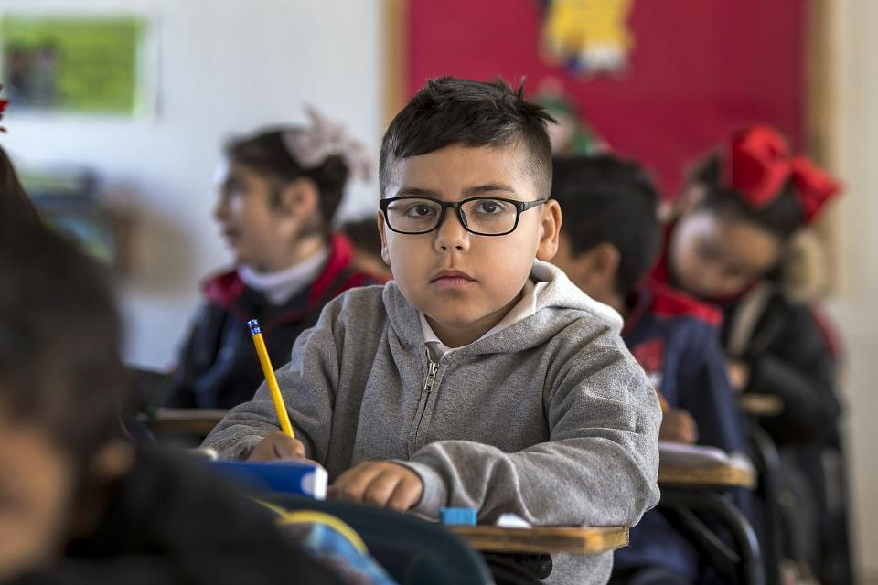
Notes:
A new child starts in your class.
What’s the ‘right thing’ to say?

Slide 6
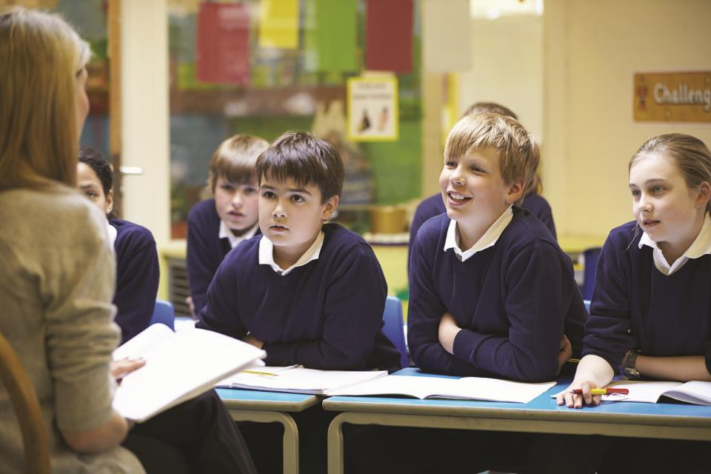
Notes:
Your teacher has had a really busy morning and has lots of jobs to get through at lunchtime.
What’s the ‘right thing’ to say?

Slide 7
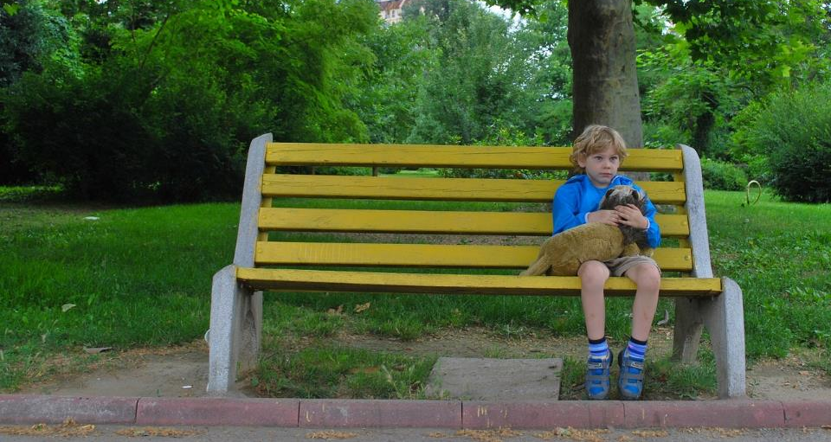
Notes:
Someone is sitting all alone at playtime, waiting on the friendship bench.
What’s the ‘right thing’ to say?

Slide 8
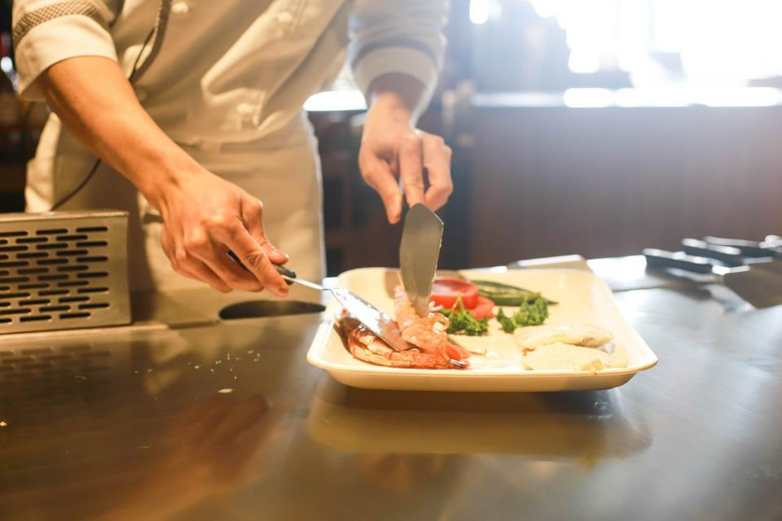
Notes:
Dad is tired, he’s cooking dinner and trying to do jobs around the kitchen at the same time.
What’s the ‘right thing’ to say?

Slide 9
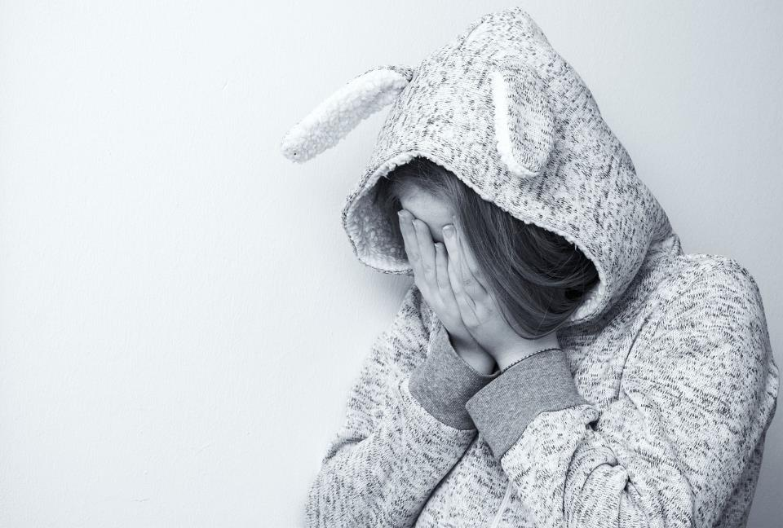
Notes:
You see a child from another class being teased.
What’s the ‘right thing’ to say?

Slide 10

Notes:
Another child in your group is having trouble with some new work.
What’s the ‘right thing’ to say?

Slide 11
‘Saying the right thing at the right time brings joy.’ (Proverbs 15:23)
Notes:
Slide 11: As we’ve just discovered, most of the time, we really do know what the ‘right thing’ to say is, but sometimes in real life, it doesn’t seem quite as easy. Sometimes we might think ‘Oh well, someone else will do that or say that’ – and so we don’t. Other times, we might not feel brave enough to say something, even when we know what we should do. During this time, leading up to Easter, we are exploring some stories about Jesus to find out how he lived out our Wise Words and to help us to see what this might mean for us in our own lives and communities. So let’s do that now….

Slide 12
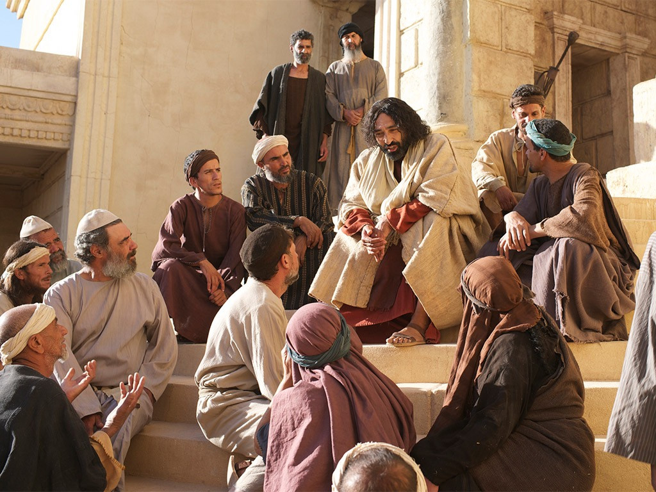
Notes:
Slide 13: Jesus was often to be found teaching people in the temple.

Slide 13
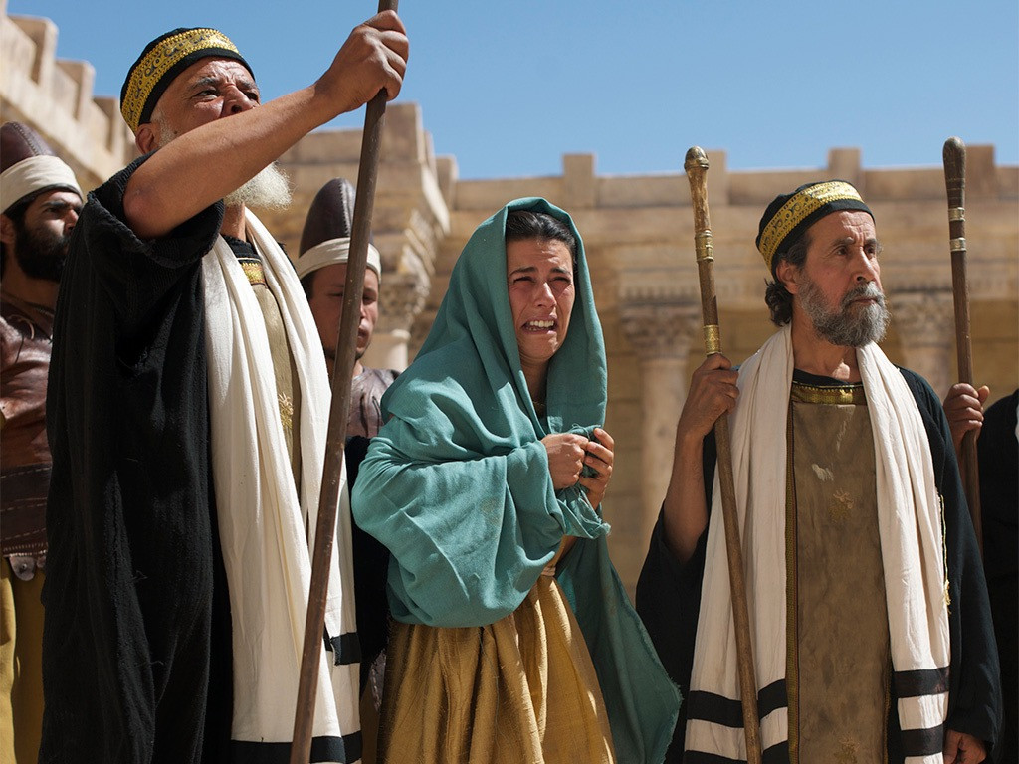
Notes:
Slide 14: One day some of the leaders in Jerusalem brought a woman to Jesus and said to him ‘Teacher! We found this woman doing something that is against the law. Should we punish her as the law of Moses says we should?’
The men were clearly very angry, and wanted to punish her.

Slide 14
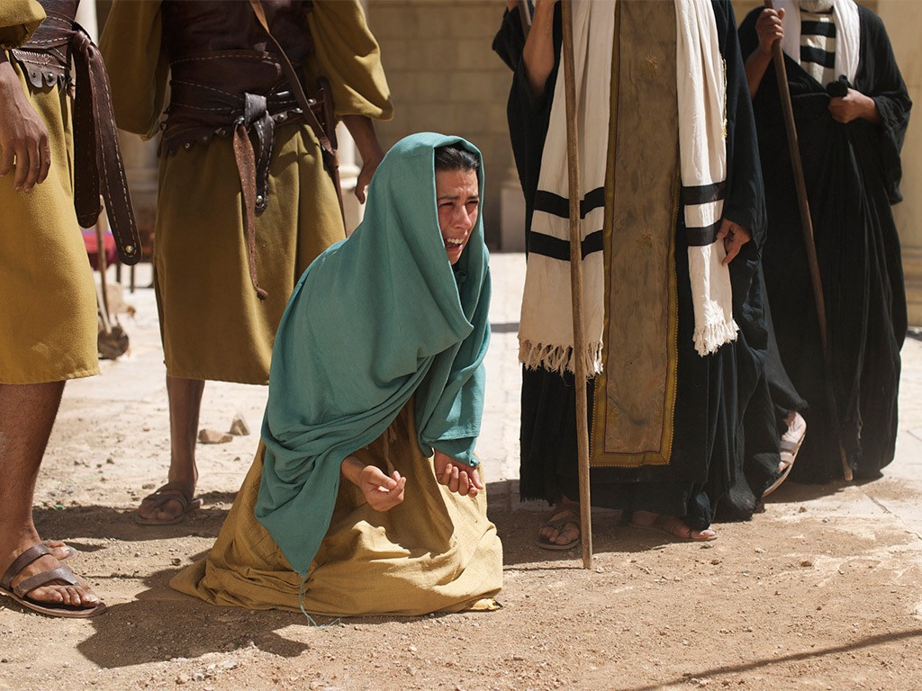
Notes:
Slide 15: But Jesus looked at the woman’s face and saw how very frightened she was – and decided to do something, even though he knew it would probably make the leaders very cross.

Slide 15
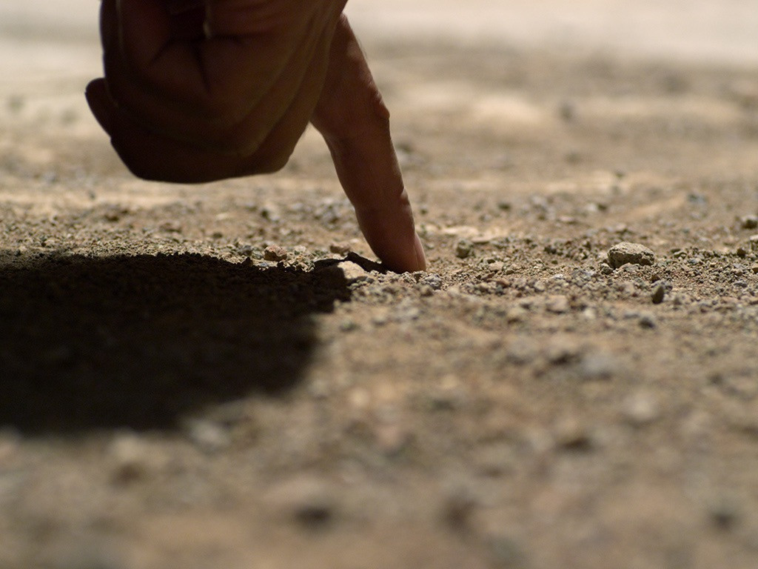
Notes:
Slide 16: He bent down and began to draw in the dust on the ground.
Then he said to the men ‘If any of you can honestly say that you have never done anything wrong in your lives, then go ahead and punish this woman for what she has done.’

Slide 16
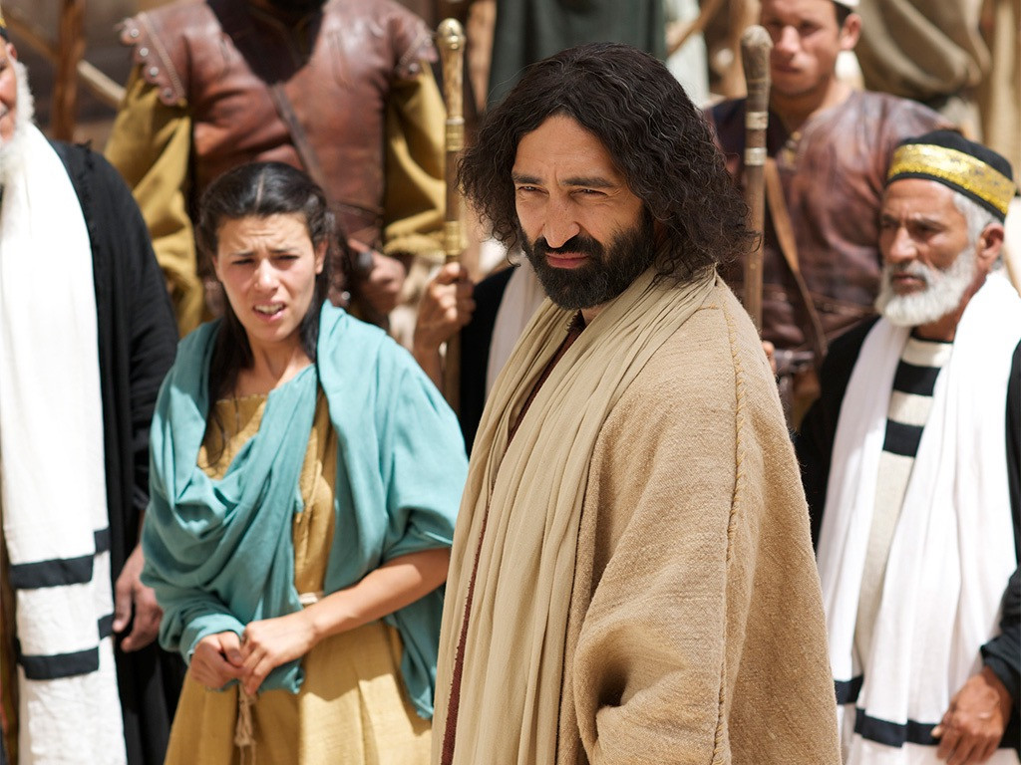
Notes:
Slide 17: Then he said to the men ‘If any of you can honestly say that you have never done anything wrong in your lives, then go ahead and punish this woman for what she has done.’ One by one, the men walked away.

Slide 17
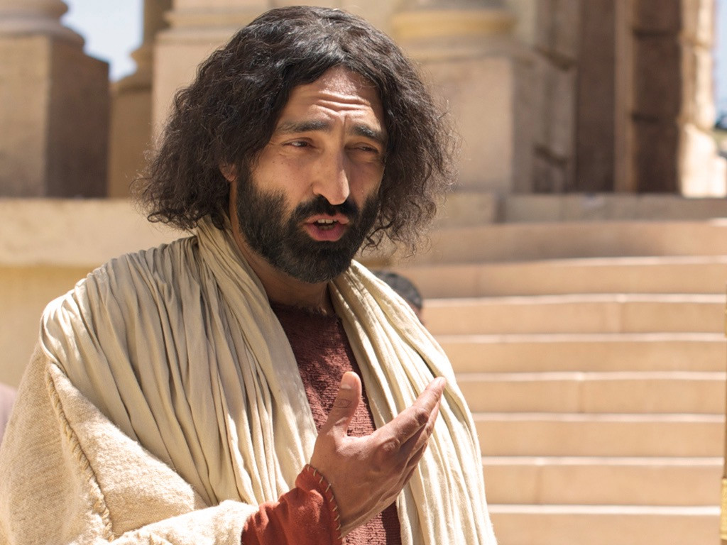
Notes:
Slide 18: When the last one had gone, Jesus looked at the woman and said to her ‘You are forgiven for what you did. Now go and live a new life.’

Slide 18

….I wonder how the woman felt, being brought to Jesus as she was?....
….I wonder how she felt when she heard what Jesus said to the leaders?....
….I wonder what difference Jesus’ words made to the rest of her life?....
….I wonder what we might learn from this story about saying the right thing?....
‘Saying the right thing at the right time brings joy.’ (Proverbs 15:23)
Notes:
Slide 19: Responding and words for worship / questions to talk about….
Let’s wonder together…..
……I wonder how the woman felt, being brought to Jesus as she was…
….I wonder how she felt when she heard what Jesus said to the leaders?....
….I wonder what difference Jesus’ words made to the rest of her life?....
….I wonder what we might learn from this story about saying the right thing?....
[leave some time for discussion and/or quiet reflection here]

Slide 19
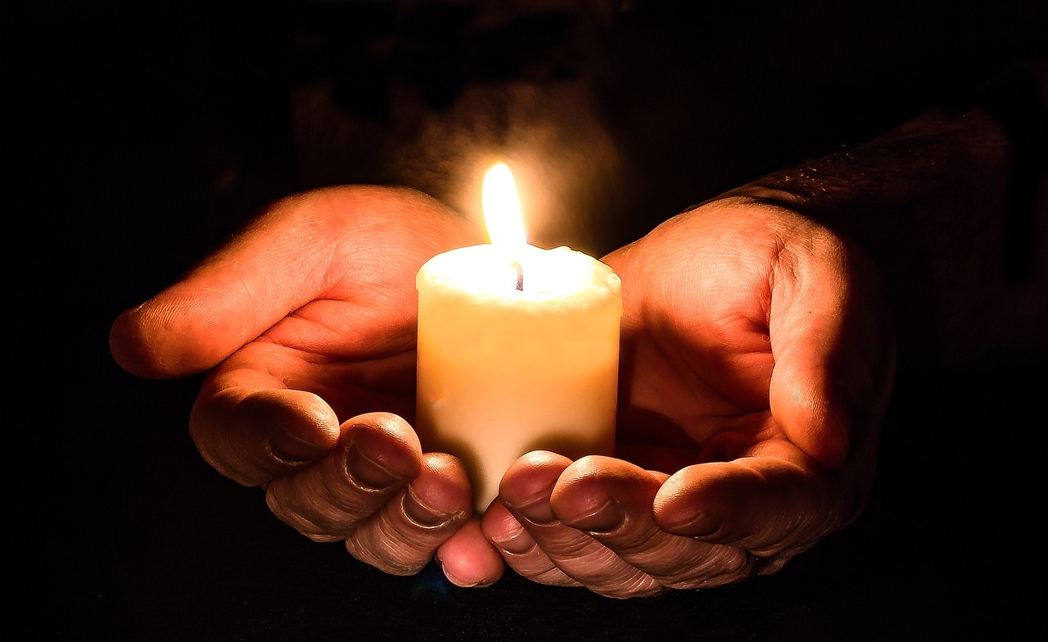
‘We will say the right thing.’
Notes:
Slide 20: Prayer
I’m going to use some words with a response for anyone who would like to pray too: your words are ‘We will say the right thing.’

Slide 20
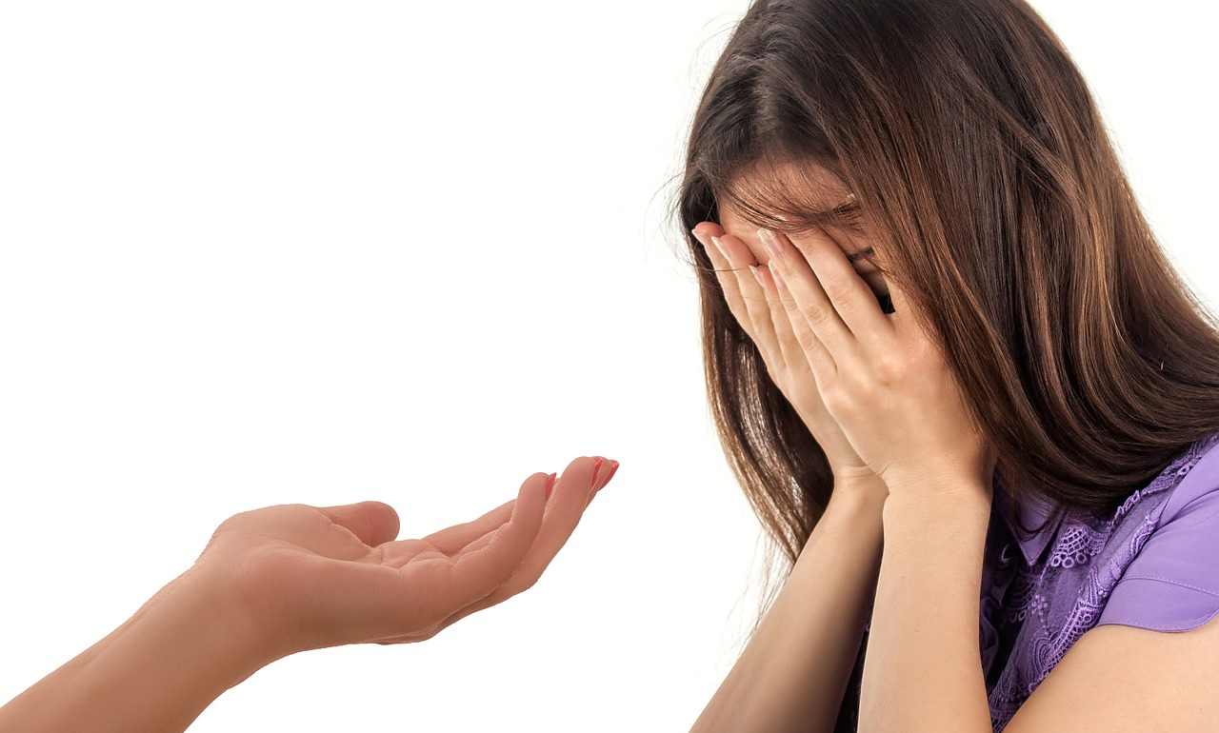
‘We will say the right thing.’
Notes:
Slide 21: When we see someone in need, ‘We will say the right thing.’

Slide 21
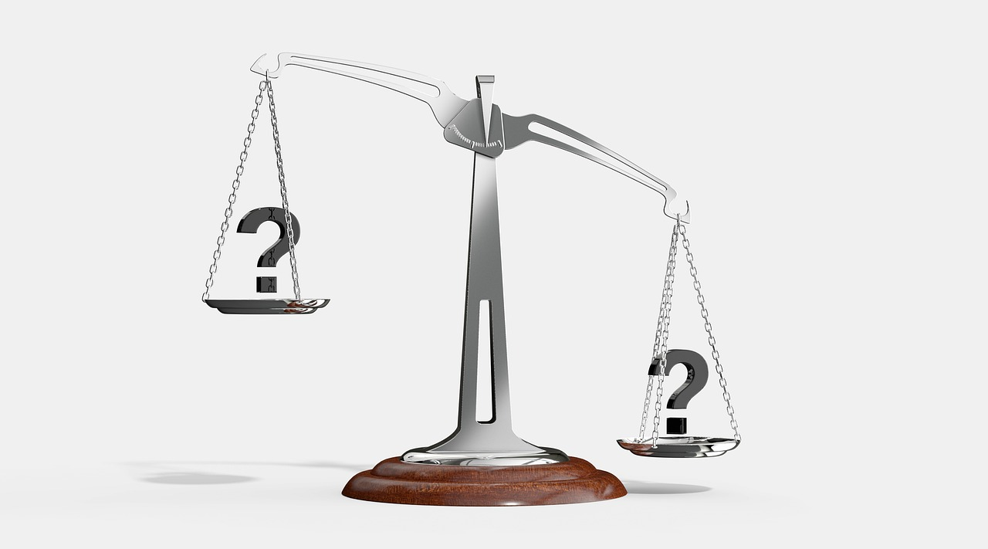
‘We will say the right thing.’
Notes:
Slide 22: When we something unfair, ‘We will say the right thing.’

Slide 22

‘We will say the right thing.’
Notes:
Slide 23: In our school today, ‘We will say the right thing.’

Slide 23


Slide 24


Leader: As we leave this place & time and go into the day ahead…
All: May today’s words help us to make wise choices.

Slide 25

Notes:
Reflective prayer activity:
Provide a tray of sand in your reflective area.
Write in the tray of sand what you think Jesus wrote…. Or some words that you think are the ‘right words’ to say

