Slide 1
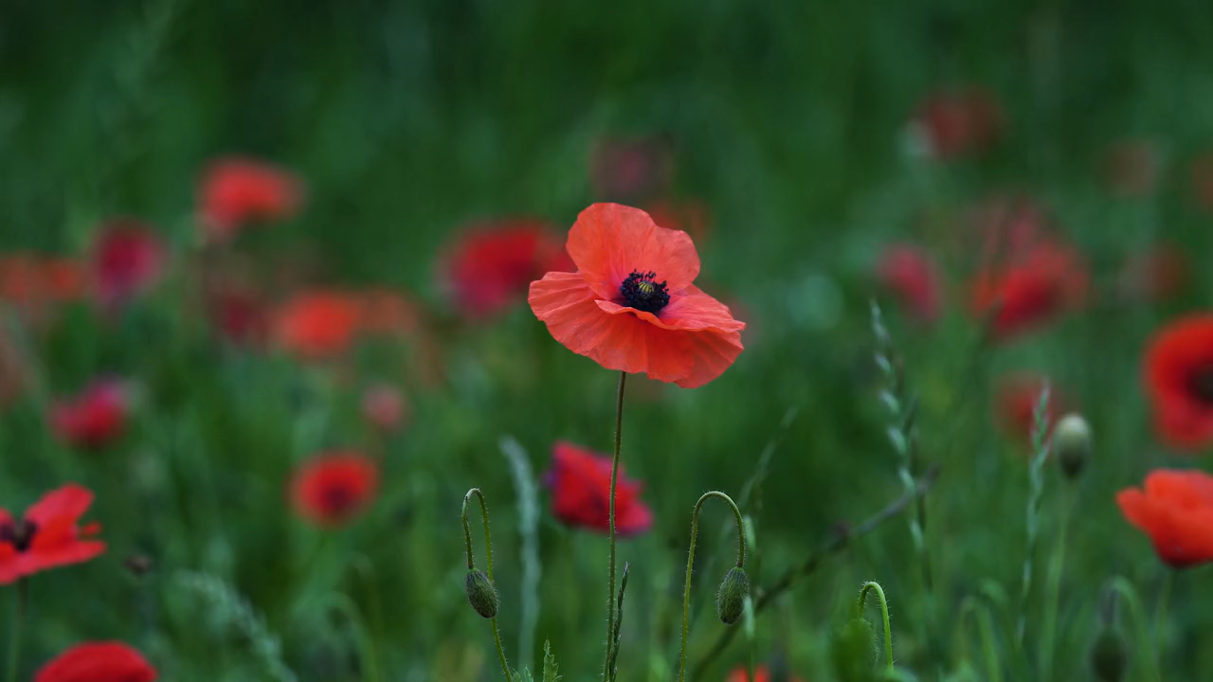
All images copyright-free from pixabay, unless otherwise identified
Notes:
Slide 1: Welcome stilling exercise – Poppies
Use the stilling slide if desired: the suggested words should be spoken slowly, leaving pauses inbetween to create a sense of stillness.
As you sit quietly here, watch the poppies blowing gently in the breeze…….PAUSE]
Now practise slower breathing…..in…..and out…..in……and out…..keep this going as you continue to watch….[PAUSE]
You maybe notice that you are feeling calmer and more relaxed….[PAUSE]
As you breathe, think about yourself and what you bring into this time today…..[PAUSE]
We come into this special / sacred space and time to be still….to think deeply…..to be together as a school community…..
In our time together today, we will….. see more images of poppies……share a story….and then think together.
But first, let’s welcome one another as we begin….

Slide 2
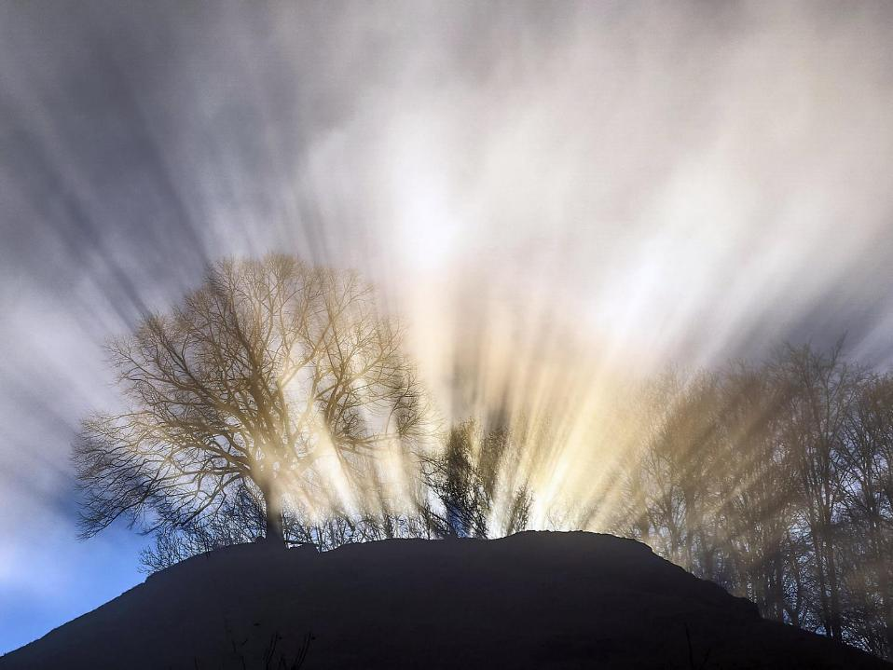
Leader: This is a day that God has made.
ALL: We will rejoice and be glad in it!
Notes:
Slides 2/3: Teach this new greeting to your school community – there are two slightly different versions from the point of view of the leader; choose which best fits your school’s context. One uses words adapted from Psalm 118:24
Leader: This is a day that God has made!
ALL: We will rejoice* and be glad* in it!
OR:
Leader: Today is a brand new day…..
ALL: May we be a blessing to each other!
*There are different BSL signs for rejoicing and joy/gladness. View them here: https://www.signbsl.com/sign/rejoice
Blessing: https://www.signbsl.com/sign/blessing (1st video)

Slide 3
Leader: Today is a brand new day!
ALL: May we be a blessing to each other!
Notes:
Slides 2/3: Teach this new greeting to your school community – there are two slightly different versions from the point of view of the leader; choose which best fits your school’s context. One uses words adapted from Psalm 118:24
Leader: This is a day that God has made!
ALL: We will rejoice* and be glad* in it!
OR:
Leader: Today is a brand new day…..
ALL: May we be a blessing to each other!
*There are different BSL signs for rejoicing and joy/gladness. View them here: https://www.signbsl.com/sign/rejoice
Blessing: https://www.signbsl.com/sign/blessing (1st video)

Slide 4
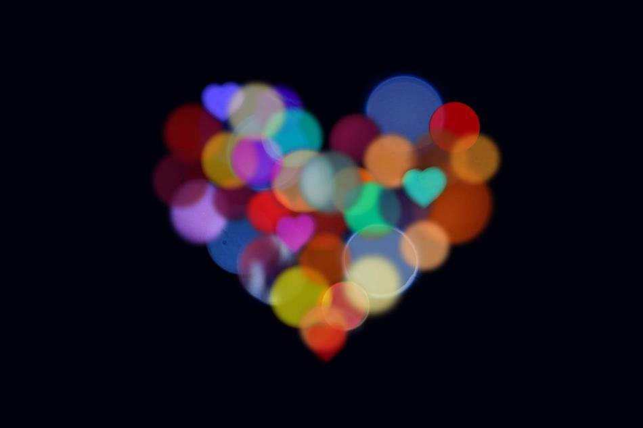
Count your blessings
Notes:
Slide 4: This term, we are thinking about our blessings – all the good things in our lives – and today we are going to be thinking about remembering with gratitude (thankfulness).

Slide 5
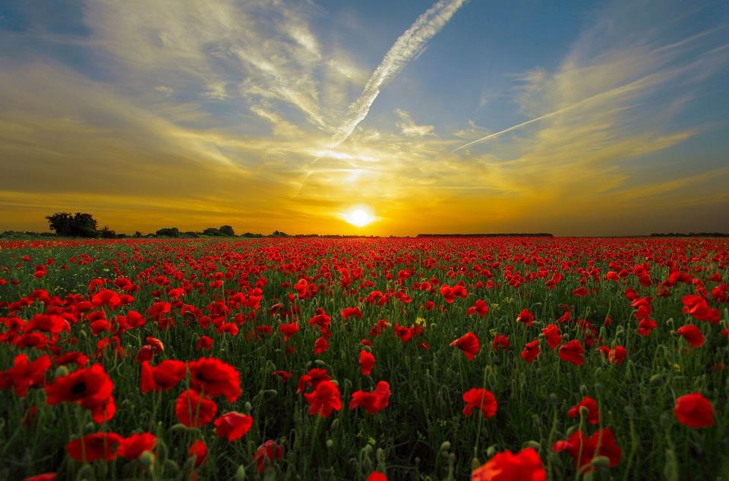
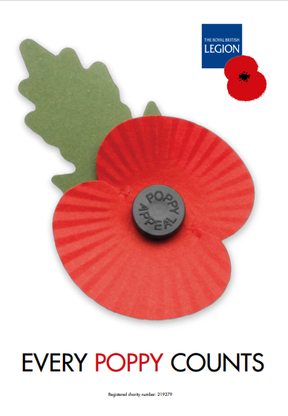
Remember with gratitude
Notes:
Slide 5: I wonder what you thought of when you saw the poppies at the beginning? For most of us, it will be ‘Poppy Day’ or more correctly, Remembrance (Armistice) Day – when across the world, the nations remember the many acts of courage, selflessness and service of those who fought in past wars, and those who are still doing so. We choose to remember with gratitude.

Slide 6
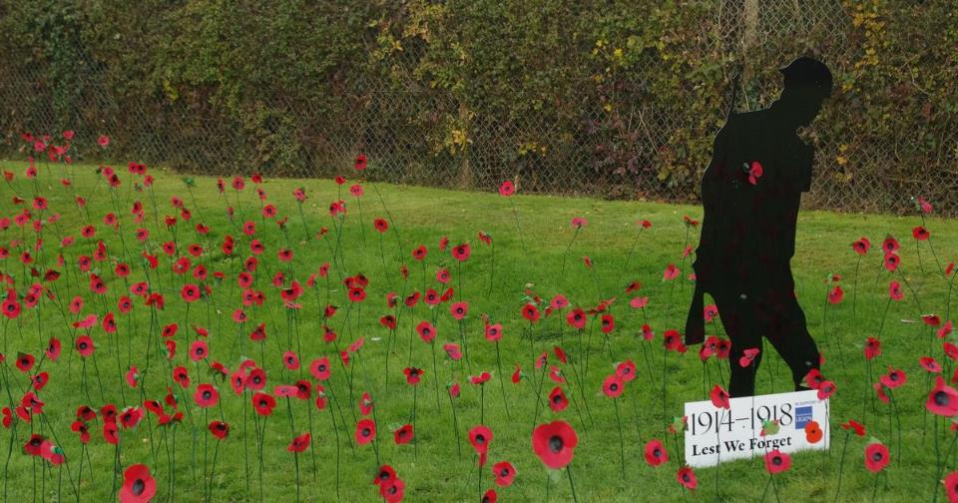
‘the war to end all wars’
Notes:
Slide 6: Since the end of the Great War (also known as WW1) in 1918, which people said was the ‘war to end all wars’, poppies have become a symbol for this act of remembering and being thankful.

Slide 7
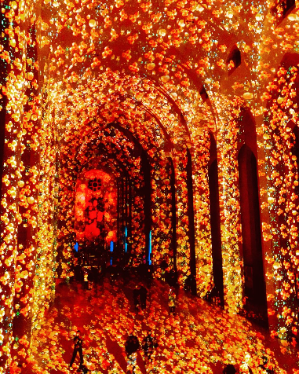
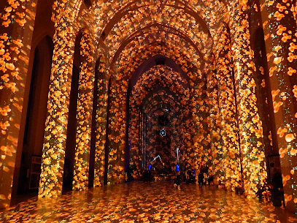
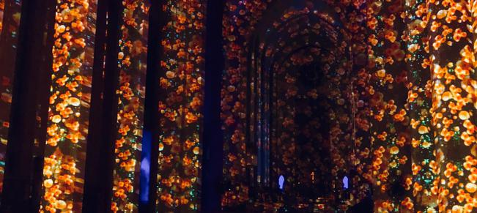
Poppy Fields Guildford Cathedral
Oct 2018
Notes:
Slide 7: Here, you can see Guildford Cathedral in 2018, full of poppies, to mark 100 years since the First World War ended in 1918. Poppies help us to remember and be grateful.

Slide 8
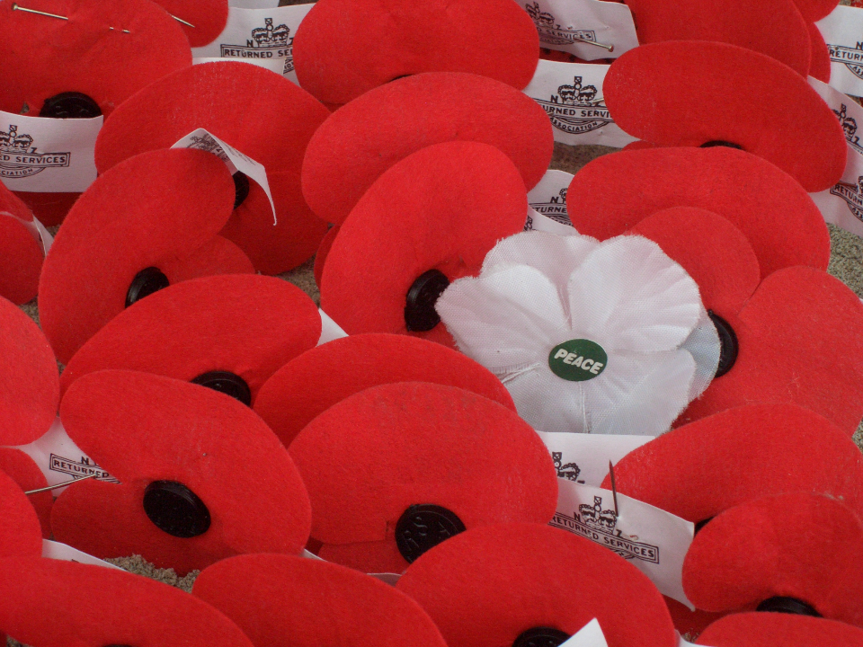
…we will remember…
Notes:
Slide 8: We often think about the soldiers who gave their lives, so that we might live in peace. We’re going to spend a short while finding out about just one soldier now and reflect on the things that we can learn from his life – and be grateful for.

Slide 9
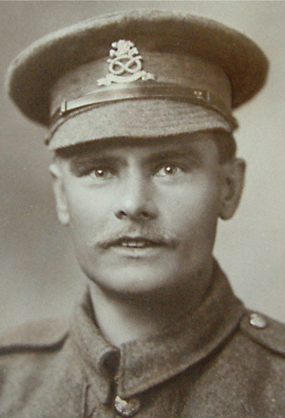
Lance Corporal William Coltman
(1891-1974)
Notes:
Slide 9: Like so many other young men, William Coltman joined up in January 1915, aged 26, initially as a rifleman in the North Staffordshire Regiment, but he never fired a shot. He was a Christian, and early on in the war, he made the decision that he wanted to be a ‘peacemaker’. He determined that he should not end lives, but try to save them.

Slide 10
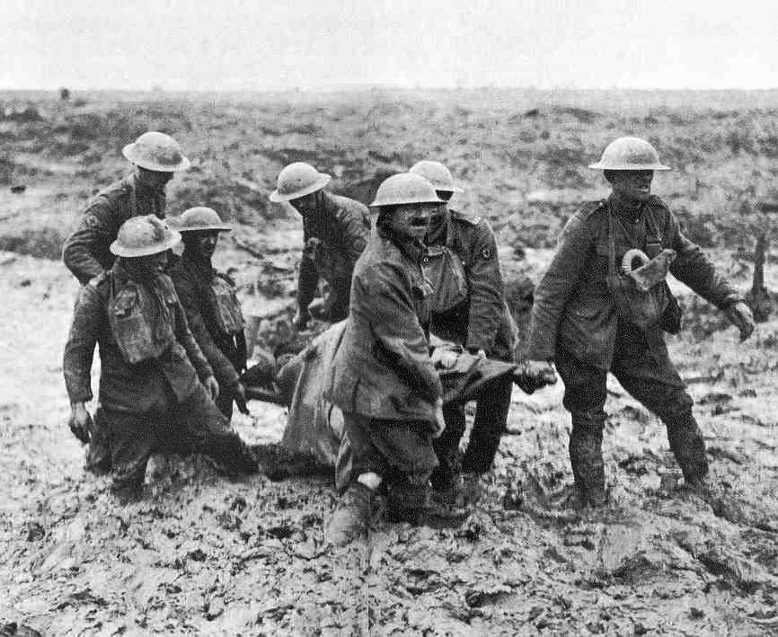
Photo © BBC
Notes:
Slide 10: And so, instead of fighting, he became a stretcher-bearer. The job of a stretcher-bearer was to rescue the injured men from where they fell, often trudging through the mud in ‘No-Man’s Land’ – through enemy fire from all sides. William was only 5’4” tall, but he didn’t let his size stop him, and he was well-known for carrying the wounded off the battlefield on his back! Most nights, he would venture out into enemy lines to see if any of his regiment were left behind.

Slide 11
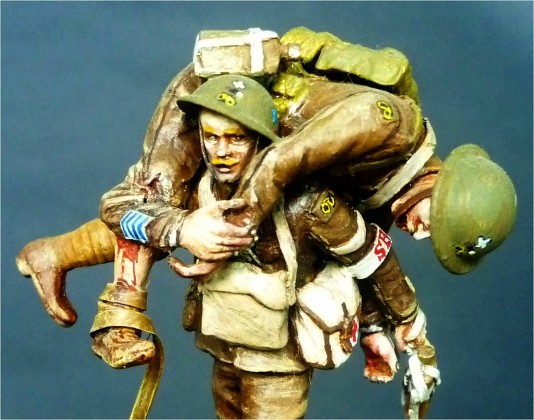
Photo © John Halley
Notes:
Slide 11: This sculpture is modelled on him, and shows him carrying a wounded soldier away from the battlefield on his shoulders.

Slide 12
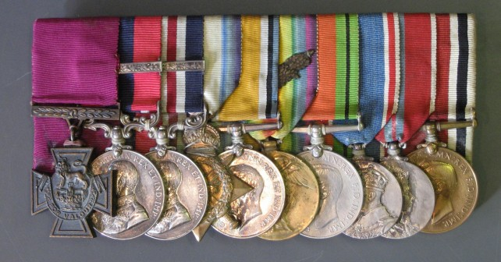
Photo © South Staffordshire Regiment Museum
‘This very gallant NCO tended the wounded unceasingly for 48hours….
He won many other medals too, yet never fired a single bullet.’
Notes:
Slide 12: He did this for three years and was awarded the Victoria Cross for his actions on October 3rd & 4th, 1918. His official letter states that: ‘This very gallant NCO* tended the wounded unceasingly for 48hours….He won many other medals too, yet never fired a single bullet.’ William Coltman was one of the few who survived WWI.
*Non-commissioned officer

Slide 13
What can we learn from William Coltman?
Notes:
Slide 13: What can we learn from William Coltman?
Talk with children about their ideas in response to this question.

Slide 14
‘At the going down of the sun, and in the morning, we will remember them…’
Notes:
Slide 14: The peace we continue to enjoy today was won at a very great cost. This is why on Remembrance Day each year, we hear the words ‘At the going down of the sun, and in the morning, we will remember them’, as we think of those who gave so much so that we might live at peace….

Slide 15
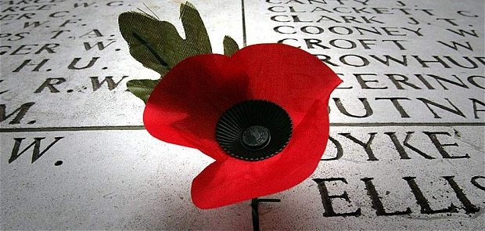
‘be a peacemaker’
Notes:
Slide 15: Jesus once talked about being a ‘peacemaker’ – and that our world would need people who would be prepared to act in ways that would bring peace – which is perhaps not what you’re expecting to hear as we’ve been thinking about the great cost of war!
We say the words ‘we will remember them’ and wear poppies to show that we are grateful to those who lives were changed forever by war, but this year, I wonder whether we can also try to do something to show we are grateful. I wonder what it might be like for us to try to live as peacemakers? I have 6 special poppies here with 6 different ideas for living peacefully. Let’s look at them together [read and display poppies] You might want to add to this ‘poppy garden’ as you think of more ideas during this week.

Slide 16
‘Be a peacemaker’
Notes:
Slide 16: Responding (and words for worship): you might also wish to hold your own period of silence at this point. We have used the same video slide here as at the start.
Let’s be still and quiet together now….
…We’ve been thinking today about how we wear a poppy to help us to remember….
….we’ve also heard about one WWI soldier whose life made a difference, and whose bravery and service is especially remembered by us today….
… even in the midst of war, it is possible to be a ‘peacemaker’ like William Coltman….
….Jesus called all who followed him to act in this way…..to be a peacemaker
….but even if you’re not a follower of Jesus, acting peacefully is still good!....
….our world needs ‘peacemakers’….
….in the stillness, you might like to think about one thing that you could do to act peacefully this week….

Slide 17
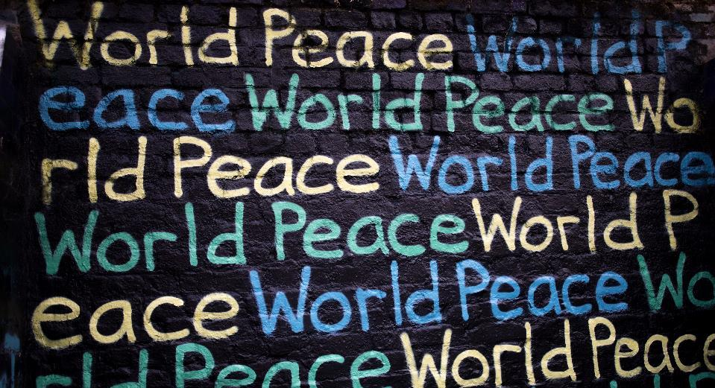
Photo by Humphrey Muleba on Unsplash
For peacemakers and peacekeepers, who seek to keep our world secure and free; may God give peace.
God give peace.
Notes:
Slide 17: Prayer
It is good to be able to pray for people who are working across our world to bring peace where there is conflict, and so if you’d like to join me and pray this as well, I invite you to join me by repeating the words God give peace at the very end.
For peacemakers and peacekeepers, who seek to keep our world secure and free; may God give peace.
God give peace.

Slide 18
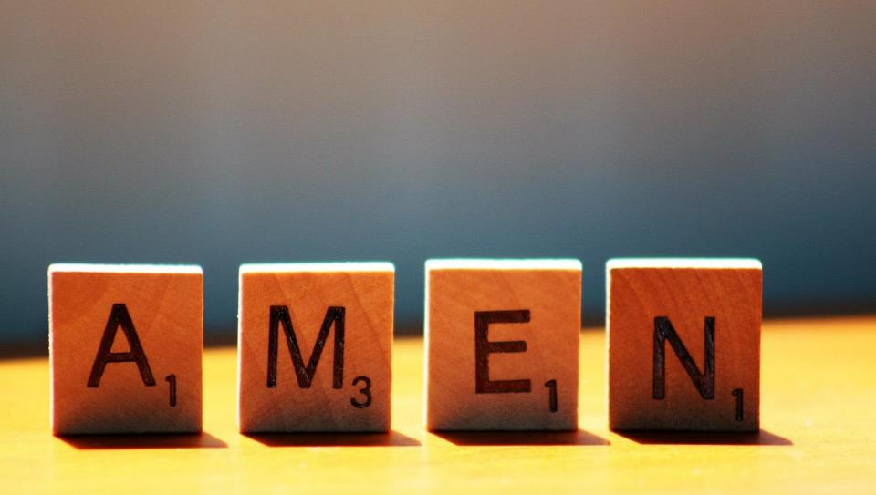

Slide 19
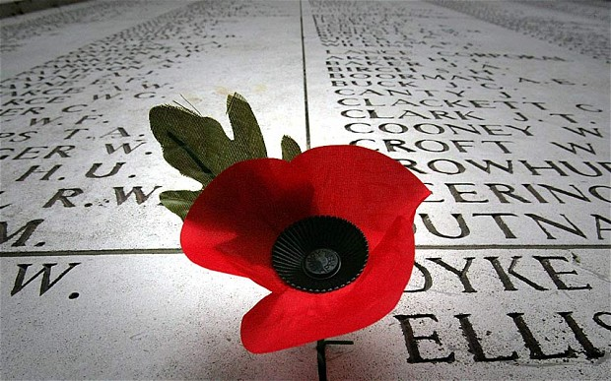


Leader: As we leave this place & time and go into the day ahead…
All: We will remember them, and live in peace.
Notes:
Slide 19: Sending
Leader: As we leave this place & time and go into the day ahead…
All: We will remember them, and live in peace.

Slide 20
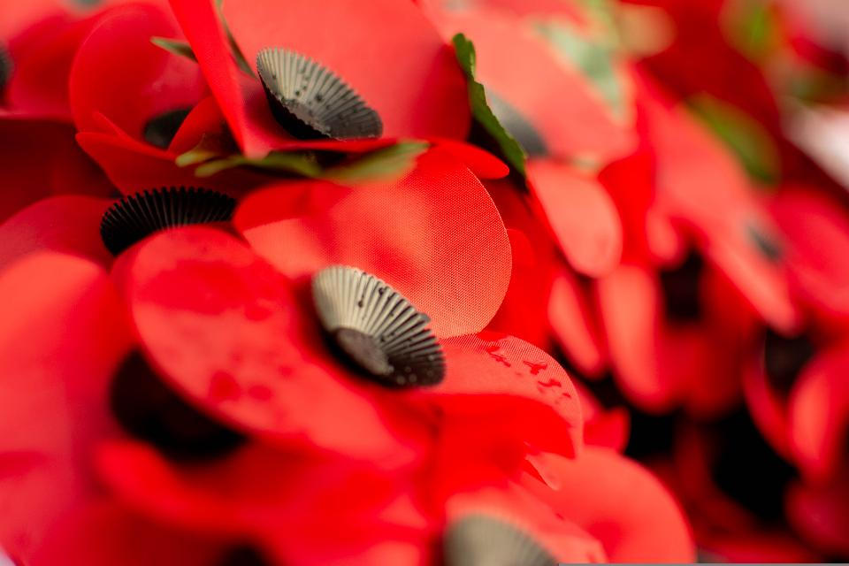
Notes:
Slide 20: Reflection areas
Print out labels from p.4, hole-punch a single hole at the end and attach a poppy to each.
Think: Read the labels and then think about what they mean. Which might be things that you could do?
Do: Go and make peace happen wherever you go today!
Talk: What other peace-making actions could we think of?

