Slide 1

Pictures copyright-free from pixabay
Leader: We are a creative community. As we gather together today…
ALL: May our thinking, talking and wondering help us to grow.
Notes:
Slide 1: Gathering
Use the new greeting, with BSL actions if desired.
Leader: We are a creative community. As we gather together today….
ALL: May our thinking, talking and wondering help us to grow.
Here are BSL actions for some of the words:
Leader’s words:
Creative: https://www.signdictionary.co.uk/view/creative?q=creative#title
Community: (we use the word ‘gathering’ as it’s a simpler sign!) https://www.signbsl.com/sign/gathering
Gather together: https://www.signbsl.com/sign/gather (1st video)
Pupils’ response:
Think: https://www.brightbsl.co.uk/signs/think
Talk: https://www.signbsl.com/sign/talk (1st video)
Wonder: https://www.signbsl.com/sign/wonder (1st video)
Grow: https://www.signbsl.com/sign/grow (2nd video)

Slide 2
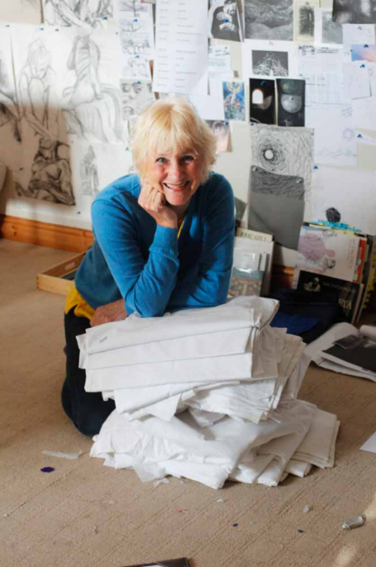
Threads Through the Cross
Notes:
Slide 2: Threads Through the Cross

Slide 3
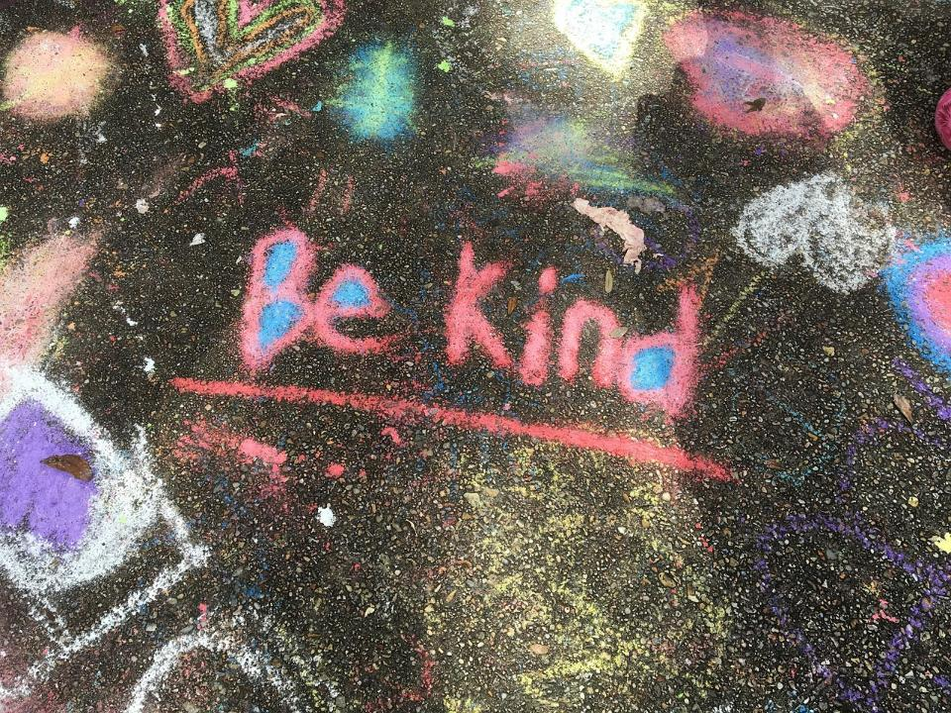
Would you rather……
…. do something nice for someone else, or have them do something nice for you?
Notes:
Slide 3: Would you rather…… A few weeks ago, we played a ‘Would you rather….?’ game – and I’ve got one more dilemma for you as we start our time together today!....
So, Would you rather……do something nice for someone else, or have them do something nice for you?
Take some time to really ponder this together – you could do this with talking partners. NB There isn’t a right answer!!
Today’s panels help us to ponder this question…

Slide 4
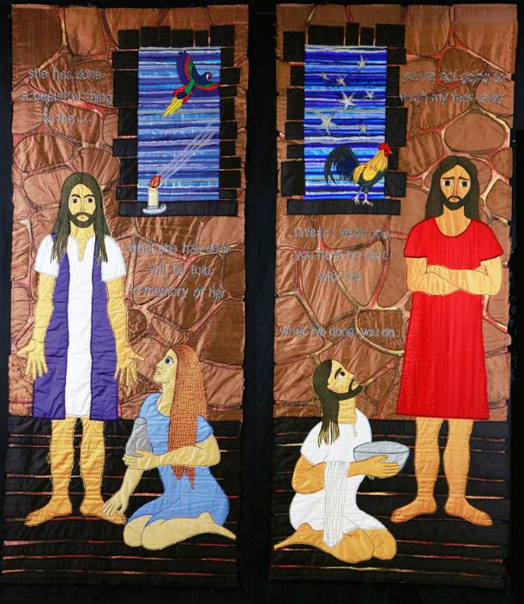
You will be remembered
Do as I have done
You’re not going to wash my feet, ever!
Unless I wash you, you have no part with me. What I’ve done, you do…
She has done a beautiful thing to me… what she has done will be told in memory of her.
Notes:
Slide 4: Washing of feet
Spend a while just gazing at the panel. Relax, and focus on calm breathing….The two halves feature events just a week apart.
Can you spot some similarities and differences?
e.g. in the people who are standing?
What are the people kneeling about to do?
Is the same person in both halves?
Can you see how Jesus is standing? What do you think he is saying in the way he is standing?
How is Peter standing? What do you think he is saying to Jesus?
Now tell the two stories using the script on p5…..with optional water!
Jacqui called these panels You will be remembered and Do as I have done.
If children ask about the birds? Jacqui says….
Macaw – symbolising the bright, bold actions of Mary!
Cockerel – a sign of what will come for Peter, who denies Jesus three times before the cock crows.

Slide 5
….I wonder what both these stories might tell us about how we should treat each other?....
Unless I wash you, you have no part with me. What I’ve done, you do…
She has done a beautiful thing to me… what she has done will be told in memory of her.
Notes:
Slide 5: Serve one another
….I wonder what both these stories might tell us about how we should treat each other?....
Does this mean we should go around washing each other’s feet – or do you think Jesus meant something else? [you might like to talk to a partner]
These stories about dirty, smelly feet are important examples for Christians of humble service, and Jesus’ words ‘What I’ve done, you do…’ remind them that this is how he said they should live, humbly serving others whenever possible. During Holy Week, which is the week leading up to Easter, Christians all over the world will re-enact this foot-washing as a reminder that they are called to serve.

Slide 6
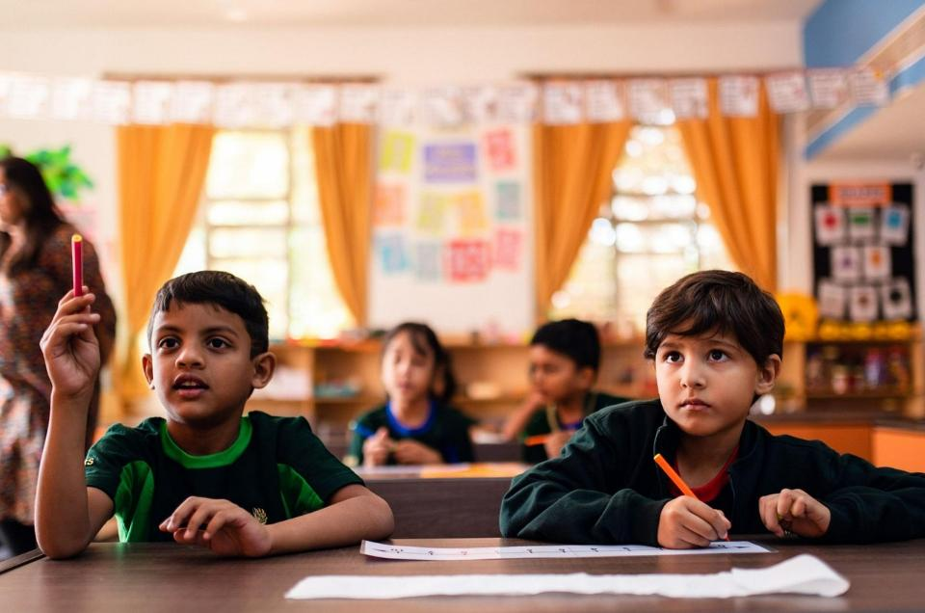
….I wonder how we might serve each other in our school family?....
Notes:
Slide 6: Serving one another in school
….I wonder how we might serve each other in our school family?....
[talk together about specific, small ways in which this might happen e.g. hanging coats up when they fall off cloakroom pegs; letting others choose the playtime game to play; making sure you keep the toilets clean so that they are nice for others to use etc. Maybe set a few challenges for this week for your whole school community!]

Slide 7
….I wonder what we might learn from these examples of humble service?....
….I wonder how others might remember us because of how we treated them?....
Notes:
Slide 7: Response and words for worship
Jesus told his friends that each time they did a small, kind deed for someone else, even if it was for someone very unimportant or if no one else noticed, it would be as if they were doing it to him….and history is full of examples of how people across the ages have done this.*^{[see below]}
As we draw our time to a close now, we’re going to take the opportunity to think about what this might mean for us – and maybe make some promises to try to serve others this week.
….I wonder what we might learn from these examples of humble service?....
….I wonder how others might remember us because of how we treated them?....
This week, we will each be presented with many opportunities to serve others; we just have to notice them – and then act!
Opportunity for reflection / prayer:
I’m going to pray now, and if this is something that you feel comfortable with, then there are some words you can join in with. These are…..
[*During the Black Death, Christians famously visited those who were afflicted with the plague, or buried the dead, often at great risk to themselves. Mother Teresa founded ‘Missionaries of Charity’ to serve the poorest communities in Calcutta. In 1811, Joshua Watson helped found the National Society with the dream of providing education for all, for free, as a bold act of service to the poor….]

Slide 8

…may we humbly serve others.
Notes:
Slide 8: May we humbly serve others….

Slide 9
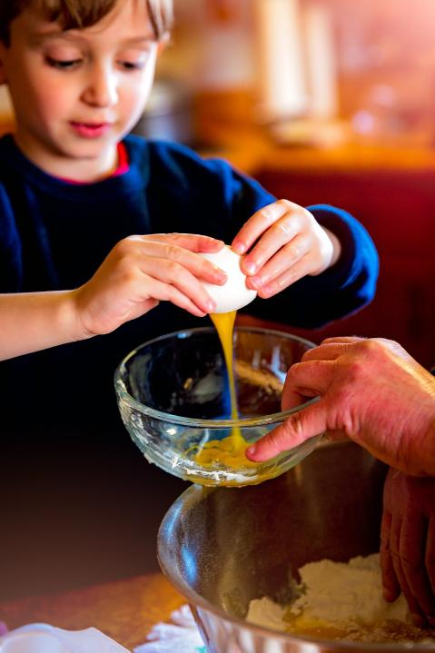
Notes:
Slide 9: In our homes, with our families….

Slide 10
…may we humbly serve others.
Notes:
Slide 10: May we humbly serve others….

Slide 11
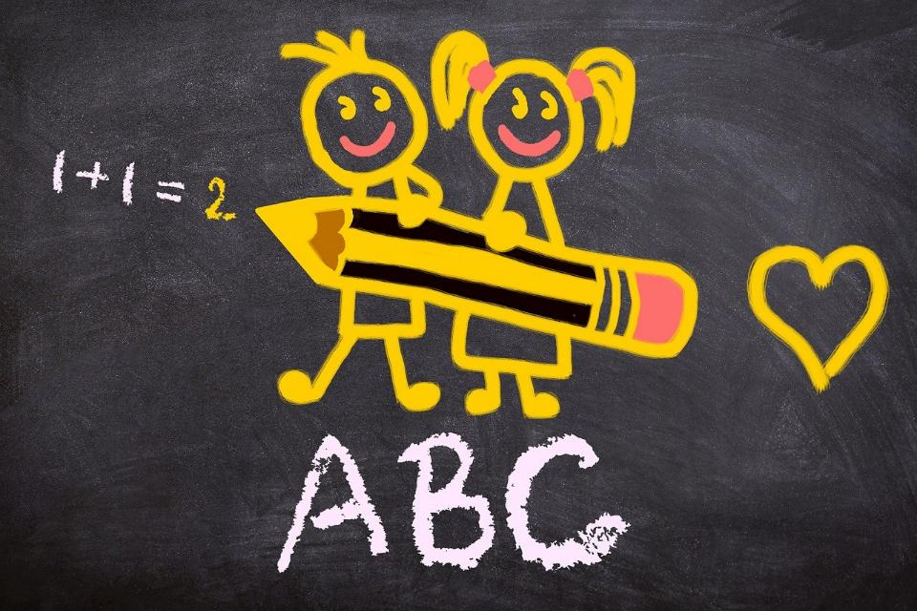
Notes:
Slide 11: In our classrooms, with our friends…..

Slide 12
…may we humbly serve others.
Notes:
Slide 10: May we humbly serve others….

Slide 13
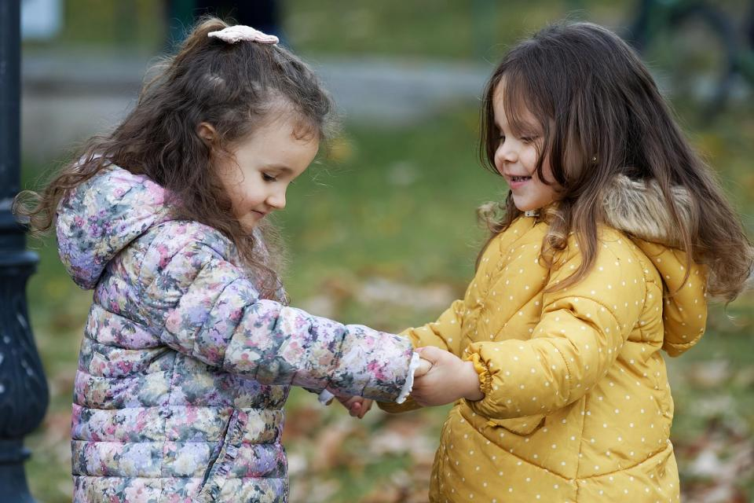
Notes:
Slide 13: In our playground, as we play…..

Slide 14
…may we humbly serve others.
Notes:
Slide 14: May we humbly serve others….

Slide 15
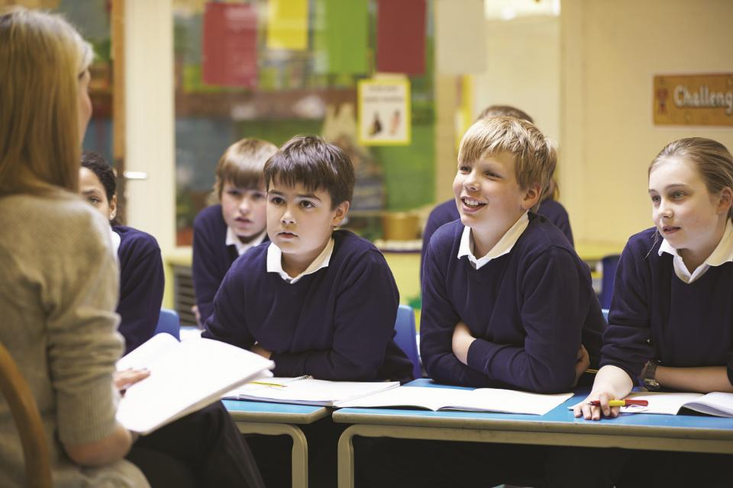
Notes:
Slide 15: As part of our school family…..

Slide 16
…may we humbly serve others.
Notes:
Slide 16: May we humbly serve others….

Slide 17


Slide 18
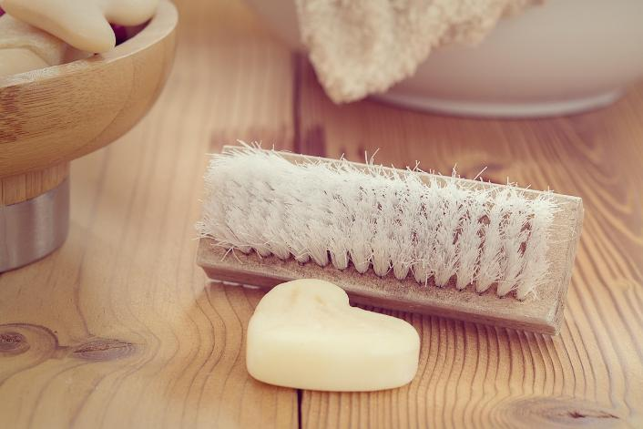


Leader: As we leave this place & time and go into the day ahead…
All: Together, we create a serving community!
Notes:
Sending: Slide 22 (NB note different word from last week!)
Leader: As we leave this place & time and go into the day ahead…
All: Together, we create a serving community!
BSL Together: https://www.signbsl.com/sign/together (1st video); Helpful: https://www.signbsl.com/sign/helpful
You already have signs for ‘community’

Slide 19


Notes:
Slide 20: Reflective areas – in your cloakroom!
Do: As you are washing your hands…..
Think: Where can you see an opportunity to serve someone today?
Talk: How did it feel when we cared for each other in this way?

Slide 20
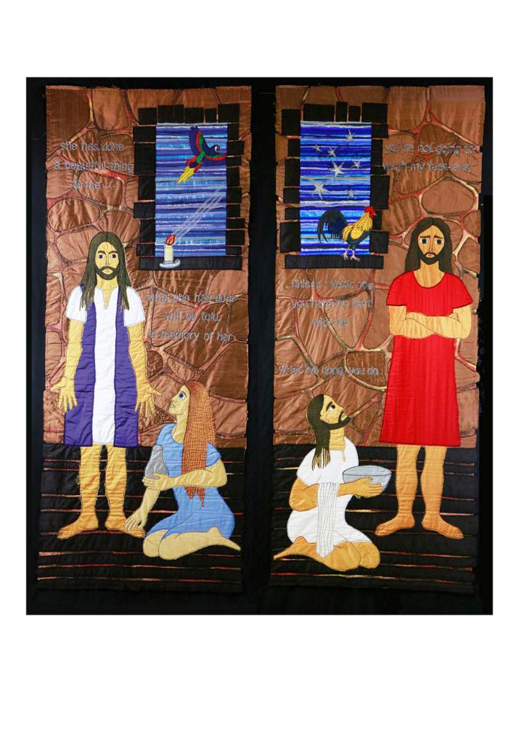
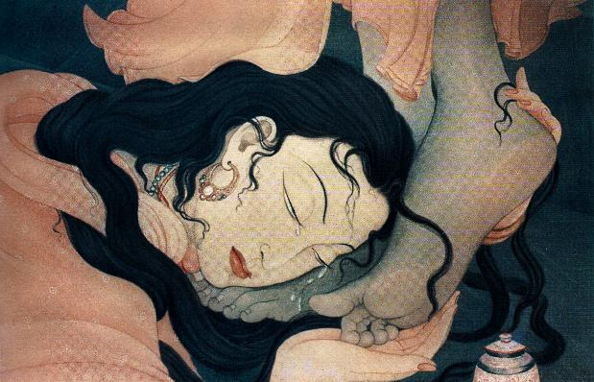
Frank Wesley, Mary Magdalene washing Jesus’ feet from Art in the Christian Tradition
Notes:
Slide 20: Showing Mary anointing Jesus’ feet from different cultural perspectives
Link to original artwork: https://diglib.library.vanderbilt.edu/act-imagelink.pl?RC=48399, which includes some key information.
Looking at these two creative interpretations of this part of the story may be something that links with your RE curriculum, reflecting the fact that Christianity is a global religion, encouraging pupils to appreciate the diversity that exists across cultures, traditions and geographical areas. It’s important for pupils’ wider understanding that they are given opportunities to think about how Christians show Jesus as being ‘like them’, and that this important story for Christians is imagined in different ways across the world. It also creates an inclusive classroom environment, giving all pupils opportunity to see themselves in the art that they view.
You may wish to consider these questions:
What is the same? What is different?
Which culture / tradition does the 2nd piece come from?
Why do we think this?
What questions might we want to / need to ask?

Slide 21
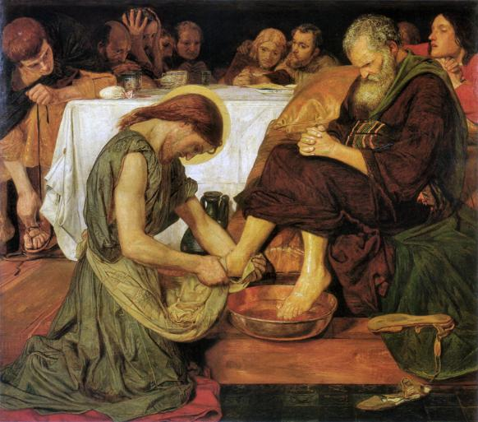
Ford Madox Brown, Jesus washes the disciples’ feet from Art in the Christian Tradition
Notes:
Slide 21: Showing Jesus washing the disciples’ feet from different cultural perspectives
Link to original artwork: https://diglib.library.vanderbilt.edu/act-imagelink.pl?RC=48399, which includes some key information.
Looking at these two creative interpretations of this part of the story may be something that links with your RE curriculum, reflecting the fact that Christianity is a global religion, encouraging pupils to appreciate the diversity that exists across cultures, traditions and geographical areas. It’s important for pupils’ wider understanding that they are given opportunities to think about how Christians show Jesus as being ‘like them’, and that this important story for Christians is imagined in different ways across the world. It also creates an inclusive classroom environment, giving all pupils opportunity to see themselves in the art that they view.
You may wish to consider these questions:
What is the same? What is different?
Which culture / tradition does the 2nd piece come from?
Why do we think this?
What questions might we want to / need to ask?

