Slide 1





We are here together….
May our attitudes make our school community a happy place today.
Notes:
Slide 1: Use the gathering words for this term
Leader: We are here together
ALL: May our attitudes make our school community a happy place today.

Slide 2


Beatitudes
Beati
‘How-to-be-attitudes’
Notes:
Slide 2: As you are expecting by now, we are going to be hearing about some more words from the Beatitudes, but first, a little puzzle for you…..

Slide 3
Face or vase?
https://en.wikipedia.org/wiki/Rubin_vase#/media/File:Face_or_vase_ata_01.svg
Rabbit or duck?
https://en.wikipedia.org/wiki/Rabbit%E2%80%93duck_illusion#/media/File:Kaninchen_und_Ente.svg
Notes:
Slide 3: Show one of the optical illusions linked from this slide. Ask children to tell you what they can see (two heads / a vase or rabbit / duck, depending which you have chosen). Explain how the image works if there are children who can’t see both.
‘Sometimes it’s difficult to see things from another, different point of view, especially where other people are concerned. We all have people in our lives who we get on with really well – and we also have people who we find difficult to get on with.

Slide 4
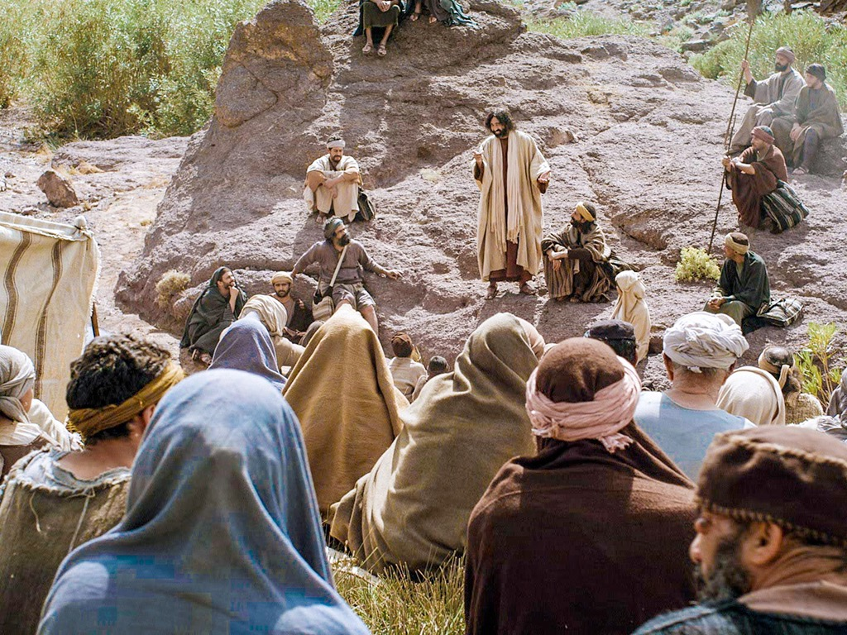

Those who are pure in heart are truly happy. They will see God.
Notes:
Slide 4: Jesus’ words from the Beatitudes [show them] talk about being ‘pure in heart’, which is a tricky phrase to try to explain! Jesus explained elsewhere that this is to do with having a heart that is open, honest and truthful, not hidden from God, which means that someone can see the world as God does.

Slide 5
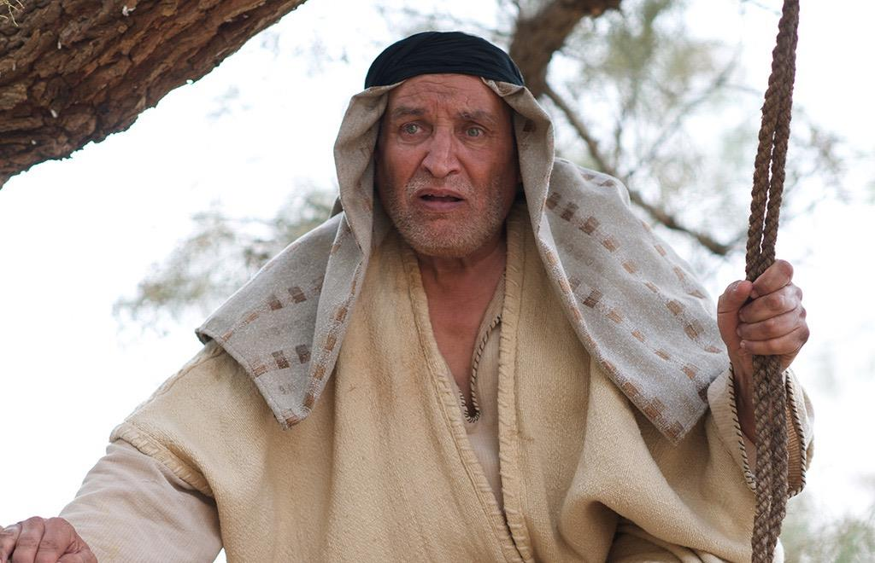
A change of heart
Notes:
Slide 5: A change of heart
Maybe it’s a bit easier to see what this looks like in another story, about someone who was able to do this for the first time. As you listen, see if you can spot who has a change of heart – and sees things differently. [use script & props on p.3]
So who had a change of heart and saw things differently?
That’s right, it was Zacchaeus. In this story, we see how Jesus was ‘pure in heart’ and saw Zacchaeus not as a cheat and a thief, but as someone who needed a friend. Jesus’ act of friendship changed Zacchaeus’ life forever, and as a result Zacchaeus found that he was seeing things God’s way for the first time – almost like putting on a new pair of glasses [put on glasses]. Zacchaeus also found that his change of heart in following Jesus meant he had to behave differently in the future. He could see how he’d cheated the people of Jericho – and he knew that he had to do something about it. His actions must’ve come as a huge surprise to the people of the town!

Slide 6
….I wonder what Jesus saw when he looked into Zacchaeus’ heart?....
…..I wonder what made Zacchaeus change?....
….I wonder what we can learn from this story about being ‘pure in heart’?....and how being pure in heart might help someone to see God and what’s important to him?....
Notes:
Slide 6: Responding and words for worship
Let’s think together now about Jesus’ words in the Beatitudes about being pure in heart – and about the story of Zacchaeus
….I wonder what Jesus saw when he looked into Zacchaeus’ heart?....
…..I wonder what made Zacchaeus change?....
….I wonder what we can learn from this story about being ‘pure in heart’?....and how being pure in heart might help someone to see God and what’s important to him?....

Slide 7
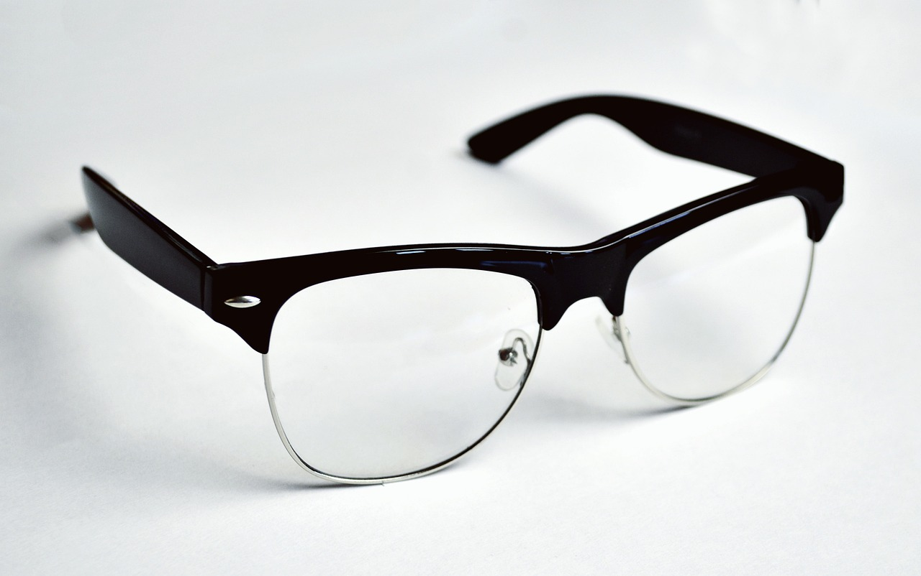
Notes:
Slide 7: This week comes with a challenge for us all. The people in the story found it hard to accept that Zacchaeus could be anything other than a bad person, because of his past actions, but Jesus chose to see something different. I wonder if there are people in our own lives like this? Maybe people who we don’t find it easy to get along with? I wonder if we might be able to see them with ‘new eyes’ (put on glasses!) and find some good things about them, like Jesus saw when he looked at Zacchaeus….
I’m going to use some words in a prayer now, to draw our thoughts to a close and ask God for his help to be ‘pure in heart’ so that we can see things as he does. If you’d prefer to be still with your own thoughts, then please do that instead….

Slide 8

Dear God
Thank you for the story of Zacchaeus and what it shows us about seeing people as you do. We all have people we know who are difficult to get along with. Please help us to see them as you do, to value them as you do and to live well together.

Slide 9
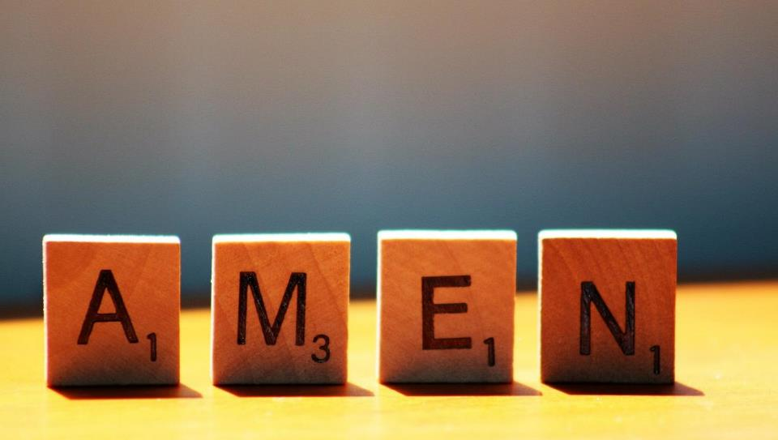

Slide 10



Leader: As we leave this place & time and go into the day ahead…
All: May we be ‘pure in heart’.

Slide 11
Notes:
Slide 11: Reflective areas
You will need some role play glasses in your reflective area today – or print and cut out card versions from the template on p. 5. Baker Ross stock card versions as well: Glasses Card Blanks (bakerross.co.uk) Put on the glasses and think about who or what you might want to see differently. You might want to pray that God will help you to see things as he does. Take a paper heart and write down three good things about that person (NB don’t write their name – keep it private) Do you feel differently about that person now you have thought about the good things about them?

Slide 12
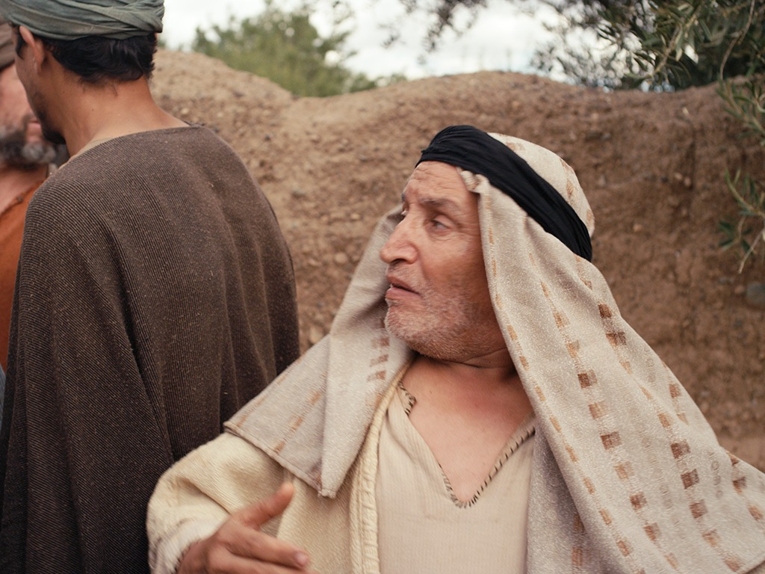
Alternative story resources
Notes:
Our story is about a man... a very little man.... a lonely man.......Zacchaeus was his name, and he lived in a big city called Jericho. Zacchaeus was a tax collector – his job was to collect the money that the people of Jericho owed to the Romans, who ruled the world at that time....And everyone hated him for it – because no-one likes to have to pay their bills!

Slide 13
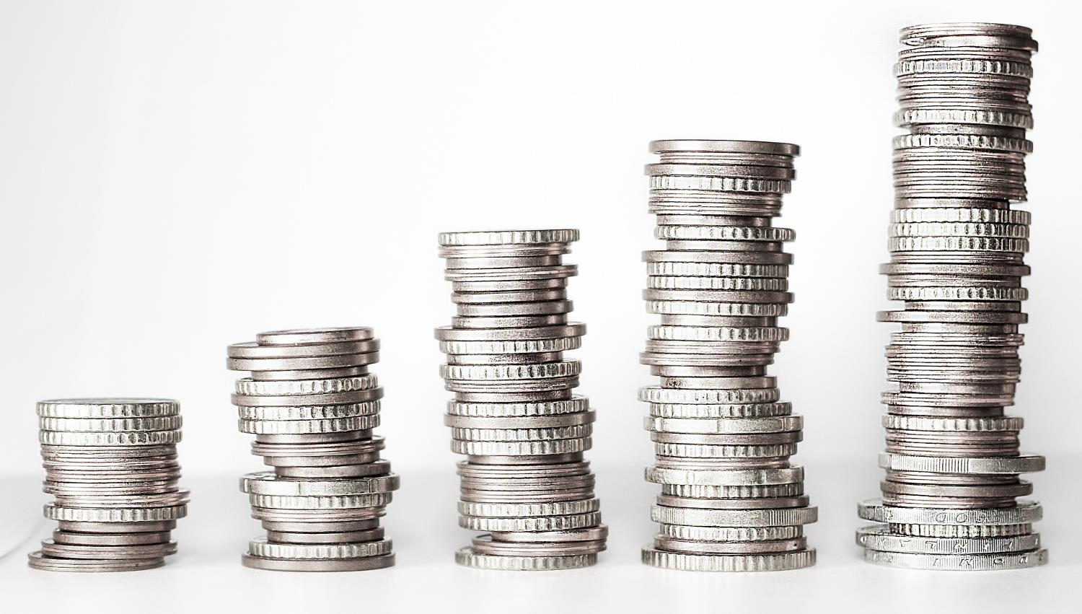
Notes:
The trouble was, Zacchaeus rather liked money and he used to demand more than he should so that he could keep the extra for himself..... And as he got richer, the people of Jericho hated him all the more and soon money became the most important thing in his life....

Slide 14
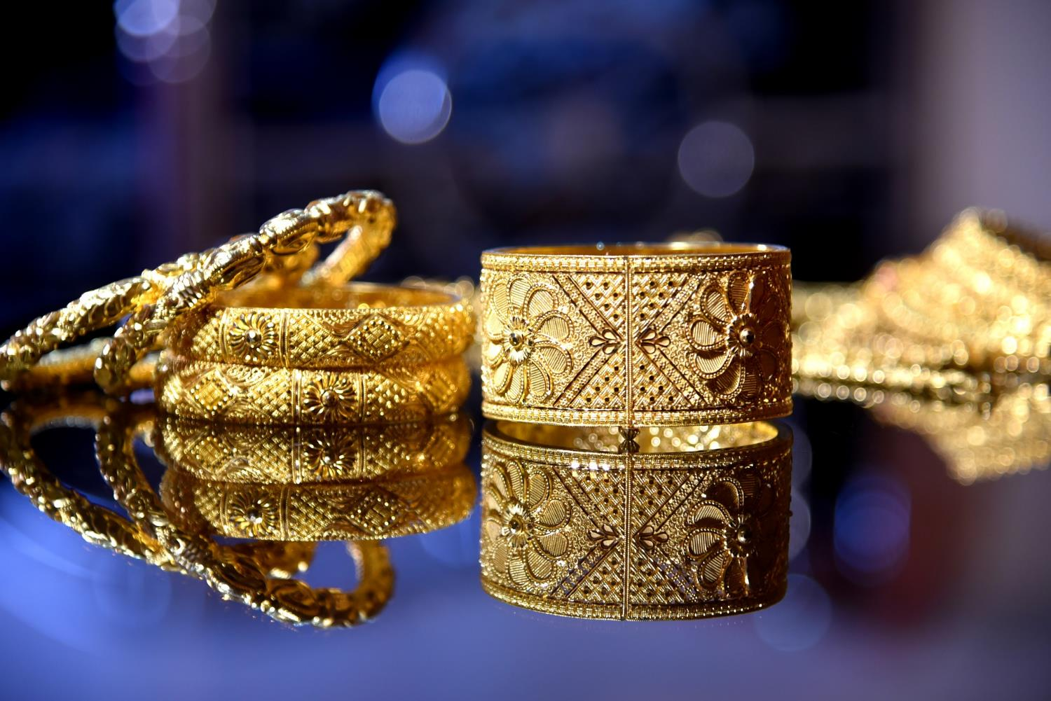
Notes:
Being rich meant that he could buy all that his heart desired – and he often did. But as time went by, he realised that he was actually not happy at all. He had many possessions and lots of money…….

Slide 15
Notes:
but they couldn’t make him truly happy….. [add double-sided card showing sad face]

Slide 16
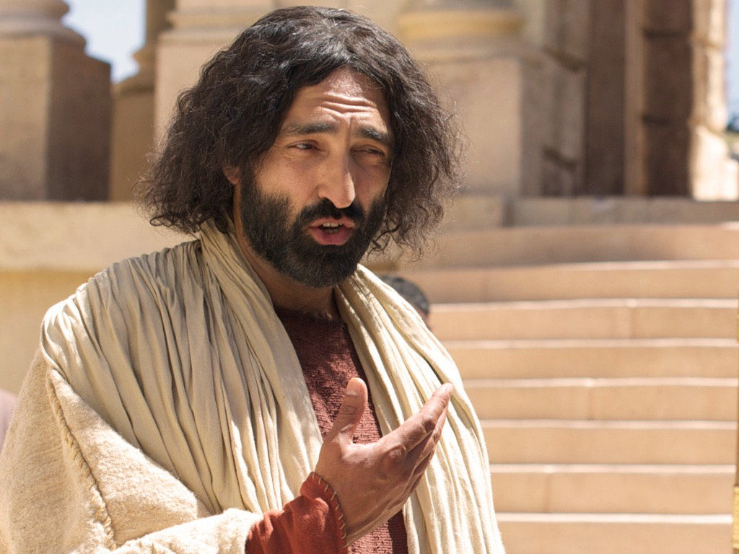
Notes:
Then one day, Jesus came to town. Wherever Jesus went, he found friends in unusual places. People called him ‘the friend of sinners’.......and Zacchaeus desperately wanted to meet him. There were crowds of people everywhere, but no-one would let him through to see Jesus as he passed. Zacchaeus couldn’t see over their heads, so he climbed up a tree

Slide 17

Notes:
As Jesus passed by the tree, he looked up and spoke directly to Zacchaeus. ‘Come down from there….

Slide 18
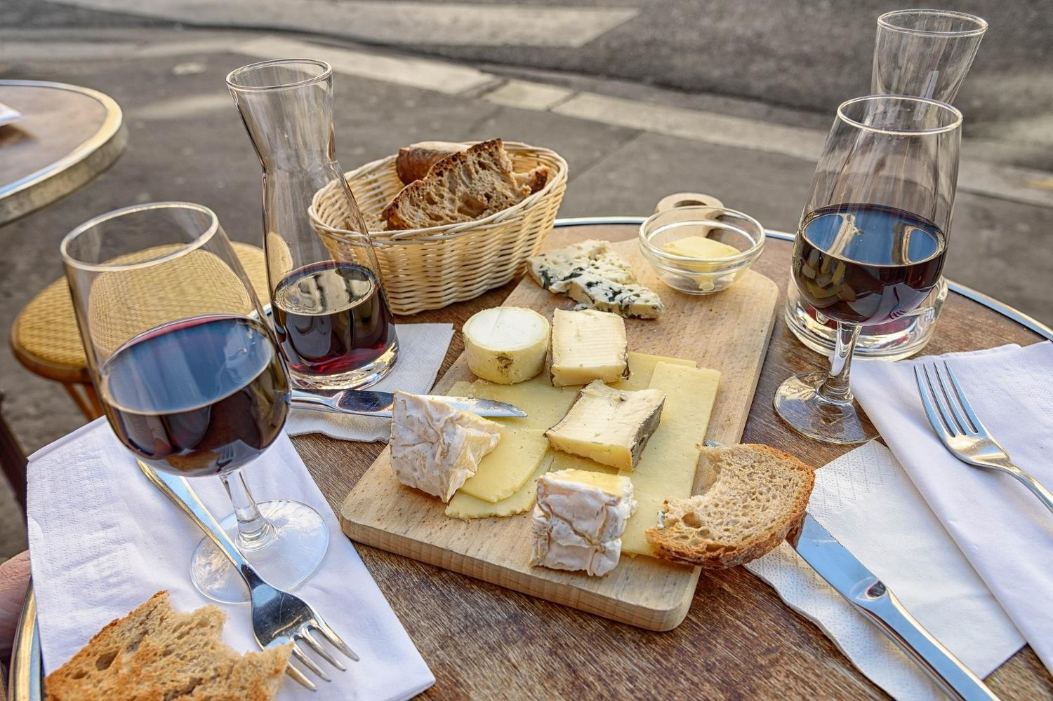
Notes:
because I’m coming to eat at your house today!....

Slide 19
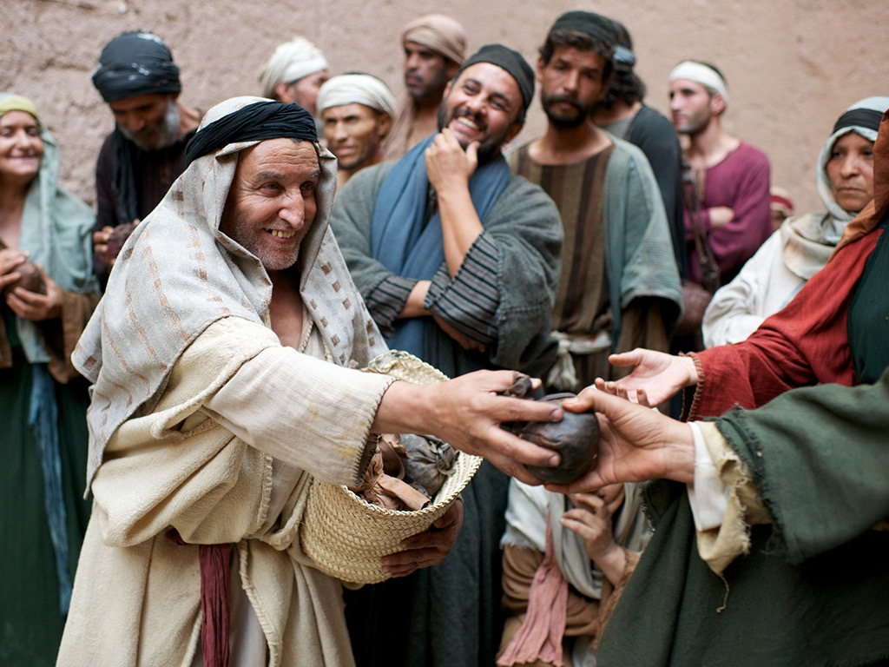
Notes:
The next day, the people of Jericho couldn’t believe the change in Zaccheus. He visited every person he’d cheated. He gave back not just the money that he’d demanded from them…..but four times what he’d taken – from his own savings. And he also gave half of all he owned to the poor.

Slide 20
Notes:
But more than that – finally Zacchaeus was happy – truly happy [turn sad face round to show happy face] because he’d found something that was worth more than money.....and for the first time, he had seen what was really important to God.

