Slide 1





All pictures copyright-free from pixabay
Notes:
Slide 1: Rising hearts stilling exercise
Use the stilling slide if desired: the suggested words should be spoken slowly, leaving pauses inbetween to create a sense of stillness.
As you sit quietly, watch the hearts rising….[PAUSE]
Now practise slower breathing…..in…..and out…..in……and out…..keep this going as you continue to look at the hearts….[PAUSE]
You maybe notice that you are feeling calmer and more relaxed….[PAUSE]
As you breathe, think back to the acts of kindness that you may have experienced last week….. [PAUSE]
How did it feel to receive them…..and to give them? [PAUSE]
We come into this special / sacred space and time to be still….to think deeply…..to be together as a school community…..
In our time together today, we will begin with a mystery, share a story and then use it to help us to think.
But first, let’s welcome one another as we begin….

Slide 2
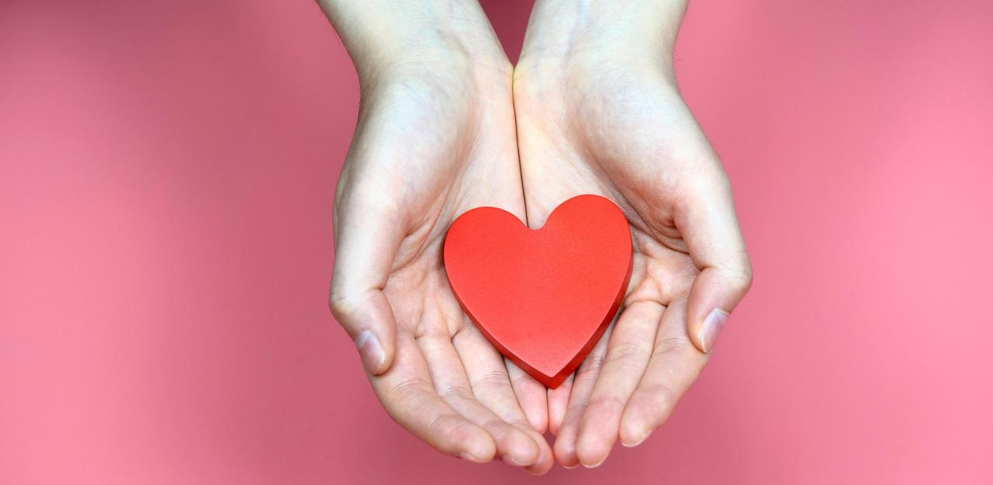
Leader: As we gather together today…
ALL: …we bring our thoughts and our hearts into this sacred space.
Notes:
Slide 2: Gathering
Leader: As we gather together today….
ALL: ….we bring our thoughts and our hearts into this sacred space.
Here are BSL actions for some of the words:
Leader’s words:
Gather: https://www.signbsl.com/sign/gather (1st video)
Today: https://www.signbsl.com/sign/today (1st video)
Pupils’ response:
Thoughts: https://www.signbsl.com/sign/thoughts (1st video)
Hearts: https://www.signbsl.com/sign/heart (1st video)

Slide 3
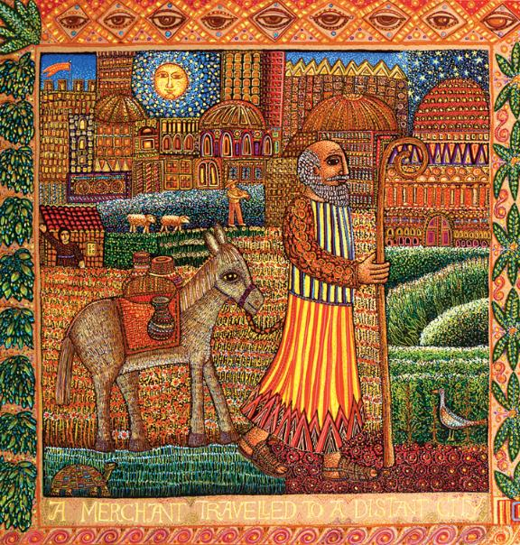
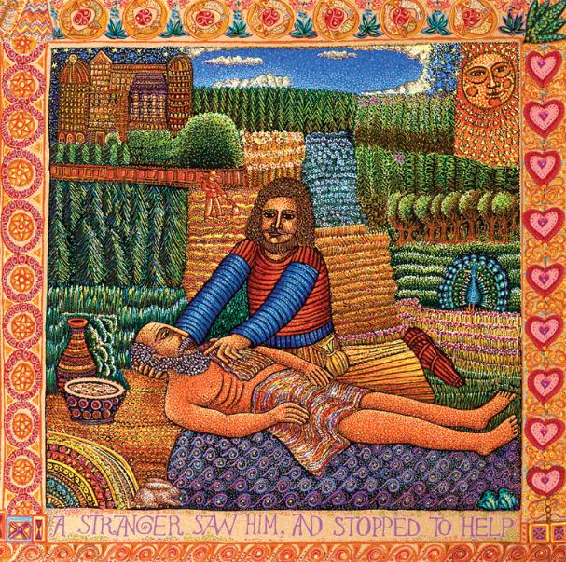
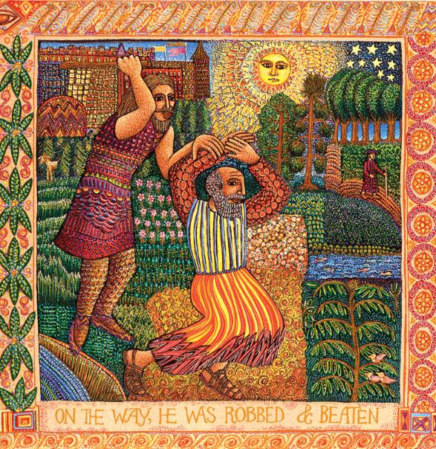
The Good Samaritan
Who is my neighbour?
Image by John August Swanson
Notes:
Slide 3: A mystery story….in 3 panels
We’re going to start with a mystery. I wonder if you can identify this story from 3 pictures and three short sentences?....
A merchant travelled to a distant city.
On the way he was robbed and beaten.
A stranger saw him and stopped to help.
So, what’s the story – and can you help with any missing parts? [e.g. two other people didn’t stop, but the Samaritan bathed his wounds and took him to an inn to be cared for until he was better again.]
I wonder if anyone can remember the really important question that a man asked Jesus, before he told this parable? [ask some children]
That’s right, the question was Who is my neighbour?
Jesus often used parables to help him to teach others about what’s important in the Kingdom of God and for thousands of years, these timeless stories have helped people to think about what this means for them, in their time and in their culture…..and the Parable of the Good Samaritan is no exception…..

Slide 4
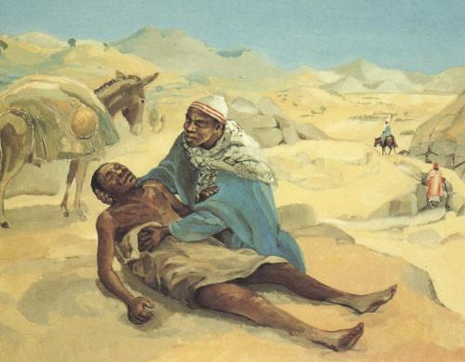
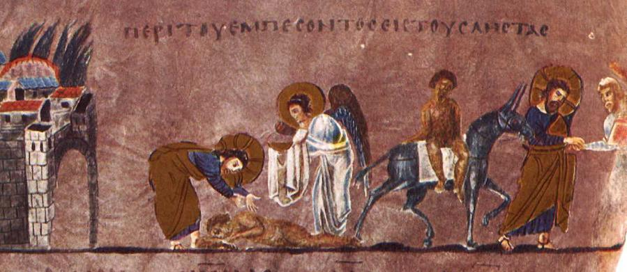
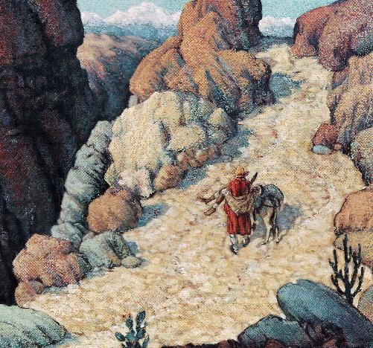
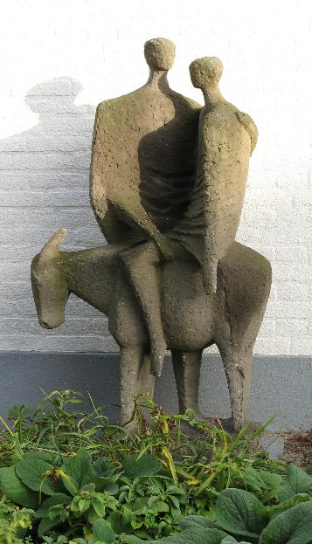
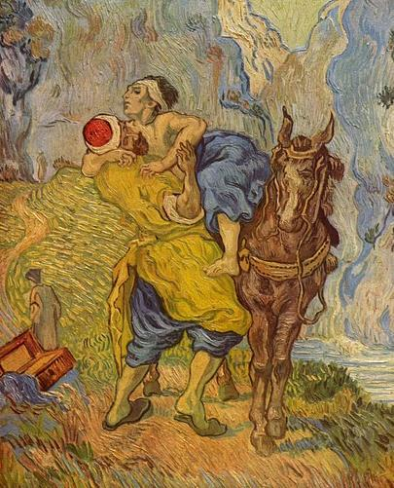
Good Samaritan in Cameroon, MAFA
Cathedral of Rosanno, Italy, 6th C CE
Cathedral of Rosanno, Italy, 6th C CE
Good Samaritan in Tibet, Frank Wesley
Then go and live like this!
Who is my neighbour?
Sculpture by Gerard Bruning
Vincent van Gogh, 1890
Notes:
Slide 4: This is just a small selection of art by artists across the world, each of them showing the kind stranger in the story, but reflecting their own culture and their own time. The oldest one here, is believed to date from just 500 years after the birth of Jesus.
Millions of Christians across the world still love this parable, and recall the words of Jesus to the man who asked him ‘Who is my neighbour?’ – they come at the very end of the story: ‘Then go and live like this.’

Slide 5
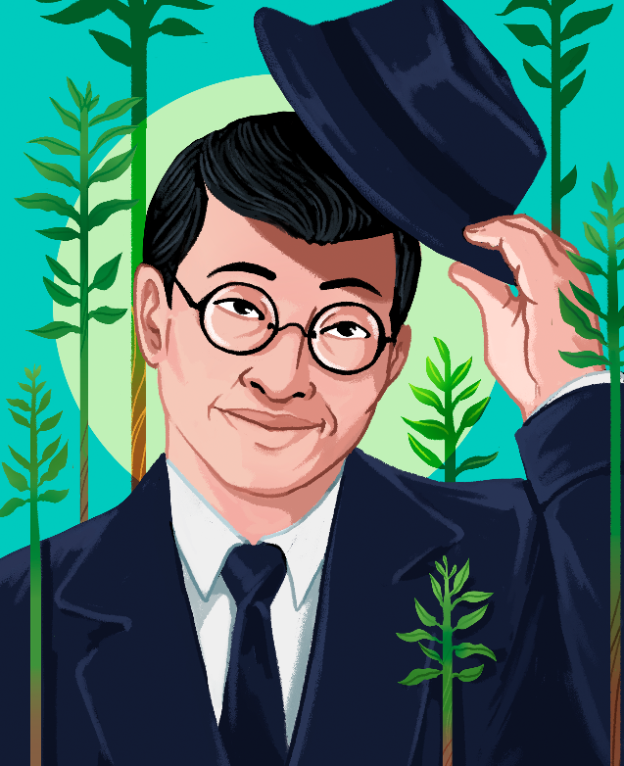
Toyohiko Kagawa
(1888-1960CE)
賀川 豊彦
Shine like stars!
These images are © Anastasia Magloire Williams & SPCK and must not be used outside of this context
Notes:
Slide 5: This parable was a favourite story of today’s Hero of Hope – and, in a moment, after we hear a bit about his life, you might understand why. This is Toyohiko Kagawa, born in the city of Kobe, in Japan, which is why you can also see his name written in Japanese! Here is Japan on our map:

Slide 6
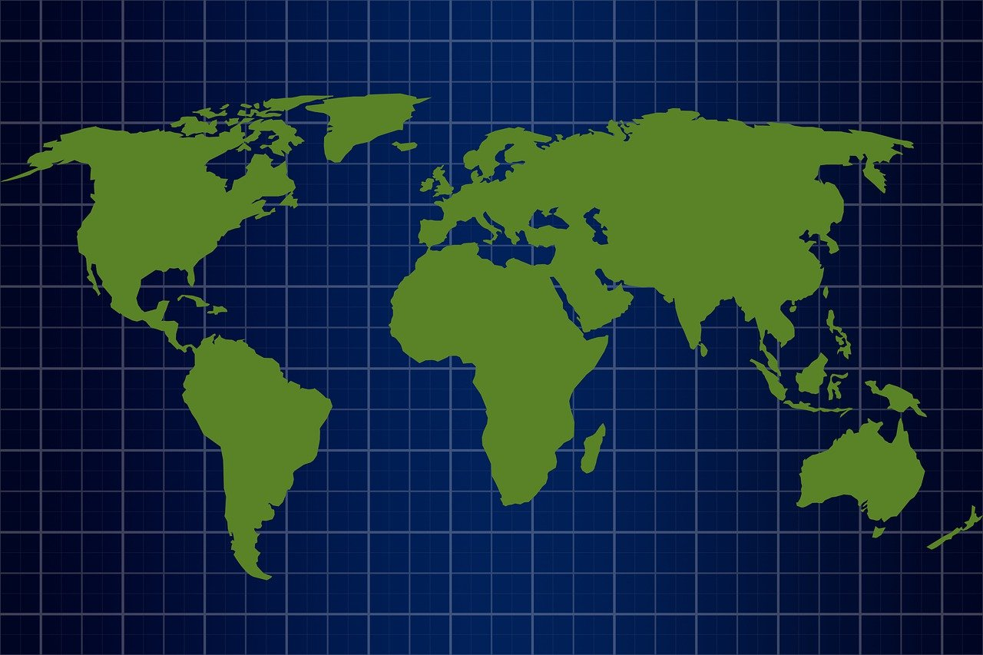
Notes:
Slide 6: World map

Slide 7
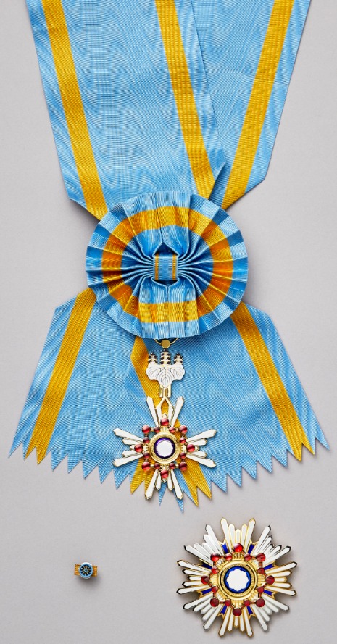
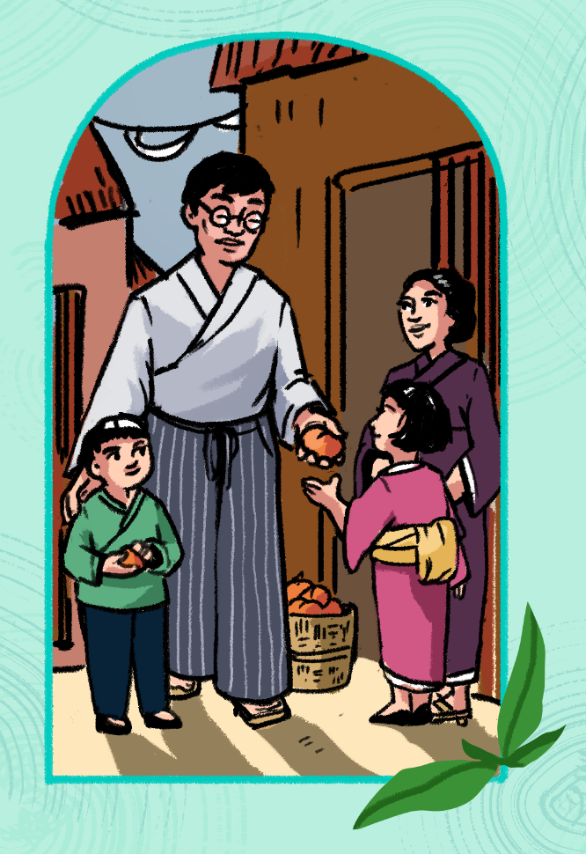
Toyohiko Kagawa (1888-1960CE)
These images are © Anastasia Magloire Williams & SPCK and must not be used outside of this context
Notes:
Slide 7: Toyohiko Kagawa is honoured in Japan for his faithful commitment to the poor and his work to change their world for the better, and was given the 2nd highest honour, the Order of the Sacred Treasure, after his death in 1960. Toyohiko believed that, as a Christian, it was important to take action on behalf of the poor, often quoting Jesus’ parable of the Good Samaritan. He also showed this in how he lived his life and lived in one of the poorest areas of Kobe so that he could work with his neighbours to help improve their living and working conditions.

Slide 8
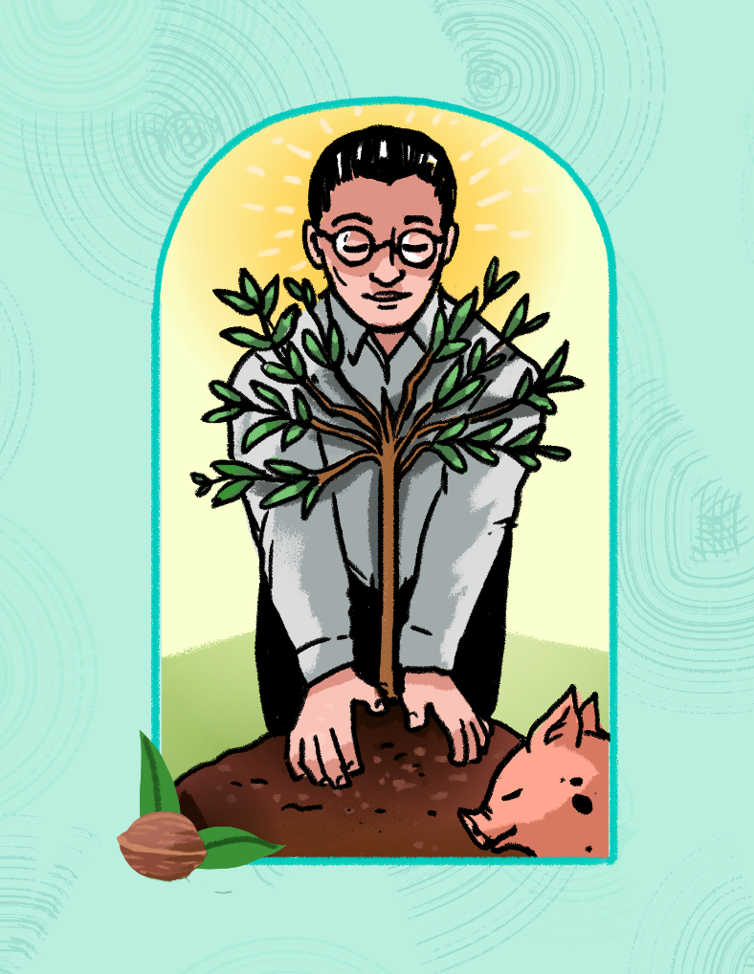
It is not enough to have ideals. We must translate them into action.
Then go and live like this!
These images are © Anastasia Magloire Williams & SPCK and must not be used outside of this context
Notes:
Slide 8: One of Toyohiko’s best ideas involved planting walnut trees, not just to provide food for the people, but also to help feed the pigs and other animals that they farmed. His project changed how people thought about farming at that time.
When WWII broke out, his beliefs about living peacefully with others made him very unpopular, but he did all he could to promote peace wherever he went. When the war ended, Toyohiko again got to work, helping to rebuild Japan as an adviser to the Japanese government, to ensure that everyone worked together for a more peaceful and harmonious future, founded on love and respect for all.
Earlier. we heard what Jesus said at the end of the parable: Then go and live like this! Toyohiko did exactly this in his life, believing that ‘It is not enough to have ideals. We must translate them into action.’ [You may need to explain this further to younger pupils] I wonder how we might do this this week?
Toyohiko Kagawa was also a prolific writer throughout his life, writing books and poems about his ideas, thoughts and experiences. We’re going to hear one of his poems now, called Discovery….

Slide 9
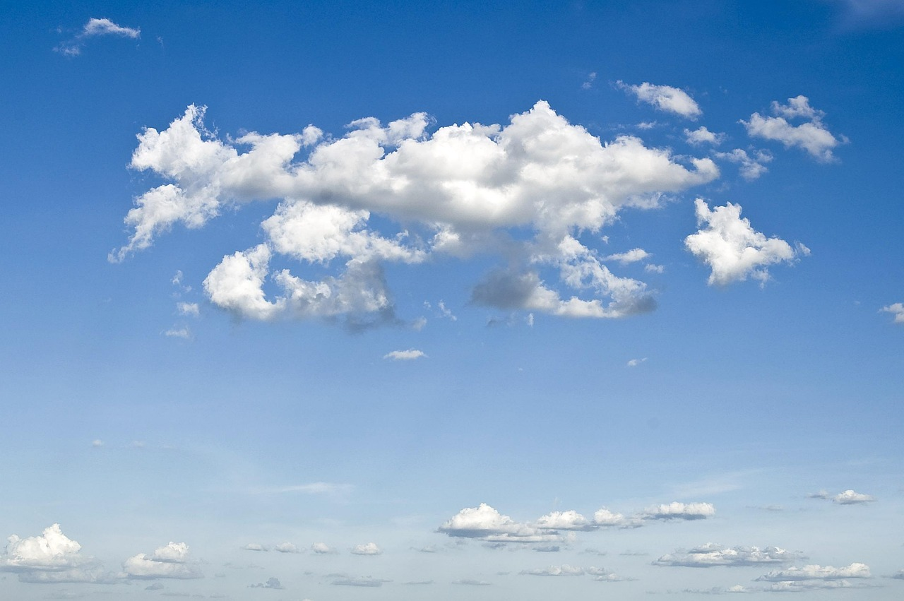
Discovery
a poem by Toyohiko Kagawa
….God, Who dwells in my hand, Knows this secret plan Of the things He will do for the world Using my hand!
Notes:
Slide 9: Discovery, a poem by Toyohiko Kagawa [read from script on p4: you will re-read the very end section as part of the reflection]
I wonder what you think these words mean? Poems aren’t always easy to understand, so don’t worry if you’re not sure! In the words of this poem, Toyohiko is thinking to himself and feeling a little bit disappointed that his life doesn’t involve creating great inventions or building fantastic machines, until a very special thought comes to him, like a streak of gold. The thought is that he can use his hands to help others – as a Christian, he believes that this is part of God’s ‘secret plan’ for him. Listen again to those most important words in the poem:
God, Who dwells in my hand, Knows this secret plan Of the things He will do for the world Using my hand!
I wonder what you think about these words? Think quietly to yourself while I read them a second time…. [read slowly, then leave a pause for children to think]

Slide 10
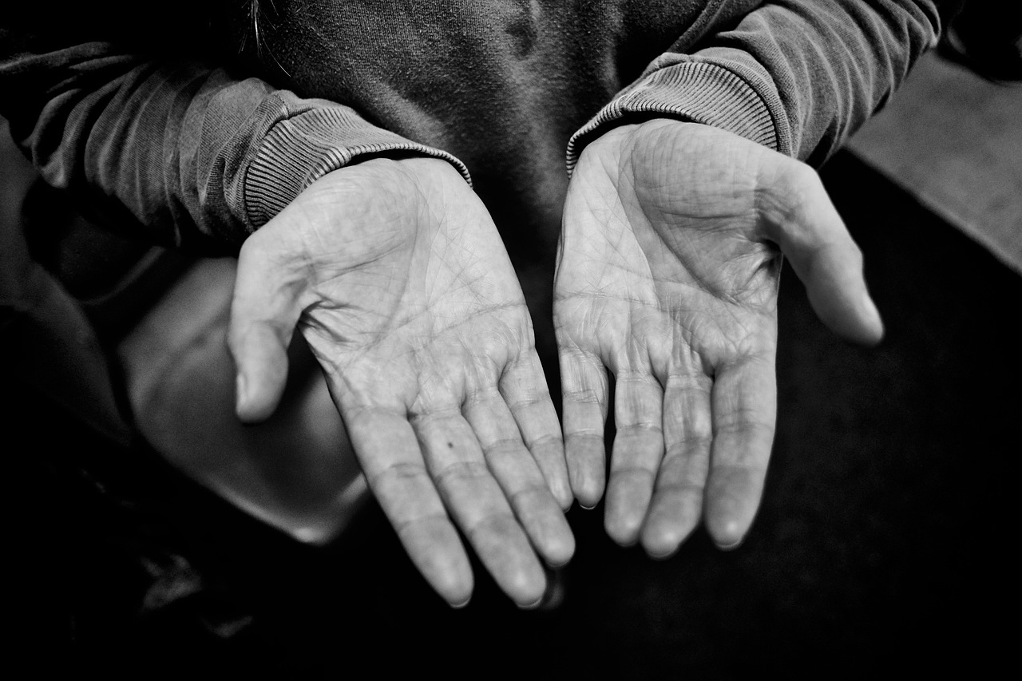
Notes:
Slide 10: Responding and words for worship [NB There are no words on the screen this week]
As you sit now, open your hands and rest them in your lap. Your hands are unique, as is the life that you live. Keep looking at your hands as we think…..[leave pauses between each phrase]
I wonder what you think of as you look at your hands?
….think about all the things that they will be doing today…...
…..working….playing…..helping…..caring…..
…..I wonder how your hands might be used to support others today?......
…..I wonder how God might dwell in your hand?...or how he might reach others through the actions of your hands?....
Now as you sit quietly, you might want to turn your thoughts into a prayer – or just carry on thinking quietly to yourself.
[leave pause before continuing]
Now, turn your hands over and rest them on your knees as we end this time, or as the ‘Amen’ to your prayer.
As you go about your day, and this week, maybe your hands will help to build our school community…..!

Slide 11



Leader: As we leave this place & time and go into the day ahead…
All: May we shine like stars!
Notes:
Sending: Slide 11
Leader: As we leave this place & time and go into the day ahead…
All: May we shine like stars!

Slide 12

Notes:
Slide 12: Reflective areas
Put Lego® bricks, or similar construction bricks in your reflective areas this week. If you have younger children in your class, you might want to build the basis of a wall for them to add their brick to.
Toyohiko Kagawa was honoured by his country as someone who tried to build up his community.
Think: What sorts of things ‘build up’ your school community and make it strong? Think of one thing that you might do this week.
Do: Take a brick and add it to the wall. If you want to, ask God to help you to build your community.
Talk: Talk about your ideas together.
We also encourage you to explore the full story of Toyohiko Kagawa from the book during the week.

