Slide 1
Leader: As we share these stories of leaders…
ALL: May we follow their example
in thoughts
and words
and actions.
Notes:
Leader: As we share these stories of leaders…
ALL: May we follow their example in thoughts and words and actions.
Signs for greeting: click on links
Thoughts: British Sign Language BSL Video Dictionary - thought (signbsl.com)
Words (use 3rd definition): British Sign Language BSL Video Dictionary - word (signbsl.com)
Actions: British Sign Language BSL Video Dictionary - action (signbsl.com)

Slide 2
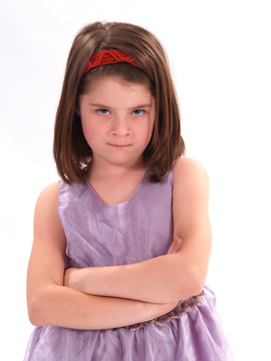
That’s not fair!
Notes:
Slide 2: That’s not fair! ‘I wonder if you’ve ever said “That’s not fair!”?…..If you have, what have you said it about? [ask a few children /adults, making no significant comments about anything anyone says, then continue:]
Today we’re going to be hearing about something that one Olympic athlete thought was very unfair, but to prepare us for this, I’ve got some statements here…..some things that might or might not be unfair, and I’d like you to help me decide which things you think are truly unfair [read out the cards, encouraging children to decide whether or not they go in the box or not. You’ll probably find that children change their minds about some as other cards get read out, which is what you want! You might also find that there are some situations that are surprising to children about how the poor / women / children are treated, so this may need to be followed up outside of the collective worship. When all the cards have been sorted to the children’s satisfaction, continue again:]

Slide 3
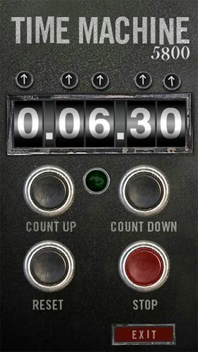
1960
2023
AD
AD
Notes:
Slide 3: There is much in our world that truly is not fair……We’re going to go back in time to the year 1960, when the Summer Olympics were in Rome, Italy……In 1960, there were laws in some countries that meant that people with black skin were not treated the same as those with white skin. To help you understand what this really means, I’m going to pretend for a few moments……

Slide 4
Notes:
Slide 4: It would be like me saying to all the children in this hall who have brown hair that they weren’t going to be allowed out at playtime with the other children, or to eat in the dinner hall at the same time as all the other children, or even be a part of the same lessons as all the other children…….if they got sick, they wouldn’t be allowed to go to the same hospitals as other children….and when they grew up, they wouldn’t be able to get good jobs because their hair was brown……in fact, they would always be treated unfairly because of the colour of their hair……
Now this is just pretend! In our school we would never treat people in that way, but it gives you an idea of what things were like in some parts of our world for people with black skin. To us, it might seem ridiculously unfair that anyone should be treated differently because of how they look – but in 1960, people with black skin were not allowed to freely mix with people with white skin. And we all know that our world is still a place where things are not fair for everyone.

Slide 5
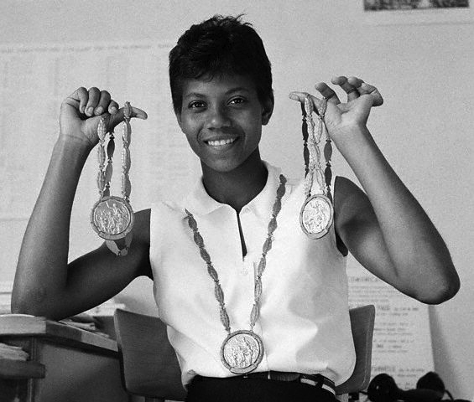
Wilma Rudolph
Notes:
Slide 5: This [show photo] is Wilma Rudolph, an American athlete. As you can also see from the photo, she won some Olympic medals, which you’ll hear about in a moment. Wilma was born into a very large family – the 20th of 22 children in fact! – and as a premature baby (that means she was born earlier than people expected), she weighed only 4.5llbs (most babies these days weigh around 8llbs). But because she was black, she couldn’t be treated at the local hospital with the white people and her family were too poor for her to be taken elsewhere.

Slide 6
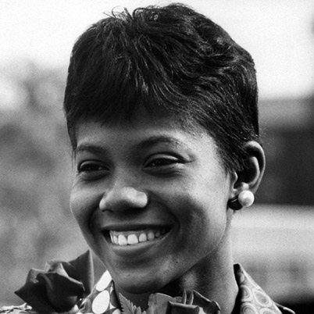
“My doctor told me I would never walk again. My mother told me I would. I believed my mother.”
Notes:
Slide 6: She was sick through much of her childhood and developed a serious disease called polio, which left her unable to use her left leg. She was only able to walk properly for the first time aged 12! Looking back on her childhood later on in her life, she said: “My doctor told me I would never walk again. My mother told me I would. I believed my mother.”
Fortunately, her mother was right, and at school, Wilma discovered she could run. She competed in her first Olympics in 1956, aged 16, and was part of the team sent to the Olympics in 1960.

Slide 7
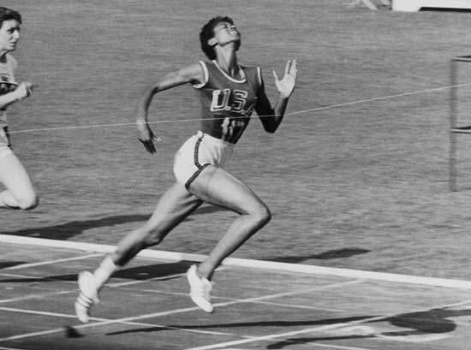
Wilma Rudolph
Notes:
Slide 7: She won three gold medals – for the 100m, the 200m and as part of the 4x100m relay team. She was the first woman ever to do this, an incredible achievement.
Back in her hometown, Clarksville, a homecoming banquet was organised in her honour, but Wilma discovered that once again, black people and white people were not going to be allowed to be together. She refused to attend this banquet unless all people were allowed to mix freely. Her homecoming meal was the first time in the city’s history that an important event was held without segregation, where all people could freely attend, whether they were black or white. Wilma Rudolph continued to protest until all the segregation laws in her town were taken away. She was a true Olympic hero….in every sense.

Slide 8
‘Now, in Christ, there is no difference between Jew and Greek. There is no difference between slaves and free men. There is no difference between male and female. You are all the same in Christ Jesus.’ [Paul’s letter to the Galations 3:28]
Notes:
Slide 8: Responding (words for worship):
….so in the stillness of this moment, let’s spend some time wondering together…..
St. Paul, whose story we heard just a couple of weeks ago, wrote these words:
‘Now, in Christ, there is no difference between Jew and Greek. There is no difference between slaves and free men. There is no difference between male and female. You are all the same in Christ Jesus.’ [Galations 3:28]
Paul lived in a world that was unfair. In God’s eyes, he said, all people are equal and all should be treated fairly….
…we’ve been thinking today about our world, and how in some places, people are still treated unfairly…..because of the colour of their skin…or because they are poor….. or a girl….. or a child……
….Wilma Rudolph grew up in an unfair world too, but it made her want to do something about it, and when she saw her opportunity, she did what she could…..
…she stood up for what she believed was right by refusing to go to her own banquet unless everyone could mix freely….
……it takes great courage to act in this way…..
…..our world needs more leaders like Wilma Rudolph…..

Slide 9
…. I wonder what we might learn from Wilma Rudolph’s life and example?...
….I wonder what we think is unfair in our world?....
….I wonder how we might make sure that our school is a fair place for everyone?....
Notes:
Slide 9: ….I wonder what we might learn from Wilma Rudolph’s life and example?....
….I wonder what we think is unfair in our world?....
….I wonder how we might make sure that our school is a fair place for everyone?....
....we heard last term that we can ‘Be the change you want to see in the world’…..
….so our school being a fair place starts with us…..
This may not always be easy for us to do, so I’m going to use a prayer asking for God’s help. If you’d like to make the prayer your own, then join in with the Amen at the end.

Slide 10
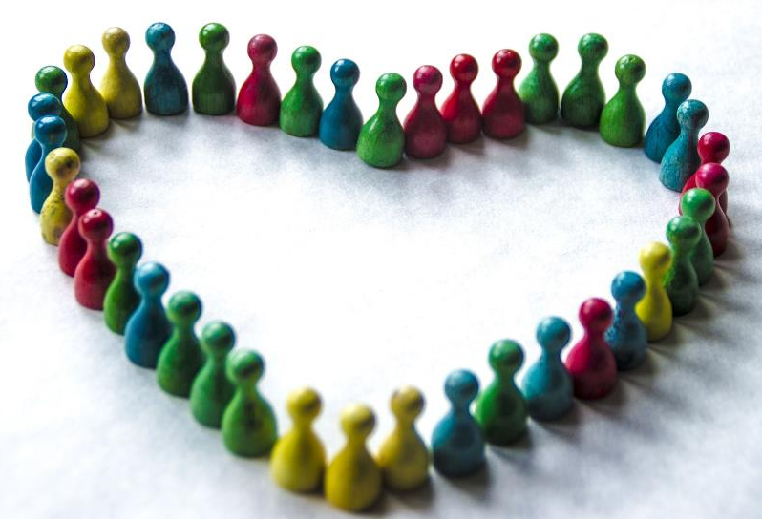
Loving God, we ask for:
Listening ears to hear others’ stories,
Watchful eyes to see who’s left out,
Outstretched hands to lift up the hurting,
Quick-to-stand legs to walk alongside,
Courageous hearts to spur us to action,
And fearless mouths to speak up for what is right.

Slide 11
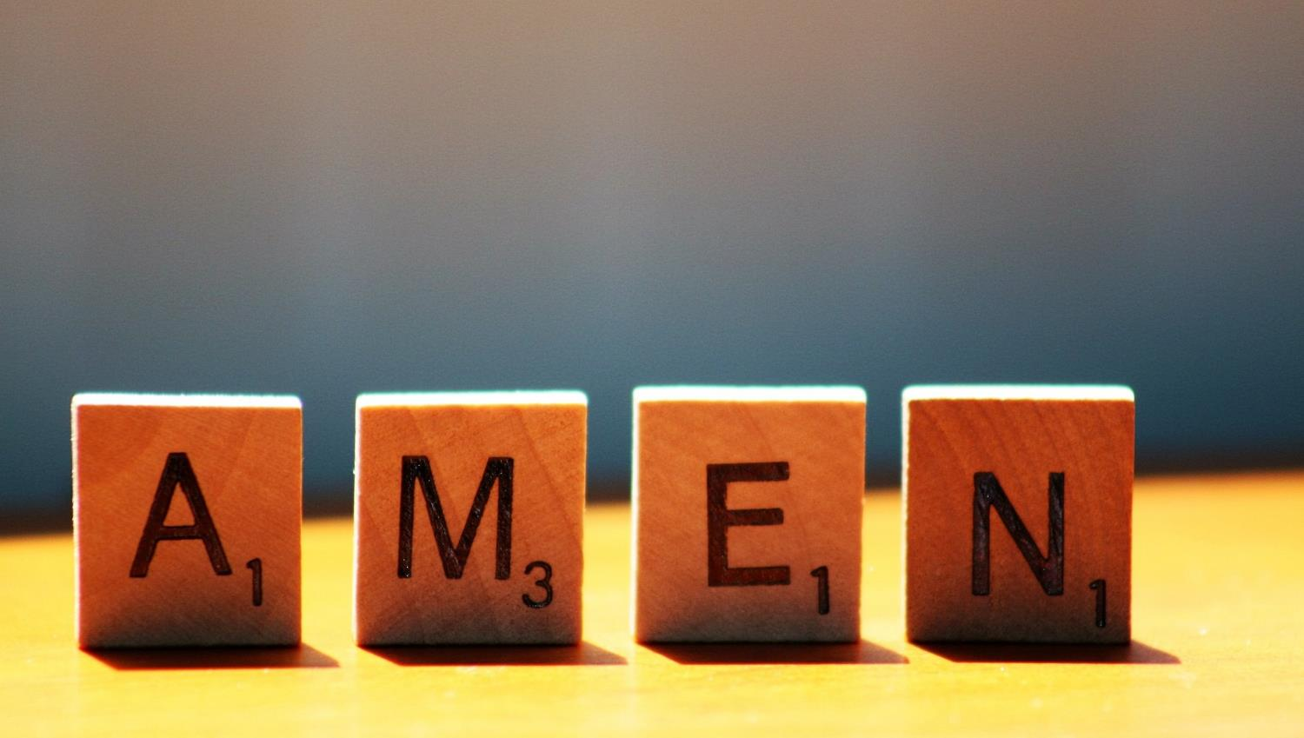

Slide 12
Leader: As we leave this place & time and go into the day ahead…
All: …may we treat each other fairly, today and every day.

Slide 13
Agree and write a class fairness charter – and commit yourselves to making it happen in your classroom.

