Slide 1



Leader: We are here together
Children: With ears ready to hear and hands ready to serve.
ALL: May we be wise in all our actions today.
Notes:
Slide 1: Use our new gathering words. Why not invent your own actions to accompany them?
Leader: We are here together
Children: With ears ready to hear and hands ready to serve.
All: May we be wise in all our actions today.

Slide 2

Notes:
Slide 2: We’ll shortly be hearing our wise words for today – and as we journey towards Easter together this half term, we’ll also be sharing a story from the life of Jesus.

Slide 3
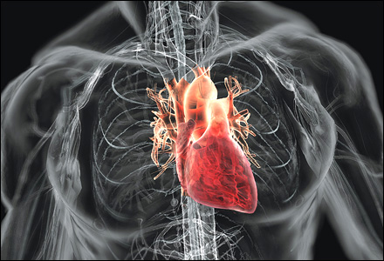
Notes:
Slide 3: I wonder if anyone knows what this is? [ask a few children, or give clues]
You won’t ever have seen one, but we’ve all got one.
It keeps us alive.
Along with our brains, it’s one of the most important parts of our bodies, because without it beating, none of us would be here.
It’s…. Your heart!
Most people realise that it’s very important that we look after our hearts – I wonder if you can tell me how? [ask a few more children]

Slide 4
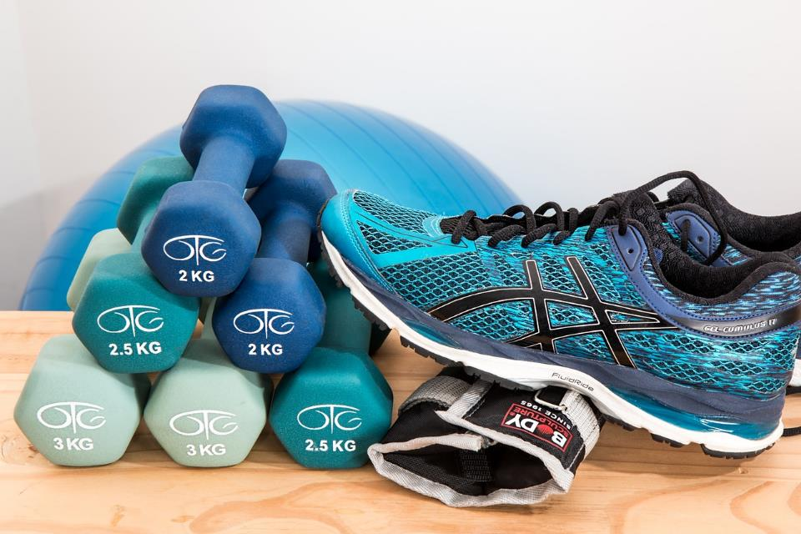
Workout!
Notes:
Slide 4: It’s workout time – and we are going to get active here in our assembly hall this morning and make our hearts pump!!
Our routine will show us what happens when we exercise, and why exercise is important for our physical hearts…
[Conduct your mini-aerobics session here, ask them to feel over their heart to see what’s happened whilst they’ve been exercising, then do the cool down. When children are settled again, continue]
So, why have we been doing all this? Well, one reason is that it’s very good for us to do this, but there is another reason entirely and it has to do with today’s Wise Words!

Slide 5


‘Whenever you are able,
do good to people who need help.’ (Proverbs 3:27)
Notes:
Slide 5: ‘Whenever you are able, do good to people who need help.’
There’s another part to our hearts, a part no-one quite knows the location of, that’s to do with our ability to feel – the ‘feeling’ part of our hearts, if you like. It’s important that this part of our bodies gets some exercise as well – and this happens through what we do to help others. Let’s keep our Wise Words in mind as we connect with a story from the life of Jesus that will help us to think more deeply….

Slide 6
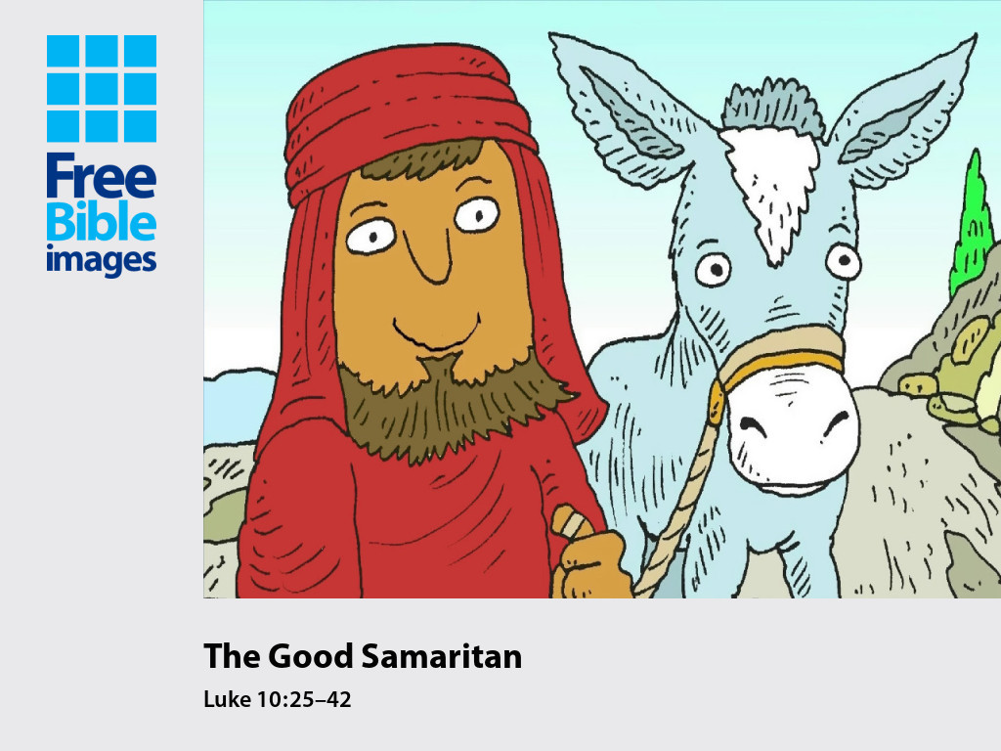
Notes:
Slide 6: Jesus often told stories to tell people something important about God, or so that people would know how to treat others. This story is found in the Bible in the book of Luke, and it’s one of Jesus’ most famous stories.

Slide 7
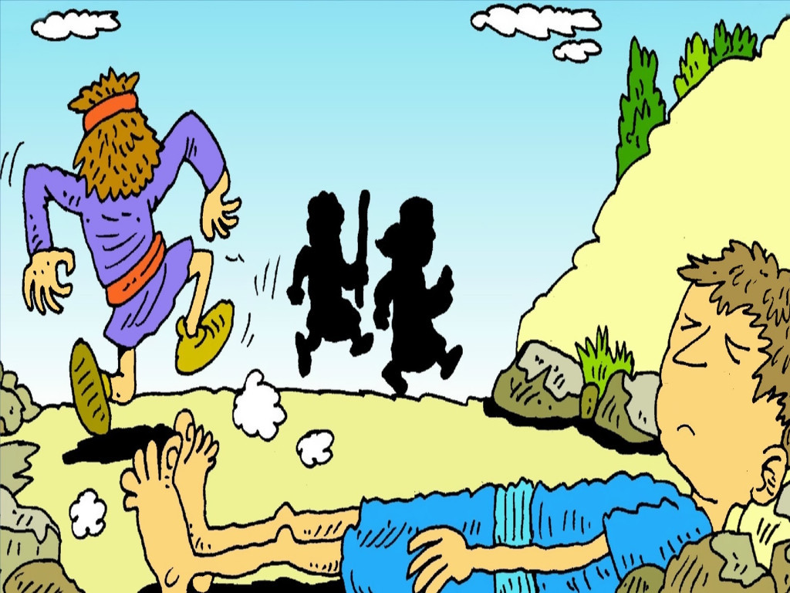
Notes:
Slide 7: A man was walking along the road from Jerusalem to the town of Jericho when some bad men stole his coat and left him lying on the side of the road, badly hurt.

Slide 8
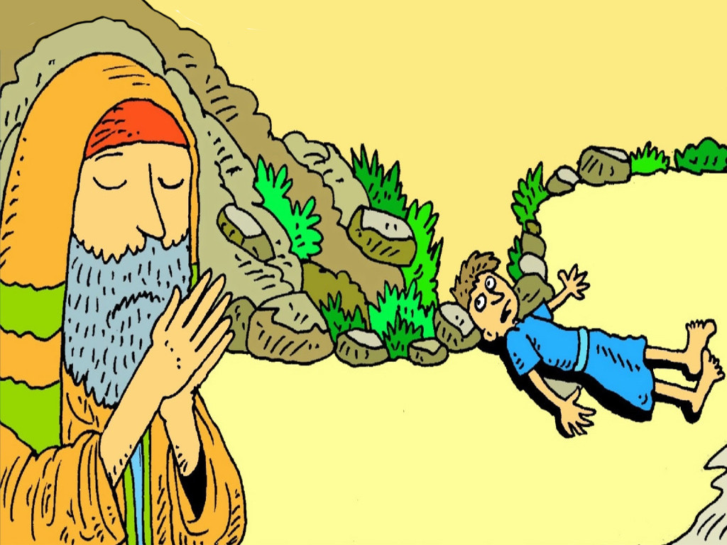
Notes:
Slide 8: The hurt man lay in the hot sun. At last, he saw someone coming past. It was a very holy man who loved to pray. ‘Help me please,’ cried the hurt man.

Slide 9
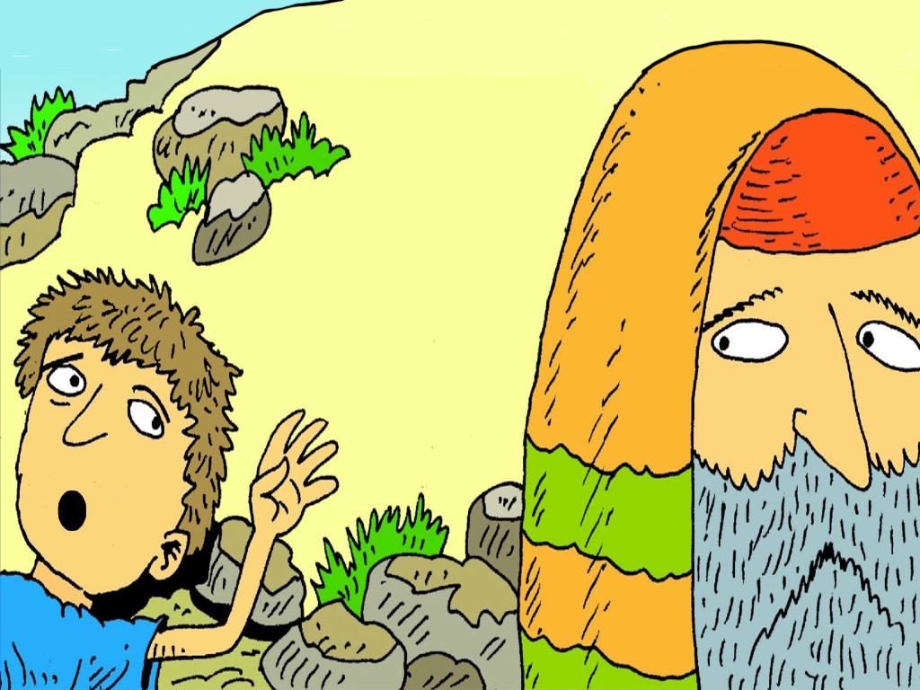
Notes:
Slide 9: But the very holy man took no notice. He walked on the other side of the road. He didn’t stop to help the hurt man. He was too busy praying to God.

Slide 10
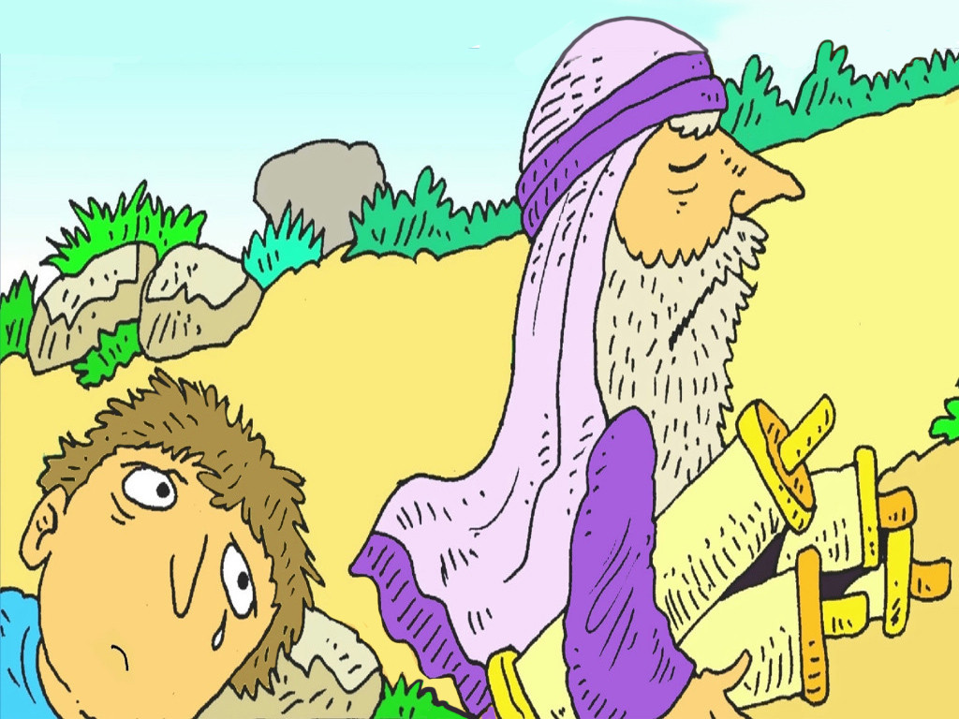
Notes:
Slide 10: A very clever teacher, from his own town, came past. He walked on the far side of the road and pretended not to see the hurt man. He did not stop to help him either.

Slide 11
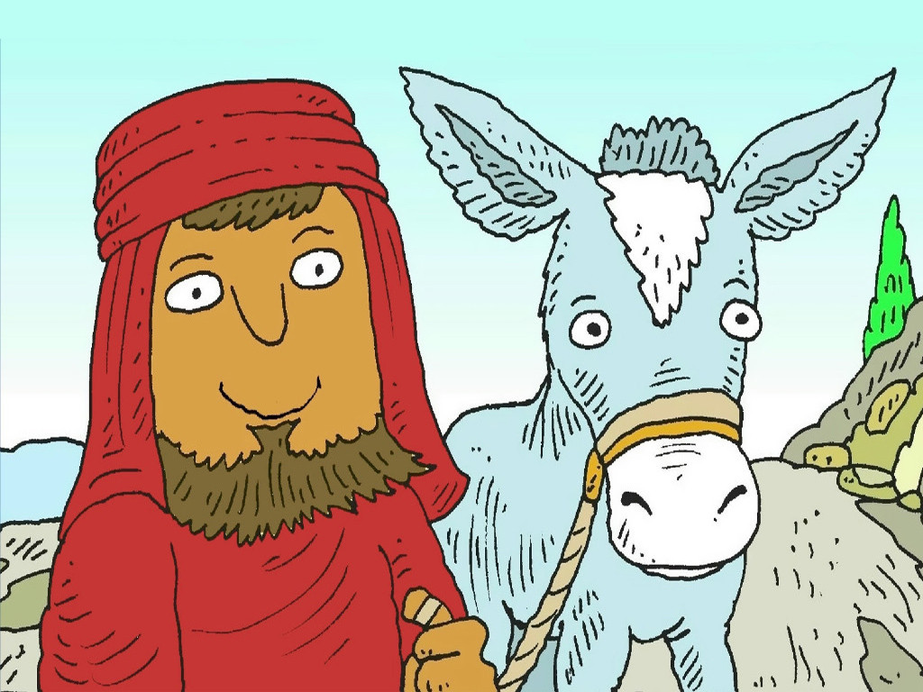
Notes:
Slide 11: A stranger from the country of Samaria came along the road with his little donkey. He saw the hurt man by the side of the road. The man from Samaria was very kind.

Slide 12
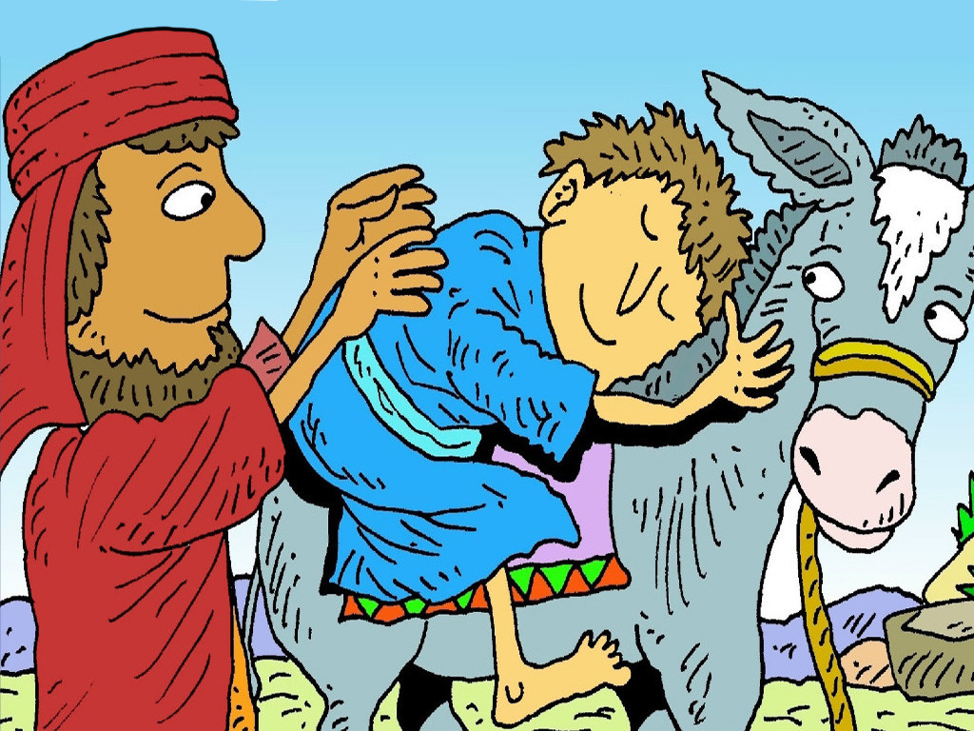
Notes:
Slide 12: ‘I will help you, my friend,’ said the kind man from Samaria. He gave the man a drink of water, helped him and put him on his donkey’s back.

Slide 13
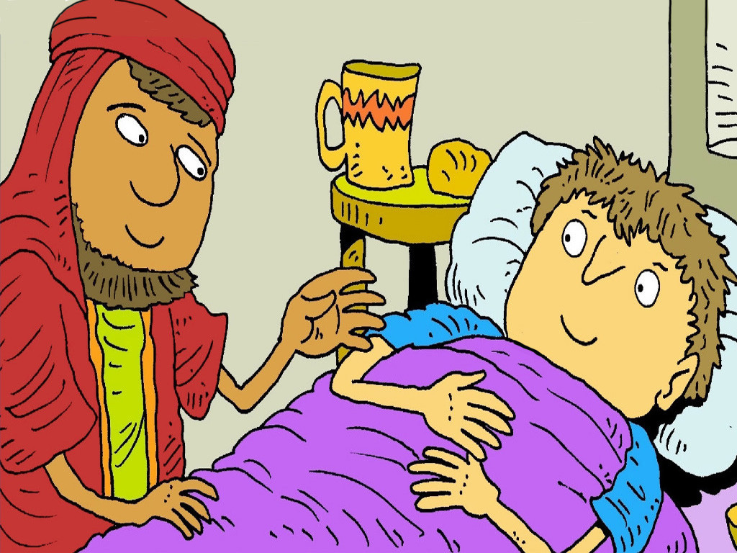
Notes:
Slide 13: He found a place for the man to stay and paid for everything he needed. What a kind person!

Slide 14
‘If you have what a person needs, don’t say to them, “Come back later. I will give it to you tomorrow.”’
(Proverbs 3:28)
‘Whenever you are able,
do good to people who need help.’ (Proverbs 3:27)
Notes:
Slide 14: Our wise words for today remind us: ‘Whenever you are able, do good to people who need help.’
So, who did this in the story?
It was the Samaritan of course! He had what people sometimes call ‘compassion’ – he saw someone in need, thought how he would feel if he was lying at the side of the road – and then did something about it.
There’s a second part to this wise saying, which says this: ‘If you have what a person needs, don’t say to him, “Come back later. I will give it to you tomorrow.”’
We might think that it’s was very obvious that the man lying by the side of the road needed help, but two people in the story walked by because they were just too busy with their own lives to be able to stop. They maybe thought ‘We can help someone tomorrow!’ I wonder if we’ve ever done this….?

Slide 15




Compassion
Notes:
Slide 15: Compassion
The Samaritan showed great compassion for the man lying in the road.
Showing compassion for others is what keeps the ‘feeling’ part of our hearts healthy, and prevents us from becoming ‘hard-hearted’. Like exercise, the more you practise being compassionate, the healthier the ‘feeling’ part of your heart will become.
I wonder how we do this? – well, let’s learn from the Samaritan in the story and see what he did!
He saw someone who needed help: we can do that too, and keep our eyes open to see people in need
He had compassion: we should think how we might feel in their position
He did something to help: and so can we. Remember that our Wise Words said ‘whenever you are able.’ Sometimes, it may not be possible – or safe – for us to help [emphasise importance of safeguarding here, in child-friendly terms as you would normally articulate it in school]

Slide 16

….I wonder what we have learned from the example of the Samaritan?....
….I wonder how we might ‘do good’ to others today?.... & not leave it until tomorrow!....
Notes:
Slide 16: Responding and words for worship
Our Wise Words for today reminded us ‘Whenever you are able, do good to people who need help.’
Let’s wonder together…..you might like to think about the story as we do…
….I wonder what we have learned from the example of the Samaritan?....
….I wonder how we might ‘do good’ to others today?.... & not leave it until tomorrow!....

Slide 17

‘Do all the good you can,
By all the means you can,
In all the ways you can,
In all the places you can,
At all the times you can,
To all the people you can,
As long as ever you can.”
Notes:
Slide 17: Prayer
I’m going to use some words written by a very famous Christian hymn-writer, John Wesley, in 1904. I wonder whether he had our wise words in mind when he wrote them?! Use the words as your own prayer if you would like to:
‘Do all the good you can,
By all the means you can,
In all the ways you can,
In all the places you can,
At all the times you can,
To all the people you can,
As long as ever you can.”

Slide 18
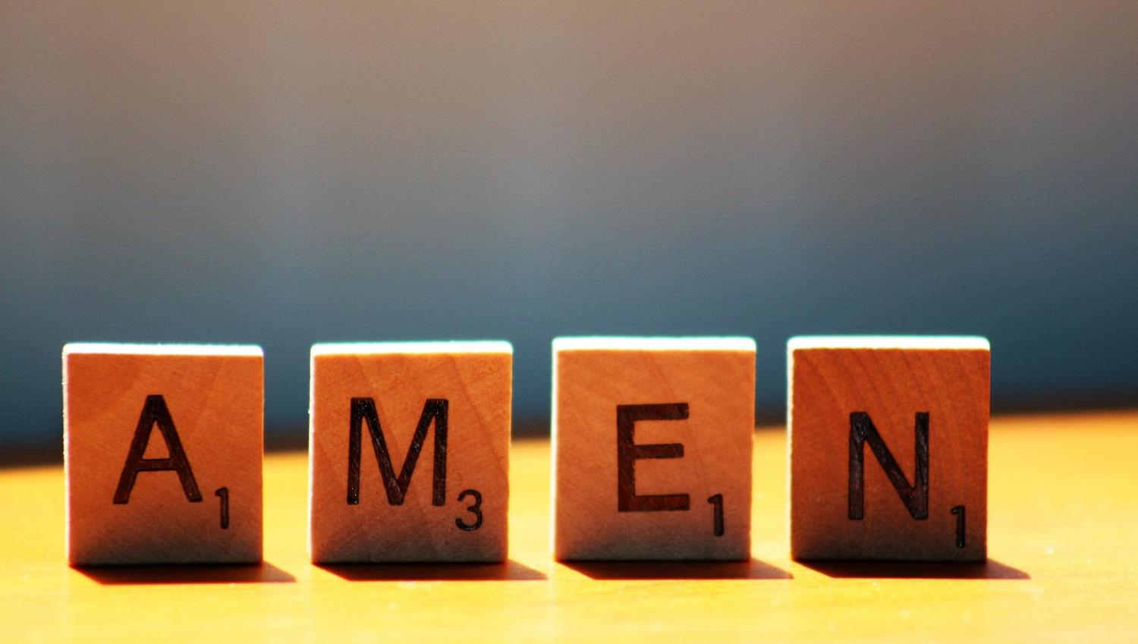

Slide 19


Leader: As we leave this place & time and go into the day ahead…
All: May today’s words help us to make wise choices.

Slide 20
Notes:
Reflective prayer activity:
On heart-shaped paper: write about or draw people who need our help – and even better, go out and do good wherever you can!

