Slide 1


Leader: As we share these stories of leaders…
ALL: May we follow their example
in thoughts
and words
and actions.
Notes:
Leader: As we share these stories of leaders…
ALL: May we follow their example in thoughts and words and actions.
Signs for greeting: click on links
Thoughts: British Sign Language BSL Video Dictionary - thought (signbsl.com)
Words (use 3rd definition): British Sign Language BSL Video Dictionary - word (signbsl.com)
Actions: British Sign Language BSL Video Dictionary - action (signbsl.com)

Slide 2

Picture copyright-free from pixabay
is…
Notes:
Slide 2: Love is….. I wonder how you might finish this sentence starter? It’s an idea that we will return to later during our time together.....

Slide 3
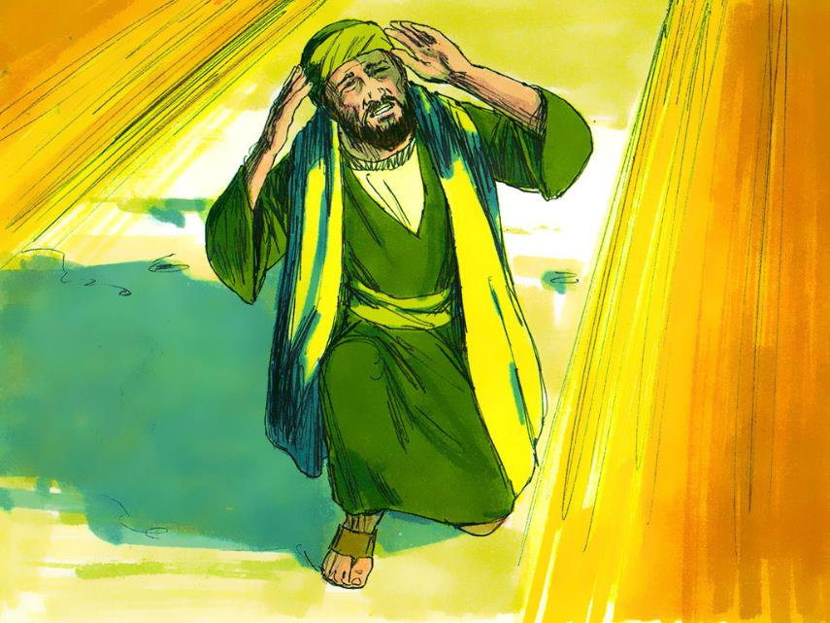

St. Paul
(AD5-67)
Notes:
Slide 3: Our story for today is about this man, who Christians call St. Paul, who became a Christian when he had a vision of Jesus as he was travelling to a place called Damascus, in Syria. He was so changed by this encounter with Jesus that he spent the rest of his life travelling around (about 10,000 miles!) to tell as many people as he could about what Jesus had done. Along with Peter, whose story we heard last week, he was one of the very first leaders of the Church.
Many of the journeys he took were dangerous, and we’re going to hear about some of them using these [show water bottle] – but with messages in, just like you’d use if you were sending an ‘SOS’ to be rescued from a desert island. [Use the bottles in order, with the script overleaf for some clarification. If you want to read the original stories, the Bible references are given]

Slide 4
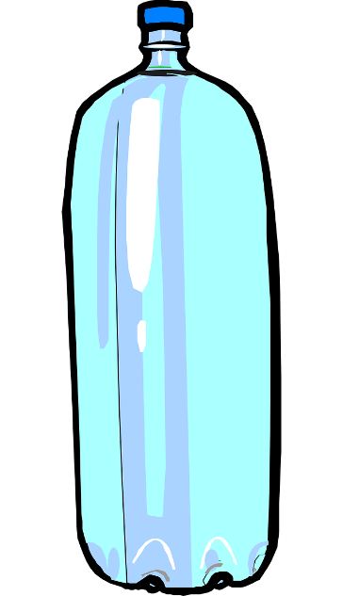

1
Picture copyright-free from pixabay
Notes:
Bottle 1

Slide 5
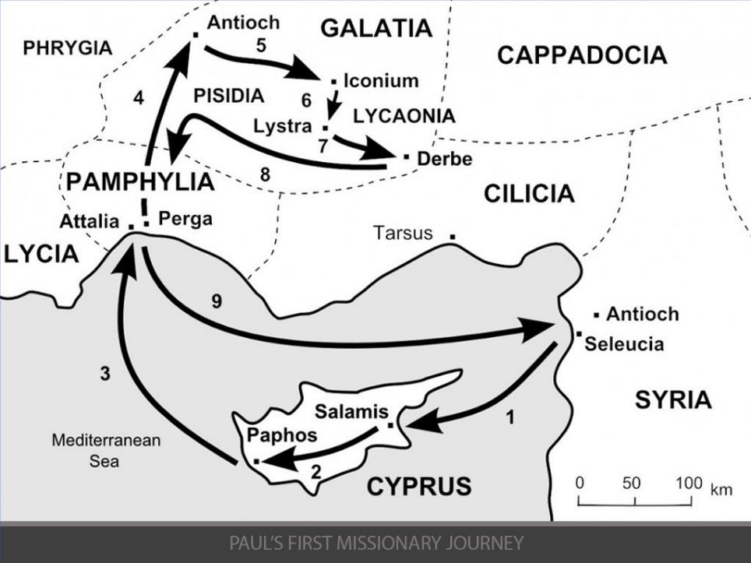

DANGER!!
44-46 AD
Notes:
1. DANGER!! [Acts 14:8-28] (LYSTRA) Slides 4&5
Crowds tried to hurt Paul because of the things he was saying about God, and they threw him out of the city. Paul began one of several journeys around the Mediterranean, telling everyone stories about Jesus.

Slide 6
2
Picture copyright-free from pixabay
Notes:
Bottle 2

Slide 7
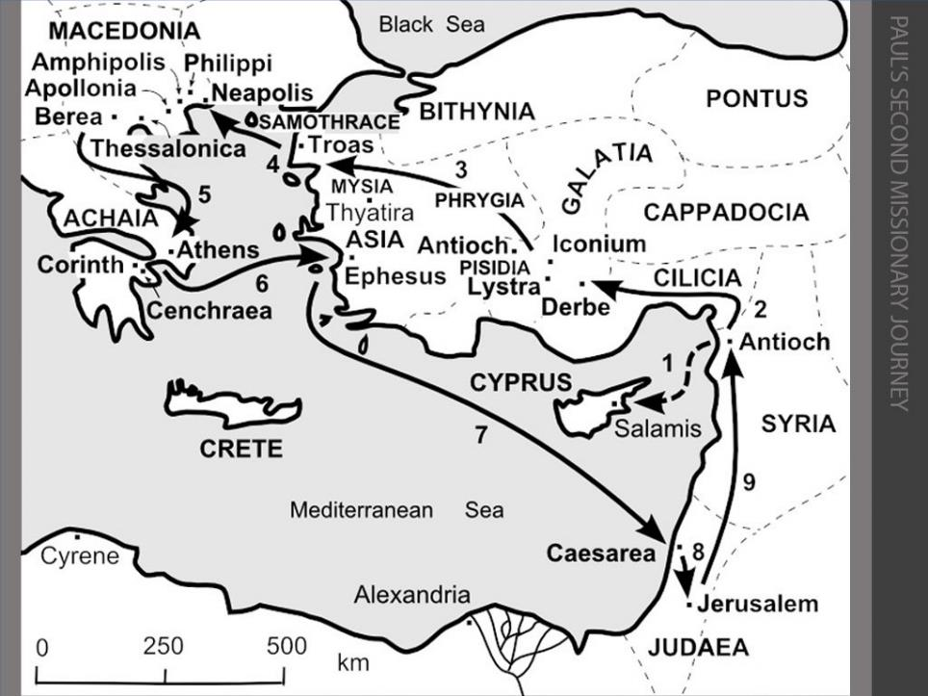
PRISON!!
49-52 AD
Notes:
2. PRISON! [Acts 16:11-40] (PHILIPPI) Slides 6&7
In Philippi, Paul was put in prison. That night, as he and his friend Silas were praying and singing, God shook the earth with an earthquake that opened all the doors of the prison and shook the chains off the prisoners.

Slide 8
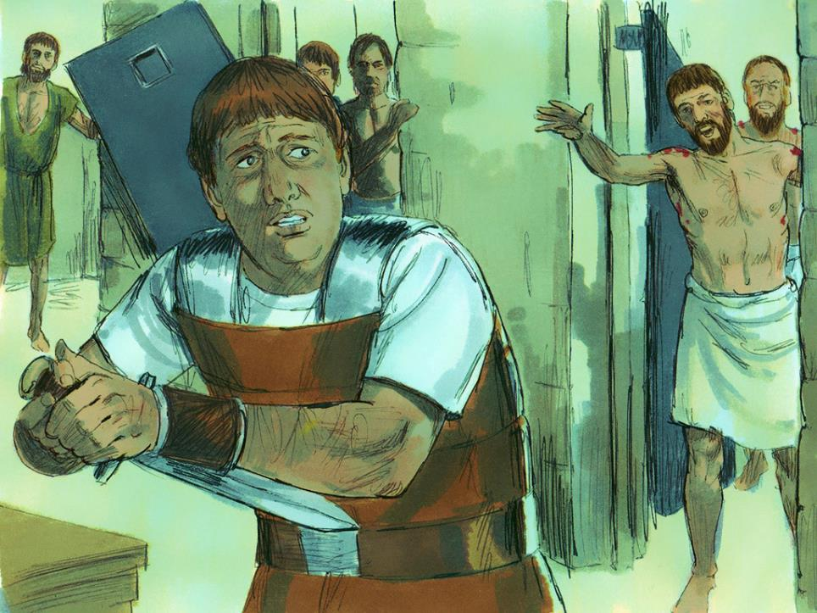
Notes:
Slide 8: Although they were free, Paul and Silas didn’t want the jailer to get into trouble because they’d escaped, so they stayed behind and waited. The jailer was so impressed, he became a follower of Jesus and the leaders in Philippi let Paul and Silas go.

Slide 9
49-52 AD
Notes:
Slides 9&10 [Acts 18:1-18] Paul then travelled through parts of Greece. In a Greek city, named Corinth,

Slide 10
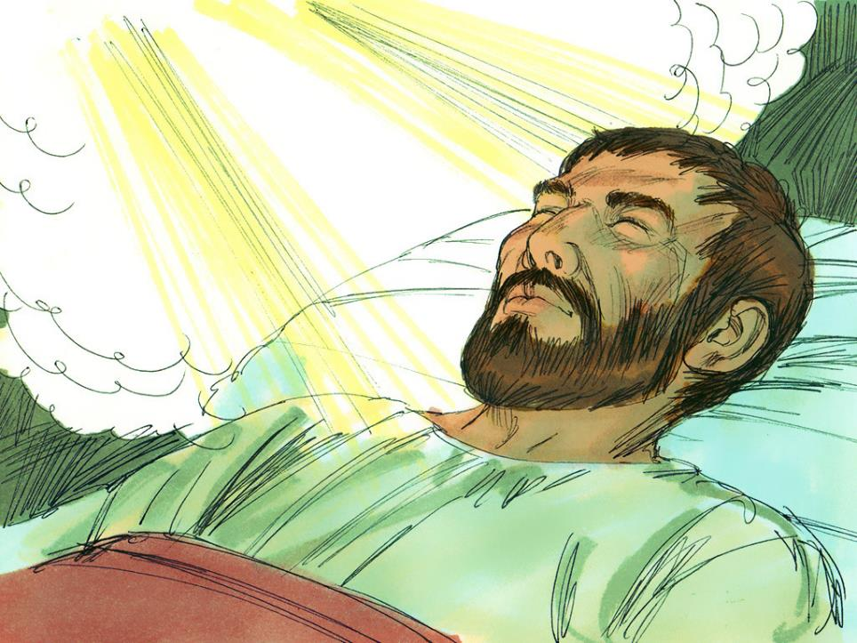
…Don’t be afraid to speak. I am with you and will keep you safe….
Notes:
Paul had a dream in which God spoke to him and told him that he would keep them safe, no matter what.

Slide 11
3
Picture copyright-free from pixabay
Notes:
Bottle 3

Slide 12
TRIAL BY ROMANS!!
Notes:
3. TRIAL BY ROMANS!! [Acts 21:27-23:35; also Acts 24&25] (JERUSALEM) Slide 11,12&13
Paul then travelled back to the church in Jerusalem.

Slide 13
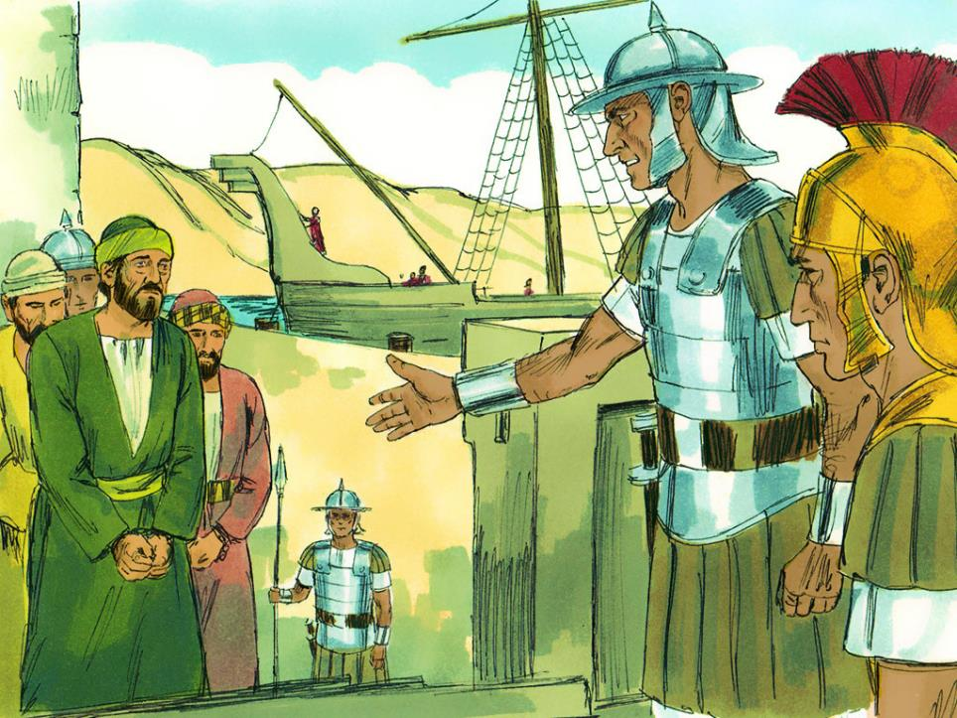
Notes:
There, he was arrested and sent before the Romans to be tried – and punished. The Roman governor sent Paul to Rome.

Slide 14
4
Picture copyright-free from pixabay
Notes:
Bottle 4

Slide 15
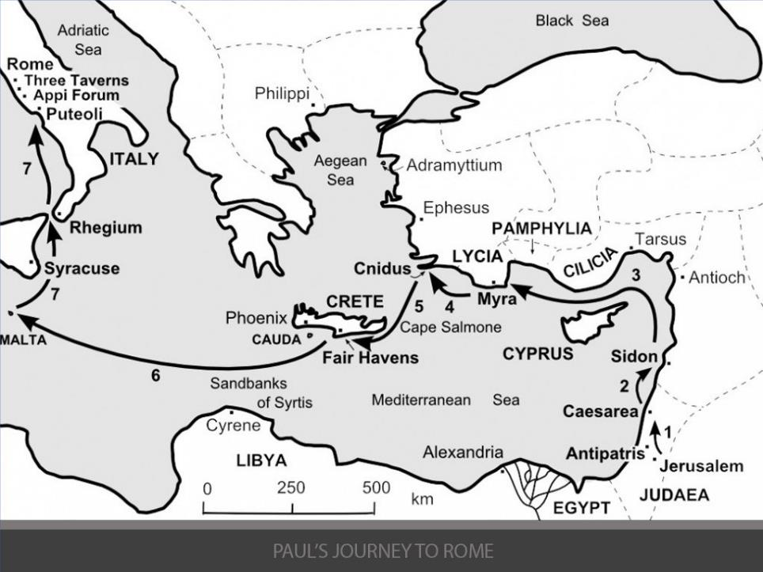
SHIPWRECKED!!
58-61 AD
Notes:
4. SHIPWRECKED!! [Acts 27:1-44] (MALTA) Slide 14&15

Slide 16
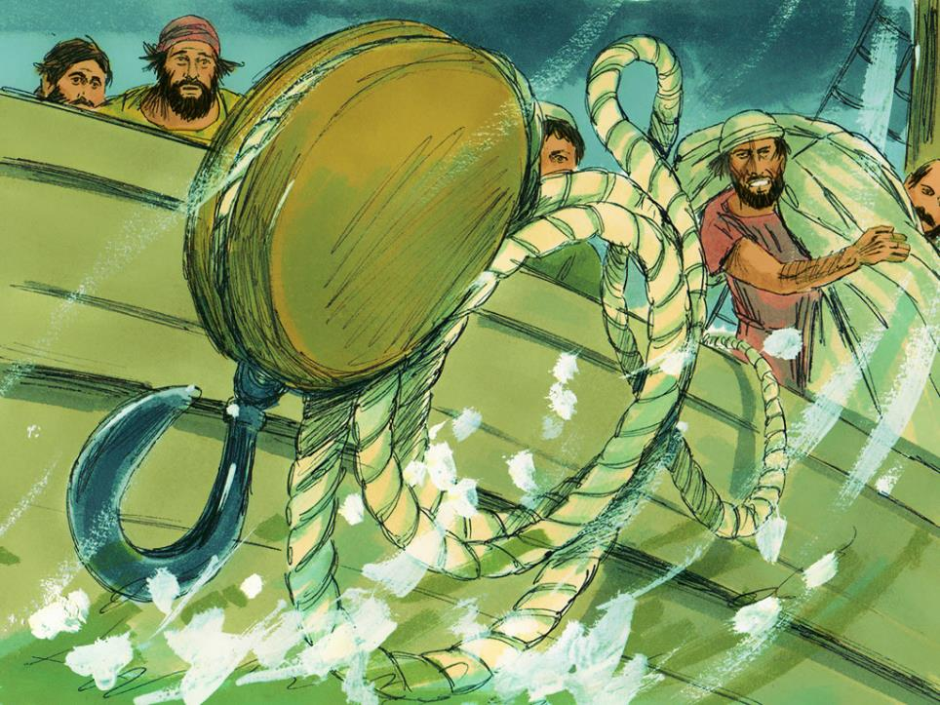
Notes:
Slide 16: On his way to Rome, a storm blew in, and the boat began to sink.

Slide 17
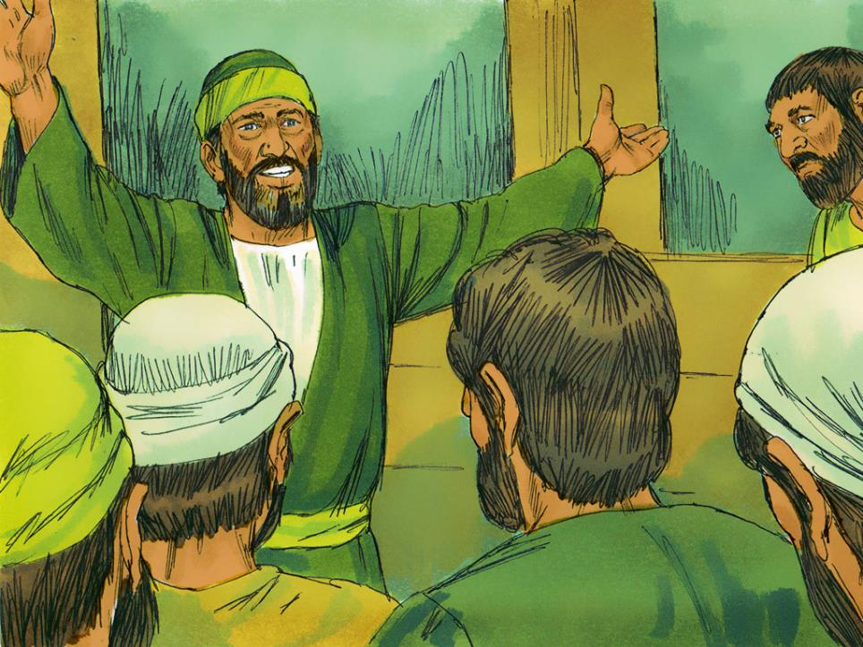
….everyone will be safe! We will be shipwrecked on an island….
Notes:
Slide 17: Paul told everyone on the boat what God had said about no-one being harmed, & that the storm would shipwreck them on an island.

Slide 18
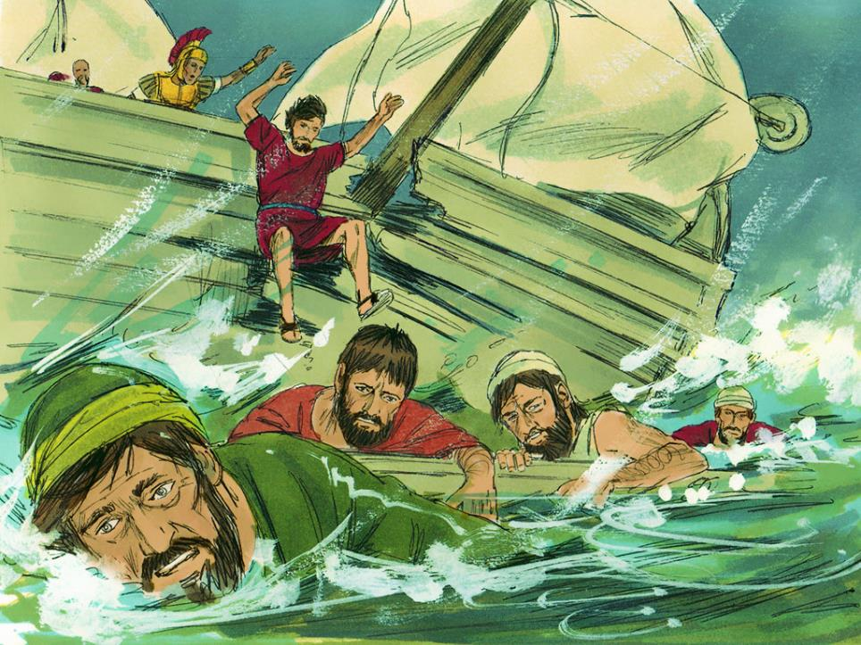

Slide 19
5
Picture copyright-free from pixabay
Notes:
Bottle 5

Slide 20
58-61 AD
Notes:
5. SNAKEBITE!! [Acts 28:1-6] (MALTA) Slides 19-21
On the island of Malta, where they were shipwrecked,

Slide 21
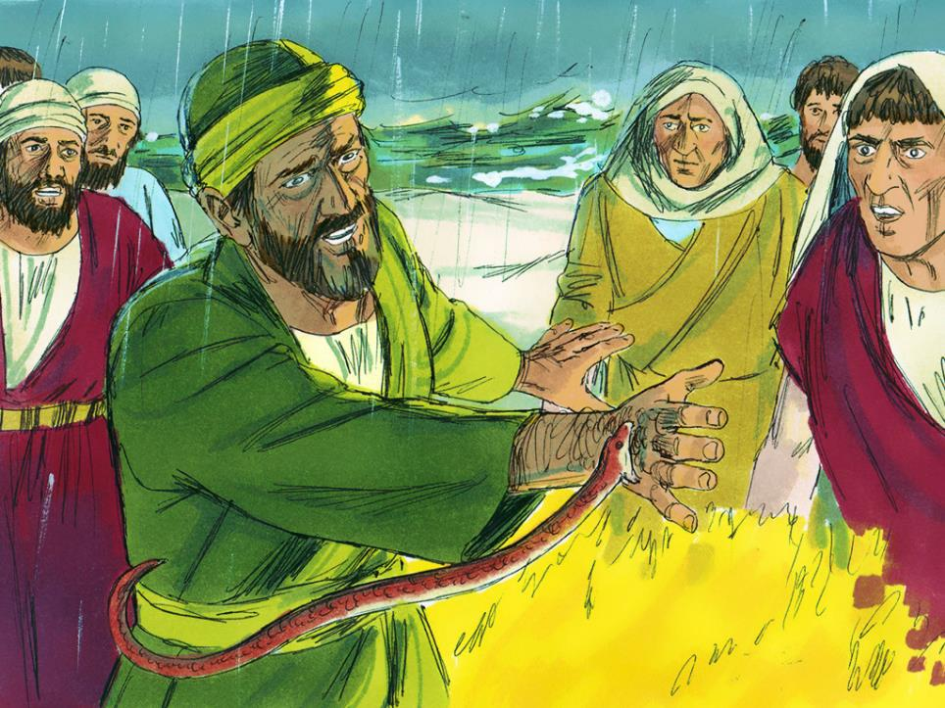
SNAKEBITE!!
Notes:
Paul was bitten by a snake, but the poison didn’t harm him! He then continued on his way to Rome.

Slide 22
6
Picture copyright-free from pixabay
Notes:
Bottle 6

Slide 23
58-61 AD
Notes:
6. HOUSE ARREST!! [Acts 28:11-31; letters to Timothy & Titus] (ROME)
Slides 22-25: In Rome, Paul was put under house arrest,

Slide 24
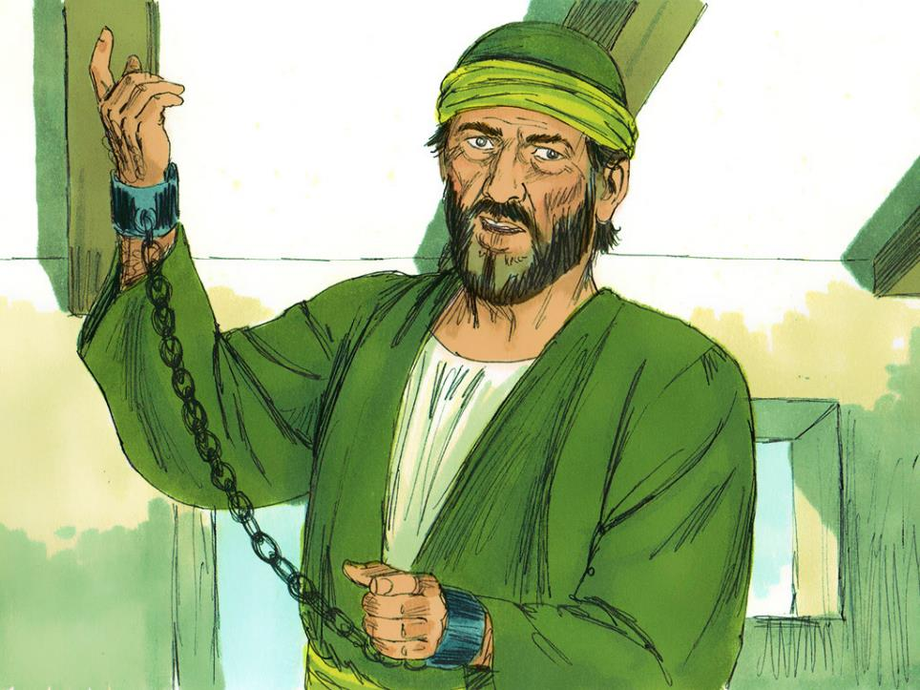
HOUSE ARREST!!
Notes:
…..which meant he wasn’t allowed to leave the place where he was staying. People think that Paul lived like this for about 2 years, waiting for his trial as a Roman citizen. What happened after this, no-one is quite sure, and Paul may have been allowed to visit some of the churches that he had set up, but we do know that he wrote lots of letters to the very first church leaders, encouraging them.

Slide 25
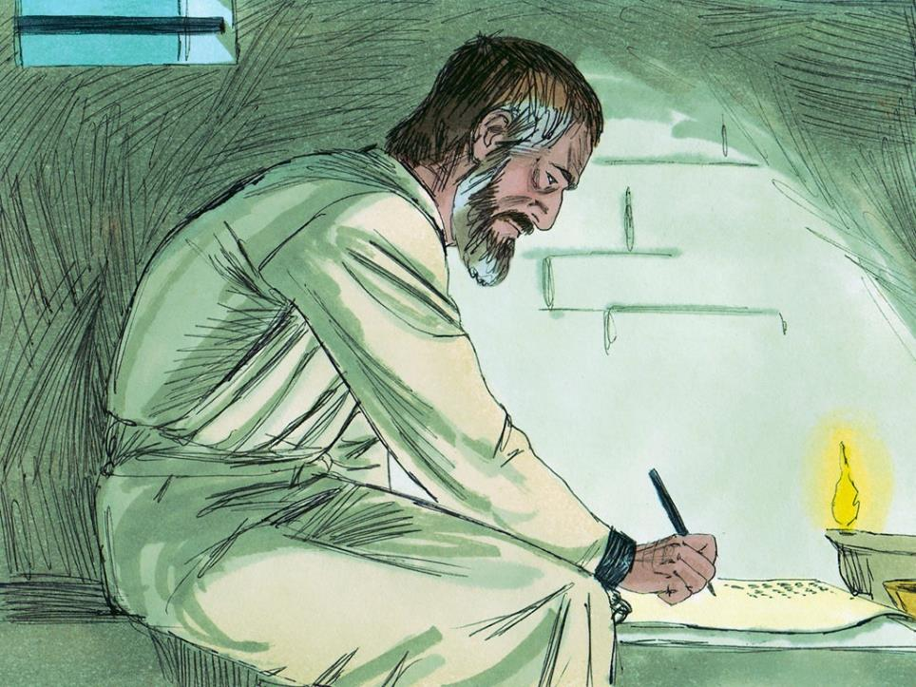
….Run the race with perseverance. Keep on going, and don’t give up!….
Notes:
Slide 25: In one of them, to the church in Jerusalem, he wrote: “Run the race with perseverance! Keep on going and don’t give up!” He wasn’t talking about an actual race, but the feeling that life is sometimes hard, like running in a race and getting tired. I wonder if you’ve ever felt like that?
He also wrote some of the most famous words in the Bible, advice that we’re going to listen to as we think how these wise words might help us to be better leaders – and followers…..

Slide 26
What if I could speak all languages of humans and of angels?
If I did not love others, I would be nothing more than a noisy gong or a clanging cymbal.
Notes:
Slide 26-28: Listen now, you might want to close your eyes to help you to concentrate….

Slide 27
What if I could…. understand all secrets and all knowledge?
And what if I had faith that moved mountains?
I would be nothing, unless I loved others.

Slide 28
….I wonder how these words might help us, here in our school?....
Notes:
Slide 28: Love is kind and patient, never jealous, boastful, proud or rude. Love isn’t selfish or quick-tempered. It doesn’t keep a record of wrongs that others do. Love rejoices in the truth, but not in evil. Love is always supportive, loyal, hopeful and trusting. Love never fails!
….I wonder how these words might help us, here in our school?....

Slide 29

…. I wonder whether the words we’ve heard about persevering, or about love, might help us to be better leaders – and followers?...
….I wonder why Paul felt that love was more important than anything?....
….I wonder what you think that ‘love is’?…
Notes:
Slide 29: Responding (words for worship):
….so in the stillness of this moment, let’s spend some time thinking together…..
…in the stillness, think about the things that we’ve heard today, about Paul and the dangers he faced to tell others about Jesus….
….about how he kept on going and didn’t give up…..
….and about how important he felt love was on the journey of life…
I wonder whether the words we’ve heard about persevering, or about love, might help us to be better leaders – and followers?...
…I wonder why Paul felt that love was more important than anything?....
…I wonder what you think that ‘love is’?…
Take a few moments of quiet now to think…..
As a kind of prayer today, I am going to use Paul’s words about love. You might just want to listen, or perhaps to pray as you listen, that God will help us to show love like this….

Slide 30
Love is kind and patient, never jealous, boastful, proud or rude. Love isn’t selfish or quick-tempered. It doesn’t keep a record of wrongs that others do. Love rejoices in the truth, but not in evil. Love is always supportive, loyal, hopeful and trusting. Love never fails!

Slide 31
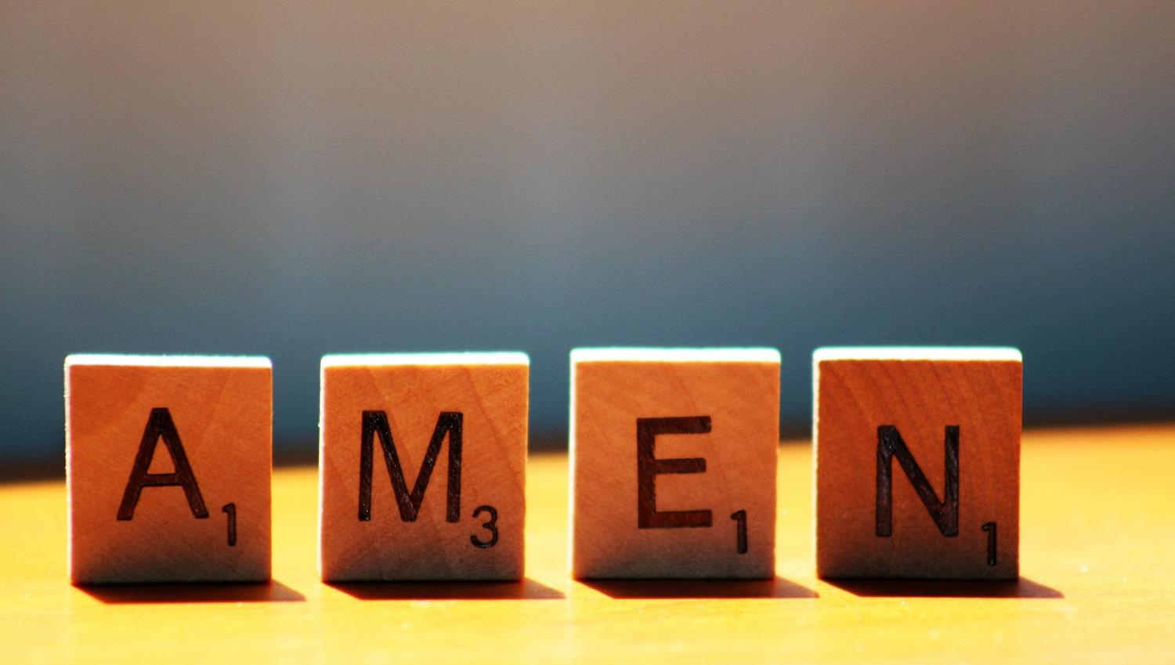

Slide 32


Leader: As we leave this place & time and go into the day ahead…
All: …may we show each other what ‘love is…’ this week.

Slide 33
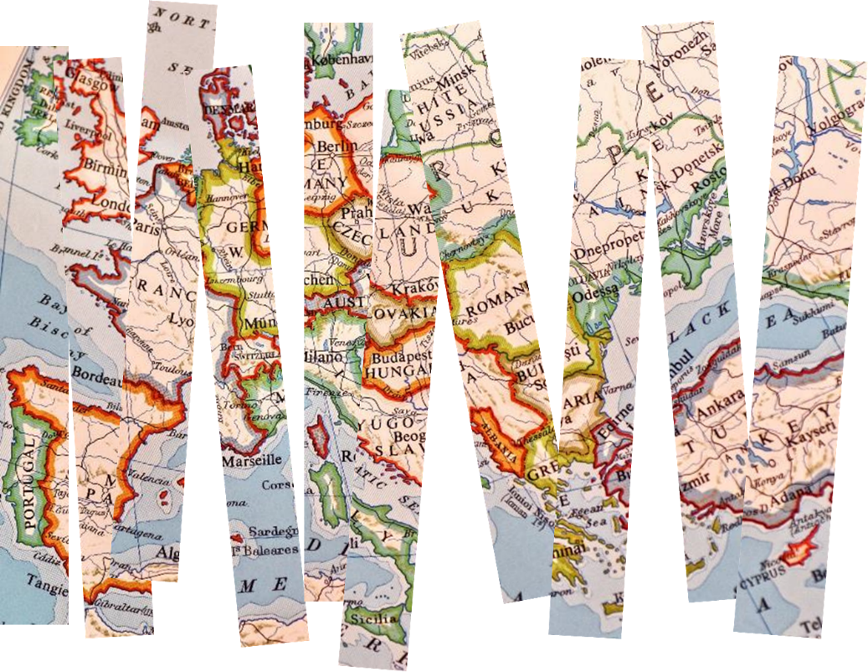
Write a thought or a prayer about love on a strip of map, then post it into the empty bottle. As you do, ask God to help you, if you’d like to.

