Slide 1

Pictures copyright-free from pixabay
Leader: We are a creative community. As we gather together today…
ALL: May our thinking, talking and wondering help us to grow.
Notes:
Slide 1: Gathering
Use the new greeting, with BSL actions if desired.
Leader: We are a creative community. As we gather together today….
ALL: May our thinking, talking and wondering help us to grow.
Here are BSL actions for some of the words:
Leader’s words:
Creative: https://www.signdictionary.co.uk/view/creative?q=creative#title
Community: (we use the word ‘gathering’ as it’s a simpler sign!) https://www.signbsl.com/sign/gathering
Gather together: https://www.signbsl.com/sign/gather (1st video)
Pupils’ response:
Think: https://www.brightbsl.co.uk/signs/think
Talk: https://www.signbsl.com/sign/talk (1st video)
Wonder: https://www.signbsl.com/sign/wonder (1st video)
Grow: https://www.signbsl.com/sign/grow (2nd video)

Slide 2
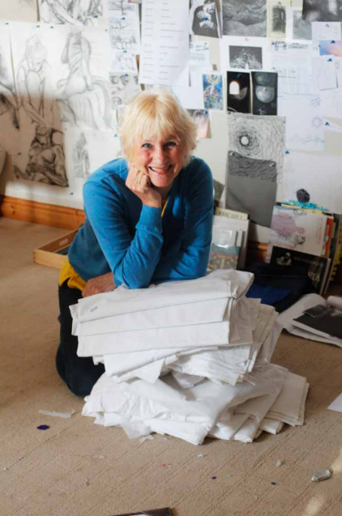
Threads Through the Cross
Notes:
Slide 2: Threads Through the Cross
Today, we will be looking at more of Jacqui’s panels: we are nearing the most important parts of Jesus’ life, as he arrives in Jerusalem.

Slide 3





Notes:
Slide 3: Emojis
We are very used to these little pictures which help express how we might be feeling when we send messages to people. Which ones do you recognise?!
[Top-bottom, L-R: happy; sad; confused; angry; worried]

Slide 4
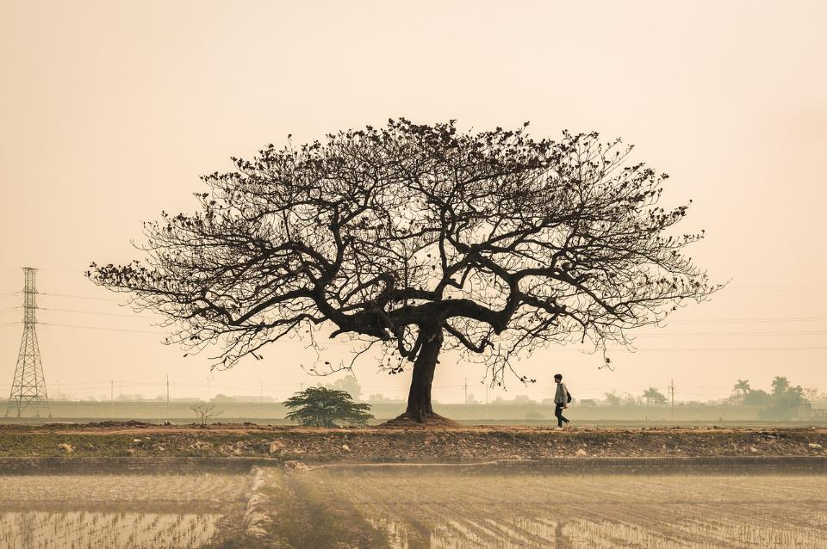
There is a right time for everything.
Everything on earth has its special season.
There is a time to cry and a time to laugh.
There is a time to be sad and a time to dance. (Ecclesiastes 3:1,4)
Notes:
Slide 4: Words from Ecclesiastes
These words come from one of the books of wisdom in the Bible called ‘Ecclesiastes’ and are some of the most well-known from this book, written by King David’s son, Solomon. The whole of this chapter (chapter 3) is full of different emotion words, but here’s a short excerpt for us to read together:
There is a right time for everything.
Everything on earth has its special season.
There is a time to cry and a time to laugh.
There is a time to be sad and a time to dance.
[Talk for a few moments to a partner about what you think they mean.]
We will return to these words shortly, but first let’s look at today’s panels…..They show events from the same day, which in the Christian calendar is known as Palm Sunday.

Slide 5
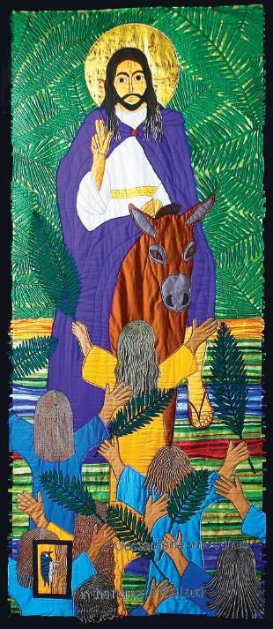
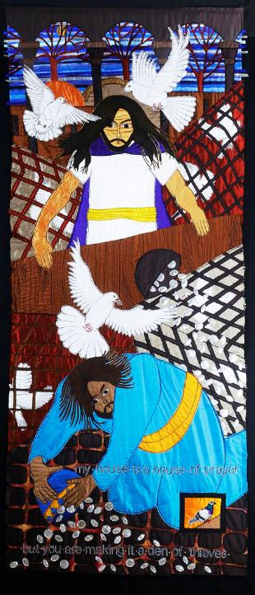
Hosanna! Jesus is Lord
My house is a house of prayer
My house is a house of prayer, but you are making it a den of thieves.
Blessed is he who comes in the name of the Lord.
Notes:
Slide 5: Palm Sunday – two contrasting panels, showing events on the same day
Spend a while just gazing at the first panel. Relax, and focus on calm breathing….
…..What is happening here?
…..Who can you see?
…..How are the people feeling?
…..Which word(s) would you use to describe this panel?
….Are there any words to read?
Pick out the words ‘Blessed is he who comes in the name of the Lord.’
Now let’s look at the other panel from the same important day in the life of Jesus.
…..What is happening here?
…..How are the people feeling, Jesus especially?
…..Why aren’t the people looking at Jesus here?
…..Which word(s) would you use to describe this panel?
.....Are there any words to read?
Pick out the words ‘My house is a house of prayer, but you are making it a den of thieves.’
…..What do you think made Jesus angry?
He was angry about the fact that people who wanted to come into the Temple to pray were being kept away by others who only wanted to make money from them. Jacqui called these panels Hosanna! Jesus is Lord and My house is a house of prayer.

Slide 6
Hosanna! Jesus is Lord
My house is a house of prayer
There is a right time for everything.
Everything on earth has its special season.
There is a time to cry and a time to laugh.
There is a time to be sad and a time to dance. (Ecclesiastes 3:1,4)
Notes:
Slide 6: Hosanna! Jesus is Lord and My house is a house of prayer
I wonder what you think connects these panels with the words we read at the very beginning?
[allow a few moments for discussion before continuing – if you click, the words will disappear]
Jesus rode into Jerusalem on a humble donkey to signal that here was a new type of King and a new type of Kingdom – we will also see this in the panels that we will look at next week. The Bible tells us that when Jesus arrived at the edges of Jerusalem, he wept about all that he saw – how lost people seemed, how they wanted a military leader to overthrow the Romans (which wasn’t the sort of King that Jesus would be!), but perhaps also knowing that everything was about to change: he was going to Jerusalem to die.
When he arrived at the Temple, what he saw changed his sadness to anger. The instructions that God had given to King Solomon were to build the temple in a way that would allow for all people to enter, with a special courtyard for the poor, and yet he saw people were charging money to the poor for coming into the part of the temple that was created for them. He was chasing out of the Temple all those who thought they could do what they wanted in this special place, taking money from the poor and putting it into the hands of the rich. And so, Jesus cleared space to make room for the people who needed help, or to be in God’s special place.
In these two panels, we see a real contrast in emotions and mood – which is perhaps not what we are used to seeing when we look at Jesus. Jesus showed that there is room for both when they come from a good place in our hearts. Sometimes, we are angry when things don’t go our way, which is selfish anger – and probably not very good for us! But there is a right kind of angry: some things we see in our world are just not right and maybe, like Jesus did, we should feel angry enough about them to do something about it.

Slide 7
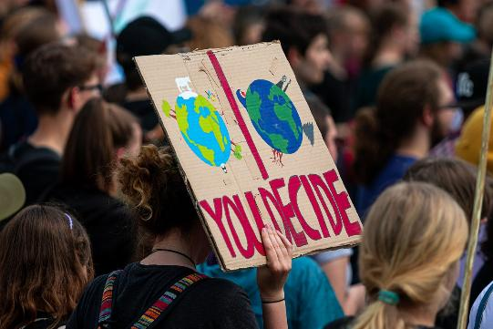
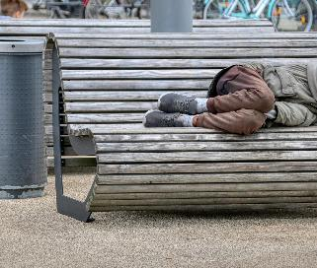
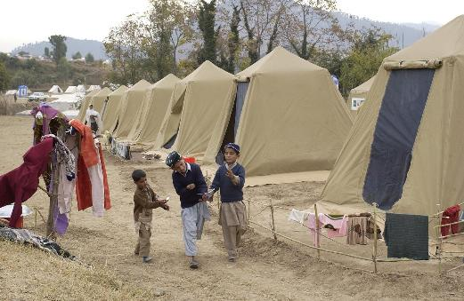
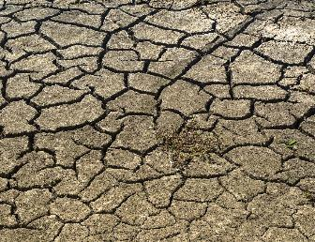
Injustice
Notes:
Slide 7: Injustice
I wonder what sorts of things we might feel are unfair in our world? [use the images to get you started]

Slide 8
My house is a house of prayer, but you are making it a den of thieves.
….I wonder what we might learn from the example of Jesus in this story?....
….I wonder what things it’s right for us to be angry or sad about?....
….I wonder if these feelings might lead us to do something?....
Notes:
Slide 8: Responding and words for worship
We’ve thought about Jesus’ contrasting emotions as he rode into Jerusalem – and the emotions that we might feel when we look on injustice in our world. So now, as we draw our thinking to a close, let’s be quiet and still together……
….I wonder what we might learn from the example of Jesus in this story?....
….I wonder what things it’s right for us to be angry or sad about?....
….I wonder if these feelings might lead us to do something?....
[You might already be taking action in different ways, as part of your school community – or wider parish community – so do contextualise this section]
We can all make a difference, even if it’s in a small way in the way that we care for our friends, our neighbours and our community – or in the charities we support that help to make a difference in the places we can’t reach.
In our classrooms this week, there will be a chance for you to light a candle for particular things that you feel are unjust, and maybe to pray – and I am going to do that here as we pray now.
[Light your candle]
Opportunity for reflection / prayer
As you look at the candle flame, you might want to bring into your heart or thoughts something that feels unjust to you. If praying is something that you feel comfortable doing, then join in with Amen at the end. If you don’t want to pray, then use the quiet to be still with your own thoughts. The words come from a very famous prayer written by St Frances of Assisi, who lived out these words in the way that he lived and cared for others…..and asks God to help us as we try to do the same…..

Slide 9
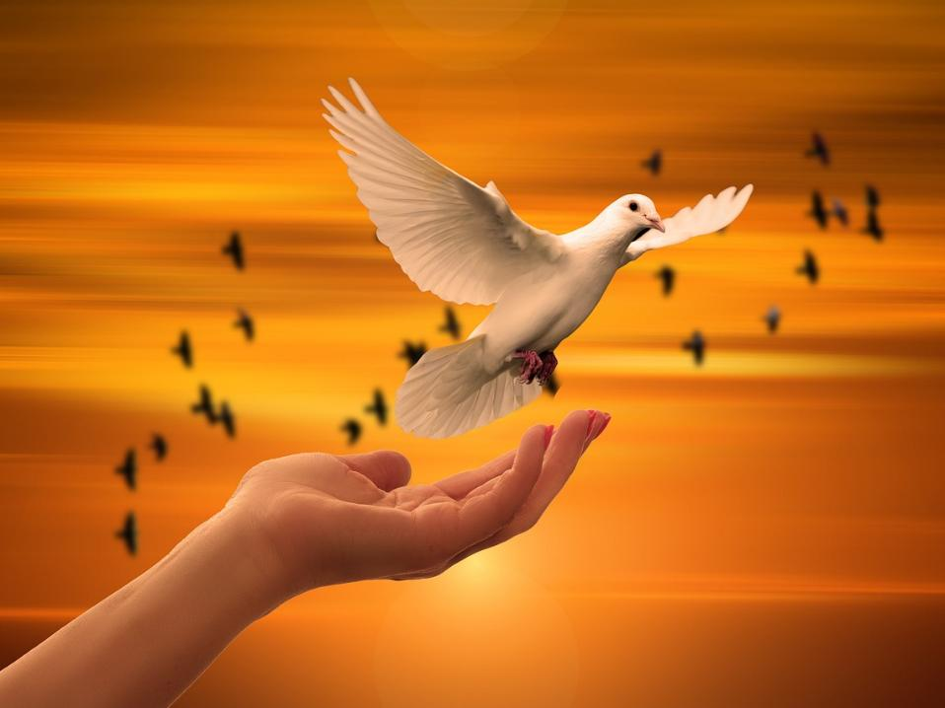
Lord, make me an instrument of your peace:
where there is hatred, let me sow love;
where there is injury, forgiveness*;
where there is doubt, faith;
where there is despair, hope;
where there is darkness, light;
where there is sadness, joy.
Notes:
Slide 9: Prayer of St Frances of Assisi [excerpt]
You might want to read these words out loud to children before you pray them…..[*this word changed from ‘pardon’ for clarity of meaning]
Lord, make me an instrument of your peace:
where there is hatred, let me sow love;
where there is injury, forgiveness*;
where there is doubt, faith;
where there is despair, hope;
where there is darkness, light;
where there is sadness, joy.

Slide 10
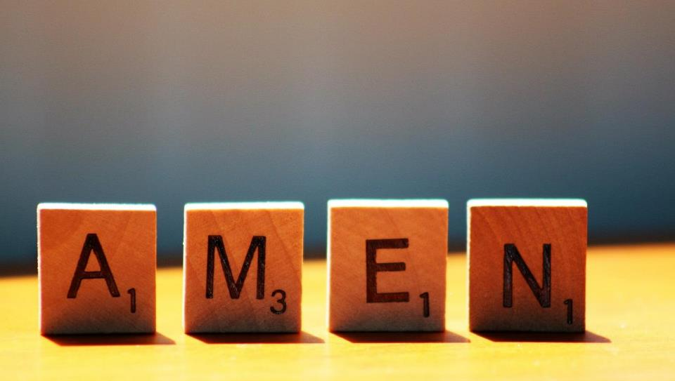

Slide 11



Leader: As we leave this place & time and go into the day ahead…
All: Together, we create a just community!
Notes:
Sending: Slide 11 (NB note different word from last week!)
Leader: As we leave this place & time and go into the day ahead…
All: Together, we create a just community!
BSL Together: https://www.signbsl.com/sign/together (1st video); Just: https://www.signbsl.com/sign/just
You already have signs for ‘community’

Slide 12

Notes:
Slide 12: Reflective areas
Think: Where do you see injustice in our world?
Talk: What can we do to help? How might we change the world in how we treat others?
Do: ‘Light’ a candle. You might want to pray before you leave it on the tray.

Slide 13
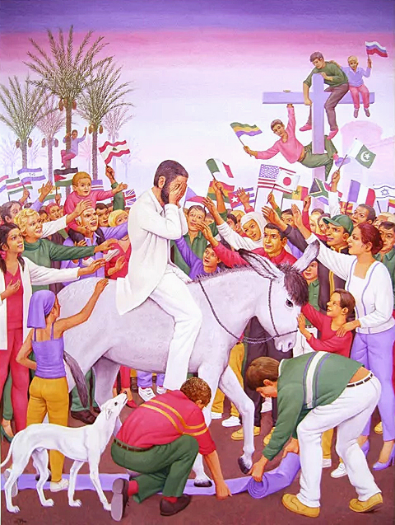
Palm Sunday by Peter Koenig from Art in the Christian Tradition
Notes:
Slide 17: Showing Palm Sunday from different cultural perspectives
Link to original artwork: https://diglib.library.vanderbilt.edu/act-imagelink.pl?RC=48399, which includes some key information.
Looking at these two creative interpretations of this part of the story may be something that links with your RE curriculum, reflecting the fact that Christianity is a global religion, encouraging pupils to appreciate the diversity that exists across cultures, traditions and geographical areas. It’s important for pupils’ wider understanding that they are given opportunities to think about how Christians show Jesus as being ‘like them’, and that this important story for Christians is imagined in different ways across the world. It also creates an inclusive classroom environment, giving all pupils opportunity to see themselves in the art that they view.
You may wish to consider these questions:
What is the same? What is different?
Which culture / tradition does the 2nd piece come from?
Why do we think this?
What questions might we want to / need to ask?
If you were to create some art to express this story, what might it look like?

