Slide 1




All pictures copyright-free from pixabay
Notes:
Slide 1: Rising hearts stilling exercise
Use the stilling slide if desired: the suggested words should be spoken slowly, leaving pauses inbetween to create a sense of stillness.
As you sit quietly, watch the hearts rising….[PAUSE]
Now practise slower breathing…..in…..and out…..in……and out…..keep this going as you continue to look at the hearts….[PAUSE]
You maybe notice that you are feeling calmer and more relaxed….[PAUSE]
As you breathe, think back to the ideas about love that we shared last week….. [PAUSE]
We come into this special / sacred space and time to be still….to think deeply…..to be together as a school community…..
In our time together today, we will play a game together, share a story and then use it to help us to think.
But first, let’s welcome one another as we begin….

Slide 2

Leader: As we gather together today…
ALL: …we bring our thoughts and our hearts into this sacred space.
Notes:
Slide 2: Gathering
Leader: As we gather together today….
ALL: ….we bring our thoughts and our hearts into this sacred space.
Here are BSL actions for some of the words:
Leader’s words:
Gather: https://www.signbsl.com/sign/gather (1st video)
Today: https://www.signbsl.com/sign/today (1st video)
Pupils’ response:
Thoughts: https://www.signbsl.com/sign/thoughts (1st video)
Hearts: https://www.signbsl.com/sign/heart (1st video)

Slide 3
Shine like stars!
Notes:
Slide 3: In a while, we will be hearing another story of one of our heroes of hope, and how their actions shone like stars….

Slide 4


Charades
Notes:
Slide 4: Charades (cards on p5)
Some of you might have played charades with other people, where one of you acts out (without speaking) a word or phrase for other people to guess. We’re going to do this now, with some very simple, everyday actions…. [you might need to demonstrate with younger pupils, using the ‘cleaning teeth’ image on screen; then select a volunteer and ask them to choose a card. Whisper a few ideas of what they could do if they’re not sure – or ask their class teacher to help…]
[Suggested examples: Washing hands – brushing or combing your hair – having a shower – putting on your shoes – eating your breakfast – reading a book – stroking a pet – drinking from a bottle of water – mopping the floor]
Many of these simple actions form a part of our everyday routines – most of us do them without even thinking!

Slide 5



Love is….
Notes:
Slide 5: Last week, we thought about what ‘love is…’, and how St. Monica showed this through her relationship with Augustine, her son. For a few moments before we hear the next story, just bring into your mind some of the things that we talked about, or what you wrote or drew into the hearts in your classroom reflective areas…..[leave a pause]
So, as we move into our story for today, be listening out for some more small, everyday actions – and (more importantly) the difference that they can make…..

Slide 6
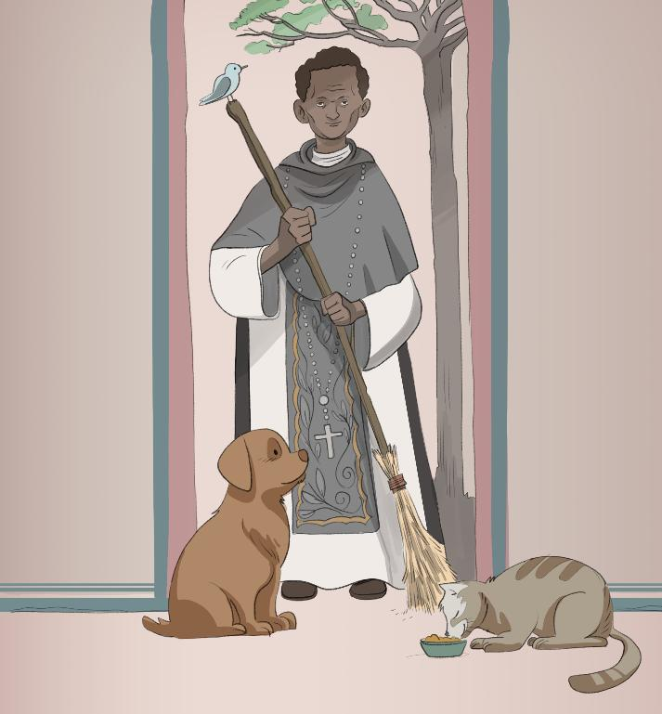
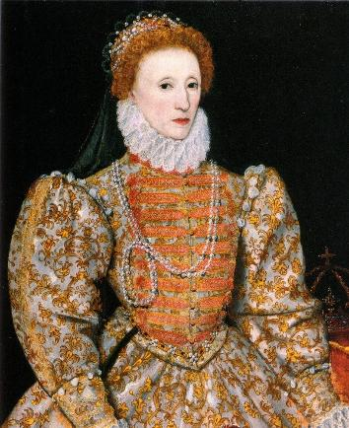
St. Martin de Porres (1579-1639CE)
Shine like stars!
These images are © Neda Kazemifar & SPCK and must not be used outside of this context
Notes:
Slide 6: Our story for today comes from about 400 years ago, around the time that William Shakespeare was writing his plays, and Queen Elizabeth I was on the throne….
This is St. Martin de Porres, who was born into a poor family in Lima in Peru in South America…..[map on next slide]

Slide 7
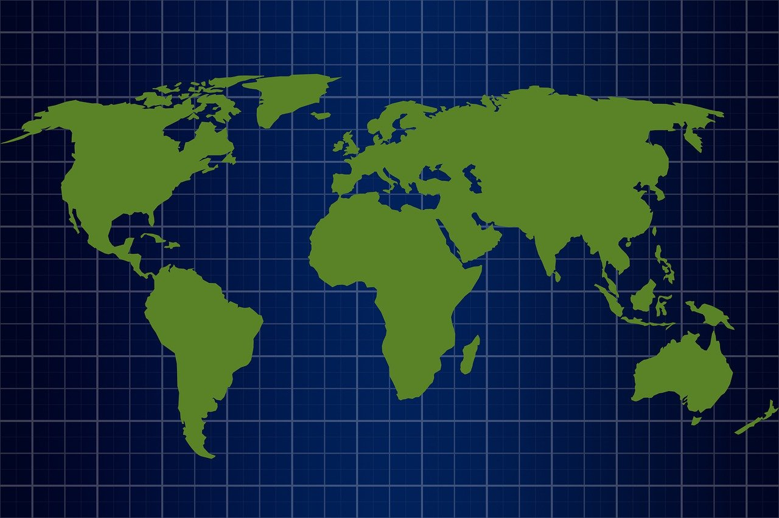
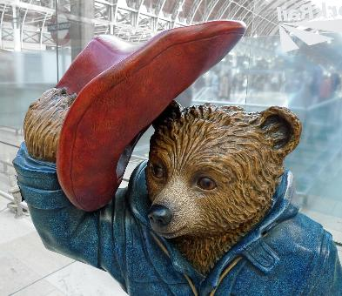
Notes:
Slide 7: World map
If you think you might have heard of that place before, Lima is the fictional home of Paddington Bear! (Another story, for another day….!)

Slide 8
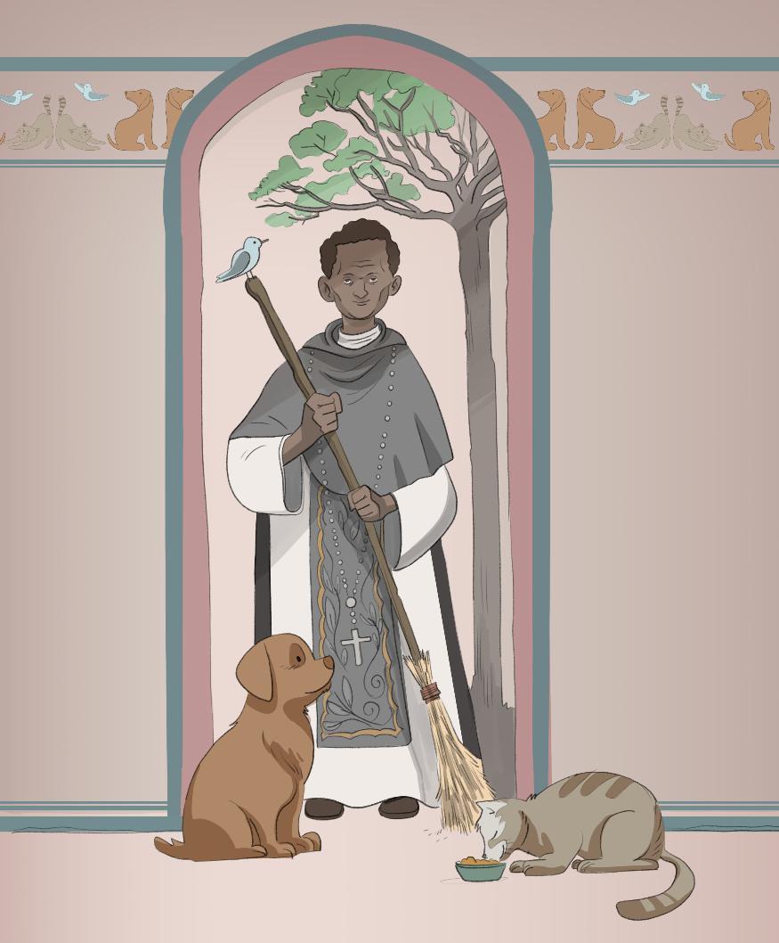
These images are © Neda Kazemifar & SPCK and must not be used outside of this context
Notes:
Slide 8: As a young man, Martin joined the Dominican Order, wanting to use his deep Christian faith to help others, especially those who were the poorest in society. Nothing was too small a task for him and people and animals alike were cared for with the deepest compassion. It was said that he had a special understanding of animals and would treat all living things with such care and respect. You can often see animals with him in pictures.

Slide 9
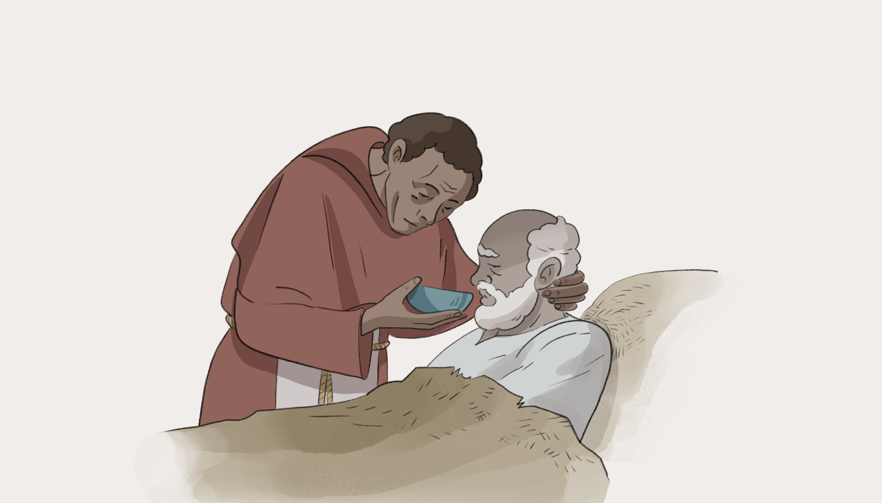
These images are © Neda Kazemifar & SPCK and must not be used outside of this context
Notes:
Slide 9: When a really serious illness spread across Lima, people were so worried that they would catch it that no-one would take care of those who were sick – except for Martin, who used his skills with herbs to make medicine to make people feel better. Despite what others said, he would often offer his bed to those who were sick or injured, and take care of them himself. Thanks to his care, many people who might have been left to die were healed. He also set up a special home for children who had no parents so that they could be looked after, and after he died in 1639, he became known as ‘Martin of Charity’, recognising his life of service to others. Before we move on, let’s just pause and think quietly for a few moments about what we have heard…..and about what we might take from this story into our hearts. [PAUSE….]

Slide 10
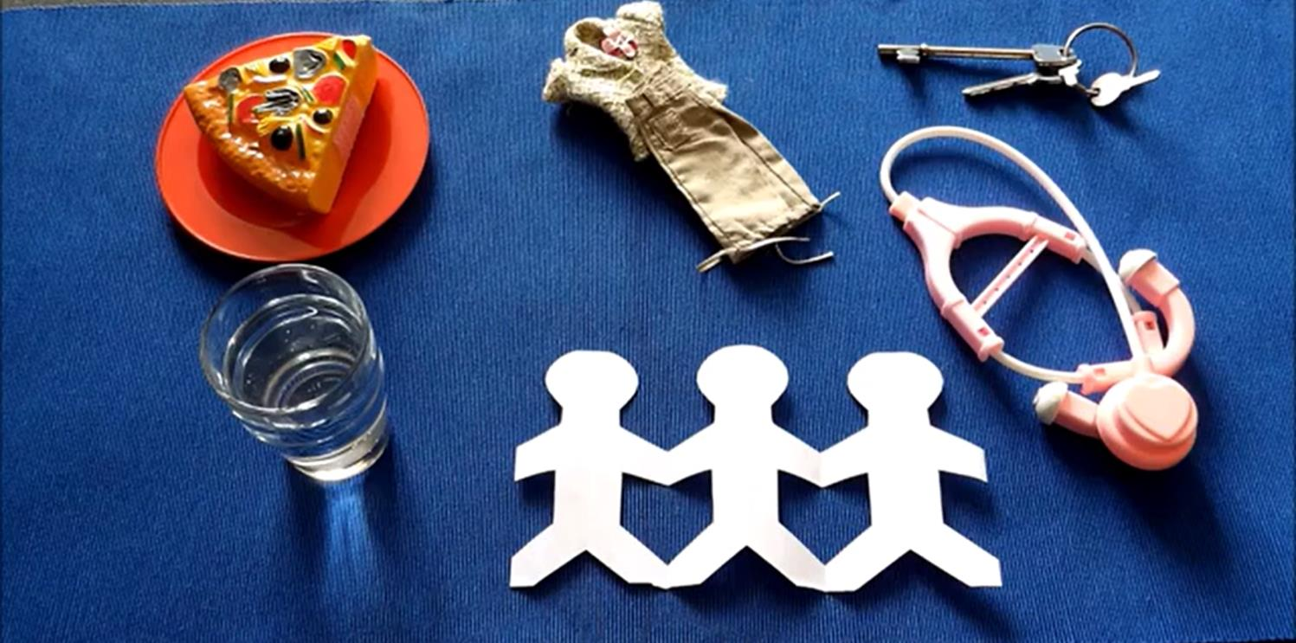
Matthew 25: 34-40
Notes:
Slide 10: Before we reflect on some words spoken by St. Martin, we are going to hear some words spoken by Jesus, about how important it is to care for others, and make sure that they have what they need, especially those who might get overlooked in our world. As you listen, think about the connections with the life of St. Martin….. [use the script and objects on p.4, or video linked from the picture. Afterwards, talk together about the links with St. Martin de Porres’ life.]

Slide 11
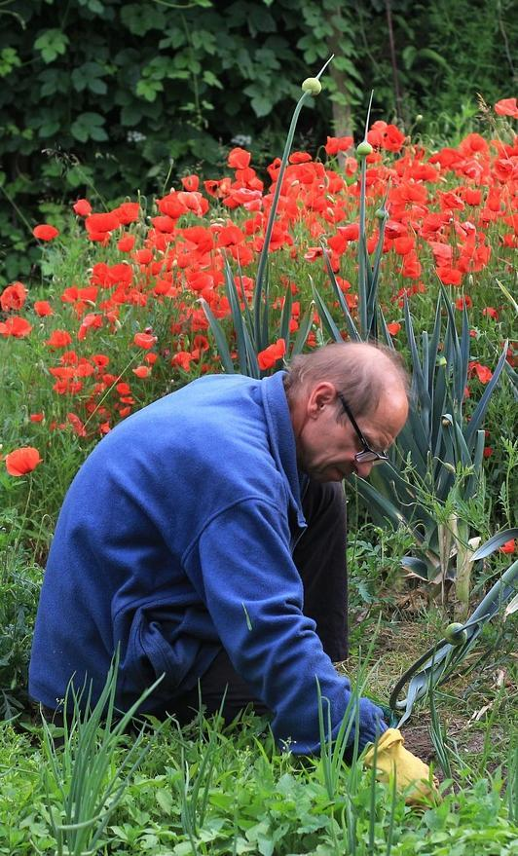
“Everything, even sweeping, scraping vegetables, weeding a garden and waiting on the sick could be a prayer, if it were offered to God.”
….I wonder what you think of Martin’s idea?....
….I wonder how these words might help us to understand why Martin lived as he did?....
….I wonder how these simple actions might be like a prayer – and ‘shine like stars’?....
….I wonder how our actions might help others or be offered like prayers?….
Notes:
Slide 11: Responding and words for worship
We’ve heard today about the life of St. Martin de Porres and how he cared for others. Let’s hear some of his own words as we draw our time together to a close. “Everything, even sweeping, scraping vegetables, weeding a garden and waiting on the sick could be a prayer, if it were offered to God.” [read them twice to allow them to sink in]
….I wonder what you think of Martin’s idea?....
….I wonder how these words might help us to understand why Martin lived as he did?.....
….I wonder how these simple actions might be like a prayer – and ‘shine like stars’?....
….I wonder how our actions might help others or be offered like prayers?….
As I leave a few moments of quiet, you might want to think about some actions that you might do for others……
I’m going to use St. Martin’s idea as we pray now. If you would like to make this prayer yours, and ask God to help your actions to make a difference, then you can join in with these words….

Slide 12
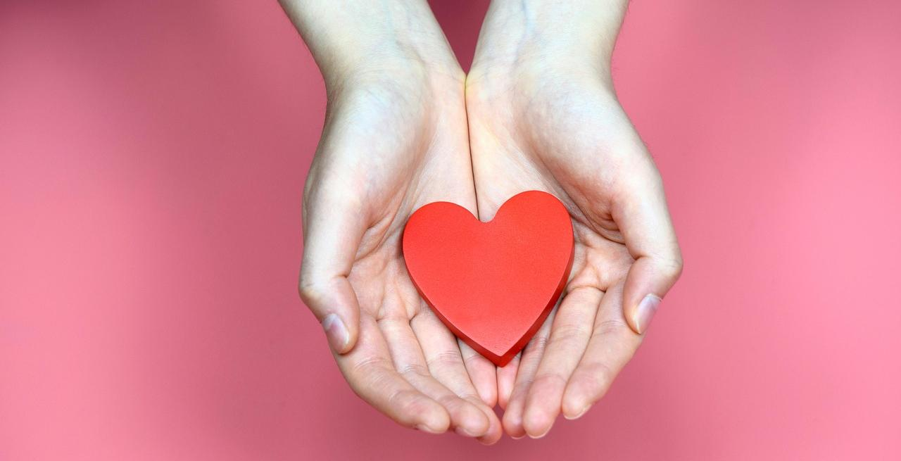
May our actions be like a prayer….
Notes:
Slide 12: May our actions be like a prayer….
So, I invite you to pray with me if you’d like to.

Slide 13
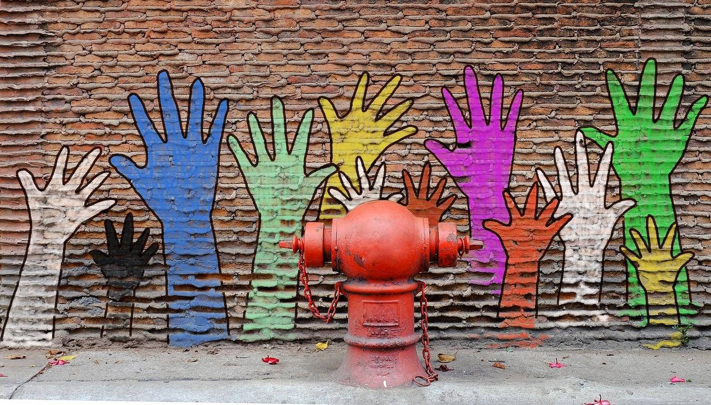
Notes:
Slide 13: When others need a helping hand….

Slide 14
May our actions be like a prayer….
Notes:
Slide 14: May our actions be like a prayer….

Slide 15

Notes:
Slide 15: When someone is hurting…..

Slide 16
May our actions be like a prayer….
Notes:
Slide 16: May our actions be like a prayer….

Slide 17
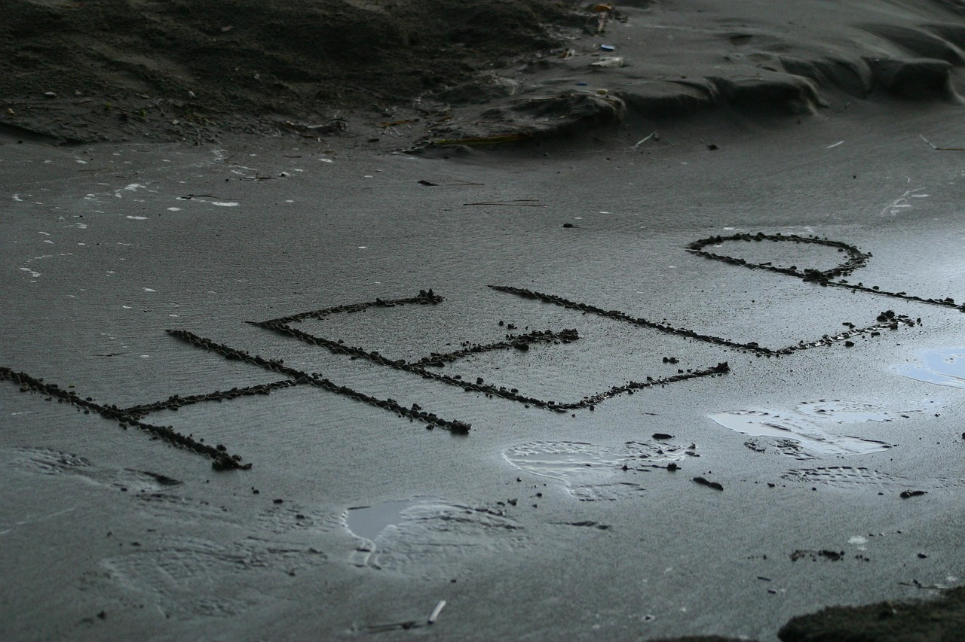
Notes:
Slide 17: Wherever help is needed…..

Slide 18
May our actions be like a prayer….
Notes:
Slide 18: May our actions be like a prayer….

Slide 19


Slide 20

Notes:
Slide 20: The Big Plastic Count [optional slide] *You will need to decide how you are engaging with this initiative and add any additional text to suit your school’s context and level of engagement. You might also want to re-use this slide at the start of next week as a reminder.
We’ve heard today how St. Martin de Porres believed that every small act could be like a prayer – and make a difference in the world. We think so too, and so next week, 9th-15th March, we are inviting you to take part in the Big Plastic Count in school / at home*. The results will be shared with important people in the Government to try to persuade them to take plastic pollution seriously – and make a difference for our world, and for millions of people from the poorest communities who feel the impact of climate change the most.

Slide 21
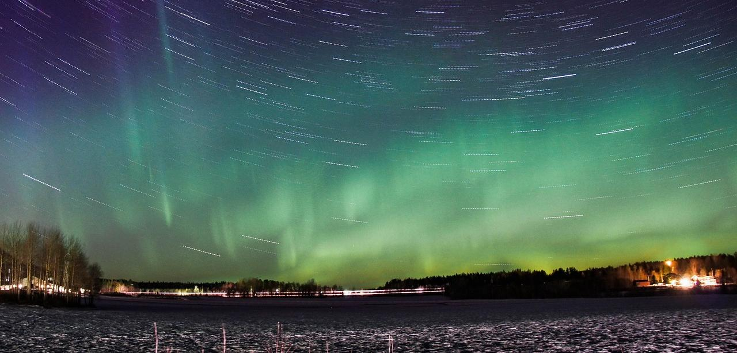


Leader: As we leave this place & time and go into the day ahead…
All: May we shine like stars!
Notes:
Sending: Slide 21
Leader: As we leave this place & time and go into the day ahead…
All: May we shine like stars!

Slide 22
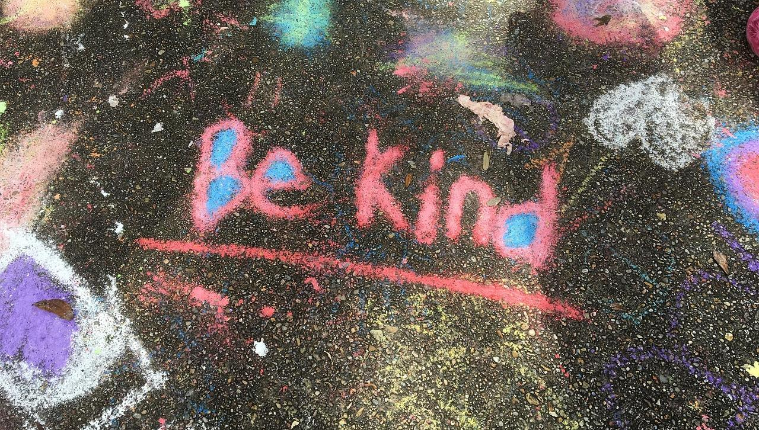
Notes:
Slide 22: Reflective areas
Print off the cards from the link:
Do: Take a card and read the words. You could choose a new one every day!
Talk: What is it asking you to do?
Think: Think about how you might do what’s on the card this week, and who to.
We also encourage you to explore the full story of St. Martin from the book during the week.

