Slide 1
Leader: We are here together
ALL: May we ‘GO FOR GOLD!’ in our words and actions today!
Notes:
Slide 1: Gathering words
Leader: We are here together
ALL: May we ‘GO FOR GOLD!’ in our words and actions today!

Slide 2
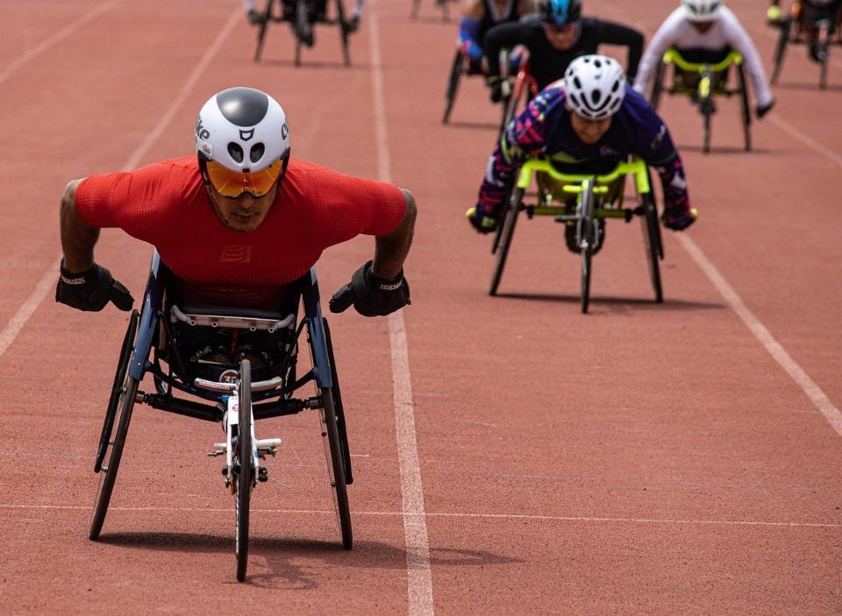
What’s going
on here?!
Notes:
Slide 2: What’s going on here?
Click and reveal sections of the picture to focus pupils on what they can see – and reveal what they know about the Paralympics – or wheelchair events like this.

Slide 3
Blind football
Wheelchair rugby
Para Judo
Para Taekwondo
Wheelchair fencing
Para archery
Para triathlon
Wheelchair tennis
Boccia
Para table tennis
Goalball
Wheelchair basketball
Sitting volleyball
Para badminton
Para powerlifting
Para swimming
Para athletics including marathon
Para cycling – road and track
Para equestrian
Para rowing
Para canoeing
Para shooting sport
How many?
Notes:
Slide 3: Today, we’re going to be finding out about the Parallel Olympics – or as we know them, the ‘Para-Lympics’. Let’s begin with a challenge for who can guess the number of paralympic events there will be this year, in Paris…. [you could ask children to randomly guess numbers, or give them a vote based on broad groups such as 1-5; 5-10 etc.]
There are actually 22, all listed on this slide [click for animation].
There are broadly two types of events – ‘wheelchair’ events for athletes in wheelchairs and ‘para’ events for all other types of athletes with disabilities, which may include those who are deaf, or blind, or are amputees, or have ongoing conditions which might not be quite so visible, such as Multiple Sclerosis [explain these a bit more if you need to. You may also have had contact with one or more athletes in your school through their education programme, so use these stories here as well]

Slide 4
A
Paralympic
Challenge!
Notes:
Slide 4: A Paralympic Challenge: As an extra activity/game you could ask children to ‘compete’ in a walking race at the front of your hall, where they are blindfolded, but have a partner to lead them, or are blindfolded and asked to try to catch a ball with a bell in it (a cat toy is ideal! – you need this to be in silence in order for your ‘athletes’ to be able to hear the ball) to begin to explore the principles behind some of the paralympic events.

Slide 5
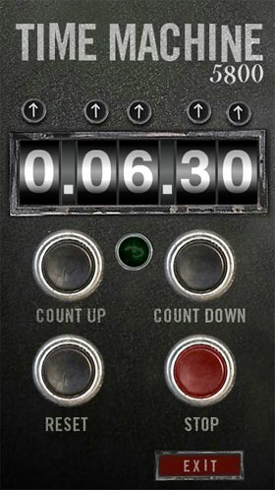
2024
CE
1948
CE
Notes:
Slide 5: So, let’s jump into our Olympic time machine again now, and go back through time and space to…… 1948, but not to the Olympic Games, yet!!

Slide 6
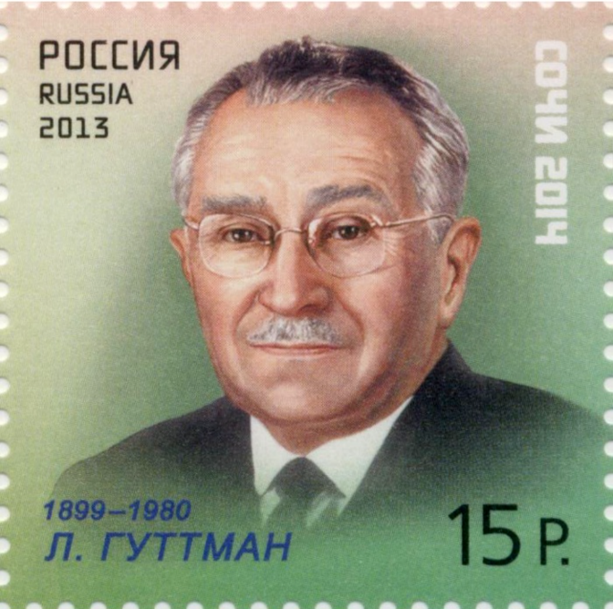
Notes:
Slide 6: This is Dr Ludwig Guttemann, who was a doctor at the Stoke Mandeville Hospital, here in the UK. After World War II, there were many service men and women who’d come back from the war with injuries, and he decided that sport was a really good way of encouraging their recovery. So in the Summer of 1948, inspired by the Olympics, he held an archery competition for just 16 athletes in wheelchairs.
Four years later, in 1952, a Dutch team were sent to the UK to compete, making it the first International Stoke Mandeville Games. The Stoke Mandeville Games took place every year, with more wheelchair participants being added every year. This competition was so successful that it was decided to make it more of a regular thing and include more sports: so, let’s jump into our Olympic time machine once more and find out what happened at the very first official Paralympic Games, in….

Slide 7
1960
CE
1948
CE
Notes:
Slide 7: 1960…..

Slide 8
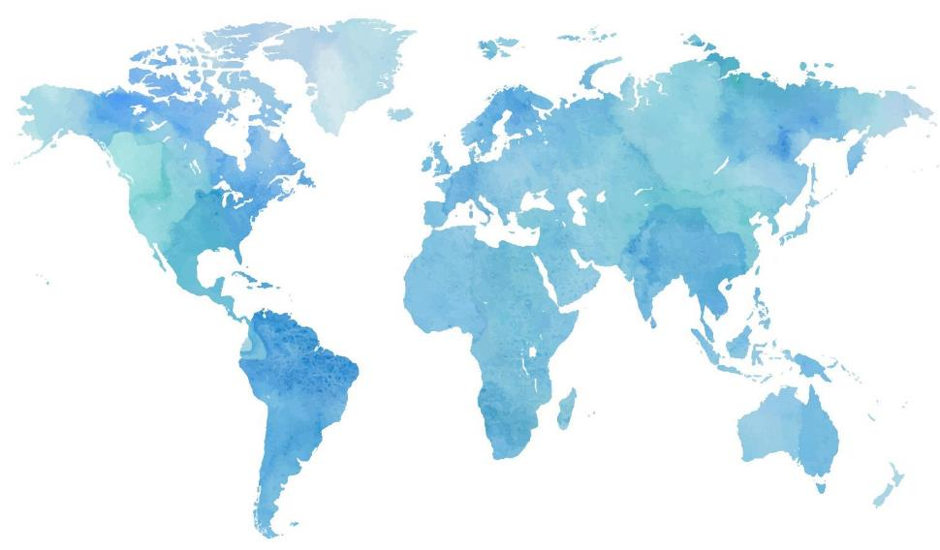
Notes:
Slide 8: …to Rome, Italy, where the Olympics were also taking place. This was the first time the Stoke Mandeville Games had ever happened outside the UK, alongside the Olympic Games. It was hoped that the Stoke Mandeville Games would become more well-known as an international event and that more athletes would be encouraged to attend. It worked, and we now know this now as the Paralympic Games. Let’s find out more about those very first Games, in 1960, when there were 400 competitors from 23 countries in 8 sports:
Archery
Athletics
‘Dartchery’ (a combination of darts and archery, which uses a dart board instead of a normal archery target)
Snooker
Swimming
Table tennis
Wheelchair basketball
Wheelchair fencing

Slide 9
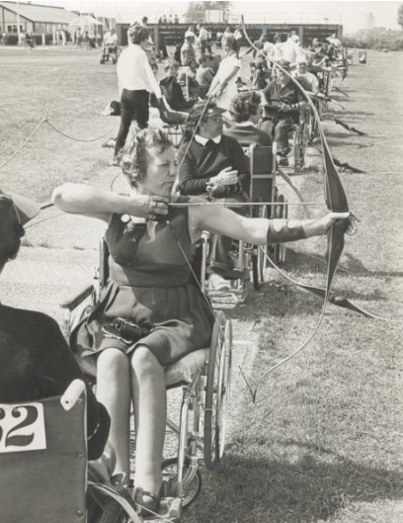
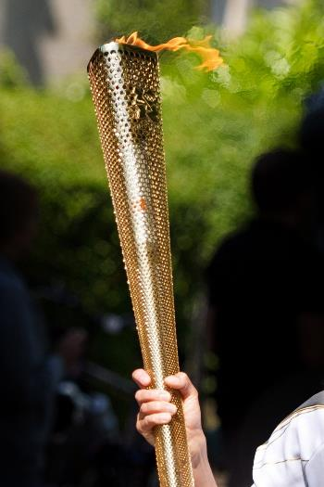
Notes:
Slide 9: This is Margaret Maughan, who was a wheelchair competitor in the archery event in the 1960 Paralympics, and also in the pool in the women’s backstroke event (she was the only swimmer in that event!).
She won a gold medal in both events – Britain’s first Paralympic medallist – and was a competitor in 4 more Paralympic Games after that. In honour of her long-standing support of the Paralympic movement, she was chosen to light the Olympic cauldron using the torch in the Opening Ceremony of the Paralympics here in London in 2012.

Slide 10
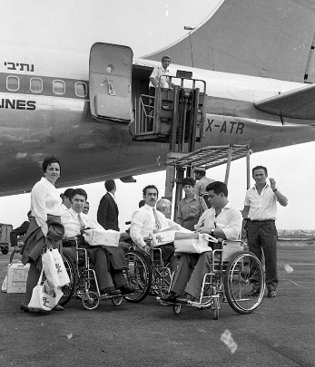
First of all we were put on a coach to go to the airport; we all had to be carried on and our wheelchairs folded and loaded. Then at Heathrow the same thing was done in reverse. It took hours! Then to get us onto the plane they had to use a fork-lift with four of us at a time in our chairs on a platform being lifted up onto the plane. Then we had to be lifted into our seats and our chairs folded and put as baggage. At the other end it all took hours more; if you were the last off the plane you were sitting waiting for two hours. But back then that was part of your life; and you just had to accept it.
Notes:
Slide 10: Here are some of Margaret’s memories about getting to Rome in 1960!
‘First of all we were put on a coach to go to the airport; we all had to be carried on and our wheelchairs folded and loaded. Then at Heathrow the same thing was done in reverse. It took hours! Then to get us onto the plane they had to use a fork-lift with four of us at a time in our chairs on a platform being lifted up onto the plane. Then we had to be lifted into our seats and our chairs folded and put as baggage. At the other end it all took hours more; if you were the last off the plane you were sitting waiting for two hours. But back then that was part of your life; and you just had to accept it.’

Slide 11
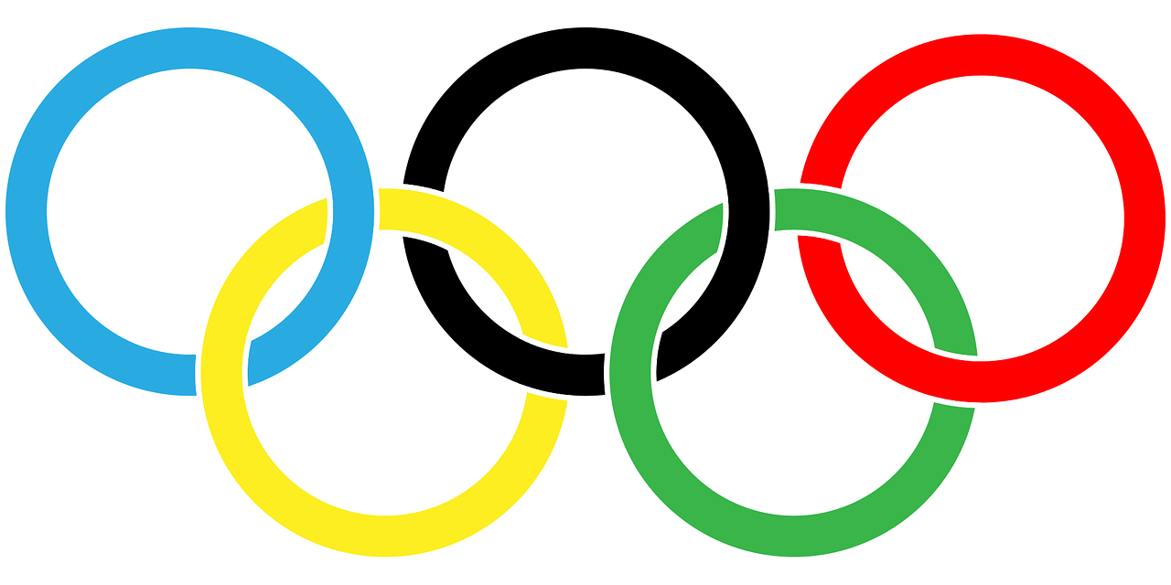
The Olympics
Respect
Friendship
Excellence
Determination
Equality
Courage
Inspiration
Olympic rings © Pixabay
Notes:
Slide 11: This certainly doesn’t feel very fair to us, looking back on the challenges of even getting to the Paralympic Games back in 1960. Imagine being lifted in and out of an aeroplane on a fork-lift truck!! I wonder how you feel that Margaret and her fellow competitors felt being treated as they were?
We’re going to focus on the Paralympic value of equality for a few moments now, which along with three others, form the modern Paralympic values. You’ll be glad to know that there are many ways in which the Paralympics have changed over the years since 1960, and that the value of equality amongst competitors is very important. The rules in each of the events try to make it fair for everyone, regardless of their disability….

Slide 12
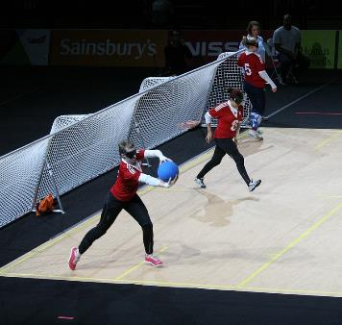
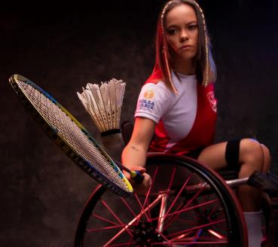
“I feel very proud to be at the start of all this. From just a team of 70 British people in wheelchairs at the first Games, now there are hundreds from all disabilities.”
Notes:
Slide 12: When interviewed in 2012, Margaret Maughan acknowledged just how much had changed in the years since 1960:
“I feel very proud to be at the start of all this. From just a team of 70 British people in wheelchairs at the first Games, now there are hundreds from all disabilities.”
We saw at the very beginning of our time together today just how many different events there will be in Paris this summer – and how many different types of athlete there will be competing, from wheelchair users like Margaret was, to those whose disabilities are less visible.
Goalball is one of these events, played by visually impaired players, all of whom wear eyeshades to make it fair for everyone. Goalball was one of the original Paralympic sports, created in 1946 to help WWII veterans to recover from their injuries. [If you click on the goalball photo, you can see a short video about how it’s played]
Later on this term, we are going to be sharing the story and some words from one of our most famous British paralympic athletes… but you’ll have to wait and see who!....

Slide 13
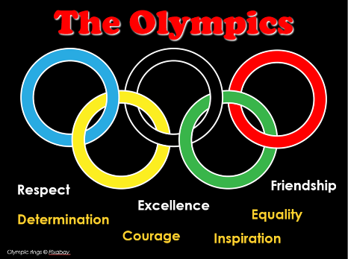
….I wonder how we might see this at the Paralympics this summer?
….I wonder what might inspire us about their participation?.....
….I wonder how it feels to achieve excellence despite challenges?.....
‘I praise you because you have made me in an amazing and wonderful way.’ Psalm 139:14
Notes:
Slide 13: Many people who’ve been spectators at the Paralympic events say that it’s more exciting than the other, ‘normal’ Olympics!
Each paralympic athlete in the Paralympic Games will show us such amazing talent – and demonstrate determination, courage, and inspiration in a place where all are treated as equals – but celebrated for their unique contribution to their team.
We’re going to bring our time together towards an end today, in excited anticipation about what we might all see this summer.
Earlier we heard the words of Margaret Maughan about the challenges that those early Paralympic athletes faced to compete in the first Paralympic Games, and though it’s true to say that challenges may still exist, you’ll be pleased to hear that the athletes are no longer lifted onto their flights by a fork-lift truck!!
All athletes have to work hard, but as we’ve heard, there are often extra or different challenges faced by paralympic athletes……
These words from the Bible have inspired Christians all over the world to see and celebrate every human being as an amazing creation, a reflection of what God is like, ‘made in his image’.
So, let’s pause together and wonder now…..
….I wonder how we might see this at the Paralympics this summer?
….I wonder what might inspire us about their participation?.....
….I wonder how it feels to achieve excellence despite challenges?.....

Slide 14
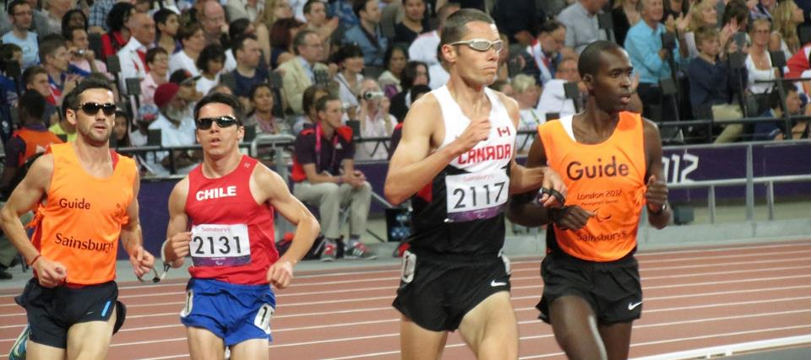
Eternal God, Giver of joy and source of all strength, we pray for those who will be preparing for the 2024 Paralympic and Olympic Games. We pray for the competitors training for the Games, their loved ones who have been a part of their journey, and for the many thousands of others who will support them as they watch. In a world where not everyone is treated fairly, we pray for a spirit of tolerance and acceptance, of humility and respect, and for the health and safety of all. Please be with them all, we pray.
Notes:
Slide 14: Prayer [based on a Church of England prayer, written for the 2012 Olympics & Paralympics]
I’m going to use some words of a prayer written for the Olympics and Paralympics that took place in London, in 2012. If praying is something that you are comfortable with, and you would like to pray these words with me, then find some way to make the prayer your own:
Eternal God, Giver of joy and source of all strength, we pray for those who will be preparing for the 2024 Paralympic and Olympic Games. We pray for the competitors training for the Games, their loved ones who have been a part of their journey, and for the many thousands of others who will support them as they watch. In a world where not everyone is treated fairly, we pray for a spirit of tolerance and acceptance, of humility and respect, and for the health and safety of all. Please be with them all, we pray.

Slide 15
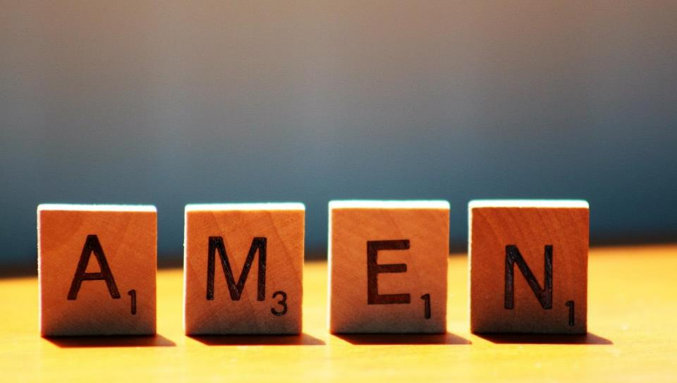

Slide 16
Leader: As we leave this place & time and go into the day ahead…
All: Let’s ‘go for gold’ in all that we do!
Notes:
Sending: Slide 16
Leader: As we leave this place & time and go into the day ahead…
All: Let’s go for gold* in all that we do!
*Again, you might need to unpick what we mean by ‘going for gold’ in the context of today’s words.

Slide 17
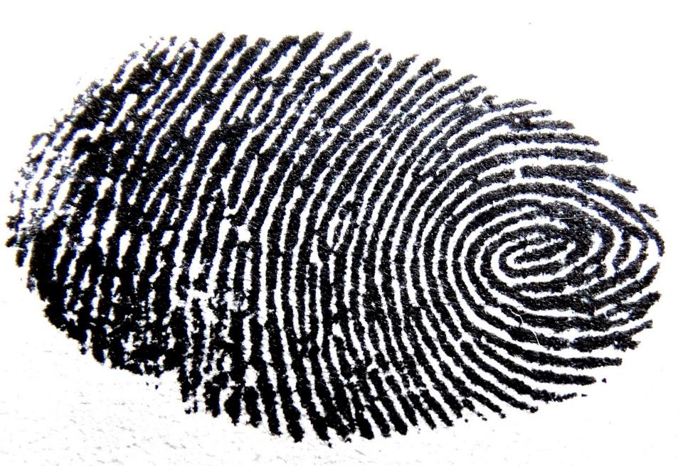
Notes:
Slide 17: Reflective areas: get practical!
In pairs, gather some ideas about things that make you unique – and worth celebrating! If you have time, share your ideas with each other at the end of the week.

