Slide 1





We are here together in our school family. May God be with us…
...and watch over us.
Notes:
Slide 1: Use these new gathering words for this term, or your usual greeting if you prefer.

Slide 2

The Lord’s Prayer
Notes:
Slide 2: “We’ve been thinking this term about the prayer that Jesus taught to his disciples to help them to pray – to talk to God – and about the kinds of things they should say to him. This prayer has become the most famous of all Christian prayers – the Lord’s Prayer.

Slide 3
Our Father in heaven,
Hallowed be your name
Your kingdom come, Your will be done on earth, as it is in Heaven.
Give us today our daily bread.
Forgive us our sins,
As we forgive those who sin against us.
Lead us not into temptation,
But deliver us from evil.
For the Kingdom, the power and the glory are yours, now and forever.
Amen
Notes:
Slide 3: The next line that Christians pray says ‘Forgive us our sins (that’s the wrong things they do), as we forgive others who sin (or do wrong things) against us.’

Slide 4
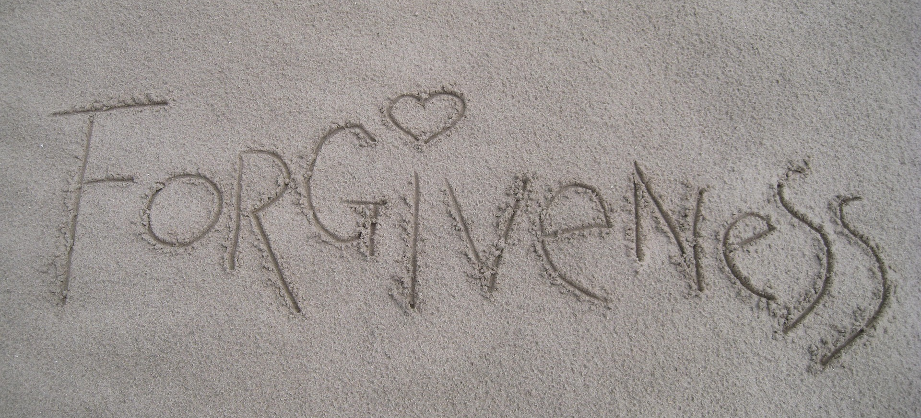
Notes:
Slide 4: I wonder what you think this word ‘forgiveness’ means? [pause to talk together]
The other tricky word in this line of the prayer is ‘sin’: to help us, I wonder if you can think of some things that we all do from time to time that hurt or upset each other? [write a few suggestions on the small whiteboard: paraphrasing might be necessary for younger children] Sometimes we don’t mean these things to cause hurt to others, but sometimes we actually do… Christians call these things ‘sin’, but whatever we call it, we all know that the things that we do that hurt each other damage our relationships.

Slide 5
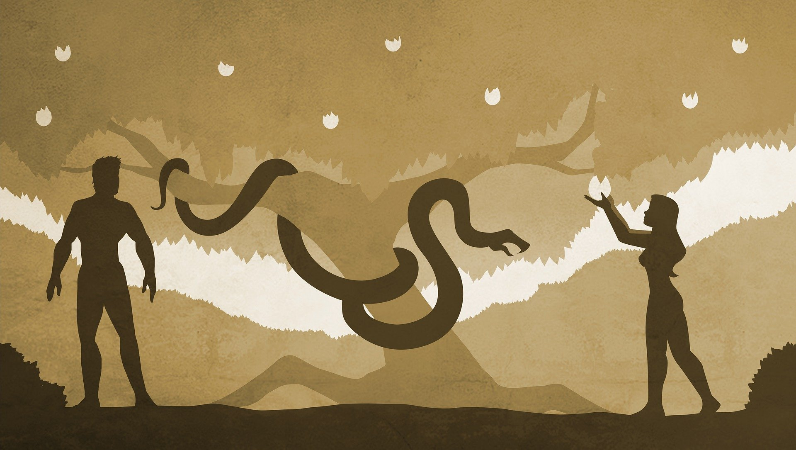
Notes:
Slide 5: Christians believe that all this started in the Garden of Eden, with Adam and Eve – and that sin damages relationships, with each other and with God.

Slide 6

Notes:
Slide 6: Forgiveness is like the medicine for broken relationships – and it’s the best way to un-do the damage. We all know how important this is in our school family [you might want to pause and talk some more about this, as you will know your own context] Saying sorry, asking for forgiveness, and forgiving others is not always easy to do. Christians believe that they need to ask God for forgiveness and show others forgiveness too, which is why they ask for God’s help in the Lord’s Prayer. Christians will try to be like God when they forgive others, so let’s look at some helpful word pictures in the Bible about what God says about sin, and his forgiveness:

Slide 7

(Isaiah 43:25)
‘God wipes away our sins.’
Notes:
Slide 7: It says in the Bible that ‘God wipes away our sins’. So, when Christians say sorry to God for doing something wrong, [pick up the whiteboard and wipe it clean] look, it’s all gone! There’s nothing left to remind them of what they’ve done.

Slide 8
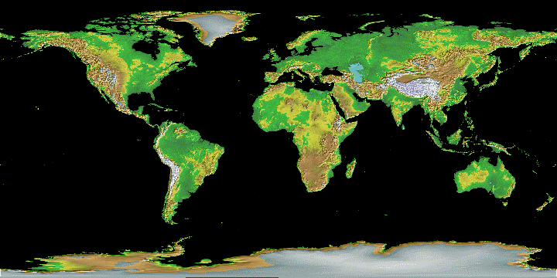
West
East
‘As far as the east is from the west, so far has God removed our sins from us.’
(Psalm 103:12)
Notes:
Slide 8: Here’s another picture about God’s forgiveness: ‘As far as the east is from the west, so far has God removed our sins from us’ – that means it’s as if God has taken the sins and put them across the other side of the world. Our world is 40,000 km from the east to the west – so that’s a very long way!!

Slide 9
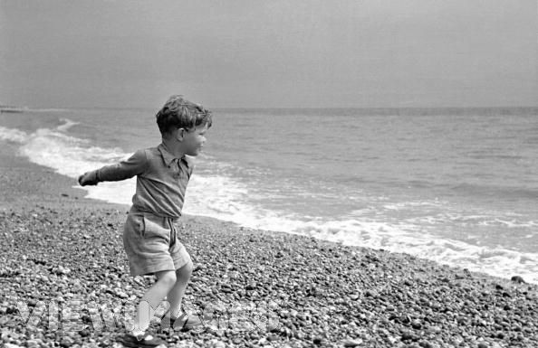
‘God hurls all our sins into the depths of the sea.’
Notes:
Slide 9: I’ve got one more picture here: ‘God hurls all our sins into the depths of the sea’. I expect some of you have thrown stones into the sea when you’ve been on the beach. But I don’t suppose any of you went searching under the sea to get your stone back again, did you? Well, neither does God go looking for the sin once Christians have said sorry to him.

Slide 10
…. I wonder what you think about these word pictures?....
….I wonder how it feels to be forgiven….and to forgive?....
….I wonder if it makes a difference to Christians that God forgives them when they say sorry?....
….I wonder if it helps them – or us – to forgive others?....
Notes:
Slide 10: Let’s wonder together…
…. I wonder what you think about these word-pictures?....
…I wonder how it feels to be forgiven…and to forgive?....
….I wonder what difference it makes to Christians that God forgives them when they say sorry?....
….I wonder if it helps them – or us – to forgive others?....

Slide 11
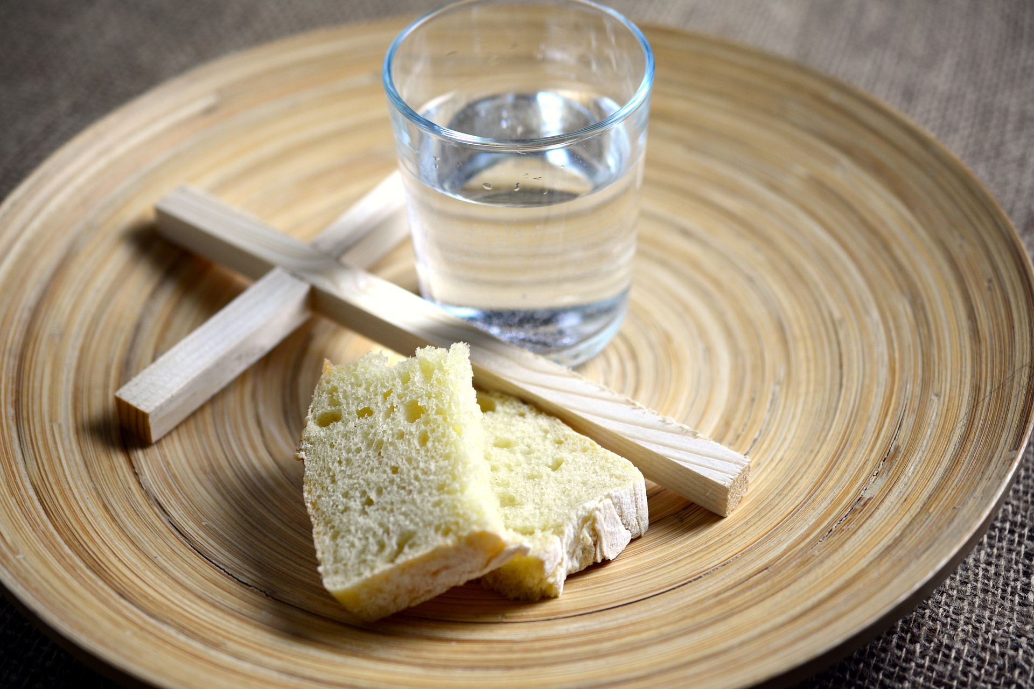
Notes:
Slide 11: This week marks the start of the season in the Christian calendar called ‘Lent’, when Christians will think about the life and example of Jesus. Lent starts 40 days before Easter. ‘Ash Wednesday’ is the first day of Lent and is a time when Christians will especially ask God for his forgiveness.

Slide 12

Notes:
Slide 12: Responding (words for worship):
For our reflection time today, I have three pebbles to help us to think….
….the words written on them are three reminders about forgiving others….
…as I read the words, think quietly to yourself about what they might mean for you….
…and what difference they might make to us in our school family….
[you might want to spend some time later in the week talking about these things]

Slide 13
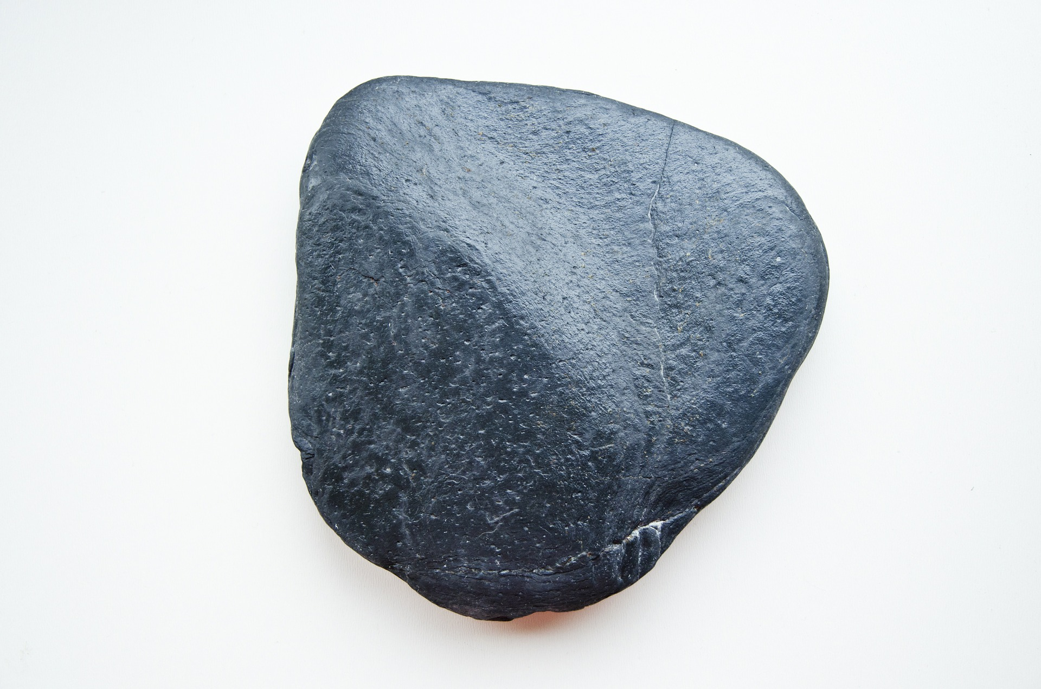
Forgiveness is...
...accepting someone
else's apology
Notes:
Slide 13: Forgiveness is…..accepting someone else’s apology

Slide 14
Forgiveness is...
...not reminding the
other person what
they did
Notes:
Slide 14: Forgiveness is….not reminding the other person about what they did to you

Slide 15
Forgiveness is...
...giving someone
another chance
(and another...)
Notes:
Slide 15: Forgiveness is….giving someone another chance (and another …and another!)
I’m going to turn my thoughts into a prayer now, and this week, will use some words of a song about forgiveness. You can make the prayer your own in some way, if you’d like to, or if you’d prefer not to pray, then just sit quietly with your own thoughts. I’m going to leave a short space at the end of each line to give you time to think or to pray….

Slide 16
For the angry words we’ve spoken,
For our hurtful, selfish ways,
Help us learn to say we’re sorry,
God, we pray….
For the people we’ve forgotten,
Or the times we’ve turned away,
May we learn to be more caring,
God, we pray….

Slide 17


Slide 18


Leader: As we leave this place & time and go into the day ahead…
All: May we forgive and be forgiven.

