Slide 1
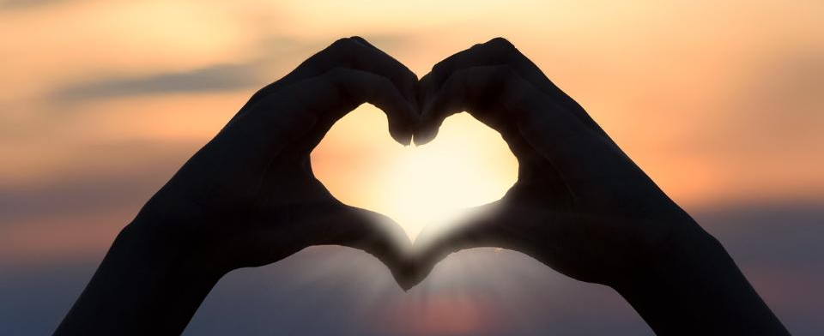
Leader: As we gather together
ALL: …we bring our hearts.
Notes:
Slide 1: Use the gathering words for this term, or your usual greeting if you prefer. The greeting comes with BSL signing; you can view the demos using links under the slide.
Leader: As we gather together,
ALL: …we bring our hearts
Signs for greeting: click on links
Hearts: British Sign Language BSL Video Dictionary - heart

Slide 2
Leader: As we gather together
ALL: …we share our thoughts.
Notes:
Slide 2: Use the gathering words for this term, or your usual greeting if you prefer. The greeting comes with BSL signing; you can view the demos using links under the slide.
Leader: As we gather together,
ALL: …we share our thoughts.
Signs for greeting: click on links
Thoughts: British Sign Language BSL Video Dictionary - thought

Slide 3
Leader: As community together
ALL: …we serve one another.
Notes:
Slide 3: Use the gathering words for this term, or your usual greeting if you prefer. The greeting comes with BSL signing; you can view the demos using links under the slide.
Leader: As community together,
ALL: …we serve one another.

Slide 4
Notes:
Slide 4: I expect some of you have tried to do one of these. This is a maze, and you have to try to get from the outside to the middle, or from one side to the other, but it’s not always as easy as it sounds is it? Why is that? [ask a child]. That’s right – we sometimes turn the wrong way and find ourselves in a dead end.
In some ways, I think that our lives are a little bit like a maze – but we’ll think some more about the reasons why after we’ve heard our story for today….

Slide 5
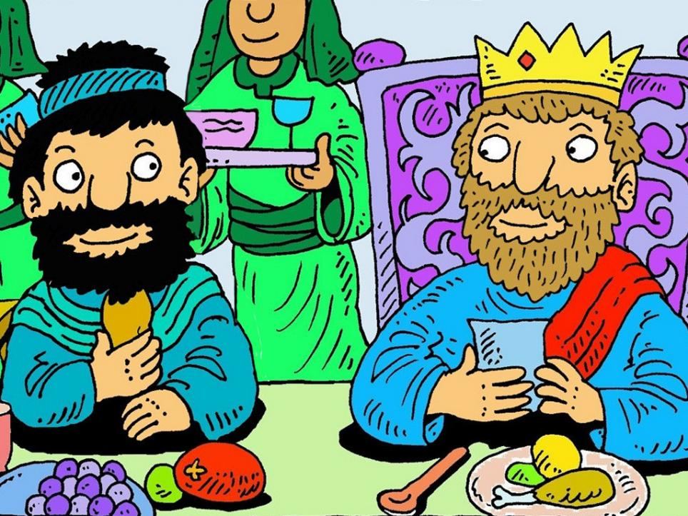
Notes:
Slide 5: In our story, David is now King of Israel, and it’s fair to say that there are many, many stories about what a great king he was, but there’s also this story, about some very bad decisions that he made, the effect that his choices had on others and what he did about them.

Slide 6
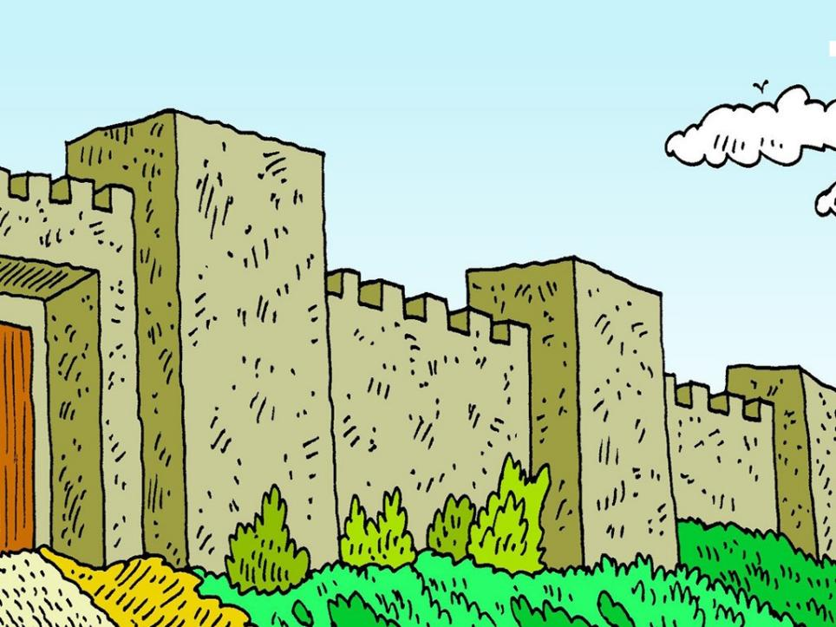
Notes:
Slide 6: One evening, David was on the roof of his palace, watching the world go by. As he looked across the rooftops, he spotted a beautiful woman as she went down to a nearby pool to wash. He asked one of his servants: ‘Who is that beautiful woman? Go and find out who she is.’ So the servant found out and told the king ‘She is Bathsheba, the wife of Uriah.’ King David was thinking about Bathsheba so much that he just couldn’t see that what he was about to do was really, really wrong.
But he was the king, and by now, he was very used to people following his orders. And so, King David made his first bad choice – wanting something that didn’t belong to him.

Slide 7
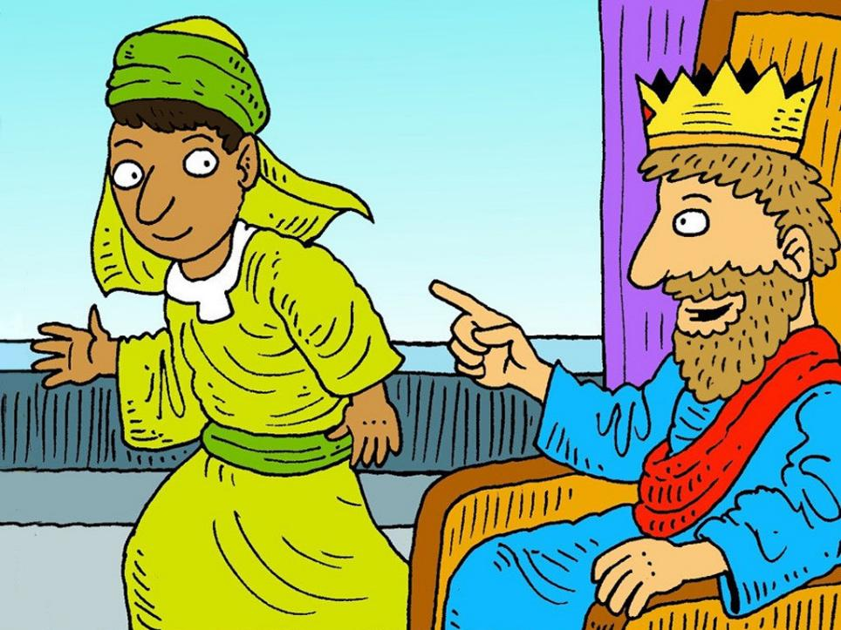
Notes:
Slide 7: He told the servant ‘Bring her to me because I want her to be my wife.’
But she was someone else’s wife, and so King David decided to do something about that too – his second bad choice. Bathsheba’s husband was in King David’s army, and the army were about to go into battle. He told Joab, who was in charge of the army, ‘Put Uriah on the front line of the battle, where the fighting is fiercest.’ He knew that this would mean that Uriah would probably be killed. What a terrible thing to do!
And that’s exactly what happened – Uriah was killed in battle, and King David married Bathsheba.

Slide 8
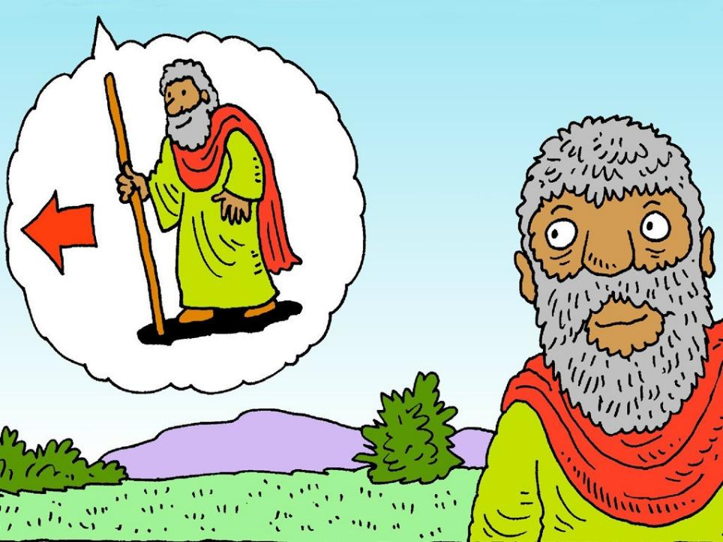
Notes:
Slide 8: But that’s not where the story ends – you’ll be pleased to know that King David had a very wise adviser called Nathan who knew that what David had done was really, really wrong, and had made God very sad. Nathan was also not afraid to go to the king and tell him so. When David saw what he had done, and realised how his actions had hurt others, and worse still, made God sad, he wrote these words in Psalm 51:

Slide 9
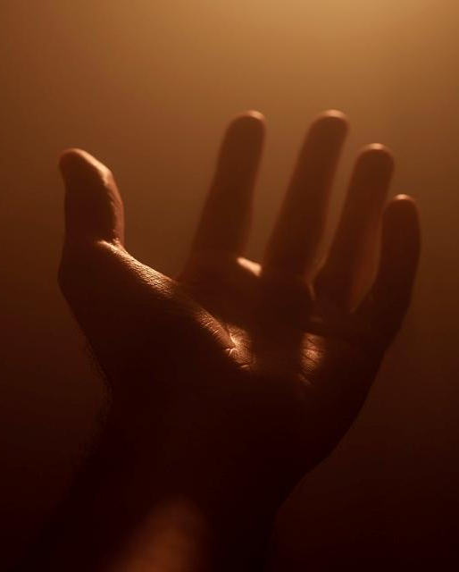
Wash away all my guilt and make me clean again. Create in me a pure heart, God. Make my spirit right again.
(Psalm 51:2&10)
Notes:
Slide 9: ‘Wash away all my guilt and make me clean again. Create in me a pure heart, God. Make my spirit right again.’ (Psalm 51: 2&10)
David knew that what he had done wrong was really serious – and that he needed to say sorry, to repent (which means ‘turn around’) in order to restore his friendship with God.
And the story tells us that God did forgive David, which made their friendship right again.

Slide 10
Notes:
Slide 10: So, what has this story to do with us, and our maze?
We said at the start that our lives can be a little bit like the maze. Like David, we can bad choices that hurt other people. This is a little bit like going the wrong way in the maze and getting stuck in a dead end [trace your finger to the first red dot].
Here are some more big red dots. The red dots will help us to find the right path through the maze – and help us to think! Each time we reach a red dot, we’re going to think about how the story of David’s big mistake might help us in our lives.
So, let’s follow the path from the start to the next red dot….

Slide 11
We all have choices
Notes:
Slide 11: (Trace your finger)
We all have choices – just like the pathways in the maze, we can go the right way or the wrong way. Sometimes in our lives, we make bad choices – just like King David did – and we have to live with the results of our bad choices.

Slide 12
We all make mistakes
We all have choices
Notes:
Slide 12: We all make mistakes – there is a difference between a mistake and a bad decision. Mistakes are accidental, they’re not deliberate or on purpose, but they can still have an effect on other people and we need to learn to be aware when our mistakes hurt others. But David’s actions were not a mistake – he made the wrong choice when he wanted Bathsheba to be his wife.

Slide 13
We all make mistakes
We all have choices
We
need to say sorry
Notes:
Slide 13: We need to say sorry
David told God that he had made the wrong choice and said he was sorry. There are many more stories about King David’s life after he made his bad choice that show how much God still loved him, and had forgiven him. When we hurt others, whether it’s a mistake or a deliberate choice, it’s important for us to say – and be – sorry. Saying sorry gives others the opportunity to forgive us.

Slide 14
We all make mistakes
We all have choices
We
need to say sorry
God is loving
‘God, be merciful to me because you are loving.’
Notes:
Slide 14: God is loving
David believed that God loved him deeply despite his bad decisions, and knew that by saying sorry, his relationship with God could be mended. He wrote in the first verse of Psalm 51 ‘God, be merciful to me because you are loving.’
David believed that because God’s character is full of love, it would mean that God would show him mercy – and forgive him.

Slide 15
We all make mistakes
We can learn from the past
We all have choices
We
need to say sorry
God loves us
‘God, be merciful to me because you are loving.’
Notes:
Slide 15: We can learn from the past
David’s bad decision taught him how to mend his broken relationship with God, and to trust God to help him in the future. We can also learn from our bad decisions, because the next time we are faced with a choice in how we behave, we can remind ourselves what happened… and hopefully choose differently….

Slide 16
Notes:
Slide 16: For many Christians across the world, this week marks the start of Lent, a time when many will be thinking about their lives and the things they are sorry for, or want to do better, as they try to be like Jesus. Like David, who talked about the state of his heart, it will be a time when they will examine their hearts and their actions, and get right with God. [share any school-based follow-up you might have here.]

Slide 17
We all make mistakes
We can learn from the past
We all have choices
We
need to say sorry
God loves us
‘God, be merciful to me because you are loving.’
Notes:
Slide 17: Responding and words for worship:
In the stillness now, you might want to look at the maze and the dots, and think about how this might make a difference in our school community or our families…..and what difference this might make in our world if more people were to live in this way….
[Leave time for pupils to pause and think]
If you’d like to pray now, find a way to make these words your own – or join me with ‘Amen’ at the end.

Slide 18
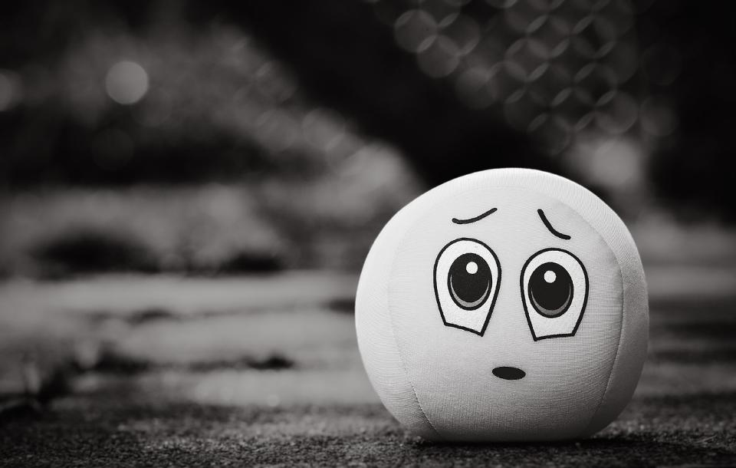
Dear God
Thank you for this story about King David and how it helps us to see the difference between making a mistake, and making a bad choice. Help us to learn from the choices we make, just like King David did, and to realise that we need to say sorry so that broken relationships can be mended.
Notes:
Slide 18: Prayer
Dear God
Thank you for this story about King David and how it helps us to see the difference between making a mistake, and making a bad choice. Help us to learn from the choices we make, just like King David did, and to realise that we need to say sorry so that broken relationships can be mended.

Slide 19
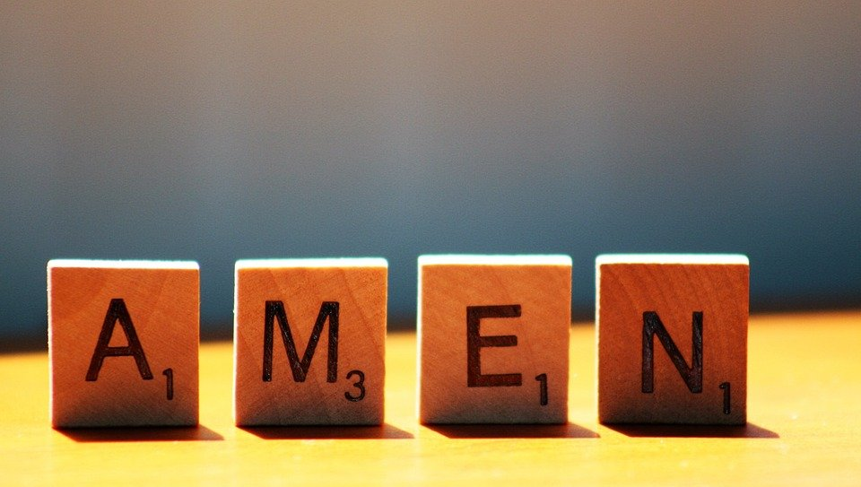
Notes:
Slide 19: ‘Amen’

Slide 20
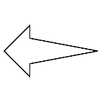
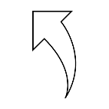
Leader: As we leave this place & time and go into the day ahead…
All: …may we serve one another in our thoughts and words and actions.
Notes:
Sending: Slide 20
Leader: As we leave this place and time and go into the day ahead,
All: ….may we serve one another in our thoughts and words and actions.
Signs for response: click on links
Thoughts: British Sign Language BSL Video Dictionary - thought (signbsl.com)
Words (use 3rd definition): British Sign Language BSL Video Dictionary - word (signbsl.com)
Actions: British Sign Language BSL Video Dictionary - action (signbsl.com)

Slide 21
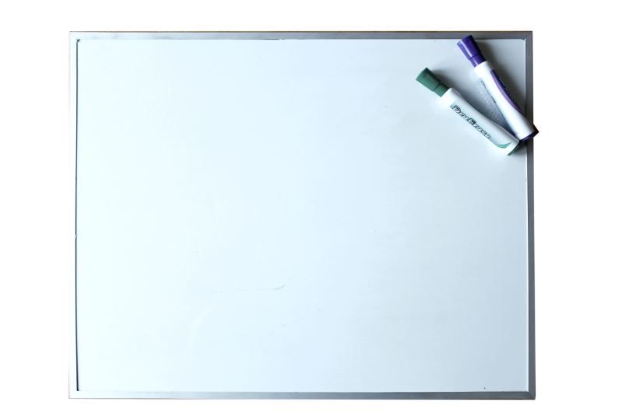
Notes:
Ideas for classroom reflection: Sorry whiteboards
Provide a small whiteboard for children.
Write some things you’re sorry for/about & rub it out, symbolising forgiveness.

