Slide 1

All images copyright-free from pixabay, unless otherwise identified
Notes:
Slide 1: Welcome stilling exercise – Falling bricks
Use the stilling slide if desired: the suggested words should be spoken slowly, leaving pauses inbetween to create a sense of stillness.
As you sit quietly here, watch the bricks carefully……as you do, think about why this is happening……[PAUSE]
Now practise slower breathing…..in…..and out…..in……and out…..keep this going as you continue to watch….[PAUSE]
You maybe notice that you are feeling calmer and more relaxed….[PAUSE]
As you breathe, think about yourself and what you bring into this time today…..[PAUSE]
We come into this special / sacred space and time to be still….to think deeply…..to be together as a school community…..
In our time together today, we are thinking about the blessing of community, and we will….. have a challenge……share a story….and then think together.
But first, let’s welcome one another as we begin….

Slide 2
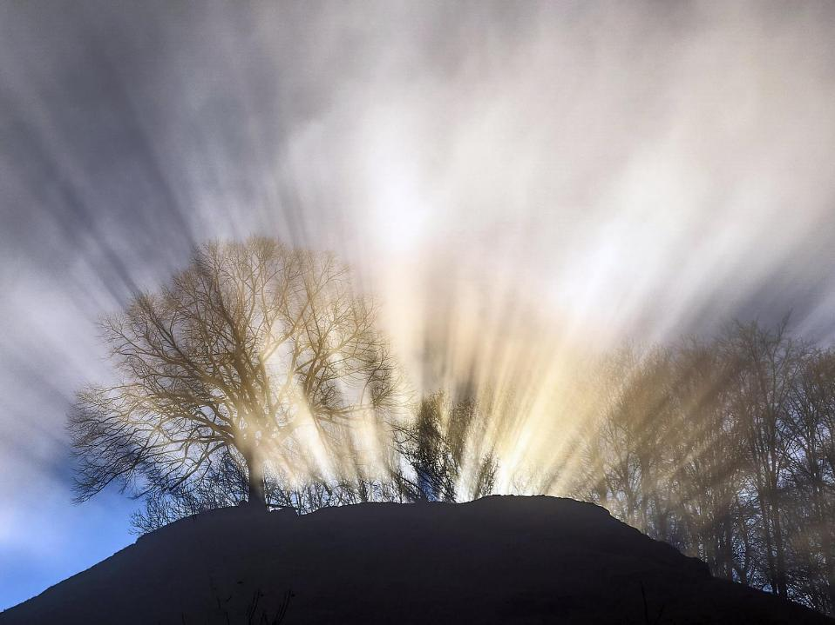
Leader: This is a day that God has made.
ALL: We will rejoice and be glad in it!
Notes:
Slides 2/3: Teach this new greeting to your school community – there are two slightly different versions from the point of view of the leader; choose which best fits your school’s context. One uses words adapted from Psalm 118:24
Leader: This is a day that God has made!
ALL: We will rejoice* and be glad* in it!
OR:
Leader: Today is a brand new day…..
ALL: May we be a blessing to each other!
*There are different BSL signs for rejoicing and joy/gladness. View them here: https://www.signbsl.com/sign/rejoice
Blessing: https://www.signbsl.com/sign/blessing (1st video)

Slide 3
Leader: Today is a brand new day!
ALL: May we be a blessing to each other!
Notes:
Slides 2/3: Teach this new greeting to your school community – there are two slightly different versions from the point of view of the leader; choose which best fits your school’s context. One uses words adapted from Psalm 118:24
Leader: This is a day that God has made!
ALL: We will rejoice* and be glad* in it!
OR:
Leader: Today is a brand new day…..
ALL: May we be a blessing to each other!
*There are different BSL signs for rejoicing and joy/gladness. View them here: https://www.signbsl.com/sign/rejoice
Blessing: https://www.signbsl.com/sign/blessing (1st video)

Slide 4

Count your blessings
Notes:
Slide 4: This term, we are thinking about our blessings – all the good things in our lives. Today we are going to be thinking about the blessing of being part of a community. Our story today will help us to think about how we are stronger together; that as human beings, we benefit from being in community together.

Slide 5
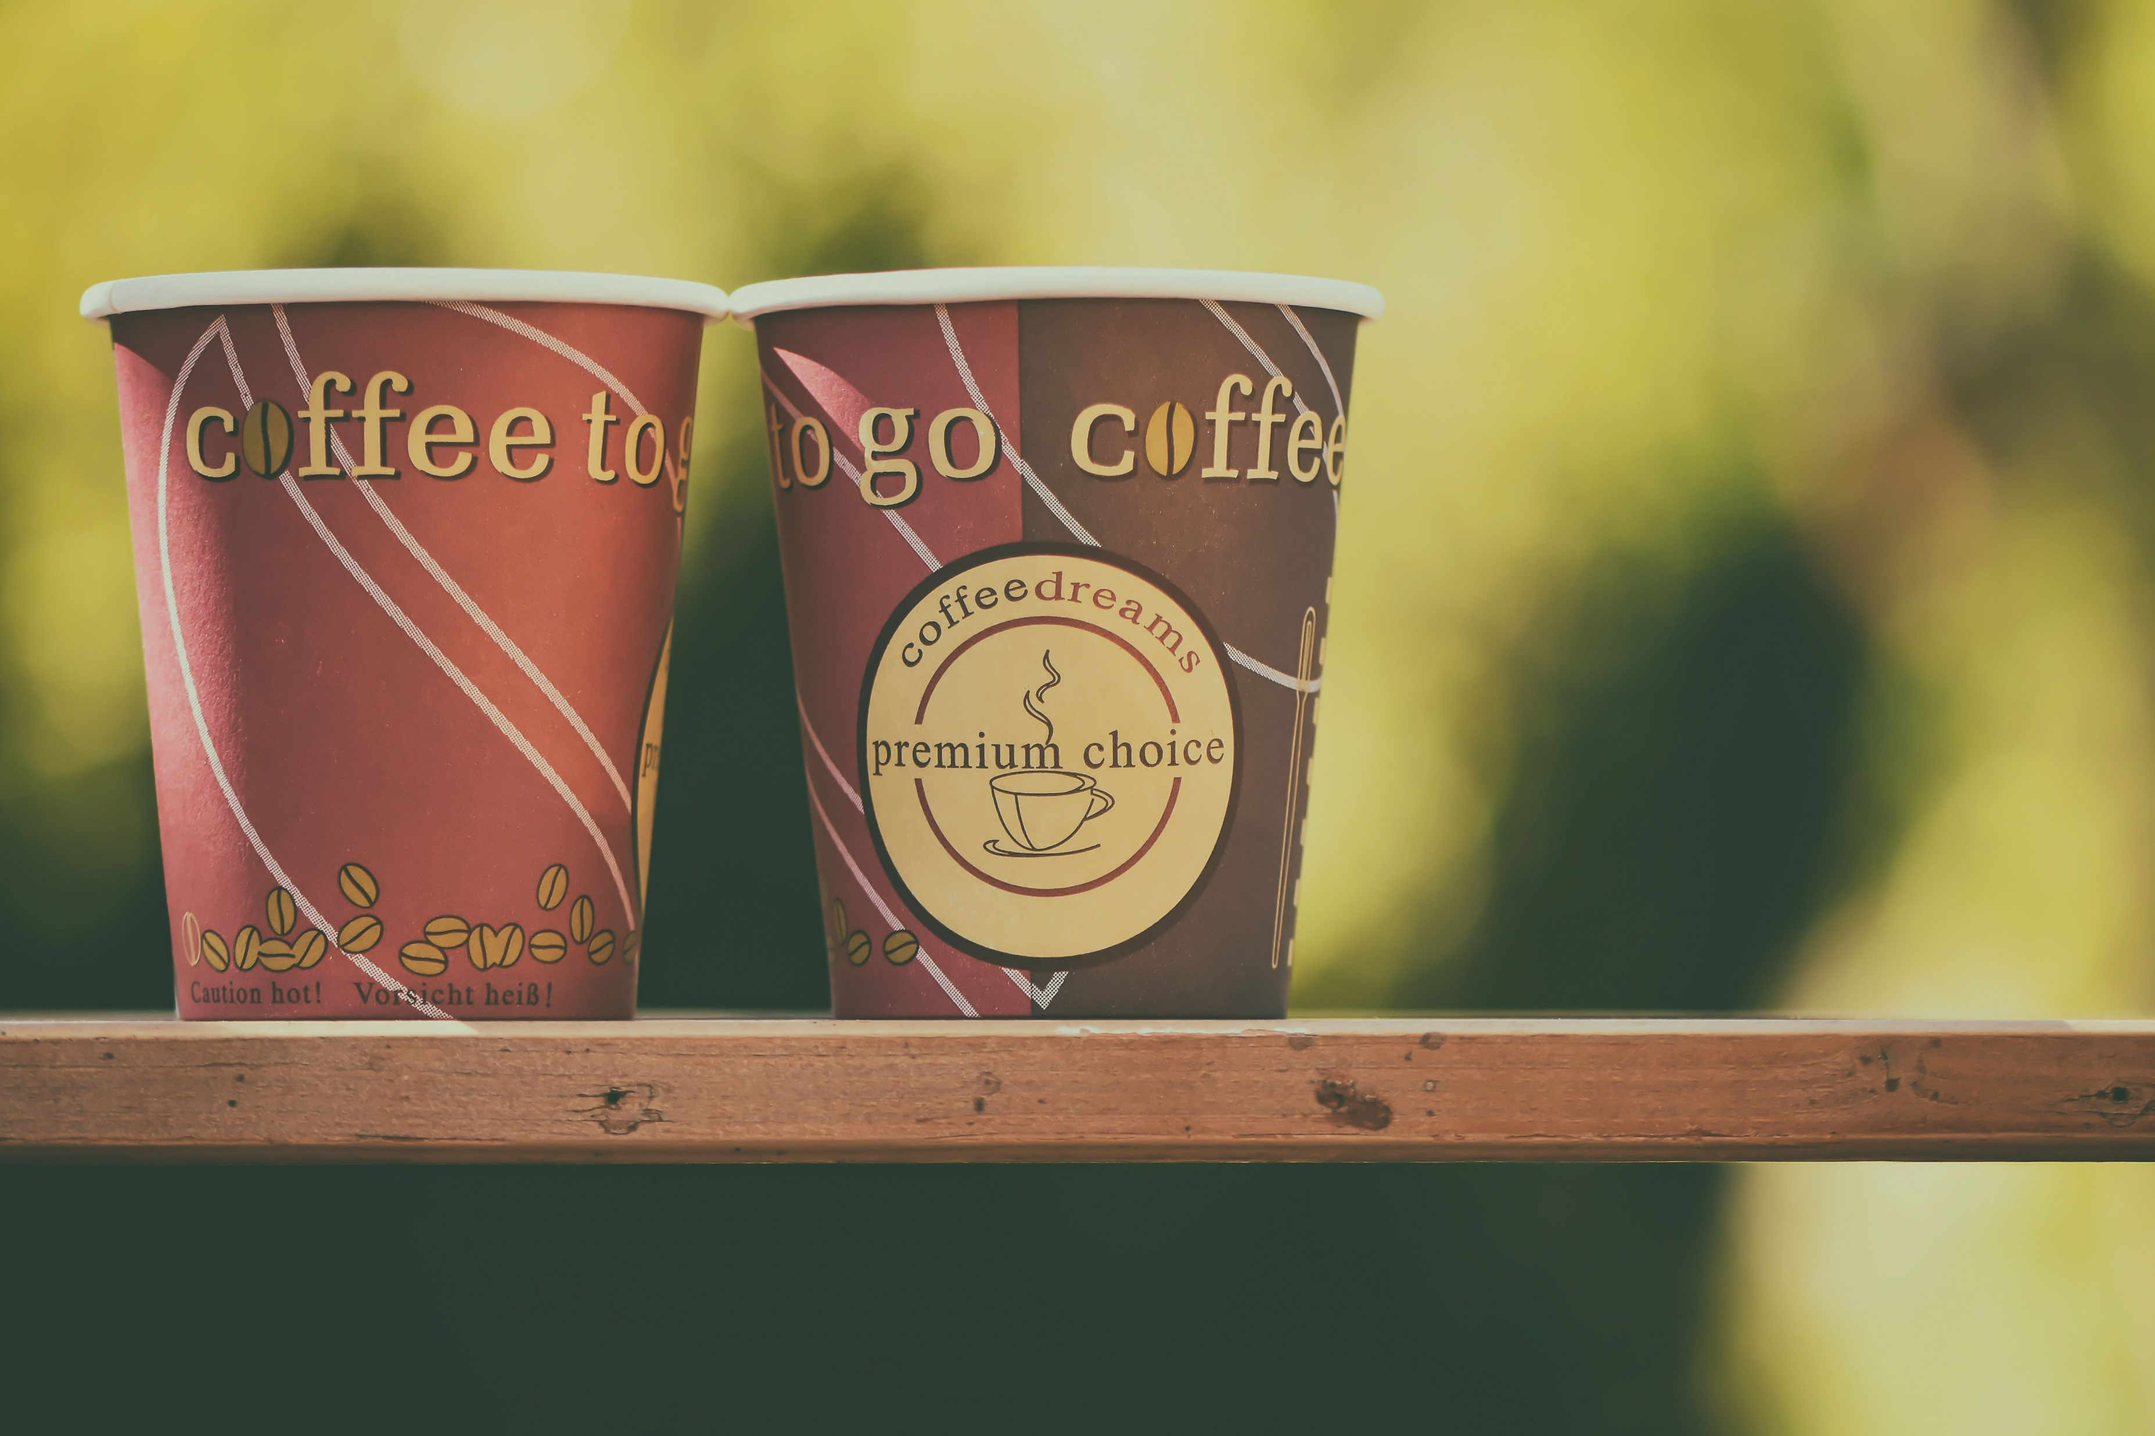
The cup challenge

Slide 6
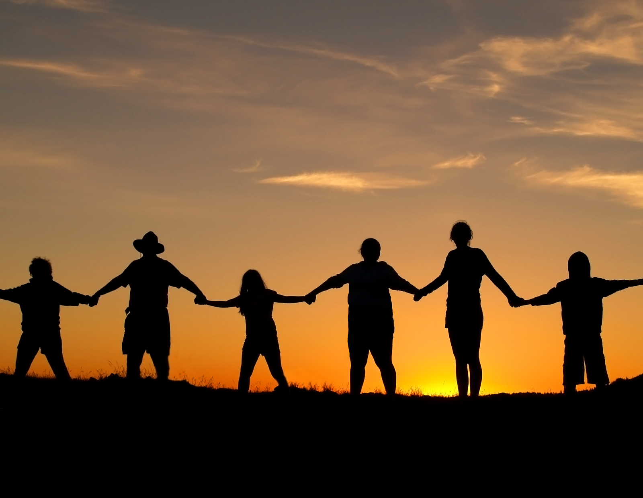
COMMUNITY
Notes:
Slide 6: We’re going to continue with this idea as we think more about us as a community – and some ancient words, from 2 different sources ….

Slide 7

‘United we stand; divided we fall’
Aesop, 620-560BC
‘All of you together are the body of Christ. Each one of you is a part of that body.’
I Corinthians 12:47, St Paul, 53CE
Notes:
Slide 7: We’ll be coming back to the second quote later in our time together, but let’s look at the first one first! ‘United we stand; divided we fall’. Those words were written about 500 years before Jesus was born, by this man,

Slide 8
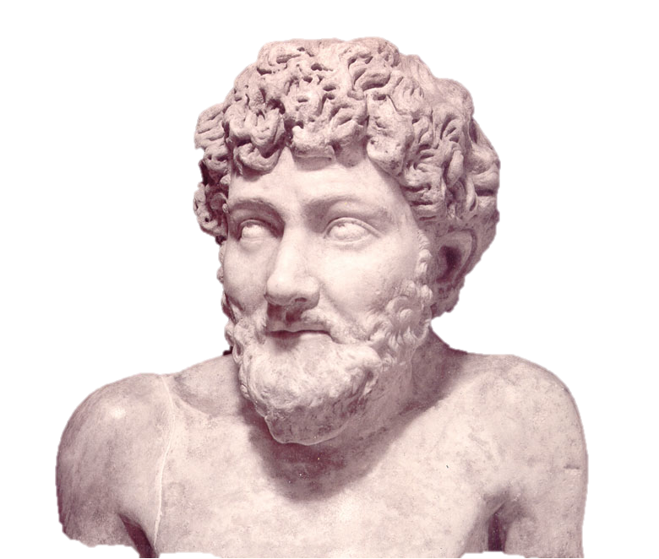
Aesop
620-560 BC
Notes:
Slide 8: Aesop – whose stories some of you might have heard of! We are going to hear one of these stories now, a story that he wrote to illustrate the words we just heard. As you listen, keep thinking…..

Slide 9
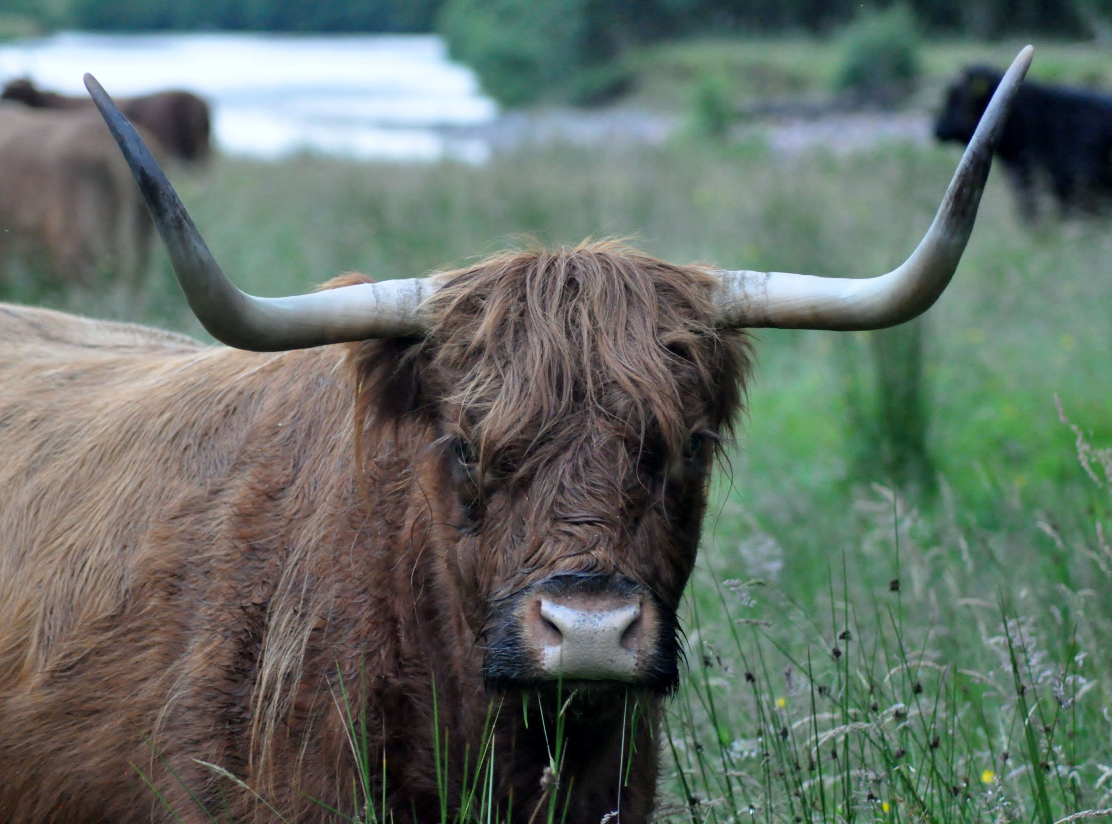
The Four Oxen
Notes:
Slide 9: It’s called The Four Oxen [use script]
[After story] Aesop ended his story with the moral: ‘United we stand, divided we fall’, which the oxen sadly found out the hard way…..
Working together gave the oxen strength that they didn’t have when they were separated. In our world today, we’re increasingly encouraged to be an individual and told that we should stand on our own two feet, and not rely on others. But many people believe that as human beings, we are made to be part of a community, that as we’ve heard today, we are strongest when we are in relationship with other people who will stick by us through thick and thin, good times and bad.

Slide 10
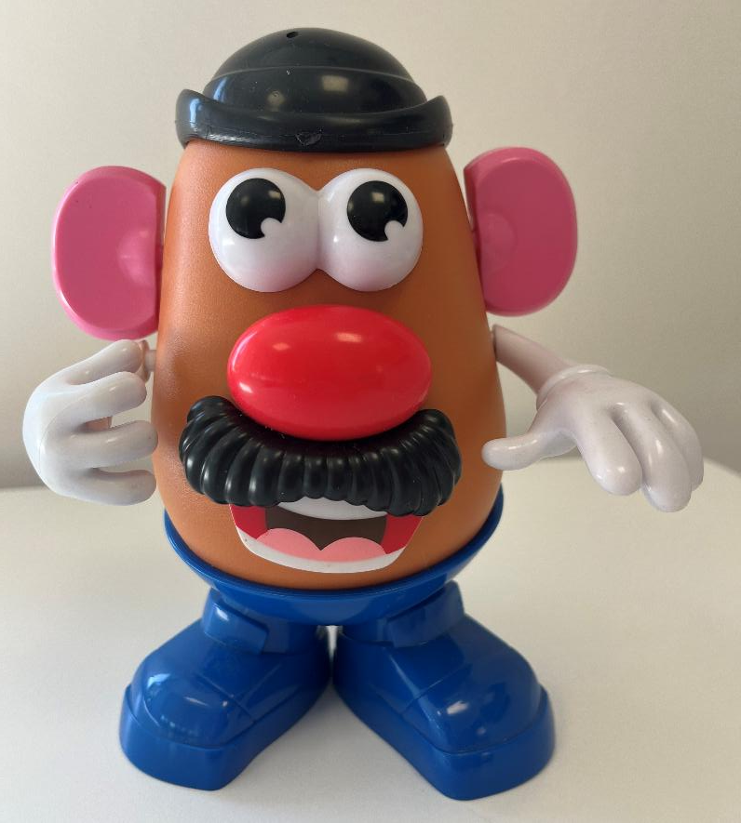
‘All of you together are the body of Christ. Each one of you is a part of that body.’
I Corinthians 12:47
St Paul, 53CE
Notes:
Slide 10: Let’s look at the second quote now: these are words written by a man named Paul, who was one of the very first Christians, and wrote many of the letters in the New Testament…He shared a very similar idea to Aesop, whose stories he would have known. In his version, Paul uses the idea of a body, arguing with itself, the head saying to the foot, for example, ‘We don’t need you!’ That would be silly!!: we know that the whole body works together! You can read this in one of his letters, to the church in Corinth, where people had been arguing with each other and not working together. Some of you might remember that we heard these words last term with the help of Mr. Potato-Head!

Slide 11
COMMUNITY
COMMUNITY
….I wonder how we can be a stronger school community today?.....
Notes:
Slide 11: So, whether you like Aesop’s story, or Paul’s words about the body – they both show us that we are stronger as a community when we work together. I don’t know if you’ve ever noticed, but there is a hidden word in ‘Community’ [click – and you’ll see it!] When we are united – we are strong. This week, this is my challenge to you all – to find new ways to work together, to be united and to support others when they need it.
Responding (and words for worship):
… We’re going to have some quiet moments now to think…..about being united as part of a community
…..Aesop said ‘United we stand; divided we fall’…..
…and Paul wrote about a body not fighting with itself, but all parts working together….
…as part of a school community, we are strongest when we stand together…..
….I wonder how we can be a stronger school community today?.....
…we are strong when we stand together….
…..when we work well, like the parts of a body…..
…. what could you do today that makes it easier for someone else to do the things they need to do?
…. how can you share the workload today, or support those who need your help…..
Now I’m going to pray and ask God for his help to be a ‘community in unity’ today. If you’d like to pray with me, then in the quietness, find a way to make the prayer your own….

Slide 12
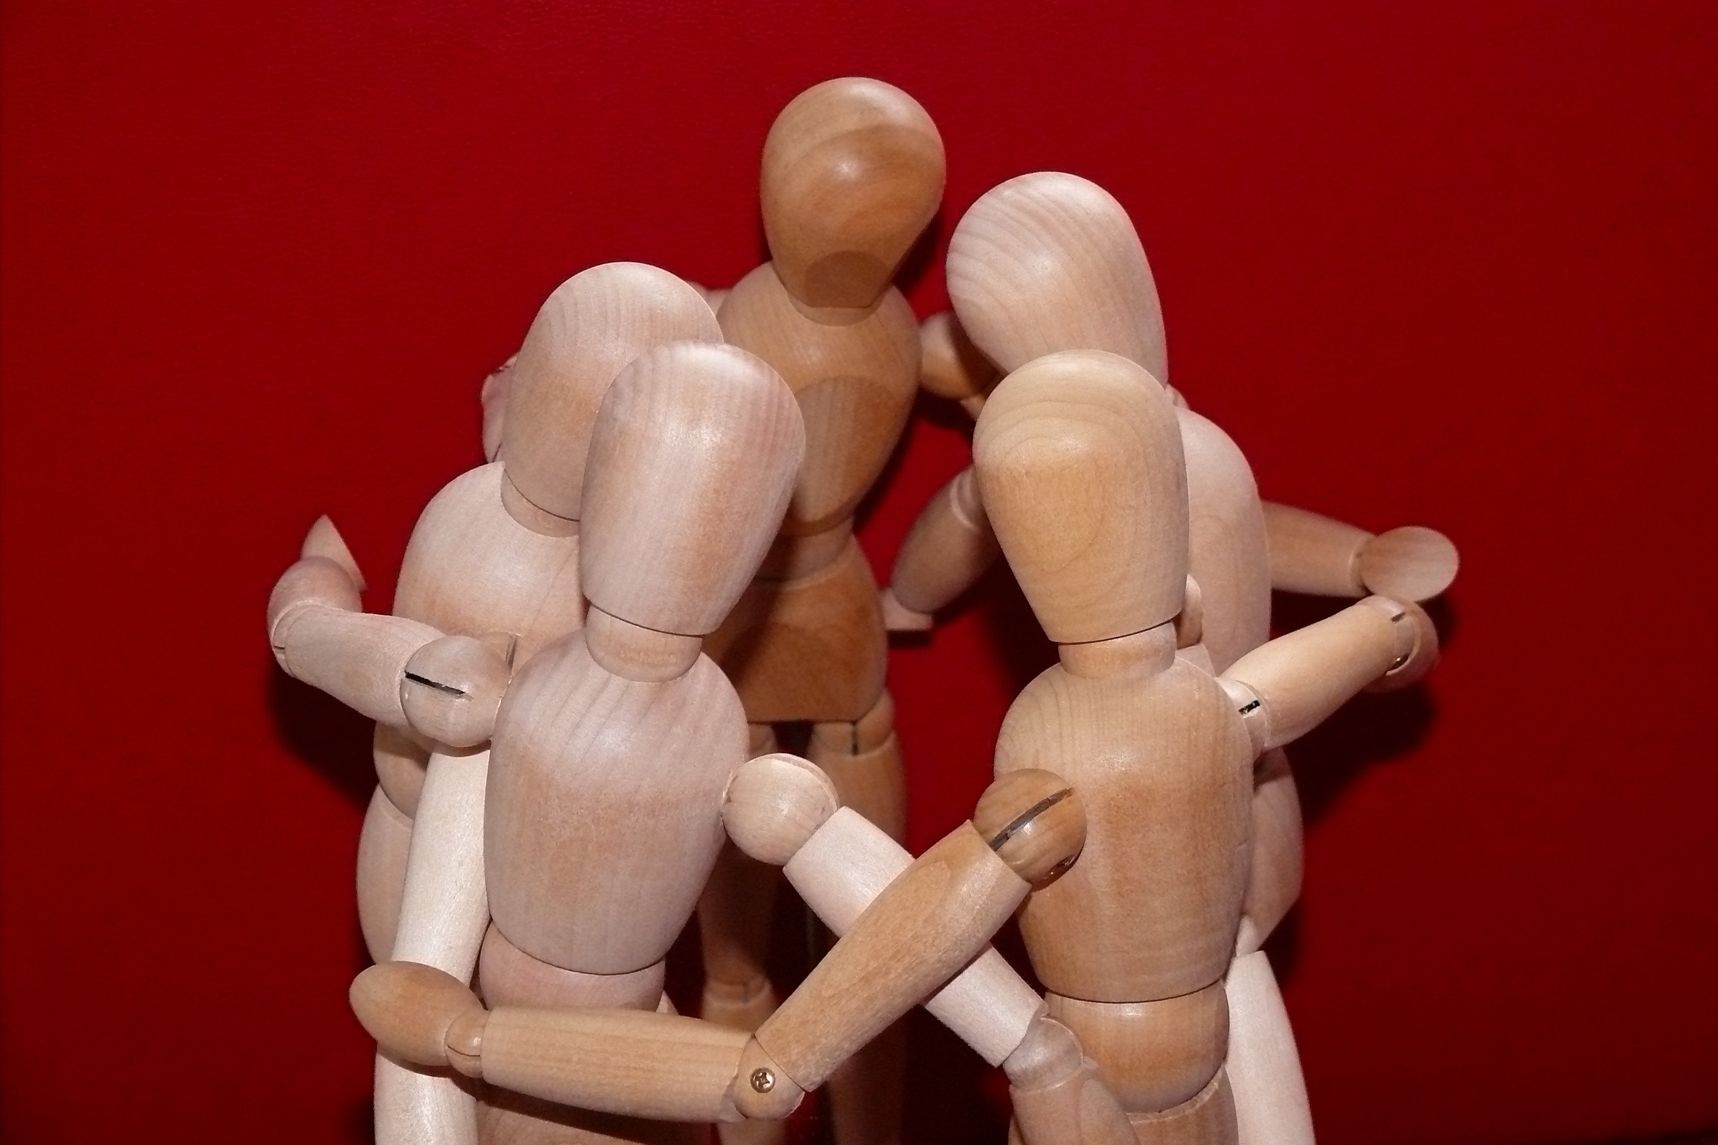
Dear God
Thank you for the strength that we find in being part of this school community. Thank you for the things we have learned today, about standing together. Help us today to find ways to be a community that is strong and united because we share each other’s loads and stand with those who need our support.
Notes:
Slide 12: Prayer:
Dear God
Thank you for the strength that we find in being part of this school community. Thank you for the things we have learned today, about standing together. Help us today to find ways to be a community that is strong and united because we share each other’s loads and stand with those who need our support.

Slide 13
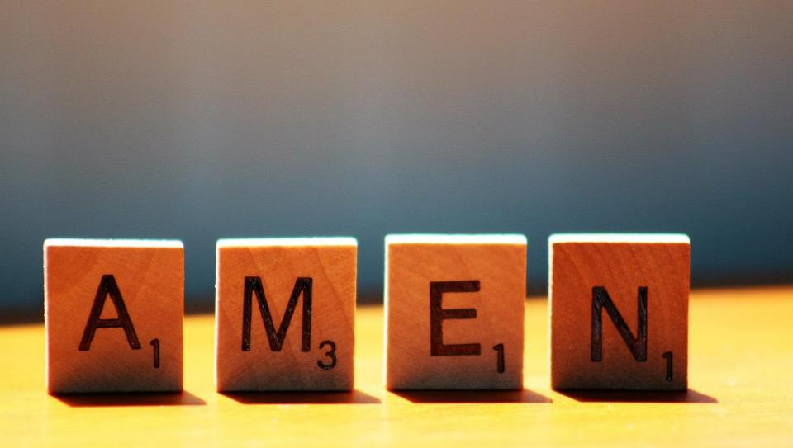

Slide 14


COMMUNITY
COMMUNITY
Leader: As we leave this place & time and go into the day ahead…
All: We will build a strong community.
Notes:
Slide 14: Sending
Leader: As we leave this place & time and go into the day ahead…
All: We will build a strong community.

Slide 15
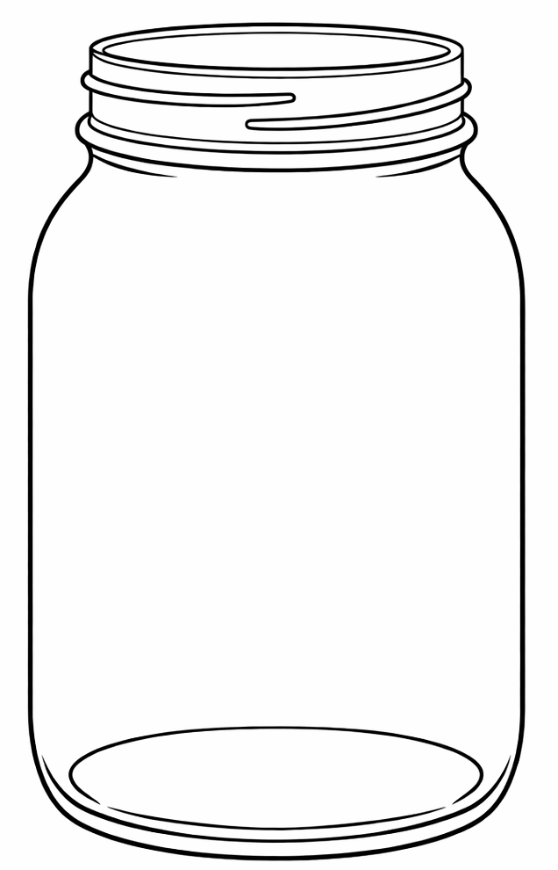
Notes:
Slide 15: Reflection areas
The familiar acronym ‘TEAM’ (Together Everyone Achieves More) is so true! Re-use the Blessings Jar from week 2 (unless you’re still gathering!) to create a ‘TEAM’ jar or box for the next few weeks, where children and adults can write on strips of paper & post the name of someone who’s demonstrated TEAM qualities.
Talk: When you are part of a TEAM – Together Everyone Achieves More. How can we work better, together?
Think: Who have you seen being a TEAM player this week?
Do: Write their name on a strip of paper and put it into the jar. At the end of the week, read out all the names and celebrate!

