Slide 1

All images copyright-free from pixabay, unless otherwise identified
Notes:
Gathering:
Slide 1: Heart-beat trace stilling exercise
Use the stilling slide if desired: the suggested words should be spoken slowly, leaving pauses inbetween to create a sense of stillness.
As you sit quietly, look at image on the screen and think about what it might be showing…… [PAUSE]
Now practise slower breathing…..in…..and out…..in……and out…..as you watch….[PAUSE]
You maybe notice that you are feeling calmer and more relaxed….[PAUSE]
As you breathe, think about yourself and what you bring into this time today….. [PAUSE]
We come into this special / sacred space and time to be still….to think deeply…..to be together as a school community…..
In our time together today, we will have a challenge, share 2 stories, and then think together.

Slide 2

Leader: As we gather to share our story today….
All: May we grow in our understanding of ourselves and of others.
Notes:
Slide 2: Use our new gathering words for this term, or your usual greeting if you prefer. These greetings may change slightly each week to reflect the spiritual elements that we will be exploring in each week’s materials.
Leader: As we gather to share our story today….
All: May we grow in our understanding of ourselves and of others.

Slide 3
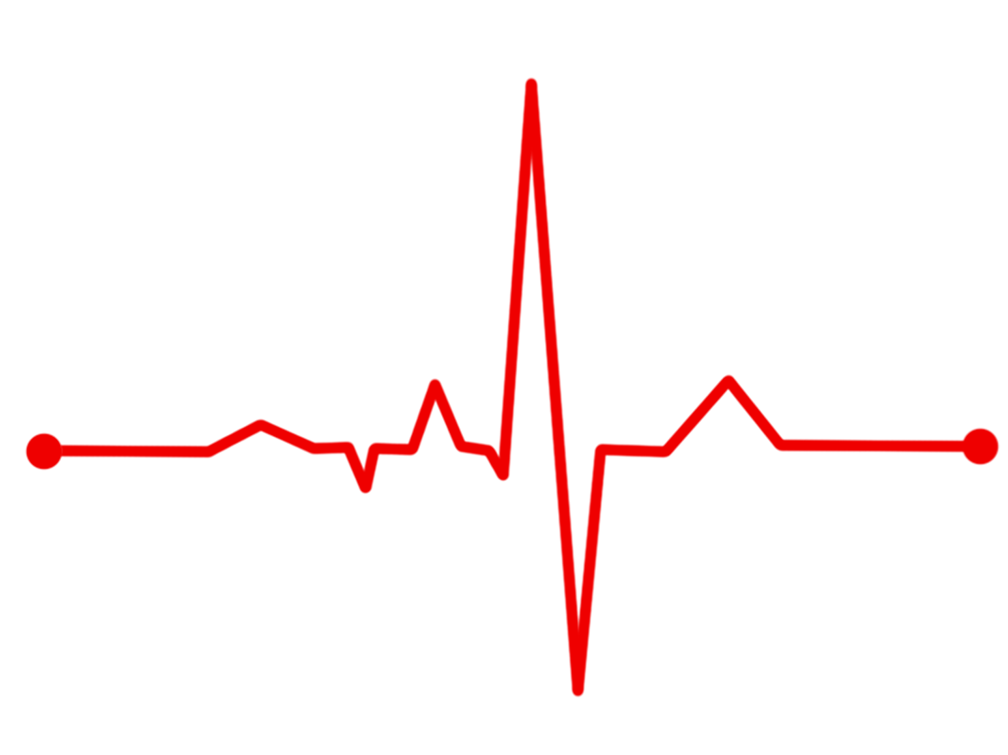
Notes:
Slide 3: We were watching a video of one of these as we settled into our time together today – does anyone know what it shows? [ask some children]
Seeing this on a heart monitor is a good sign – it shows that the heart is working well. We all know how important the heart is in having a healthy and properly-functioning body! We’re going to start our time together today with a challenge – using our bodies!

Slide 4
Where in the body?....
Notes:
EITHER: Slide 4: Where in the body? Set your challenges (see ‘Resources’ section) based on the location of body parts, with pupils pointing to where they think this is on their own body. OR:

Slide 5
Heads, shoulders, knees and toes….
Notes:
OR: Slide 5: Heads, shoulders, knees and toes…. Sing together. There is a simple video version (more suitable for KS1) here: https://www.youtube.com/watch?v=RxVQeS1tr7A but far better to just sing it yourself!

Slide 6
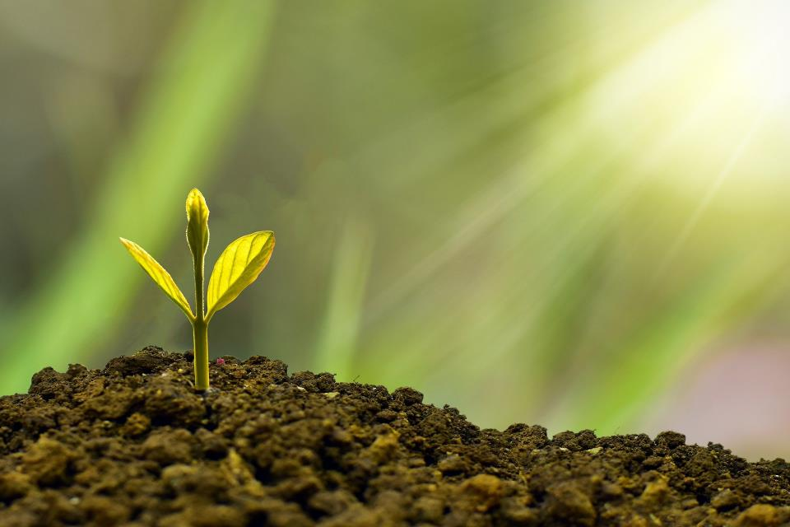
Stories that help us to grow
Notes:
Slide 6: Stories to help us to grow
We’ve been thinking about some of Jesus’ parables over the past few weeks, and searching together for the treasure in each, and in a few moments, we are going to be doing the same – with not one, but TWO stories: one written some 600 years before Jesus was telling parables and the second written by St. Paul to a church where some Christians were disagreeing with each other….. Nobody really knows whether Aesop’s story was known to St. Paul, but they have some striking similarities!*
[*The Bible-writer Paul was a well-educated Roman citizen, and a fluent Greek speaker and writer, so it is quite likely that these stories would have been familiar to him. In the education of ancient Greeks and Romans, fables were known as 'progymnasmata’, translated as ‘fore-exercises’, training students in the ancient skill of rhetoric (persuasive speaking/writing). For those of you who know the writings of St. Paul, this is significant!]

Slide 7
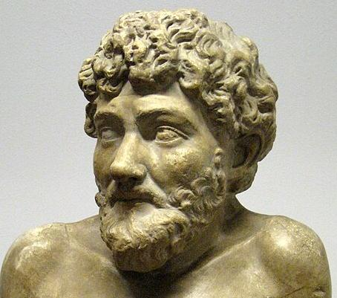
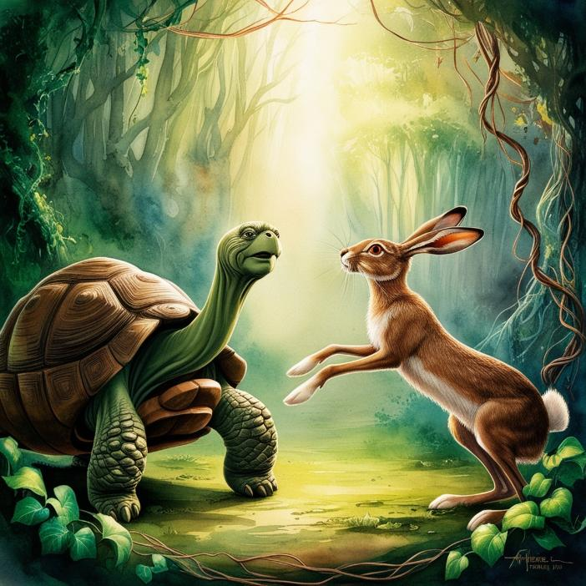
user:shakko, CC BY-SA 3.0 <https://creativecommons.org/licenses/by-sa/3.0>, via Wikimedia Commons
Aesop (c.620-564 BCE)
The Divided Body
Notes:
Slide 7: Aesop
The Greek writer Aesop was born in roughly 630BCE and was probably a slave who won his freedom through the telling of the stories for which he is famous. He is known all over the world for these fables (which are a little bit like parables), and especially those that are about animals. We probably all know his most famous, the Hare and the Tortoise – which is not our story for today!
Let’s listen to his story ‘The Divided Body’…. [https://classictales.co.uk/fables/divided-body You can download the very short script, or use the audio track. When you have listened, spend a few moments talking about the meaning of the story – that for a body to work well, all parts are important…or similar thinking!]
So, now let’s hear the version by St. Paul now, written to the Early Church in Corinth, who were having some difficulties agreeing with one another.

Slide 8
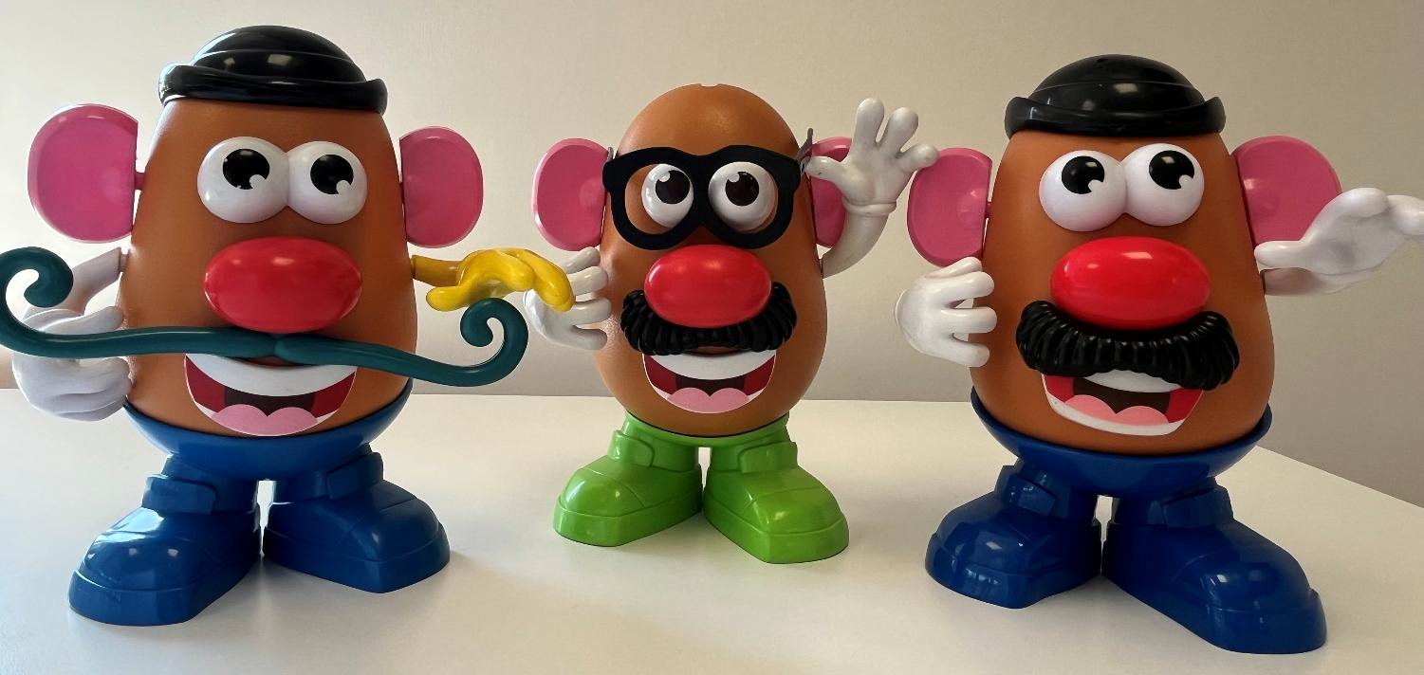
With thanks to Merrow Schools for lending us their Mr Potato-Heads!
1 Corinthians 12: 14-21
[adapted for Mr. Potato-Head!]
Notes:
Slide 8: This version has been created with the help of a familiar friend, Mr Potato-Head (without his angry eyes!!)

Slide 9
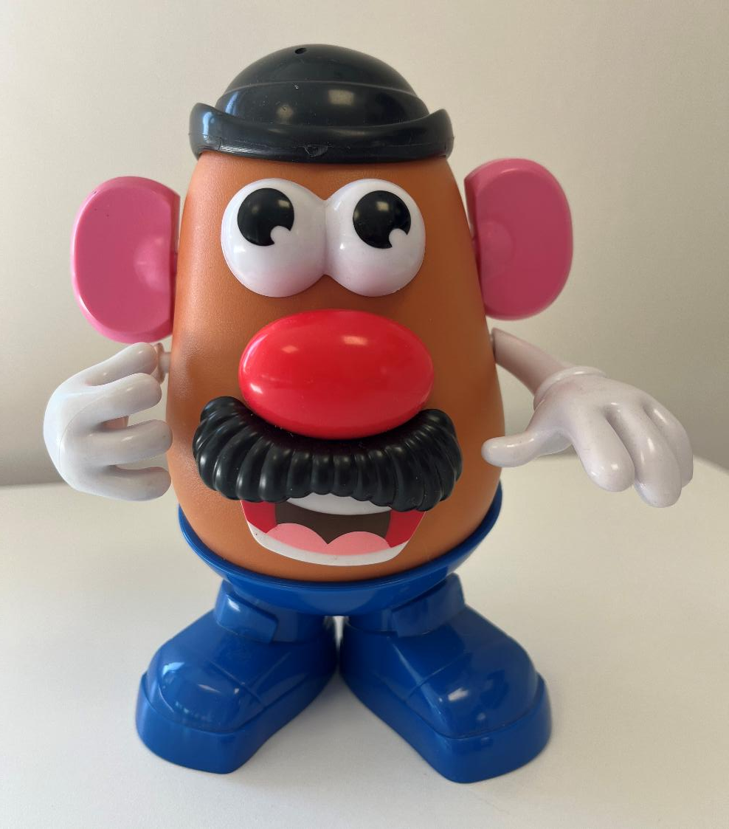
Notes:
Slide 9: A person’s body has more than one part. It has many parts. Let’s name them…. [identify parts of the body with age-appropriate vocabulary]

Slide 10
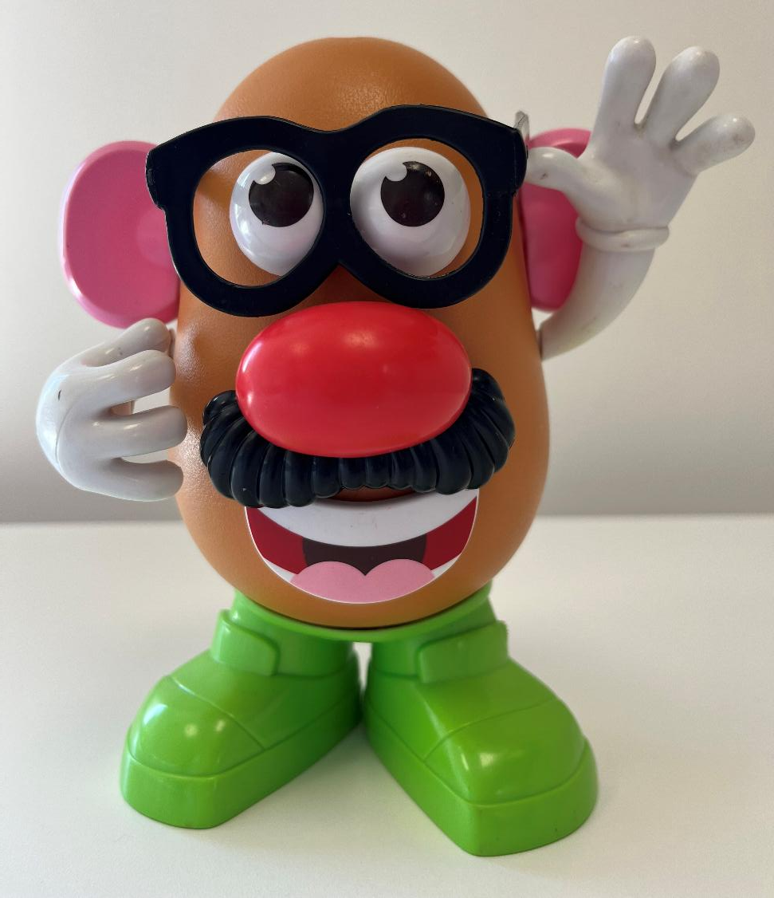
I don’t matter!
Notes:
Slide 10: The foot might say, “I don’t matter! I am not a hand. So I am not part of the body.” But saying this would not stop the foot from being a part of the body.

Slide 11
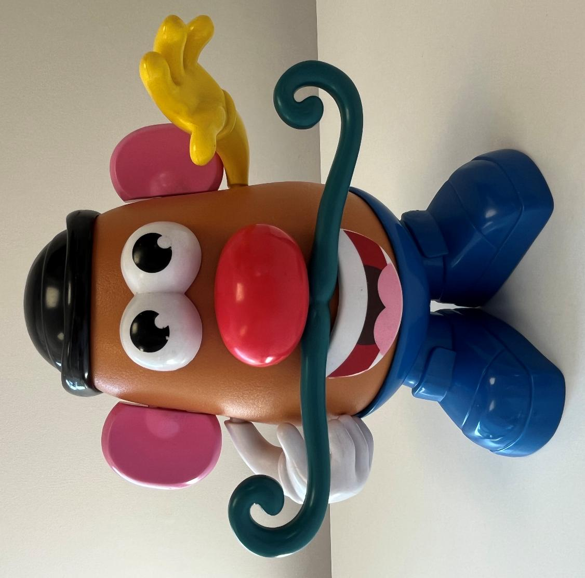
I don’t matter!
Notes:
Slide 11: The ear might say, “I don’t matter! I am not an eye. So I am not part of the body.” But saying this would not make the ear stop being a part of the body.

Slide 12
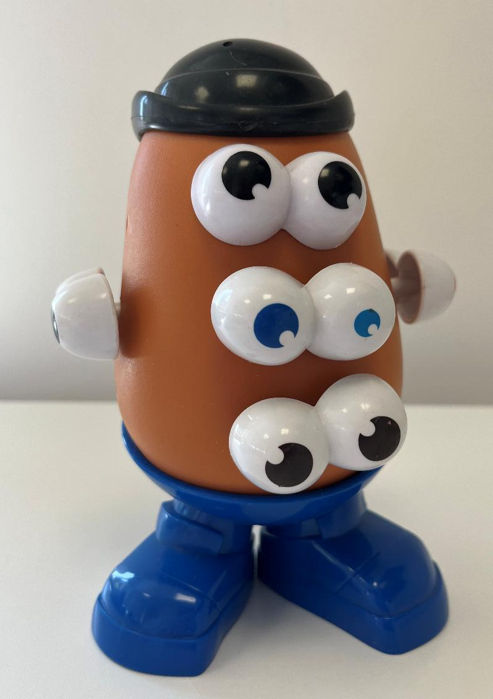
Notes:
Slide 12: If the whole body were an eye, the body would not be able to hear.

Slide 13
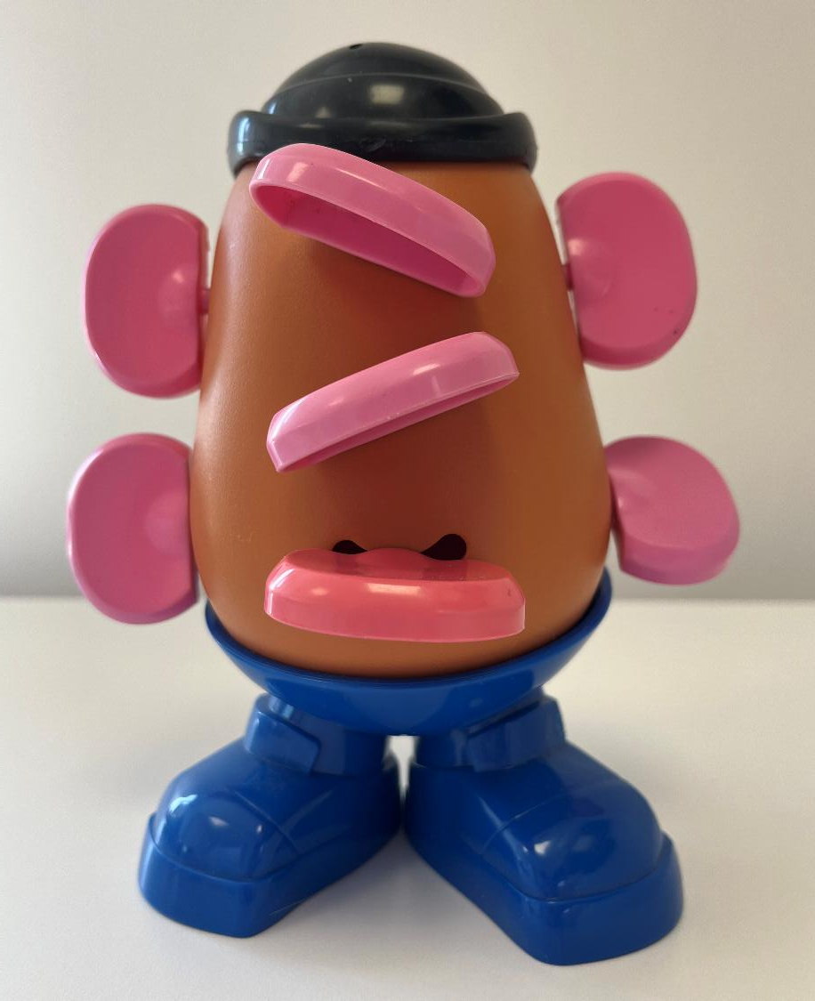
Notes:
Slide 13: If the whole body were an ear, the body would not be able to smell anything.

Slide 14
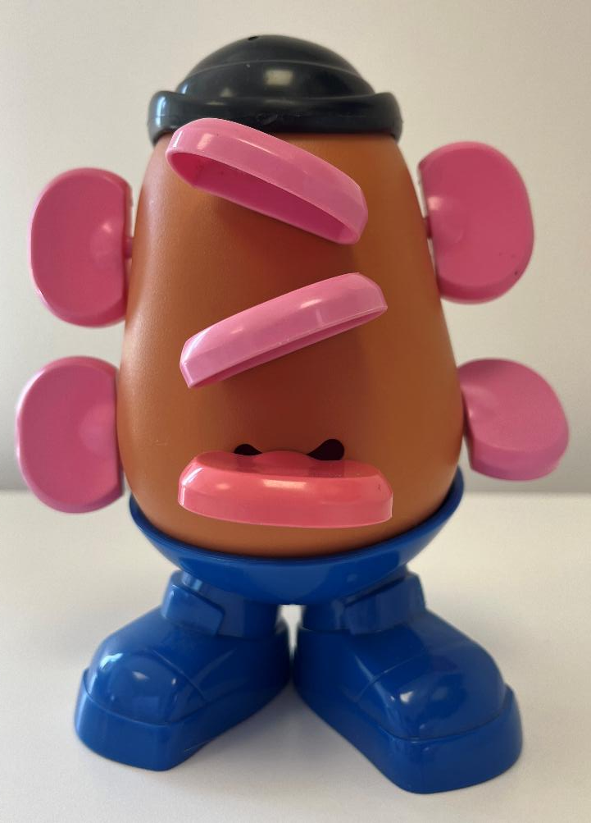
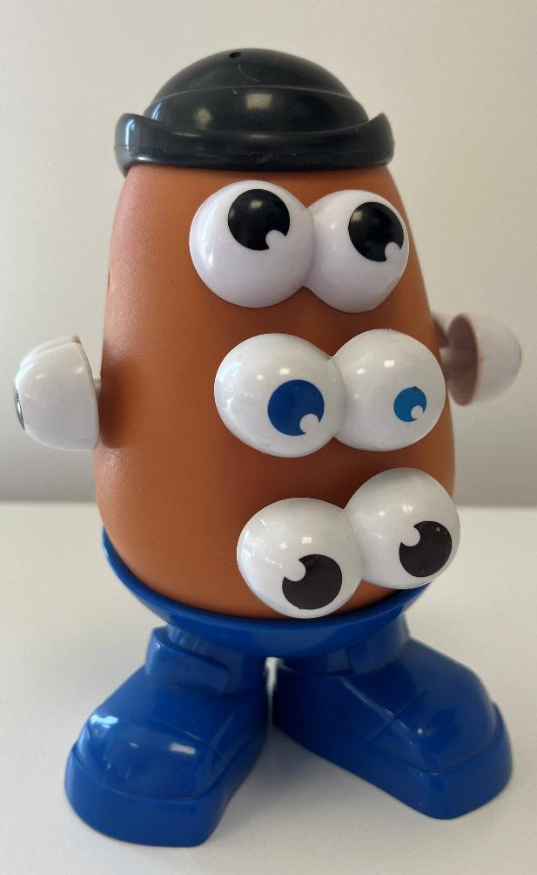
Notes:
Slide 14: If each part of the body were the same part, there would be no body….

Slide 15
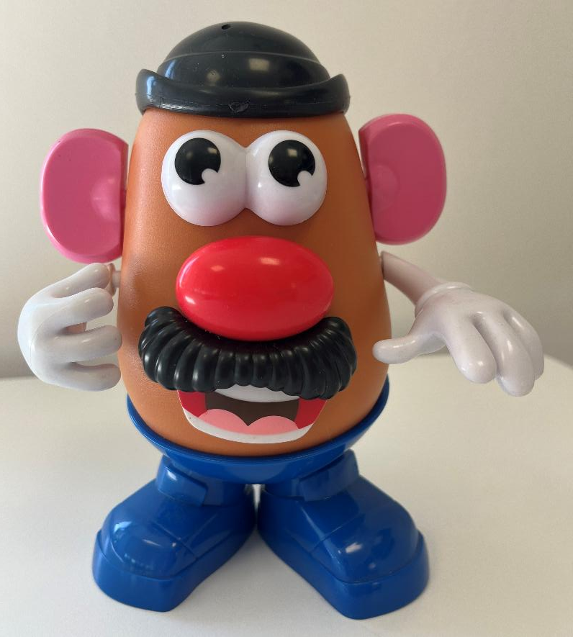
I don’t need you!
I don’t need you!
He made a place for each one of them.
Notes:
Slide 15: The eye cannot say to the hand, “I don’t need you!” because it’s not true! And the head cannot say to the foot, “I don’t need you!” because that’s not true either! …..God put the parts in the body as he wanted them. He made a place for each one of them.

Slide 16
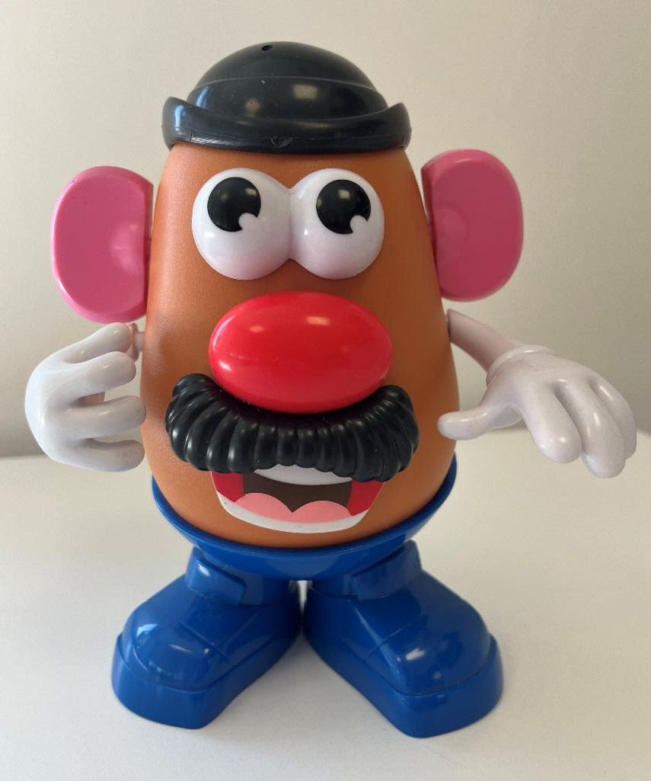
Notes:
Slide 15: So, thinking about both of these stories now – what are they both saying to us about working together or about being part of a community? [you might like to allow some discussion time here]
The idea of the body parts arguing with themselves might seem a bit ridiculous – and I think both writers were using the humour to make a point with their audiences – but when we think about our own school community, there may be some serious lessons that we might learn from these funny stories!
You might want to talk through & push the logic of some of St. Paul’s arguments here, in ways that support the ages of pupils e.g.
Why can’t a foot be a hand, or an ear an eye?
What would happen if the whole body was an eye or an ear….or a hand?
What would happen if the feet or the hands went missing?
Thinking back to Aesop’s fable, what happened when the arms and the legs stopped working to help the stomach?
What messages do these stories have for us about working together? Or for the way we think about ourselves?

Slide 17
…I wonder if we’ve ever felt like Mr Potato-Head’s foot, wishing to be something we are not?...
…or maybe wanted to not be ourselves, but be someone else?...
Notes:
Slide 16: Responding (and words for worship)
Let’s stop to ask some wondering questions now which might help us to go deeper….
…I wonder if we’ve ever felt like Mr Potato-Head’s foot, wishing to be something we are not?...
…or maybe wanted to not be ourselves, but be someone else?...

Slide 18
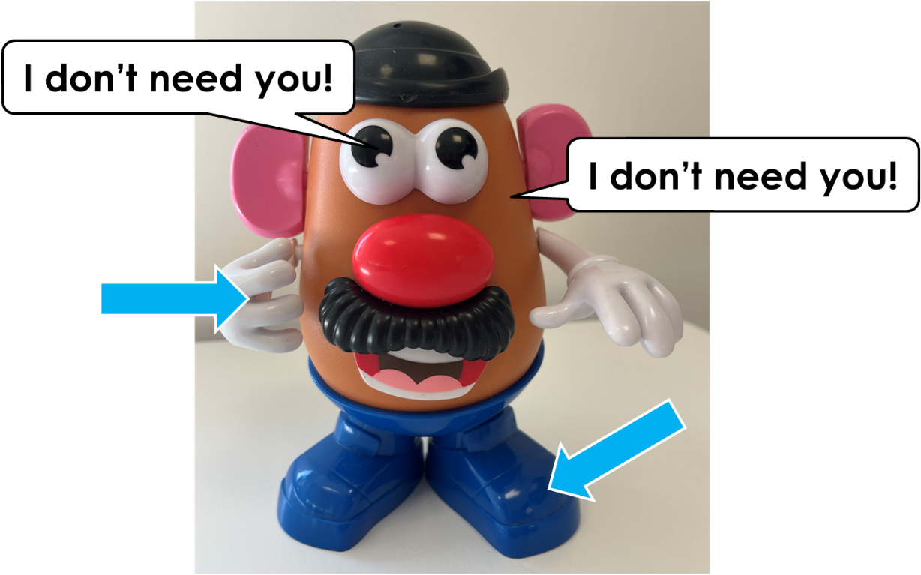
…I wonder whether we’ve ever said anything to someone else that has made them feel as if they don’t matter?...
…or that we are more important than they are?...
Notes:
Slide 17: …I wonder whether we’ve ever said anything to someone else that has made them feel as if they don’t matter?...
…or that we are more important than they are?...

Slide 19
‘…God put the parts in the body as he wanted them. He made a place for each one of them.’
…I wonder how we can show this within our school family?...
Notes:
Slide 18: We heard St. Paul’s words, which I’m going to read twice to help us to hear them well: [read twice]
‘…God put the parts in the body as he wanted them. He made a place for each one of them.’
…each one of you is unique and your place in our school community matters….
…I wonder how we show this within our school family?...
We’re going to draw this special time together today with a chance to pray if this is something you are comfortable with. There are some words you can join in with if you would like to…. [or there’s an option to use Mr. Potato-Head to pray, later in the script!]

Slide 20
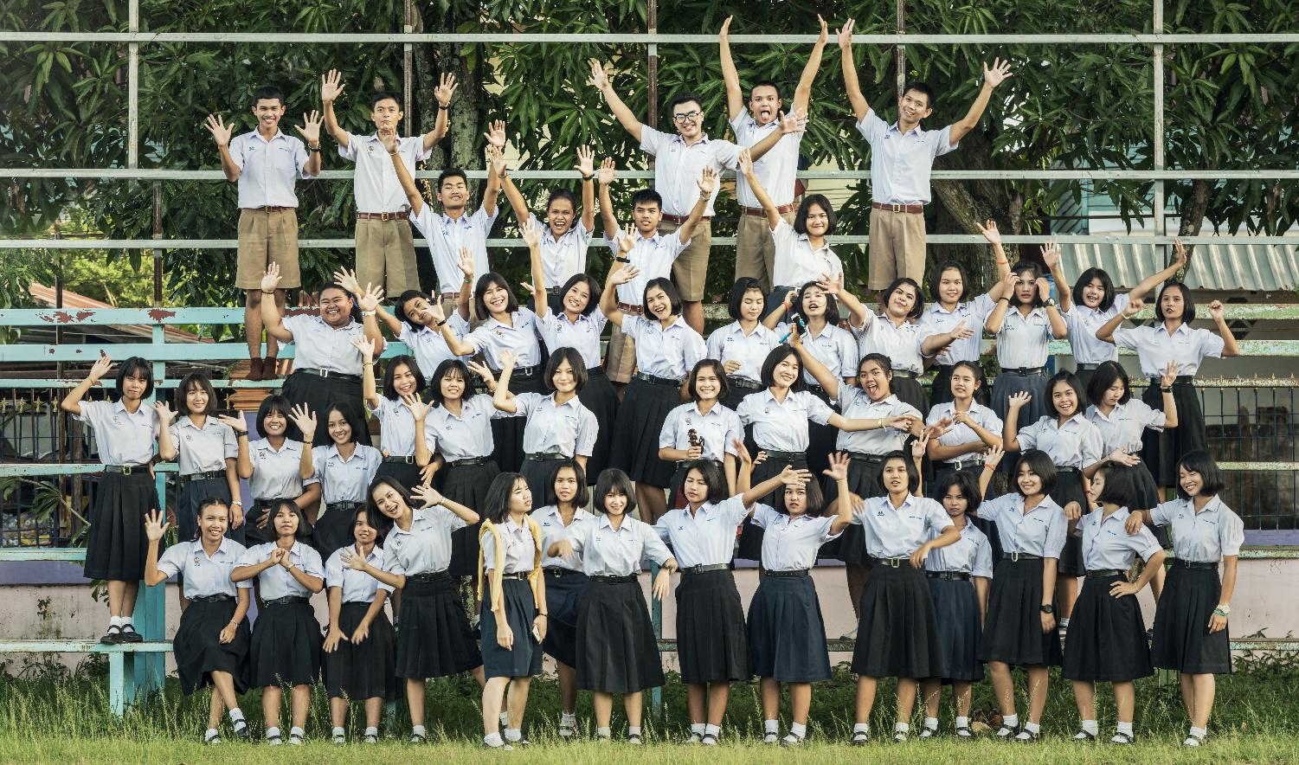
…we belong together!
Notes:
Slide 19: …we belong together!
Or, if you prefer, just be still and quiet with your own thoughts…..

Slide 21
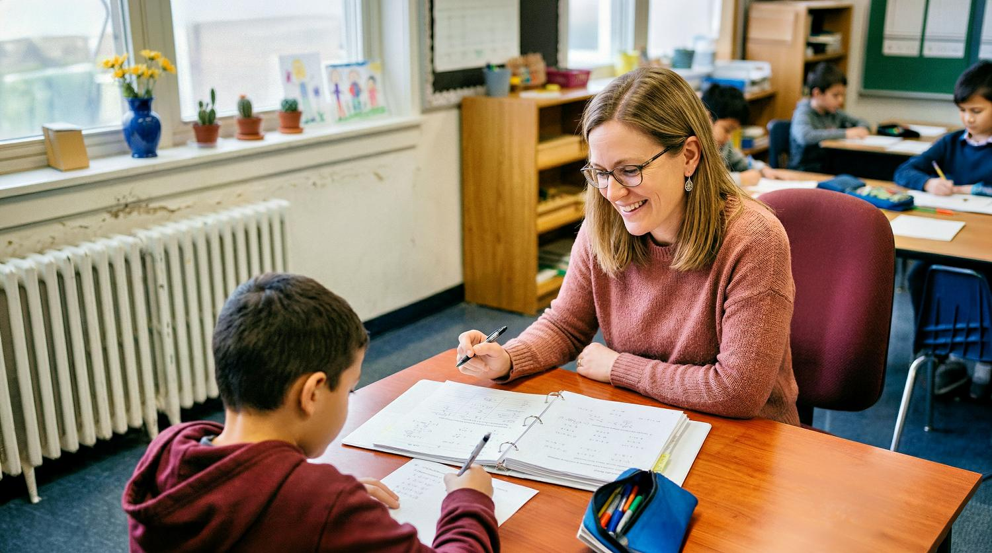
…we belong together!
Notes:
Slide 20: In our classes……we belong together!

Slide 22
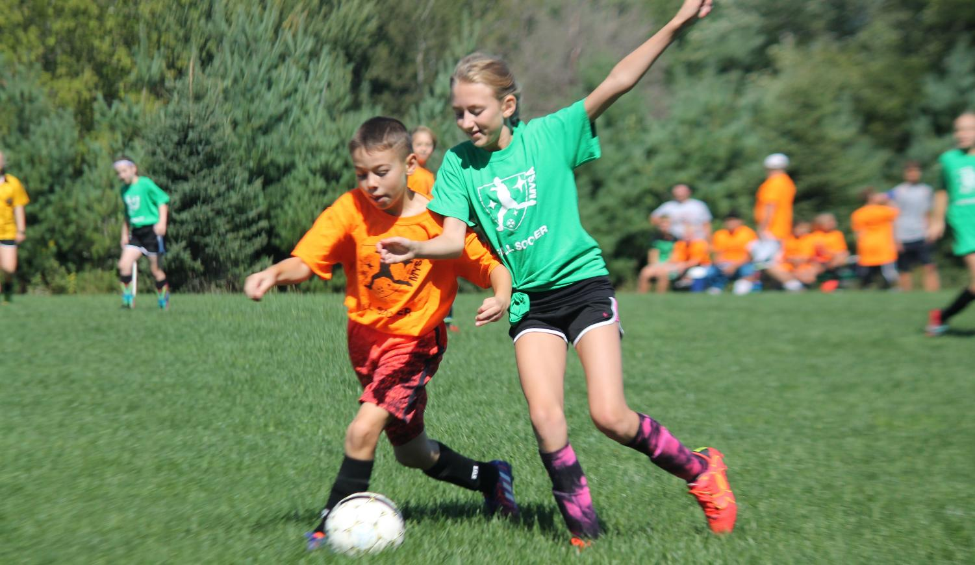
…we belong together!
Notes:
Slide 21: Whatever we are good at……we belong together!
.

Slide 23
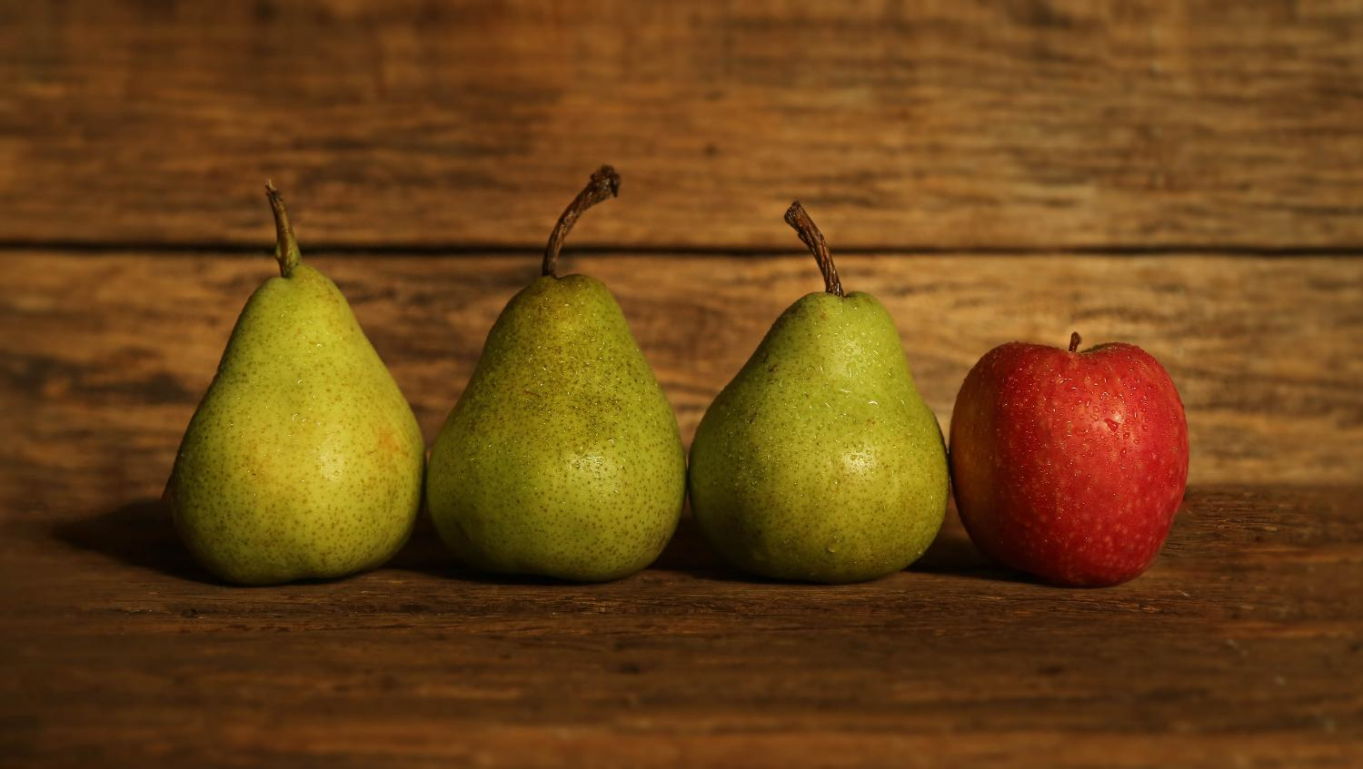
…we belong together!
Notes:
Slide 22: Even if we’re feeling like we don’t quite fit!…we belong together!
.

Slide 24
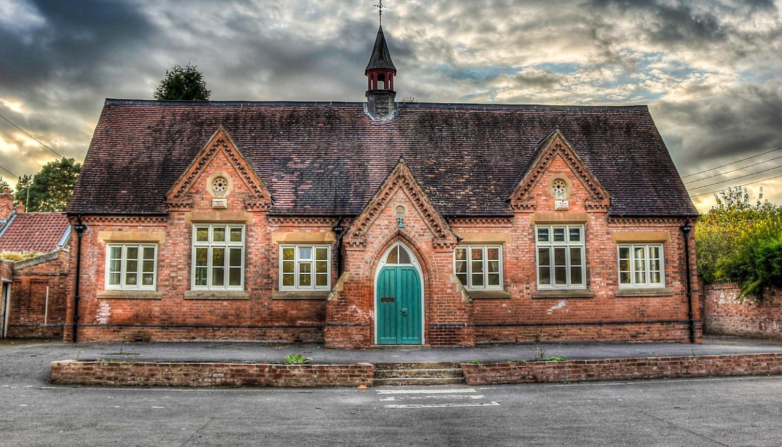
…we belong together!
Notes:
Slide 23: In our school family……we belong together!

Slide 25
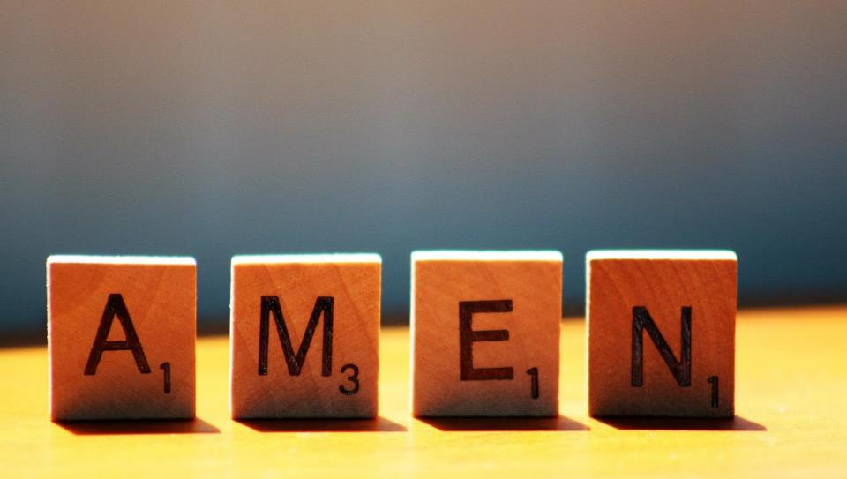
Notes:
Slide 25: Amen

Slide 26
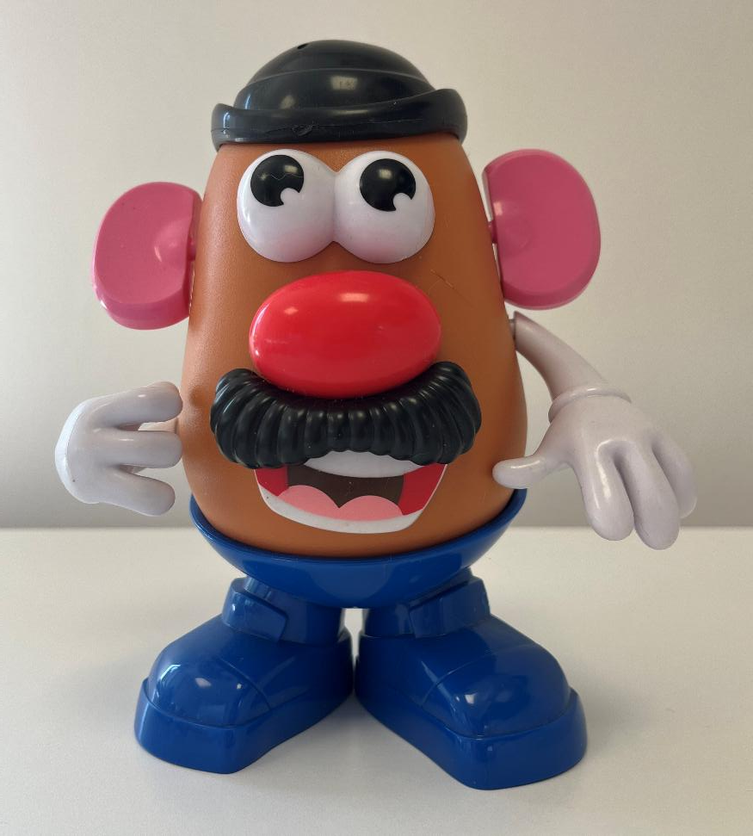
Praying with Mr. Potato-Head
Notes:
Slide 26: Optional prayer opportunity, based on reflective activity (p6), using Mr Potato-Head’s body parts!
As you add his body parts, use these words:
Legs:…may our legs take us to places where we can help others this week.
Hands:…may we use our hands to serve others this week.
Eyes:…may we see opportunities to love others this week.
Ears:…may we really listen when others speak to us this week.
Nose: Mr Potato-Head’s nose is in the centre of his face…may our actions put others at the centre of all we do.
Mouth: …may we speak well of others this week.
Now put his hat on and say Amen!

Slide 27
Notes:
Slide 20: Amen
[Alternative prayer: We’re going to sing our prayer today: it's a song that asks for one of those ‘fruits’, God’s peace, to be with us in all that we do.
Use the song ‘Peace be in our waking’, inviting children to join in any words that they would like to.

Slide 28
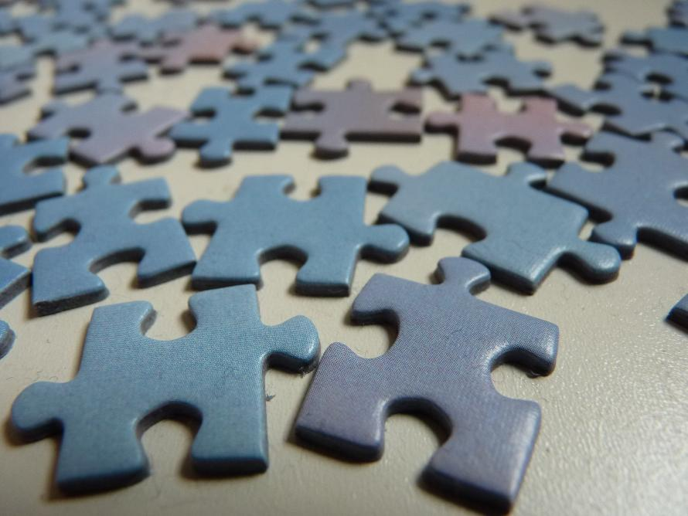


[Slide 4:]
Leader: As we leave this place & time and go into the day ahead…
All: May we remember that we belong together!
Notes:
Slide 28: Sending
Leader: As we leave this place & time and go into the day ahead…
All: May we remember that we belong together!

Slide 29
Notes:
Slide 29: Reflective areas
You will need a simple jigsaw
Do: Pick up a piece of jigsaw puzzle and think about how it has a special place. You have a special place as part of our school family.
Think: Think about times when you feel you really belong at our school.
Talk: As you build the puzzle together, talk about ways we can value everyone in our school community.

Slide 30
Notes:
This is to use to help you decide on bones / organs you could use in the opening challenge. There are similar images for internal organs e.g. lungs

