Slide 1
Leader: We are here together
ALL: May we ‘GO FOR GOLD!’ in our words and actions today!
Notes:
Slide 1: Gathering words
Leader: We are here together
ALL: May we ‘GO FOR GOLD!’ in our words and actions today!

Slide 2
Which is more
powerful?
Notes:
Slide 2: Today, we’re going to start with a big question! ‘Which do you think has more power?

Slide 3
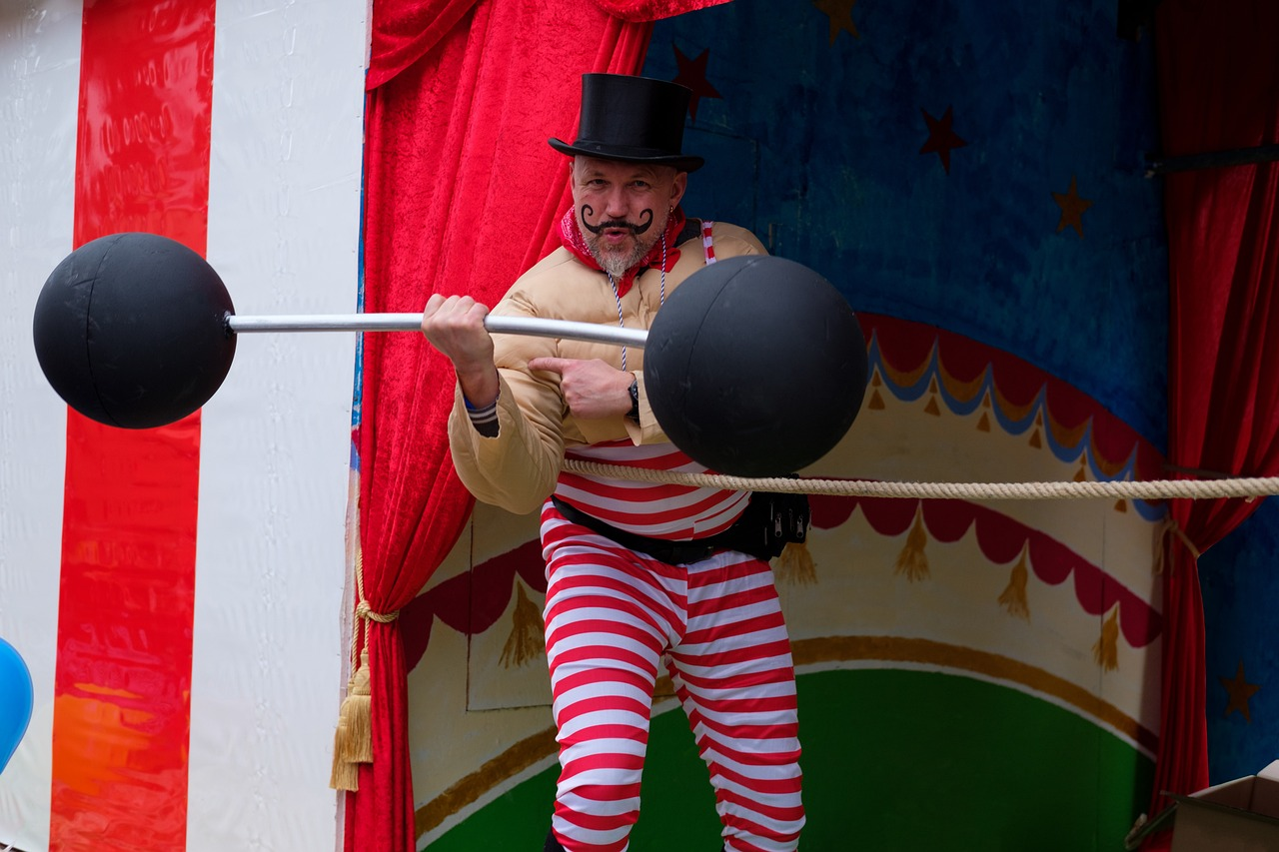
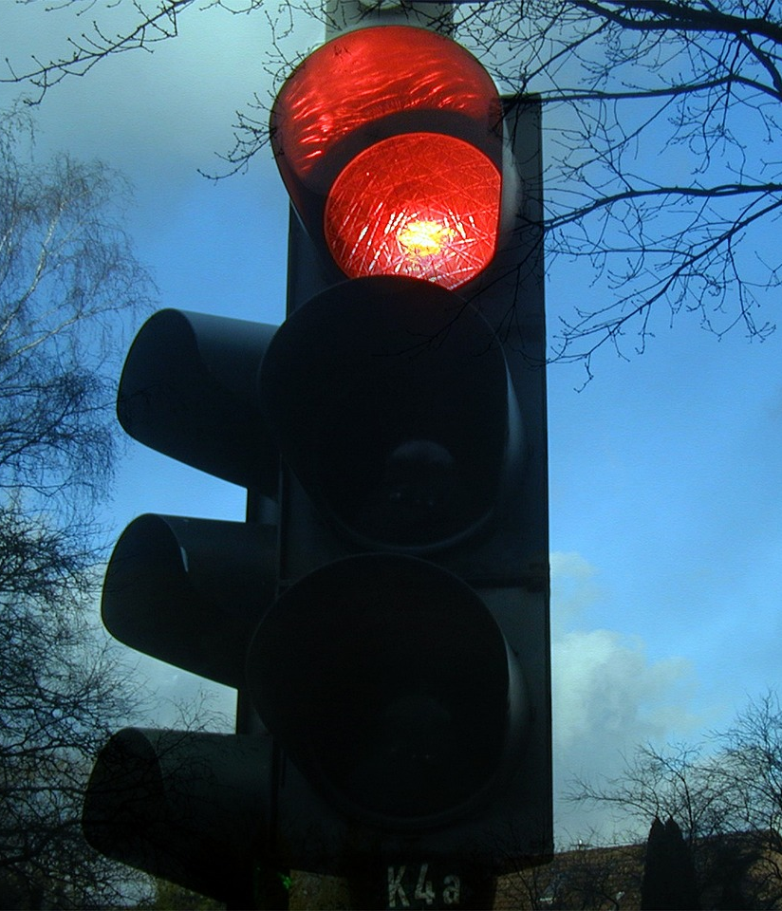
Notes:
Slide 3: A strong man, a traffic light or a letter?’

Slide 4
The Olympics
Respect
Friendship
Excellence
Determination
Equality
Courage
Inspiration
Olympic rings © Pixabay
Notes:
Slide 4: This term, we’re reflecting on Olympic values, and today we’re going to share a story about the inspiration of one young man who changed Olympic history….a story of friendship between nations.

Slide 5
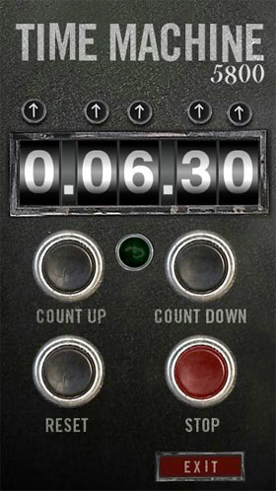
2024
CE
1956
CE
Notes:
Slide 5: We’re going to jump into our Olympic time machine again, and travel back to …..1956…..when the Summer Olympic Games came

Slide 6
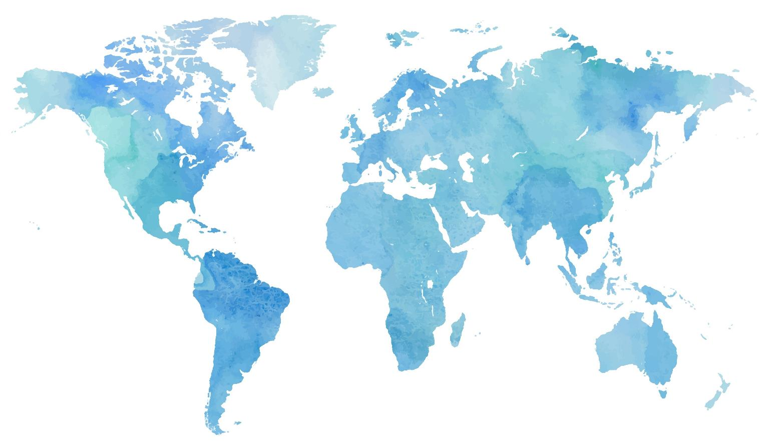
Notes:
Slide 6: from Melbourne, Australia. The world at this time was still very unsettled after World War II…… some countries were still fighting with each other, and people all over the world were protesting about this. The unrest affected the Olympics too –

Slide 7
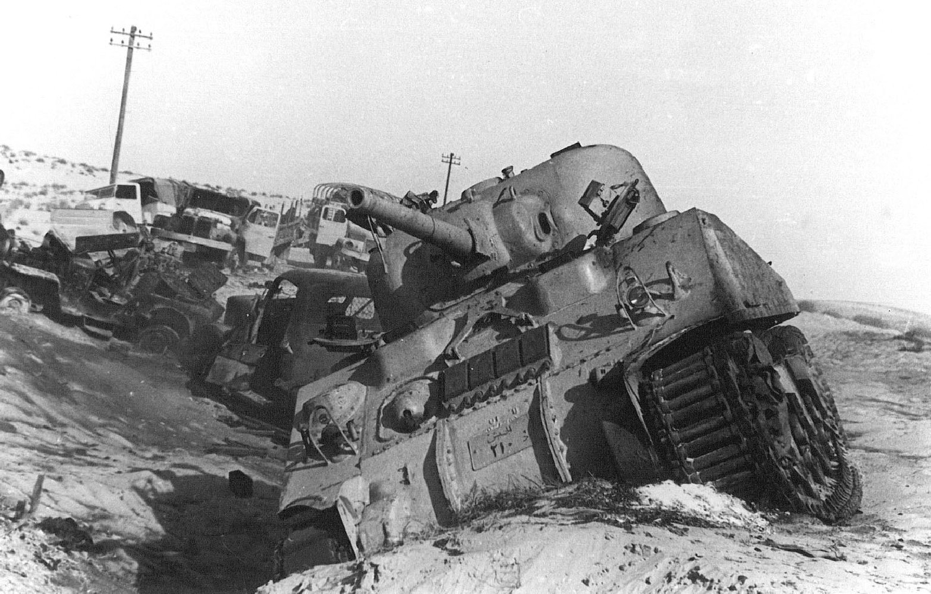
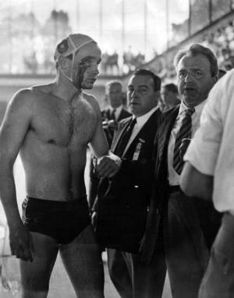
Boycotts - 1956
Notes:
Slide 7: 8 different countries refused to attend, and some of those who did had been ordered not to have anything to do with certain other countries. During the actual Olympics, fighting broke out between the Hungarian and Russian water polo teams as they competed……hardly the peaceful contest that Baron de Coubertin had started.
But something happened to change all this – here’s what…..

Slide 8
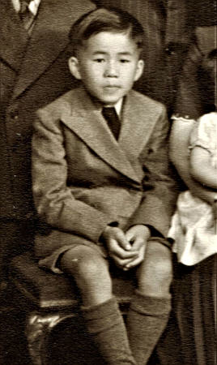
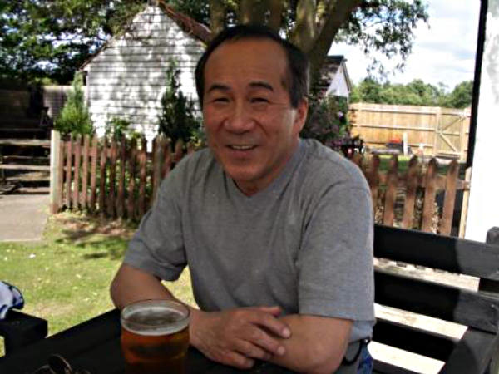
John Ian Wing
Notes:
Slide 8: John Ian Wing grew up in a children’s home in Melbourne. He was 17 when he read all of this in the newspapers, and he had an idea for something that might help the athletes who’d travelled to Australia to demonstrate more peacefully ….so he wrote a letter to Mr Hughes, President of the International Olympic Committee. This is what he wrote – in his own words:

Slide 9
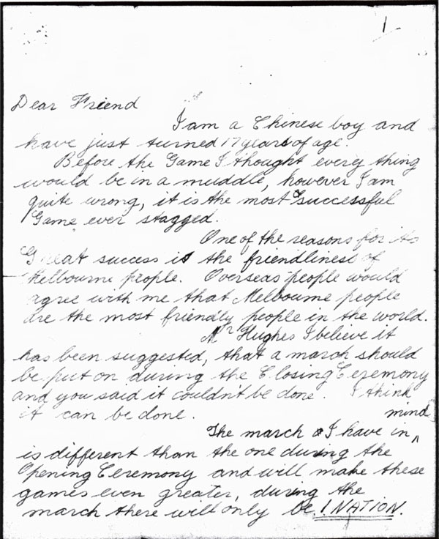
Notes:
Slide 9: “I am a Chinese boy and have just turned 17 years of age. Mr Hughes, I believe it has been suggested that a march should be put on during the Closing Ceremony and you said it couldn't be done. I think it can be done.
The march I have in mind is different than the one during the Opening Ceremony and will make these games even greater, during the march there will only be 1 NATION. War, politics and nationality will be all forgotten, what more could anybody want, if the whole world could be made as one nation.

Slide 10
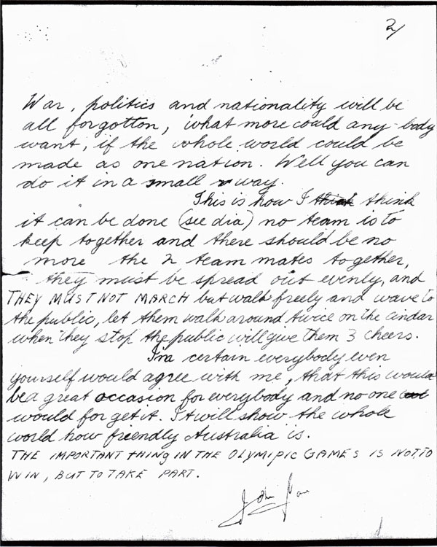
Notes:
Slide 10: Well you can do it in a small way.….. no team is to keep together and there should be no more than 2 team mates together, they must be spread out evenly, and THEY MUST NOT MARCH but walk freely and wave to the public, let them walk around twice ….. when they stop the public will give them 3 cheers.I'm certain everybody even yourself would agree with me, that this would be a great occasion for everybody and no one would forget it. It will show the whole world how friendly Australia is.’And then he quoted Baron de Coubertin: ‘THE IMPORTANT THING IN THE OLYMPIC GAMES IS NOT TO WIN, BUT TO TAKE PART.’
He posted his letter on the Wednesday before the closing ceremony was due to happen.

Slide 11
Notes:
Slide 11: In 1956, not many people had their own TVs, so weren’t able to watch the Olympics as we will be in a few months’ time. People regularly gathered around the windows of shops selling TVs to watch big events. Imagine John Ian Wing’s surprise, then, when on the day of the closing ceremony, he passed a TV shop and saw his idea in action…..

Slide 12
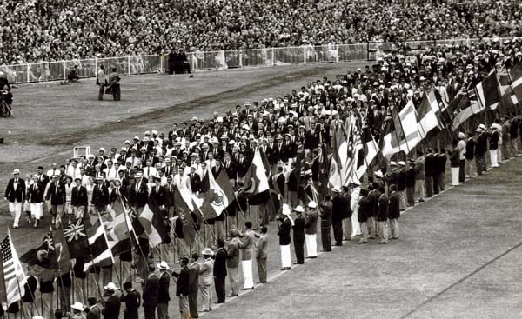
The closing ceremony, 1956
Notes:
Slide 12: All the athletes were walking, not marching round the Olympic track….they weren’t in their teams, but all nations mixed up together, smiling and waving to the crowds in the stadium.
And from that day since, this walk of friendship has taken place at the end of every Olympic Games, as the nations of the world come together as a symbol of unity. And all because one young man decided to write a letter……

Slide 13
Notes:
Slide 13: So, let’s come back to the puzzle we started with…. Which do you think has more power? A strong man, a traffic light or a letter? [ask for another show of hands]

Slide 14
….I wonder what ‘peace’ looks like to us?.....
….I wonder if our dreams for a peaceful world can start here, in our school?…..
….I wonder how you might bring peace where it’s needed today?…..
Notes:
Slide 14: Responding and words for worship
Let’s be quiet and still with our own thoughts now…..
We’ve heard today about one young man’s letter….
…. a letter describing a simple idea to demonstrate unity….
….a letter sharing his dream for a peaceful world…..
….I wonder what ‘peace’ looks like to us?.....
….I wonder if our dreams for a peaceful world can start here, in our school?…..
…..I wonder how you might bring peace where it’s needed today?…..
….maybe helping to sort out arguments…..
….showing others how to work together…..
….maybe letting someone else be in charge of your games at playtime…..
….or finding a way to make things fair…..
…..or simply by being the best friend that you can be…..

Slide 15
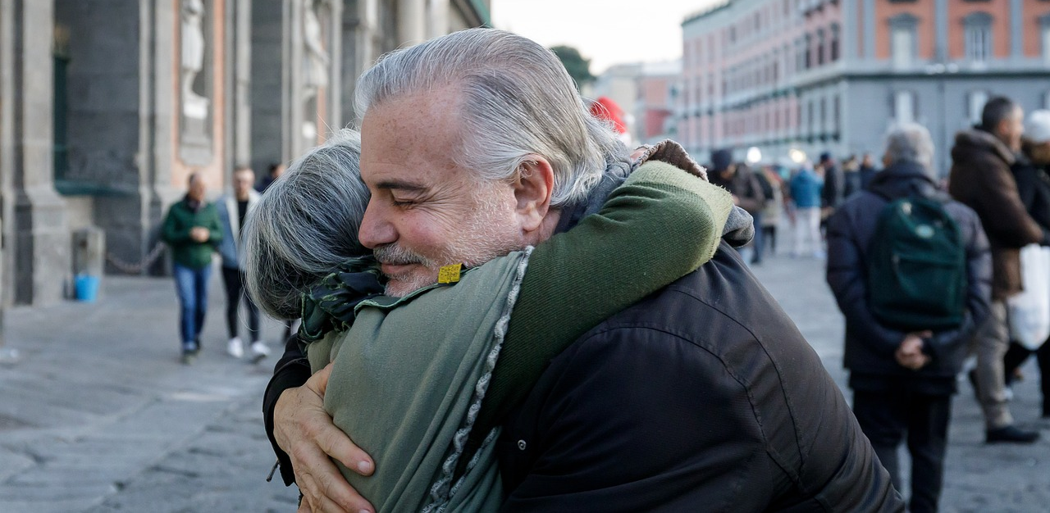
‘If any of you needs wise advice, you should ask God, who loves to help.’
(James 1:5)
God blesses those who make peace.
(Matthew 5:9)
Notes:
Slide 15: Christians believe that Jesus came to show the world how to live in peace with each other…..
…Jesus taught that being a ‘peacemaker’ not only pleases God, but brings people true happiness….
….but being a ‘peacemaker’ isn’t always easy…..
So to help us, I’m going to pray, to ask God for his help. If you’d like to join with me, then you can make the prayer your own by saying ‘Amen’ at the end:

Slide 16
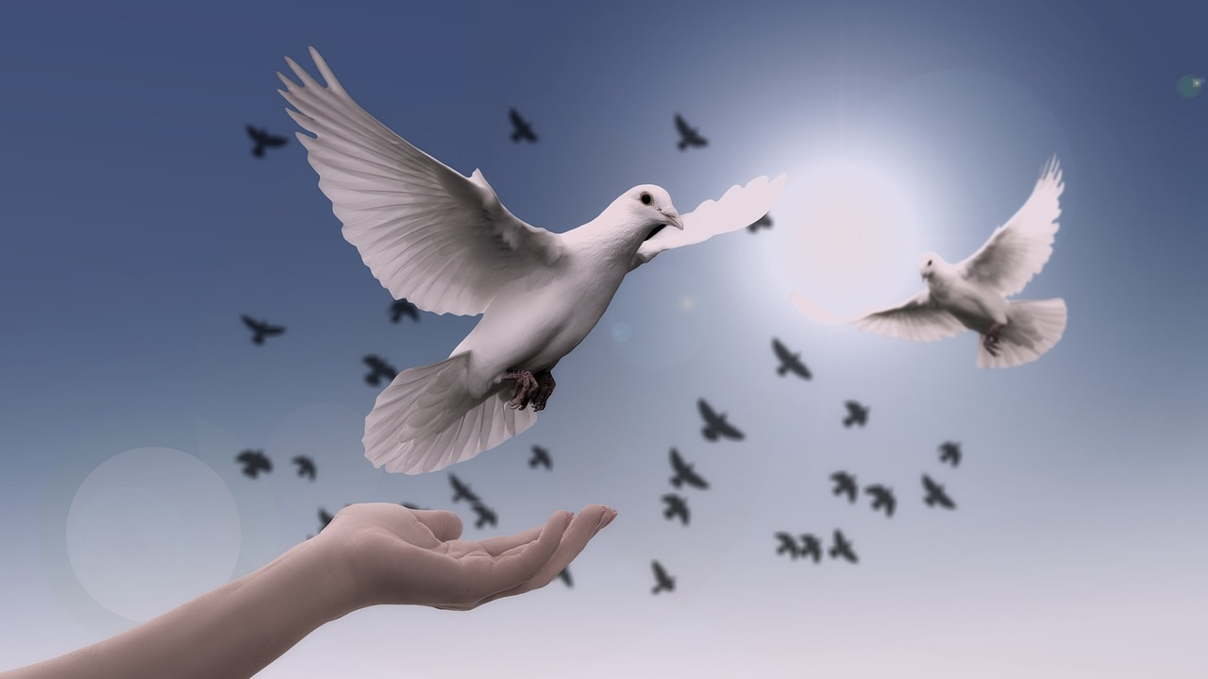
Notes:
Slide 16: Prayer:
Dear God
Thank you that you love peace. Please help us as we work together to make this school, our community, and our world a more peaceful place.

Slide 17
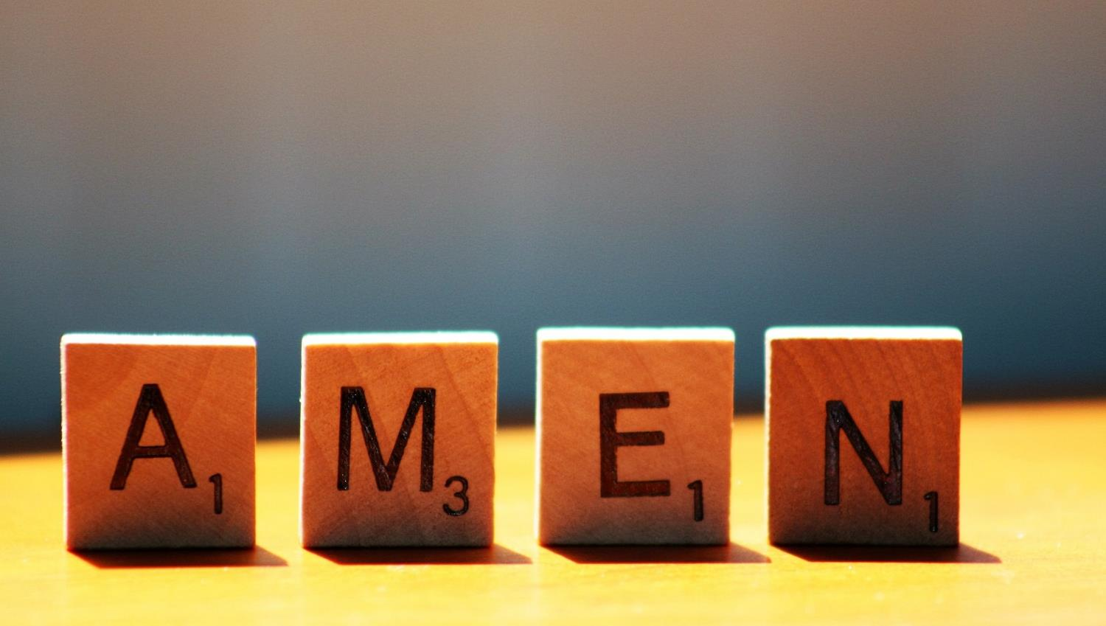

Slide 18
Leader: As we leave this place & time and go into the day ahead…
All: Let’s ‘go for gold’ in all that we do!
Notes:
Sending: Slide 15
Leader: As we leave this place & time and go into the day ahead…
All: Let’s go for gold* in all that we do!
*Again, you might need to unpick what we mean by ‘going for gold’ in the context of today’s words.

Slide 19
Notes:
Slide 18: Reflective areas: get practical!
Get practical this week and write a letter (which you could send to your MP if you’re brave?!) about working for peace, or another issue that you feel strongly about. Or write a ‘manifesto style piece of writing about living at peace in your school community.
Or, finish sentence starters beginning ‘Peace is….’

