Slide 1





We are here together in our school family. May God be with us…
...and watch over us.
Notes:
Slide 1: Use these new gathering words for this term, or your usual greeting if you prefer.

Slide 2

What’s in my lunchbox?
Notes:
Slide 2: Get out your lunchbox, show the label and give the assembled children a teaser, that you’ll let them see inside before they leave. Be as dramatic as you can: make it clear that you’re really looking forward to your lunch – and wonder what it might be!

Slide 3

The Lord’s Prayer
Notes:
Slide 3: “We’ve been thinking this term about the prayer that Jesus taught to his disciples to help them to pray – to talk to God – and about the kinds of things they should say to him.

Slide 4
Our Father in heaven,
Hallowed be your name
Your kingdom come, Your will be done on earth, as it is in Heaven.
Give us today our daily bread.
Forgive us our sins,
As we forgive those who sin against us.
Lead us not into temptation,
But deliver us from evil.
For the Kingdom, the power and the glory are yours, now and forever.
Amen
Notes:
Slide 4: This next part [show words] says ‘give us today our daily bread’. We’re going to start today’s assembly with a quick story from the life of Jesus that has something to do with this line of the prayer….see if you can work out what! [use script, slides 5-13]

Slide 5
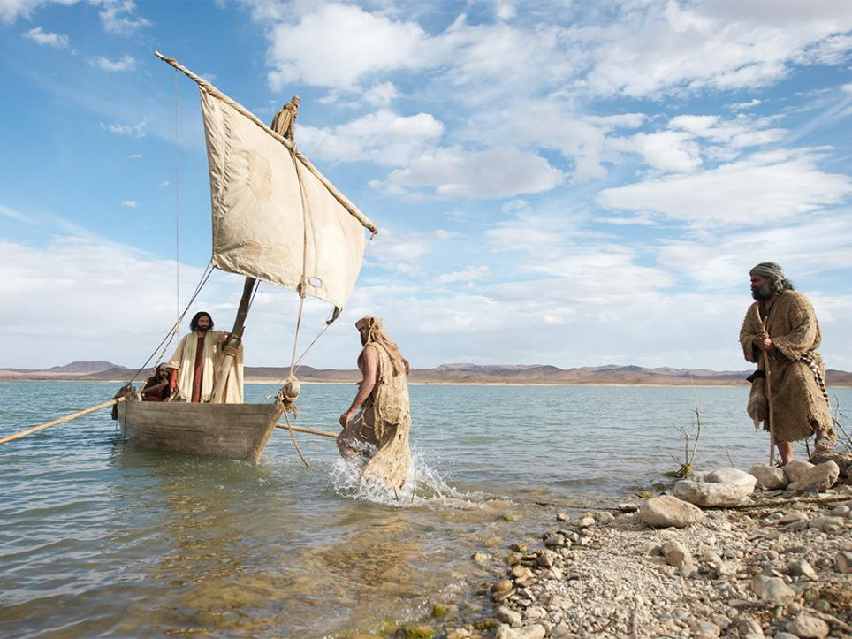
Notes:
Slide 5: Jesus had received some bad news about his cousin John, and he went by boat with his disciples to a quiet place, to be away from the crowds.

Slide 6
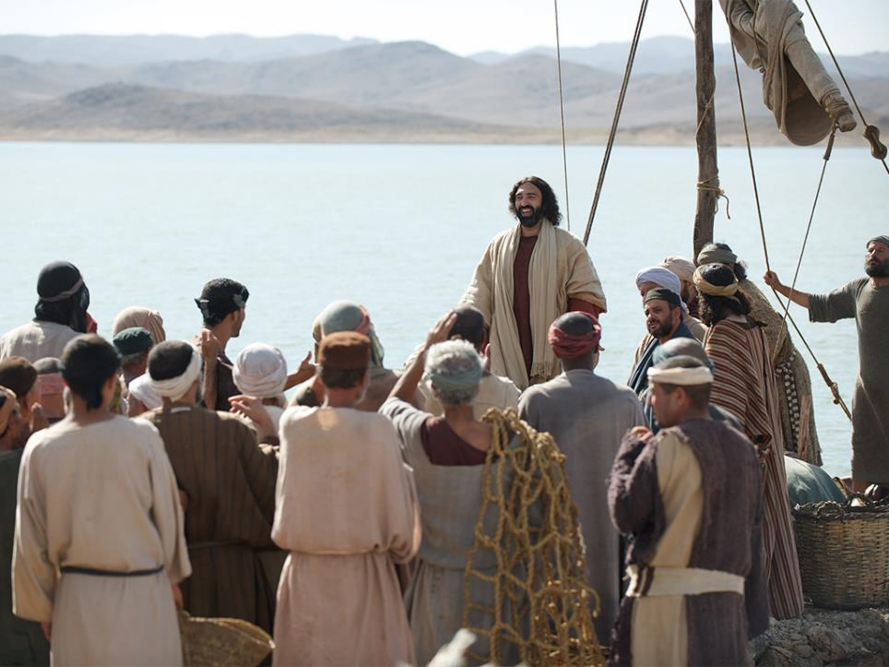
Notes:
Slide 6: People from all around heard where he was, and went to find him. Even though he wanted to be alone, Jesus saw how many of them needed help.

Slide 7
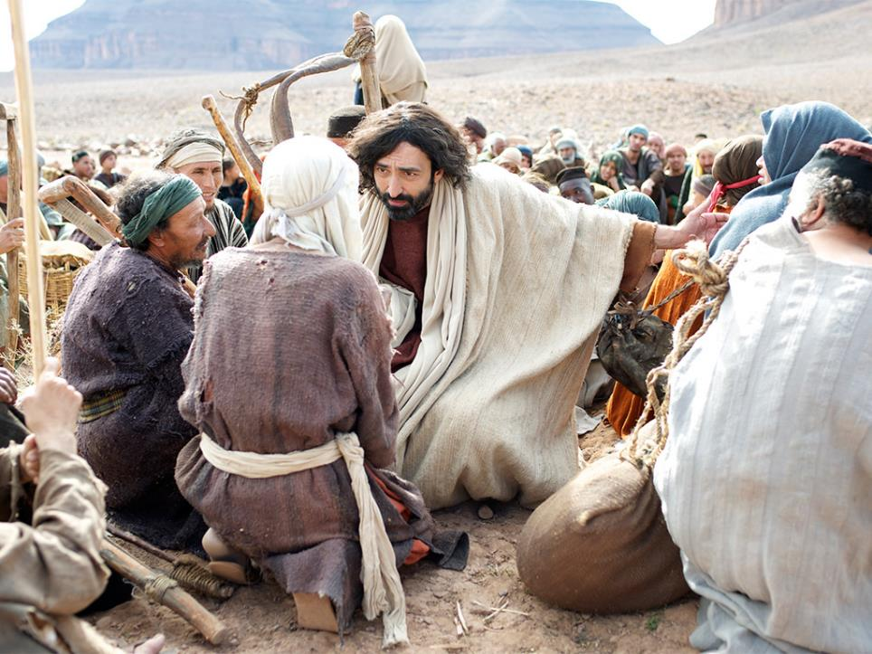
Notes:
Slide 7: He felt sorry for them and so he stayed. Many people who came were sick, and Jesus healed them.
No-one noticed how late it was getting. Before long, it was dinner-time – and the disciples’ tummies were beginning to rumble!

Slide 8
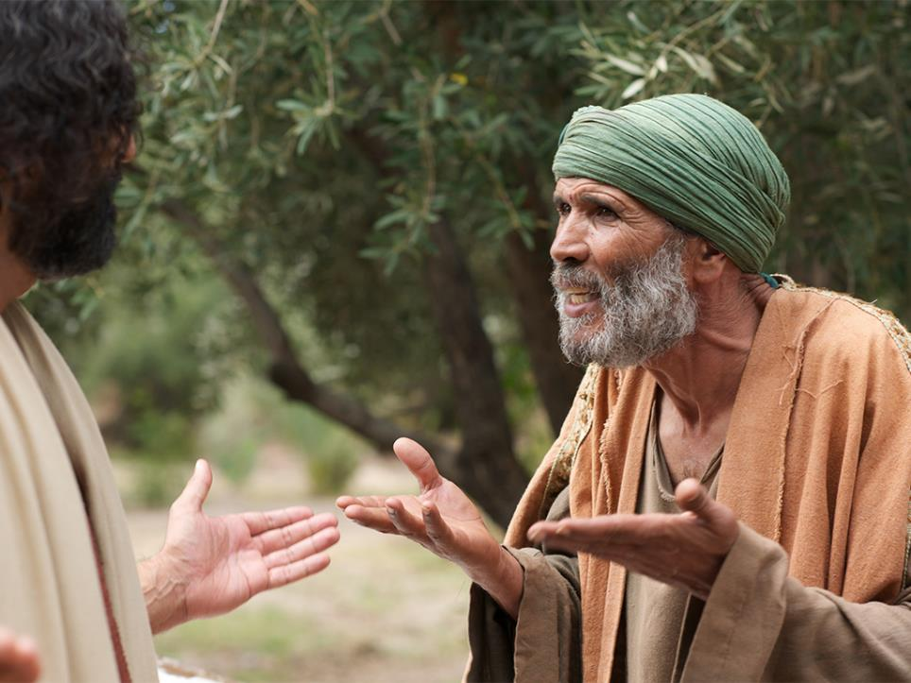
Notes:
Slide 8: They went to Jesus and said ‘Master – have you noticed what time it is? We’re hungry, and so are all these people. Send them into the villages to buy food.’ But Jesus replied ‘It’s late. They don’t need to leave here. You can find them something to eat…’ Imagine what a job that was! The crowd was enormous – more than 5000 people – and no-one had got that amount of food. Even if there had been enough food left in the village for 5000 people, they certainly hadn’t got enough money to pay for it all.
They went about in the crowd to see what food they could find and came back to Jesus with

Slide 9
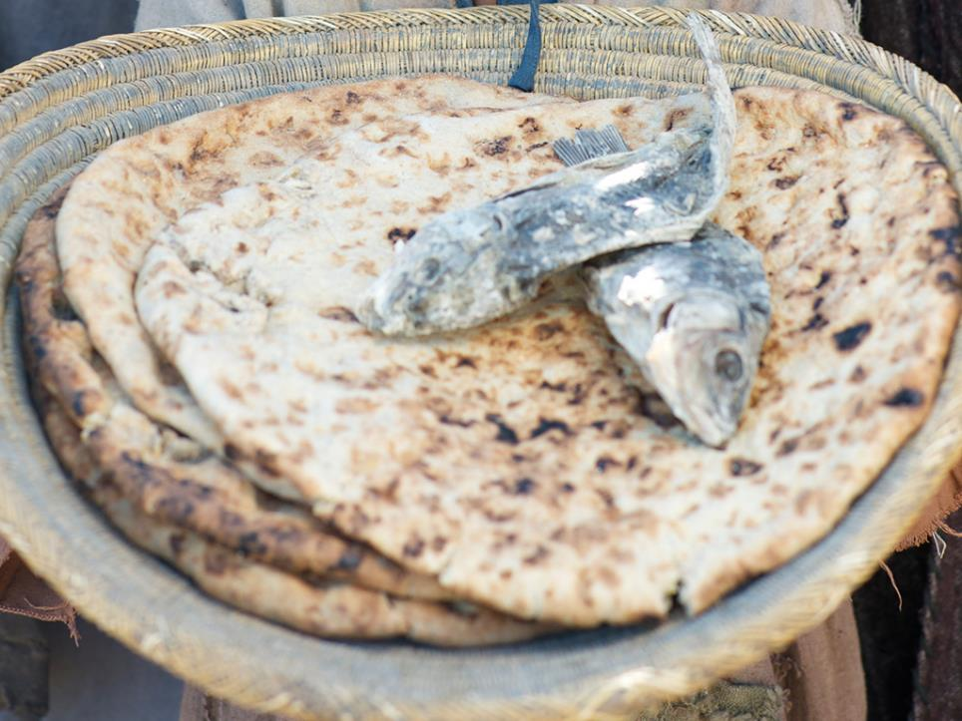
Notes:
Slide 9: …..five small loaves of bread and two fish:

Slide 10
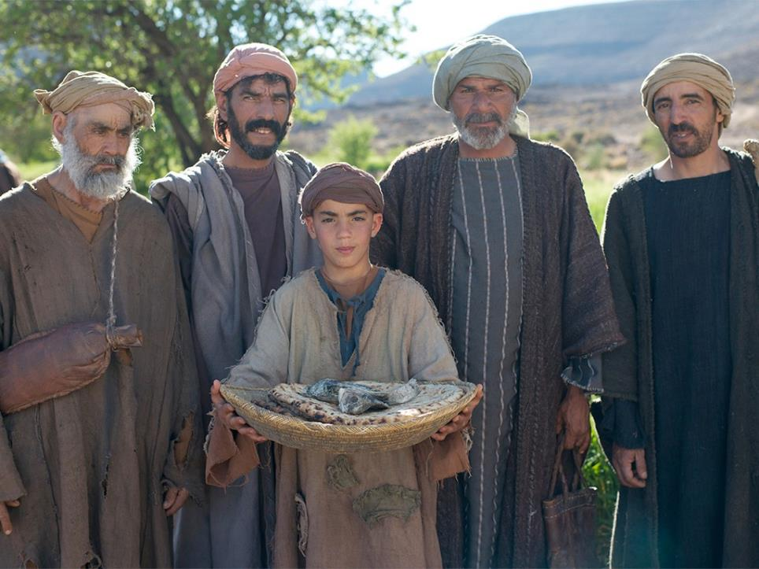
Notes:
Slide 10: a little boy’s packed lunch. ‘This is all we could find, Master’ they said, and gave the food to Jesus.

Slide 11
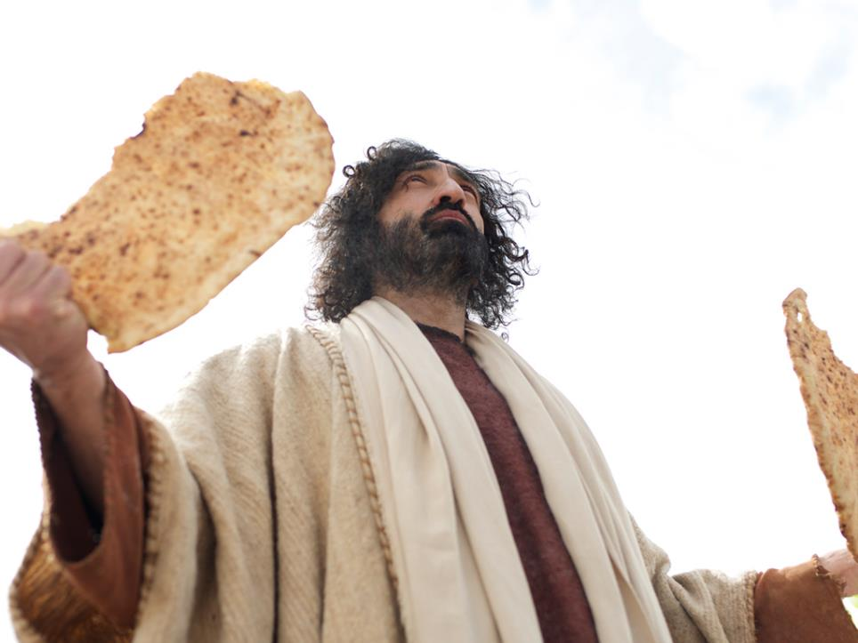
Notes:
Slide 11: Jesus looked up to heaven and gave thanks, broke the bread and the fish up into small pieces, then said to the disciples – ‘Make the people sit in groups of about fifty, and share this amongst them.’

Slide 12
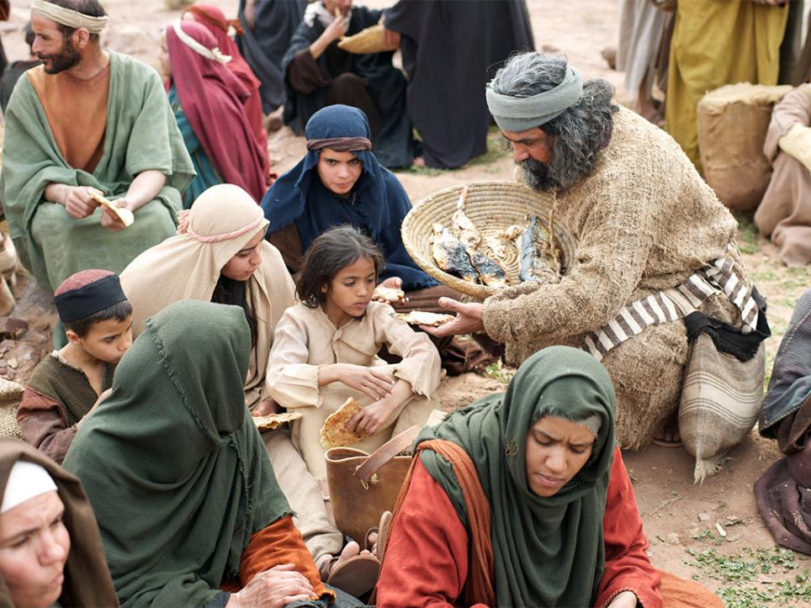
Notes:
Slide 12: The disciples did as they had been told – and to their complete amazement, every single person ate, and was full at the end of their meal! Imagine that – five loaves and two fish had fed over 5000 people….

Slide 13
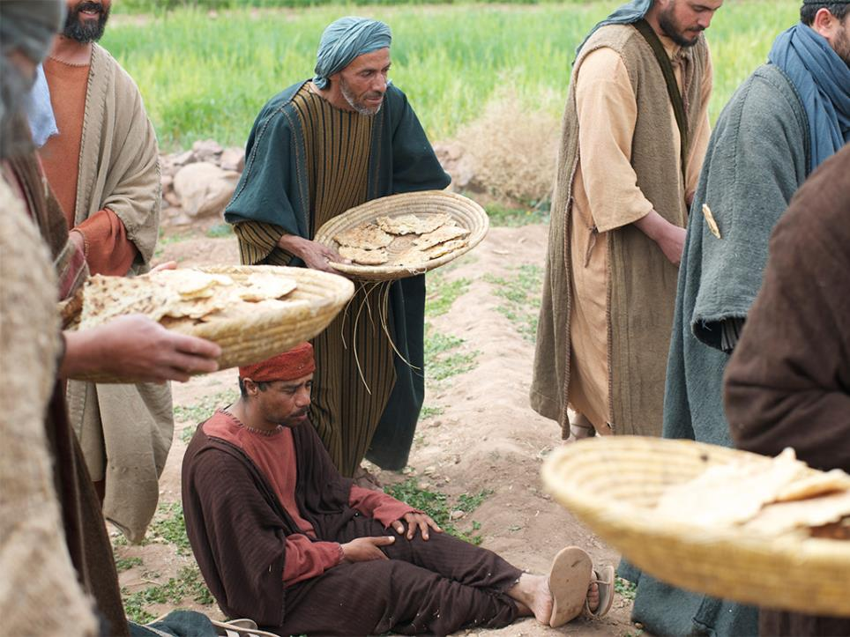
Notes:
Slide 13: and there were still twelve baskets of leftovers!

Slide 14
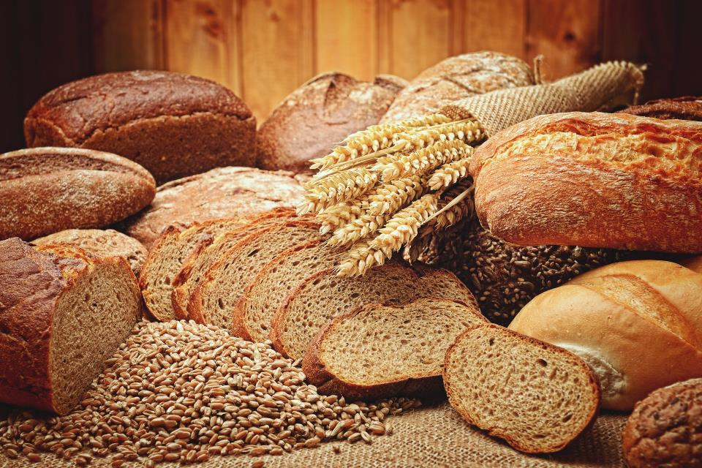
‘Our daily bread’
Notes:
Slide 14: “So, what might this story have to do with ‘daily bread’? [ask some volunteers]
“Did you notice in the story how Jesus knew what they really needed: that some of them really needed his help. Jesus also knew that the people were hungry – and that the disciples would need his help to feed them. There are many other stories from his life that show Jesus always knew just what people really needed – not what they wanted, what they needed. [you might want to pause here and talk about the difference] When Christians pray about their ‘daily bread’, they are reminding themselves that God, their father, knows just what they need.
I wonder what things you might think of as being things that you really need?…..food, for example!

Slide 15
What’s in my lunchbox?
Notes:
Slide 15: That reminds me, I was going to show you MY daily bread: my lunch!! [open your lunch box] Hang on, this doesn’t look like my lunch!….maybe they’re also my ‘daily bread’? [show the other items, talking a little about each in terms of our other basic needs – family, friendship, love and a place to call home]
In the Lord’s prayer, Jesus taught that people can pray about the things they really need when they talk to him. Did you also notice in the story of the feeding of the 5000 that Jesus gave God his father thanks for the food that they were all about to share? Jesus understood that all good things – including the food he ate – are gifts from God. Christians believe that praying is about being grateful as well as asking for things. Having a grateful heart shows that are not taking these good things for granted

Slide 16
…. I wonder what it was like to be present at the feeding of the 5000?....
….I wonder how this story helps Christians to trust God for the things that they need?....
….I wonder what your ‘daily bread’ is?....
Notes:
Slide 16: Let’s wonder together…
…. I wonder what it was like to be present at the feeding of the 5000?....
….I wonder how this story helps Christians to trust God for the things that they need?....
….I wonder what your ‘daily bread’ is?....

Slide 17
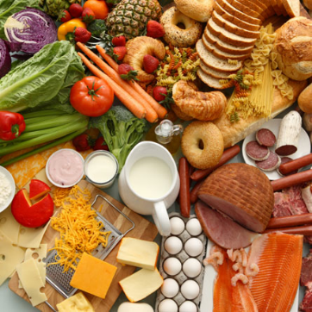



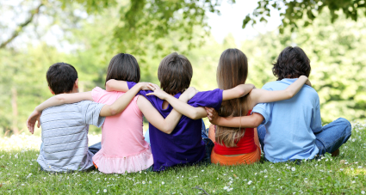
‘…our daily bread…’
Notes:
Slide 17: Responding (words for worship):
Let’s be still and quiet together now….
…in the stillness, think about the things that you’ve heard today….
…think about the food we eat, and the things we really need….
….our daily bread…..
….these are good things, and we can be grateful for them….
…..take some time now to do that if you’d like to…..
I’m going to turn my thoughts into a prayer now, using some words from the song we listened to as you were coming in. Make the prayer your own if you’d like to…or if you’d prefer not to pray, then just sit quietly with your own thoughts.

Slide 18

God, we are grateful.
Notes:
Slide 18: Prayer
I’m going to turn my thoughts into a prayer now, and there are some words you can join in with if you’d like to pray as well ‘God we are grateful’…or if you’d prefer not to pray, then just sit quietly with your own thoughts.

Slide 19
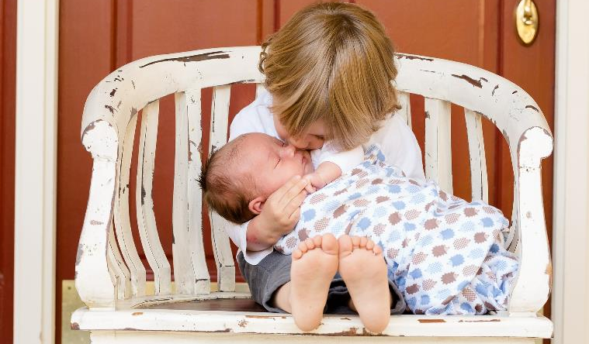
For friends and family,
God, we are grateful.

Slide 20

For the love in our hearts,
God, we are grateful.

Slide 21
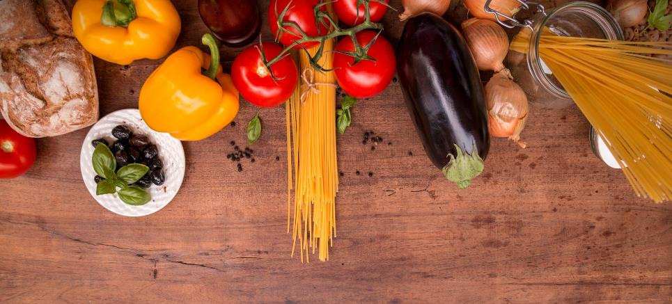
For the food on our tables,
God, we are grateful.

Slide 22
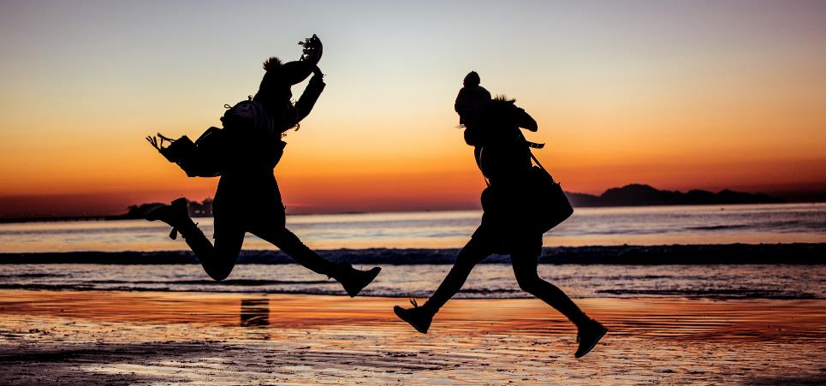
For all our ‘daily bread’,
God, we are grateful.

Slide 23


Slide 24
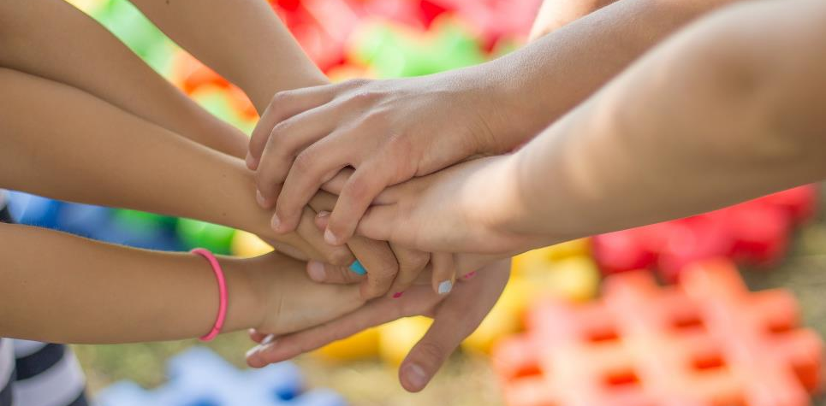


Leader: As we leave this place & time and go into the day ahead…
All: May we be grateful for all our ‘daily bread’.

